Slide 1
TREATMENT OF ACUTE KIDNEY INJURY
A REVIEW OF CURRENT APPROACHES AND EMERGING INNOVATIONS
DR RAMANA BALAJI A

Slide 2
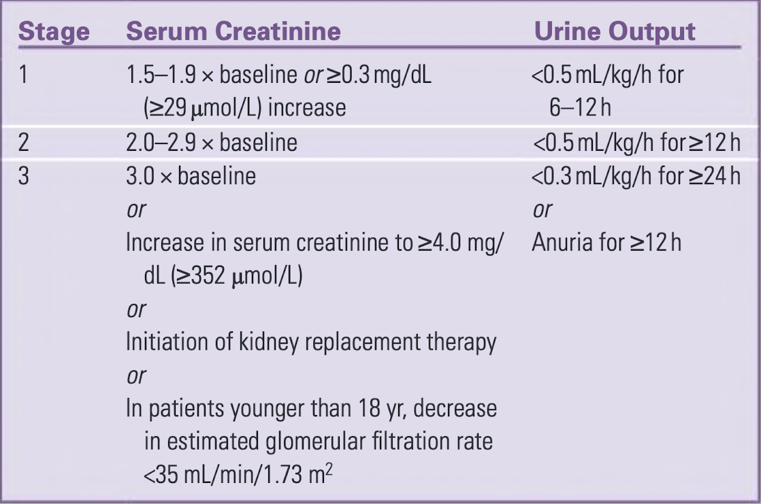
WHAT IS AKI?
KDIGO DEFINTION

Slide 3
CAUSES OF AKI
    PRE RENAL
    INTRINSIC RENAL
      Glomerular disease
      Interstitial disease
      Tubular disease
      Vascular disease
    POST RENAL

Slide 4
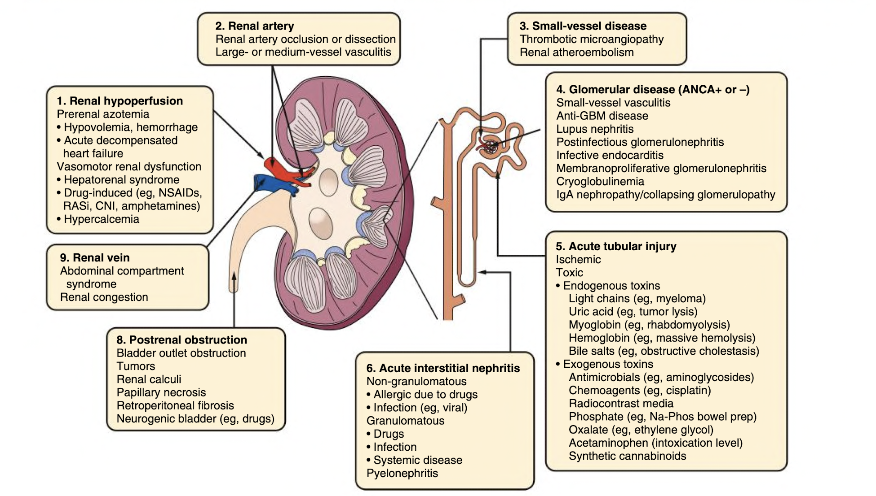

Slide 5
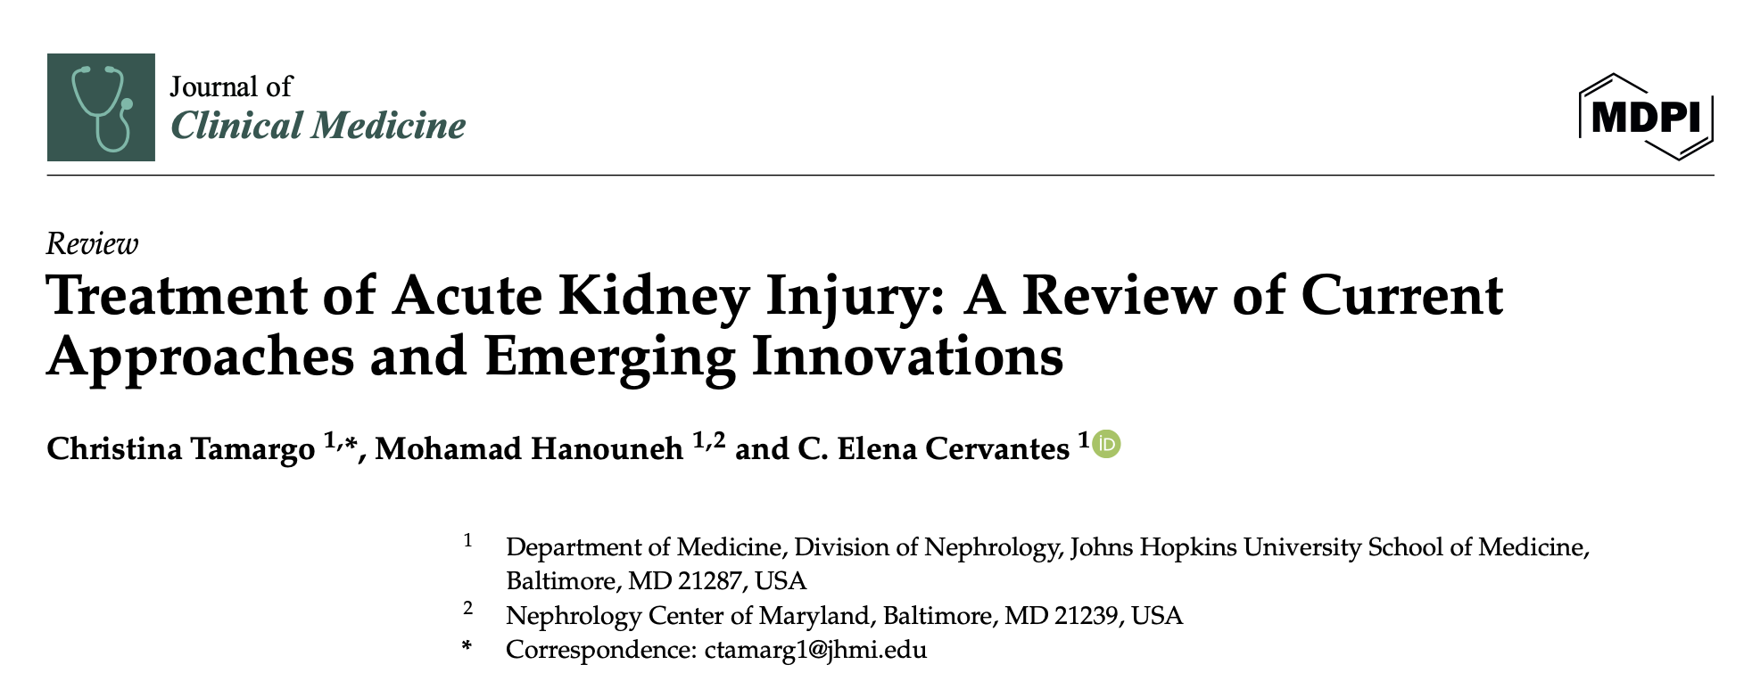

Slide 6
Areas of focus
Blood pressure targets in AKI
Fluid management in AKI
Vasopressor therapy
Indication and timing for Kidney replacement therapies.

Slide 7
BLOOD PRESSURE TARGET IN AKI
In contrast to SPRINT trial which suggested lower SBP target <120 mmHg have better CV benefits, AKI patient we tend to keep the SBP target high.
Most of these studies are conducted in patients with sepsis, individual undergoing surgery or post cardiac surgery
The rationale behind keeping high SBP or MAP targets is , upto a certain extent of fall in BP, the auto regulatory mechanism can help to maintain the GFR
Auto regulatory mechanism include prostaglandin mediated afferent arteriolar dilatation and angiotensin mediated effort arteriolar constriction.

Slide 8
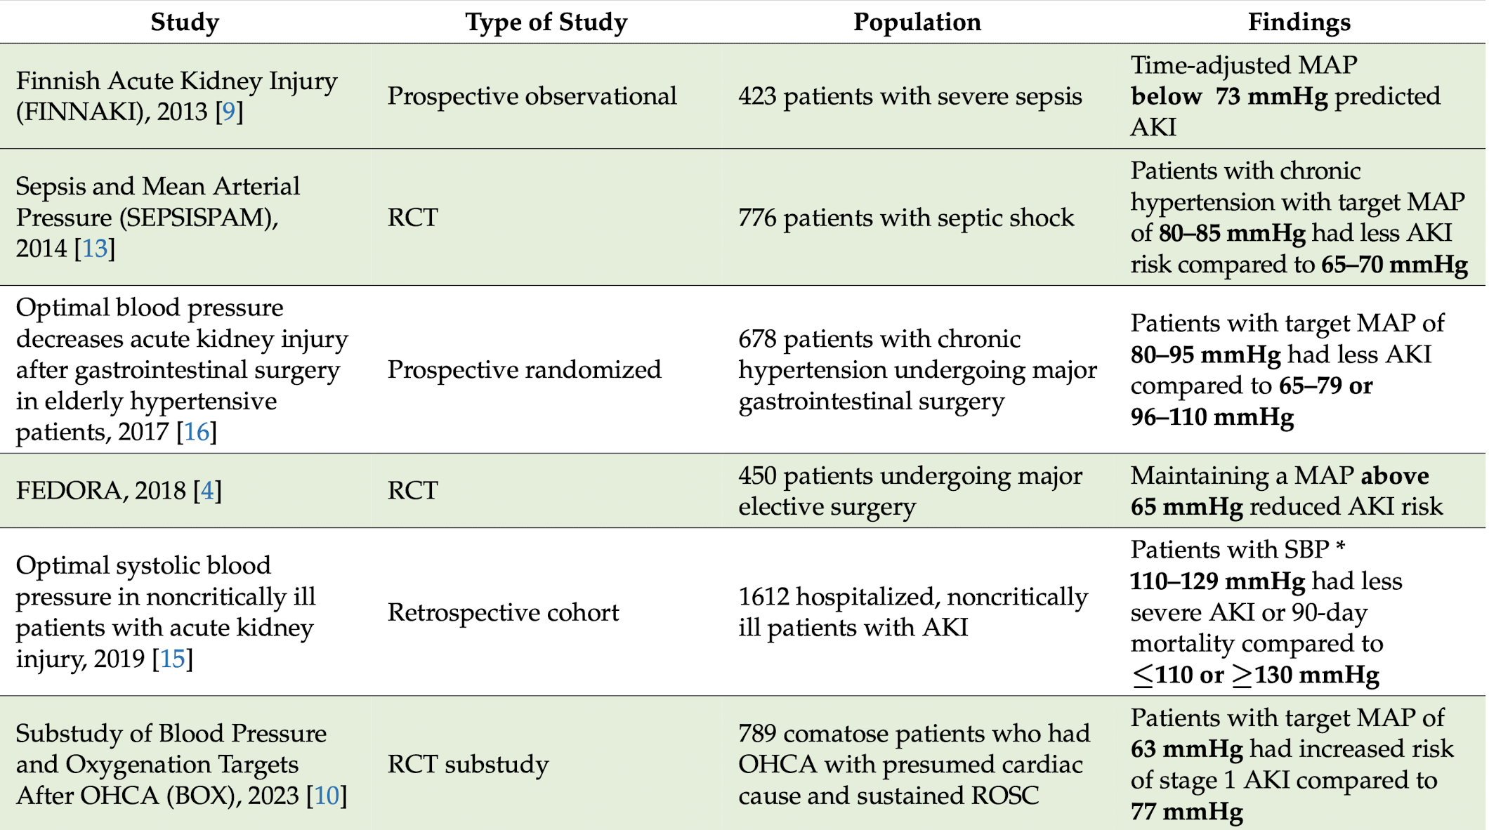

Slide 9
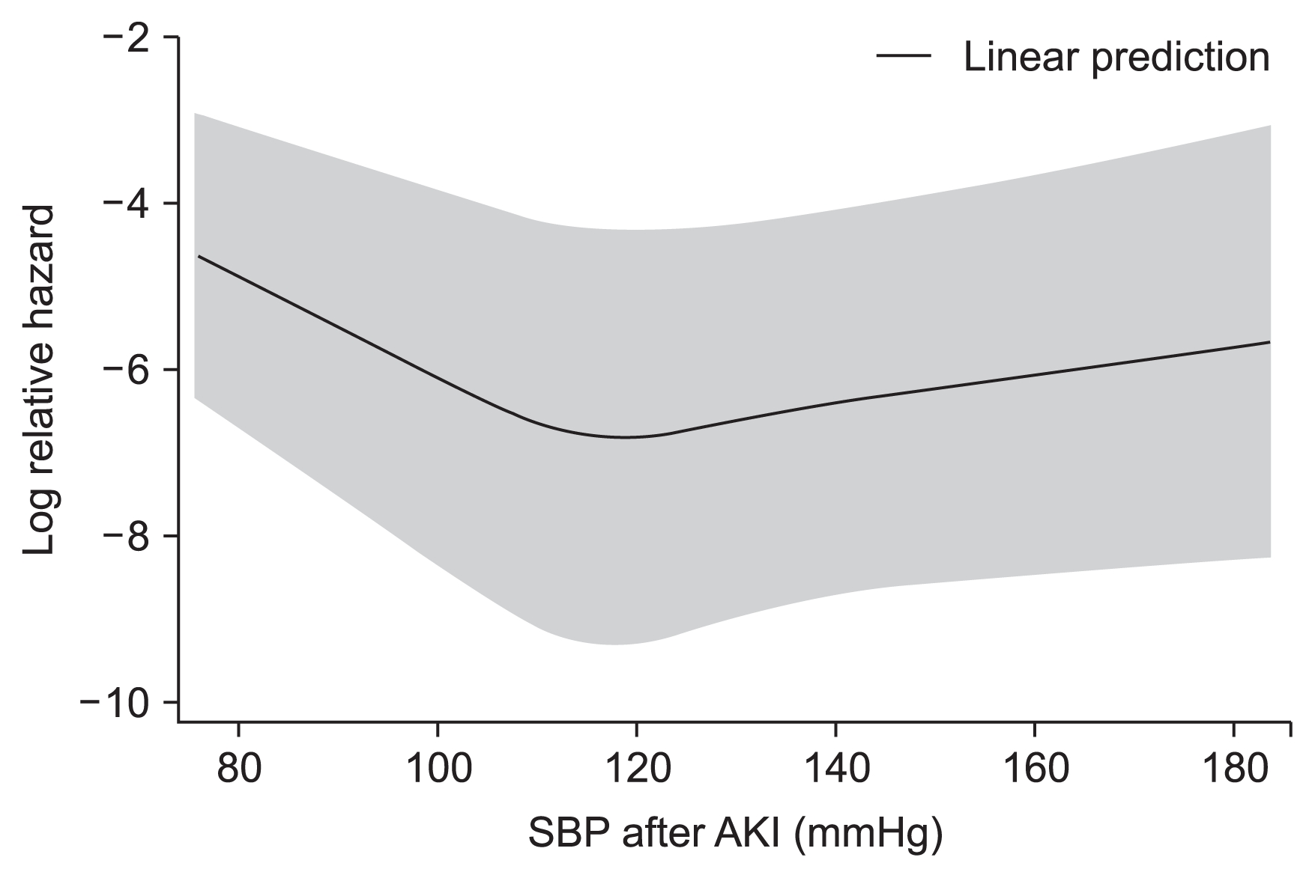
In non critically ill patients the relation between SBP and adverse outcome showed U shaped curve with minimum mortality in individual with SBP of 110- 129 mmHg
Also, 2.5-fold increase in severe AKI or mortality with SBP <100 mmHg compared to 110–129 mmHg in patients on antihypertensive medications at baseline. In non-hypertensive patients, the event rate was higher with higher SBP targets, stressing the importance of baseline blood pressures

Slide 10
“In summary the MAP target in AKI is high, but it should be individualised to the baseline BP of the patient.”

Slide 11
FLUID THERAPY IN AKI
Determining the volume of fluid resuscitation, has shifted away from classical 30ml/kg approach.
Even surviving sepsis campaign has moved it from “strongly recommending” to “suggesting” in its recent guideline.
More tailored approach is recommended to avoid adverse outcome of excessive fluid resuscitation, causing worsening renal function by causing intra renal compartment syndrome, abdominal compartment syndrome and renal oxygen demand- supply mismatch.

Slide 12
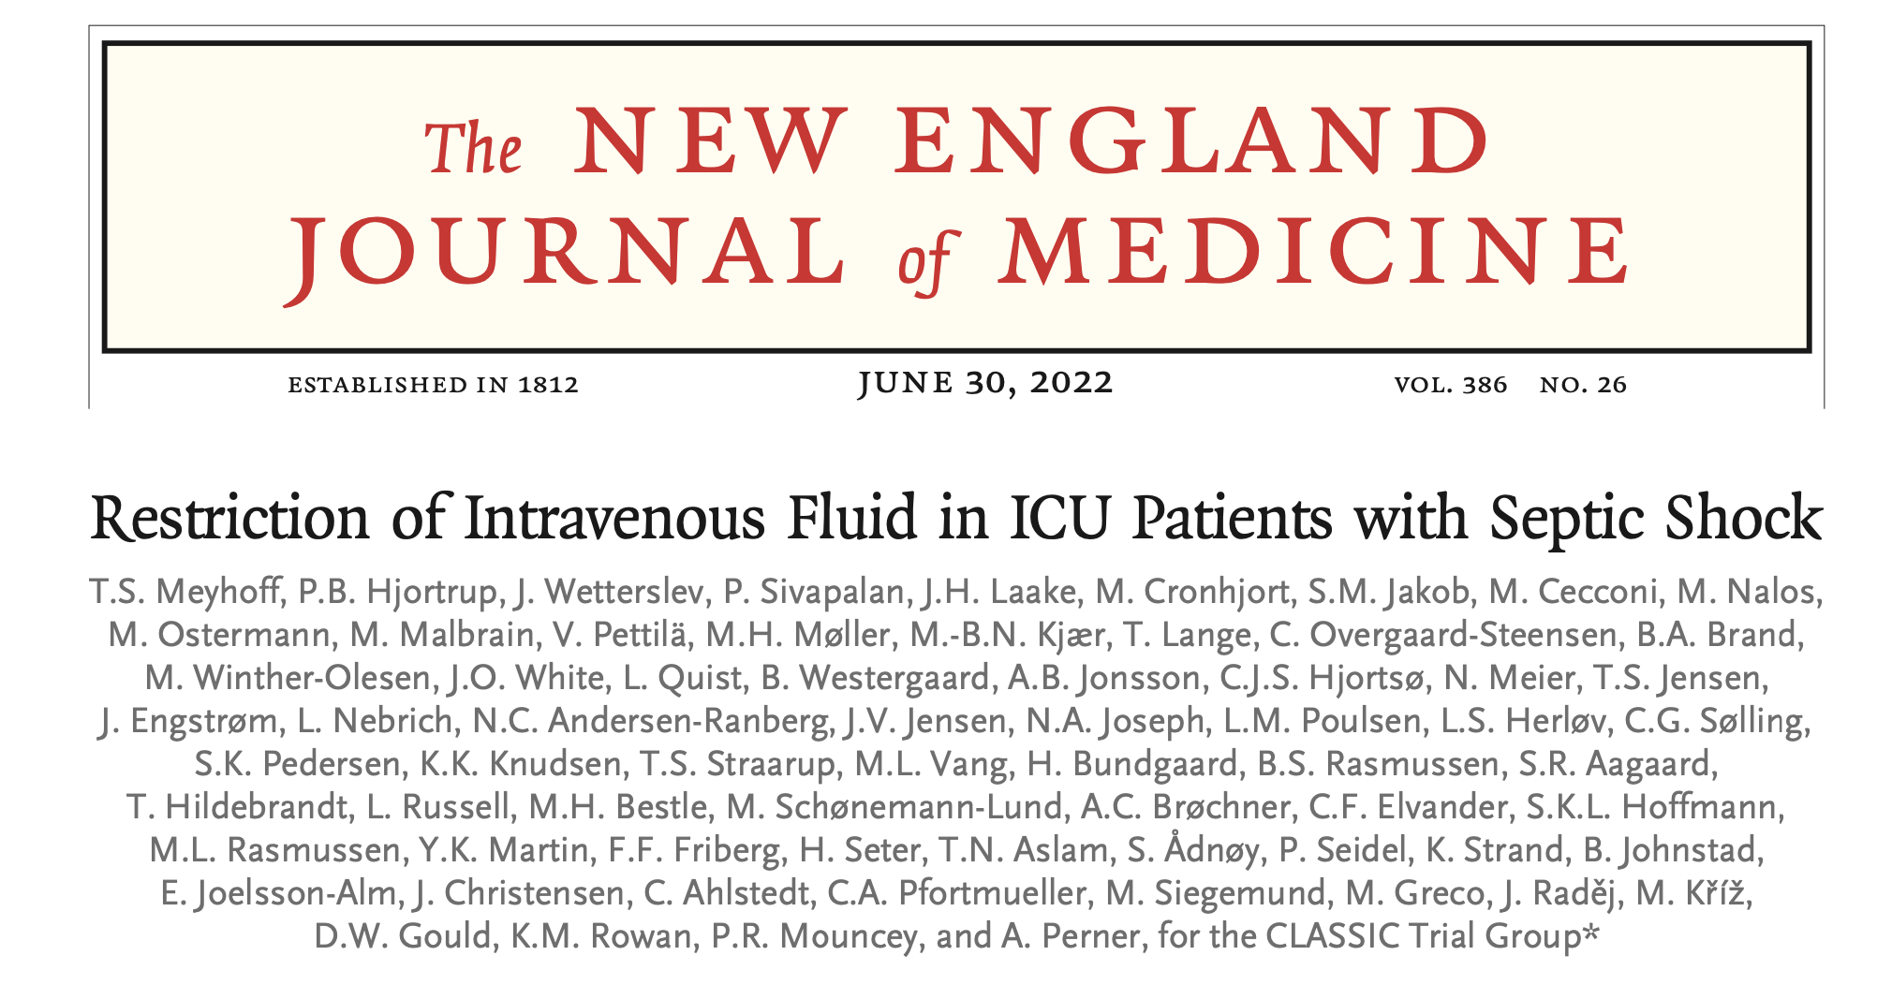
The CLASSIC RCT
CONSERVATIVE VERSUS LIBERAL APPROACH TO FLUID THERAPY OF SEPTIC SHOCK IN ICU

Slide 13
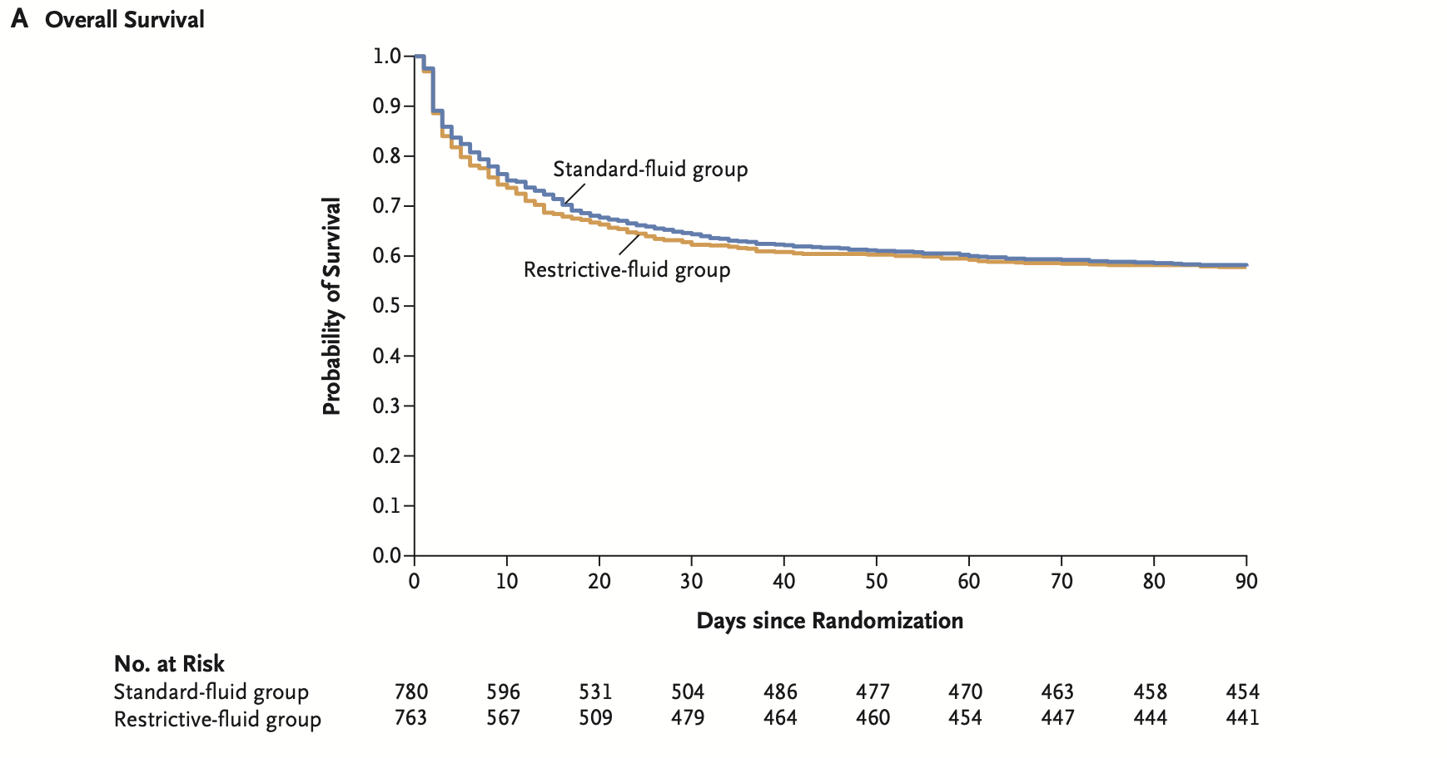
Suggests that there is no difference in 90 days mortality in individual receiving conservative isotonic fluid compared to liberal fluid

Slide 14
How to determine the fluid “sweet spot”?
History
Physical examination
Invasive and non invasive methods

Slide 15
History gives clue on aetiology and severity of AKI
Physical indicator
    Fluid responsive - dry mucosal membrane, delayed capillary refill time
    Fluid unresponsive - pedal oedema, presence of hepatojugular reflex

Slide 16
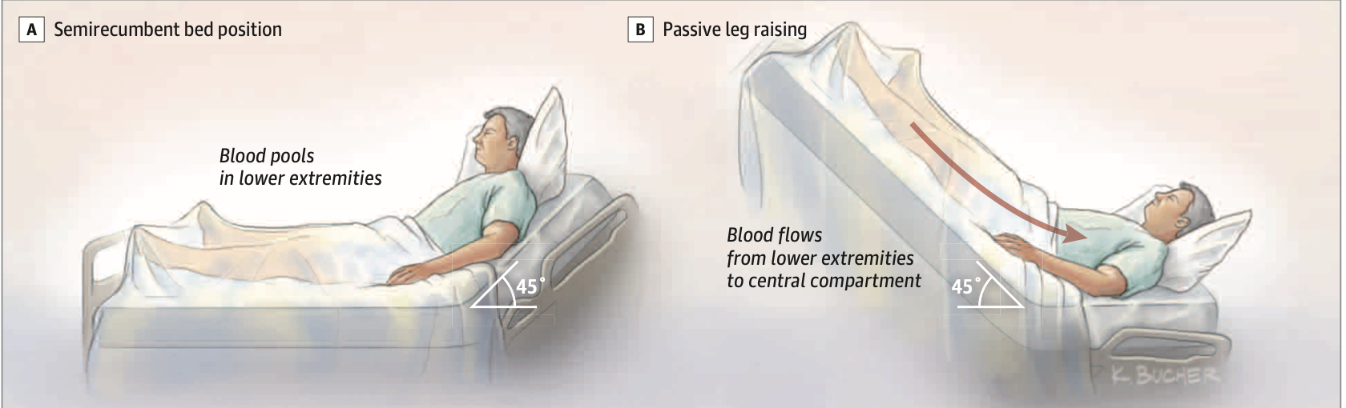
Passive leg rising test
Increasing the preload by mobilising the blood from lower limb, increase In cardiac output, stroke volume and pulse pressure indicate fluid responsiveness.

Slide 17
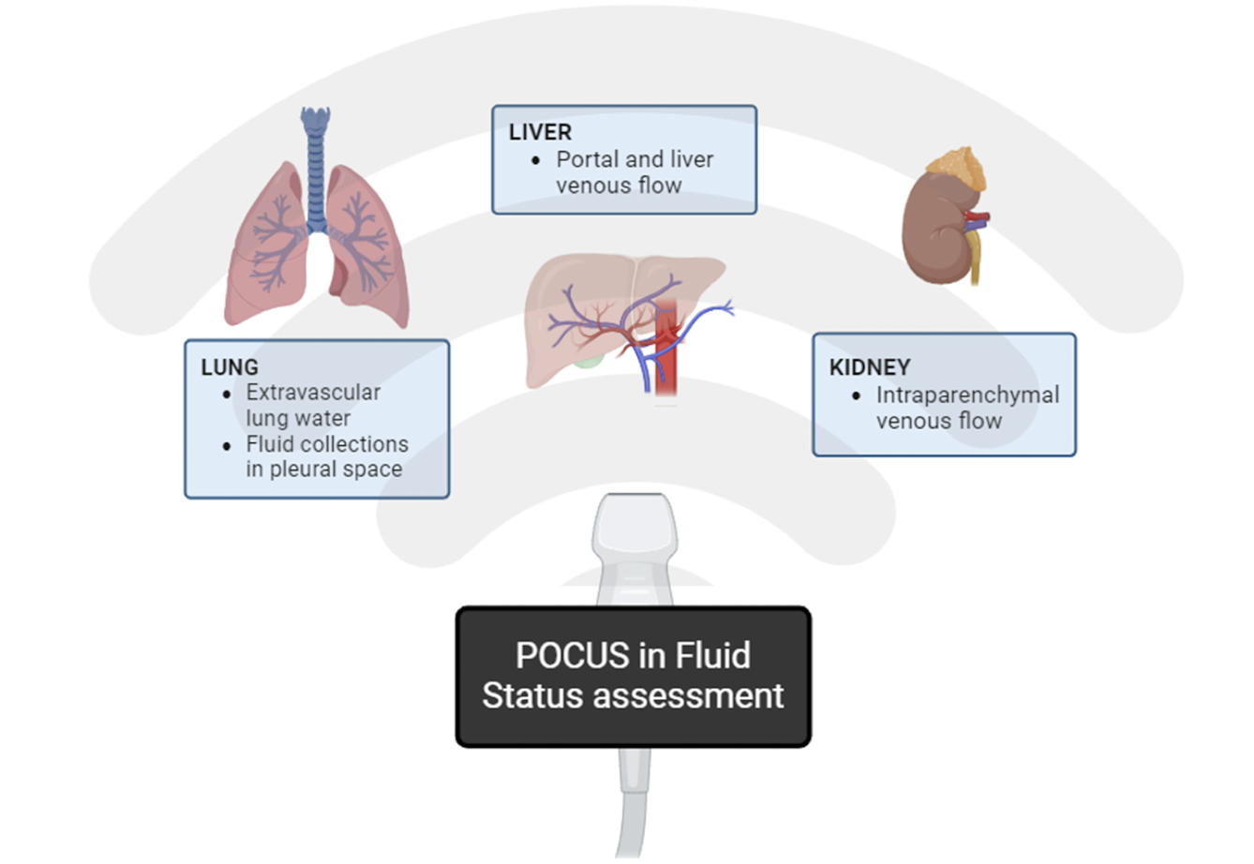
POCUS
To assess the volume status of the patient, by assessing IVC, liver, kidney and lung
VExUS grading provide the degree of volume excess by using the parameter like hepatic vein doppler, intra renal venous doppler and portal vein doppler.

Slide 18
Choice of fluid
FLUIDS
COLLOIDS
They have oncotic macromolecules act as volume expanders, stays intravscularly
Albumin
Dextran
Gelatin
Starches
Blood
CRYSTALLOIDS
They use sodium for volume expansion
Normal saline
Ringer lactate
Plasmalyte A

Slide 19
Studies on fluid of choice
STUDY | STUDY TYPE | POPULATION SIZE | FINDINGS
Saline versus albumin fluid evaluation (SAFE) | RCT | 7000 patients across 12 icu | Similar risk at 28 day saline versus 4% albumin Albumin showed increased mortality in traumatic brain injury cases
Albumin Italian outcome sepsis (ALBIOS) study | RCT | 1818 | Albumin replacement in addition to crystalloids, as compared with crystalloids alone, did not improve the rate of survival at 28 and 90 days and AKI
Fluid type and use of RRT in sepsis | Meta analysis | Ten studies (6664) | No difference in risk requiring RRT between those who receives crystalloids and albumin
Volume substitution and insulin therapy in severe sepsis (VISEP) study | RCT | 537 | Hydroxyethyl starch (colloid) have more risk of acute renal failure requiring RRT

Slide 20
“Crystalloids better”

Slide 21
Which crystalloid?
Crystalloids can be further classified into balanced and unbalanced crystalloids based on the buffer contents
    Balanced - ringer lactate, plasmalyte A
    Unbalanced - saline

Slide 22
STUDY | STUDY TYPE | POPULATION SIZE | FINDINGS
The isotonic solution and major adverse renal event trial (SMART) | RCT | 15802 patients across 5 icu | Low composite of death, new RRT requirement and persistent renal dysfunction is low in balanced crystalloid group compared to saline group, except for traumatic brain injury
Saline against lactated ringer or plasmalyte in emergency department (SALT-ED) trial | RCT | 19949 | No difference between hospital free days in both group but low rate of renal dysfunction seen in. Balanced crystalloids group

Slide 23
“Balanced colloid better!!”

Slide 24
Why balanced colloid better?
Contains buffer resembles plasma
Normal saline due to supra physiological level of chlorine causes hyperchloremic metabolic acidosis
Hyperchloremia can also reduces renal perfusion causing worsening renal function
A small RCT done on twelve healthy individual showed reduced renal blood flow velocity and cortical perfusion after infusion of saline compared to balanced colloids.

Slide 25
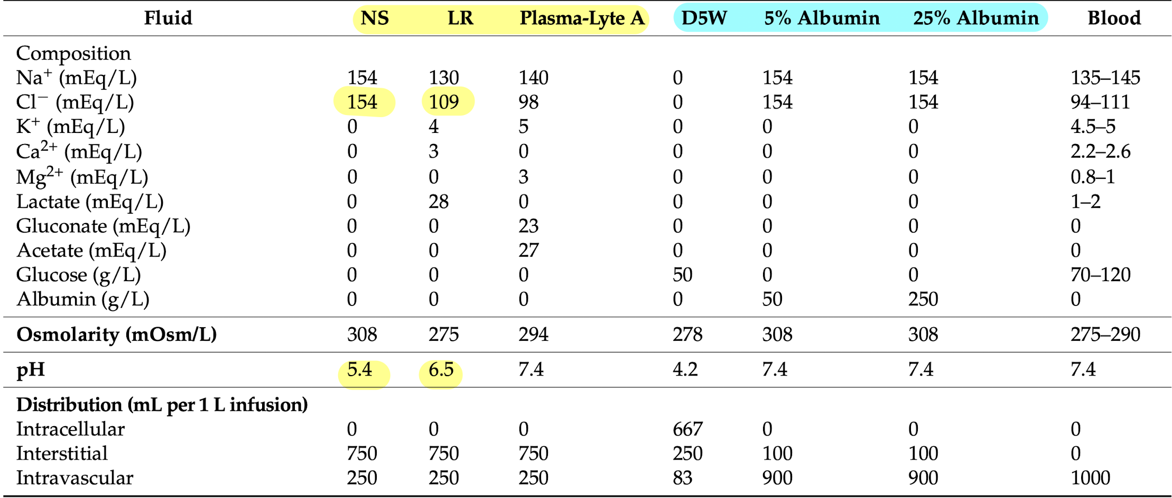

Slide 26
Vasopressor of choice
STUDY | STUDY TYPE | POPULATION SIZE | FINDINGS
Vasopressin and septic shock trial (VASST) | RCT | 778 | No difference in renal dysfunction and need of RRT in both vasopressin and norepinephrine, but post hoc analysis revealed individual in RIFLE “risk” category with vasopressin shows less progression to renal “failure” or “loss” of category, lower rate of RRT.
Vasopressin vs norepinephrine as initial therapy in septic shock (VANISH) | RCT | 409 | Early addition of vasopressin to norepinephrine was associated with higher urine output and lower rate of RRT in individuals with septic shock.
Vasopressin versus norepinephrine in patients with vasoplegic shock after cardiac surgery (VANCS) | RCT | 330 | Vasopressin can be used as a first line vasopressor postcardiac surgery vasoplegic shock

Slide 27
“Vasopressin better!!”

Slide 28
Why vasopressin better?
High dose norepinephrine causes mesenteric and renal vasoconstriction via alpha 1 agonistic action
Vasopressin shows minimal renal afferent arteriolar constriction with some renal effort arteriolar constriction thus increasing the glomerular supply and improving the GFR.

Slide 29
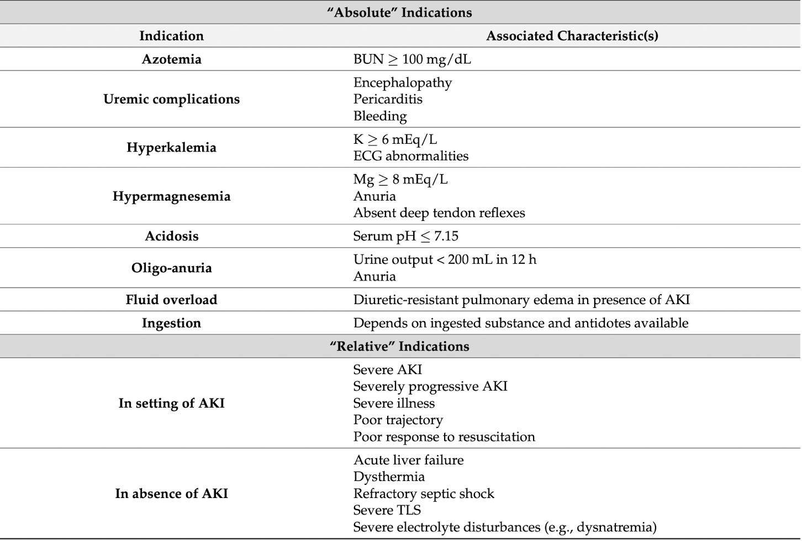
Renal replacement therapy

Slide 30
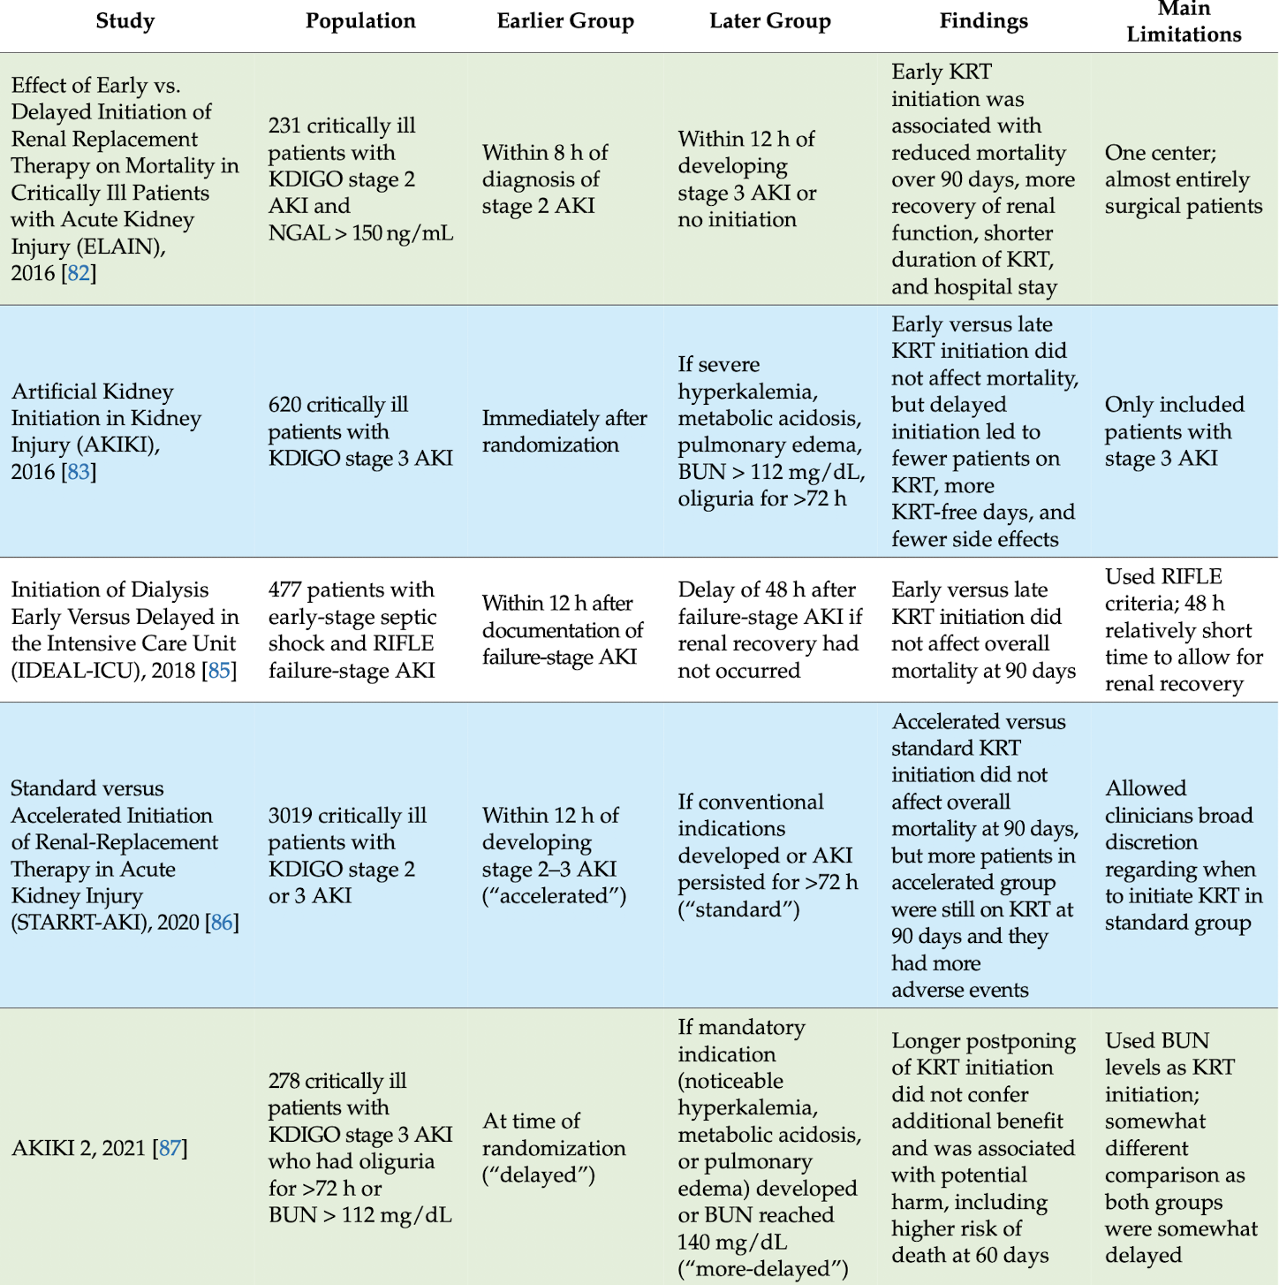
Early versus late initiation of RRT

Slide 31
Limitation of all these studies:
    Population varies widely, from mild to severe AKI, from individual undergoing surgery to septic shock patients
    Uses different criteria, KDIGO or RIFLE
    Early and delayed have different definition in different studies

Slide 32
“Early RRT have no significant benefit over delayed RRT”

Slide 33
Complications of AKI
Metabolic acidosis- The BICAR-ICU trial suggests bicarbonate therapy did not affect the composite outcome of death by day 28, presence of at least one organ dysfunction by day 7 but it reduces the outcome and 28 day mortality in individual with AKI

Slide 34
How Bicarbonate should be replenished?
Indications:
    pH < 7.1
    Hco3- <8
Given only after correcting respiratory acidosis, otherwise causes paradoxical intracellular acidosis
Always given as isotonic bicarbonate solution.
1-2 mEq/l and reassess after 1 hr

Slide 35
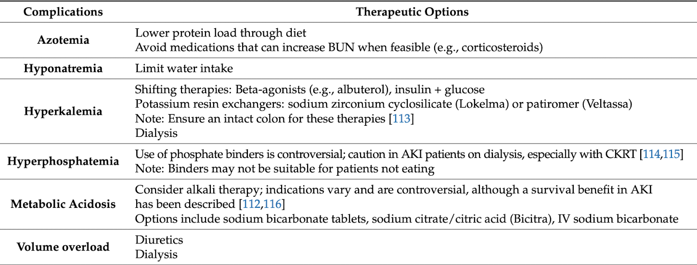

Slide 36
Take home messages
BP target- usually high but it should be individualised by the patients baseline BP
Balanced colloid is better than unbalanced colloid for fluid resuscitation in AKI, due to near physiological constituent, not worsening acidosis or causing hyperchloremia
Vasopressin is better vasopressor in individual with AkI due to its Renoprotective effect.
There is no benefit in early RRT compared to delayed RRT
Bicarbonate can be helpful in Metabolic acidosis with AKI

Slide 37
Thank you

