Slide 1
APPROACH TO SYNCOPE
DR. ALBY MARIA MATHEWS
JUNIOR RESIDENT
TDMC ALAPPUZHA

Slide 2
SYNCOPE
Transient self limited loss of consciousness due to global cerebral hypoperfusion.
Syncope (Greek, synkope) :- cessation/cutting short /pause
Synonymous with fainting
common medical phenomena.

Slide 3
Characterized by
Onset –rapid
Duration –brief , <10 sec
Recovery – spontaneous and complete.
Although syncope occur without any warning symptoms, a syncopal prodrome (presyncope) is common

Slide 4
Presyncope : sudden loss of strength and other symptoms characterized by impending or incomplete fainting spell.
Presyncopal symptoms include- dizziness, light headedness, faintness, weakness, fatigue , visual and auditary disturbances.

Slide 5
Epidemiology and natural history of syncope
Nearly 3 % of all emergency room visits
1% of all hospital admissions
Life time cumulative incidence – 35% of all general population.

Slide 6
Peak incidence
young – 10- 30 years
(mean age – 15 years )
-Most common cause is neurally mediated syncope.
Elderly – sharp rise in incidence after 70 years

Slide 7
Most common cause is neurally mediated syncope
Females > males
Young subjects- positive family history in first degree relative
Second most common cause- cardiogenic
Cardiac arrhythmias and structural heart diseases.

Slide 8
Orthostatic hypotension – prevalence increases with age.
Due to reduced baroreflex responsiveness and reduced cardiac compliance.
Age related attenuation of vestibulo-sympathetic reflex.

Slide 9
Prevalence of orthostatic hypotension in elderly
More in institutionalized patients (54-68 %) than community dwelling (6%)
Predisposing neurological disease
Physical impairment
Vasoactive medications

Slide 10
Prognosis after an episode of syncope
Generally benign
Excellent prognosis – noncardiac & unexplained syncope in young patients.

Slide 11
Cardiogenic syncope- either due to structural heart disease or primary arrhythmic disease has increased risk of sudden cardiac death and mortality
Increased mortality associated with syncope related to orthostatic hypotension In elderly

Slide 12
Reflex mechanisms for control of blood pressure
Negative feedback reflux mechanisms
The Baroreceptor Arterial Pressure Control System—Baroreceptor Reflexes
initiated by stretch receptors - baroreceptors or pressoreceptors
at specific points in the walls of several large systemic arteries.

Slide 13
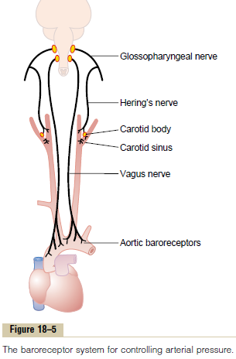

Slide 14
Maintenance Of Postural Normal Tension baroreflex
Standing
Pooling of 500 -1000ml blood in lower extremities and splanchnic circulation
Decreased venous return and CO
baroreceptors in carotid sinus and aortic arch
Glossopharyngeal and vagus nerve-afferents
NTS in dorsomedial medulla

Slide 15
N ambiguous
Caudal ventrolateral medulla[excitation ]/ rostral VL medulla[inhibitory]
Disinhibition of R VLM
Vasopressin release from A1 noradrenergic cell group in VL medulla
Activate VP synthesis from hypothalamus
Increased vasomotor tone

Slide 16
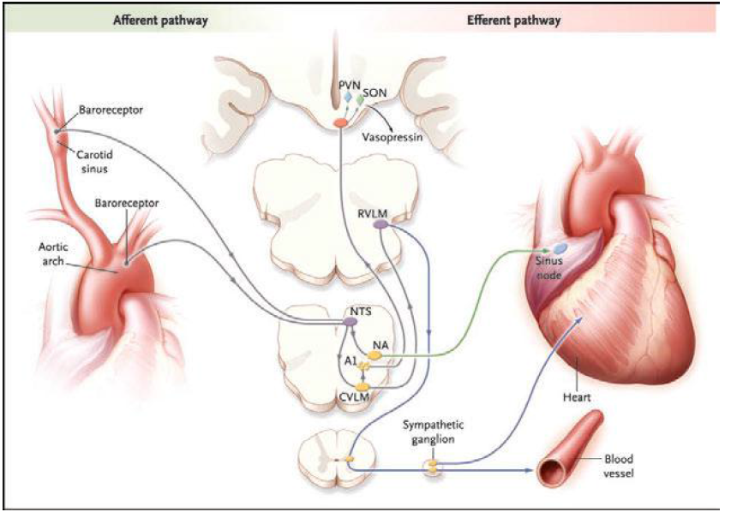

Slide 17
Rise in arterial pressure
Stretches the baroreceptors
Transmit signals into the central nervous system.
“Feedback” signals sent back through the autonomic nervous system to the circulation
To reduce arterial pressure downward toward the normal level.

Slide 18
Pathophysiology of syncope
Standing
Pooling of 500-1000ml of blood in the and splanchnic circulation lower extremities
Decreases the venous return and reduced ventricular filling occurs
Reduced cardiac output and fall in blood pressure

Slide 19
Hemodynamic changes provokes the compensatory reflex responses
Initiated by the baroreceptors in the carotid sinus and aortic arch
Increased sympathetic outflow and decreased vagal activity
Increased peripheral resistance, venous return and cardiac output
Limits the fall in bp

Slide 20
AUTOREGULATION OF CEREBRAL BLOOD FLOW
CEREBRAL BLOOD FLOW
MYOGENIC FACTORS
AUTONOMIC NEUROVASCULAR CONTROL
LOCAL METABOLITES

Slide 21
Latency of the response : 5-10 sec
Cerebral blood flow -50-60ml/min/100gm brain tissue
Remain constant over a wide range of perfusion pressure : 50-150 mm Hg

Slide 22
Cessation of blood flow for 6-8 sec result in loss of consciousness
Impairment of consciousness- <25ml/min/100mg of brain tissue
Syncope - fall in systolic BP to 50 mm Hg or lower

Slide 23
Causes of syncope
SYNCOPE
NEURALLY MEDIATED SYNCOPE
CARDIOGENIC SYNCOPE
ORTHOSTATIC HYPOTENSION

Slide 24
Syncope mimics
Disorders without impairment of consciousness
  Falls
  Drop attacks
  Cataplexy
  Psychogenic pseudo-syncope
  Transient ischemic attacks
Disorders with loss of consciousness
  Metabolic disorders
  Epilepsy
  Intoxications
  Vertebrobasilar transient ischemic attack

Slide 25
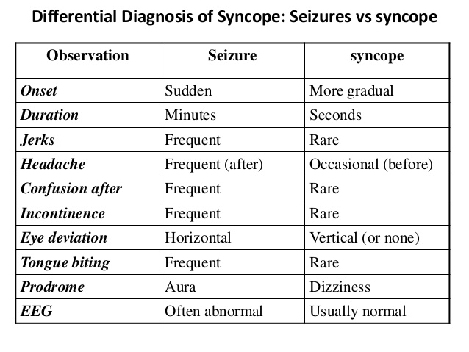
Seizure VS Syncope

Slide 26
NEURALLY MEDIATED SYNCOPE

Slide 27
Multiple triggers of the afferent limb of the reflex arc stimulate a syncope.
(Eg: carotid sinus, GI tract or bladder)
TYPES OF NEURALLY MEDIATED SYNCOPE
vasovagal & situational reflex syncope. ( based on afferent pathway and provocative trigger)
-vasodepressor and cardio-inhibitory syncope ( based on efferent pathway )-sympathetic & parasympathetic

Slide 28
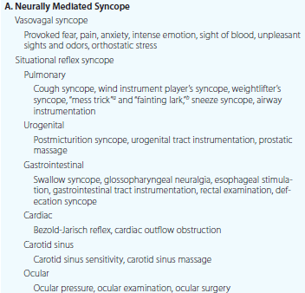

Slide 29
Vasovagal syncope (common faint)- Most common type of syncope
provoked by fear, pain, anxiety, intense emotion, sight of blood, unpleasant sight and odours
sudden fall of BP with or without bradycardia, often preceded by a prodromal symptoms such as nausea, headache, sweating, hyperventilation, parasthesia, chest pain and palpitation

Slide 30
symptoms – persists minutes or hours after syncope
Often occurs in youngsters and resolves spontaneously once the patient assumes supine position.

Slide 31
Pathophysiology of Vasovagal Syncope
In Vasovagal syncope: facilitating factors trigger baroreceptors and medullary centres through afferent fibres, activating the parasympathetic tone but inhibiting the sympathetic tone through vagal efferent fibres resulting in hypotension and bradycardia and thereby syncope

Slide 32
Micturition syncope
Seen in men & elderly
Mostly episodes nocturnal
Abrupt onset LOC, Rapid and complete recovery
Nocturnal collapse may cause serious injuries

Slide 33
Full bladder- vasoconstriction
Upon emptying vasodilatation occurs
Combined with an element of postural hypotension result in syncope
Vagus mediated bradycardia
Mild valsalva effect
Alcohol,hunger,URTI- provokes

Slide 34
Defecation Syncope
Occurs mostly in elders, usually arising from the bed at night or during manual disimpaction of the rectum
Mechanism: triggering of mechanoreceptors in the gut wall in the presence of predisposing and facilitating factors
Predisposing factors: fatigue, decreased food intake, alcohol consumption, GIT pathology.
Facilitating factors: change in the sleep, Valsalva manoeuvre during defection, orthostatic hypotension

Slide 35
Syncope associated with glossopharyngeal neuralgia
Sixth decade
Paroxysms of pain complicated with syncope
Bradycardia and hypotension occurs
“Deglutitional syncope”

Slide 36
Tussive & valsalva syncope
Following severe paroxysms of cough
Usually heavy smokers,chronic bronchitis
Children-pertussis,laryngitis
Due to elevated intrathoracic pressure- reduced venous return
Increased CSF pressure & dimnished Pco2
Result in cerebral vasoconstriction

Slide 37
Rarely associated with Mobitz II or complete heart block, obstructive cardiomyopathy and severe cerebrovascular disease
during endotracheal intubation /bronchoscopy
sneeze syncope associated with Arnold-Chari malformations.

Slide 38
Valsalva syncope :
usually in the presence of predisposing factors (such as cerebrovascular disease or sick sinus syndrome) causes syncope
due to progressive fall in venous return, arterial pressure and CO as a result of prolonged increase in the intrathoracic pressure

Slide 39
Diver’s syncope:
underwater diving leads to sudden death .
form of neurocardiogenic syncope
Weight lifter’s blackout
Syncope during weight lifting
Effect of valsalva manouvre and squatting

Slide 40
Postprandial syncope
postprandial hypotension (usually 45-60 min after meals)
due to splanchnic blood pooling and peripheral vasodilatation may lead to syncope especially in the elderly pts.
Impaired baroreflex function and thereby inadequate sympathetic activity and release of gastrointestinal peptides could be the contributing factors.

Slide 41
Carotid Sinus Hypersensitivity / Carotid Sinus Syncope
Occurs particularly in elderly
Stimulation of carotid sinus causes bradycardia and hypotension.
Usually initiated by turning head to one side wearing tight collar./shaving area of carotid sinus.
nearly always occur when in upright posture

Slide 42
Types of neutrally mediated syncope:
Cardio inhibitory/vagal type: reflex cardiac slowing (sinus bradycardia, sinus arrest, AV bock).
Vasodepressor type: fall in arterial pressure without bradycardia.
Mixed type.

Slide 43
Predisposing factors:
For carotid syncope: CAD and hypertension in majority, neck pathology (enlarge neck L/N, carotid body tumors, parotid tumors, thyroid tumors, head and neck tumors)
For carotid sinus hypersensitivity: sinus node dysfunction and AV node conduction abnormalities are often noted in the pts.

Slide 44
CARDIOGENIC SYNCOPE

Slide 45
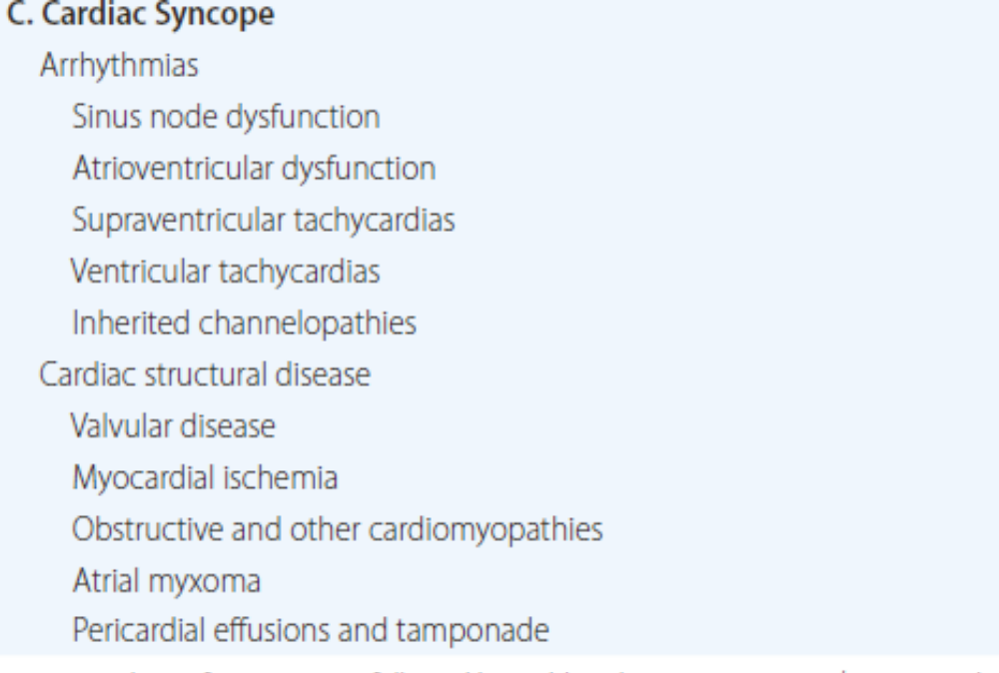

Slide 46
Mechanism of syncope in arrhythmias
In Tacharrhythmias: mild-moderate tachycardia increase CO, where as marked tachycardia (>140/min) leads to decrease in diastolic filling and CO , resulting in hypotension and syncope.
In Bradyarrhythmias: Usually severe bradycardia leads to prolonged ventricular filling resulting in decreased cerebral perfusion.

Slide 47
Tachyarrhythmias:
ventricular tachycardia < 200bpm are less likely to cause syncope.
INHERITED CHANNELOPATHIES
LONG QT SYNDROME
can lead to syncope and sudden cardiac death due to polymorphic VT(Torsades de pointes) that degenerates into ventricular fibrillation.
due to defect in K channel α/β subunits, voltage gated Na channel Ankyrin B( AMK 2)

Slide 48
BRUGADA SYNDROME
Can lead to idiopathic ventricular fibrillation with RV ECG abnormalities.
Mutations in Na channel α subunit SCN5A
CATECHOLAMINERGIC POLYMORPHIC TACHYCARDIA
Exercise or stress induced ventricular arrhythmias, syncope or sudden death
ACQUIRED QT PROLONGATION DUE TO DRUGS

Slide 49
BRADYARRHYTHMIAS
Accounts for 31% of cardiac syncope
Profound sinus bradycardia , SA node exit block, high AV block and sick sinus syndrome (SSS) are common causes
Sinus bradycardia : It may be due excessive vagal tone, decreased sympathetic tone or sinus node disease itself

Slide 50
Sick Sinus Syndrome (SSS): 25-70% of SSS patients which is characterized by disturbance of SA impulse formation or conduction
Stoke Adams syndrome: syncope due to bradycardia , asystole or complete heart block.
Pacemaker related: syncope in pts with pacemaker implantation is due to pacemaker malfunctioning or pacemaker syndrome

Slide 51
Structural heart diseases
Due to structural abnormalities leading to decreased outflow: exertional syncope is a common manifestation of all types of heart disease in which cardiac output is fixed and does not rise or may fall with exercise
LVOTO: common conditions AS, HCM

Slide 52
Aortic stenosis
Syncope occurs in 42% with severe AS, usually with exertion
Due to fixed CO, CO decreases on exertion due to reflex fall in peripheral vascular resistance

Slide 53
HOCM
In 30%
Mechanism: Dynamic LVOTO is worsened by an increase in LV contractility (stimulating the LV mechanoreceptors), decrease in chamber size, or decrease in after load (Hence, a Valsalva manoeuvre, severe cough or drugs precipitates hypotension and syncope)
VT reported in 25% of adults pts

Slide 54
LV inflow obstruction
MS it rarely leads to syncope and it could be due to:
Decreased LV filling which in turn may lead to decreased CO and syncope
AF with rapid ventricular rate
Pulmonary artery hypertension
Cerebral embolic event

Slide 55
Ball valve thrombus
Associated AS or CAD
Atrial myxomas: it result in obstruction of MV or TV and may obstructive ventricular filling leading to decrease CO and syncope especially with change in position

Slide 56
RV outflow tract obstruction
Causes: Pulm. HTN secondary to CHD (TOF and eisenmenger complex ), Pulm. Stenosis, Pulm. Embolism
Mechanism: inability to increase CO in association with a reflex fall of peripheral resistance results in hypotension and syncope

Slide 57
Coronary artery disease
Syncope can occur in 5-12% in Acute MI especially in elderly pts, while syncope in unstable angina and coronary spasm is rare
Mechanism: sudden pump failure producing hypotension and decreased perfusion of the brain

Slide 58
Others: acute mechanical complications – MR, VSD, ventricular wall rupture
Cardiac tamponade
Drug induced: vasodilators (nitrates, CCBs, morphine), volume depletion due to diuretics

Slide 59
ORTHOSTATIC HYPOTENSION

Slide 60
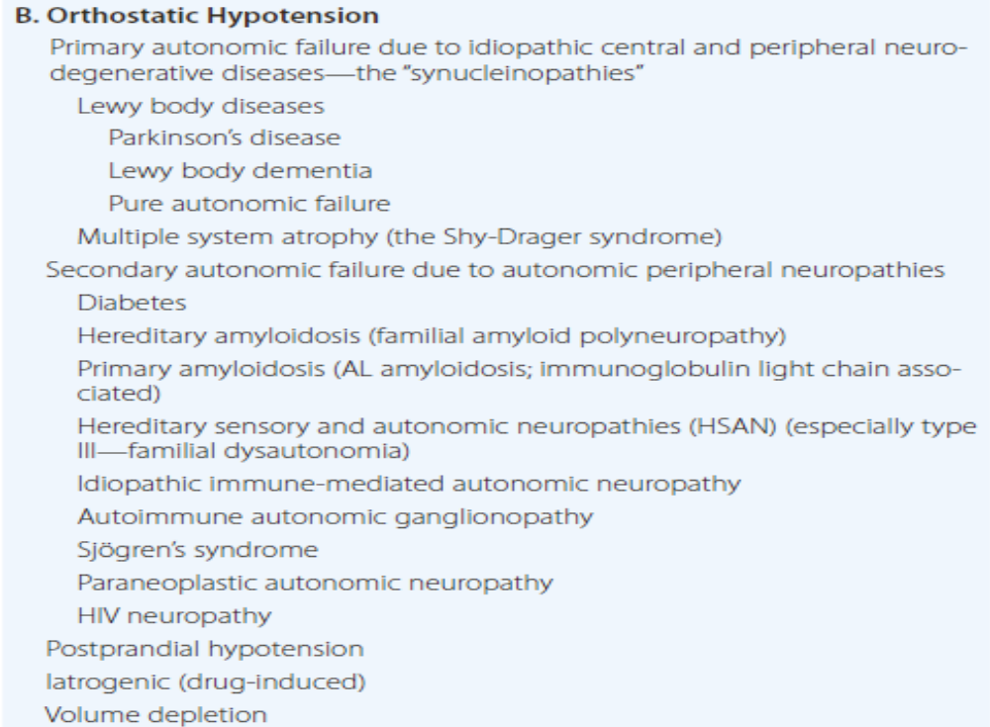

Slide 61
Manifestation of sympathetic vasoconstrictor (autonomic) failure.
Reduction in systolic BP of at least 20 mm Hg or diastolic BP of 10 mm Hg within 3 min of standing or head up tilt on a tilt table.
No compensatory rise in heart rate despite hypotension.

Slide 62
Delayed orthostatic hypotension
Hypotension occurs beyond 3min of standing
Mild/early form of sympathetic adrenergic dysfunction.
Initial orthostatic hypotension
Occurs within 15 sec of standing
Due to mismatch b/w cardiac output and peripheral resistance.

Slide 63
Supine hypertension
Common in pts. with Orthostatic Hypotension due to autonomic failure(> 50%)
OH may follow treatment for HTN
SH may follow treatment for OH
Baroreceptor reflux dysfunction in presence of residual sympathetic flow –esp in central autonomic degeneration.

Slide 64
Symptoms:
Light headedness, dizziness, presyncope
Nonspecific symptoms
Visual blurring- retinal ischemia/occipital lobe ischemia
Neck pain-”coat hanger head ache”
Orthostatic dyspnoea or angina
Exacerbated by-exertion,prolonged standing,increased ambient temperature,meals.

Slide 65
Drug induced orthostatic hypotension
Vasodilators: Ca channel blockers, nitrates, hydralazine, ACE inhibitors, and prazosin
Other antihypertensives: methyldopa, clonidine, labetalol, and diuretics
Antidepressants: mono amino oxidase (MAO) inhibitors.
Tranquilizers: phenothiazines and barbiturates
Antiparkinsonian drugs
Iatrogenic volume depletion due to diuresis

Slide 66
EVALUATION AND MANAGEMENT OF SYNCOPE

Slide 67
EVALUATION OF SYNCOPE
RISK STRATIFICACTION
HISTORY
PHYSICAL EXAMINATION
DIAGNOSTIC TESTING

Slide 68
DIFFERENTIAL DIAGNOSIS
Several disorders with transient real or apparent LOC may create diagnostic confusion.
Generalised and partial seizures
Transient LOC due to hypoglycemia
Cataplexy
Falls due to vestibular dysfunction, cerebellar disease , extrapyramidal system dysfunction and other gait disorders.
Apparent loc due to psychiatric disorders

Slide 69
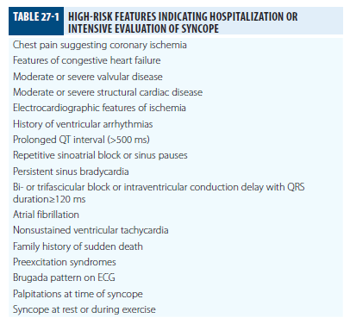

Slide 70
CLINICAL HISTORY
Obtain a detailed medical history -first step
Provided by the patient (and witnesses, if any) will often reveal the most
Guiding subsequent testing and treatment.

Slide 71
Clinical History
Mode of onset
Duration of episode
Precipitating factors (triggers)
How was consciousness regained ?
Associated factors – before ( prodromes, aura) during, and after (postictal)
Predisposing factors
Family history

Slide 72
Mode of onset
Rapid sudden onset - cardiac and vasovagal syncope & seizure disorders
Gradual onset - hypoglycaemia related syncope & hyperventilation
Unrelated postures: arrythmogenic and seizure disorder.
Prolong standing facilitates vasovagal syncope
After arising: in orthostatic hypotension

Slide 73
Duration of episode:
In syncope duration of episode usually lasts <=5 min
While seizure, the duration of unconsciousness is usually > 5 min
Restoration factors:
Regained consciousness promptly in syncope (of cardiac origin),
While in seizure disorder, it occurs slowly

Slide 74
Provocative factors
During or immediately after exercise
During or immediately after urination, defecation, coughing or swallowing
While in a warm and/or crowded place
During prolonged standing

Slide 75
During the post-prandial period
In association with emotional stress, fear, or intense pain
Immediately following abrupt neck movements

Slide 76
Family History
Family history of epilepsy
Positive family history in HOCM, long QT syndrome.

Slide 77
Physical examination
Any trauma
Initial vital signs
Orthostatic blood pressure measurements
Vascular (pulses and carotid bruits)
Cardiac & pulmonary signs(evidence of congestive heart failure),
Abdominal & rectal signs
skin/nail (anemia) signs.
New focal neurologic findings

Slide 78
Diagnostic testing
Basic laboratory testing
As clinically indicated
Complete blood count
Fecal occult blood testing,
HCG testing in women of childbearing age
Troponin testing -identify cardiac etiology

Slide 79
ECG
All patients with syncope
Diagnostic yield is 3% to 5%,
Aid in diagnosing –
Arrhythmia Ischemia
Pulmonary Embolus Hypertrophic Cardiomyopathy
Brugada Syndrome Bundle Branch Block
Intraventricular Conduction Delay
Sinus Bradycardia

Slide 80
ECG MONITORING
Holter monitoring for 24 to 48 hours( 1 or more per week)
External loop recorders for four to six weeks (> 1 episode per month),
Implantable loop recorders for up to three years

Slide 81
Echocardiograpy
Electrophysiological Studies
EEG
Neuroimaging- Computed Tomograpy
Carotid Doppler
Cardiac Catheterisation

Slide 82
Carotid sinus massage
In patients older than 40 years
Diagnostic if ventricular pause is more than three seconds /if systolic blood pressure decreases by more than 50 mm Hg
Contraindicated - patients with bruits or a history of transient ischemic attack/ cerebrovascular accident within the past three months

Slide 83
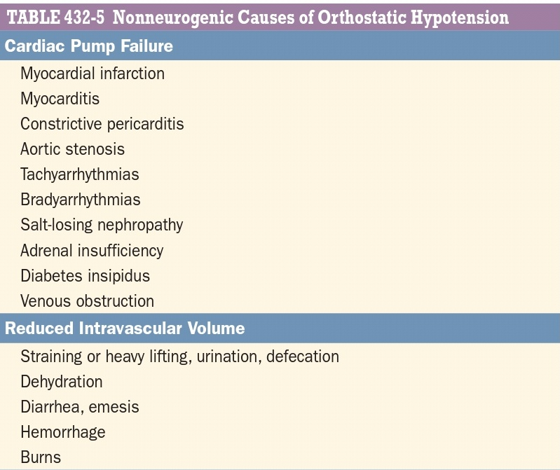

Slide 84
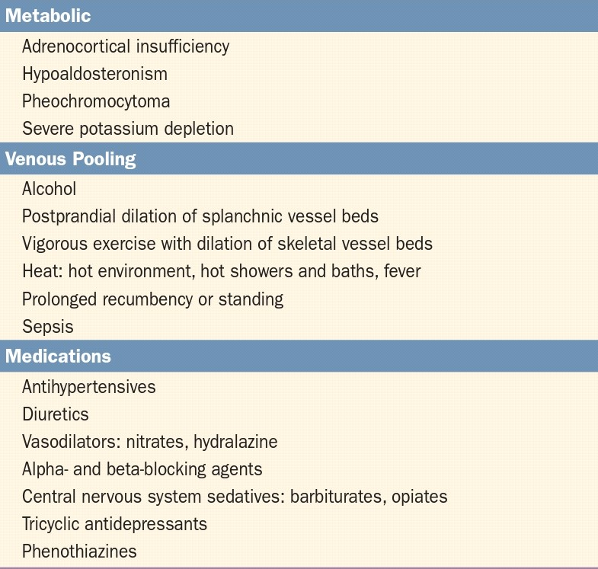

Slide 85
Autonomic function tests
Heart rate variation with deep breathing : depends on multiple factors like position, rate and depth of respiration, age, medications, weight and degree of hypercapnia. Results compared with age matched controls.
Valsalva response : assesses the integrity of baroreflex control of heart rate and BP.

Slide 86
3. Sudomotor function :
Quantitative Sudomotor Axon Reflex Test (QSART) - measure of regional autonomic function mediated by ACS induced sweating.
Thermoregulatory Sweat Test (TST) – qualitative measure of global sweat production in response to an elevation of body temperature
A post ganglionic lesion is present if both QSART and TST show absent sweating.
In a preganglionic lesion the QSART is normal but TST shows anhidrosis
4. Orthostatic BP recordings
Beat to beat BP measurements determined in supine, 70 degree tilt and tilt back positions to quantitate orthostatic failure of bp control
5. Tilt Table testing for Syncope
used to make diagnosis of vasovagal syncope.

Slide 87
HEAD UP TILT TEST
Neurally mediated VS orthostatic hypotension syncope,
Syncope with jerking movements VS seizure
Unmask VVS susceptibility

Slide 88
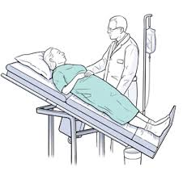

Slide 89
Relative contraindications
  Syncope with clinically severe – LVOTO
  Syncope in presence of critical MS
  Syncope in setting of known critical proximal coronary artery stenosis
  Syncope with known critical cerebrovascular stenosis

Slide 90
goals of treatment
Prevent recurrences
Prevent injuries
Improve quality of life
Prevent risk of mortality

Slide 91
Neurally mediated syncope
Reassurance, education.
Plasma volume expansion with fluid and salt.
In situational syncope, -avoid potential triggers.
Physical counterpressure maneuvers -leg crossing, squatting& tensing the lower extremities are effective at the onset of prodromal symptoms.
Tilt training involves standing for prolonged periods, and compliance is generally poor.

Slide 92
Pharmacologic therapy
Beta blockers, alpha agonists, and fludrocortisone has shown no effectiveness or conflicting results in reducing vasovagal syncope.
Cardiac pacing – cardio inhibitory vasovagal syncope with frequency > 5 attacks per year or severe physical injury or accident and age > 40

Slide 93
Orthostatic hypotension
Remove vasoactive medications.
NON PHARMACOLOGICAL INTERVENTIONS-
Patient education regarding staged movements from supine to upright
Isometric counter pressure manuvers
Head end elevation
Increasing dietary fluid and salt.

Slide 94
Drugs causing OH- nitrates, tricyclic antidepressants, diuretics, neuroleptics, and alpha blockers, should be stopped.

Slide 95
Pharmacological therapy
Increasing blood volume / raising peripheral vascular resistance
Fludrocortisone
Midodrine
Droxidopa
Prostaglandin inhibitors
Clonidine
Pyridostigmine

Slide 96
Cardiogenic syncope
Sinus node dysfunction (Including brady & tachycardia syndrome)
Cardiac pace maker therapy is indicated and is proven highly effective when bradyarrythmias is documented as the cause of the syncope
Catheter ablation for control of atrial arrhythmias may have role in suspected pts. with brady-tachy syndrome

Slide 97
AV conduction system disease
Cardiac pacing is first-line therapy for treatment of syncope AV block
Pacing improves survival and prevents syncopal recurrence in pts. With heart block

Slide 98
THANK YOU

