Slide 1
SCD
Dr Akhil Suresh

Slide 2
a neurological complication of vitamin B12 (cobalamin) deficiency
characterized by degeneration of the dorsal columns and the lateral columns of the spinal cord due to demyelination.

Slide 3
commonly presents with sensory deficits, paresthesia, weakness, ataxia, and gait disturbance.
In severe untreated cases, it can lead to spasticity and paraplegia.

Slide 4
The absorption of vitamin B12 is a multistep process
any abnormality in the steps of absorption can lead to a deficiency

Slide 5
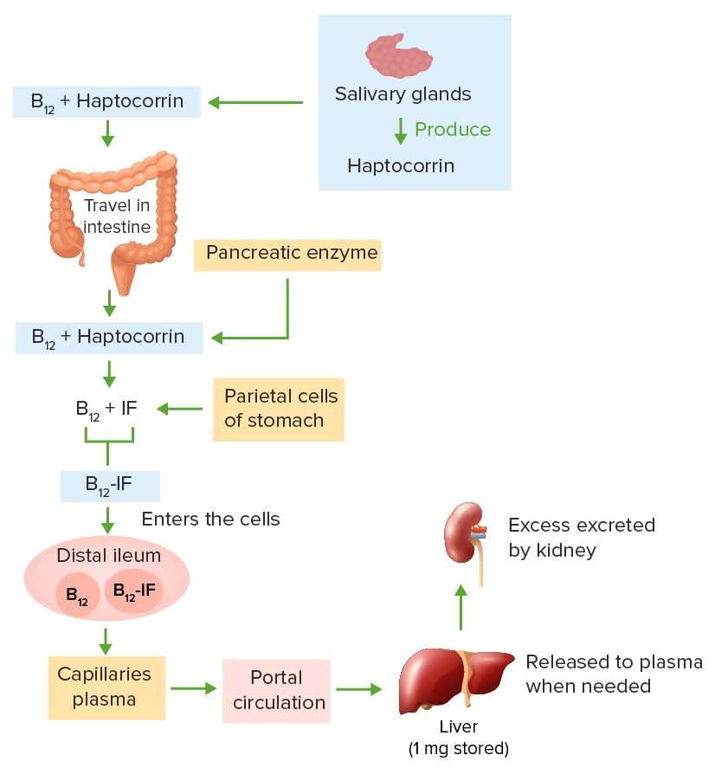

Slide 6
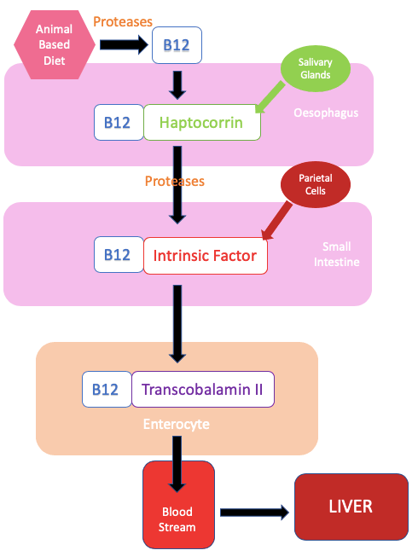

Slide 7
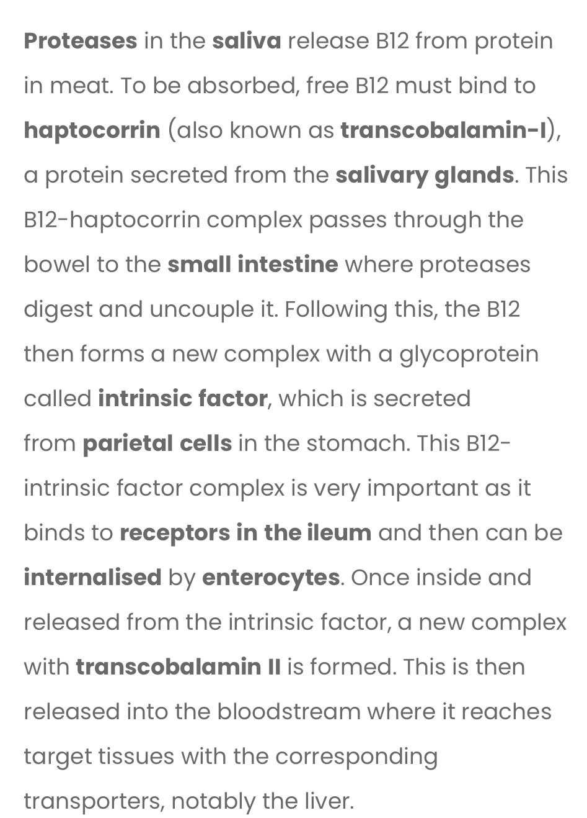

Slide 8
Nutritional deficiency
water-soluble vitamin
Cannot be synthesized by the human body
meat, fish, dairy products, eggs, and fortified cereals.
The richest sources of vitamin B12 are clams and animal liver
Plant-based food does not contain cobalamin.

Slide 9
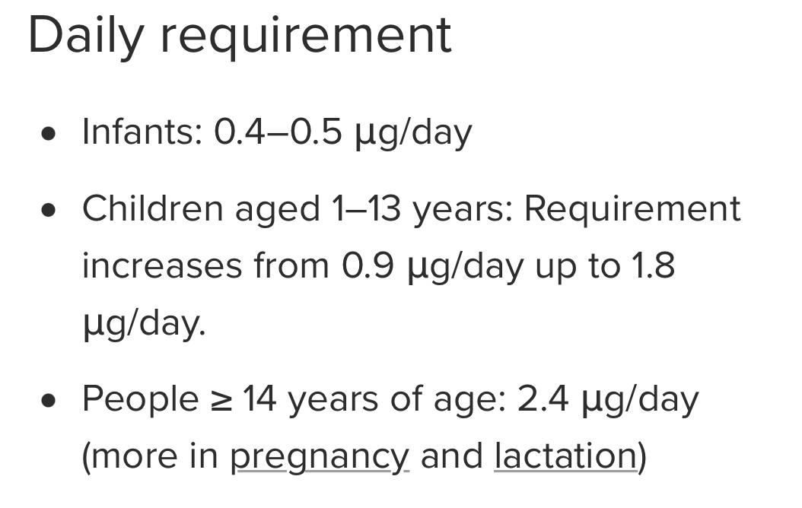

Slide 10
Gastric surgery/gastritis
Loss of parietal cells of the stomach
leads to a decline in the production of gastric acid and intrinsic factors

Slide 11
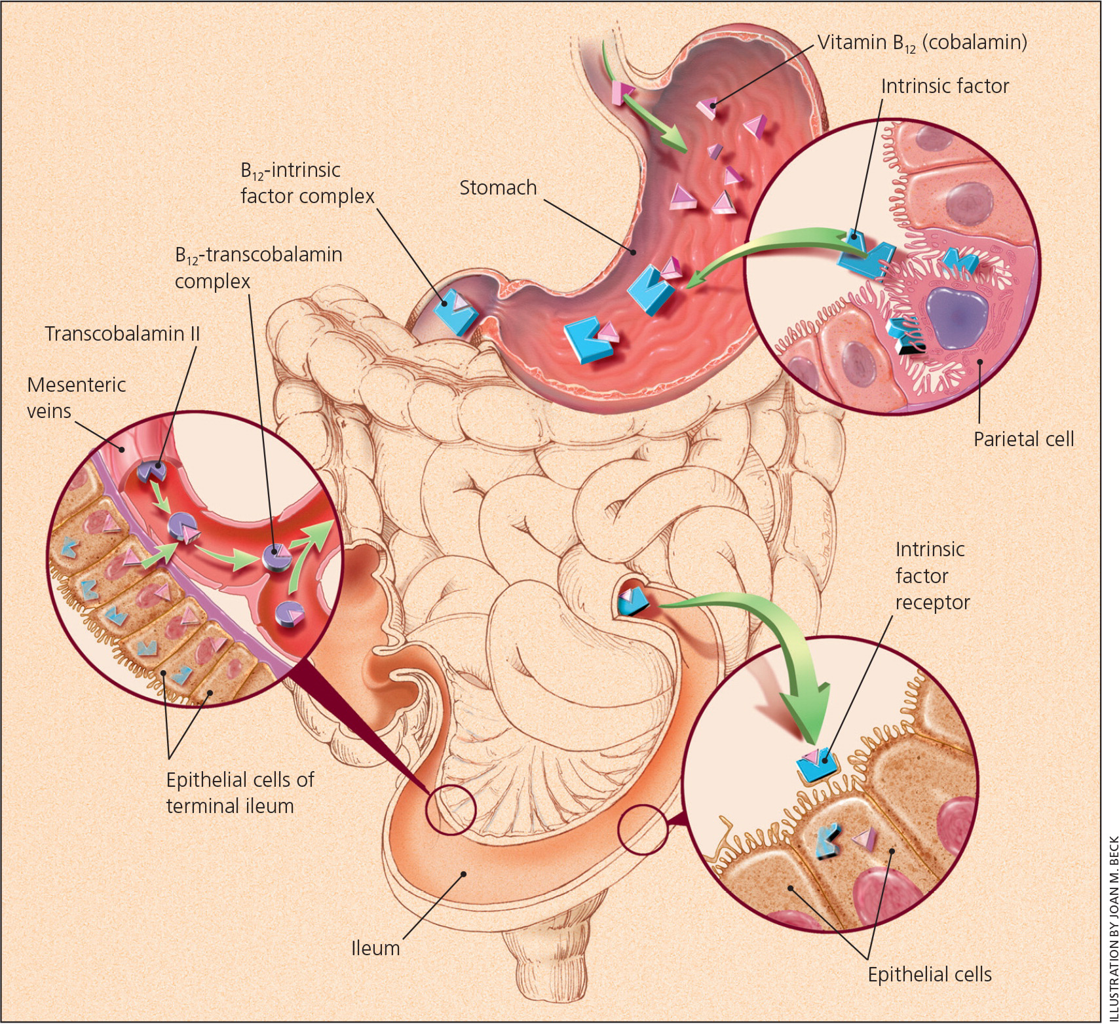

Slide 12
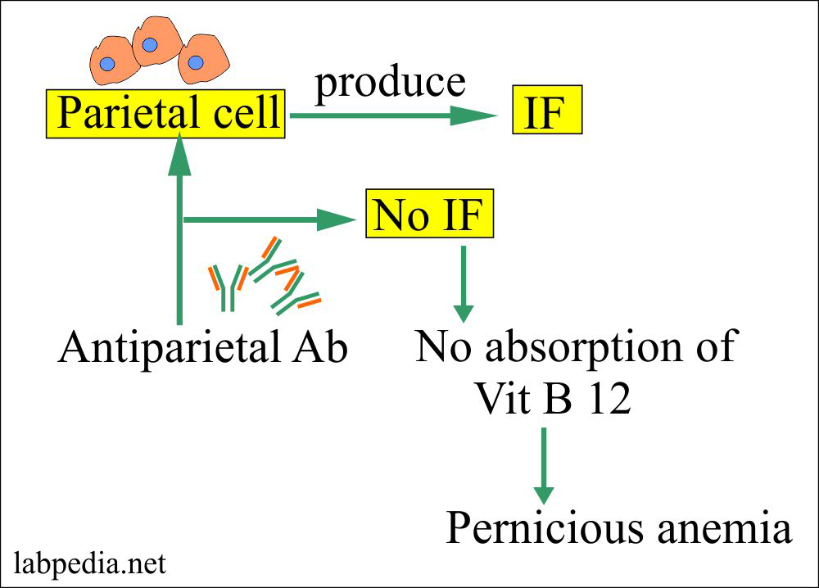

Slide 13
Autoimmune gastritis
previously known as pernicious anemia
most common cause of vitamin B12 deficiency.

Slide 14
autoimmune-mediated destruction of the parietal cells
chronic inflammation
atrophy of the mucosa of the corpus and fundus of the stomach.

Slide 15
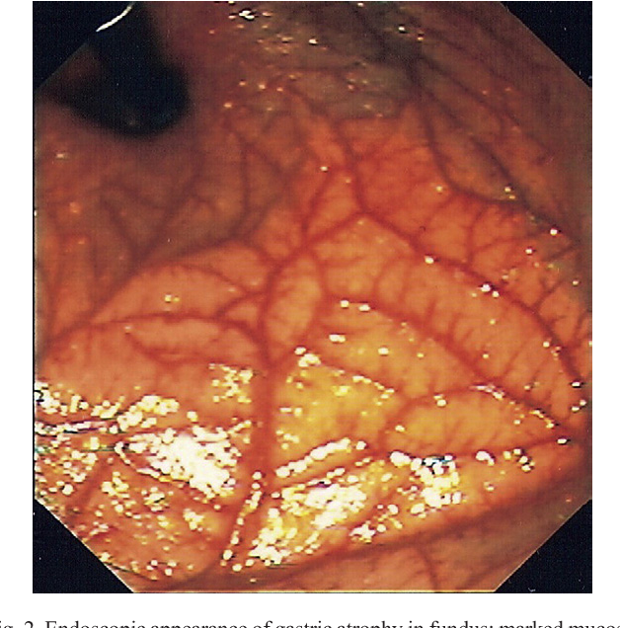

Slide 16
Small bowel disease
inflammatory bowel disease, sprue, radiation enteritis, lymphoma, and amyloidosis. .

Slide 17
Small intestinal bacterial overgrowth
seen in intestinal motility disorders, anatomic abnormalities (blind loop, diverticulitis), and chronic pancreatitis, increases the utilization of vitamin B12-intrinsic factor

Slide 18
Celiac disease
can lead to vitamin B12 deficiency if there is non-adherence to a gluten-free diet

Slide 19
Ileal resection
can result in a deficiency by reducing the absorptive surface area.

Slide 20
Pancreatic diseases
Pancreatic enzymes
pancreatic insufficiency or chronic pancreatitis

Slide 21
Drug induced
gastric acid suppressants, metformin, and nitrous oxide

Slide 22
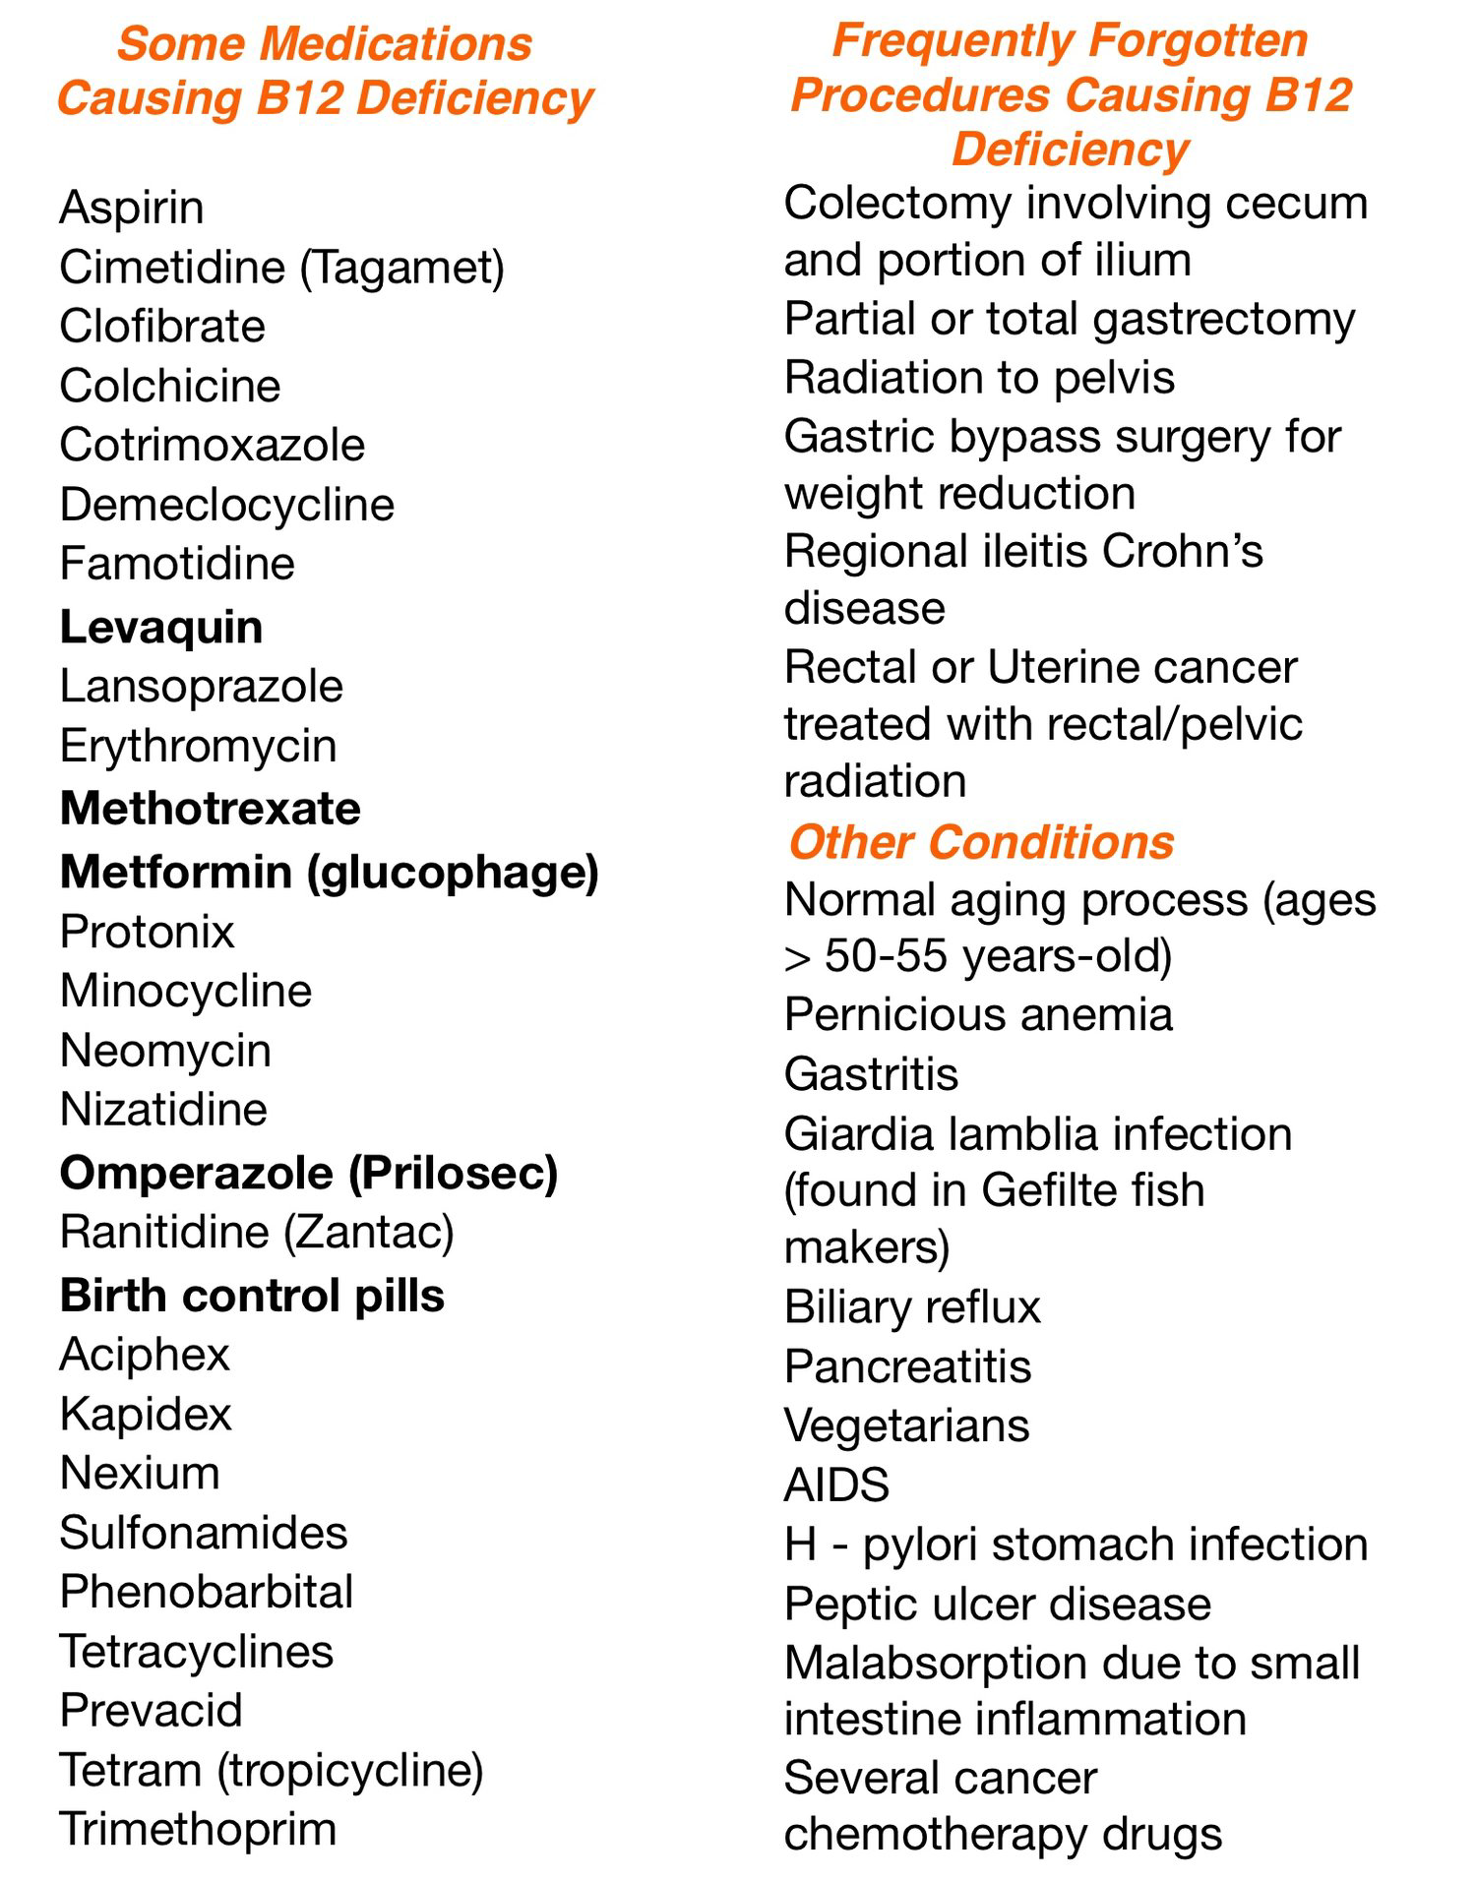

Slide 23
Patients with a pre-existing B12 deficiency are particularly prone to developing acute life-threatening neurological symptoms on exposure to nitrous oxide, which can be fatal

Slide 24
Fish tapeworm infestation
Dibothriocephalus latus
competes with the host for vitamin B12 absorption

Slide 25
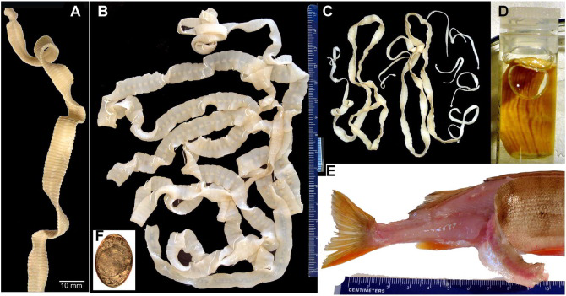

Slide 26
Genetic conditions
transcobalamin deficiency and Imerslund Grasbeck syndrome.

Slide 27
Pathophysiology
Vitamin B12 plays a vital role in DNA synthesis and odd chain fatty acid metabolism, which are required to maintain the integrity of neuronal myelin

Slide 28
Homocysteine methyltransferase
conversion of homocysteine to methionine.
Methionine is a precursor for S-adenosyl methionine, which is a methyl donor and is required to maintain the integrity of the neuron sheath.
A deficiency of vitamin B12 disrupts this reaction, which leads to reduced formation of S- adenosyl methionine.

Slide 29
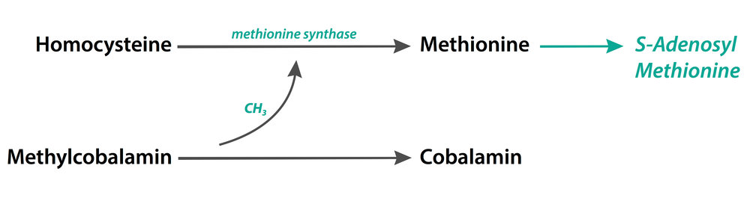

Slide 30
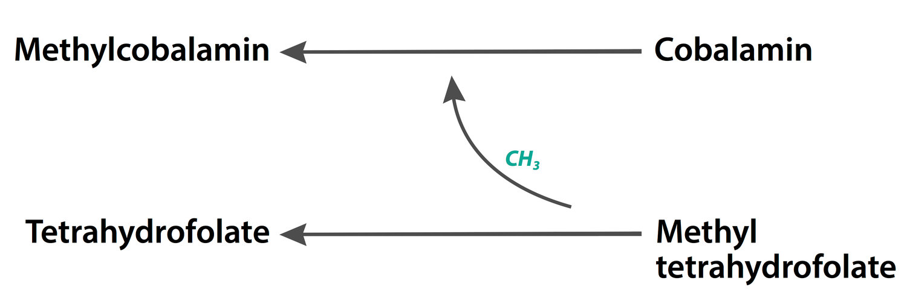

Slide 31
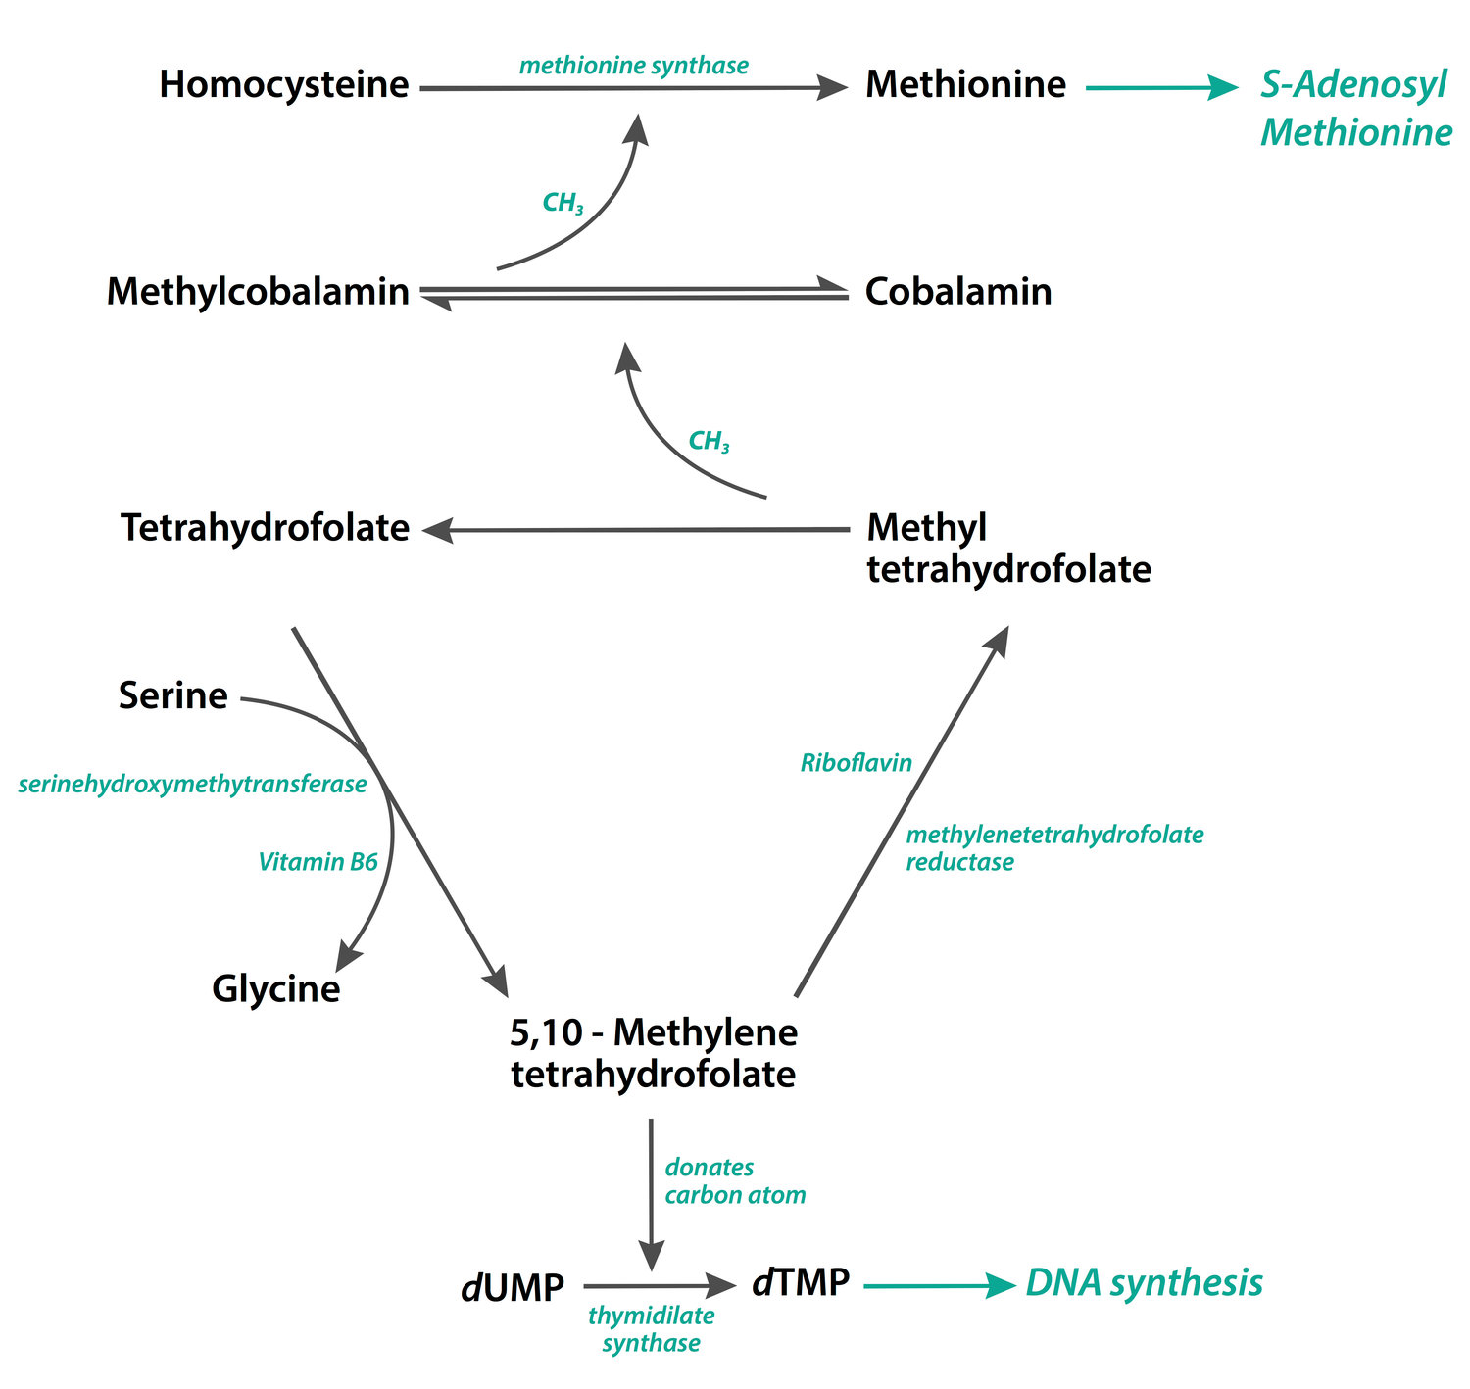

Slide 32
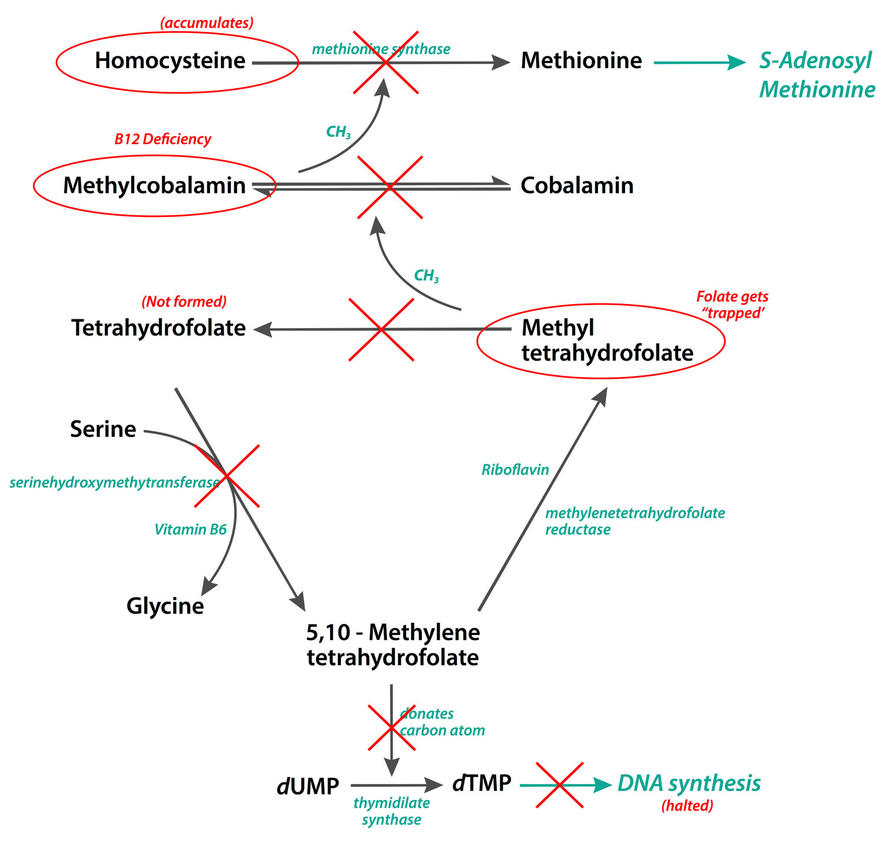

Slide 33
This impairs methylation of myelin basic protein and lipids and leads to damage to the myelin sheath.

Slide 34
Homocysteine methyltransferase also catalyzes the conversion of 5-methyl-tetrahydrofolate to tetrahydrofolate, which acts as a one-carbon donor for DNA synthesis.
A deficiency of vitamin B12 causes folate to be trapped in its methylated form of 5-methyl-tetrahydrofolate.

Slide 35
Methylmalonyl-CoA mutase
responsible for converting methylmalonyl-CoA to succinyl-CoA, which is required for myelin synthesis.
Interruption of this step leads to the accumulation of methylmalonyl-CoA and propionyl-CoA.

Slide 36
This, in turn, disrupts the process of normal myelin synthesis and leads to the accumulation of abnormal fatty acids.

Slide 37
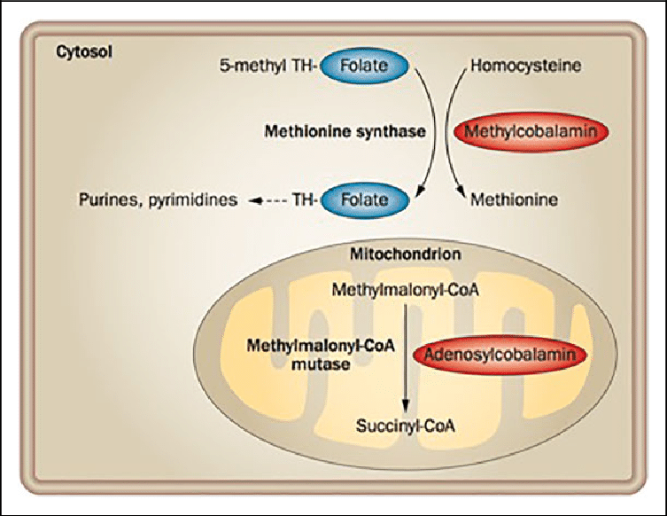

Slide 38
the neurological manifestations of vitamin B12 deficiency are caused by demyelination

Slide 39
dysfunction of homocysteine methyltransferase
abnormal accumulation of methylmalonyl-CoA, propionyl-CoA, and abnormal fatty acids as the cause for the demyelination of tracts in the spinal cord.

Slide 40
imbalance between the levels of tumor necrosis factor-alpha (TNF-α) and epidermal growth factor (EGF) and interleukin-6.
high levels of TNF and low levels of EGF and IL-6.
observed in the cerebrospinal fluid of humans with SCD and gastrectomised rats

Slide 41
HisTopathology
multifocal myelopathic spongy vacuolation

Slide 42
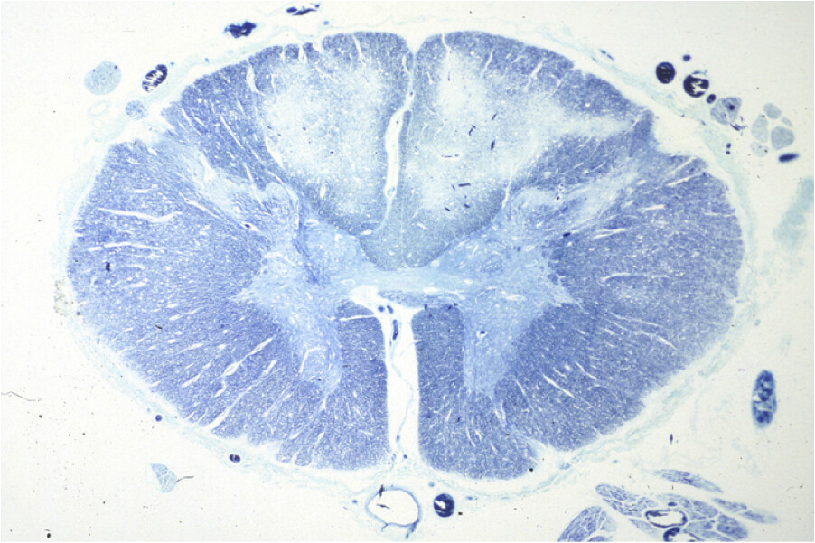

Slide 43
Demyelinating lesions initially appear in the center of the dorsal columns of the upper thoracic cord.
The lesions then spread laterally to involve lateral corticospinal tracts and cranially involving the cervical cord and medulla.

Slide 44
History
Diet
Malabsorption GI complaints
Alcohol
Sexual history ( HIV and neuro syphillis )
Drug history

Slide 45
Neurological symptoms
Symmetrical
involvement of the dorsal columns, spinocerebellar tracts, and lateral corticospinal tracts.
peripheral nerve involvement, visual deficits, and neuropsychiatric disease (depression and dementia).

Slide 46
Dorsal column
impaired tactile discrimination, proprioception, and vibration sense.
The earliest symptoms of dorsal column involvement are paresthesia, observed in the form of tingling, burning, and sensory loss of the distal extremities.

Slide 47
Either the upper or lower limbs are involved first, or all four limbs are affected simultaneously.
Lhermitte's sign may be present.

Slide 48
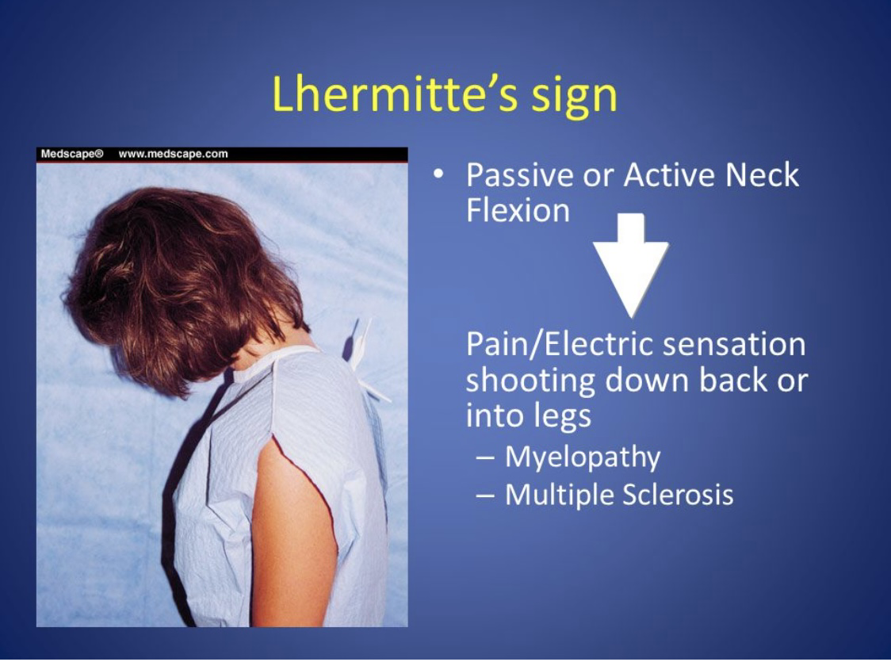

Slide 49
Loss of proprioception usually presents as a difficulty in maintaining balance in the absence of visual cues (e.g., in the dark or with closed eyes).

Slide 50
Corticospinal tract
muscle weakness, hyperreflexia, and spasticity.
Stiffness is often the initial symptom of lateral cord involvement.

Slide 51
Diffuse hyperreflexia
although ankle reflexes are usually absent.
ankle clonus and Babinski sign may be present

Slide 52
Spasticity can progress to paraplegia or quadriplegia if the condition remains untreated.
Sphincter involvement in advanced cases can lead to bowel and bladder incontinence

Slide 53
Spinocerebellar tract degeneration
causes gait abnormalities in the form of sensory ataxia.

Slide 54
pallor, fatigue, and signs of congestive heart failure in severe cases.
Glossitis beefy red tongue and occurs due to loss of tongue papillae.
A yellow-lemon tint due to jaundice

Slide 55
Evaluation
HEMATOLOGY
CONFIRM DEFICIENCY

Slide 56
Serum b12 levels
Chemiluminescence assay
Generally, B12 levels >300 pg/mL are considered normal. Levels between 200 and 300 pg/mL are borderline, and <200 pg/ml are low and are considered deficient

Slide 57
Serum B12 level is not a reliable marker for physiological stores.
Most B12 measurement assays only measure the protein-bound form of B12, which is unavailable to tissues.

Slide 58
A deficiency is therefore possible with borderline or normal serum B12 levels and requires measurement of metabolite levels.
A meta-analysis showed that one-third of patients with subacute combined degeneration have normal or high serum B12 levels

Slide 59
low sensitivity in patients with autoimmune gastritis
falsely low serum B12 levels ——multiple myeloma, HIV, pregnancy, or due to the use of oral contraceptives

Slide 60
Metabolite Levels
Measuring MMA and homocysteine is indicated when neurological findings of B12 deficiency are present, but serum B12 levels are either normal or borderline.
The normal range for methylmalonic acid is from 70 to 270 nmol/L and for homocysteine from 5 to 15 micromol/L

Slide 61
Methylmalonic acid is considered a more accurate marker of deficiency than B12 levels.
Methylmalonic acid is also a more specific marker of B12 deficiency compared to homocysteine

Slide 62
homocysteine can be elevated in folate and B12 deficiency
, methylmalonic acid is elevated only in B12 deficiency.

Slide 63
elevation of both methylmalonic acid and homocysteine suggests B12 deficiency.
Elevation of homocysteine with normal methylmalonic acid indicates folate deficiency

Slide 64
methylmalonic acid may be elevated in other conditions such as renal failure and methylmalonic aciduria

Slide 65
Folate levels
Folate deficiency can mimic the hematological picture of cobalamin deficiency

Slide 66
Determine the cause of cobalamin deficiency:
Autoantibodies
Serum gastric
Shilling’s test

Slide 67
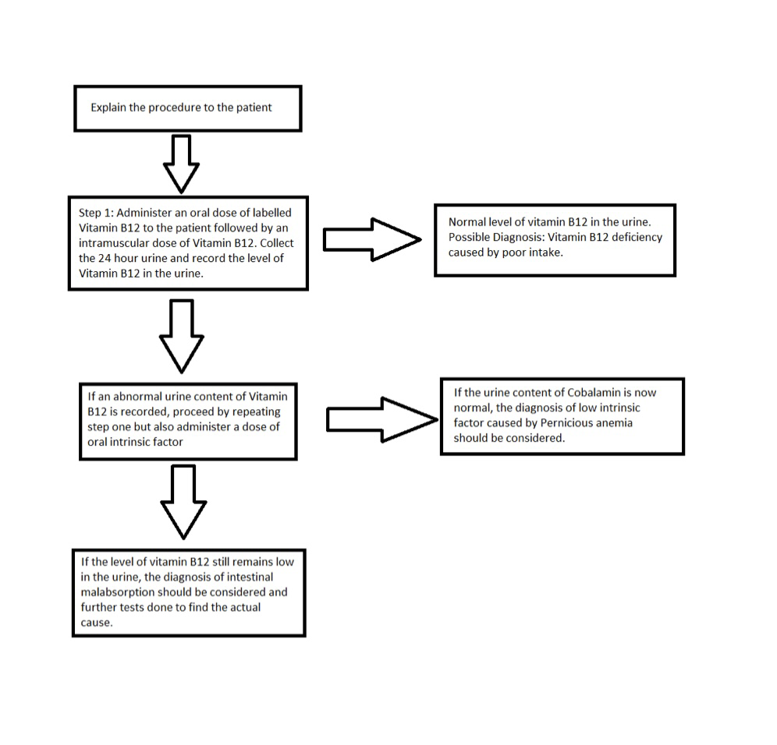

Slide 68
Identify demyelinating lesions
early stages of the disease:bilateral paired regions of T2 hyperintensity in the dorsal columns of the cervical and upper thoracic spinal cord
. This finding is often referred to as the “Inverted V” or “Inverted rabbit ears” sign

Slide 69
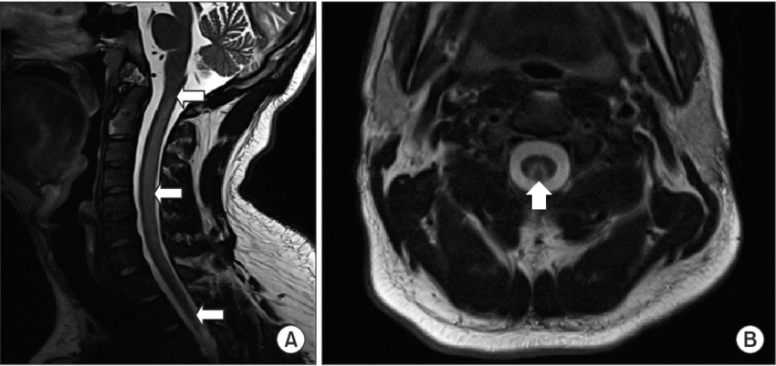

Slide 70
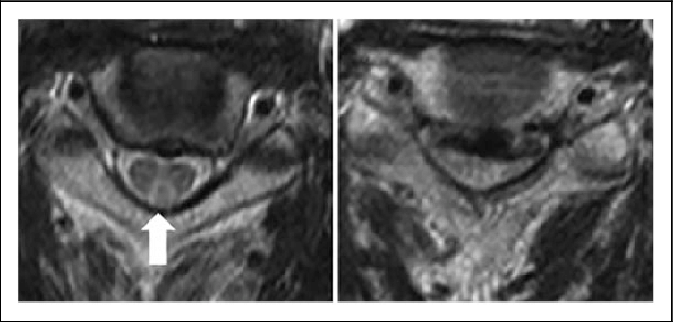

Slide 71
In later stages, T2 hyperintensity may also be seen in the lateral columns of the spinal cord.
A decreased T1-weighted signal and contrast enhancement of the same regions

Slide 72
Treatment
Oral
Parenteral
RDA 2.4 mcg

Slide 73
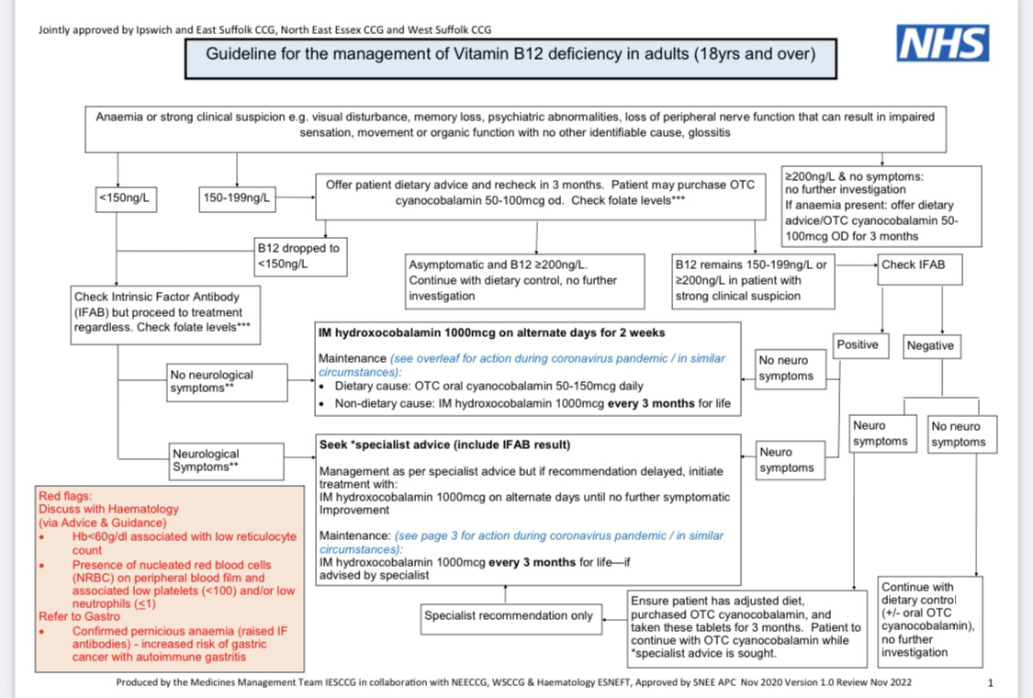

Slide 74
Maintenance treatment with hydroxocobalamin 1 mg intramuscularly every 3 months for life — where B12 deficiency is not thought to be diet related. Maintenance treatment with oral cyanocobalamin tablets or a twice-yearly hydroxocobalamin 1 mg injection — where vitamin B12 deficiency is thought to be diet related.

Slide 75
Early folate correction without b12 correction precipitates SCD
Due to accumulation of homocysteine and methylmalonic acid

Slide 76
Differential diagnosis
Copper deficiency
Vitamin E deficiency
Methotrexate induced myelopathy
Transverse myelitis
HIV

Slide 77
Tabes dorsalis
Differentiating features include dorsal root involvement, lancinating pain, and the presence of Argyll Robertson pupils.

Slide 78
Leukoencephalopathy with brainstem and spinal cord involvement and lactate elevation
Friedrichs ataxia
Sarcoidosis
Ischemia
Malignancy

Slide 79
86 % show clinical resolution after treatment, only 14 % attain complete clinical resolution

Slide 80
Thankyou !

