Slide 1

Rare poison_"Imidacloprid"
DR ARYAKRISHNA A
JR1
INTERNAL MEDICINE

Slide 2
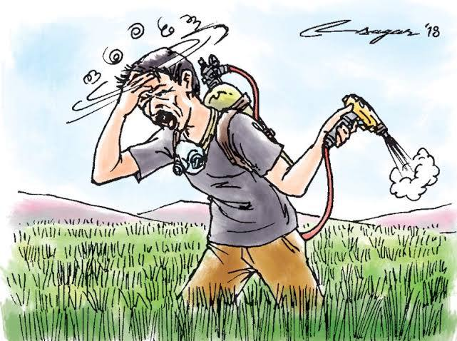
55/ male
No known comorbidities
Alcoholic ,smoker
Farmer

Slide 3
A/H/O consumption of an insecticide _50 ml
at home under influence of alcohol
Presented with multiple episode of vomiting

Slide 4
At causalty
Pt was drowsy
VITALS _
PR _65 ,REGULAR
BP _ 80/50 MMHG
RR _ 30
SPO2 _98 % ON RA
TEMP _ AFEBRILE
Pupils - moitic and sluggishly reactive

Slide 5
Cslty mgt
RT wash
Ivfs
Inj thiamine

Slide 6
In ward
Pt conscious ,obeying commands
PR_64/' regular
spo2_ 97% RA
RR _ 22/ '
P/A _ soft no tender no organomegaly
Resp _ clear , b/l air entry equal
CVS _ s1s2 present , no murmur
CNS_ moving all limbs , b/l plantar flexor

Slide 7
Investigations
CBC | LFT | RFT | PTINR | Trop i | Ecg
Hb_14.8 Wbc_15300 Plt_3.08l | Bil _0.6 Pro_7 alb_4.3 OT _49 PT_48 ALP_76 | Sur_19 Scr_1.1 Na _137 K _2.7 | Pt_12.2 Inr_0.88 | Negative Ca2+_8.6 Po4 _2.3 | NSR VR _75 / ' No ST T changes

Slide 8
ABG
PH_7.273
PCO2_28.1
PO2_78
BEecf _ _14
Hco3_13
Tco2_14
SO2_94
LAC _5.25
Imp* metabolic acidosis

Slide 9
When toxicology arrived
Detected the presence of imidaclopride in RTA and urine samples

Slide 10
Nephro consx
In v/o metabolic acidosis and hypotension
Advised correction of hypokalemia and bicarbonate deficits
No role of hemodialysis

Slide 11
Mgt in ward
Plenty of fluids
thiamine
Pantop
Inj. noradr infusion # hypotension
Inj.kcl # hypokalemia
Inj ceftriaxone ( aspiration )
Rpt values _ normal

Slide 12
Imidacloprid
Mechanism of action
2 clinical Features
3 Management

Slide 13
Imidacloprid
Insecticide
neonicotinoids __imidacloprid ,thiamethoxam ,clothianidin dinotefuran
moderately hazardous WHO class 2
Acts On CNS of insects

Slide 14
Mechanism of action
NAchR in brain ,spinal cord ( post ganglionic sympathetic and parasympathetic neurons ,NMJ
Cation ionic channel
Action : activation >>>>cell depolarisation
repeated Stimulation >>> functional paralysis of receptor
Biphasic pattern

Slide 15
Ingestion ,dermal or inhalation route
binds More strongly to insect neuron receptors
More toxic to insectide than to mammals
less Toxic than op
Lethal dose _200 ml

Slide 16
Clinical features
Cholinergic effects _Miosis , bronchorrhea , salivation vomiting diarrhea
Tachy or Brady arrhythmias
Shock *** fluid loss or cardiotoxicity
Resp.depression >> apnea
Fasiculations followed by weakness or paralysis
seizures
Rhadomyolysis

Slide 17
Clinical features cont'd........
Biphasic pattern
Mild __ nausea 🤮 diarrhea miosis
Salivation ,drowsiness, tachycardia
Pallor diaphoresis dizziness
moderate _ bronchorrhea bronchospasm
Fasiculations hyperactivity agitation
Tremor ,seizures

Slide 18
Marked inhibition __ bradycardia ,arrhythmias ,hypotension skeletal muscle paralyis apnea ,coma

Slide 19
Rare ones
causes of mortality __ aspiration ,respiratory failure
Neuropsychiatric manifestations
Cns _ transient AF with raised cardiac enzymes
Leucocytoclastic vasulitis
hepatotoxicity

Slide 20
Management
Symptomatic management
No effective antidote

Slide 21
Mgt cont'd
Skin decontamination
Cholinergic symptoms _ give atropine
Support ABC
anticipate Early ET >>> skeletal muscle fasiculations
treat Arrythmias ,shock ,seizures

Slide 22

Thank you

