Slide 1
Approach to edema

Slide 2
Edema is represented by an excess of interstitial fluid which has becpme clinically evident
Total body water : 1/3 extracellular & 2/3 intracellular
Extracellular compartment: 25 % intravascular 75 % extravascular
Fluid volume is normally maintained by starlings forces

Slide 3
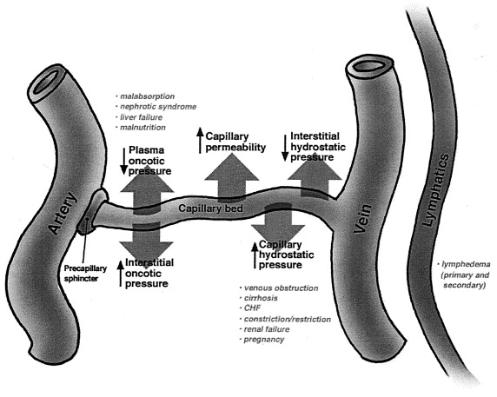

Slide 4
Net movement of fluid from intravascular to interstitium occurs in :
Increase in capillary hydrostatic pressure
Reduction in plasma oncotic pressure
Increase in interstitial oncotic pressure
Capillary endothelial barrer damage
Inadequate lymphatic drainage

Slide 5
Effective arterial volume is reduced in many forms of edema
Diminished renal flow
Renin release from jg cells
Acts on angiotensinogen (liver)
Release Angiotensin 1(decapeptide)
Angiotensin 2 (octapeptide)

Slide 6
All have generalised vasoconstrictor properties
Decreases hydrostatic pressure in peritubular capillaries,increases oncotic pressure in these vessels
enhanced salt and water reabsorption from pct and ascending limb of loop of henle
Increased aldosterone production

Slide 7
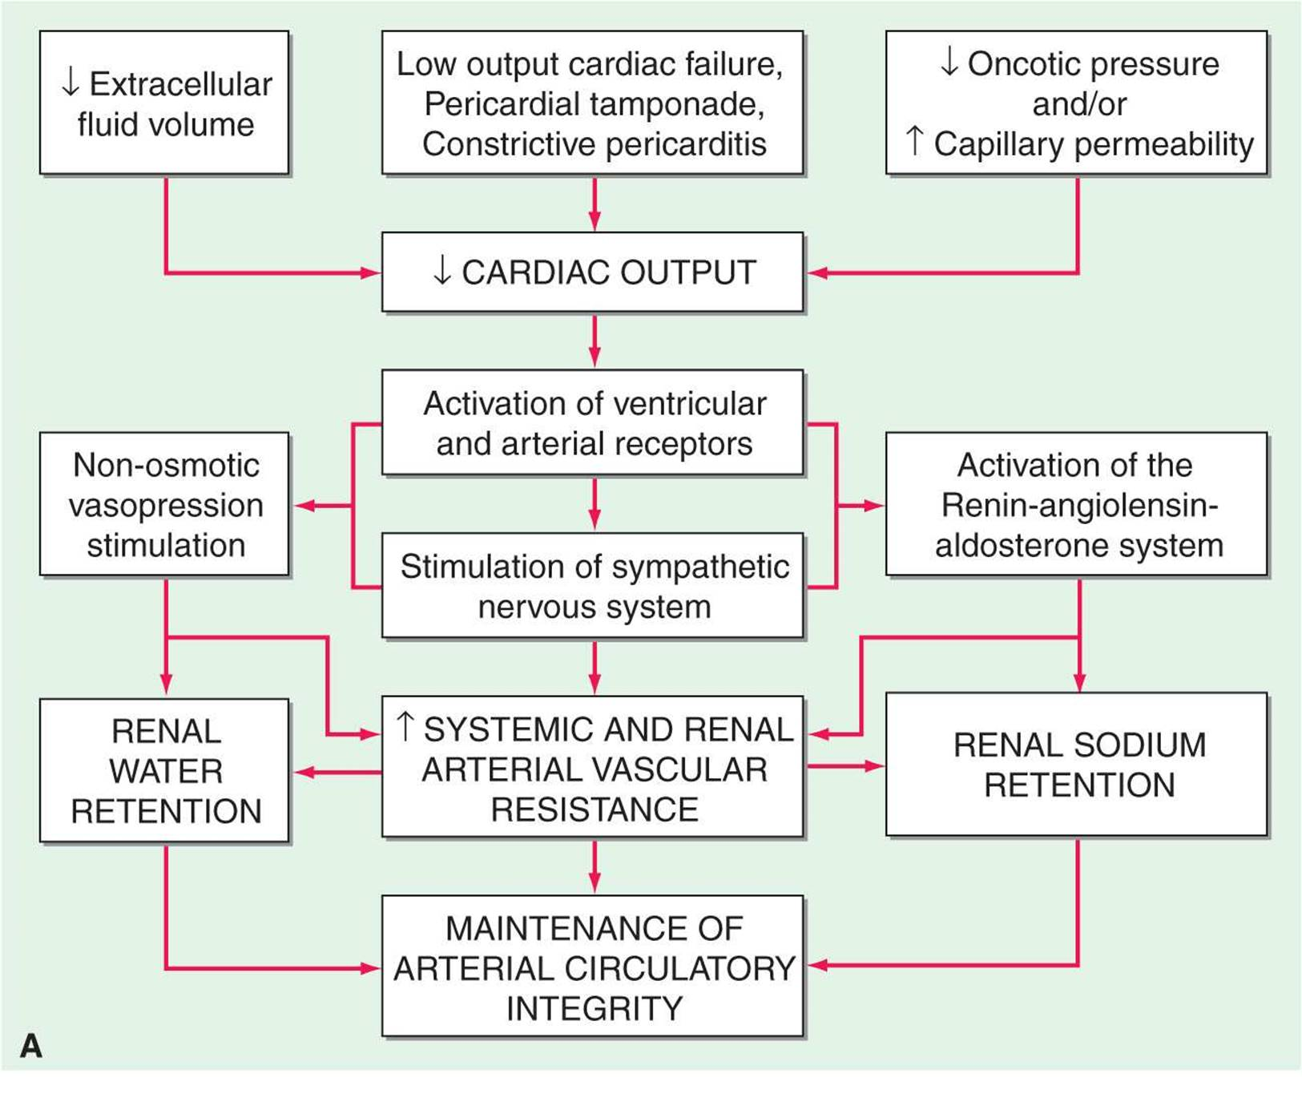

Slide 8
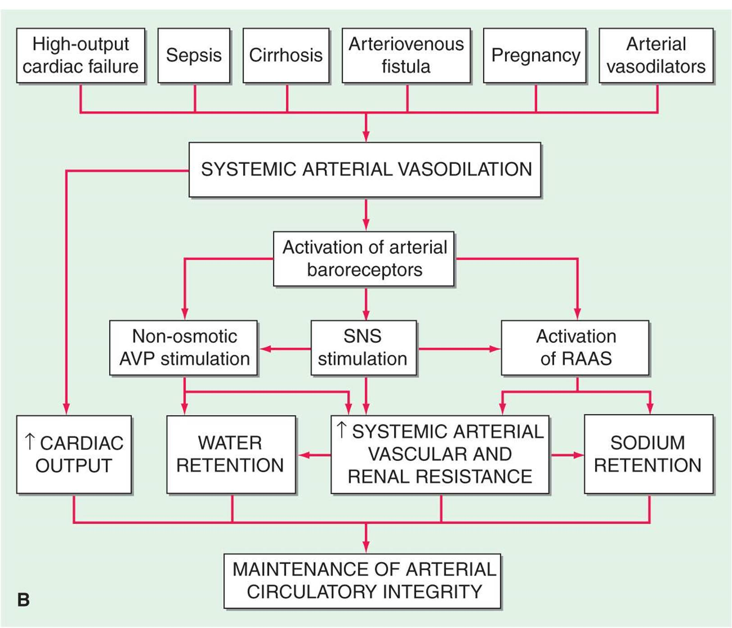

Slide 9
ARGININE VASOPRESSIN : released by posterior pituitary in response to increased intracellular osmolar concentration (v2 receptors)
ENDOTHELIN : Increased in severe heart failure: renal vasoconstriction and sodium retention
ANP & BNP : produced by atrial distension & increase in ventricular diastolic pressure respectively causing i) excretion of sodium and water
ii)dilation of arterioles and venules
but not sufficiently potent to prevent edema

Slide 10
Classification of edema
Based on site of involvement : localised/generalised
based on type: exudative / transudative
Clinically : pitting / nonpitting

Slide 11
Causes of generalised edema
Cardiac
Hepatic
Renal
Drug induced
Edema of nutritional origin

Slide 12
Causes of localised edema
VENOUS EDEMA
Deep vein thrombosis
2) varicose veins/ivc obstruction
svc/ivc obstruction
May thurners syndrome
LYMPHATIC EDEMA
1)Chronic lymphangitis
2)Resection of regional lymph nodes
3)Filariasis
4)Radiotherapy
5)congenital(milroys)
INFLAMMATORY CAUSES : cellulitis

Slide 13
Generalised edema – cardiac origin
Symptoms : exertional dyspnoea,orthopnoea,pnd
Physical examination : elevated jvp
s3 gallop
peripheral cyanosis,cool extremities
small pulse pressure
Lab investigations : eleated urea nitrogen:creatinine ratio
decreased sodium
elevated natriuretic peptides

Slide 14
Generalised edema :renal causes
Symptoms: usually chronic
might be associated with uremic symptoms
dyspnoea less prominent than heart failure
Physical examination : Elevated BP
hypertensive/diabetic retinopathy
nitrogenous fetor
pericardial friction rub

Slide 15
LAB FINDINGS IN EDEMA OF RENAL ORGIN
S.creatinine,serum cystatin – elevation
Albuminuria
Hyperkalemia
Metabolic acidosis
Hyperphosphatemia
Hypocalcemia
anemia

Slide 16
EDEMA OF HEPATIC ORGIN
HISTORY : dyspnea uncommon,except with significant ascites
Examination :
ascites
normal jvp
bp lower than renal or cardiac disease
chronic liver disease stigmata
Lab findings:
decreased serum albumin,cholesterol,fibrinogen,transferrin
  Elevated liver enzymes
  Tendency towards hypokalemia
  Respiratory alkalosis
  Macrocytosis from folate deficiency

Slide 17
Nutritional edema

Slide 18
Drugs causing edema
Nsaids
Antihypertensives
Direct arterial vasodilators :hydralazine,clonidine,methyldopa,minoxidil,guanethidine
Calcium channel antagonists
Alpha adrenergic antagonists
Thiazolidinedione
Steroids :glucocorticoids/anabolic steroids/estrogen/progesterone
Cyclosporine
Growth hormone
Immunotherapies:il2/okt3 monoclonal antibody

Slide 19
Localised edema
LOWER LIMB EDEMA CAN BE 1) UNILATERAL i)acute
ii)chronic
2) BILATERAL i)acute
ii)chronic

Slide 20
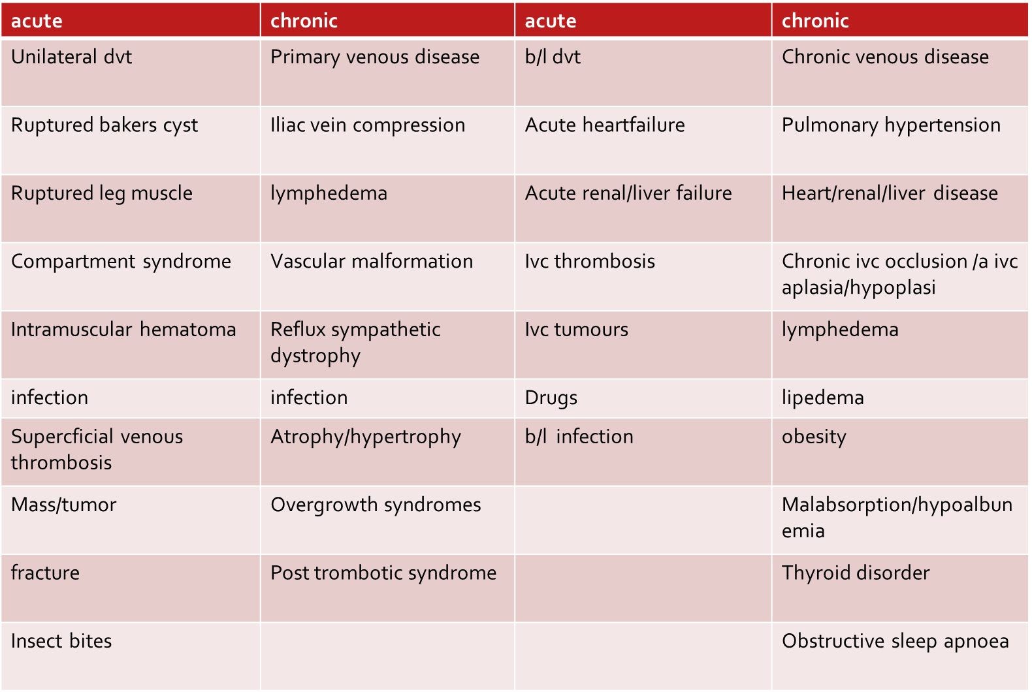
Unilateral lower limb pedal edema

Slide 21
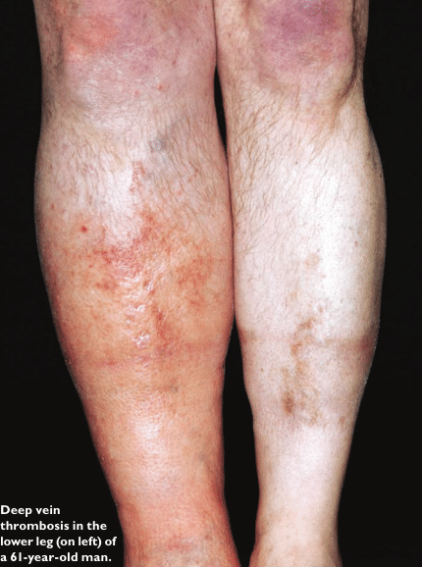
ACUTE CAUSES OF UNILATERAL EDEMA
DVT
evidence of dvt : calf tenderness
pain or firmness along courseof a vein
unilateral warmth/erythema
larger circumference of calf in affected leg :most useful finding
homans sign : not reliable

Slide 22
No evidence of dvt :
1)CELLULITIS : Warmth and redness skip areas
usually associated with constitutional symptoms
2) SUPERFICIAL THROMBOPHLEBITIS : Palpable,tender superficial veins
3) POPLITEAL (BAKERS) CYST :
Calf symptoms usually occur when cyst ruptures
distinguished from dvt by1) posterior knee pain
2)knee stiffness
3)swelling behind the knee ( prominent on knee extension)
Compression of popliteal veins : leg swelling/secondary dvt

Slide 23
CALF MUSCLE PULL OR TEAR : History of inciting injury,signs of bleeding (usg)
bruising at the ankle may be presnt
MAY THURNERS SYNDROME :young females(2nd or 3rd decade)
acute pain and swelling over entire lower extremity
with or without thrombosis compression of left iliac vein between right common iliac artery and 5th lumbar vertebra
INFLAMMATORY PATHOLOGY OF THE KNEE : Pain and swelling accompany kneejoint pathology can mimic dvt / popliteal cyst

Slide 24
CHRONIC UNILATERAL PEDAL EDEMA
Most common cause : chronic venous insufficiency
Other less common causes: primary/secondary lymphedema , pelvic neoplasms,complex regional pain syndrome
Findings if not consistent with above causes : COMPRESSION ULTRASONOGRAPHY WITH DOPPLER
Can Confirm chronic venous disease
Normal study: lymphedema/complex regional pain syndrome
Pelvic outflow obstruction : neoplasm : ovarian/endometrial/bladder/lymphoma/prostate cancer

Slide 25
Bilateral pedal edema
acute | chronic
b/l dvt | Chronic venous disease
Acute heart failure | Pulmonary hypertension
Acute renal/liver failure | Heart/renal/liver disease
Ivc thrombosis | Chronic ivc occlusion/ivc aplasia/hypoplasia
Ivc tumours | Lymphedema
Drugs | Obesity/nutritional
b/l infection | Malabsorption/hypoalbuminemia
 | Thyroid Obstructive sleep apnoea

Slide 26
INVESTIGATION :
Urine dipstick-for protein
serum creatinine
serum albumin
prothrombin time
liver function tests
thyroid-stimulating hormone
If these tests are unrevealing we obtain an echocardiogram to evaluate the possibility of heart failure or pulmonary hypertension.
If echo also unrevealing most probably chronic venous disease -pigmentary changes, induration, and ulceration
typical skin findings of chronic venous disease are absent, we obtain imaging of the pelvis to exclude a pelvic neoplasm or other lesion-causing venous outflow obstruction Eg TVS , CECT of pelvis

Slide 27
LYMPHOEDEMA
Not a true edematous state.
The major causes of lymphedema in adults in developed countries are axillary lymph node dissection in patients with breast cancer and axillary or inguinal lymph node dissection in patients with melanoma.
Worldwide, the most common cause is filariasis.
The edema is typically limited to an arm or leg.
The clinical hallmark of lymphedema is the presence of cutaneous and subcutaneous thickening, as manifested by cutaneous fibrosis, peau d’orange, and a positive Stemmer sign, which refers to an inability to tent the skin at the base of the digits.

