Slide 1
MEDIASTINUM:AN Unchartered sea

Slide 2
HISTORY
62 year old male known case of Type 2 DM, systemic hypertension, dyslipidemia, OSA and CAD (NSTEMI S/P PCI on 9/11/22) now presented with complaints of:
Upper Back ache X 3 weeks
Lower abdominal pain and dysuria X3 weeks
Fever with chills (on and off) X 3 weeks

Slide 3
HISTORY
Upper back pain present during day and night, mechanical type pain ( aggravated by movements, reduced by rest)
No history of weakness of upper/lower limbs, no history of radicular pain.
No history of bowel/ bladder symptoms.

Slide 4
history
Fever with chills associated with dysuria: patient sought medical help from our casualty (after 1 week of symptoms), was advised admission but discharged against medical advice due to lack of beds in ward.
No history of obstructive urinary symptoms,frequency, urgency
No history of nausea/vomiting.

Slide 5
PAST HISTORY
Known case of type 2 DM, systemic hypertension, Dyslipidemia, Obstructive sleep apnea and CAD (NSTEMI S/P PCI on 9/11/22) on regular medication
He was a non smoker and non alcoholic
No history of recurrent UTIs in past.

Slide 6
GENERAL EXAMINATION
Conscious, oriented, well built and nourished
No pallor, icterus, cyanosis, clubbing, lymphadenopathy, pedal edema
Vitals: PR: 92/min, regular rhythm, normal volume, No radiofemoral delay
BP: 150/90 mm Hg, SpO2 on Room air: 96 %
Patient is febrile

Slide 7
SYSTEM examination
RESP: Normal vesicular breath sounds, Air entry bilaterally equal
CVS: S1 and S2 heard, no murmurs
GIT: Per abdomen soft, Mild tenderness on suprapubic region on deep palpation
CNS: Higher mental functions were normal, No focal neurological deficit, plantar B/L mute.
Local examination: Mild tenderness present on upper thoracic spine region (T6, T7)
No renal angle tenderness

Slide 8
Investigations
Blood investigations: Hb: 11.1, TC: 18300…..12000 with 90 percent neutrophils, ESR: 135, platelet count: 4.45 lakh.
RFT: 33/0.9
LFT: S.bilirubin: 1.1, T.protein/S.albumin: 7.1/2.8, Na/K: 130/4.6, S.Ca: 8.9
CRP : 268, URE: showed 25-30 pus cells, no albumin, sugar 1+
Chest x ray: bilateral clear lung fields., X ray thoracic spine lateral views showed decreased height of T12 vertebrae.

Slide 9
Course in hospital
Patient was initiated on IV antibiotics ( cefaperazone plus sulbactum), single antiplatelet and other supportive treatement. Due to the raised ESR with thoracic spine tenderness, Potts spine was suspected, hence a USG thorax was done to look for paraspinal collection/pulmonary lesion.
USG thorax report: Heteroechoic area noted in left paraspinal aspect, mediastinal widening present, suggested cect to rule out mediastinal lesion.

Slide 10
Course in the hospital
MRI thoracic spine was planned but deferred by cardiologist due to recent PCI.
Meanwhile patient progressively developed breathlessness along with acute onset of dysphagia and hoarseness of voice, Emergency ENT consultation done along with X ray soft tissue neck lateral view ( As cect could not be performed), which suggested no obvious pathologies explaining the sudden onset symptoms.
In between, patient was also developing generalized sweating episodes.
Video laryngoscopy and CECT thorax were planned, But patient expired due to cardiac arrest following respiratory distress before investigations could be performed.

Slide 11
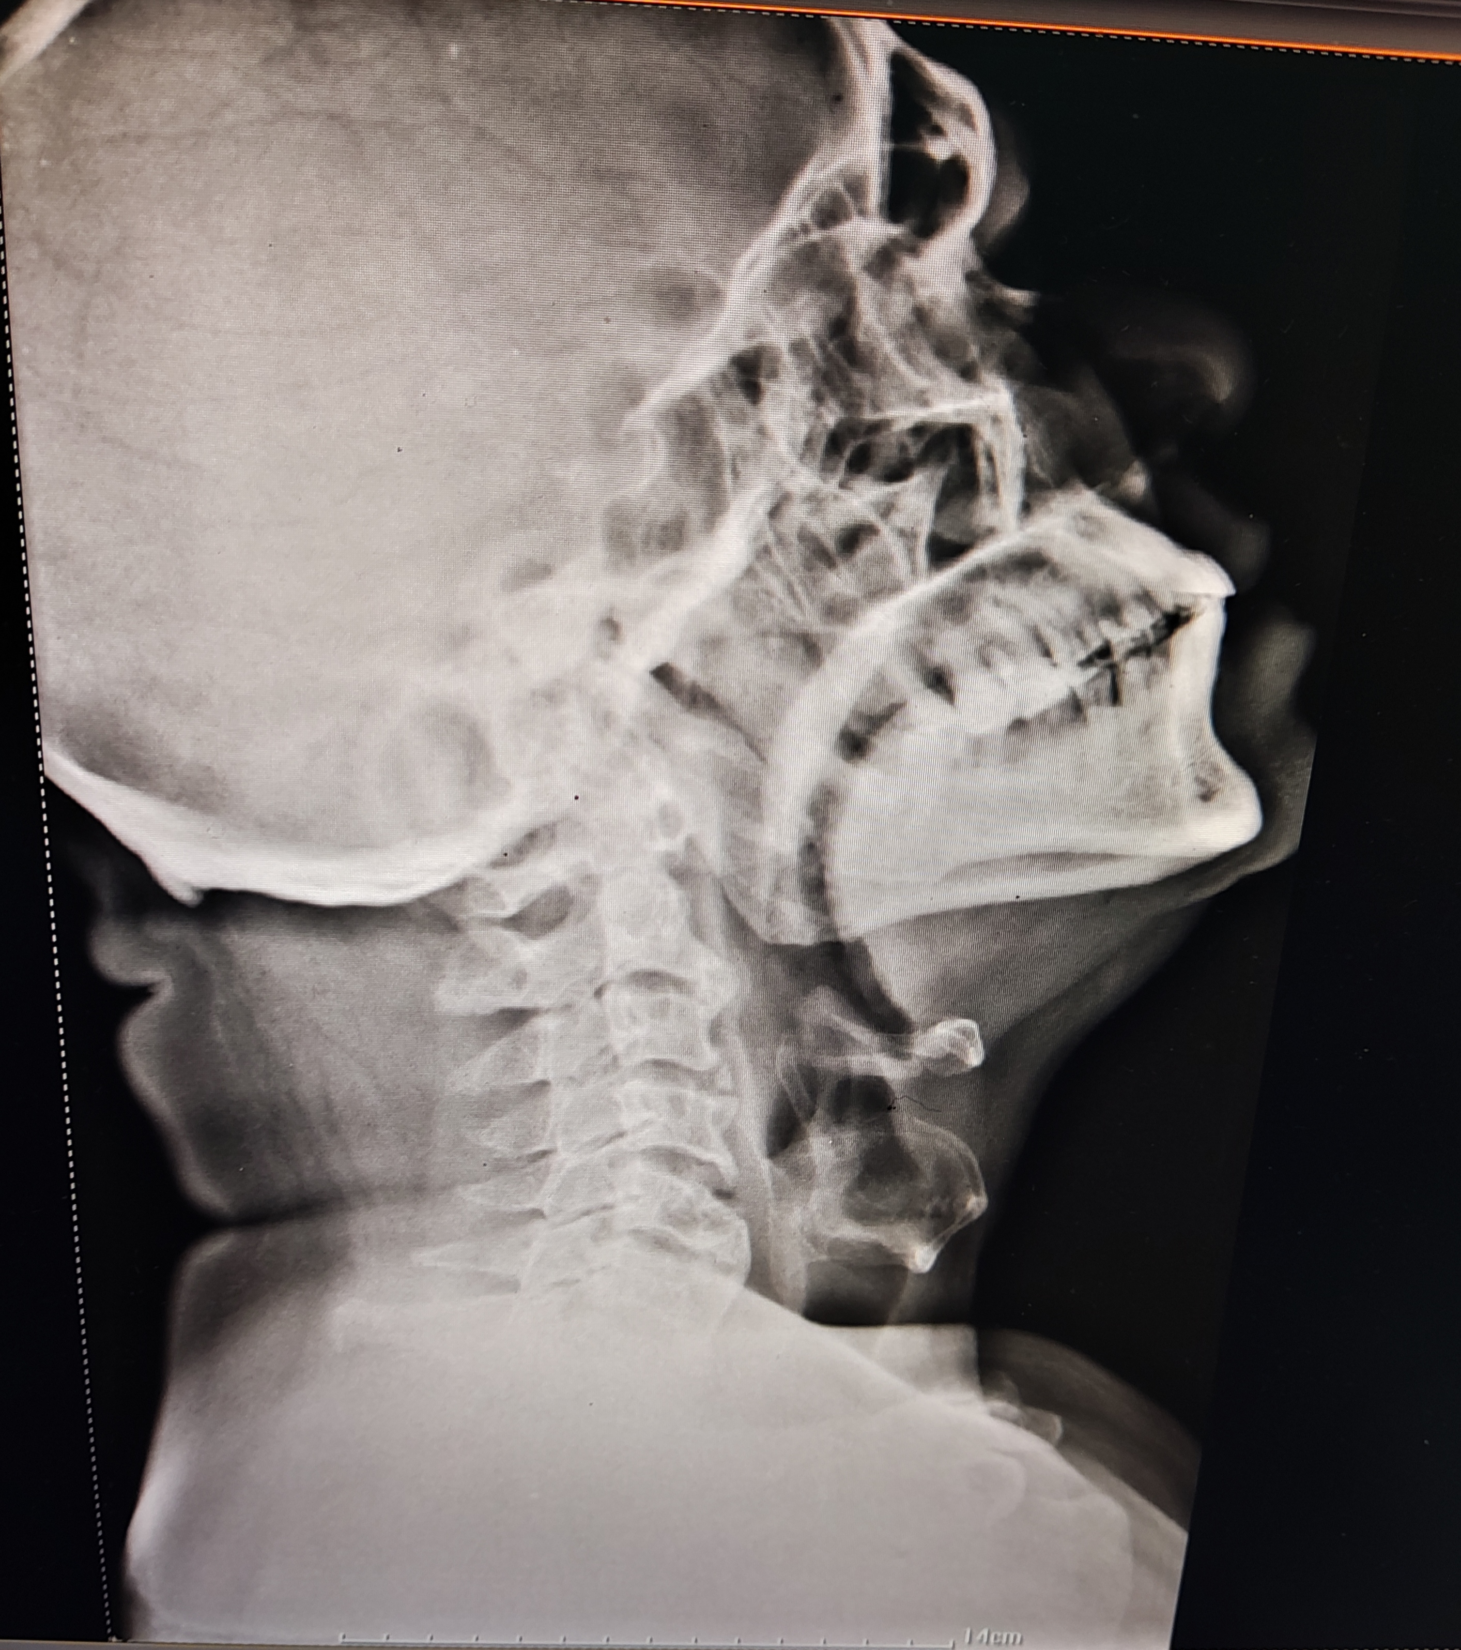

Slide 12
Provisional diagnosis
Urinary tract infection : ?cystitis
Vertebral pain and tenderness: ?inflammatory , ?infective

Slide 13
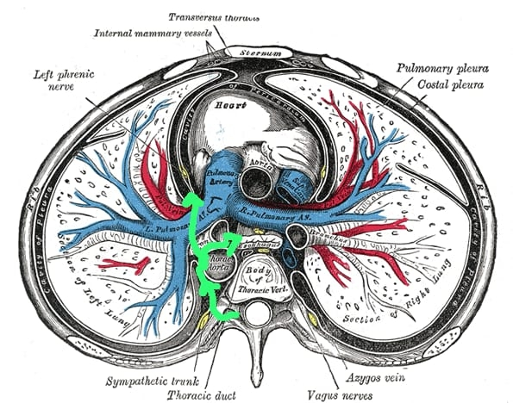
Our conclusion
Paraspinal abscess tracking to mediastinum causing nectrotizing mediastinitis leading to vagus nerve involvement (which can explain the hoarseness) and sympathetic trunk involvement( which explains the sweating episodes).

Slide 14
mediastinitis
WHEN TO SUSPECT: Oropharyngeal infections, odontogenic infections and deep cervical infections, post surgery/procedure (CABG, thoracotomy), less common infections including acute tonsillitis, retropharyngeal and peritonsillar abscess
Presence of comorbidities: DM, alcoholism, smoking, chronic kidney disease, and liver cirrhosis can further facilitate this rapid extension and increase the occurrence of complications.

Slide 15
mediastinitis
It has a high mortality rate of around 40% , hence high clinical suspicion, Early diagnosis, aggressive surgical intervention, and close surveillance with serial CT scan are crucial.
Symptoms: anorexia, dyspnea, tachypnea, fever, odynophagia, hoarseness, erythema, anterior neck edema, and crepitus. Symptoms of mediastinal infection include chest discomfort, respiratory insufficiency.

Slide 16
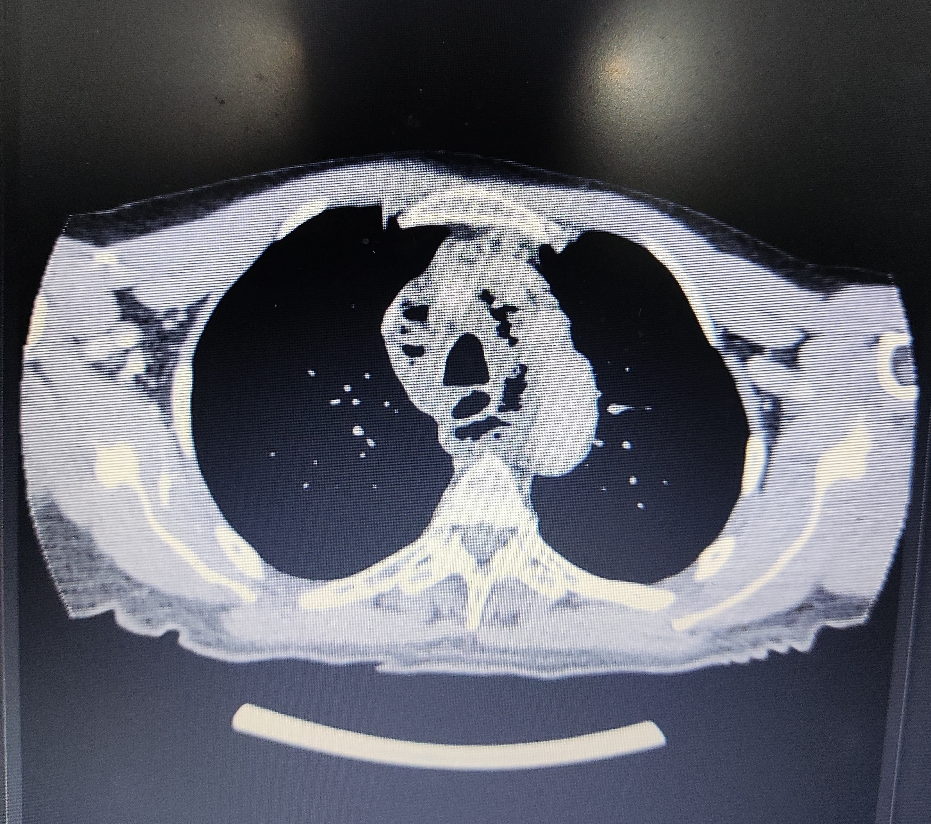
diagnosis
CECT thorax is the preferred modality:
type 1: localized above the carina
type 2: below carina
  type 2a: extends to the lower anterior mediastinum
  type 2b: extends to the anterior and posterior mediastinum

Slide 17
treatment
Type 1 may be managed conservatively using IV antibiotics ( carbapenam + clindamycin) with/without surgical /ct guided drainage.
Type 2 requires aggressive mediastinal drainage and debridement via thoracotomy.

Slide 18
THANK YOU

