Slide 1
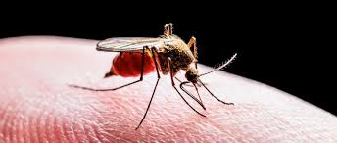
MALARIA
DR MUTH S BHASKAR

Slide 2
malaria is transmitted in 91 countries
3 billion people and causes ~1200 deaths each day
Malaria was eliminated from the United States, Canada, Europe, and Russia >50 years ago

Slide 3
Six species
P. falciparum
P. vivax
P. ovale (curtisi and wallikeri)
P. malariae
P. knowlesi

Slide 4
INTRODUCTION
From the Italian “malaria” - Bad Air
  Also known as marsh disease
  Descriptions of malaria go as far back as 3550 B.C.
Malaria is a protozoan disease transmitted by bite of infected Anopheles mosquito caused by parasites of genus Plasmodium
In Nov. 1880,Charles Louis Alphonse Laveran, was the first to notice parasites in the blood of a patient suffering from malaria.
Ronald Ross was the first to demonstrate that a mosquito could transmit a malaria parasite.
Chloroquine(Resochin) was discovered by a German, Hans Andersag, in 1934.

Slide 5
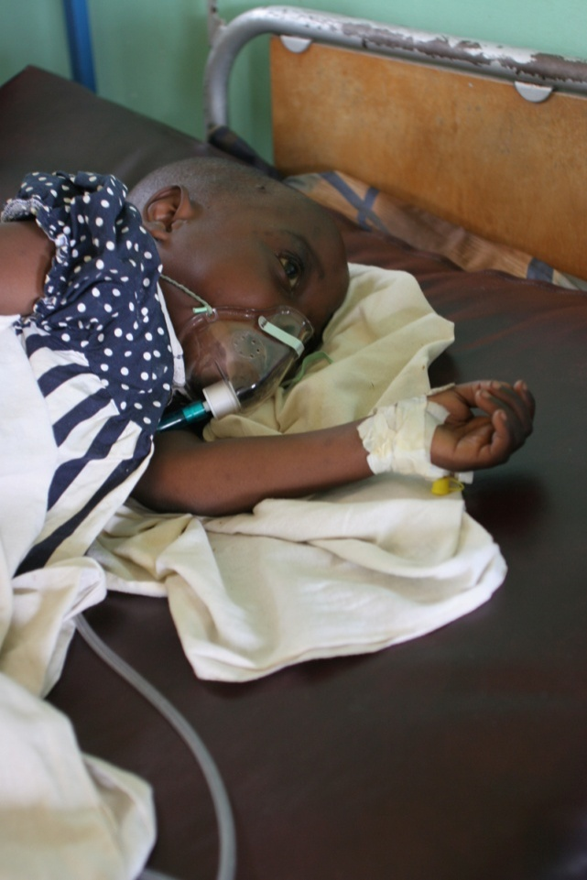
Incidence facts
225 million cases of malaria worldwide and 781,000 deaths every year.
A child dies of malaria every
30 seconds.
Over 90% of malaria deaths are in Africa.
200,000 newborns die each year as a result of malaria.
Statistics: 2010 WHO Malaria Report and Malaria No More UK
Image: Bonnie Gillespie, Voices for a malaria free future
Notes:
According to the World Health Organization, there were 225 million cases of malaria worldwide and 781,000 deaths in 2009. Although this is a lot, these numbers have decreased from 233 million cases and nearly 1 million deaths in 2000.
The majority of malaria deaths are due to the Plasmodium falciparum parasite and are in children under the age of five in Africa.
Pregnant woman are also vulnerable to malaria as they have lower natural immunity to the disease. If they are infected with malaria when pregnant this can have a serious impact on their unborn child. Pregnant women with malaria are susceptible to:
placental infections (a build up of parasites in the placenta) that can lead to miscarriage
death of newborns due to premature birth or low birth weight.

Slide 6
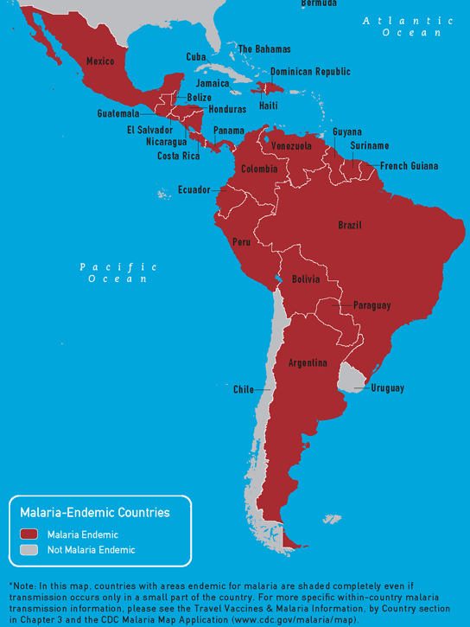
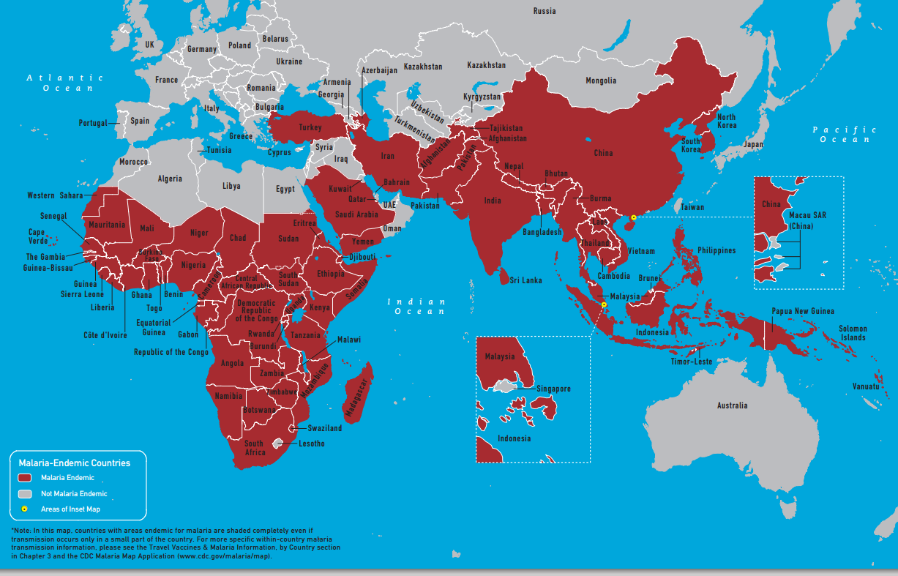
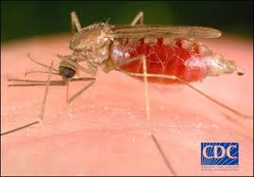
Malaria –Endemic Countries

Slide 7
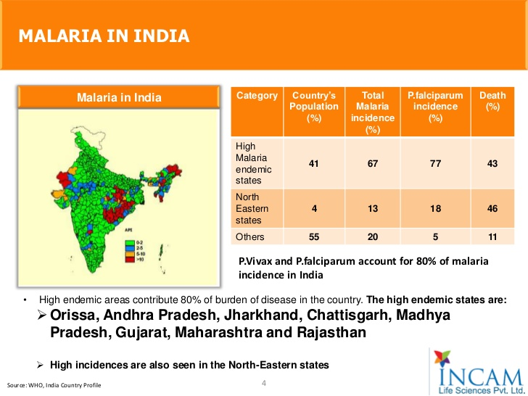
x

Slide 8
Anopheles Mosquito

Slide 9
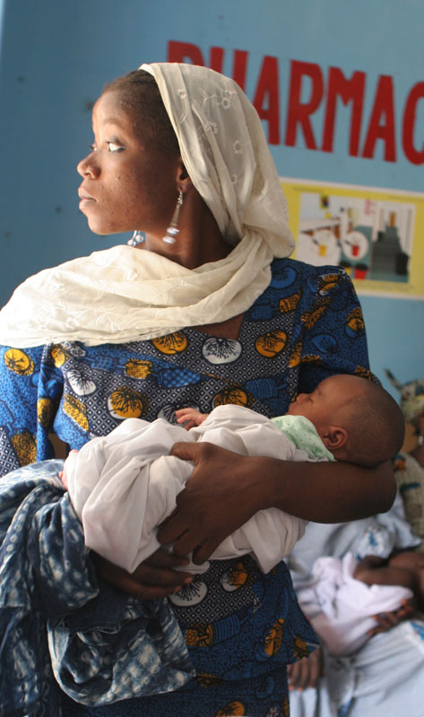
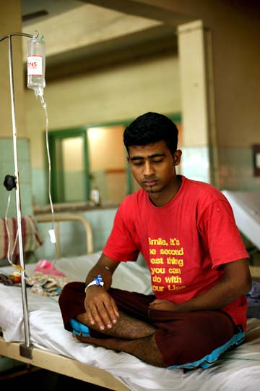

Who are affected?
Images: Bonnie Gillespie, Voices for a malaria free future, Courtney Dudley, JHU/ Voices for a Malaria Free Future, Cape Union Mart
Notes:
Pregnant women and children under the age of five are most vulnerable to malaria infections. This is because they have a lower natural immunity to the disease compared to others in the community.
Adults can also be affected by malaria, however if they have lived in the same area for a long period of time they are likely to build up some immunity to the parasite. This does not mean that they are not infected but may mean they have less severe symptoms.
People who travel from malaria free areas to malaria endemic areas are also at risk of contracting the disease. Holiday makers and immigrant workers can be vulnerable to infections as they have no immunity to the disease. Drugs are available that can be given to these people to kill the parasite if they become infected.

Slide 10

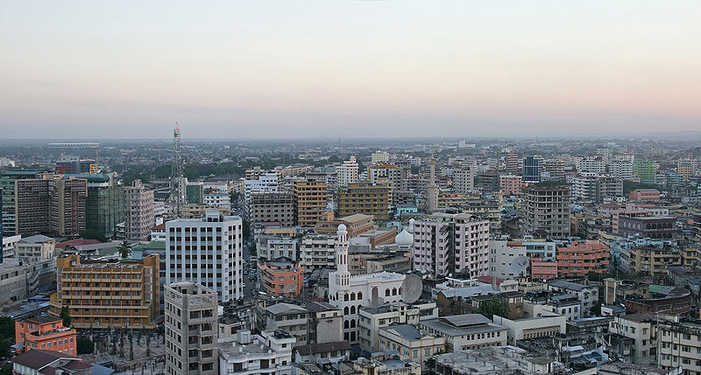
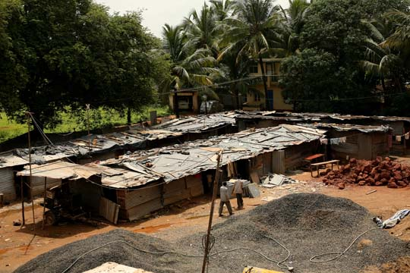
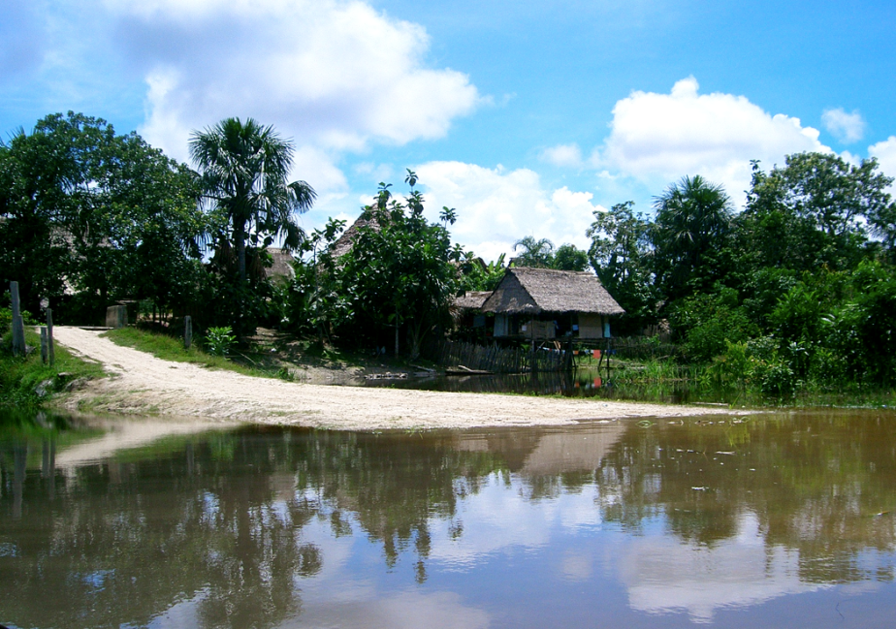
Why these areas?
Images: Manfred Werner, Courtney Dudley, JHU/Voices for a Malaria Free Future, Muhammad Mahdi Karim micro2macro.net, Julian Rayner
Notes:
These are images from four regions where malaria is found: Cambodia in South East Asia (top left), Dar Es Salaam, Tanzania, Africa (top right) Shanty town in India, (bottom left), a remote rural village in Peru, South America (bottom right).
Question to the students: Why do you think these areas have high levels of malaria? What do they have in common?
Warm climate (over 19-20 °C) and heavy rainfall. Long rainy seasons can form areas of standing water which are ideal mosquito breeding grounds.
Poor housing and sanitation facilities. The houses in these areas don’t always have windows or mesh screens to prevent mosquitoes and other biting insects entering the house.
Some are in rural areas, in close proximity to forest (except Dar es Salaam in Tanzania) which provides ideal habitats for some mosquito species.

Slide 11
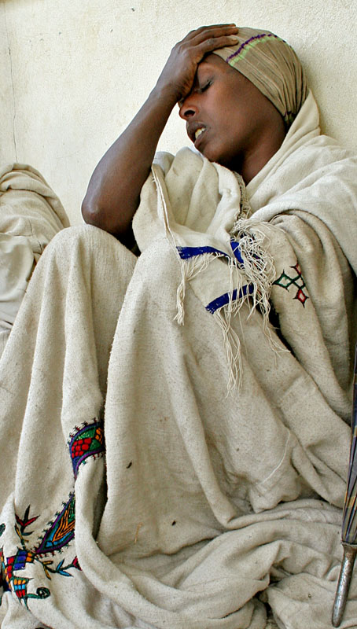
Why is malaria a problem?
Malaria has a significant economic impact on countries with high levels of malaria transmission.
In affected countries the disease accounts for:
  40% of public health drug expenditure
  30-50% of in patient hospital admissions
  up to 60% of outpatient health clinic visits
Statistics: 2010 WHO Malaria Report
Image: Bonnie Gillespie, Voices for a Malaria Free Future
Notes:
Malaria causes significant economic losses, and can decrease gross domestic product (GDP) by as much as 1.3% in countries with high levels of transmission. It is estimated that malaria-related health expenditure and lost productivity costs Africa’s economy over $8 billion per year. It also deters foreign investment, tourism and trade. These sustained annual economic losses have resulted in substantial differences in GDP between countries with and without malaria, particularly in Africa.
Malaria disproportionately affects poor people who cannot afford treatment or have limited access to health care. This traps families and communities in a vicious cycle of poverty and disease which they are unable to break away from.

Slide 12
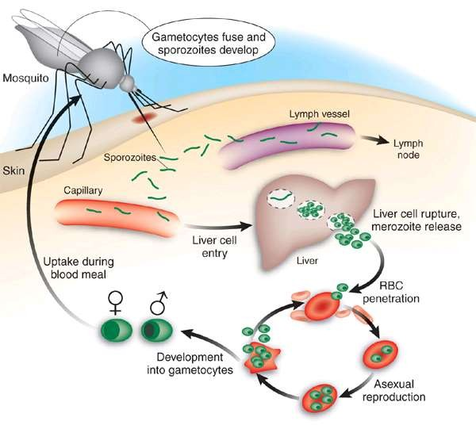
Events in Humans start with Bite of Mosquito
Man – Intermediate
host.
Mosquito – Definitive host
– Sporozoites are infective forms
Present in the salivary gland of female anopheles mosquito
After bite of infected mosquito sporozoites are introduced into blood circulation.

Slide 13
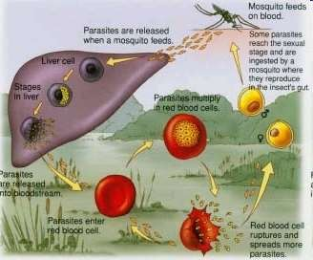
Pre erythrocytic cycle
Sprozoites undergo developmental phase in the liver cell
a single sporozoite may produce from 10,000 to >30,000 daughter merozoites
Multiple nuclear divisions develop to Schizonts
swollen infected liver cells eventually burst, discharging motile merozoites into the bloodstream

Slide 14
Period of Pre erythrocytic cycle
1 P.vivax 8 days
2 P.falciparum – 6 days
3 P.malariae - 13 – 16 days,
4 P.ovale 9 days

Slide 15
Erythrocyte cycle
Merozoites released invade red cells
P.vivax infects young erythrocytes
P.malariae Infects old erythrocytes
P.falciparum infects RBC of all ages
The Merozoites are pear shaped 1-5 microns in length

Slide 16
invade red blood cells (RBCs) to become trophozoites and multiply six- to twentyfold every 48 h
(~100 million parasites in the blood of an adult) symptomatic stage of the infection begins
In P. vivax and P. ovale infections, a proportion of the intrahepatic forms do not divide immediately but remain inert for a period ranging from 2 weeks to ≥1 year. These dormant forms, or hypnozoites, are the cause of the relapses that characterize infection with these species.

Slide 17
Attachment of merozoites to RBC specific erythrocyte surface receptors
P. falciparum merozoites erythrocyte binding antigen 175 and glycophorin
Duffy blood-group antigen Fya or Fyb
P. vivax malaria & P. knowles

Slide 18
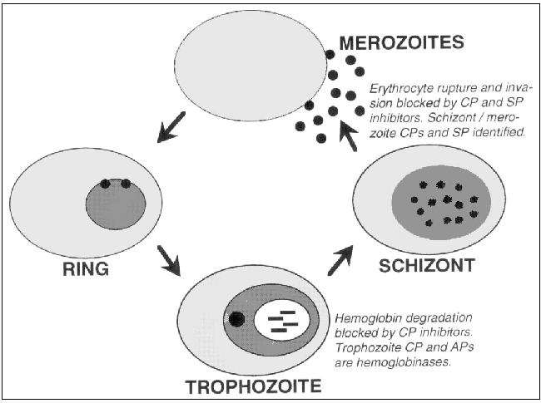
Erythrocytic Schizogony
Liberated Merozoites penetrate RBC
Three stages occur 1 Trophozoites
  Schizont
  Merozoite

Slide 19
Gametogony
Merozoites differentiate into Male and female gametocytes
They develop in the red cells
Found in the peripheral blood smears
Microgametocyte of all species are similar in size
Macro gametocytes are larger in size.

Slide 20
ingested in the blood meal of a biting female anopheline mosquito
the male and female gametocytes fuse to form a zygote [midgut]
Ookinete
penetrates and encysts in the mosquito’s gut wall

Slide 21
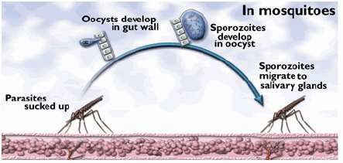
Mosquito cycle
A definitive Host – Mosquito

Slide 22
oocyst expands by asexual division until it bursts to liberate myriad motile sporozoites
migrate in the hemolymph to the salivary gland of the mosquito

Slide 23
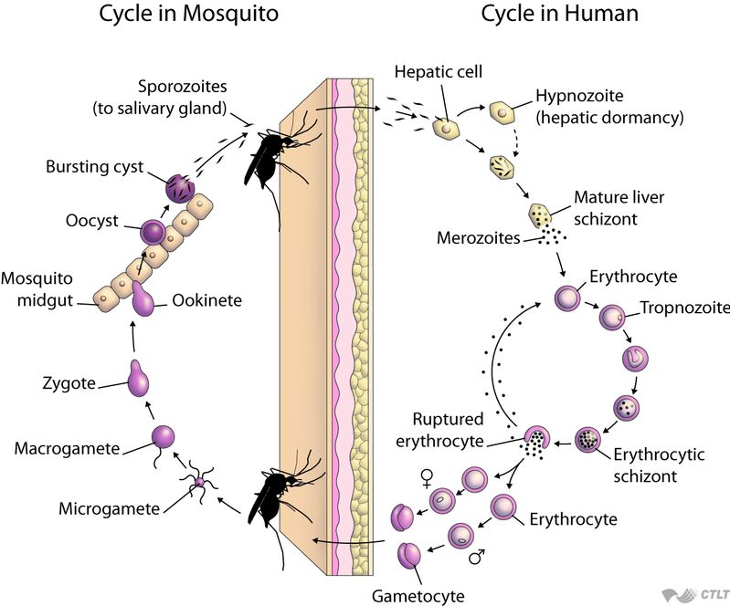

Slide 24
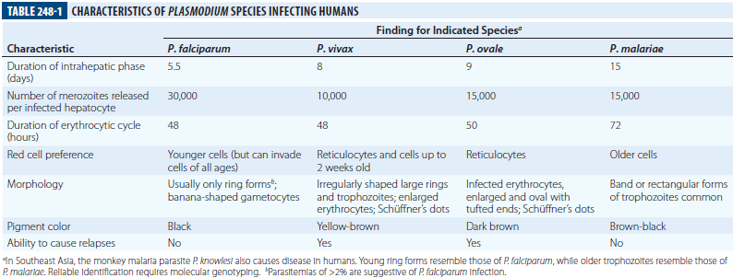
CHARACTERISTICS OF DIFFERENT PLASMODIUM SPECIES

Slide 25
Endemicity [rates of microscopy-detected parasitemia or palpable spleens in children 2–9 years of age
hypoendemic (<10%)
mesoendemic (11–50%)
hyperendemic (51–75%)
holoendemic (>75%)

Slide 26
Constant, frequent, year-round infection is termed stable transmission
In areas where transmission is low, erratic, or focal, full protective immunity is not acquired, and symptomatic disease may occur at all ages. This situation usually exists in hypoendemic areas and is termed unstable transmission.

Slide 27
pathophySiology
ERYTHROCYTE CHANGES IN MALARIA
Growing parasite progressively consumes and degrades intracellular proteins, majorly Hemoglobin.
Degradation of Hemoglobin produces toxic Heme which is detoxified by lipid mediated crystallization to inert Hemozoin.
Parasite alters the RBC membrane. So RBC becomes more irregular, more antigenic and less deformable.

Slide 28
In P. falciparum infections- membrane protuberances appear on the erythrocyte’s surface
These “knobs” extrude a high-molecular-weight, antigenically variant, strain-specific erythrocyte membrane adhesive protein (PfEMP1) that mediates attachment to receptors on venular and capillary endothelium (cytoadherence)

Slide 29
These infected RBCs may also adhere to uninfected RBCs (to form rosettes) and to other parasitized erythrocytes (agglutination).
The processes of cytoadherence, rosetting, and agglutination are central to the pathogenesis of falciparum
Erythrocytes containing more mature parasites stick inside and eventually block capillaries and venules

Slide 30
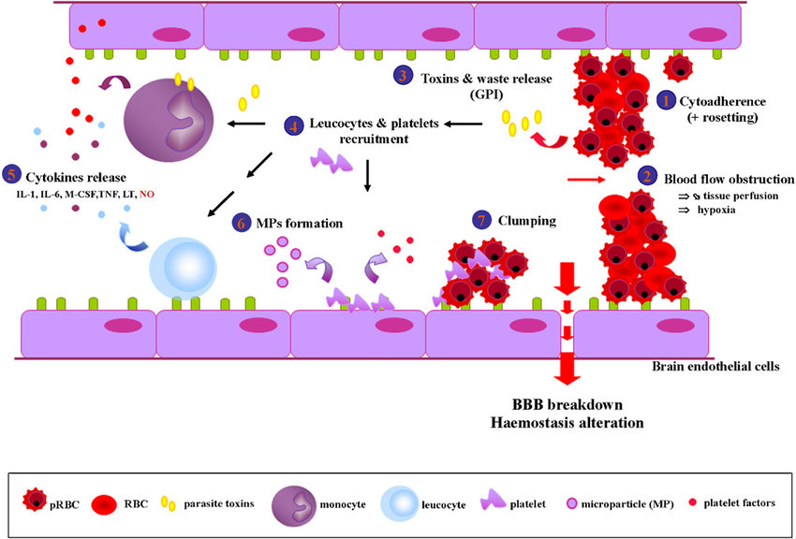

Slide 31
Symptoms are due to:
Hemolysis of Red Blood Cells : with release of metabolites and pigments from Malaria parasite.
Plugging of capillaries by parasitized erythrocytes :
.

Slide 32
Several vascular receptors have been identified
intercellular adhesion molecule 1
endothelial protein C receptor are important in the brain
chondroitin sulfate B predominates in the placenta
CD36 binds parasitized RBCs in most other organs

Slide 33
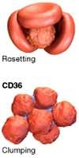
Sequestration & cytoadherence
Rosetting (adhesion of infected RBCs to other RBCs) and clumping (adhesion between infected cells) was first observed in in vitro culture

Slide 34
HOST RESPONSE
Initially, the host responds to malaria infection by activating nonspecific defense mechanism
Splenic immunologic and filtrative clearance functions are augmented, and the removal of both parasitized and uninfected erythrocytes is accelerated.
The spleen also removes damaged ring-form parasites (a process known as “pitting”)

Slide 35
The parasitized cells escaping splenic removal are destroyed when the schizont ruptures
The toxins release induces monocyte/ macrophage activation and the release of proinflammatory cytokines, which cause fever and other pathologic effects
Temperatures of ≥40°C (≥104°F) damage mature parasites

Slide 36
thalassemias, sickle cell disease, hemoglobins C and E, hereditary ovalocytosis, and glucose- 6-phosphate dehydrogenase (G6PD) deficiency

Slide 37
CLINICAL FEATURES
Malaria should be suspected in patients residing in endemic
areas or who have recently visited endemic area and presenting
with
Fever – Classical fever spikes at regular intervals with chills and rigors are unusual.
Lack of sense of well being
Headache and muscle aches
Fatigue
Nausea
Vomiting
Generalized seizures may occur.
The symptoms of malaria can be non-specific and mimic other diseases like viral
infections, enteric fever etc.
SIGNS – mild Pallor, mild jaundice and a palpable spleen maybe seen.

Slide 38
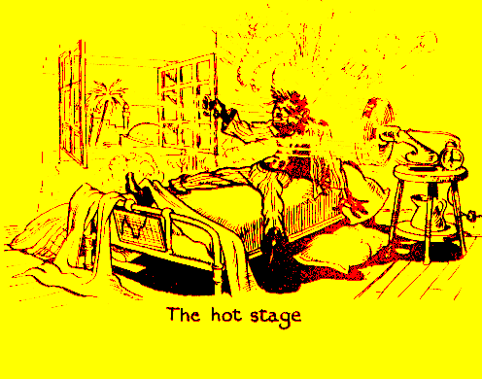
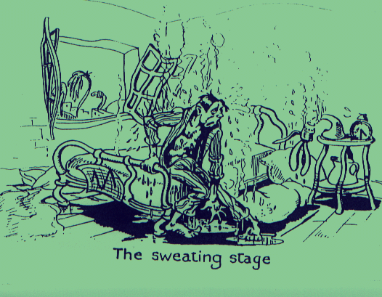
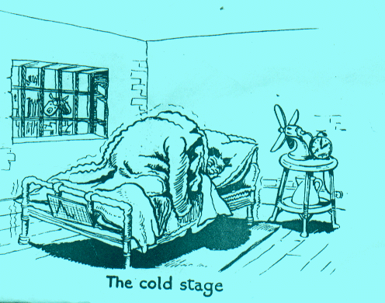
CLINICAL SIGNS & SYMPTOMS OF MALARIA
Fever
Sweating
Chills

Slide 39
Malarial Paroxysm
cold stage chills feeling of intense cold vigorous shivering lasts 15-60 minutes hot stage fever intense heat throbbing headache lasts 2-6 hours sweating stage profuse sweating declining temperature exhausted and weak → sleep lasts 2-4 hours

Slide 40
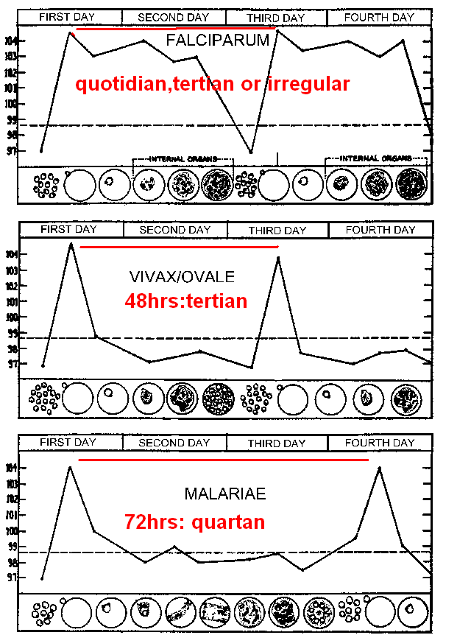
The pattern of fever in different species of malaria
  Plasmodium falciparum (fever tertian, irregular)
  Plasmodium vivax (fever every 48hours tertian)
  Plasmodium ovale (fever every 48 hours tertian)
  Plasmodium malariae (fever every 72 hours quartan)
Plasmodium falciparum::
Plasmodium vivax,
Plasmodium ovale
Plasmodium malariae\:

Slide 41
Cerebral Malaria
Coma is a characteristic and ominous feature
Failure to localize or respond appropriately to noxious stimuli or coma persisting for > 30 min after generalized convulsion.
Manifests as diffuse symmetric encephalopathy. Focal signs are unusual.
signs of meningeal irritation are absent

Slide 42
The eyes may be divergent, and bruxism and a pout reflex are common
other primitive reflexes are usually absent
The corneal reflexes are preserved, except in deep coma.
Muscle tone may be either increased or decreased.
The tendon reflexes are variable
the plantar reflexes may be flexor or extensor
the abdominal and cremasteric reflexes are absent.
Flexor or extensor posturing may be seen.

Slide 43
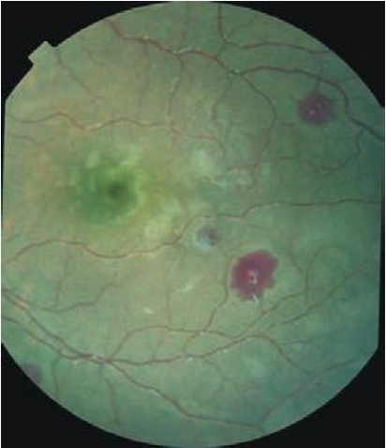
Perimacular whitening and Pale-centered retinal hemorrhages
The EYE in cerebral malaria:
-retinal hemorrhages (30–40%)
-discrete spots of retinal opacification (30–60%),
-papilledema (8% among children, rare among adults),
-cotton wool spots (<5%)
-decolorization of a retinal vessel or segment of vessel (occasional cases).

Slide 44
Convulsions, which are usually generalized and often repeated, occur in ~10% of adults and up to 50% of children with cerebral malaria.
adults rarely (<3% of cases) suffer neurologic sequelae
~10% of children surviving cerebral malaria—especially those with hypoglycemia, severe anemia, repeated seizures, and deep coma—have residual neurologic deficits when they regain consciousness
hemiplegia, cerebral palsy, cortical blindness, deafness, and impaired cognition may all occur

Slide 45
HYPOGLYCEMIA
Plasma glucose level of < 40 mg/dl is associated with poor prognosis particularly in children and pregnant women.
Results from failure of hepatic gluconeogenesis and increase in consumption of glucose by both host and parasite.
Quinine – used in Falciparum malaria enhances insulin release and aggravates hypoglycemia.
The usual physical signs (sweating, gooseflesh, tachycardia) are absent.
The neurologic impairment caused by hypoglycemia cannot be distinguished from that caused by malaria.

Slide 46
ACIDOSIS
Plasma pH of < 7.25 or plasma bicarbonate < 15 mmol/L; Lactate level of > 5 mmol/L.
Results from-
-accumulation of organic acids produced by anaerobic glycolysis in tissues due to impaired microcirculatory flow
-lactate production by the parasites
-failure of hepatic and renal lactate clearance.
Manifests as laboured deep breathing or acidotic breathing – a sign of poor prognosis.
Is followed by circulatory failure and respiratory arrest.
Plasma concentrations of bicarbonate or lactate are the best biochemical prognosticators in severe malaria

Slide 47
NONCARDIOGENIC PULMONARY EDEMA
Often aggravated by over hydration.
Pathogenesis is unclear.
May develop even after several days of antimalarial therapy in falciparum malaria.
Mortality rate is > 80% in severe Falciparum malaria and usual in vivax malaria

Slide 48
RENAL FAILURE
Serum Creatinine level of > 3mg/dL;
24hr urine output < 400 ml in adults or < 12 ml/ Kg in children
No improvement with rehydration.
Maybe due to impaired micro-circulatory flow and metabolism.
Manifests as Acute tubular necrosis
Urine flow resumes in a median of 4 days, and serum creatinine levels return to normal in arround 17 days
Early dialysis or hemofiltration increase the chances of patient survival.

Slide 49
HEMATOLOGIC ABNORMALITIES
Severe normocytic normochromic anemia due to accelerated RBC destruction by spleen and parasite.
Splenic clearance is increased as RBCs show reduced deformability.
In areas of unstable transmission, anemia can progress rapidly and transfusion may be required.
Slight coagulation abnormalities are common in falciparum malaria and mild thrombocytopenia is usual.
DIC with significant bleeding occurs in < 5% of patients.

Slide 50
Acute hemolytic anemia with massive hemoglobinuria (“blackwater fever”) may occur
Hemoglobinuria may contribute to renal injury
Sudden hemolysis may follow many days after artesunate treatment of hyperparasitemia, usually as a result of relatively synchronous loss of once-parasitized “pitted” RBCs

Slide 51
Anemia is a common consequence of antimalarial drug resistance, which results in repeated or continued infection.
mild thrombocytopenia is usual
Fewer than 5% of patients with severe malaria have significant bleeding with evidence of disseminated intravascular coagulation.
Hematemesis from stress ulceration or acute gastric erosions also may occur rarely

Slide 52
LIVER DYSFUNCTION
Mild hemolytic jaundice is common in malaria but severe jaundice may occur in P.falciparum infections.
Jaundice is more common in adults than in children and results from hemolysis, hepatocyte injury and cholestasis.
Liver dysfunction leads to hypoglycemia, lactic acidosis and impaired drug metabolism.

Slide 53
Other Complications
Malaria anemia is worsened by concurrent infections with intestinal helminths, hookworm
Septicemia may complicate severe malaria, particularly in children.
Chest infections and catheter-induced urinary tract infections are common among patients who are unconscious for >3 days
Aspiration pneumonia may follow generalized convulsion

Slide 54
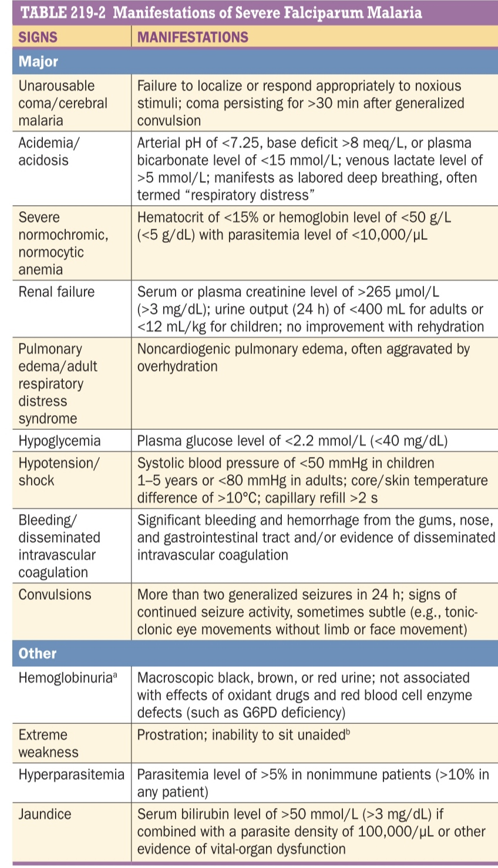

Slide 55
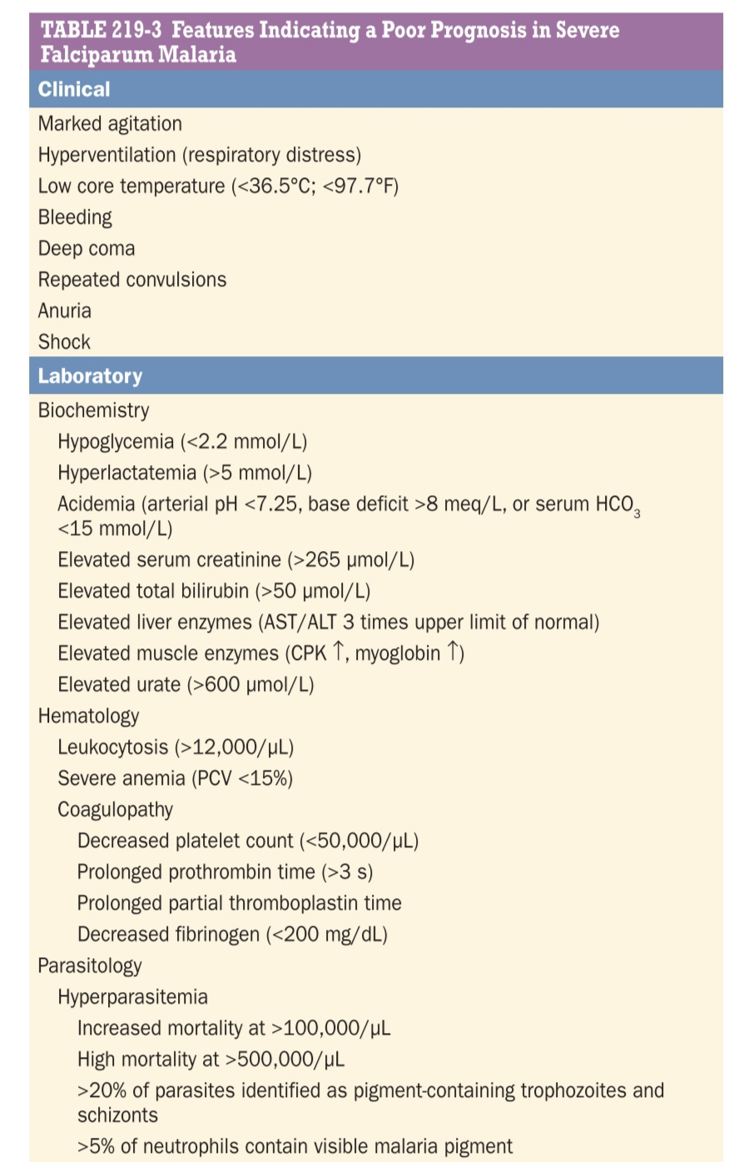

Slide 56
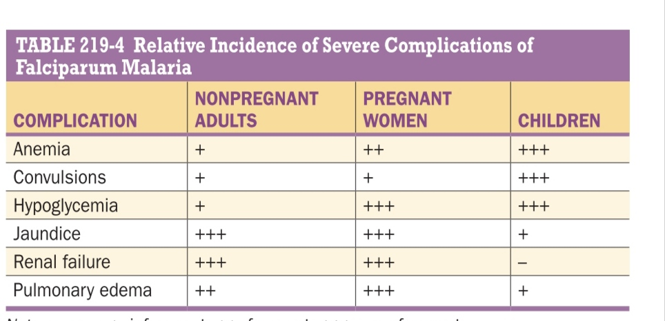

Slide 57
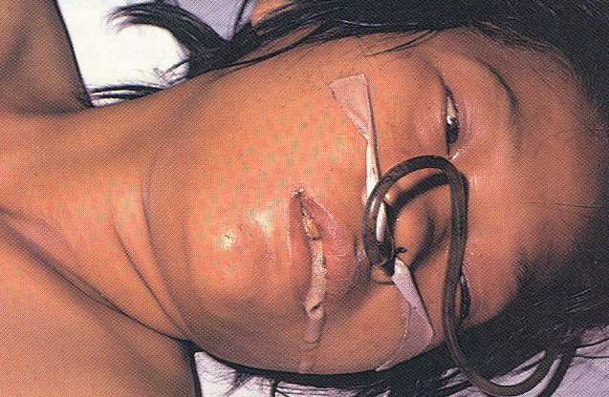
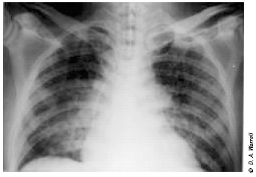
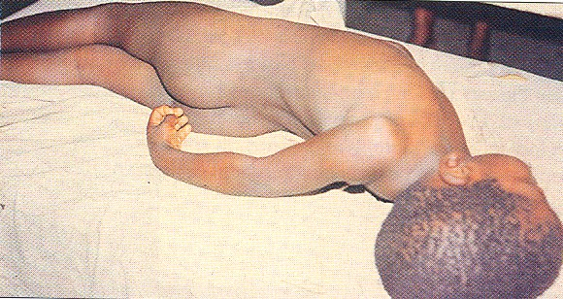
Severe Complications of malaria :
P. falciparum
Hypo glycaemia and pulmonary edema in pregnancy
Cerebral malaria

Slide 58
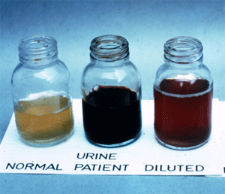
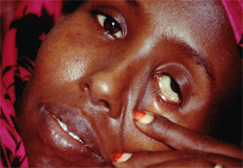
Malarial haemoglobinuria
P. falciparum
Clinical Picture :
Hemoglobinuria associated with malaria (blackwater fever) is uncommon and malarial hemoglobinuria usually presents in adults as severe disease with anemia and renal failure.

Slide 59
CHRONIC COMPLICATIONS OF MALARIA
■■ HYPERREACTIVE MALARIAL SPLENOMEGALY
hypergammaglobulinemia; normochromic, normocytic anemia; and, in certain situations, splenomegaly.
massive splenomegaly
Hepatomegaly
marked elevations in serum IgM and malarial antibody titers
hepatic sinusoidal lymphocytosis, and (in Africa) peripheral B cell lymphocytosis.

Slide 60
production of cytotoxic IgM antibodies to CD8+ T lymphocytes
antibodies to CD5+ T lymphocytes
increase in the ratio of CD4+ to CD8+ T cells
uninhibited B cell production of IgM and the formation of cryoglobulins (IgM aggregates and immune complexes)
stimulates lymphoid hyperplasia and clearance activity and eventually produces splenomegaly

Slide 61
abdominal mass or a dragging sensation in the abdomen and occasional sharp abdominal pains suggesting perisplenitis
anemia and some degree of pancytopenia (hypersplenism)
in endemic areas should receive antimalarial chemoprophylaxis
In nonendemic areas, antimalarial treatment is advised

Slide 62
■ QUARTAN MALARIAL NEPHROPATHY
P. malariae
soluble immune complex injury to the renal glomeruli nephrotic syndrome
focal or segmental glomerulonephritis
Subendothelial dense deposits are seen on ems
IF-deposits of complement and immunoglobulins
BURKITT’S LYMPHOMA AND EPSTEIN-BARR VIRUS INFECTION

Slide 63
Relapse Vs Recrudesence
Depending upon the cause , recurrence can be classified either as recrudescence or relapse
Recrudescence is when symptoms return after a symptoms free period. It is due to parasites surviving in the blood as a result of inadequate or ineffective treatment.
Relapse is when symptoms reappear after the parasites have been eliminated from blood but persist as dormant hypnozites in liver cells.
Relapse is common in P.ovale and P.vivax infection
Recrudescence is commonly seen in P.falciparum

Slide 64
DIAGNOSIS OF MALARIA
thick and thin blood smears
demonstration of asexual forms of the parasite in stained peripheral-blood smears
Giemsa at pH 7.2 is preferred; Field’s, Wright’s, or Leishman’s stain can also be used.
Staining of parasites with the fluorescent dye acridine orange allows more rapid diagnosis of malaria

Slide 65
thin blood smear
air-dried
fixed in anhydrous methanol
Staine
the RBCs in the tail of the film should then be examined under oil immersion (×1000 magnification)
The density of parasitemia is expressed as the number of parasitized erythrocytes per 1000 RBCs.

Slide 66
thick blood film
uneven thickness
dried thoroughly
stained without fixing
increasing diagnostic sensitivity
Both parasites and white blood cells (WBCs) are counted
the number of parasites per unit volume is calculated from the total leukocyte count

Slide 67
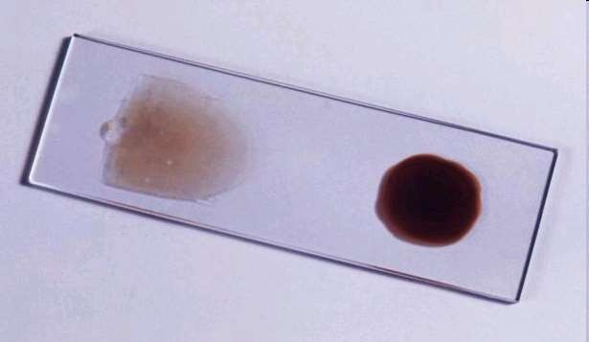
Thin and Thick smear

Slide 68
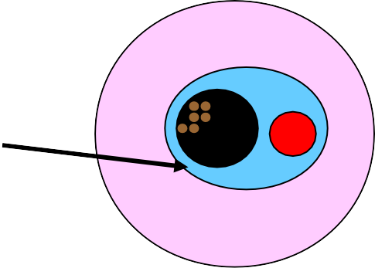





Recognizing Erythrocytic Stages:
Schematic Morphology
Blue Cytoplasm
RING
Red Chromatin
TROPHOZOITE
Brown Pigment
SCHIZONT
GAMETOCYTE

Slide 69
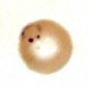
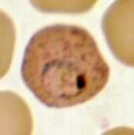
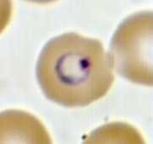
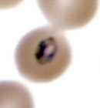
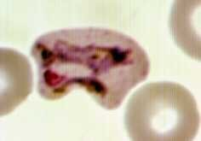
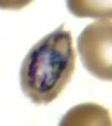

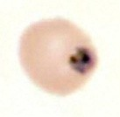
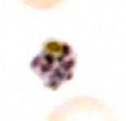
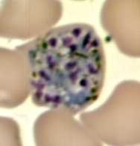
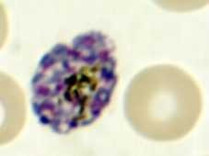
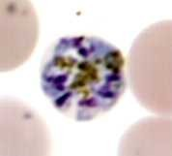
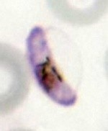
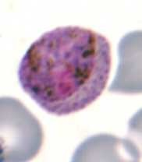
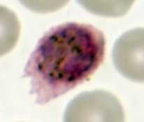
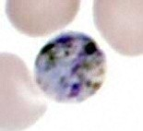
Species Differentiation on Thin Films
P. falciparum P. vivax P. ovale P. malariae
Rings Trophozoites
Schizonts Gametocytes
02/19/15
VAIDEGI.D
10

Slide 70








Plasmodium falciparum
Infected erythrocytes: normal size
M I
Gametocytes: mature (M)and immature (I) forms (I is rarely seen in peripheral blood)
Rings: double chromatin dots; appliqué forms; multiple infections in same red cell
Schizonts: 8-24 merozoites (rarely seen in peripheral blood)
Trophozoites: compact (rarely seen in peripheral blood)

Slide 71









Plasmodium vivax
Infected erythrocytes: enlarged up to 2X; deformed; (Schüffner’s dots)
Rings
Trophozoites: ameboid; deforms the erythrocyte
Schizonts: 12-24 merozoites
Gametocytes: round-oval

Slide 72










Plasmodium ovale
Infected erythrocytes: moderately enlarged (11/4 X); fimbriated; oval; (Schüffner’s dots) “malariae - like parasite in vivax - like erythrocyte”
Trophozoites: compact
Rings
Schizonts: 6-14 merozoites; dark pigment; (“rosettes”)
Gametocytes: round-oval

Slide 73



Plasmodium malariae
Infected erythrocytes: size normal to decreased (3/4X)
Trophozoite: typical
band form
Schizont:
6-12 merozoites; coarse, dark pigment
Gametocyte: round; coarse, dark pigment
Trophozoite: compact

Slide 74
Calculating Parasite Density
Count the number of parasitized and nonparasitized RBCs in the same fields on thin smear
Count 500-2000 RBCs
_{% parasitemia =} # parasitized RBCs _{X 100}
total # of RBCs
Count ≥ 200 WBCs on thick film Assume WBC is 8000/μl (or count it)
_{parasites/μl =} parasites counted _{X WBC count/μl} WBC counted

Slide 75
Fluorescent Microscopy
Modification of light microscopy Fluorescent dyes detect RNA and DNA that is contained in parasites
Nucleic material not normally in mature
RBCs
Kawamoto technique
Stain thin film with acridine orange (AO) Requires special equipment – fluorescent microscope
Nuclei of malaria parasites floresce
bright green and cytoplasm red. Staining itself is cheap Sensitivities around 90%

Slide 76


fluorescent microscope
malaria parasites

Slide 77
Quantitative Buffy Coat(QBC)
Useful for screening large numbers of samples
Quick, saves time
Requires centrifuge, special stains Malaria parasite floresce green yellow against dark red –black background.
3 main disadvantages
Species identification and quantification difficult
High cost of capillaries and equipment Can’t store capillaries for later reference

Slide 78


Principle of QBC System

Slide 79
Malaria Serology
Antibody detection
Immunologic assays to detect host response
Antibodies to asexual parasites appear some days after invasion of RBCs and may persist for months
Positive test indicates past infection
Not useful for treatment decisions
Valuable epidemiologic tool
Useful for
Identifying infective donor in transfusion-transmitted malaria Investigating congenital malaria, esp. if mom’s smear is negative
Diagnosing, or ruling out, tropical splenomegaly syndrome

Slide 80
Malaria Antigen Detection
Target antigens for malaria (rapid detection test) RDT Card / cassette / dipstick
HRP2
HRP2 & aldolase pLDH Pf & pan pLDH Pf & Pv
"COMBO" tests
HRP2, pLDH pan
HRP2, pLDH pan & pLDH
Pv aldolase
A: HRP-2 (histidine-rich protein 2) (ICT)
B: pLDH (parasite lactate dehydrogenase)(Flow)
C: HRP-2(hIstidine-rich protein 2) (PATH)
02/19/15
24

Slide 81


Plastic cassette format of RDT

Slide 82

INDIRECT FLUORESCENT ANTIBODY(IFA)
Indirect fluorescent antibody (IFA) test. The fluorescence indicates that the patient serum being tested contains antibodies that are reacting with the antigen preparation (here, Plasmodium falciparum parasites).
02/19/15
31

Slide 83
■■ LABORATORY FINDINGS IN ACUTE MALARIA
Normochromic, normocytic anemia
The leukocyte count is generally normal
slight monocytosis, lymphopenia, and eosinopenia, with reactive lymphocytosis and eosinophilia
platelet count is usually reduced to ~105/μL
The erythrocyte sedimentation rate, plasma viscosity, and levels of C-reactive protein and other acute-phase proteins are elevated.
by prolonged prothrombin and partial thromboplastin times and by more severe thrombocytopenia.
Antithrombin III levels are reduced even in mild infection.
In uncomplicated malaria, plasma concentrations of electrolytes, blood urea nitrogen (BUN), and creatinine are usually normal.
Findings in severe malaria may include metabolic acidosis, with low plasma concentrations of glucose, sodium, bicarbonate, phosphate, and albumin, together with elevations in lactate, BUN, creatinine, urate, muscle and liver enzymes, and conjugated and unconjugated bilirubin. Hypergammaglobulinemia
In adults and children with cerebral malaria, the mean cerebrospinal fluid (CSF) opening pressure at lumbar puncture is ~160 mm H2O; usually the CSF content is normal or there is a slight elevation of total protein level (<1.0 g/L [<100 mg/dL]) and cell count (<20/μL).

Slide 84
TREATMENT
World Health Organization (WHO) recommends artemisinin- based combination therapy (ACT) as first-line treatment for uncomplicated falciparum malaria in malaria-endemic areas

Slide 85


Slide 86
Classification
4-Aminoquinolines Chloroquine Amodiaquine
2) Quinoline methanol Mefloquine
3) Cinchona alkaloid Quinine
Quinidine
4) Biguanides Proguanil (Chloroguanide)

Slide 87
Diaminopyrimidines Pyrimethamine
8-Aminoquinoline Primaquine
Tafenoquine
Sulfonamides & sulfone Sulfadoxine Sulfamethopyrazine Dapsone
Antibiotics Tetracyclins
Doxycycline

Slide 88
Sesquiterpine lactones Artesunate Artemether Arteether
Amino alcohols Halofantrine Lumefantrine
Naphthyridine Pyronaridine
Naphthoquinone Atovaquone

Slide 89
Tissue schizonticides
That eliminate pre erythrocytic/exo-erythrocytic
stages in liver
Erythrocytic schizonticides
act on erythrocytic parasites
Gametocides
kill gametocytes in blood and prevent transmission to mosquitoes

Slide 90
Clinical cure
  Terminate the episode of malarial fever
Radical cure
eliminate both hepatic and erythrocytic stages
Causal prophylaxis
Suppressive propylaxis

Slide 91
Uncomplicated Malaria
Known chloroquine-sensitive strains of Plasmodium vivax, P. malariae, P. ovale, P. falciparum
Chloroquine (10 mg of base/kg stat followed by 5 mg/kg at 12, 24, and 36 h or by 10 mg/kg at 24 h and 5 mg/kg at 48 h)
or Amodiaquine (10–12 mg of base/kg qd for 3 days)

Slide 92
Radical treatment for P. vivax or P. ovale infection
P. ovale infection
In addition to chloroquine or amodiaquine as or ACT ,primaquine (0.5 mg of base/kg qd in Southeast Asia and Oceania and 0.25 mg/kg elsewhere) should be given for 14 days to prevent relapse.
In mild G6PD deficiency, 0.75 mg of base/kg should be given once weekly for 8 weeks.
Primaquine should not be given in severe G6PD deficiency.

Slide 93
Uncomplicated
P. falciparum malaria
Artesunate (4 mg/kg qd for 3 days) plus sulfadoxine (25 mg/kg)/pyrimethamine (1.25 mg/kg) as a single dose or
Primaquine 0.75 mg/Kg body weight on day 2
or
Artesunate (4 mg/kg qd for 3 days) plus amodiaquine (10 mg of base/kg qd for 3 days)e or Artemether-lumefantrine (1.5/9 mg/kg bid for 3 days with food) or
Artesunate (4 mg/kg qd for 3 days) plus mefloquine (24–25 mg of base/kg—either 8 mg/kg qd for 3 days or 15 mg/kg on day 2 and then 10 mg/kg on day 3)e or
DHA-piperaquine (target dose: 4/24 mg/kg qd for 3 days in children weighing <25 kg and 4/18 mg/kg qd for 3 days in persons weighing ≥25 kg)

Slide 94
Second-line treatment/treatment of imported malaria
Artesunate(2 mg/kg qd for 7 days) or quinine (10 mg of salt/kg tid for 7 days) plus 1 of the following 3:
1. Tetracycline (4 mg/kg qid for 7 days)
2. Doxycycline(3 mg/kg qd for 7 days)
3. Clindamycin (10 mg/kg bid for 7 days)
or Atovaquone-proguanil (20/8 mg/kg qd for 3 days with food

Slide 95
Severe Falciparum Malaria
Artesunate (2.4 mg/kg stat IV followed by 2.4 mg/kg at 12 and 24 h and then daily if necessary;
for children weighing <20 kg, give 3 mg/kg per dose)h or,
if unavailable, Artemether(3.2 mg/kg stat IM followed by 1.6 mg/kg qd) or,
if unavailable, Quinine dihydrochloride (20 mg of salt/kg infused over 4 h, followed by 10 mg of salt/kg infused over 2–8 h q8hj) or,
if none of the above are available, Quinidine (10 mg of base/kg infused over 1–2 h, followed by 1.2 mg of base/kg per hour with electrocardiographic monitoring)

Slide 96
1. Treatment of severe falciparum malaria
 | Preferred regime | Alternative regime
 | IV Artesunate (60mg): 2.4mg/kg on admission, followed by 2.4mg/kg at 12h & 24h, then once daily for 7 days. Once the patient can tolerate oral therapy, treatment should be switched to a complete dosage of Riamet (artemether/lumefantrine) for 3 day. | IV Quinine loading 7mg salt /kg over 1hr followed by infusion quinine 10mg salt/kg over 4 hrs, then 10mg salt/kg Q8H or IV Quinine 20mg/kg over 4 hrs, then 10mg/kg Q8H. Plus Adult & child >8yrs old: Doxycycline (3.5mg/kg once daily) or Pregnant women & child < 8yrs old: Clindamycin (10mg/kg twice daily). Both drug can be given for 7 days.
 | Reconstitute with 5% Sodium Bicarbonate & shake 2-3min until clear solution obtained. Then add 5ml of D5% or 0.9%NaCl to create total volume of 6ml. Slow IV injection with rate of 3-4ml/min or IM injection to the anterior thigh. The solution should be prepared freshly for each administration & should not be stored. | Dilute injection quinine in 250ml od D5% and infused over 4hrs. Infusion rate should not exceed 5 mg salt/kg per hour.

Slide 97
In endemic areas where malaria transmission is low, except in pregnant women and infants, a single dose of primaquine (0.25 mg of base/kg) should be added as a gametocytocide to all falciparum malaria treatments to prevent transmission

Slide 98
Special groups
Pregnancy
First trimester
quinine + clindamycin
2nd and 3rd trimester
Artesunate + clindamycin or
Quinine + clindamycin

Slide 99
THE PHARMACOLOGY OF ANTIMALARIALS
Class Definition Examples | Class Definition Examples | Class Definition Examples
Blood schizonticidal drugs | Act on (erythrocytic) stage of the parasite thereby terminating clinical illness | Quinine, artemisinins, amodiaquine, chloroquine, lumefantrine, tetracyclineª , atovaquone, sulphadoxine, clindamycinª , proguanilª
Tissue schizonticidal drugs | Act on primary tissue forms of plasmodia which initiate the erythrocytic stage. They block further development of the infection | Primaquine, pyrimethamine, proguanil, tetracycline
Gametocytocid al drugs | Destroy sexual forms of the parasite thereby preventing transmission of infection to mosquitoes | Primaquine, artemisinins, quinine^{b}
ª Slow acting, cannot be used alone to avert clinical symptoms
^{b} Weakly gametocytocidal

Slide 100
THE PHARMACOLOGY OF ANTIMALARIALS (cont.)
Class Definition Examples | Class Definition Examples | Class Definition Examples
Hypnozoitocidal drugs | These act on persistent liver stages of P.ovale and P.vivax which cause recurrent illness | Primaquine, tafenoquine
Sporozontocidal drugs | These act by affecting further development of gametocytes into oocytes within the mosquito thus abating transmission | Primaquine, proguanil, chlorguanil

Slide 101




I
IMPORTANT*: Infections with P.falciparum and P.malariae have no exoerythro
Infections with P.vivax and P.ovale have exoerythrocytic stage (* the source: Rang and dale's pharmacology- sixth edition- page704 “see the last
cytic stage
page”)

Slide 102
MALARIA PREVENTION
■ PERSONAL PROTECTION AGAINST MALARIA
the avoidance of exposure to mosquitoes at their peak feeding times (usually dusk to dawn)
use of insect repellents containing 10–35% DEET (or, if DEET is unacceptable, 7% picaridin)
suitable clothing
ITNs or other insecticide-impregnated materials
bed nets treated with residual pyrethroids

Slide 103

How do you prevent malaria?
Key methods to prevent malaria transmission are:
  Long lasting insecticide impregnated nets (LLINs)
  Insecticide-treated nets (ITNs)
  Indoor residual spraying
  Mosquito repellents
  Preventative drug treatments
Image: p_skov_vestergaard_frandsen
Notes:
Protection against mosquito bites and controlling vector populations are effective methods of preventing malaria transmission. Vector control in particular works to reduce malaria transmission at a community level and can significantly reduce transmission from very high levels to close to zero. For individuals, personal protection against mosquito bites through the use of bed nets and insect repellents is the first line of defense to prevent malaria.
Insecticide-treated nets (ITNs) and long lasting insecticide impregnated nets (LLINs) offer both a physical and chemical barrier to mosquitoes.
LLINs are the preferred form of insecticide treated nets for public health distribution programmes and recommended by the World Health Organization as they can be effective for 3-5 years.
Indoor residual spraying (IRS) with insecticides is an extremely effective way to rapidly reduce malaria transmission. It can be effective for 3-6 months, depending on the insecticide used and the type of surface on which it is sprayed. DDT can be effective for 9-12 months in some cases.
Drugs can also be used to prevent malaria. For travellers, malaria can be prevented through chemoprophylaxis, taking drugs that suppress the blood stage of malaria infections, thereby preventing malaria disease.
Pregnant women are also offered anti-malarial drugs during their pregnancy. This is known as Intermittent Preventive Treatment in pregnancy (IPTp). This practice aims to reduce the possible complications during pregnancy such as severe anaemia and placental infections which can threaten the life of the mother and child.

Slide 104
cHEMOPROPHYLAXIS
Mefloquine (250mg) weekly is the only drug advised for pregnant women traveling to areas with drug-resistant malaria
drug is generally considered safe in the second and third trimesters of pregnancy
Doxycycline may be given until 15 weeks of pregnancy
intermittent preventive treatment (IPT) to pregnant women, and in some areas to infant

Slide 105
sulfadoxine-pyrimethamine at each antenatal visit (maximum, once monthly) in the second and third trimesters of pregnancy
Travelers should start taking antimalarial drugs 2 days to 2 weeks before departure
Antimalarial prophylaxis should continue for 4 weeks after the traveler has left the endemic area
except if atovaquone-proguanil or primaquine has been taken; these drugs have significant activities against the liver stage of the infection (causal prophylaxis) and can be discontinued 1 week after departure from the endemic area.

Slide 106
Atovaquone-proguanil (Malarone; 3.75/1.5 mg/kg or 250/100 mg, daily adult dose) is a fixed-combination, once-daily prophylactic agent
This combination is effective against all types of malaria, including multidrug-resistant falciparum malaria.
Atovaquone-proguanil is best taken with food or a milky drink to optimize absorption.
It is not recommended if the estimated glomerular filtration rate is <30 mL/min.

Slide 107


Slide 108


