Slide 1
Approach to hyponatremia
                Dr ANGANA S

Slide 2
INTRODUCTION
Hyponatremia – most common electrolyte abnormality
15-30% of hospitalized patients
Independent predictor of mortality acute-50% chronic 10-20%
Challenge among physicians ---> cause
Basically a water imbalance

Slide 3
hyponatremia
Plasma Na+ conc <135 mM
Concentration of Na+ in ECF is a reflection of tonicity of body fluids , not of total body sodium content
Hyponatremia can be asso. With low , normal or high tonicity.

Slide 4
PSEUDO-HYPONATREMIA
It is associated with normal or increased tonicity.

Slide 5
ISOTONIC HYPONATREMIA
Expansion of ECF with isotonic fluids that do not contain Na
There is no transcellular shift of water but the Na decreases
Ex- Hypertriglyceridemia , Hyperproteinemia (multiple myeloma )

Slide 6
Hypertonic HYPONATREMIA
Seen when there is increase in effective osmoles in the ECF
Shift of water from the cells to ECF and thus causing translocational hyponatremia
Ex – 1.Hyperglycemia in T2DM ( plasma Na falls by 2meq/l for every 100mg/dl increase in glucose between 200-400 mg/dl and by 4meq/l at glucose > 400mg/dl)
2.Hypertonic mannitol

Slide 7
Hypotonic hyponatremia
Most common form of hyponatremia
Occurs by 2 mechanisms
1) impaired renal water excretion
2)excess water intake
Hypotonic hyponatremia classified as hypovolemic , euvolemic & hypervolemic on the basis of ECF volume as assessed clinically by changes in BP , heart rate , edema, jugular venous pressure, skin turgor , mucous membranes.

Slide 8
HYPOVOLEMIC HYPONATREMIA
Total body water
Total body Na
Causes can be divided into 2 types
Conditions with UNa >20
Renal causes – inappropriate loss of Na+-Cl- in the urine leading to volume depletion & increase in circulating AVP.

Slide 9
Mineralocorticoid deficiency(aldosterone deficiency)
* Hyperkalemia & Hyponatremia in Hypotensive and/or hypovolemic patient with high urine Na concentration
Salt losing nephropathies – hyponatremia occurs if salt intake is reduced due to impaired renal tubular function
* reflux nephropathy
* interstitial nephropathies
* post obstructive uropathy
* medullary cystic disease
* Recovery phase of acute tubular necrosis

Slide 10
Diuretic excess
Thiazides
Loop diuretics > blunting the counter current mechanism
[Water diuresis > natriuresis]

Slide 11
Osmotic diuresis
Excretion of osmotically active non reabsorbable or poorly reabsorbable solute.
Glycosuria
Ketonuria
Bicarbonaturia { renal tubular acidosis or metabolic alkalosis in which asso bicarbonaturia leads to loss of Na)

Slide 12
Cerebral salt wasting
Rare cause of hypovolemic hyponatremia
Clinical hypovolemia
Hyponatremia
Inappropriate natriuresis
Seen in intracranical disease like SAH, Trauma , craniotomy, encephalitis , & meningitis
Release of BNP in cerebral dysfunction
D/D – SIAD
Cerebral salt wasting typically responds to aggressive Na-Cl replenition.

Slide 13
Hypovolemic hyponatremia Condition with Una<20
Extrarenal causes
GI Loss , vomiting, diarrhoea, tube drainage
Ex – pancreatitis , burns
A rapid increase in plasma Na+ conc in response to intravenous normal saline .
Saline induces a water diuresis in this setting , as circulating AVP levels decreases.

Slide 14
Euvolemic HYPONATREMIA
No edema
Tbw
Na
Una > 20
Hyponatremia with normal ECF volume is seen in
SIAD
Endocrine deficiency:
Glucocorticoid deficiency
Hypothyroidism

Slide 15
SIAD
ADH is inappropriately elevated in SIAD by a variety of mechanisms:
Enhanced and unregulated ADH secretion (by tumour or hypothalamus )
Elevated secretion of ADH in basal state and in response to hypertonicity.
Any Reset in osmostat
Activating mutation of the V2 receptor permitting reabsorption of water in absence of ADH.
Natriuresis ( increases ANP ) in presence of water retention leads to inappropriately concentrated urine.

Slide 16
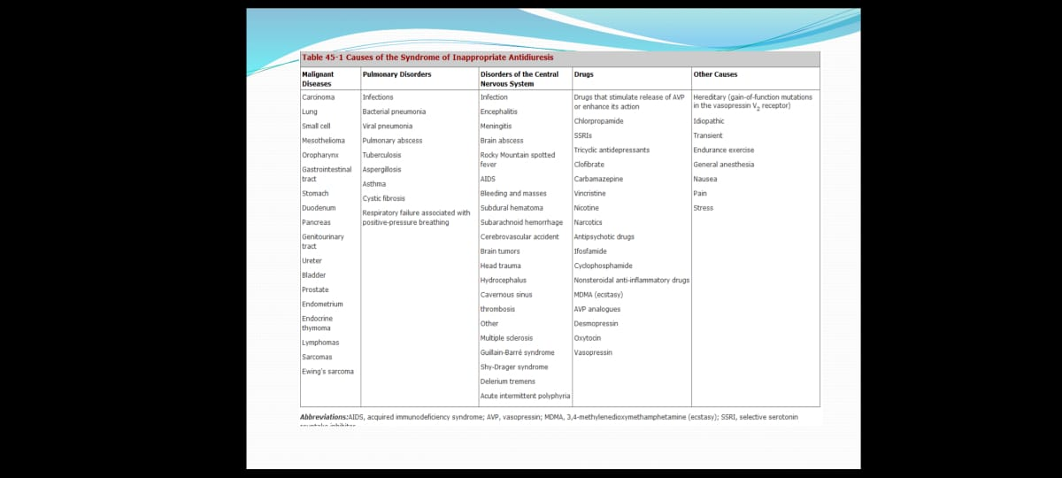
Causes of SIAD

Slide 17
Diagnostic Criteria of SIADH
Plasma sodium concentration <135 mmol/l
Plasma osmolality <280mosmol/kg
Urinary Sodium concentration >20meq/l
Patient clinically euvolemic
Absence of clinical or biochemical features of adrenal & thyroid dysfunction.

Slide 18
S. Uric acid is often low <4mg/dl in patients with SIAD , consistent with suppressed proximal tubular transport in setting of increased distal tubular Na-Cl and water transport.
In contrast , patients with hypovolemic hyponatremia are often hyperuricemic due to shared activation of proximal tubular Na-Cl & urate transport

Slide 19
Endocrine Deficiency
Hypothyrodism & glucocorticoid deficiency – impairs reduced cardiac output > ADH release .
Isolated glucocorticoid deficiency – through corticotropin releasing factor mediated release of ADH
Correction of these hormaonal deficits corrects for the water excretion defect and hyponatremia.

Slide 20
Hypervolemic hyponatremia
Disorders can be separated by effect of Una concentration
Una >20
-- Acute renal failure
-- Chronic renal failure
Una<20
-- congestive heart failure
-- nephrotic syndrome
-- hepatic cirrhosis
Low intraarterial filling
Movt of water from vascular to interstitial space due to hypoalbuminemia
Activation of neurohormonal compensatory mechanisms

Slide 21
Exercise induced hyponatremia
Marathon runners
Females
With low body weight
Excessive drinking of hypotonic solutions >1.5 l/hour of water or hypotonic soft drinks )
Inappropriate secretion of ADH due to muscle derived IL6

Slide 22
PRIMARY POLYDIPSIA
Compulsive water drinking 10-15 liters/day
Psychiatric patients – schizophrenia
Central effect in thirst regulation
Excessive secretion or renal action of ADH
Antipsychotic drugs by anticholinergic action

Slide 23
LOW SOLUTE INTAKE
A low dietary solute intake(tea toast diet , extreme vegetarian) as in debilitated residents in nursing homes or chronic alcohol ingestion( beer potomania) causes hyponatremia by decreasing the ability of the kidney to excrete water.
Water intake above this and insensible water loss causes hyponatremia.
Beer is very low in protein and salt content containing only 1-2 millimole per litre of Na+.

Slide 24
Clinical diagnosis
Symptoms are primarily neurologic
Development of cerebral edema within a rigid skull- headache , lethargy
Confusion , gait abnormalities
Nausea , vomiting
Severe hyponatremia- seizures, coma , brainstem herniation, permanent brain damage or death.

Slide 25
Hyponatremia
Mild <135
Moderate <130
Severe <120
Severe hyponatremia & rapid development of hyponatremia (<48hrs) - key complication is normocapnic or hypercapnic respiratory failure
Normocapnic resp failure is non cardiogenic , neurogenic pulmonary edema , with normal pulmonary capillary wedge pressure.

Slide 26
Diagnostic evaluation of hyponatremia
Clinical assessment
Underlying cause
Detailed drug history
Volume status
Multifactorial , consider all possible causes

Slide 27
Laboratory investigations
S.osmolarity , Na , K
BUN and s. Creatinine
S. glucose , Uric acid
Urine Na , K
Urine osmolarity
S. protiens & lipid profile
Thyroid , adrenal & pituitary function
Radiology – CXR , CT THORAX & brain

Slide 28
HYPONATREMIA
S.OSMOLARITY> 280
PSEUDOHYPONATREMIA
S.OSMO<280
URINE OSMOLARITY<100
Decreased solute intake
Primary polydipsia
HYPOTONIC HYPONATREMIA
HYPOVOLEMIC HYPONATREMIA
EUVOLEMIC HYPONATREMIA
HYPERVOLEMIC HYPONATREMIA

Slide 29
MANAGEMENT
Three major considerations to guide therapy for hyponatremia.
Severity of symptoms
Risk for ODS
Highly unpredictable response
Once the urgency in correcting the plasma Na+ concentration has been established and appropriate therapy instituted, the focus should be on treatment or withdrawal of the underlying cause.

Slide 30
Equations are available to help calculate the initial rate of fluids to be administered.
A widely used formula –Adrogue-Madias formula.
Change in serum Na+ with infusing solution=
[infusate(Na+K)]-serum Na
(total body water+1)
Infusate Na+ is the [Na+] in the infused fluid (154mEq/L in 0.9%NS, 513mEq/L in 3%NS, 77mEq/L in 0.45%NS and 0mEq /L in D5W)

Slide 31
The above equation predicts the amount of [Na+] change by 1 liter of infusate.
Dividing the targeted change in Sr.Na by the result of above equation gives volume of infusate required & thus the rate of infusion.

Slide 32
FOR EXAMPLE
60 Kg female with Na+ - 110mEq/L.
Correction using 3%NaCl (513mEq/L)
(513-110)/30+1=400/31=13mEq/L
So infusion of 1L of 3% NaCl in this pt will raise Na by 13mEq/L.
So 100ml will raise 1.3 meq
-If correction is doing at 1mEq/L/hr, 1litre of 3% NaCl has to be infused over 13 hrs
i.e 154ml/hr
i.e 40 macrodrops/hr

Slide 33
Management
SODIUM DEFICIT(in mEq/L) = 0.55 X body weight X ( targeted Na. conc – Starting Na. conc)
(0.5incase of females)
DELIVERY RATE =
Sodium deficit/[(513mEq/1000ml)]
24hrs
For eg : starting Na is 124 , sodium deficit will be 210
Delivery rate = 210/ [513 meq / 1000ml ]
24hrs
= 17ml/hr

Slide 34
ACUTE STAGE(<48 hrs)
an increase 4-6mEq/L in the Sr.Na – for reversing neurological manifestations.
if associated with severe neurological manifestations (seizures)
-3% saline 100ml can be given over 10 minutes
-can be repeated twice, if not improving

Slide 35
Total correction to be done = 10-12 mEq/L/day
- In which initial increase of 4mEq/L in S.Na can be done in first 4-6 hrs(2-4ml/kg/hr)

Slide 36
CHRONIC STATE
Rate correction – 0.5mEq/L/hr
6-8mEq/l in first 24 hrs
<16mEq/L in 48 hrs

Slide 37
Euvolemic and hypervolemic hyponatremia
In mildly symptomatic and asymptomatic cases
-fluid restriction
-Vaptans in case of euvolemic (SIAD)
-Diuretics and Vaptans in case of hypervolemic

Slide 38
OSMOTIC DEMYELINATION SYNDROME
Rapid correction
Movement of water out of the edematous neurons, causing shrinkage and disruption myelin sheaths
Predisposed – chronic alcohol abuse, hepatic failure and malnutrition
Central pontine myelinosis
-quadriplegia
-Pseudobulbar palsy
-seizures
-coma and death
Extra pontine myelinolysis
Cerebellum
Lateral Geniculate body
Thalamus
Putamen
Cerebral cortex
Hyponatremia reinduced by Desmopressin acetate (DDAVP) and/or the administration of free water , typically intravenous D2W
Goal is to prevent or reverse the development of ODS

Slide 39
MANAGEMENT OF ODS
5% DEXTROSE (3ml/kg/hr) and Desmopressin

Slide 40
VASOPRESSIN ANTAGONISTS (VAPTANS)
Highly effective in treating SIAD and hypovolemic hyponatremia due to heart failure or cirrhosis
Aquaretic effects(augmentation of free water clearance)
Important role in circulatory & water homeostasis
3 receptor sub-types
-V1a→vascular smooth muscle→vasoconstriction/cardiac hypertrophy
-V2→renal collecting duct system→resorption of free water
-V3→limbic system→stimulates ACTH & Endorphins

Slide 41
Tolvaptan
-oral V2 antagonist
-approved by the U.S. Food and Drug Administration.
-most appropriate for the management of significant and persistent SIAD
-Dosage -30mg , 60mg od
Conivaptan
-intravenous vaptan
-a mixed V1a/V2 antagonist
-risk of hypotension due to V1a receptor inhibition
-inflammation at infusion sites
-20-40mg /day IV

Slide 42
Therapy with Vaptans must be
-initiated in a hospital setting
-with a liberation of fluid restriction (>2L/d) and
-close monitoring of plasma Na+ concentration.
Vaptans are not to be used in
-hypovolemic hyponatremia
-acute hyponatremia
-SIAD caused by activating mutation in vasopressin receptor
-cerebral salt wasting
-psychogenic polydipsia

Slide 43
OTHER VAPTANS
V2 SELECTIVE
-Satavaptan
-Lixivaptan
-Mozavaptan
V1A SELECTIVE
-Relcovaptan
V1B SELECTIVE
-Nelivaptan

Slide 44
Vaptans in Cirrhosis
-Tolvaptan effective in raising Na
-Conivaptan – increase risk of GI Bleed
Vaptans in CHF
-Rapid & sustain decrease in body weight
-Normalization of S.Na with Tolvaptan.
-Trend towards lower mortality in patients with congestion, hyponatremia & abnormal renal function.
-No significant difference in worsening of heart failure compared to placebo.

Slide 45
Safety of Vaptans ?
-Trials showed correction of hyponatremia faster than recommended
-No guidelines for back titration once over correction occurs.
-No case of ODS reported till date with Vaptans

Slide 46
THANK YOU

