Slide 1
HEPATIC ENCEPHALOPATHY
Mohammed Fazil k

Slide 2
DEFINITION
Alteration in mental status and cognitive function occurring in the presence of liver failure.

Slide 3
The prevalence of overt hepatic encephalopathy at the time of diagnosis of liver cirrhosis is 15%
Its occurance is a poor prognostic indicator, with projected 1 year survival rates of 42%, withuout liver transplantation.

Slide 4
THREE MAJOR TYPES OF HEPATIC ENCEPHALOPATHY
1] TYPE A - Acute liver failure
2] TYPE B - Portosystemic shunts in the absence of liver disease
3] TYPE C - CLD and portal hypertension
# The type C HE is the m/c type and has historically been graded from 0 to 4 based on the West Haven Criteria.

Slide 5
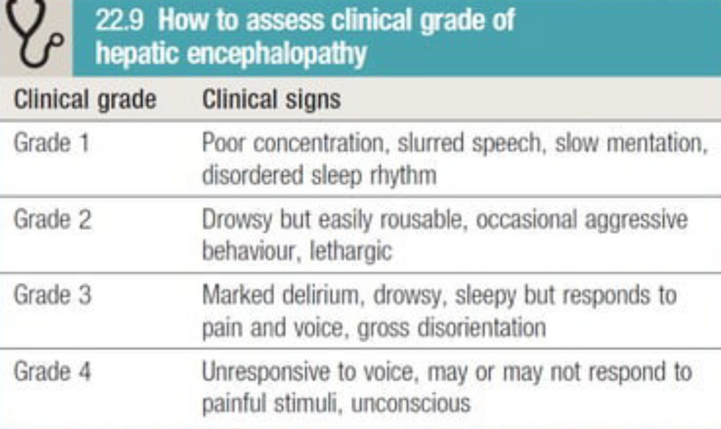
WEST HAVEN CRITERIA

Slide 6
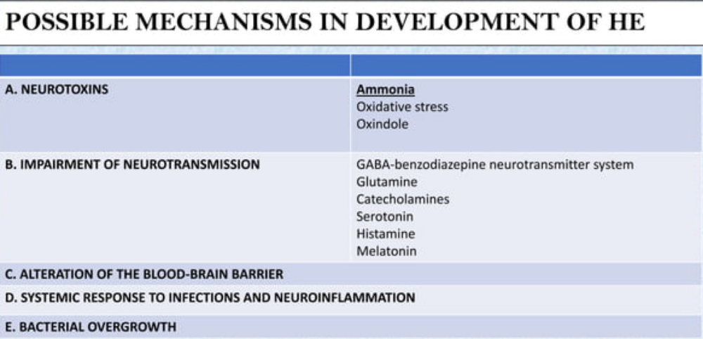

Slide 7
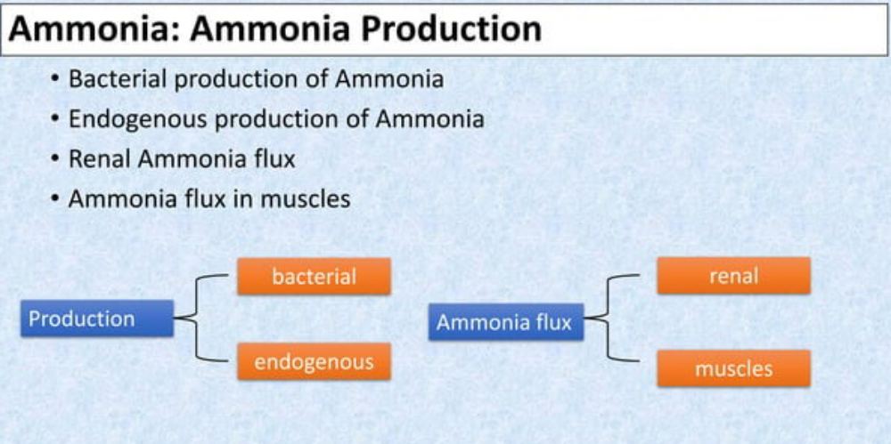

Slide 8
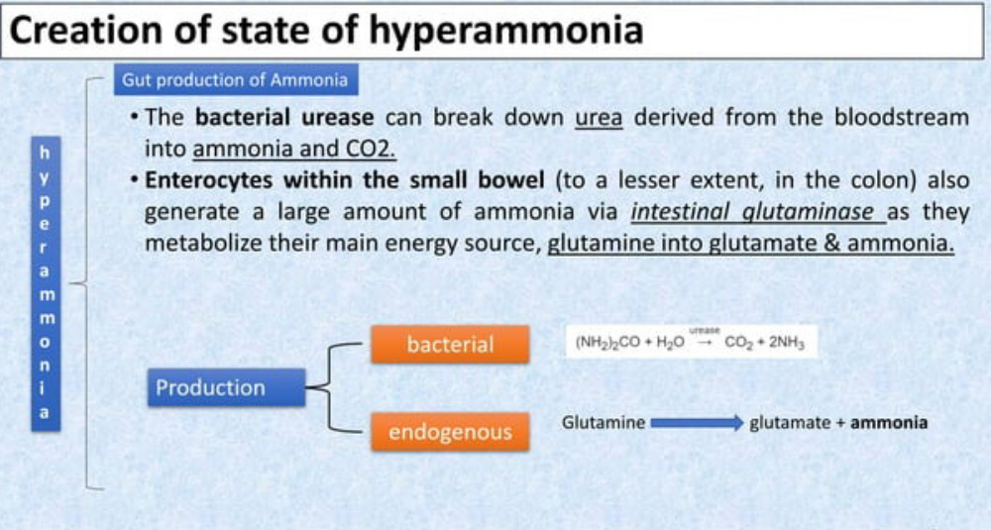

Slide 9
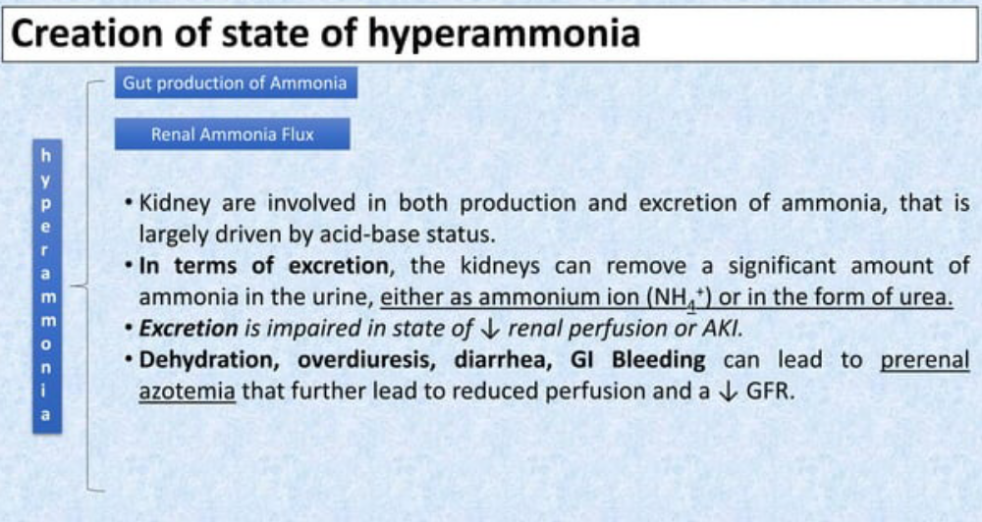

Slide 10
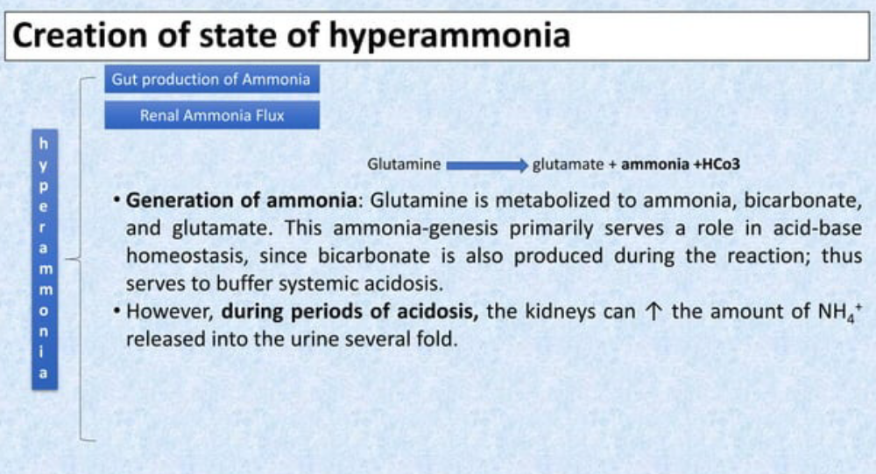

Slide 11
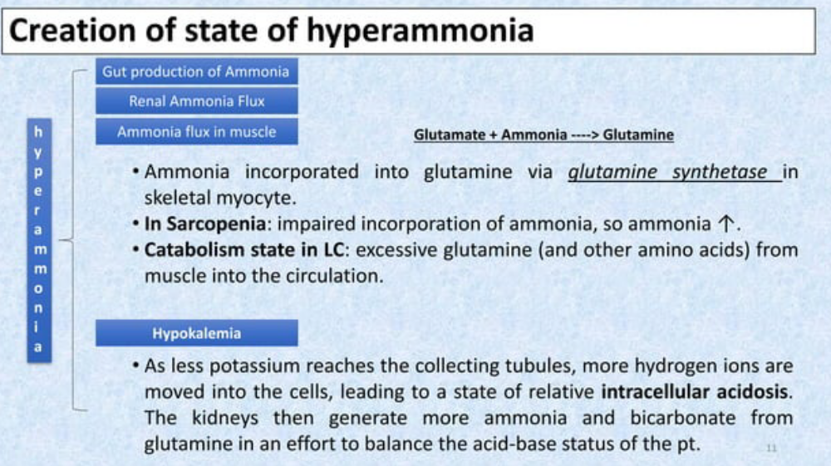

Slide 12
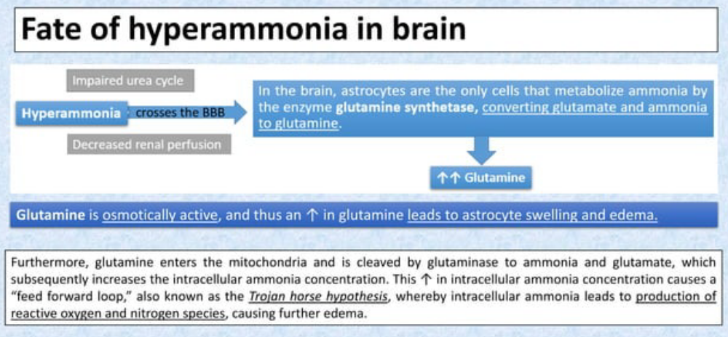

Slide 13
CEREBRAL EDEMA
Causes increased intracranial pressure, causing
- unequal or abnormally reacting pupils, fixed pupils
- hypertension , bradycardia
- hyperventilation, profuse sweating
- local or general myoclonus, focal fits or decerebrate posturing.
Papilledema occurs rarely and is late sign

Slide 14
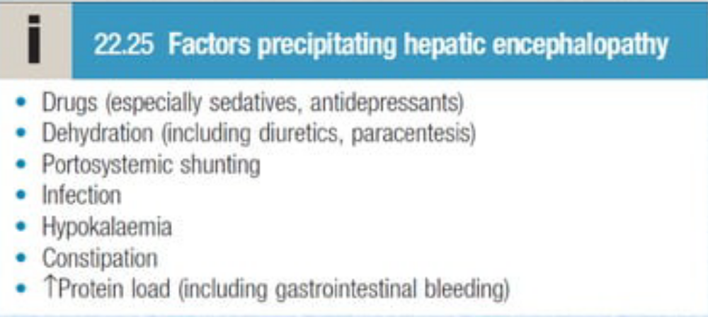
RISK FACTORS
Controlling precipitating factors in the Mx of overt HE is of paramount importance , as nearly 90% of patients can be ttreated with just correlation of the precipitating factor.

Slide 15
DIAGNOSIS OF MININMAL HEPATIC ENCEPHALOPATHY
It is currently based on neuropsychiatric tests, including the
number connection test
digit symbol test
block design test

Slide 16
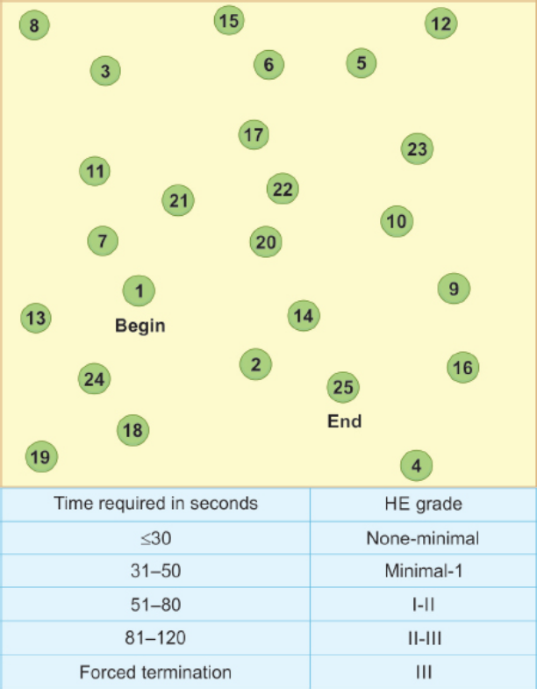
Reitan’s number-connection test
- 25 numbered circles which can normally be joined together within 30 secs.

Slide 17
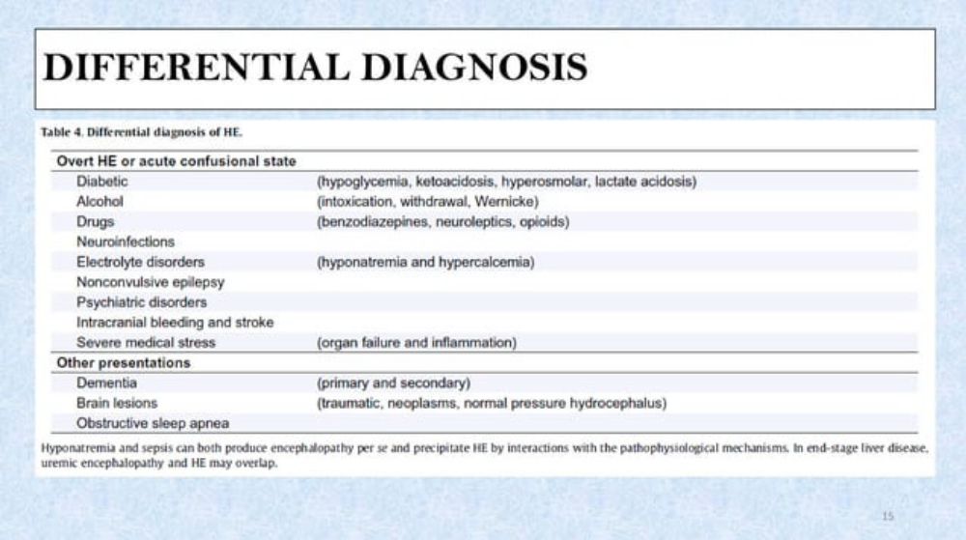
DIFFERENTIAL DIAGNOSIS

Slide 18
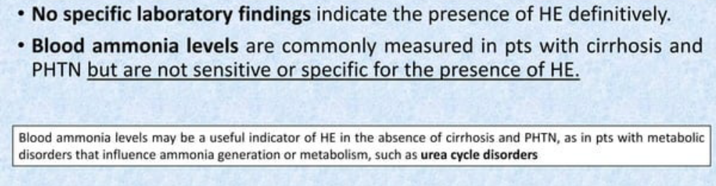
DIAGNOSIS

Slide 19
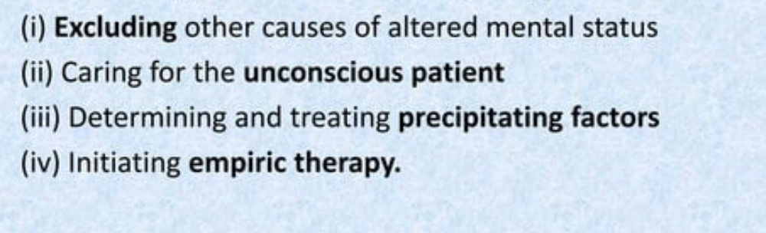
MANAGEMENT OF HEPATIC ENCEPHELOPATHY

Slide 20
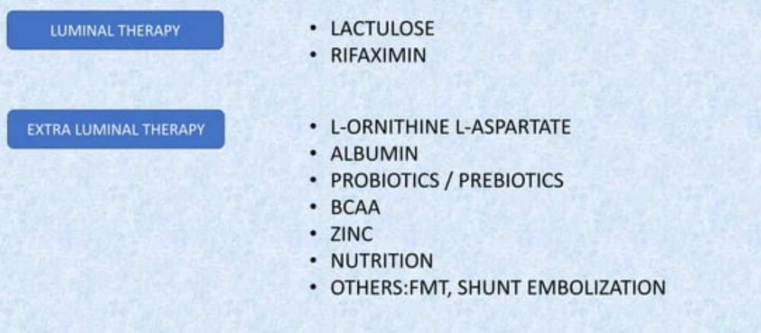
THERAPIES

Slide 21
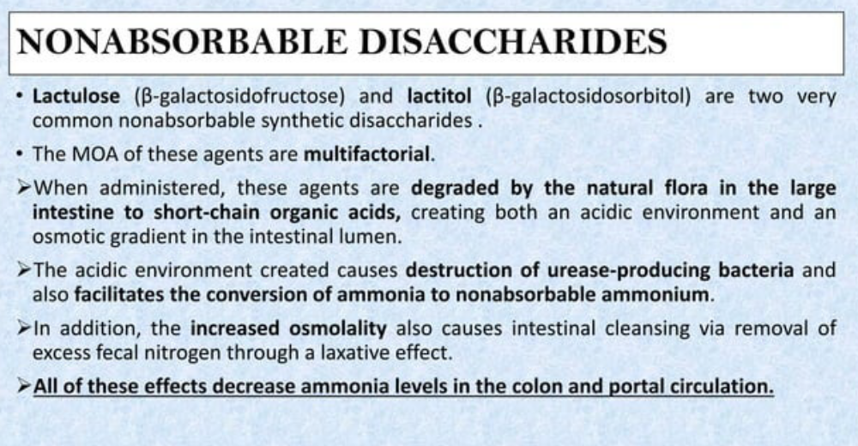

Slide 22
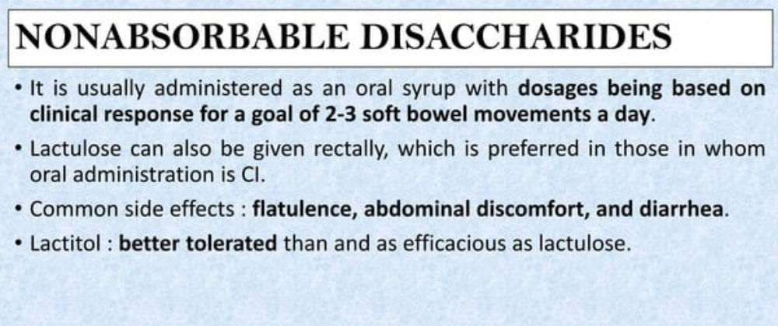

Slide 23
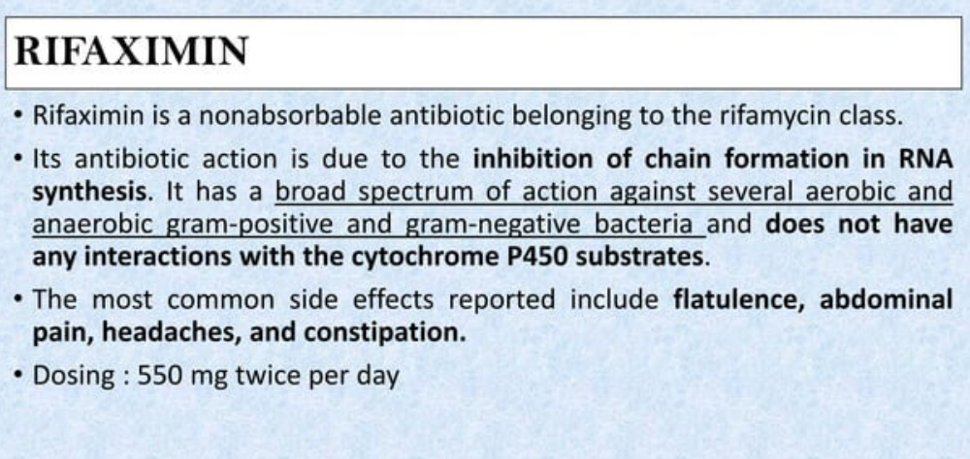

Slide 24
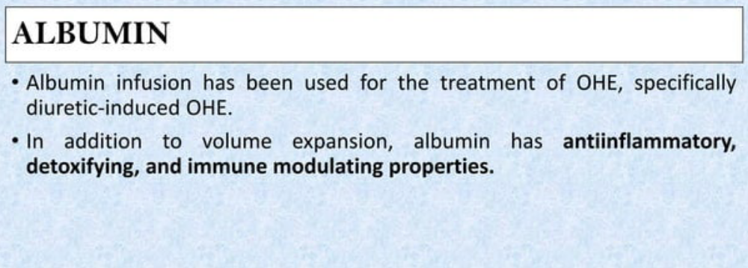

Slide 25
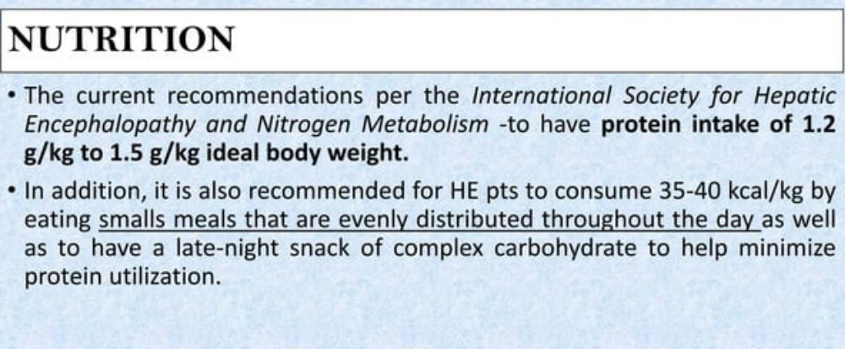

Slide 26
- LIVER TRANSPLATATION
Although it is not commonly the primary indication for LT, HE is generally relieved by a successful graft.

Slide 27
THANK YOU

