Slide 1
GLOSSOPHARYNGEAL AND VAGUS NERVE
Dr Monet Philipose
JR, General Medicine

Slide 2
GLOSSOPHARYNGEAL NERVE

Slide 3
Principal distribution- tongue and pharynx
GSA, SSA - posterior third of tongue
Pharynx, tonsil, TM,ext ear skin
GVA - Carotid body and sinus
Skeletomotor - stylopharyngeus muscle

Slide 4
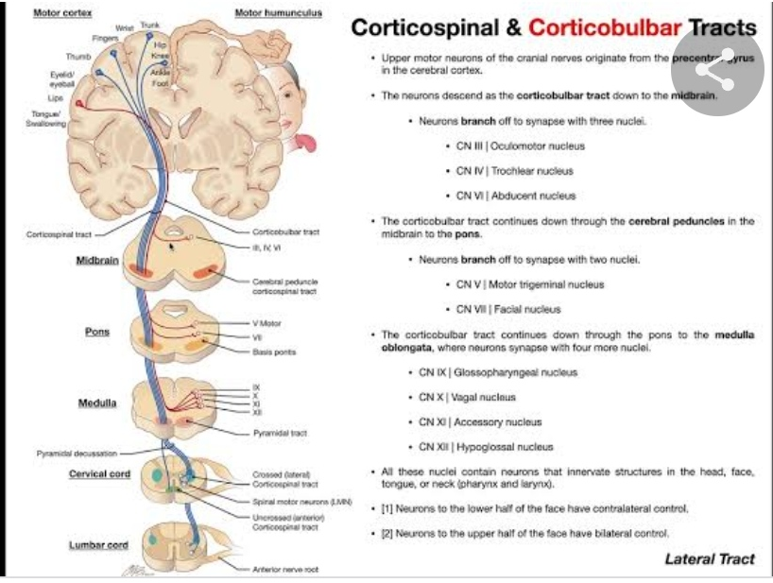
UMN influence on IX

Slide 5
Nucleus ambiguus - IX, X
Innervates muscles of 3rd,4th and 5th branchial arches
IX exits skull through jugular foramen.

Slide 6
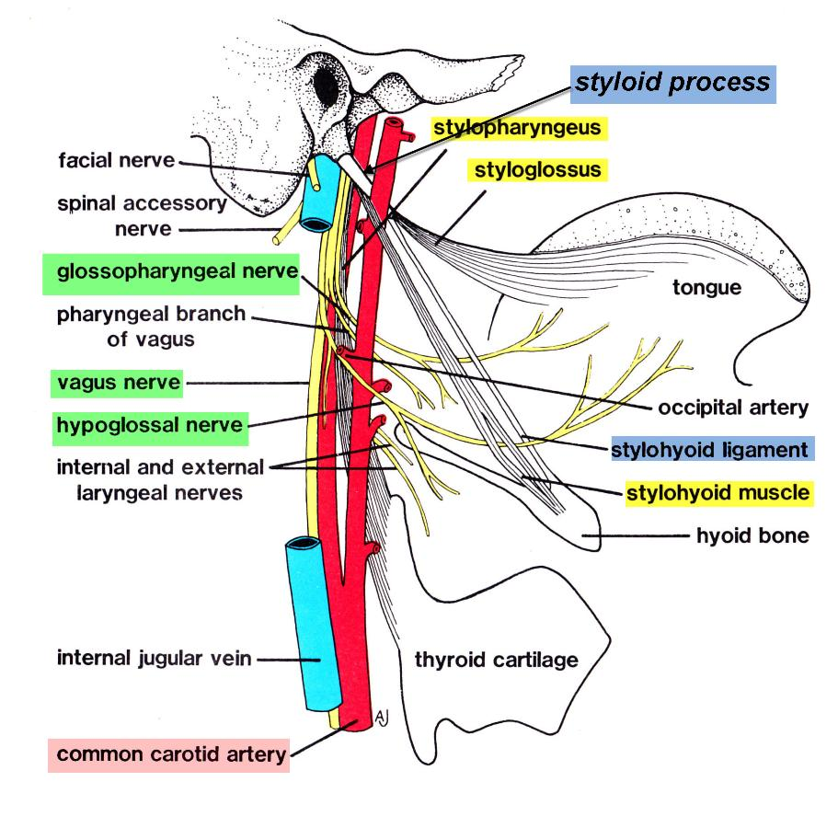

Slide 7
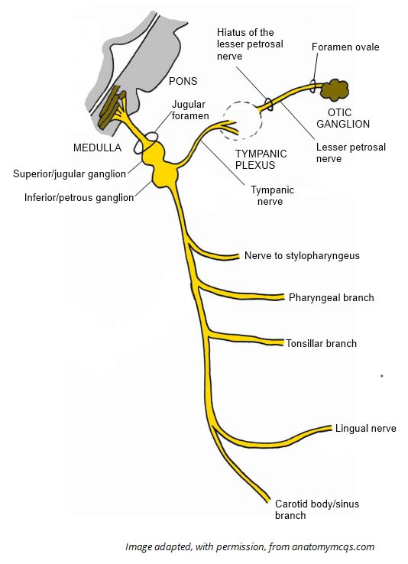
2 ganglia and the 6 terminal branches

Slide 8
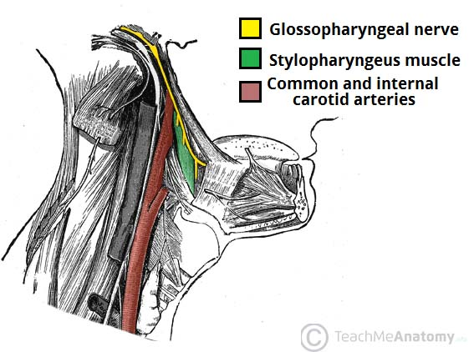
Branchiomotor supply
Most pharyngeal muscles are supplied by IX, X together
Stylopharengeus - IX alone.

Slide 9
Parasympathetic innervation
Parotid gland and mucous membranes of posterior inferior mouth and pharynx
Parasympathetic nuclei - superior and inferior salivatory nucleus, dorsal motor nucleus of Vagus (DMNX) - lower brainstem

Slide 10
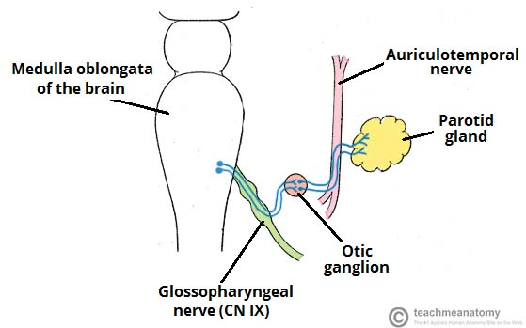

Slide 11
Sensory neurons
Located in the superior and inferior glossopharyngeal ganglia
GSA - Exteroceptive - mucous membrane of tympanic cavity, mastoid air cells, auditory canal via tympanic branch
GVA - from carotid body and sinus - reflex control of HR, BP, Respiration
Central processes terminate in the trigeminal nuclei
SVA - lingual br - pharynx,soft palate, tongue -terminates in NTS (gustatory nucleus). Central - taste fibres of VII

Slide 12
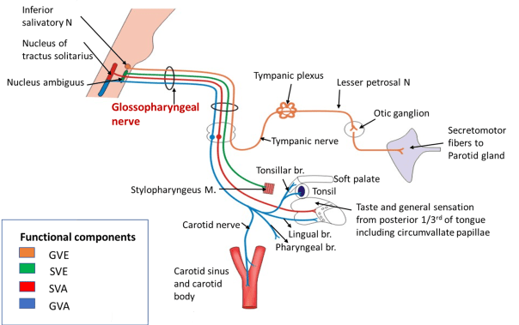
Summary of anatomy

Slide 13
CLINICAL EXAMINATION
Difficult to examine - functions are shared by other nerves
Motor weakness - only detectable deficit - slight lowering of the palatal arch at rest on the involved side
Gag reflex

Slide 14
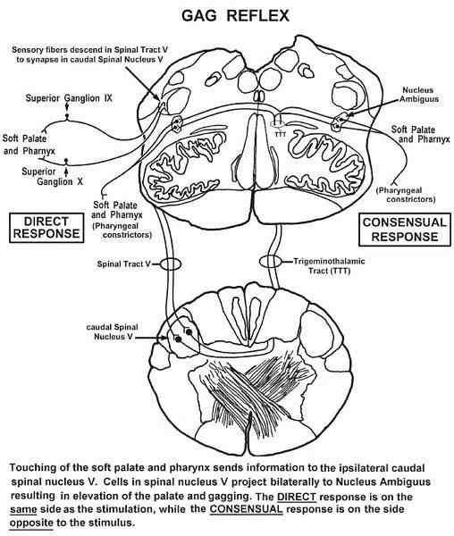

Slide 15
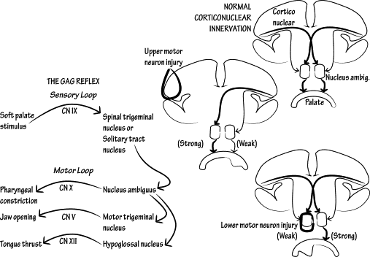

Slide 16
Gag reflex
Protective reflex
Palatal reflex - touching one side of soft palate or uvula
Pharyngeal reflex - touching the lateral oropharynx in the region of anterior faucial pillar
Afferent - IX, Efferent - IX,X

Slide 17
3 motor components of gag reflex
1. Elevation of soft palate to seal off nasopharynx
2.closure of glottis to protect the airway
3.constriction if pharynx to prevent the entry of substance

Slide 18
Unilateral weakness - raphe deviate to normal side
Signifies LMN lesion
Unilateral cerebral lesion - no detectable weakness
Predictor of swallowing difficulty
Gag reflex - not imp in swallowing

Slide 19
Hyperactive gag reflex - in bilateral cerebral lesions
Pseudobulbar palsy, ALS

Slide 21
VAGUS NERVE

Slide 22
ANATOMY

Slide 23
Longest, most widely distributed CN
4 brainstem nuclei :
Nucleus ambiguuus, DMNX, Nucleus of spinal tract of V, Nucleus tractus solitarius
carries skeletomotor axons from NA to pharynx and larynx.

Slide 24
Parasympathetic axons - DMNX to smooth muscles and glands of larynx, pharynx, and to and viscera
Exits skull - jugular foramen

Slide 25
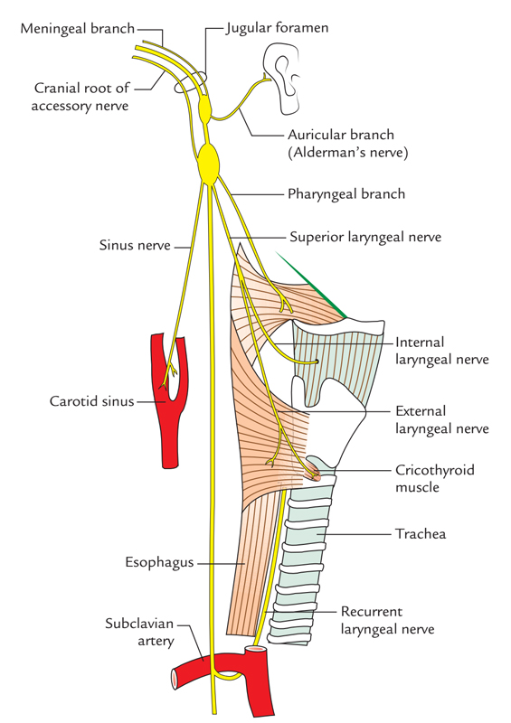

Slide 26
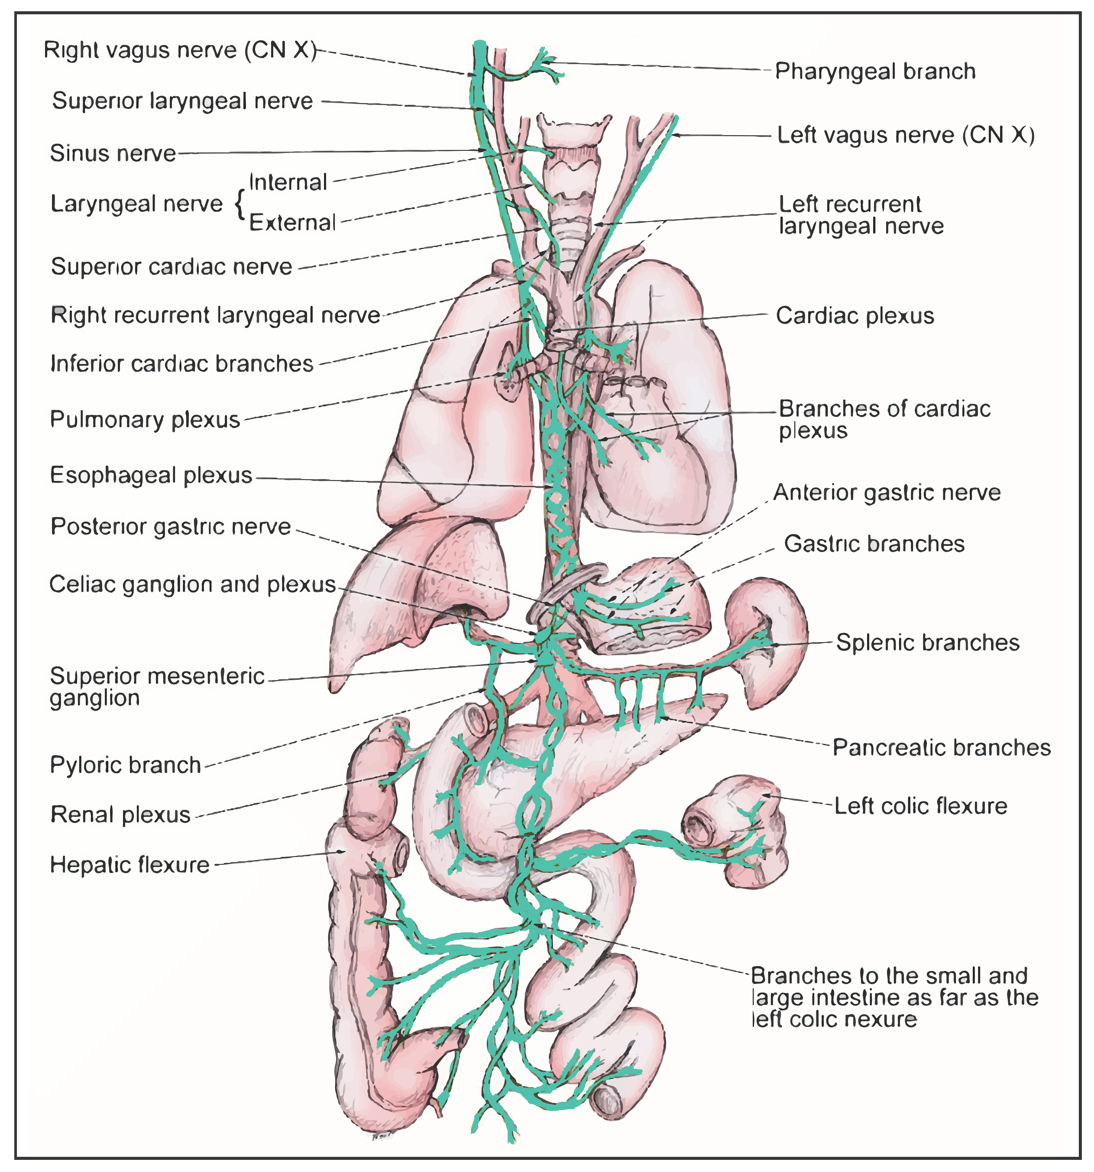

Slide 27
The motor portion of X
Cortex - lower part of precentral gyrus
Corticobulbar tracts - synapse in NA.
3 major branchiomotor br:
pharyngeal br, superior laryngeal, recurrent laryngealnerve
Superior laryngeal - ext, internal - sensory f
Ext br - cricothyroid

Slide 28
Parasympathetic fibres - from DMNX, medial aspect of nucleus ambiguus
Nucleus ambiguus - heart
DMNX - other vagally innervated viscera

Slide 29
Vagal discharge results in:
Bradycardia, hypotension,
bronchoconstriction, bronchorrhea,
increased peristalsis,
increased gastric secretion,
inhibition of adrenal function.

Slide 30
The sensory portion of X
Both vagal ganglia - sensory
Superior vagal ganglion - upper part of jugular foramen - somatic sensations - auricular nerve
Inferior vagal ganglion - just beneath jugular foramen - general visceral sensation, taste

Slide 31
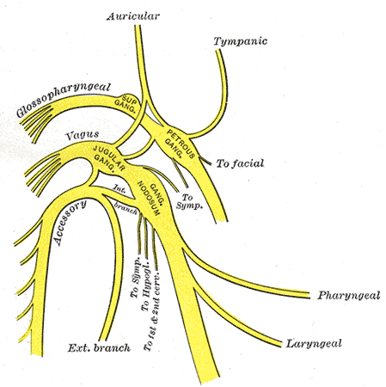

Slide 32
GVA from larynx,pharynx, viscera, baroreceptors and chemoreceptors in aorta -inferior vagal ganglion - centrally terminate in caudal part of NTS.
Collaterals to DMNX, RF, other CN nuclei - important visceral reflexes, CV, Resp, GI function.

Slide 33
Normal functions of IX, X
Swallowing, phonation, airway protection and modulation

Slide 34
Clinical examination of X
Gag reflex
Character of the voice, ability to swallow
Acute unilateral lesions - nasal qualityof speech, dysphagia liquids>solids
Nasal regurgitation risk due to velopharyngeal insufficiency

Slide 35
U/l lesion - weakness of levator veli palatini and musculus uvulae - drooping of palate, flattening of palatal arch
Loss of palatal gag reflex in that side
Median raphe deviates to normal side on phonation

Slide 37
B/l vagus involvement - palate cannot elevate on phonation, may or may not droop
Palatal gag reflex - absent b/l
Nasal speech, nasal regurgitation++
Speech - similar to cleft palate

Slide 38
Pharyngeal weakness
Spontaneouscough, cough reflex impaired
Dysphagia
Examination: contraction of pharyngeal muscles onphonation, elevation of larynx during swallowing, pharyngeal gag reflex

Slide 39
Vernet's Rideau phenomenon
U/l weakness of superior pharyngeal constrictor - curtain movement - motion of the pharyngeal wall to non paralysed side on testing gag reflex, or at phonation

Slide 40
U/l weakness of vocal cord - alters characterand quality of voice
- lesion of one recurrent laryngeal nerve
Lesions of other individual vagal branches are rare

Slide 41
Infranuclear inv - lesions at base of brain, cpa, jugular foramen, course of vagus nerves
Extramedullary, intracranial inv - in processes inv meninges, extramedullary tumors, aneurysms, trauma, sarcoidosis, skull fractures.

