Slide 1

FACIAL NERVE

Slide 2
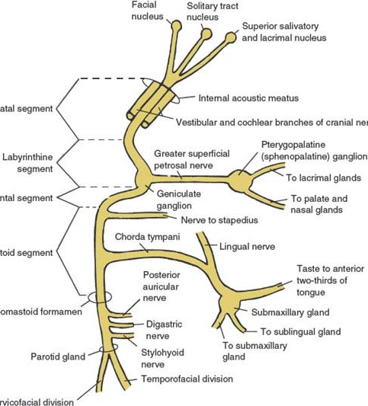
▸
overview
FACIAL NERVE
7th cranial nerve
Mixed : 2 roots
Motor root – muscles of facial expression
Nervus intermedius – sensory and parasympathetic supply

Slide 3
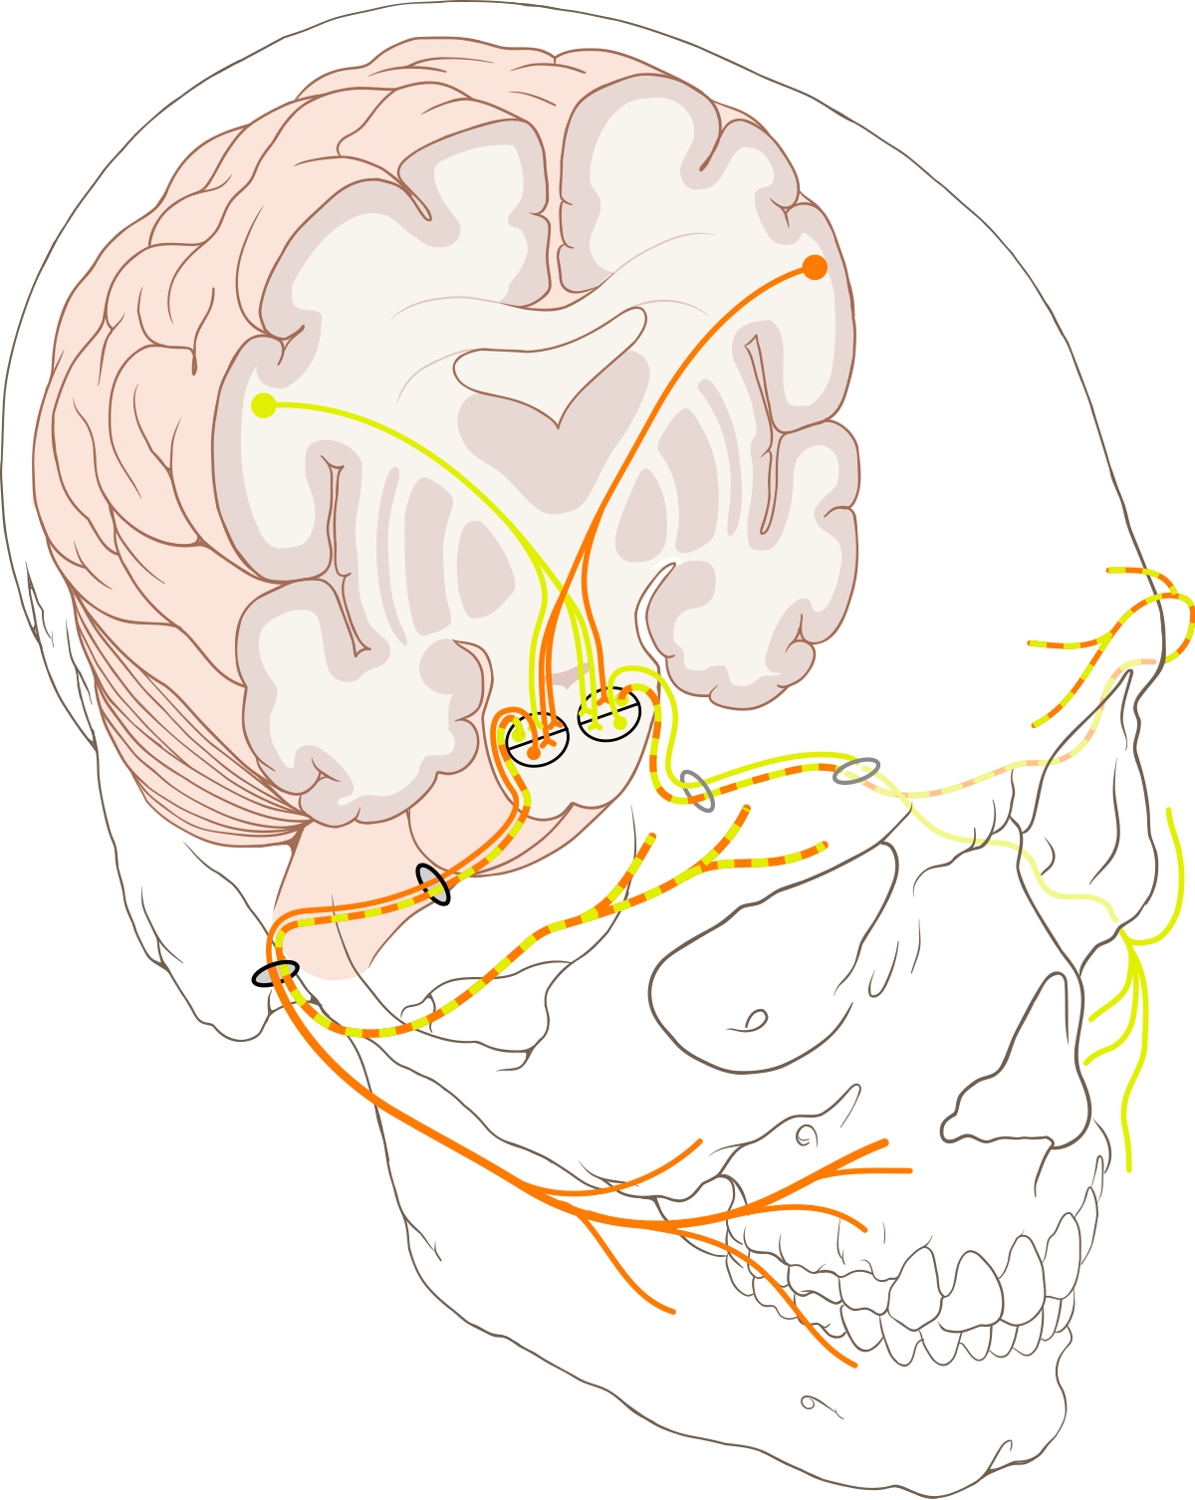
Segments
§ Brain stem / intramedullary segment
§
Brainstem nuclei to the exit point
§ Cisternal segment
§
Exit point to the entrance into the IAC
§
Meatal / canal segment
§
Course through the IAC

Slide 4
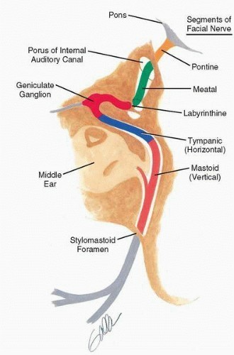
Labyrinthine segment
§
Til the geniculate ganglion
Short horizontal segment
§
To the pyramidal eminence of the posterior wall of the middle ear
Mastoid segment
§
Til the stylomastoid foramen
Extratemporal / peripheral segment
§
Forms the pes anserinus

Slide 5
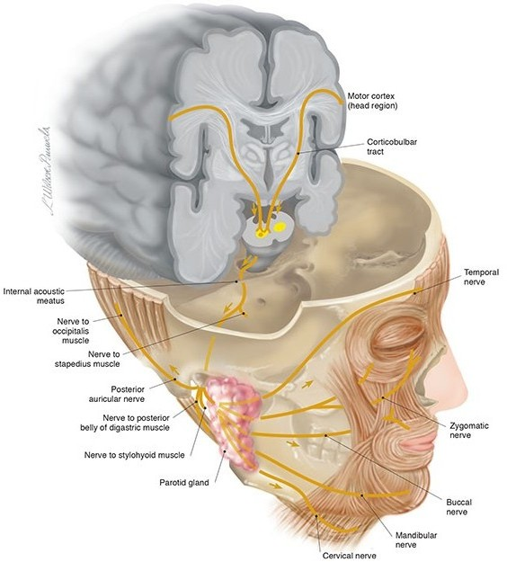

MOTOR PORTION
Lower3rd of contralateral precentral gyrus/ facial area of motor homonculus
Corticobulbar tract through corona radiata
Genu of internal capsule
Medial portion of cerebral peduncles Pons – decussate

Slide 6
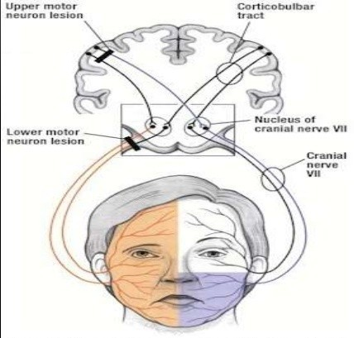
This scheme applies to voluntary facial movements only
Unconscious, emotional, involuntary supranuclear control follows different pathway and may have different degrees of involvement.

Slide 7
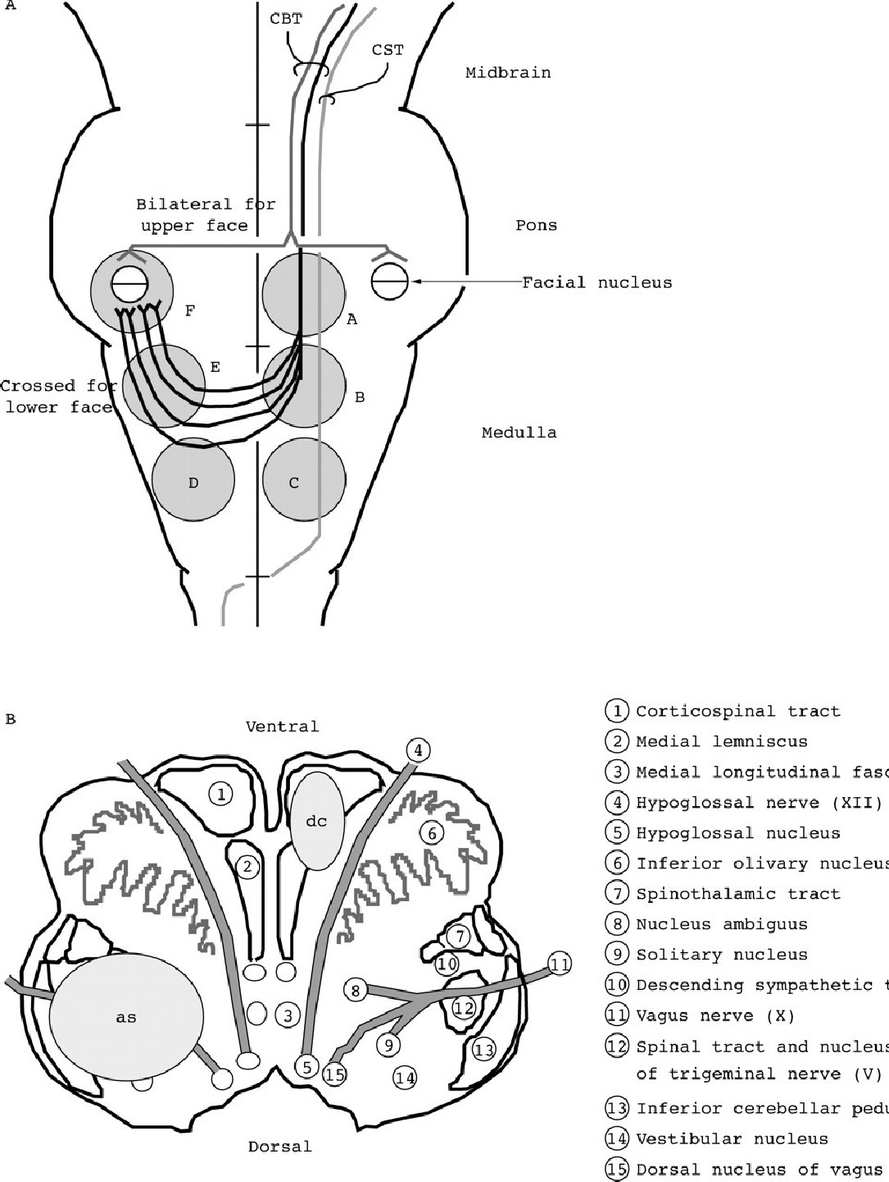





Aberrant pyramidal tract
Some fibres descent in the aberrant pyramidal tract to medullary levels
Ascent contralaterally in the dorsolateral medulla to reach the facial nucleus.
Decussate there

Slide 8
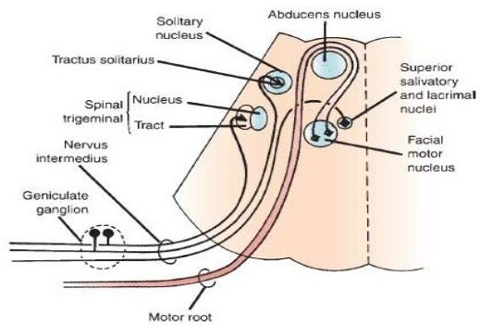
FACIAL NUCLEUS
§ It is special visceral efferent or branchiomotor.
§
§
Lies in the tegmentum of the caudal pons
Related as : anteromedial to nucleus of spinal tract of CN V
Anterolateral to the nucleus of CN VI Posterior to the superior olivary nucleus
§
§
§
It has medial, lateral and dorsal subnuclei, arranged in columns.
MEDIAL – POSTERIOR AURICULAR, PLATYSMA, OCCIPITAL, STAPEDIUS
LATERAL SUBNUCLEUS – LOWER FACIAL MUSCLES, BUCCINATOR DORSAL – UPPER FACIAL MUSCLES

Slide 9
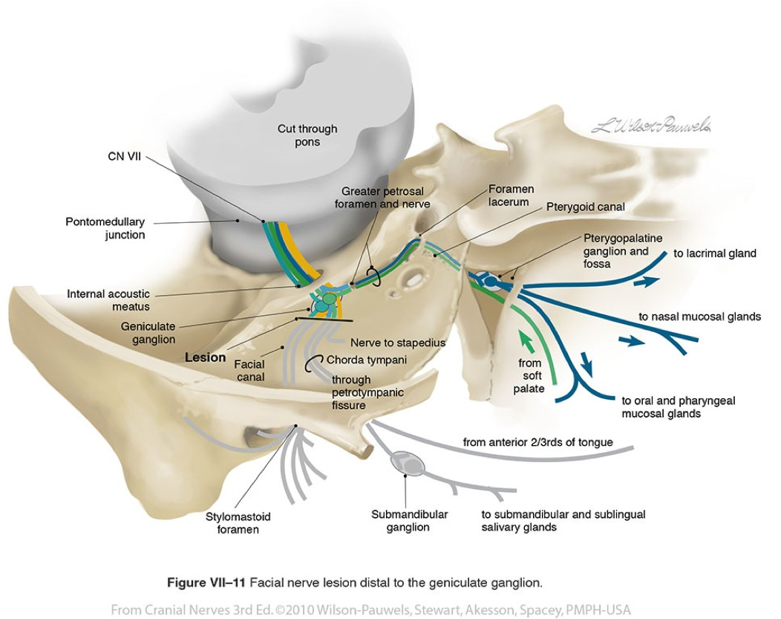

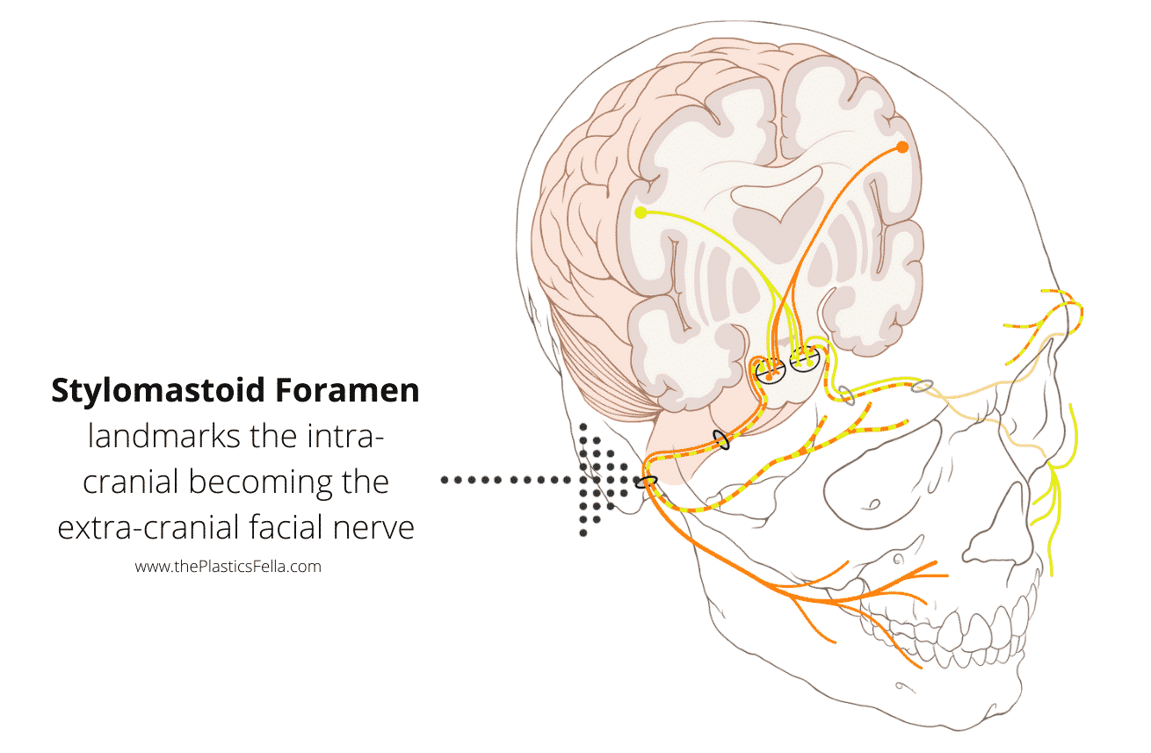
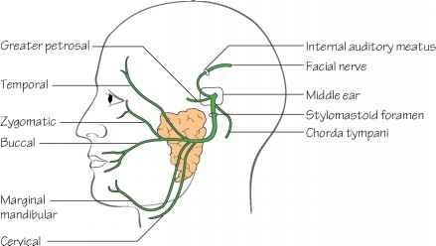
COURSE OF FACIAL NERVE
Anatomically, the course of the facial nerve can be divided into two parts:
Intracranial
The course of the nerve through the cranial cavity, and the cranium itself.
Intratemporal
  Intrameatal
  Labyrinthine
  Tympanic
  Mastoid
Extracranial
The course of the nerve outside the cranium, through the face and neck.

Slide 10
COURSE OF FACIAL NERVE
Anatomically, the course of the facial nerve can be divided into two parts:
Intracranial
The course of the nerve through the cranial cavity, and the cranium itself.
Intratemporal
  Intrameatal
  Labyrinthine
  Tympanic
  Mastoid
Extracranial
The course of the nerve outside the cranium, through the face and neck.

Slide 11
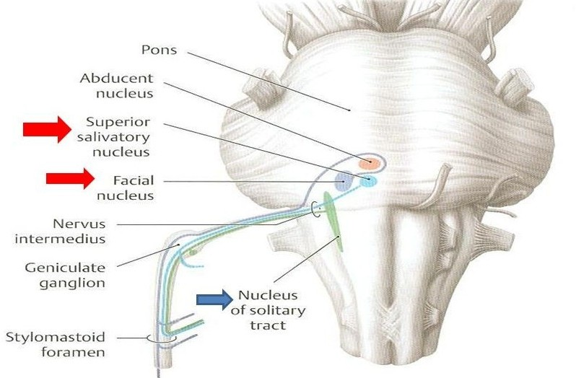
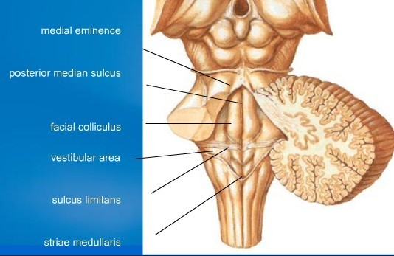
INTRAMEDULLARY SEGMENT
Arises from the dorsal surface of the nucleus, encircles around the abducens nucleus
Forms an INTERNAL GENU.
Forms facial colliculus
Relations with : Fibres and nucleus of CN VI, pontine paramedian reticular formation, CN V, CN VIII, long tracts through pons.
Two components – motor root (70% fibres) and sensory (30%)
Sensory root forms the NERVUS INTERMEDIUS (NI) OF WRISBERG : both sensory and autonomic fibres,
Intramedullary segment contains all three types of axons

Slide 12
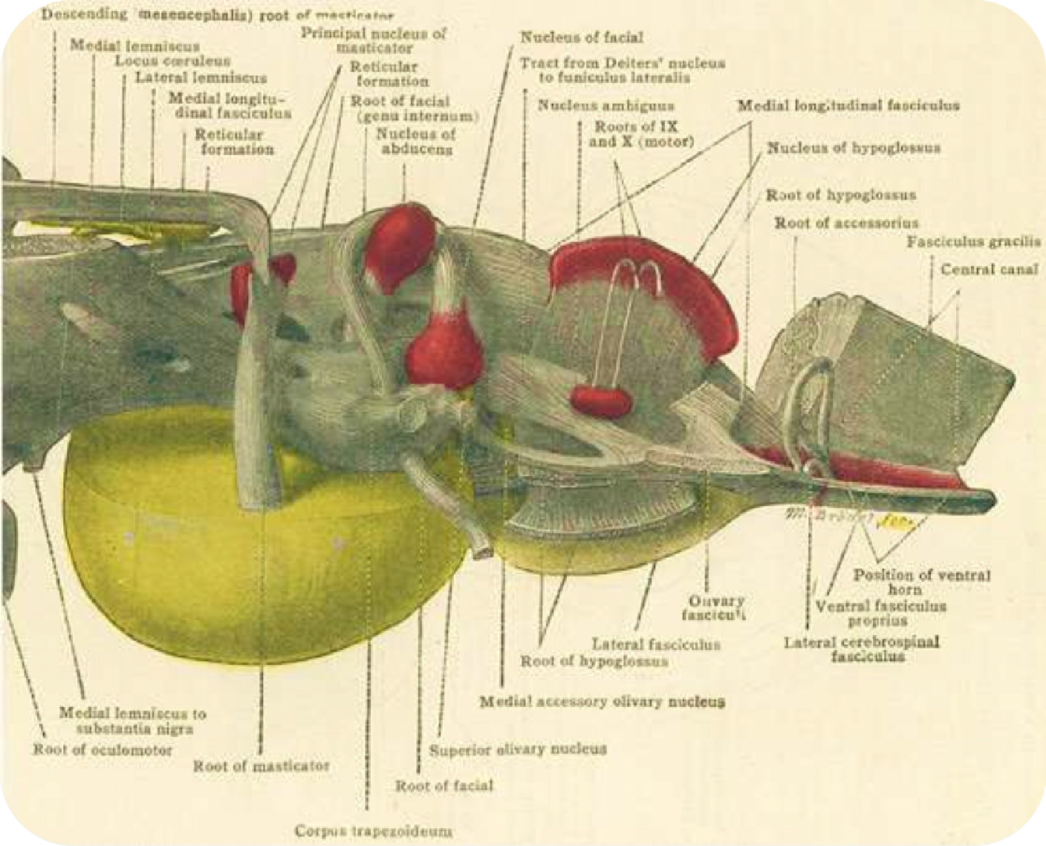

Slide 13


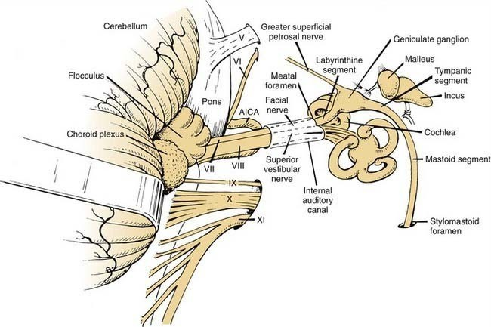
CISTERNAL SEGMENT
Nerve exits the pons laterally at the pontomedullary junction, just caudal to the roots of CN V between the olive and the inferior cerebellar peduncle
The NI is a small bundle that usually leaves the pons closer to CN VIII than CN VII and runs between the larger trunks across the cerebellopontine angle (CPA).
At the entrance to the IAC, the facial nerve motor root lies in a groove on the anterosuperior surface of the vestibulocochlear nerve, with the NI in between.
The facial nerve at this point lies in close proximity to the anterior inferior cerebellar artery (AICA).
the subarachnoid space extends along the facial nerve to the geniculate ganglion.

Slide 14
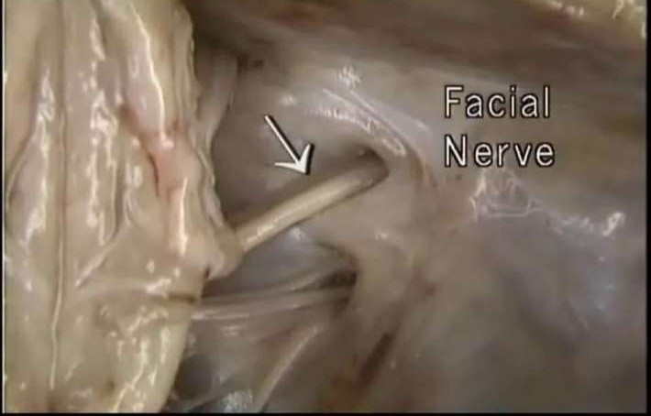

Slide 15
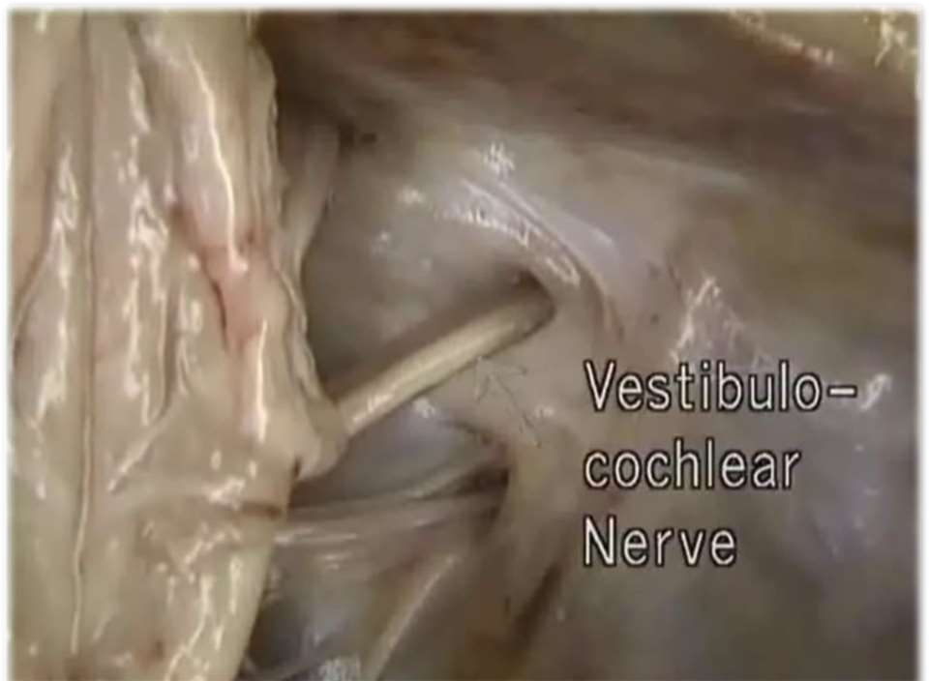

Slide 16


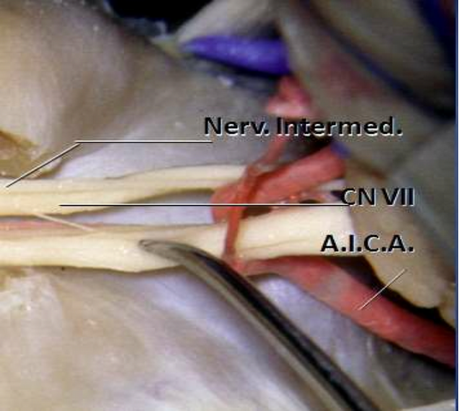

Slide 17
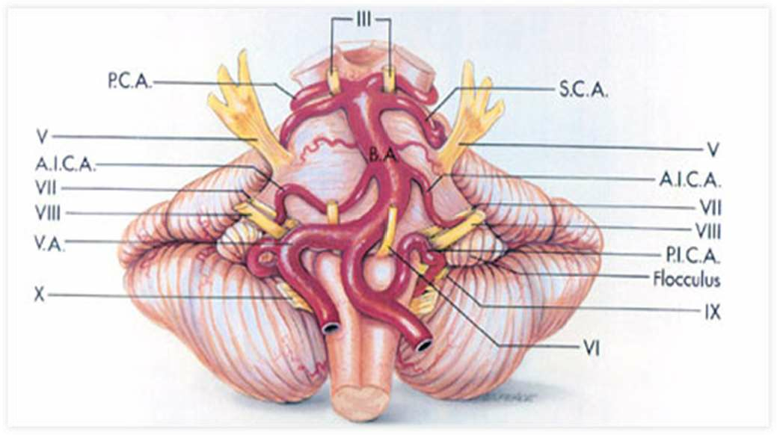

Slide 18
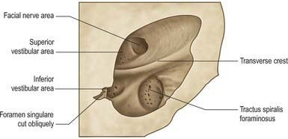
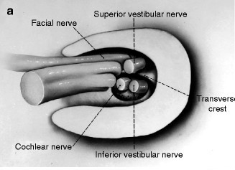
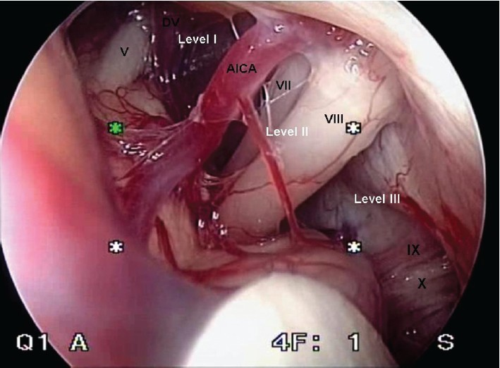
z

Slide 19
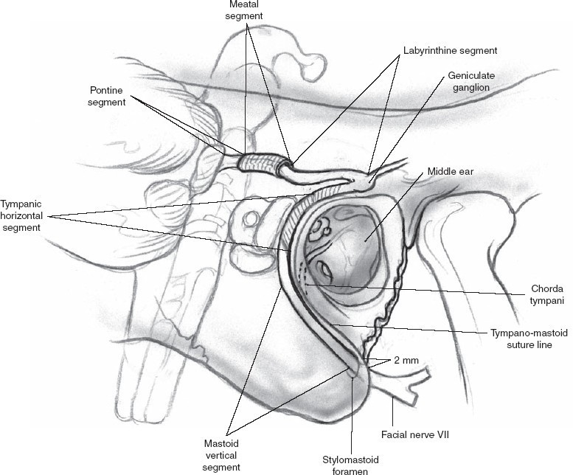


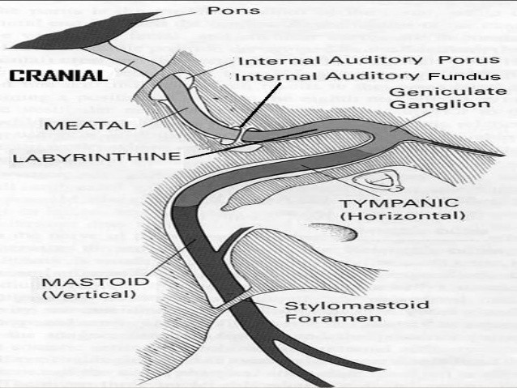
MEATAL SEGMENT
At the bottom or lateral end of the IAC, the nerve pierces the meninges and enters the facial canal, or fallopian aqueduct.
The point of entry is the narrowest portion of the canal.
The facial nerve and the NI merge as the nerve enters the canal.
In traversing the facial canal, the nerve makes two abrupt, tortuous turns, creating two external genus.
In its course through the petrous bone, from its entrance into the facial canal until its exit from the stylomastoid foramen, the nerve has three segments: labyrinthine, horizontal or tympanic, and mastoid or vertical.

Slide 20
Applied Anatomy
Within the meatus, the facial nerve has no separate sheath, but shares dural investment with the nervus intermedius and the vestibulocochlear nerve and is bathed in cerebrospinal fluid (CSF), again making it vulnerable to surgical manipulation.

Slide 21

LABYRINTHINE SEGMENT
The labyrinthine segment lies laterally between the cochlea and vestibule, toward the medial wall of the tympanic cavity, running perpendicularly to the long axis of the petrous pyramid.
The labyrinthine segment ends at the first external genu where the geniculate ganglion lies.

Slide 22
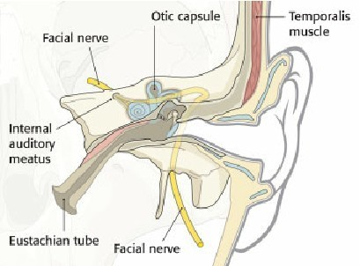
z

Slide 23
HORIZONTAL / TYMPANIC SEGMENT
The nerve turns abruptly and runs horizontally for about 1 cm, then turns backward and arches downward behind the tympanic cavity (mastoid or vertical) segment.
The branch to the stapedius muscle arises from the distal tympanic or upper end of the mastoid segment.
At the end of the tympanic segment, the nerve encounters the second external genu as it makes a 90-degree turn to enter the mastoid segment.

Slide 24
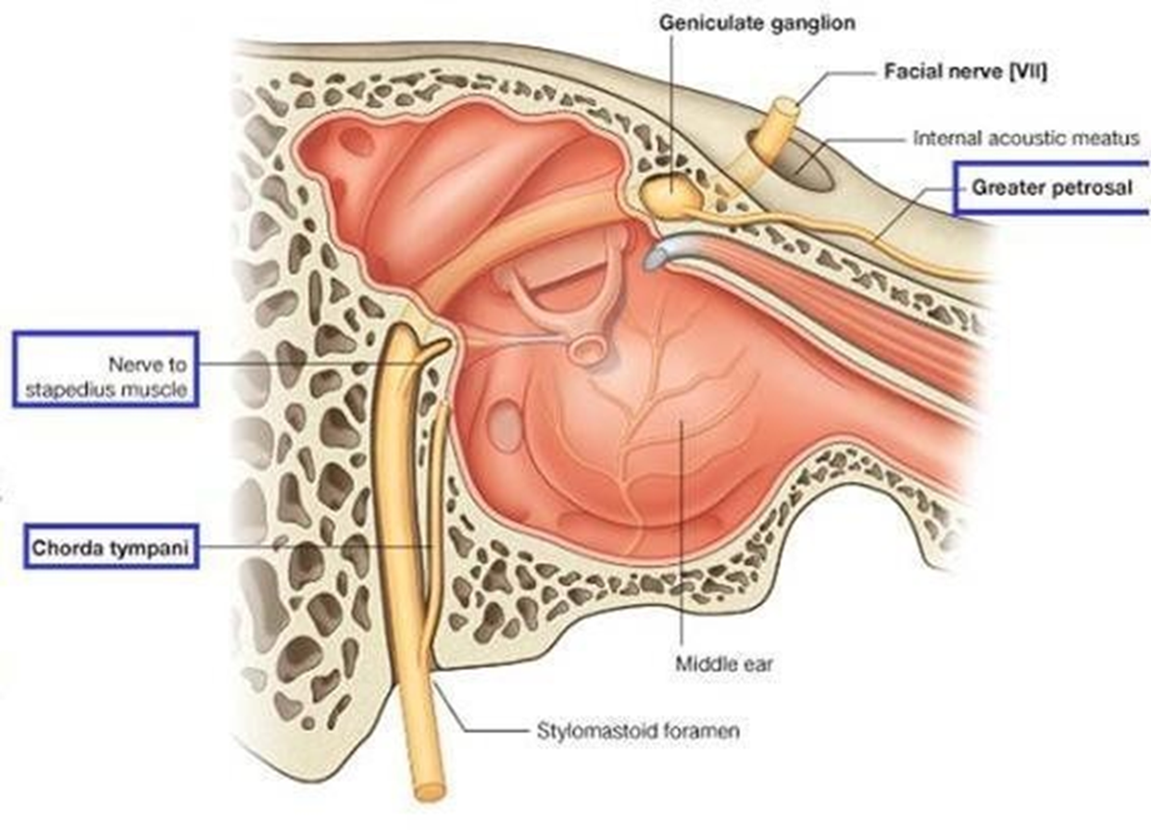

Slide 25



MASTOID SEGMENT
The mastoid segment then descends toward the stylomastoid foramen, gives off the chorda tympani about 6 mm before its exit, and emerges from the stylomastoid foramen.
The tight confines of the bony canal may make the nerve particularly vulnerable to damage from inflammation and edema, a point of possible significance in some CN VII neuropathies

Slide 26

EXTRATEMPORAL SEGMENT
Just after exit, the posterior auricular, digastric, and stylohyoid branches arise.
The posterior auricular branch supplies the occipitalis, posterior auricular, and transverse and oblique auricular muscles.
The digastric and stylohyoid branches supply respectively the posterior belly of the digastric and the stylohyoid.
The nerve turns forward and passes into the parotid gland.

Slide 27
Within the substance of the parotid, it divides into temporofacial and cervicofacial divisions at the pes anserinus (intraparotid plexus) in the cleft between the superficial and deep lobes of the gland
The temporofacial branch crosses the zygoma about 1 cm anterior to the ear, where it is vulnerable to injury.

Slide 28


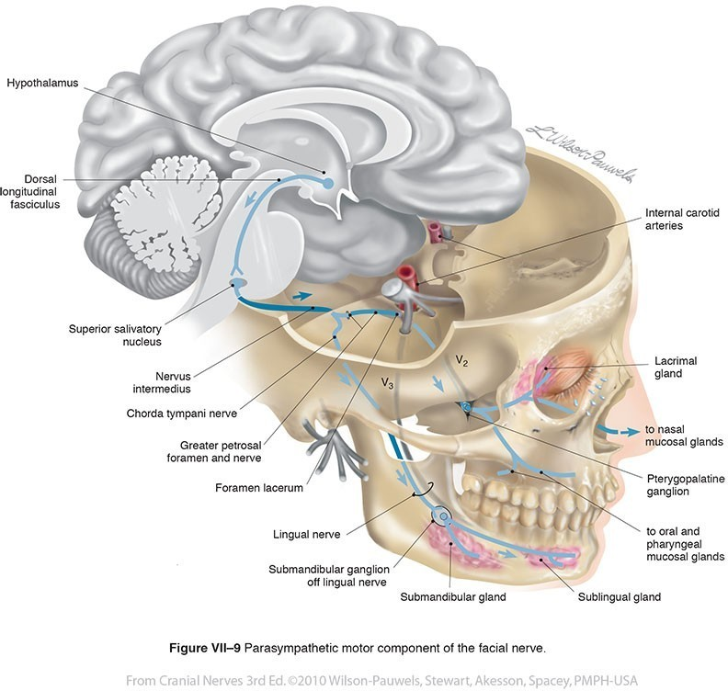
NERVUS INTERMEDIUS
The NI is the sensory and autonomic component of the facial nerve.
The sensory cells located in the geniculate ganglion are general somatic afferent (GSA) and special visceral afferent (SVA)
The GSA fibers carry exteroceptive impulses from the region of the external auditory canal and tympanic membrane.
The SVA fibers convey taste from the anterior two-thirds of the tongue.
The autonomic component of the NI consists of preganglionic general visceral efferent parasympathetic fibers from the superior salivatory and lacrimal nuclei, which consist of scattered cells in the reticular formation near the caudal end of the motor nucleus.
Their axons are bound for the submandibular gland enroute to the sublingual and submaxillary glands, the lacrimal glands, and glands in the nasal mucosa.

Slide 29

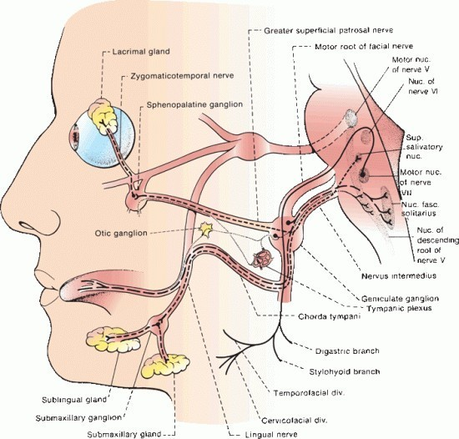
COURSE AND BRANCHES
GREATER (SUPERFICIAL)
PETROSAL NERVE
Carries preganglionic parasympathetic fibres, conveyed by NI to the geniculate ganglion.
They pass through the ganglion, without synapsing, into the GPN
Then goes forward through the hiatus of the facial canal to join the DEEP PETROSAL NERVE to form the NERVE OF THE PTERYGOID CANAL/VIDIAN’S NERVE
It then runs to the sphenopalatine ganglion, from where postganglionic fibers proceed to the lacrimal gland.

Slide 30
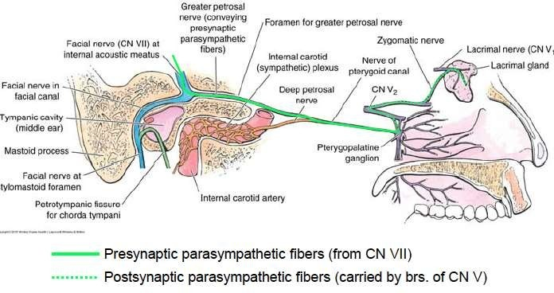

Slide 31
NERVE TO STAPEDIUS
Arises from the distal tympanic / upper mastoid segment
Passes forward through a small canal to reach the muscle.

Slide 32
CHORDA TYMPANI
Leaves the main trunk, slightly above the
stylomastoid foramen.
Carries taste and general visceral afferent fibres
as well as preganglionic parasympathetics.
Sometimes, visible as a small cord behind the eardrum, on otoscopy.
It runs to exit the skull and join the lingual nerve, branch of CN V3, on its posterior border.

Slide 33
The chorda tympani also carries preganglionic parasympathetic fibres to the submandibular gland.
Postganglionic fibres convey secretory and vasodilator impulses the the submandibular and sublingual glands and mucuous membranes of the mouth and tongue.
They also receive sympathetics from the superior cervical ganglion and the carotid plexus.

Slide 35
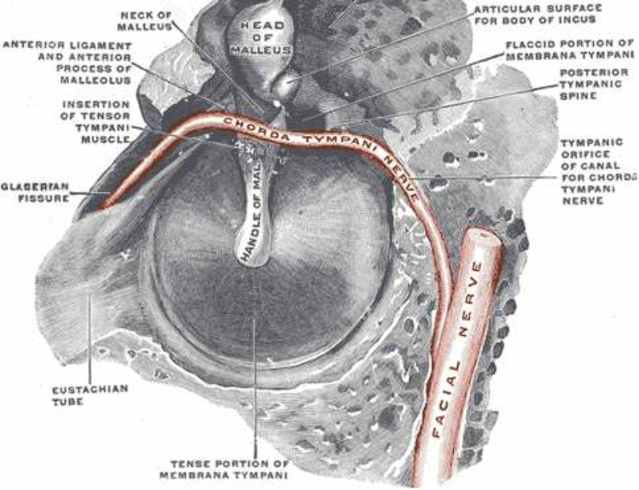

Slide 36
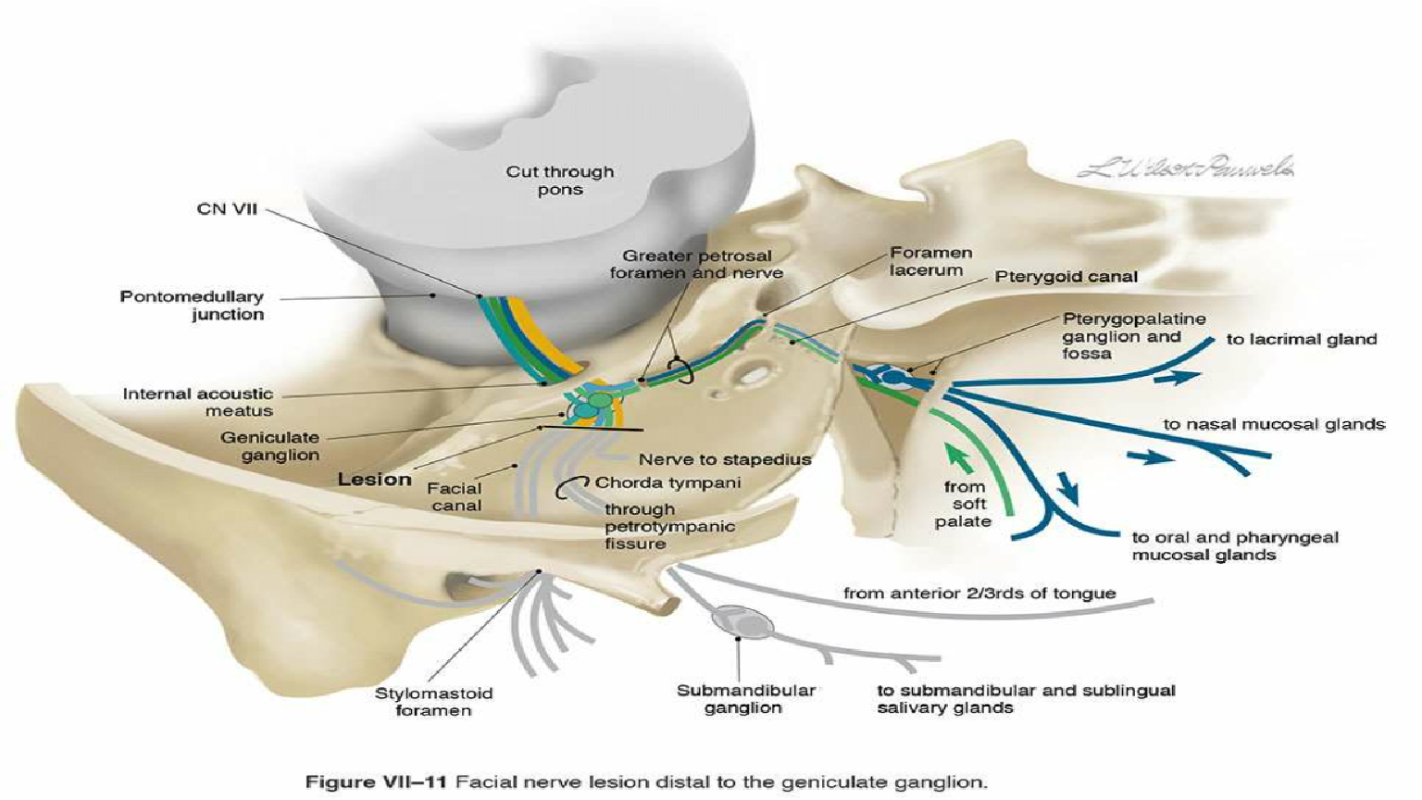

Slide 37


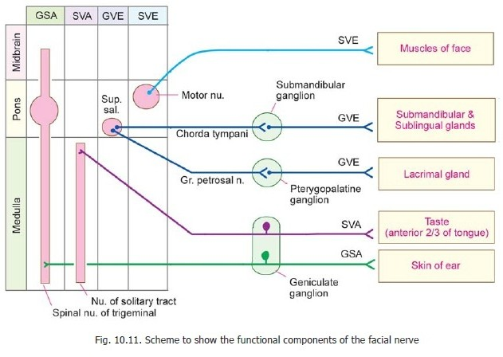


▸
Functional components AND NUCLEI of facial nerve
SVE
GVE
EFFERENT
SVA
GSA
AFFERENT

Slide 38
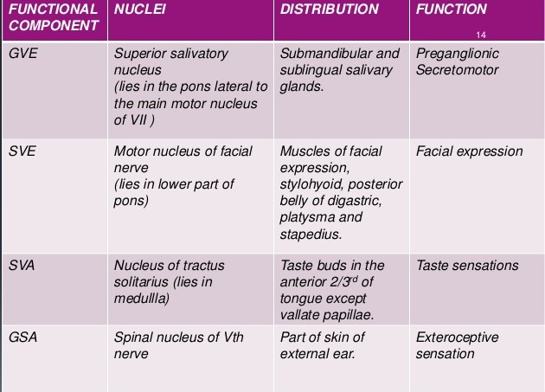

Slide 39
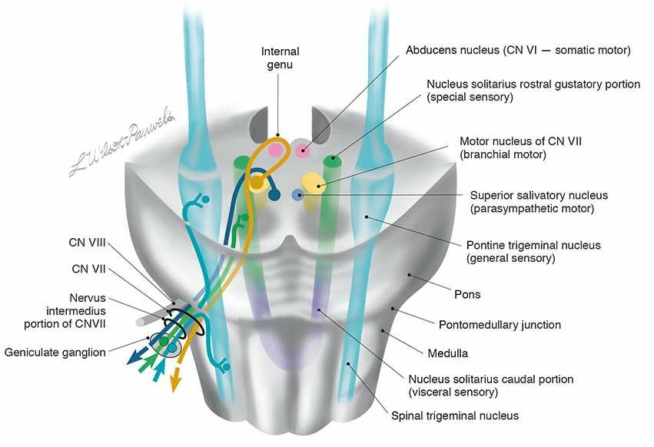





Slide 40
Branches of Distribution
Facial canal
Greater Petrosal nerve
Nerve to stapedius
Chorda tympani
Stylomastoid foramen
Posterior auricular
Nerve to stylohyoid
Nerve to digastric (posterior belly)
In face
A.Temporal
B.Zygomatic C.Buccal
D.Marginal mandibular
E.Cervical

Slide 41
The facial nerve gets it’s blood supply from 4 vessels:
Anterior inferior cerebellar artery – at the cerebellopontine angle
Labyrinthine artery(branch of anterior inferior cerebellar artery) – within internal acoustic meatus
Superficial petrosal artery (branch of middle meningeal artery) – geniculate ganglion and nearby parts
Stylomastoid artery (branch of posterior auricular artery) – mastoid segment
Posterior auricular artery supplies the facial nerve at & distal to stylomastoid foramen

Slide 42


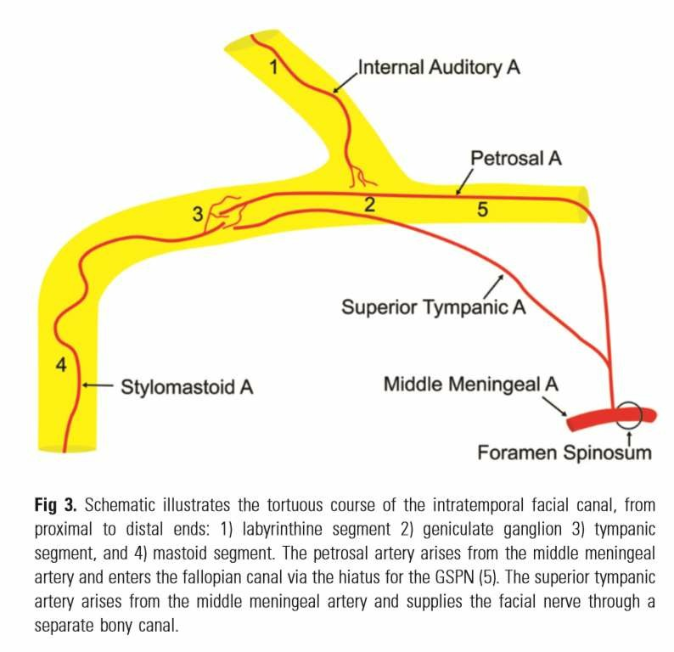
Applied anatomy
The Labyrinthine portion does not have any overlap
Petrosal artery alone
More vulnerable for ischemia

Slide 43
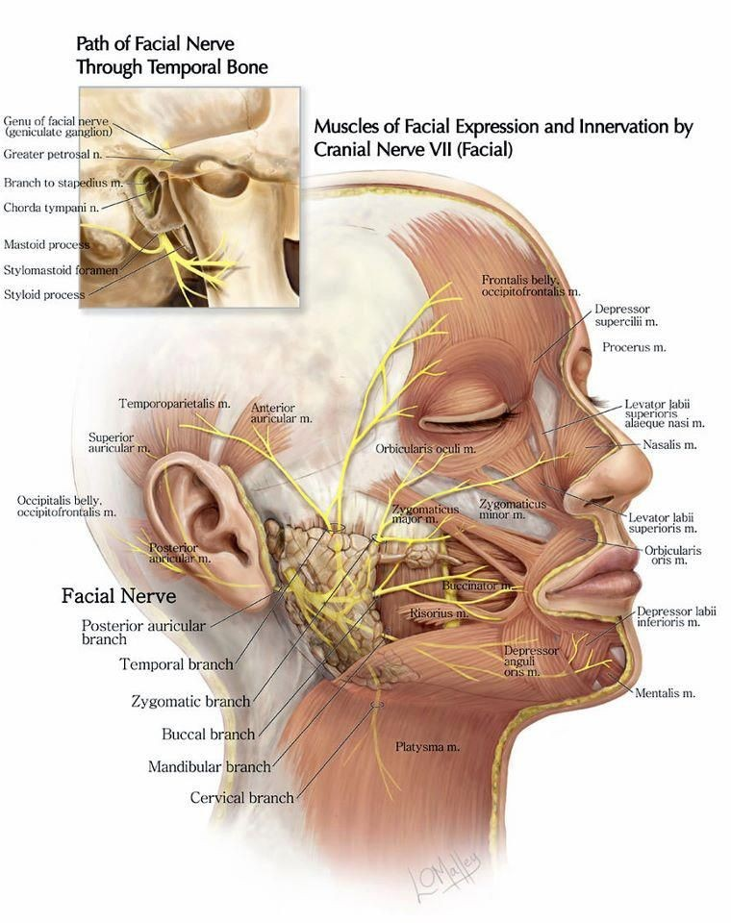
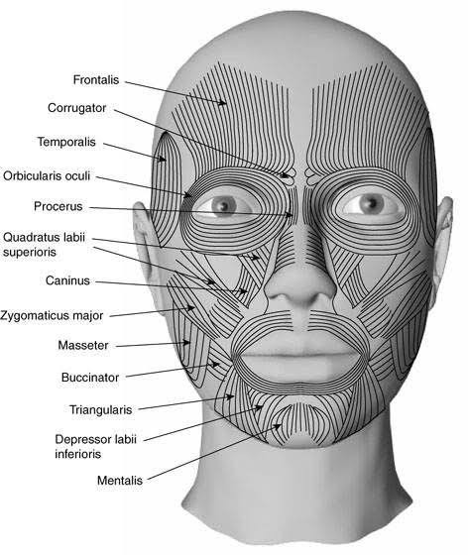
MUSCLES OF FACE: THEIR ACTIONS AND INNERVATIONS

Slide 44
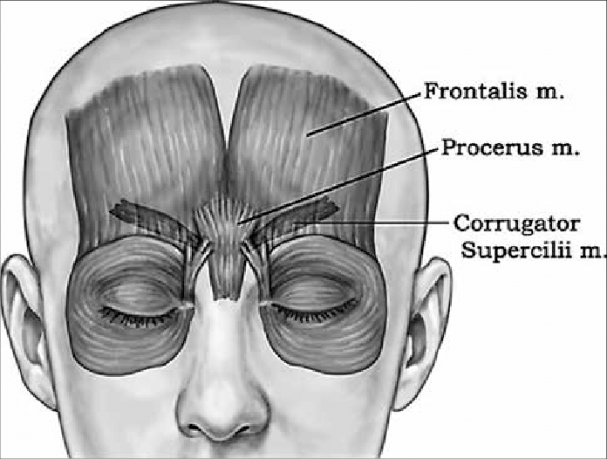
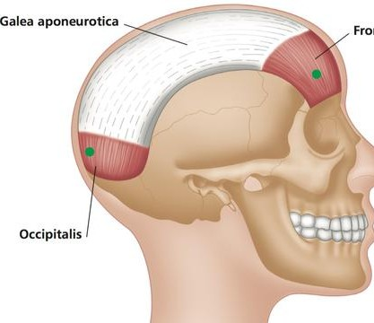
TEMPORAL BRANCH
MUSCLES SUPPLIED
▸
▸
▸
▸
▸
FRONTALIS PROCERUS CORRUGATOR
ORBICULARIS OCULI (UPPER PART) OCCIPITALIS

Slide 45
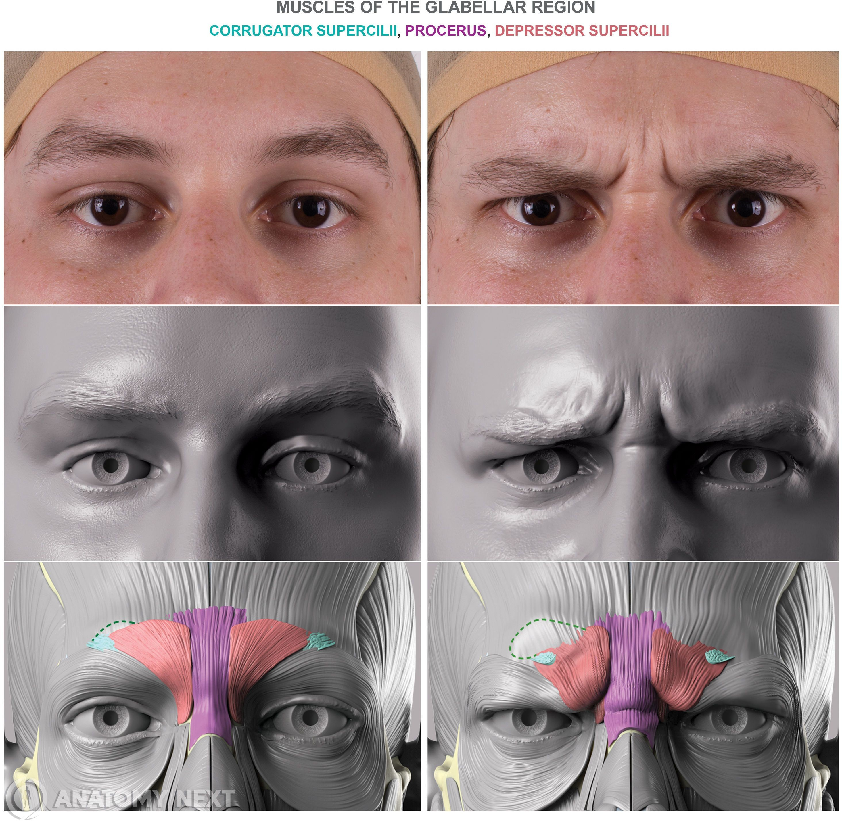
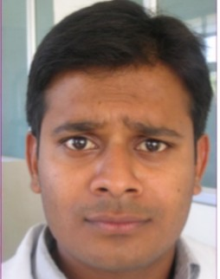
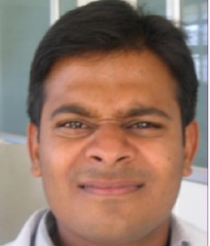
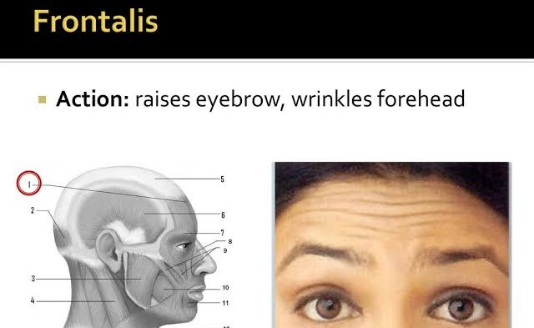

Slide 46
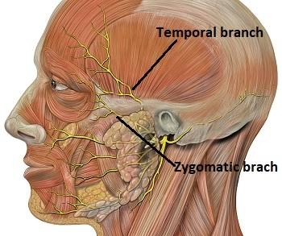
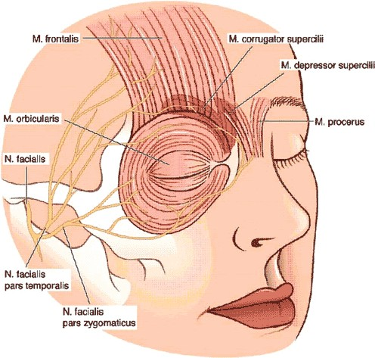
ZYGOMATIC BRANCH
MUSCLES SUPPLIED
▸
ORBICULARIS OCULI : Lower and Lateral part

Slide 47
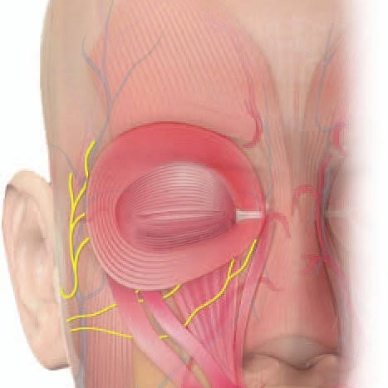






Innervation of ORBICULARIS OCULI

Slide 48
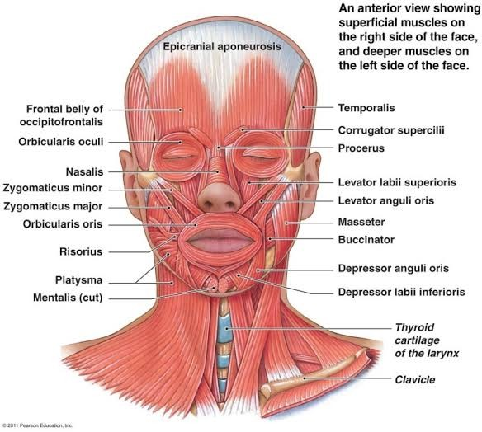
BUCCAL BRANCH
▸
▸
▸
▸
▸
▸
ORBICULARIS OCULI BUCCINATOR ZYGOMATICUS NASALIS
LEVATOR ANGULI ORIS LEVATOR LABII SUPERIORIS

Slide 49
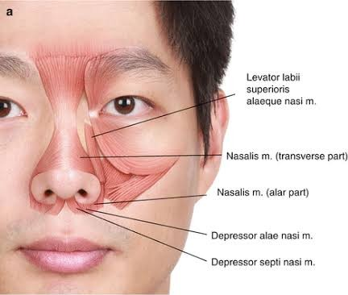
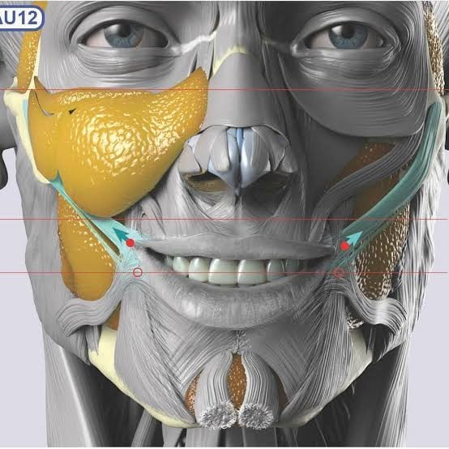
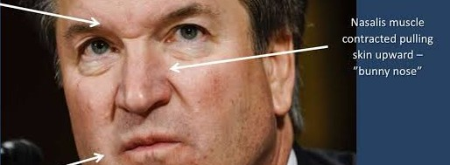
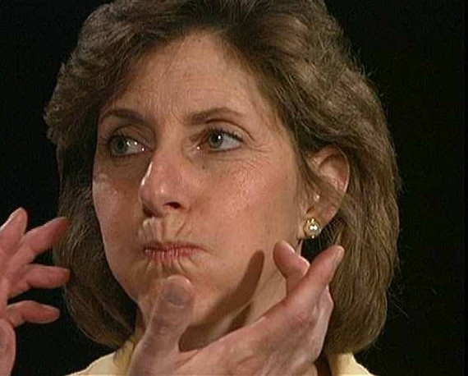
ZYGOMATICUS- DRAWS MOUTH
BACKWARD and UPWARD
BUCCINATOR -
compresses cheeks

Slide 50




Slide 51
MANDIBULAR BRANCH
MUSCLES SUPPLIED
▸
▸
▸
▸
▸
ORBICULARIS ORIS (lower part) MENTALIS
RISORIUS
DEPRESSOR ANGULI ORIS (TRIANGULARIS) DEPRESSOR LABI INFERIORIS (QUADRATUS LABI INFERIORIS)

Slide 52


CERVICAL BRANCH
MUSCLES SUPPLIED
▸
PLATYSMA
Pulls Lower Lip and Angle of mouth down. Depresses Lower Jaw
Raises and wrinkles Skin of Neck

Slide 53

CENTRAL FACIAL PALSY
FLATTENED NASOLABIAL FOLD WITH SYMMETRIC FOREHEAD WRINKLES

Slide 54

PERIPHERAL FACIAL PALSY
FLATTENED NASOLABIAL FOLD WITH SMOOTHENED FOREHEAD WRINKLES ON SAME SIDE

Slide 55
Central facial paralysis
Upper motor neuron lesion
Movements of the frontal and upper orbicularis oculi tend to be spared →Because of uncrossed contributions from ipsilateral supranuclear areas

Slide 56
2 variations of CFP
A) volitional or voluntary- weakness more marked on voluntary contraction, when patient asked to smile /bare his teeth
Lesion in corticobulbar tract or lower third of precentral gyrus
B)Emotional or mimetic– facial asymmetry more apparent with spontaneous expression, as when laughing
Thalamic or striatocapsular lesion

Slide 57

Peripheral paralysis
Lower motor neuron lesion
At rest : less prominent wrinkles on forehead of affected side, eyebrow drop, flattened nasolabial fold, corner of mouth turned down
Unable to : wrinkle forehead, raise eyebrow, wrinkle nasolabial fold, purse lips, show teeth, or completely close eye

Slide 58
Peripheral Facial Palsy • There is flaccid weakness of all the muscles of facial expression on the involved side, both upper and lower face, and the paralysis is usually complete
Palpebral fissure is open wider than normal, and there may be inability to close the eye (lagophthalmos).

Slide 59
Bell’s phenomenon- Attempting to close involved eye causes a reflex upturning of the eyeball
Levator sign of Dutemps and Céstan- Patient look down, then close the eyes slowly; because the function of levator palpebrae superioris is no longer counteracted by orbicularis oculi, upper lid on the paralyzed side moves upward slightly.

Slide 60
•
Negro’s sign- eyeball on the paralyzed side deviates outward and elevates more than the normal one when the patient raises her eyes.

Slide 61
Platysma sign of Babinski- asymmetric contraction of the platysma, less on the involved side, when the mouth is opened

Slide 62
House-Brackmann grading system
•
•
Grade I - Normal
Grade II - Mild dysfunction, slight weakness on close inspection, normal symmetry at rest
Grade III - Moderate dysfunction, obvious but not disfiguring difference between sides, eye can be completely closed with effort
Grade IV - Moderately severe, normal tone at rest, obvious weakness or asymmetry with movement, incomplete closure of eye
Grade V - Severe dysfunction, only barely perceptible motion, asymmetry at rest
Grade VI - No movement
•
•
•
•

Slide 63
Examination of facial nerve
1.MOTOR PART
Muscles of facial expression
Wrinkling of forehead- Ask the patient to look up or raise the eyebrows, involvement of frontal belly of occipitofrontalis
Blinking- reduced on affected side in LMN palsy
Bell’s phenomenon- Ask to close the eyes, eyeballs rolling upwards & outwards
Forced eye closure- test for orbicularis oculi

Slide 64
Nasolabial fold
Smile/show teeth- Risorius is tested
Blowing of cheek- ask to purse lips & blow cheek, Buccinator is tested
Whistling- orbicularis oris is tested
Platysma- bare the teeth & open mouth, look & palpate for contraction of platysma along inferior border of mandible & lateral aspect of neck

Slide 65
Involuntary movements- any twitching/ contraction Nerve to stapedius- ask for hyperacusis
Secretomotor function- look for any drying of eyes

Slide 66
2.SENSORY PART
Special sensation- taste in ant 2/3 rd of tongue
Somatic sensation- look for any vesicle in EAC

Slide 67
Fallacies
Some degree of facial asymmetry can occur normally
LMN lesion if long standing can lead to contractures & angle of mouth may deviate to affected side
UMN lesion may rarely involve some part of upper face

Slide 68
In B/L lesion upper & lower halves may universally involve
; this is differentiated by
absence of Bell’s phenomenon,
dissociation b/w emotional & volitional function, presence of long tract sign
exaggerated facial reflexes indicate UMN palsy
loss of taste in ant 2/3rd of tongue, hyperacusis favour LMN palsy

Slide 69

FACIAL REFLEXES

Slide 70



Orbicularis oculi - FOCAL
Pinch skin over temple lateral to outer canthus using thumb and index finger
Induces sudden stretch and muscle contraction of orbicularis oculi
Tap on finger or thumb briskly
Closing of eye

Slide 71

Orbicularis oculi – NON FOCAL
DEPENDING ON SITE OF STIMULUS :
SUPRAORBITAL
TRIGEMINOFACIAL
McCarthy’s or NASOPALPEBRAL
GLABELLAR TAP (MYERSON’S SIGN)
supraorbital ridge – outer aspect
•
Tapping over:
Forehead(t ill hairline margin)
Glabella
Orbital margin (around)
Causes bilateral blinking

Slide 72





Slide 73

Auditory-palpebral / cochleo-orbicularis reflex
Reflex contraction of o.oculi
Bilateral eye closure
Loud noise
(Eye Closure More On Ipsilateral Side Of Noise)

Slide 74


Visuo-palpebral / blink / menace reflex
Reflex eye closure in response to bright light or sudden visual stimulus

Slide 75

Palpebro-oculogyric reflex/bell’s phenomenon
Tight eye closure
Eyeballs turn upward
= Normal response, but not visible due to fast and complete eye closure
If this response is visualized, indicates eye closure is weak
Method of testing reflex upgaze in patients with upgaze deficits
Clinical significance

Slide 76







Chovstek sign
Tetanic or
spasmic contraction of ipsilateral facial muscles
Tapping over pes- anserinus
Hypocalcemia/tetany
Hyperreflexia/UMN dysfunction

Slide 77
Disorders of Facial Nerve
Facial Nerve Lesions 1.Central facial palsy
3. Peripheral lesion

Slide 78
PERIPHERAL FACIAL NERVE PALSY

Slide 79


Differential diagnosis of lesions of facial nerve
Location of lesions:
NUCLEAR INTRAPONTINE FIBERS
CEREBELLOPONTINE ANGLE(PERIPHERAL TO PONS) FACIAL CANAL :
AT GENICULATE GANGLION
DISTAL TO GENICULATE GANGLION BUT PROXIMAL TO Nerve to stapedius
BETWEEN ORIGIN OF Nerve TO STAPEDIUS AND CHORDA TYMPANI Nerve
DISTAL TO ORIGIN OF CHORDA TYMPANI Nerve
AFTER EMERGENCE FROM STYLOMASTOID FORAMEN

Slide 80

NUCLEAR
Etiologies
•
•
•
Motor Neuron Disease Moebius Syndrome Neoplasm
Associated findings
No localizing findings
Fasciculations +/-
Frequently bilateral dysfunction
Other evidence of MND
Diagnostic Test
Needle EMG

Slide 81



INTRAPONTINE FIBERS
Etiologies
Infection Hemorrhage Neoplasm Syringobulbia Abscess
Central pontine myelinolysis Tuberculoma
Granuloma Trauma
Multiple sclerosis, other DD

Slide 82

Associated findings
Normal taste sensation
Hyperacusis +/-
Decreased lacrimation +/-
Facial fasciculations
Facial myokymia
Ipsilateral CN6 palsy
I/L weakness muscles of mastication
C/L hemiparesis arm and leg

Slide 83
Diagnostic Tests
•
•
•
•
MRI
Auditory evoked potentials EMG Blink reflex
Facial muscle needle EMG

Slide 84




CEREBELLOPONTINE ANGLE (PERIPHERAL TO PONS)
Etiologies
Neoplasm : eg -Acoustic neuroma
Cholesteatoma Head Trauma
Meningeal inflammation or infiltration

Slide 85

Associated findings
Tinnitus,vertigo,deafness : CN 8 inv
Facial pain or sensory dysfunction : CN 5 inv
Loss of taste(antr 2/3rd tongue)
Decreased salivary and lacrimal secretions : nervus intermedius inv
Hyperacusis : lesion proximal to stapedius branch
I/L ataxia and nystagmus : inv of cerebellum/its connections

Slide 86
MRI with IAC view
Posterior fossa CT myelogram CSF Examination
Diagnostic Tests
•
•
•
•
•
•
•
Auditory evoked potentials EMG
Blink reflex
Facial muscle needle EMG

Slide 87

FACIAL CANAL : At geniculate ganglion
Etiologies
Bells palsy
Ramsay hunt syndrome Guillain barre syndrome Petrous bone fracture Neoplasm
Diabetes mellitus
Sarcoidosis Lyme disease HIV infection

Slide 88

Associated findings
Decreased tearing
Etiology asso findings:
Pain in the region of ear and mastoid
Vesicular eruptions with Ramsay Hunt syndrome
Battle sign/ racoon eyes with basilar #
Hyperacusis
Loss of taste

Slide 89

FACIAL CANAL : between geniculate ganglion and nerve to stapedius
Normal tearing
Associated findings
Hyperacusis
Loss of taste
Decrease salivation

Slide 90


FACIAL CANAL : BETWEEN ORIGIN OF Nerve TO STAPEDIUS AND CHORDA TYMPANI Nerve
Associated findings
Loss of taste sensation
•
Weakness muscles of facial expression

Slide 91

AFTER EMERGENCE FROM STYLOMASTOID FORAMEN
Involvement may be partial because of selective involvement of certain division of pes anserinus with weakness of some muscles not all

Slide 92


Parotid tumor or abscess
AFTER EMERGENCE FROM STYLOMASTOID FORAMEN
Etiologies
Trauma
Diagnostic tests
Facial nerve conduction studies
Needle EMG
Parotid imaging

Slide 93

BELL’S PALSY
•
First described more than a century ago by Sir Charles Bell
Most common cause of facial paralysis worldwide

Slide 94
Demographics of Bells palsy
Higher in persons of Japanese descent.
Sex: No difference exists
Age: highest in persons aged 15-45 years. Bell palsy is less common in those younger than 15 years and in those older than 60 years.

Slide 95
Etiology
Idiopathic
Herpes simplex virus 1
Herpes zoster
CMV, EBV, HHV6, Coxsackie
Inactivated intra nasal influenza vaccine

Slide 96
Pathophysiology of Bells palsy
Main cause of Bell's palsy is latent herpes viruses (herpes simplex virus type 1 and herpes zoster virus), which are reactivated from cranial nerve ganglia
Polymerase chain reaction techniques have isolated herpes virus DNA from the facial nerve during acute palsy
Inflammation of the nerve initially results in a reversible neurapraxia. Herpes zoster virus shows more aggressive biological behaviour than herpes simplex virus type1

Slide 97
Onset-acute
½ of cases attain max paralysis in 48hrs
All cases are clinically prominent by 5 days
Pain behind ear may preceed paralysis by day 1 or2
Impairment of test rare beyond 2 nd week
Paralysis partial in 30%, complete in 70%

Slide 98
Features of Bell’s Palsy
Unilateral involvement
Inability to smile, close eye or raise eyebrow
Whistling impossible
Drooping of corner of the mouth
Inability to close eyelid (Bell’s sign)
Inability to wrinkle forehead
Loss of blinking reflex VIII .Slurred speech
Mask like appearance of face
Loss/ alteration of taste

Slide 99


Slide 100
Diagnosis of Bells palsy
By exclusion Criteria
Paralysis or paresis of all muscle groups of one side of the face
Sudden onset
Absence of signs of CNS disease
Absence of signs of Ear disease

Slide 101
MRI, gadolinium enhanced- enhancement of facial nerve
Increased lymphocytes, mononuclear cells in CSF
Prognosis
80% recover within 2-12 wk
10% permanent long term sequelae
8% recurrence

Slide 102
Management of Bells palsy
Eye care : It focuses on protecting the cornea from drying and abrasion due to problems with lid closure and the tearing mechanism. Lubricating drops should be applied hourly during the day and a simple eye ointment should be used at night
All patients are instructed to massage the face daily
There is general agreement that 70-80% of these patients recover completely, while the reminder develop various sequelae within one to three months

Slide 103
Medical treatment Corticosteroids : Prednisolone 80 mg/day in divided dose initial 4-5 days, then tapered over next7-10 days
Corticosteroids combine with antiviral drug is better
Acyclovir 400 mg 5 times/day for 10 days
Valacyclovir 500 mg bd for 5-7 days

Slide 104
Surgical treatment Facial nerve decompression
•
•
Indication: Completely paralysis .
Appropriate time for surgery is 2-3 weeks after paralysis
No evidence that surgical decompression of facial nerve is effective

Slide 105
Complications
Incomplete Recovery – Facial asymmetry persists.
Exposure Keratitis – Eye cannot be closed, tear film from the cornea evaporates causing dryness, exposure keratitis and corneal ulcer.
Synkinesis – Mass Movement – Attempts to move one group of facial muscles may result in contraction of all .
Tics and Spasms – Involuntary movements are seen on the affected side of the face. They are the result of faulty regeneration of fibres .

Slide 106

Contractures – They result from fibrosis of atrophied muscles or fixed contraction of a group of muscles. They affect movements of the face.
Hemifacial Spasms – see pic
Crocodile tears – Gustatory Lacrimation – There is unilateral lacrimation with mastication. Caused by faulty regeneration of parasympathetic fibres which supply the lacrimal gland instead of the salivary glands.

Slide 107

Herpes zoster oticus Ramsay Hunt syndrome
Geniculate ganglion involved
Symptoms:
ØFacial paralysis ØEar pain ØVesicles
ØSensorineura l hearing loss
Vertigo

Slide 108


Lyme Disease
It is caused by a
bacteria Borrelia
burgdorferi.Transmitted by tick bites. Most common neurological complication is Facial Palsy usually on one side.

Slide 109


Acute and chronic otitis media
Otitis media is an infection in the middle ear, which can spread to the facial nerve and inflame it, causing compression of the nerve in its canal.

Slide 110

Melkersson Rosenthal Syndrome
Idiopathic disorder consisting of a triad of facial paralysis, swelling of lips and fissured tongue. Paralysis – recurrent and bilateral.

Slide 111

Guillain Barre Syndome
It is a post infectious, autoimmune disorder affecting the peripheral nerves. Facial paralysis is often bilateral.

Slide 112
Neurosarcoidosis
Facial nerve paralysis, bilateral, is a common manifestation of neurosarcoidosis (sarcoidosis of the nervous system). It is a rare condition.
Neoplasms
Carcinoma of external and middle ear, glomus tumour, rhabdomyosarcoma and metastatic tumours of temporal bone all result in facial paralysis. Facial nerve neuromas occur anywhere along the course of the nerve and produce paralysis. It is treated by excision and nerve grafting.

Slide 113
Central/Supranuclear causes (Facial muscle paralysis with forehead spared)
Cerebral mass lesion (e.g. tumor)
Cerebrovascular Accident (typically with ipsilateral Hemiparesis or Hemiplegia)
Multiple Sclerosis

Slide 114
TESTS OF FUNCTION - FACIAL NERVE
1. Schirmer’ test for lacrimation (GSPN)
2. Stapedial reflex test (Stapedial branch)
3. Taste testing (Chorda tympani nerve)
4. Salivary flow rates & pH (Chorda tympani
TOPOGNOSTIC TESTING
1.Nerve excitability test (NET)
2.Electromyography(EMG)
3.Maximal stimulation test (MST)
4 Electroneuronography (ENoG)
ELECTROPHY SIOLOGIC TESTS

Slide 115


Schirmer's Test
TOPOGNOSTIC TESTING
1. Schirmer’ test for lacrimation (GSPN)
2. Stapedial reflex test (Stapedial branch)
3. Taste testing (Chorda tympani nerve)
4. Salivary flow rates & pH (Chorda tympani
Geniculate ganglion & petrosal nerve function test
Schirmer’s test +ve when
Affected side shows less than half the amount of lacrimation seen on the normal side
Sum of the lengths of wetted filter paper for both eyes less than 25 mm
Lesion at or proximal to the geniculate ganglion.

Slide 116



Slide 117


Stapedius reflex
TOPOGNOSTIC TESTING
2. Stapedial reflex test (Stapedial branch)
Nerve to stapedius muscle test
Impedence audiometry can record the presence or absence of stapedius muscle contraction to sound stimuli 70 to 100 db above hearing threshold
An absence reflex or a reflex less than half the amplitude is due to a lesion proximal to stapedius nerve

Slide 118


Taste (Electrogustometry)
TOPOGNOSTIC TESTING
3. Taste testing (Chorda tympani nerve)
Chorda tympani nerve test
Solution of salt, sugar, citrate, quinine or Electrical stimulation
Compares amount of current required for a response each side of tongue.

Slide 119





Salivary flow rates & pH
TOPOGNOSTIC TESTING
.4. Salivary flow rates & pH (Chorda tympani)

Slide 120





Nerve Excitability Test
ELECTROPHYSIOLOGIC TESTS
•
The nerve is stimulated at steadily increasing intensity till facial twitch is just noticeable and compared with the normal side.
•
When the difference between 2 sides exceeds 3.5 milliamps, the test is positive for degeneration.

Slide 121

Maximum stimulation Test: MST
Similar to nerve excitability test, but instead of measuring the threshold of stimulation , the current level which gives maximum facial movement is determined and compared with the normal side.
•
Reduced or absent response indicates degeneration and is followed by incomplete recovery.

Slide 122



Electroneurography: ENoG
Facial nerve is stimulated at the
stylomastoid foramen and compound muscle action potentials are picked up by the surface electrodes. Response of action potentials are compared with that on the normal side.
% of degenerating fibres is calculated
>90% ---- indicates poor prognosis
This test is most useful between 14-21 days of the onset of complete paralysis .

Slide 123



Electromyography: EMG
Tests the motor activity of facial muscles by direct insertion of needle electrodes (usually in orbicularis oculi & orbicularis oris) – record at rest and voluntary contraction of muscle.
Biphasic and Triphasic potentials - Normal resting muscle
Fibrillation potentials – Denervated muscle
Polyphasic potentials – Regeneration of the nerve

