Slide 1
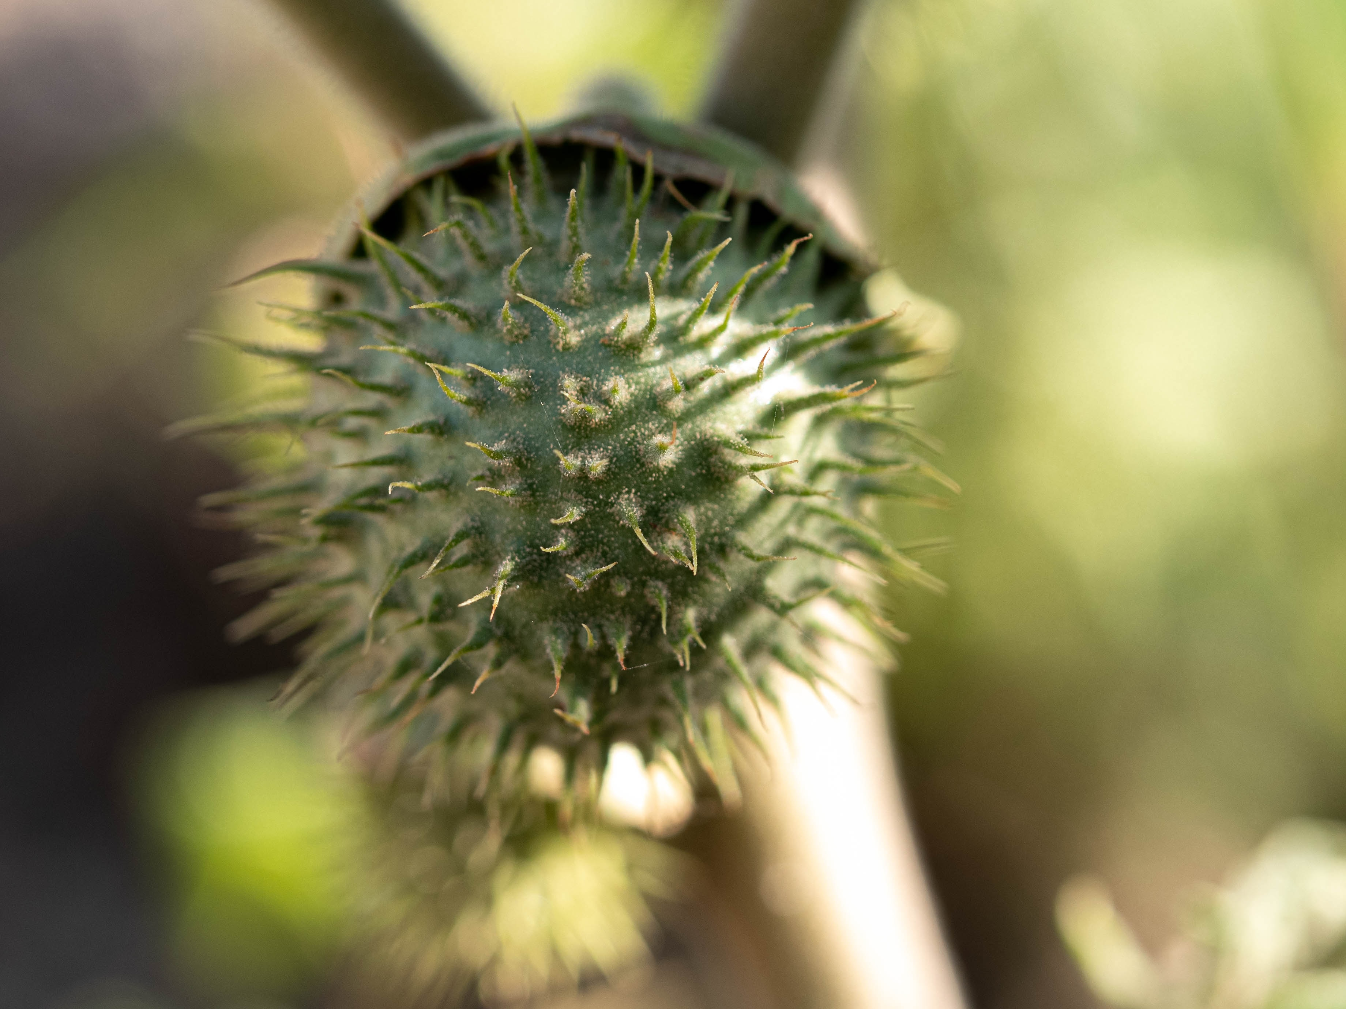
DATURA POISONING
DR ROBINS ROY
JR1
INTERNAL MEDICINE

Slide 2
A 20 year old female patient was brought to casuality with deliberate ingestion of datura stramonium 3 nos
On arrival patient presented with blurring of vision
On examination mydriatic and areactive pupils and without signs of meningeal irritation.
She was agitated,with a body temperature of 38.0 C and dry skin and mucosa,with
tachycardia[heart rate 111/minute] and bp of 130/85

Slide 3
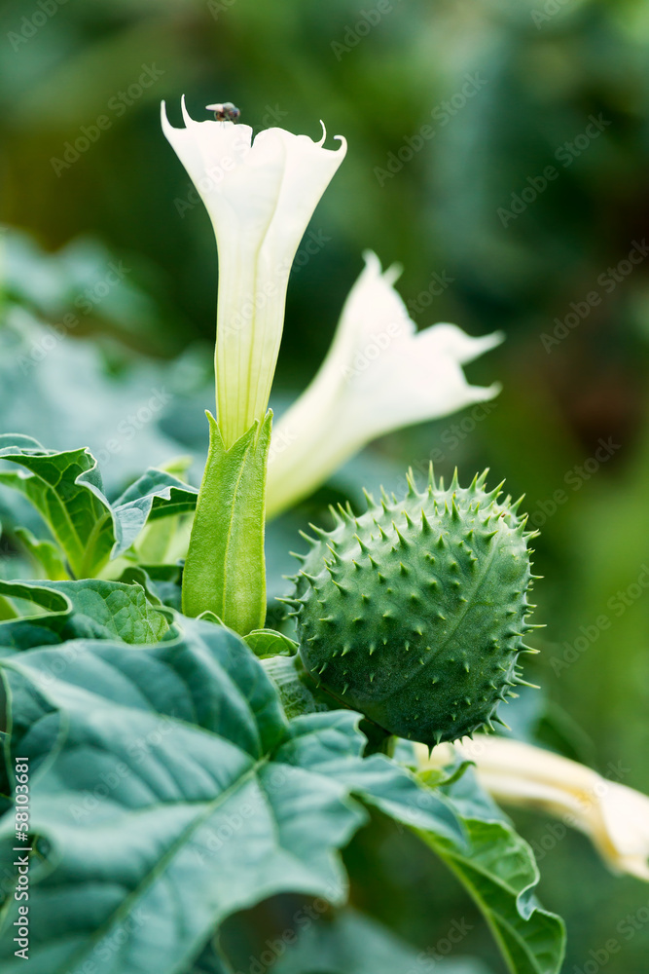
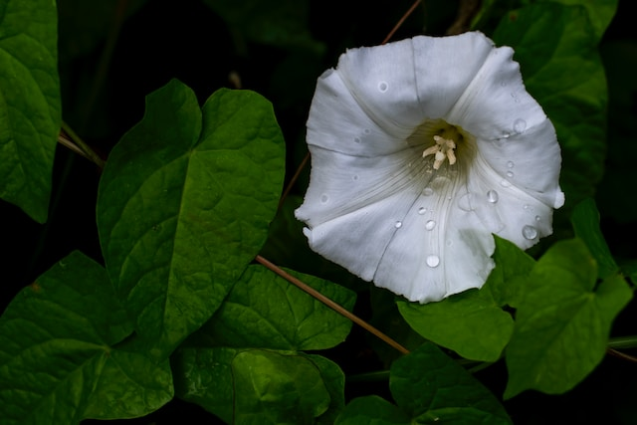
Datura Stramonium
Datura stramonium is one of the most poisonous plant found in india
All parts of plants are toxic .
Seeds and fruits are most toxic

Slide 4
MECHANISM OF TOXICITY
Toxicity occurs because of the presence of up to 28 belladonna alkaloids ,predominated by atropine ,hyoscine,
All parts of the Datura species contain belladonna alkaloids
The highest levels of toxins are found in seeds approximating .1 mg of atropine per seed or 3-6 mg/50-100 seeds
Symptoms starts in 60 minute ,lasts for 48 hours
Mode of toxicity :suicidal ,hallucinogenic use

Slide 5
Belladona alkaloids
Belladona alkaloids include hyoscyamine contained in leaves,roots ,seeds; it mainly contain hyoscine ,atropine,hyoscyamine
Anticholinergic symptoms:They act as competitive antagonist to peripheral and central muscarinic acetylcholine receptors leading to a general paralysis of the parasympathetic innervated organs

Slide 6
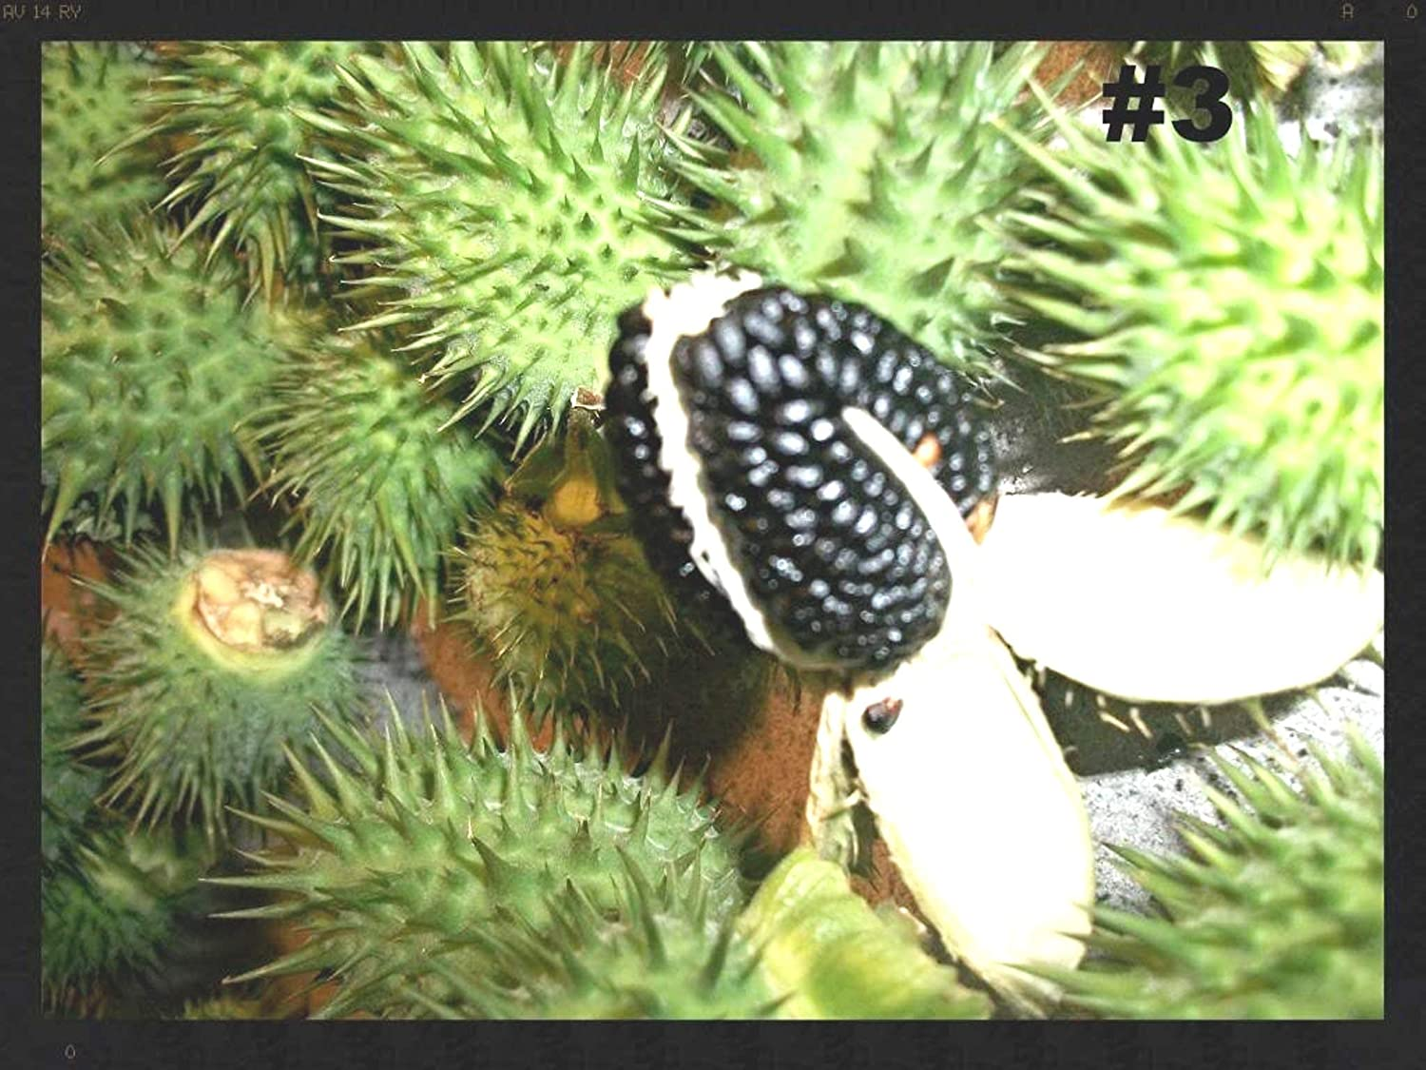
FATAL DOSE =100-125 seeds
FATAL PERIOD = 24 hour
STUPEFACTION DOSE = 50-60

Slide 7
CLINICAL FEATURES
Symptoms occur due to blockade of peripheral muscarinic receptors that innervate exocrine glands ,smooth muscle,cardiac tissue
This leads to symptoms like mydriasis due to blockade of papillary sphincter muscle and iris muscle,dry mouth ,tachycardia,fever ,erythema
CNS
Anxiety,agitation,dysarthria,confusion,diosorientation,visual hallucination,delirium,psychosis,coma,seizure

Slide 8
MANAGEMENT
Agitation and seizure treatment
Benzodiazepines are effective and safe they can be used in high dose
Phenothiazines and butyrophenones shouldn`t used as they are themselves anticholinergic
Gastrointestinal decontamination
Decontamination with activated charcoal[1g/kg maximum 50g]
Antidotal physostigmine therapy
Physostigmine to patients with an isolated anticholinergic poisoning and sign of central anticholinergic toxicity
Adult dosage .5 to 2 mg[.02mg/kg iv ]
Contraindication reactive airway disease ,intestinal obstruction,seizure,cardiac conduction abnormality

Slide 9
THANK YOU

