Slide 1
CLINICAL CLUB

Slide 2
A CASE OF NON RESOLVING PNEUMONIA

Slide 3
Patient details
67/Femlae patient
working in paddy field
Hailing from Thakazhi
DOA: 20/9/22
DOD: 16/10/22

Slide 4
Presenting complaints
Generalised tiredness x 1 week
Decreased appetite and decreased food intake x 5 days
Fatigue x 5 days
h/o recent admission on 3/9/22 to 10/9/22 with Fever with AKI-resolved
IgM dengue was positive

Slide 5
No history of fever/cough/breathlessness
No history of rashes
No history of vomiting/loose stools/abdominal pain
No history of chest pain/palpiation/giddiness
No history of dysuria/haematuria
No history seizures/headache/vomiting
No history of altered behaviour

Slide 6
Past history
Diabetes mellitus detected 3 years back in a medical camp
She was on irregular medication and on some indigineous medication for same
Uncontrolled blood sugar levels for 3 years
No history of HTN/CAD/CVA/renal disease/liver disease/tuberculosis
No history of surgey in past
No history of drug allergy

Slide 7
Family history
3rd daughter of non consanguineous marriage
Married and have 1 son
No significant family history

Slide 8
Personal history
Mixed diet
Sleep and appetite decreased
Bowel and bladder habits normal
No addictions

Slide 9
Socioeconomic status
Lives in a pucca house
h/o goat farming
Pets

Slide 10
General examination
Conscious,oriented to time,place and person
Moderately built and nourished
Weight : 58 kg Height:164 cm
BMI : 21.5 kg/m2
Pallor +
Icterus –
Cyanosis –
Clubbing –
Lymphadenoapathy –
No pedal edema

Slide 11
vitals
Pulse: 90/min,regular,normal volume,normal character,no radio radial or radio femoral delay,no vessel wall thickening,all peripheral pulsations felt bilaterally equal
BP:140/70mmHg in right upperlimb in sitting position
RR:22/min regular,thoraco abdominal
Temp:98.4 degree F

Slide 12
Systemic examination
Respiratory system
Trachea : central
Chest expansion:normal
Normal vesicular breath sounds
No added sounds
CVS
S1 S2 heard normal
no added sounds

Slide 13
Gastrointestianl system:
Oral cavity: dental caries +
Abdomen normal shape,non tender
No organomegaly
No free fluid
Nervous system examination
higher mental function normal
No focal neurological deficit

Slide 14
investigations
Hb- 9.2
TC- 14,820
DC- N86L6
Plt-2.91
MCV-92
MCH-29.8
MCHC-32.4
ESR-140
RBS- 229
RFT- 25/1.1
Na+/K+-124/4.2
TB:1
TP/Alb-6.4/4.1
OT/PT:58/51
ALP-120
Ca2+/PO4/UA:7.2/2/6.4

Slide 15
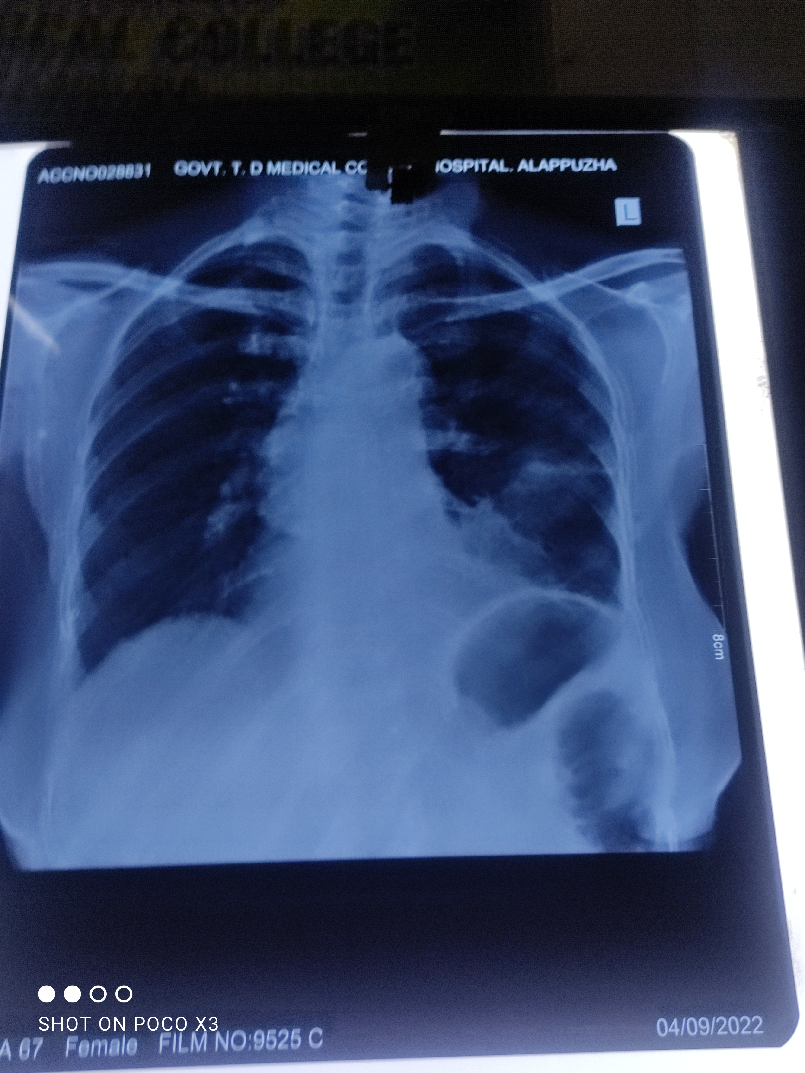
URE : Albumin 1+,sugar:1%,deposit:nad
Chest Xray on 4/9/22
ECG:NSR VR:90/min regular no ST-T changes

Slide 16
Course in hospital
2nd day of admission patient started developing high grade intermittent fever spikes associated with chills
No h/o cough/sputum
No h/o dysuria/abdominal pain/loose stools
No headache/vomiting/altered behaviour
No lowerlimb pain/swelling

Slide 17
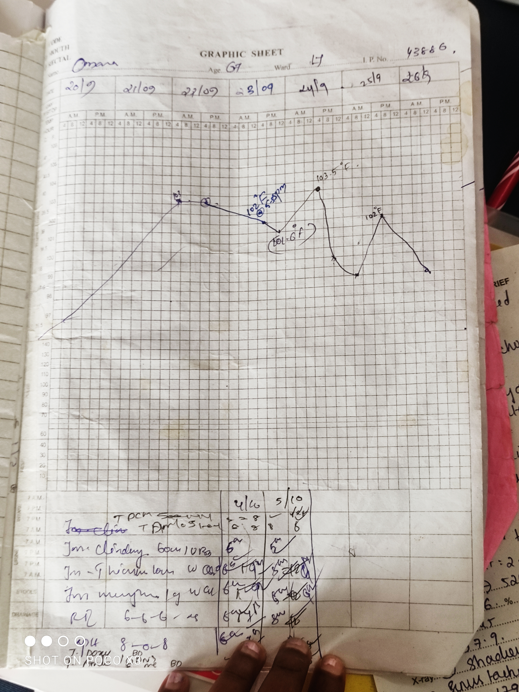
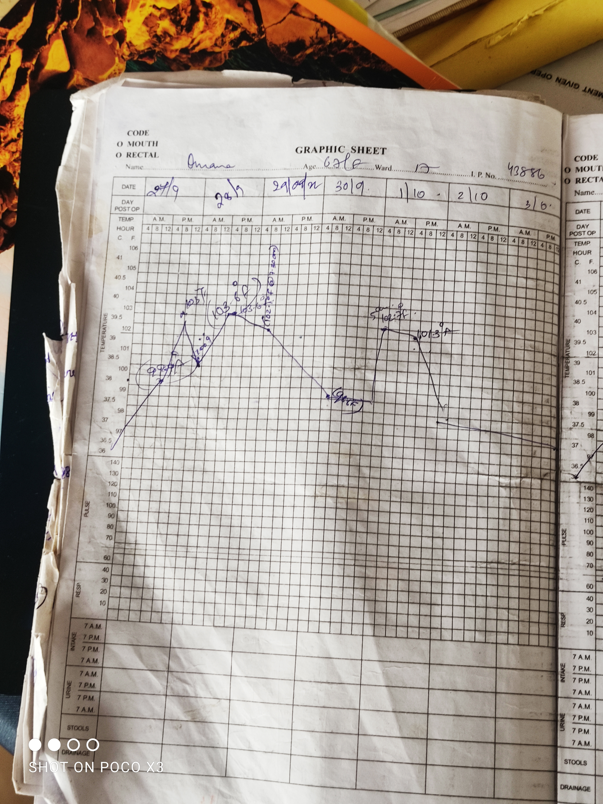
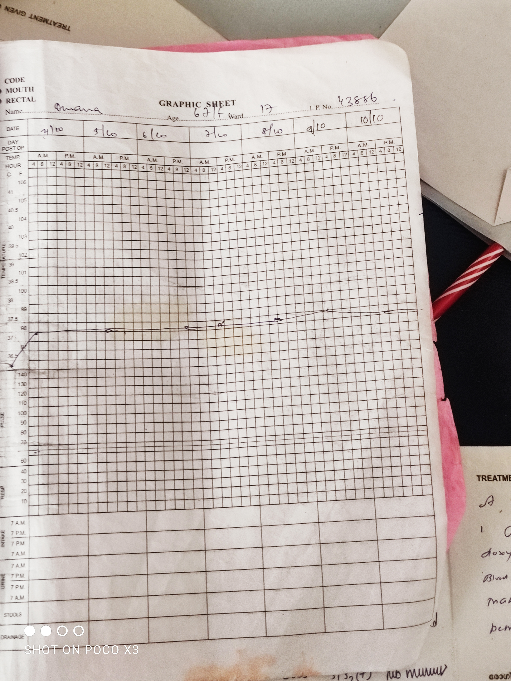
Temperature chart

Slide 18
O/E:
Patient was febrile (103.2degree F)
Tachycardia PR:116/min regular BP:110/60 mmHg
Respiartory system
Air entry bilaterally equal
Inspiratory crepitations + in Left upperzone

Slide 19
 | 20/9/22 | 24/9/22 | 28/9/22
Hb | 9.2 | 7.8 | 7.7
TC | 14,820 | 9600 | 21410
DC | N86L6 | N77L15 | N80L16
Plt | 2.91 | 2.17 | 2.26
ESR | 140 |  | 135
RFT | 25/1.1 | 27/1 | 20/0.9
TB | 1 |  | 1.1
TP/Alb | 6.4/4.1 |  | 5.4/2.2
OT/PT | 58/51 |  | 83/38
ALP | 120 |  | 157

Slide 20
CRP: 256.3 mg/L
IgM lepto -
IgM dengue -
IgM scrub –
HIV –
HBsAg –
AntiHCV-
USG Abdomen:liver&spleen:normal,cholelithiasis,endometrium mild thickening

Slide 21
Peripheral smear: normocytic normochromic anaemia
S.Ferritin :> 1500ng/mL
TSAT:13%
IRON: 48microgm/dl
TIBC:359 microgm/dl
SOB:negative
SPEP:no M band,Hypoalbuminemia
Rafactor:negative
ANA- IF:negative

Slide 22
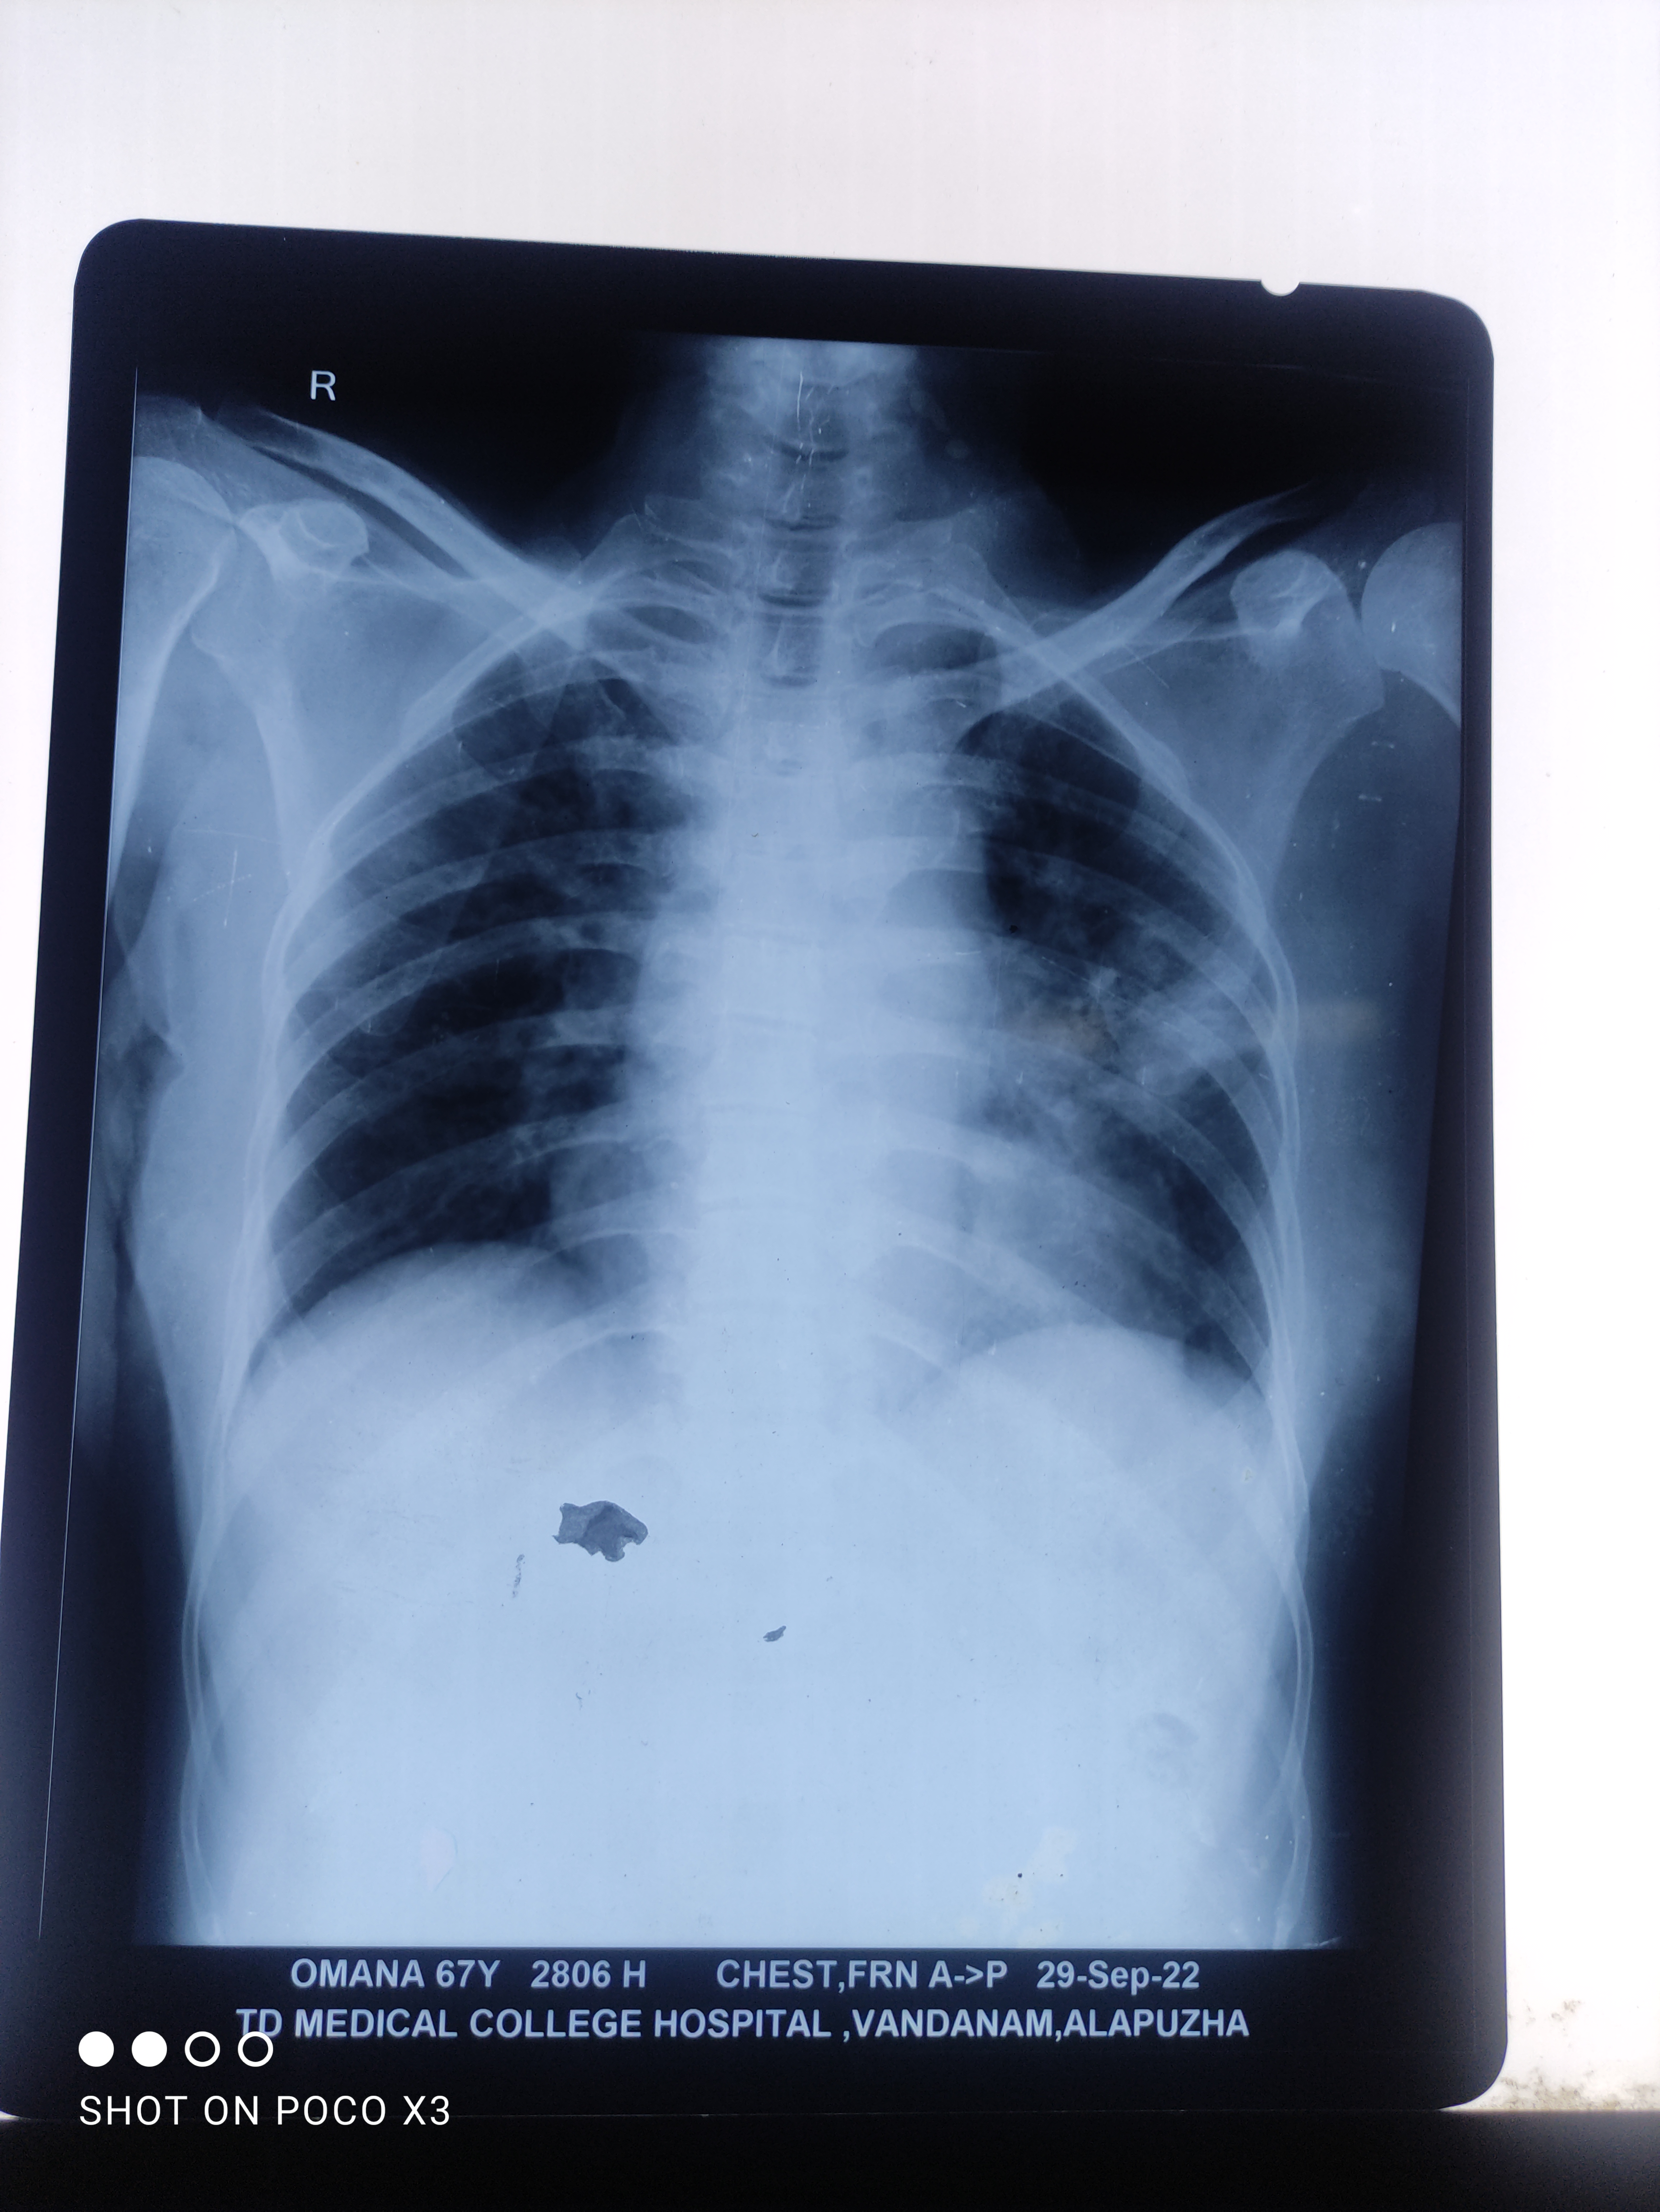

Slide 23
On Day 5 patient developed Right ankle pain and swelling
O/E:tenderness+,edema+,local rise of temperature+
Usg Right ankle joint: no evidence of joint effusion
subcutaneous edema+
Right LL venous doppler:no evidence of DVT

Slide 24
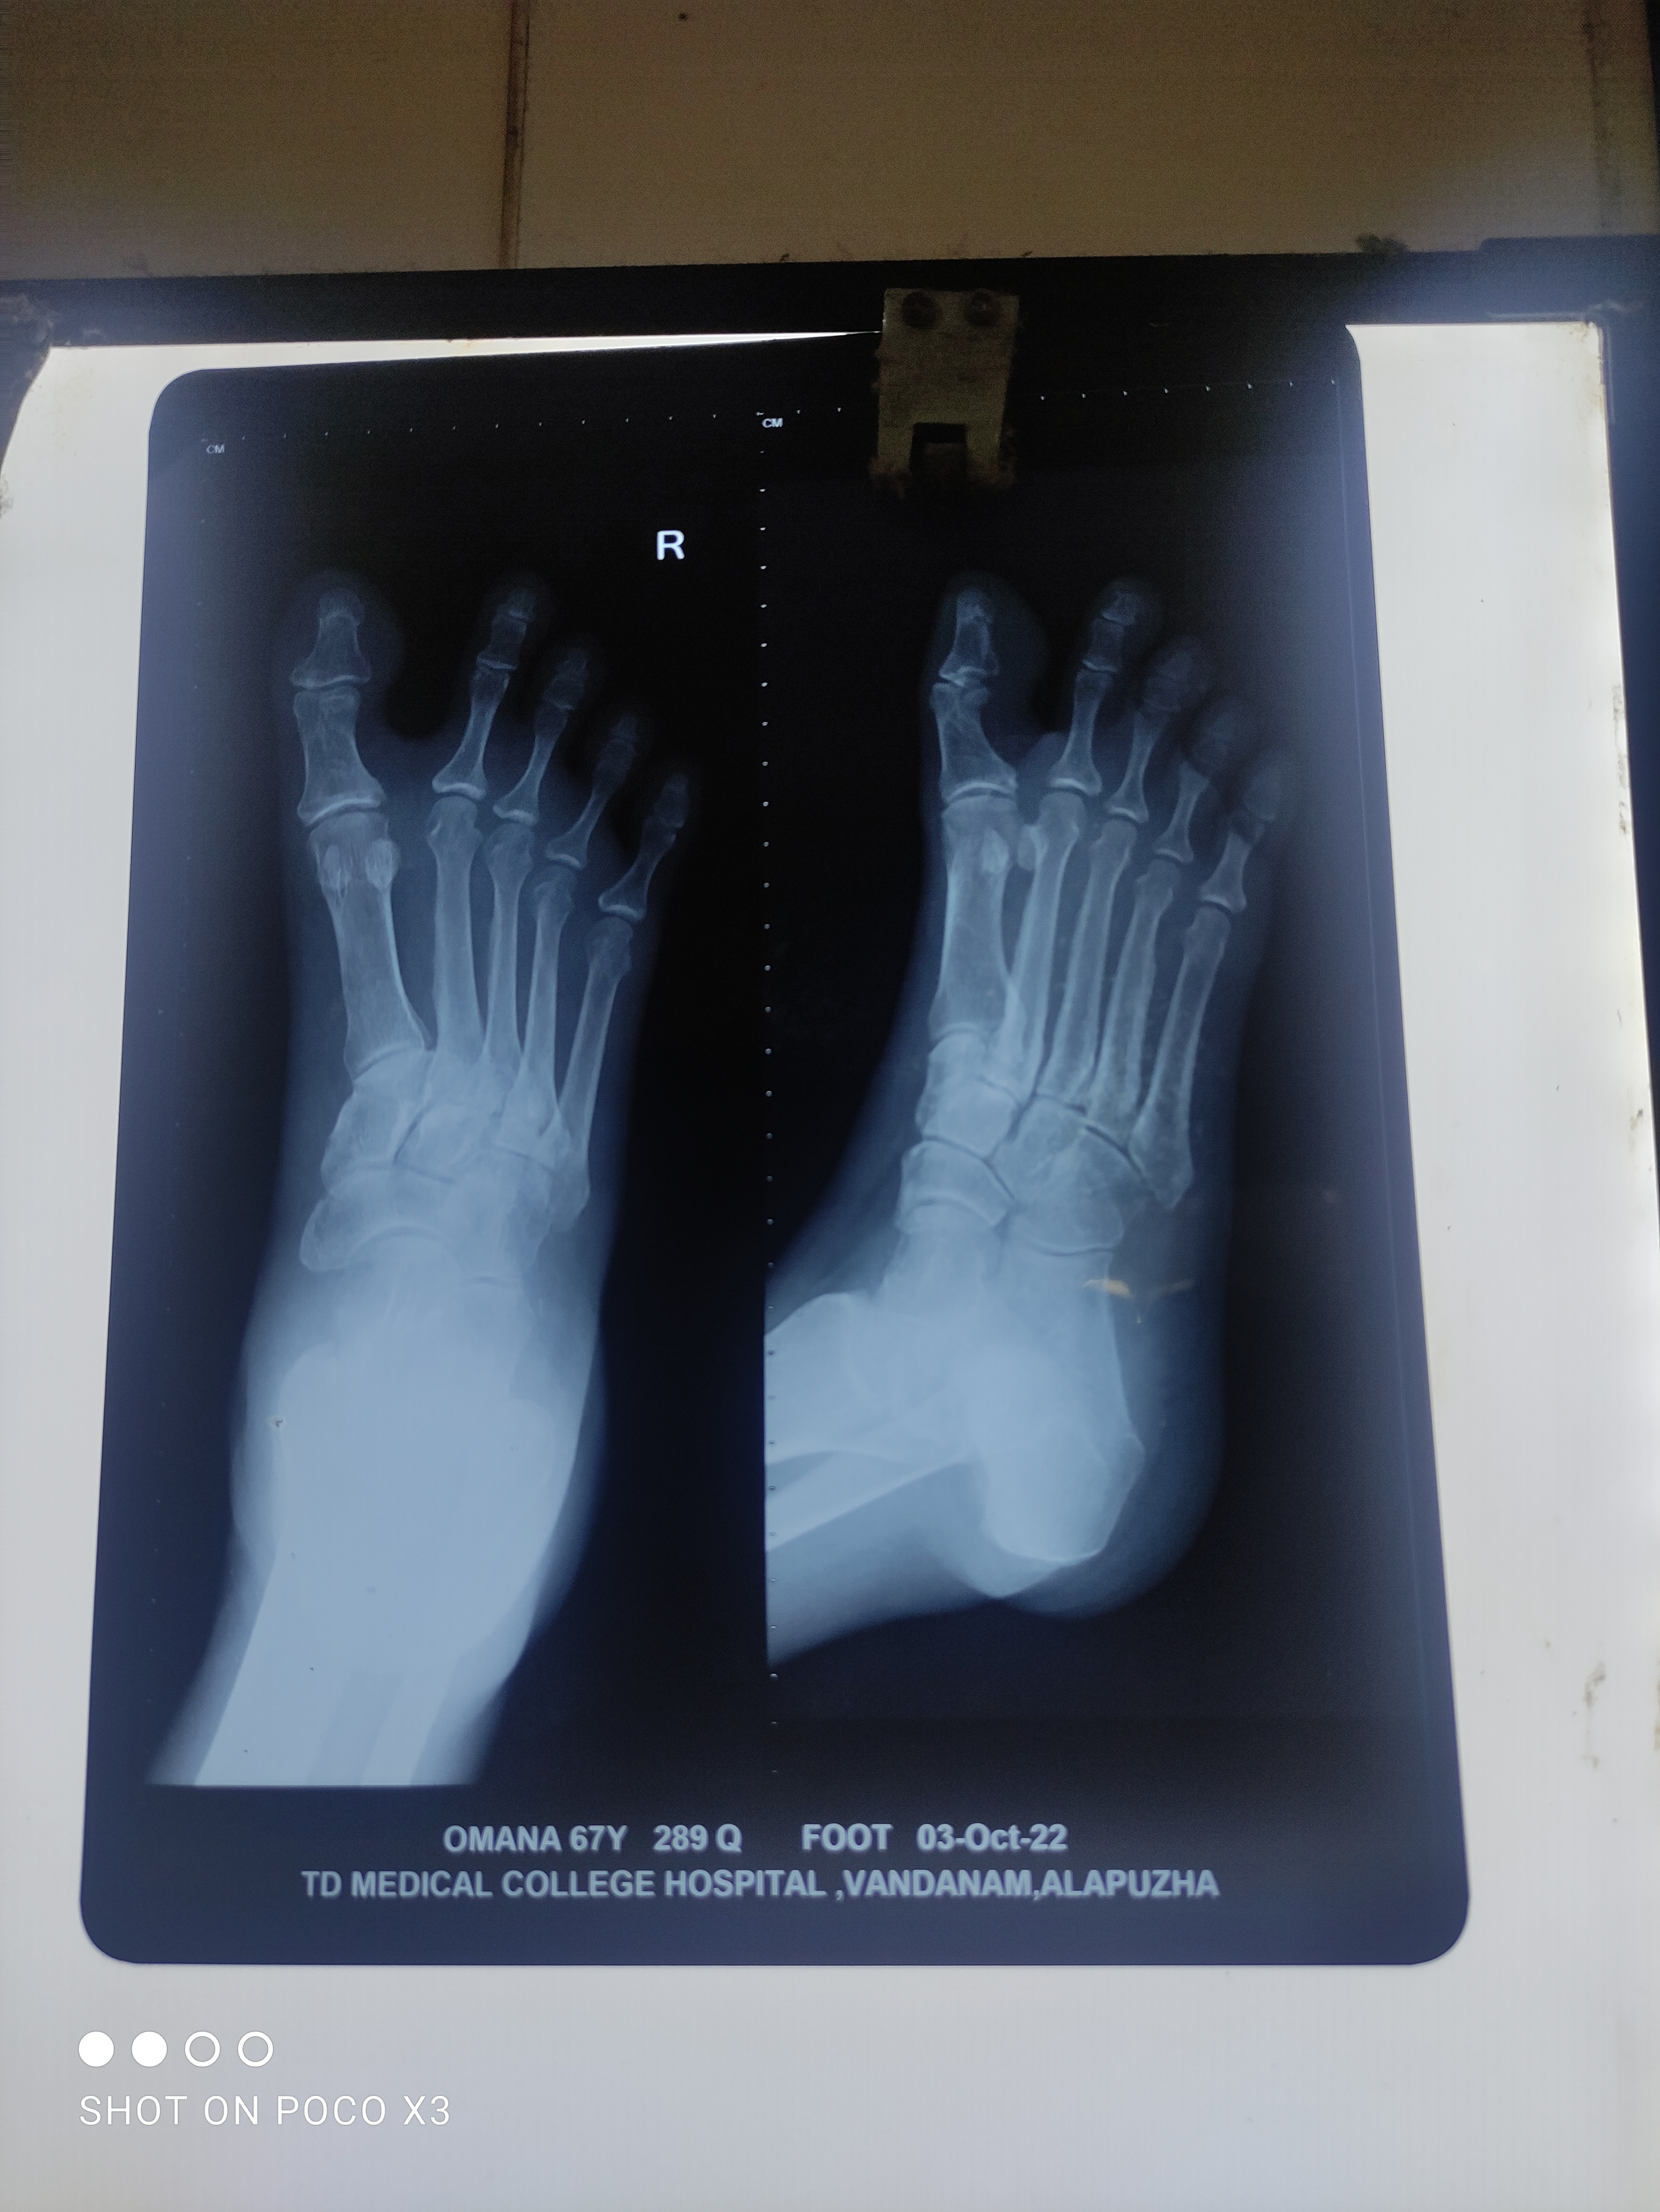
Xray right foot

Slide 25
Gram Stain:
MA palte:non lactose fermenting colonies
Oxidase test:late positive
Intrinsic resistance to polymyxin B
Culture:Blood agar with wrinkled colonies with metallic sheen

Slide 26
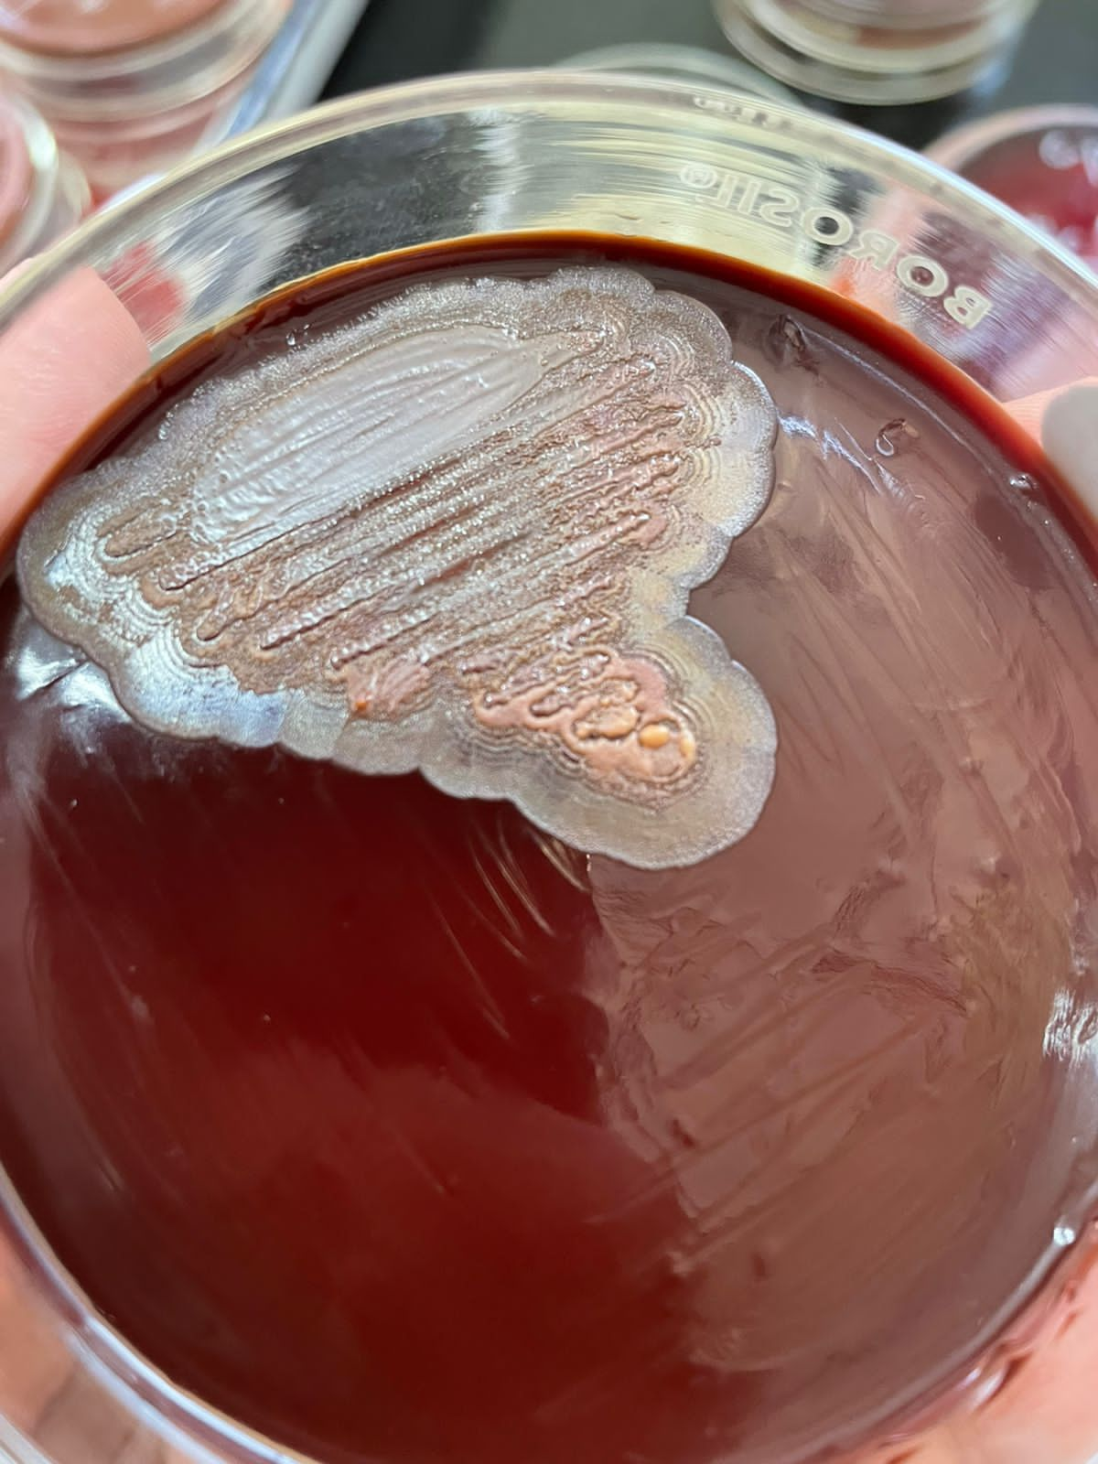
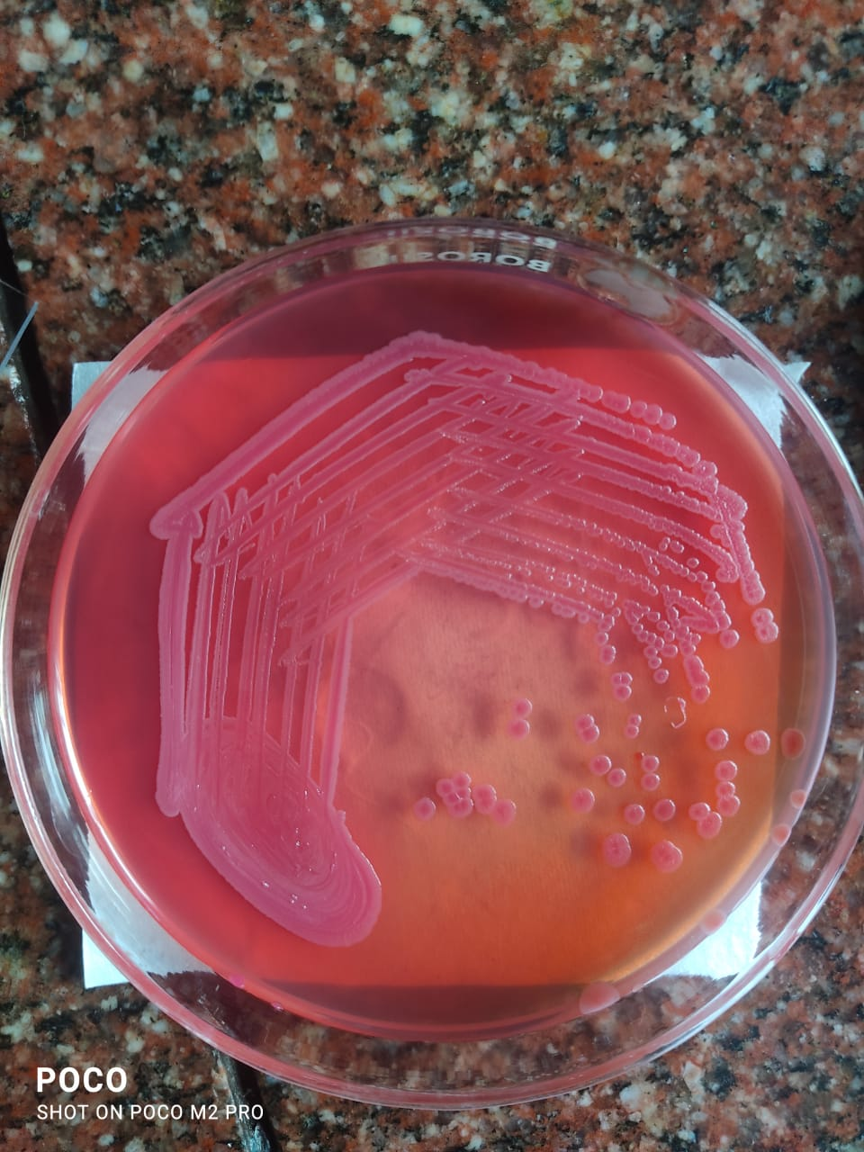

Slide 27
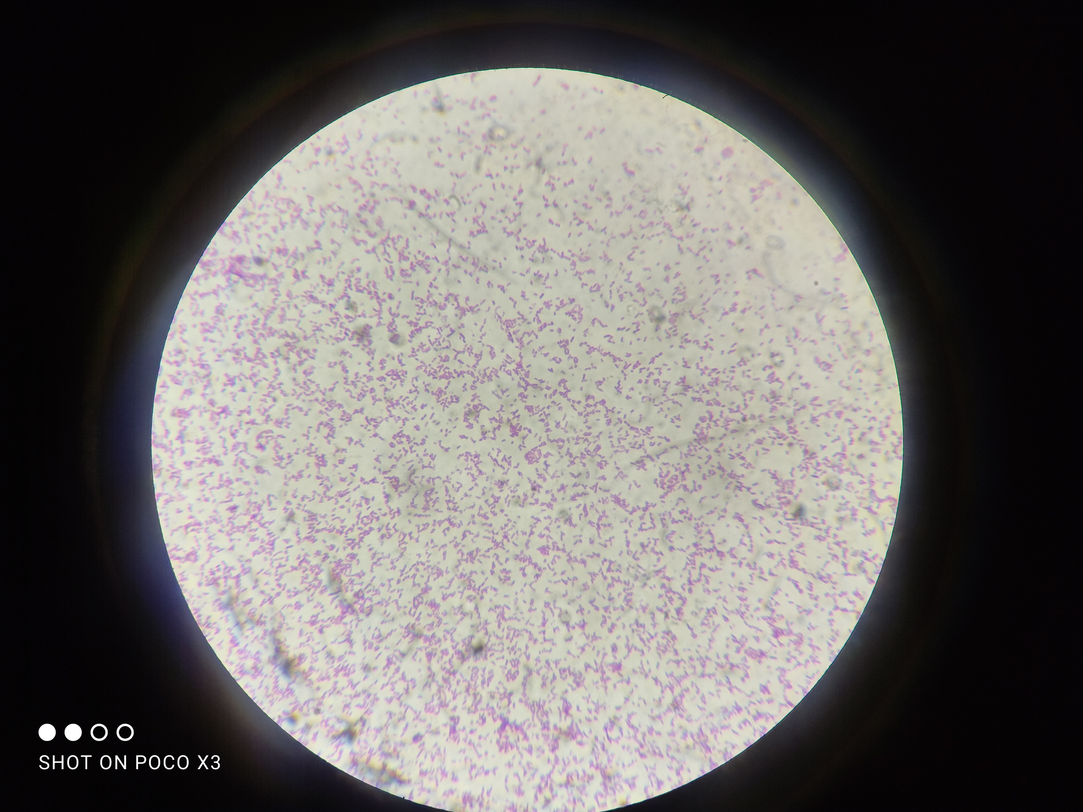

Slide 28
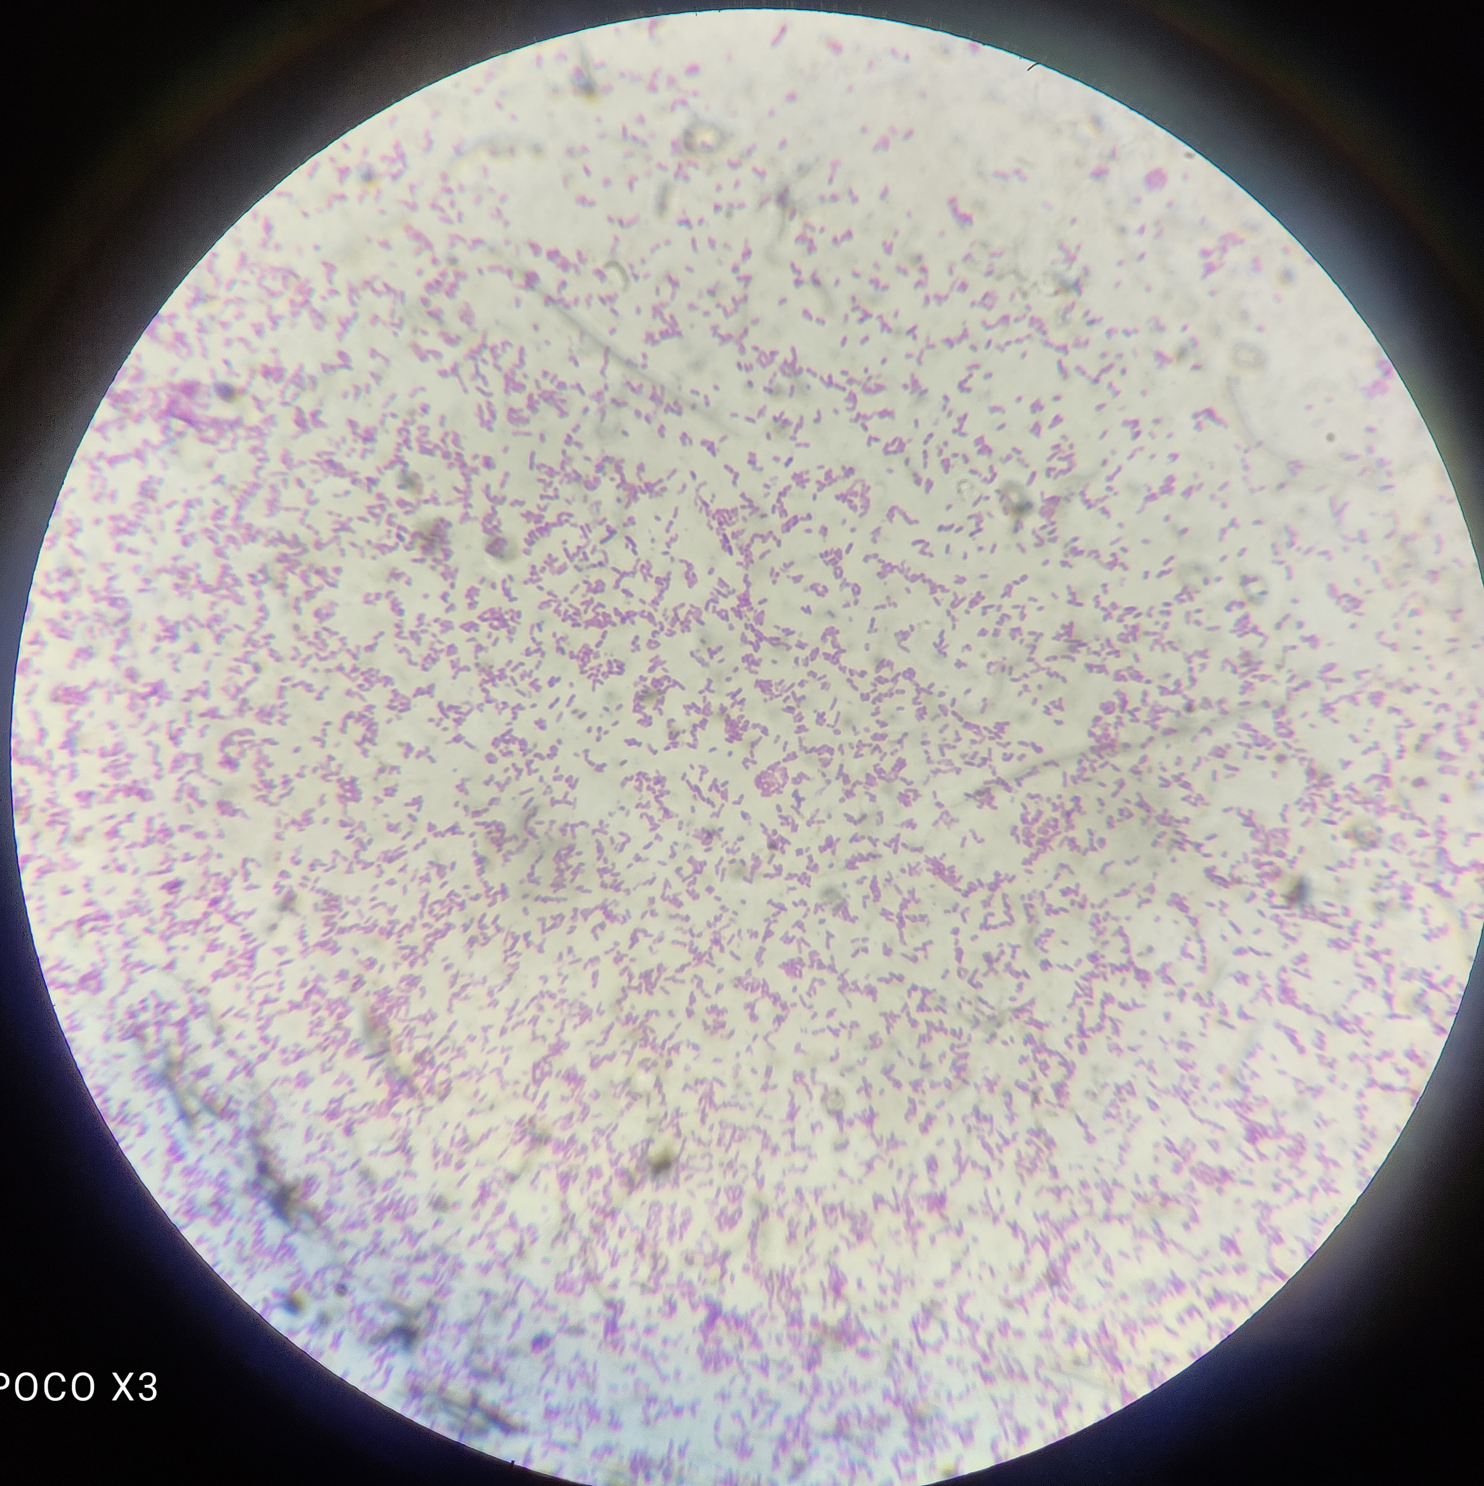

Slide 29
Burkholderia pseudomallei
melioidosis

Slide 30
DISCUSSION
Found in soil and water
Infected by inoculation,inhalation or ingestion
Severe or fatal melioidosis most commonly occurs in individuals with specific comorbidities
DM
CKD
Chronic lung disease
Hazardous alcohol use
IP:1-21 days

Slide 31
Clinical Features
The most common acute clinical manifestation is pneumonia
Other sites of infection:skin and soft tissue & genitourinary tract
Cutaneous melioidosis :skin ulcers,abscesses/pustules/furuncles
Genitourinary melioidosis:prostatic infection/abscess/kidney abscess/UTI
Bacteremia/septic shock
Septic arthritis/osteomyelitis/neurologic infection/abscess in visceral organ
Chronic infection: c/c pulmonary symptoms that may mimic TB/non healing skin ulcer/abscess

Slide 32
Diagnosis
Growth of B.pseudomallei from culture of any site is diagnostic of melioidosis
B.pseudomallei grows well on MacConkey,blood and choclate agars
Ashdown agar /ashdown liquid transport broth allows selective growth of this organism
Oxidase positive/NLF/gram negative bacillus
Gram stain:bipolar stainig with “safety pin appearance”
Serologic test are not a reliable method

Slide 33
Treatment
2 stges:initial intensive phase and eradication phase
Intensive phase:to prevent mortality from severe disease
Inj.Ceftazidime 2gm IV Q6H is the preferred drug
Meropenem/imipenem can be used in patients with critical illness(25mg/kg upto 1 gm IV Q8H)

Slide 34
Eradication therapy
To prevent the relapse of melioidosis:12 weeks
For adults 40-60 kg: TMP-SMX 240 mg of the trimethoprim component orally twice daily
For adults >60 kg:TMP-SMX 320 mg of the trimethoprim componenet orally twice daily
T.doxycycline 100 BD/200 mg OD is an alternative.

Slide 35
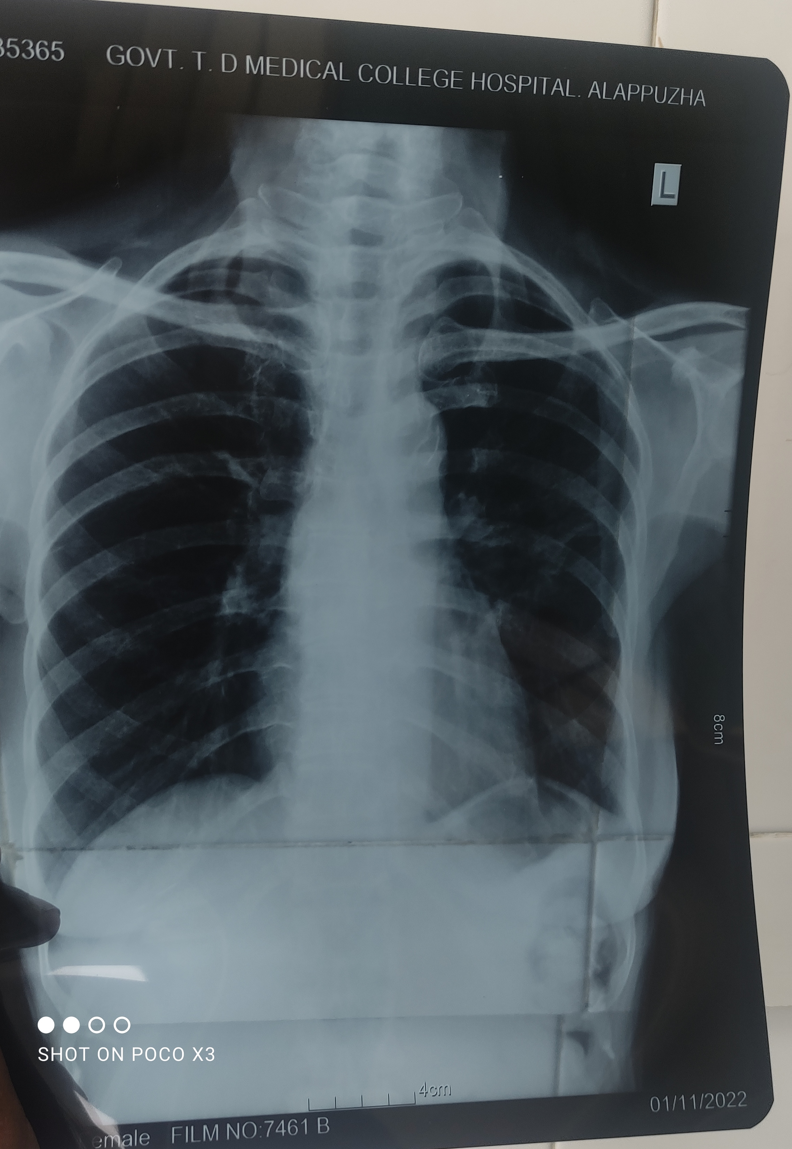
treated with inj.meropenem 1gm IV Q8H x 2 weeks f/b T.Doxycycline 100 mg BD x 12 weeks

Slide 36
THANK YOU

