Slide 1
“I CAN HOLD BUT I CAN’T WRITE”
CLINICAL CLUB
DR. FAZIL
JR MEDICINE

Slide 2
Mr. HARIKUMAR / 66 / Male
Photographer
p/w c/o
- Difficulty in writing ( for past 1 year )
- Difficulty in carrying out his professional
activities ( for past 1 year )

Slide 3
History of present illness
Apparently normal till 1 year back ,then his complaints started as insidious onset slowly progressive difficulty in writing ..earlier he could write legibly.
Now he is complaining that his hand writing is becoming illegible and there is difficulty in making signature.
However, there was no difficulty in making a food bolus,buttoning n unbuttoning or holding on to the pen tightly

Slide 4
6 months later, he noticed that he had difficulty in carrying routine work at his office.
He could not complete the task of editing and printing photos from the computer, which he used to do since last 15-20 yrs.

Slide 5
Since last 8 months his wife gives a history that, he has multiple episodes of falls backwards .
When he tries to get up from the chair, he has a tendency to fall backwards suddenly.
It is not associated with any loss of consciousness/involuntary movmnts of limbs /greying of vision.
Since last 7 months there is generalised slowing of activities including those of daily living.
He feels that his limbs are stiff and he has difficulty in coming downstairs >climbing upstairs.

Slide 6
His wife noted that nowadays he is less active and is not interested in watching TV, reading newspapers and interacting with neighbours.
No history suicidal ideations, death wishes, alteration in sleep.

Slide 7
No history of episodic memory impairment/visual hallucinations/seizures
No history of anosmia, diplopia, drooping of eyelids, other features of cranial nerve dysfunction.
No history of any cramps, motor weakness, sensory symptoms, swaying while walking.
No postural greying of vision, erectile dysfunction, early satiety.
No history of dystonic posturing, myoclonus, stooping, tremulousness of limbs.

Slide 8
H/O PAST ILLNESS
S.HTN for 2 yrs (on losartan 50)
No past suggestive of encephalitis, drug intake
trauma, stroke
FAMILY HISTORY
t2dm/s.htn/stroke/ca with mets for mother
PERSONAL HISTORY
mixed diet / bowel & bladder habits – normal
ex-smoker / alcoholic

Slide 9
SOCIOECONOMIC STATUS
educated upto SSLC
photographer by profession
Own house
Lower middle class family

Slide 10

ON EXAMINATION
Patient is moderately built and nourished
mask facies and startled expression
Pulse – 80/min, regular
Supine Bp- 114/70
Standing BP-110/70
RR – 14/ min afebrile
No Pallor,icterus,cyanosis,clubbing,lymphadenopathy,
edema

Slide 11
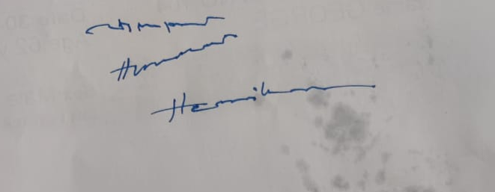
NERVOUS SYSTEM EXAMINATION
HIGHER MENTAL FUNCTION
slowed cognitive processing speed
Executive dysfuntion( defective trail making test in MOCA scale)
Apathy
Monotonous speech, with dull expression
No delusions / hallucinations
no memory deficits
Writing - micrographia

Slide 12
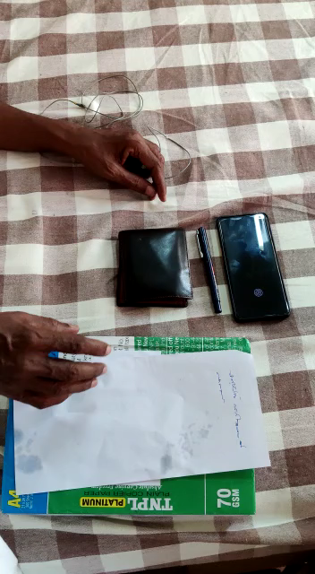

Slide 13
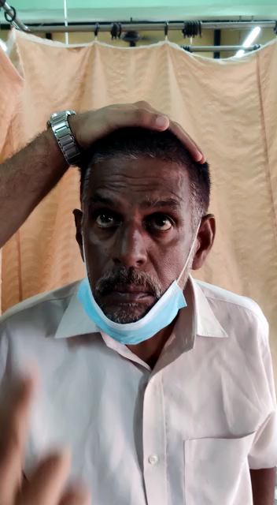
CRANIAL NERVES
Olfactory, optic N – normal
3,4,6 - vertical gaze palsy
persuits and saccades were
normal
no ptosis/squint/diplopia

Slide 14
CN - 5,7,8,9,10,11,12 normal

Slide 15
MOTOR SYSTEM EXAMINATION
 | RIGHT |  | LEFT
 | UL | LL | UL | LL
BULK | normal | normal | normal | normal
TONE | normal | normal | normal | normql
POWER | normal | normal | normal | normal

Slide 16
REFLEXES
SUPERFICIAL REFLEXES
- conjunctival n corneal reflex – normal
- abdominal reflex – normal
- bulbocavernous reflex – normal
- plantar – b/l flexor response

Slide 17
PRIMITIVE REFLEXES
Glabellar tap- positive
Pout reflex-positive
Finger grasp- absent
Palmomental reflex- positive

Slide 18
DEEP TENDON REFLEXES
- jaw jerk – present
- B/l biceps/triceps/supinator - 2+
- B/l knee jerk – 2+
- B/l ankle jerk – 1+

Slide 19
SENSORY SYSTEM
Touch,pain,temp – normal
Joint position, vibration – normal
Cortical sensation – normal

Slide 20
Co-ordination – normal
GAIT –Stance-normal
Stride length decreased
slowness of speed
Arm swings near normal
Involuntary movements –nil
No signs of meningeal irritation
Skull and spine normal

Slide 21
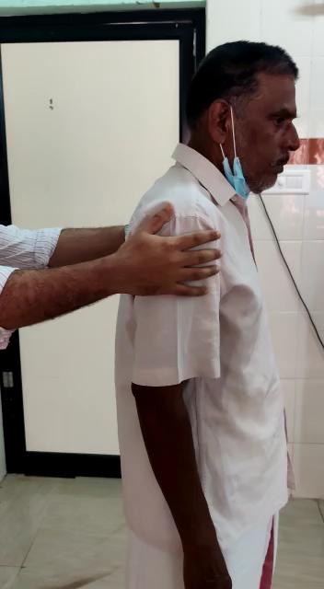
Examination of extrapyramidal system
No tremor/cogwheel rigidity
Pull back test positive

Slide 22
CLINICAl DIAGNOSIS
Extrapyramidal syndrome:
1) Axial rigidity
2) Occulomotor abnormalities- vertical gaze palsy
3) Cognitive impairment- executive dysfunction

Slide 23
INVESTIGATIONS
Routine blood reports within normal limits
Chest xray and ecg were normal
NCCT brain: normal

Slide 24
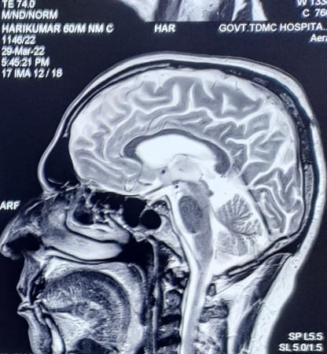

MRI BRAIN – humming bird sign

Slide 25
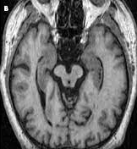

Slide 26
DIAGNOSIS
PROGRESSIVE SUPRANUCLEAR PALSY
-FRONTAL VARIANT(EXECUTIVE DYSFUNCTION/ APATHY)

Slide 27
Differential diagnosis
Closest DD is parkinson’s disease
Other conditions:
- Alzheimer’s d/s
- Cortico-basal degeneration
- creutzfeld Jacob’s d/s

Slide 28
PSP- differences from parkinsons disease
Early fallings (rocket sign)
Symmetrical onset of symptoms
Resting tremor rare
Marked decreased blink rate (3-5/min)
Vertical gaze palsy
Astonished facial expression (procerus sign)
Changes in mood and behaviour
Little response to parkinsons medications

Slide 29
PROGRESSIVE SUPRENUCLEAR PALSY
Also known as Steele-Richardson-Olszewski syndrome, is a neurodegenerative disease that affects cognition, eye movements, and posture.
It is first described as clinicopathologic entity in 1964
Most cases appears to be sporadic
Both environmental and gentic influences have been postulated

Slide 30
PATHOLOGY
Taupathies (tau protein)
Microtubule associated protein (part of cell framework)
Tau is abnormally processed in psp
Accumulated as hyperphosphorylated 4-repeat tau seen within neurons and glia
.

Slide 31
PATHOLOGY
B/l loss of neurons and gliosis in the periaqueductal grey matter, superior colliculus, subthalamic nucleus, red nucleus, pallidum , dentate nucleus, pretectal and vestibular nucleui and to some extend in the oculomotor nuclei

Slide 32
CORE FEATURES (OPCA)
Occularmotor dysfuction
Postural instability
Cognitive dysfunction
Akinesia

Slide 33
Occular motor dysfunction
(O1) vertical supranuclear gaze palsy
(O2) slow velocity of vertical saccades
(O3) frequent macro square wave jerks or “eyelid
opening apraxia”

Slide 34
Postural instability
(P1) repeated unprovoked falls within 3 yrs
(P2) tendency to fall on the pull test within 3 yrs
(P3) more than 2 steps backward on the pull test within 3
years

Slide 35
Cognitive dysfunction
(C1) speech/language disorder(ie, nonfluent aphasia
or progressive apraxia of speech
(C2) frontal cognitive/behavioural presentation
(C3) corticobasal syndrome

Slide 36
Akinesia
(A1) progressive gate freezing within 3 yrs
(A2) parkinsonism,akinetic rigid, predominantly
axial, and levodopa resistant
(A3)Parkinsonism, with tremor and / or asymmetric and
/or levodopa responsive

Slide 37
Mandatory inclusion criteria
Sporadic occurance
Age 40 years or older at onset

Slide 38
Mandatory clinical exclusion criteria
Predominant, otherwise unexplained impairment of episodic memory – s/o Alzeimer d/s
Predominant, otherwise unexplained autonomic failure
like orthostatic hypotension s/o MSA orLBD
Predominant, otherwise unexplained visual hallucinations or or fluctuations in alertness- s/oLBD
Predominant, otherwise unexplained multisegmental umn and lmn signs, s/o MND

Slide 39
Vascular etiology / autoimmune etiologies/metabolic encephalopathies or prion disease
History of encephalitis
Prominent appendicular ataxia
Identifiable causes for postural instability( primay sensory deficit/vetibular dysfunction,severe spasticity)

Slide 40
Diagnostic aids
MRI brain
CSF analysis

Slide 41
Treatment
Challenging
Dopamine agonists , tricyclic antidepressants
Electroconvulsive therapy(ECT) may ameliorate motor symptoms in some
Rehabilitation ,prism glasses
Treatment of the sleep difficulties

Slide 42
THANK YOU

