Slide 1
CLINICAL CLUB-
AN INTERESTING CASE OF ANEMIA.

Slide 2
SHINEY MATHEW
40 YRS , FEMALE
HOUSE WIFE
MANKOMBU
DOA 01/10/21

Slide 3
Presenting complaints
C/O DYSPNOEA ON EXERTION FOR THE PAST 6 MONTHS .

Slide 4
HISTORY OF PRESENTING ILLNESS
C/O DYSPNEA ON EXERTION FOR THE PAST 6 MONTHS
WORSENED FROM FUNCTIONAL CLASS I TO FUNCTIONAL CLASS III FOR THE PAST 1 MONTHS .
H/O EPISODES OF ORTHOPNOEA +.
NO H/O EPISODES OF PND .
C/O BILATERAL PEDAL EDEMA FOR THE PAST 1 MONTH .
NO H/O ABDOMINAL DISTENSION , OLIGURIA
NO H/O CHEST PAIN , PALPITATION OR SYNCOPE .
NO H/O FEVER , COUGH .
NO H/O BLEEDING PR , MELENA OR HEMATURIA .

Slide 5
PAST HISTORY
K/C/O BRONCHIAL ASTHMA FOR THE PAST 3 YEARS ON MDI BUDECORT AND MDI SALBUTAMOL .
CASE OF PRIMARY INFERTILITY , EVALUTED OUTSIDE , USG 08/09 ? PID
HYDROTUBATION DONE IN 2011 – BOTH TUBES PATENT
USG 08/12 /14 ANTERIOR WALL FIBROID UTERUS
NOT A K/C/O DM, CAD , CVA ,SHTN, SEIZURE DISORDER , THYROID DISORDER
NO PAST H/O TB
NO H/O HOSPITAL ADMISSIONS OR SURGERIES

Slide 6
PERSONAL HISTORY
NO ADDICTIONS
HOUSE WIFE
FOLLOWS NON VEGETARIAN DIET .
MENARCHE ATTAINED AT THE AGE OF 13 YEARS
IRREGULAR CYCLES
H/O DYSMENORRHEA , MENORRHAGIA +.
LMP 18/09/21

Slide 7
MARRIED AT THE AGE OF 26 YEARS
PRIMARY INFERTILITY
EVALUATED .
NORMAL BOWEL AND BLADDER HABITS .

Slide 8
FAMILY AND SOCIOECONOMIC HISTORY
NUCLEAR FAMILY
FATHER IS A K/C/O TYPE II DM, CKD
MOTHER IS A K/C/O CAD, BRONCHIAL ASTHMA .
ELDER BROTHER 42 YRS OLD , NO DOCUMNTED CO MORBIDITIES
MIDDLE CASS

Slide 9
GENERAL EXAMINATION
CONSCIOUS, ORIENTED AND CO OPERATIVE
MODERATELY BUILT AND WELL NOURISHED
HEIGHT 160 CM , WEIGHT 70 KG BMI
SEVERE PALLOR +, NO ICTERUS , CLUBBING , CYANOSIS , NO LYMPH NODE ENLARGEMENT
BILATERAL MILD PITTING PEDAL EDEMA +

Slide 10
VITALS
PR 80/MIN, REGULAR , NORMAL IN VOLUME AND CHARACTER , NO RADIORADIAL DELAY , NO RADIOFEMORAL DELAY , NO VESSEL WALL THICKENING , EQUALLY FELT IN ALL PERIPHERAL AREAS
BP 160/100 IN RIGHT ARM IN SITTING POSITION
RR 16/MIN , THORACOABDOMIAL, SP02 98 IN RA
AFEBRILE

Slide 11
EXAMINATION OF CARDIOVASCULAR SYSTEM
PRECORDIUM – NORMAL . JVP NOT ELEVATED
APICAL IMPULSE – LEFT 5TH INTERCOSTAL SPACE 1.5 CM MEDIAL TO MIDCALVICULAR LINE
NO SIGNIFICANT PALPATORY FINDINGS
S1, S2 HEARD , NORMAL
NO MURMURS OR ADDITIONAL HEART SOUNDS .

Slide 12
RESPIRATORY SYSTEM
TRACHEA CENTRAL
CHEST MOVEMENTS EQUAL ON BOTH SIDES
VOCAL FREMITUS – NORMAL OVER ALL AREAS
PRECUSSION- RESONANCE FELT OVER ALL AREAS
VESICUALAR BREATH SOUNDS HEARD EQUALLY OVER ALL AREAS
NO BRONCHIAL BRATHING , NO ADVENTITIOUS LUNG SOUNDS

Slide 13
GASTROINTESTINAL SYSTEM
LIPS , ORAL CAVITY , TONGUE , PHARYNX NORMAL
ABDOMEN – SOFT , NON TENDER , NO HEPATOSPENOMEGALY
BOWEL SOUNDS HEARD
NO GUARDING/ RIGIDITY

Slide 14
CENTRAL NERVOUS SYSTEM
HIGHER MENTAL FUNCTIONS NORMAL
CRANIAL NERVES - WNL
NO SENSORY OR MOTOR DEFICITS
CEREBELLAR FUNCTIONS – ELICITED WELL
SPINE AND CRANIUM – NORMAL

Slide 15
BLOOD INVESTIGATIONS
HB 4.9, RBC 1.56 M , TC 6700, DC P52 L35, PLT 2.71L HCT14.9, MCV75.5
MCH 34.4 MCHC 32.9, RDW 15.6
RBS 95 , U/CR 32/1.2, SERUM ELECTROLYTES137/3.3
TB 2.6, TP/ALB 7.1/4.2 OT/PT 24/13
ALP 77
DB O.4, IB 1.5
URE- ALBUMIN NIL , SUGAR NIL , DEPOSITS – NO ABNORMLITIES DETECTED .

Slide 16
CHEST X RAY PA VIEW – INCREASED HILAR PROMINENCE ON RIGHT SIDE .
ECG – SINUS TACHYCARDIA @100/MIN, NO SIGNIFICANT ST T CHANGES
USG ABDOMEN – HEPATOSPLENOMEGALY, GRADE 1 FATTY LIVER
RENAL ARTERY DOPPLER – NORMAL DOPPLER STUDY
PERIPHERAL SMEAR ON 04/10 – ANISOCYTOSIS , MICROCYTIC HYPOCHROMIC ANEMIA, MACROCYTES , PENCIL CELLS , TEAR DROP CELLS .
NO PARASITES
RETICULOCYTE COUNT 0.3%
SOB NEGATIVE

Slide 17
DCT ON 05/1O AND 06/10 – POSITIVE
LDH 451 (<480)
HBSAG, ANTI HCV, HIV – NEGATIVE
SPUTUM CBNAAT- MTB NOT DETECTED
MANTOUX TEST – NEGATIVE
TSH 1.02 NORMAL
VITAMIN B 12 LEVEL 471 NORMAL

Slide 18
SERUM FERRITIN 263 NORMAL
UIBC 225 NORMAL
TIBC 290 NORMAL
TSAT 22.41
ANA – NEGATIVE BY IMMUNOFLORESCENCE , ANA PROFILE NEGATIVE
ANTI DSDNA – NEGATIVE
FBS 85
FASTING SEROM CHOLESTROL 118
LDL 78
PT INR , APTT – WNL

Slide 19
CECT THORAX AND ABDOMEN ON 13/10 – FILLING DEFECT SUGGESTIVE OF PULMONARY EMBOLISM NOTED IN SEGMENTAL AND SUBSEGMENTAL BRANCHES OF BILATERAL PULMONARY ARTERIES .HEPATOSPLENOMEGALY WITH SPLENIC INFARCT ,FLUID DENSITY AREAS IN BETWEEN RIGHT BCV, SVC AND AORTA , POSSILBLY HIGH RIDING VARIANT OF SUPERIOR PERICARDIAL RECESS .
BILARETAL LOWER LIMB VENOUS DOPLLER – NO EVIDENCE OF DVT
ECHOCARDIOGRAPHY ON 15/10-GOOD BIVENTRICULAR FUNCTION EF 67%
NO THROMBUS VISUALISED IN MPA, PROXIMAL RPA,LPA. NO CLOT/ VEGETATION NO PERICARDIAL EFFUSION , ALL VALVES NORMAL, NO PAH.

Slide 20
ANTIPHOSPHOLIPID ANTIBODY – IG M POSITIVE , IG G NEGATIVE
ANTICARDIOLIPIN ANTIBODY – IG M POSITIVE , IG G NEGATIVE
ANTI BETA 2 GLYCOPROTEIN ANTIBODY – IG M POSITIVE , IG G NEGATIVE
SERUM HOMOCYSTEINE – NORMAL
SERUM HAPTOGLOBULIN NORMAL
LUPUS ANTICOAGULANT 35.5 (28-45
REPEAT PERIPHERAL SMEAR ON 22/ 10 – NO EVIDENCE OF ACTIVE HEMOLYSIS , ANISOPOIKILOCYTOISIS , NORMOCYTS, MICROCYTES , OVALOCUYES

Slide 21
?
PRIMARY ANTIPHOSPHOLIPID SYNDROME AND AUTOIMMUNE HEMOLYTIC ANEMIA
SEGMENTAL AMD SUBSEGMENTAL PULMONARY EMBOLISM .
PRIMARY INFERILITY

Slide 22
PATIENT WAS TREATED WITH O2 INHALATION , INJ.FRUSEMIDE
PRC TRANSFUSIONS GIVEN FOR CORRECTION OF ANEMIA .
ORAL IRON GIVEN .
INJ. METHYL PREDNISOLONE PULSE THERAPY GIVEN , THEN SWITHED TO ORAL PREDNISOLONE
INJ. LMWH GIVEN , LOW DOSE APIRIN STARTED .
OAC( WARFARIN STRATED ) .
PT- INR MONITORING DONE , WARFARIN DOSE ADJUSTED TO OPTIMIZE INR

Slide 23
PATIENT WAS DIACHRGED AFTER OPTIMIZING MEDICATIONS AND ANEMIA CORRCETION
ON NEXT M4 OP DAY , SHE WAS PRESENTED WITH HEMATURIA , DIAGNOSED AS WARFARIN INDUCED COAGULOATHY .
ADMITTED , TREATED AND DISCHARGED .
ADVISED GYNAECOLOGY CONSULTATION FOR MANAGEMENT OF PRIMARY INFERTILITY .

Slide 24
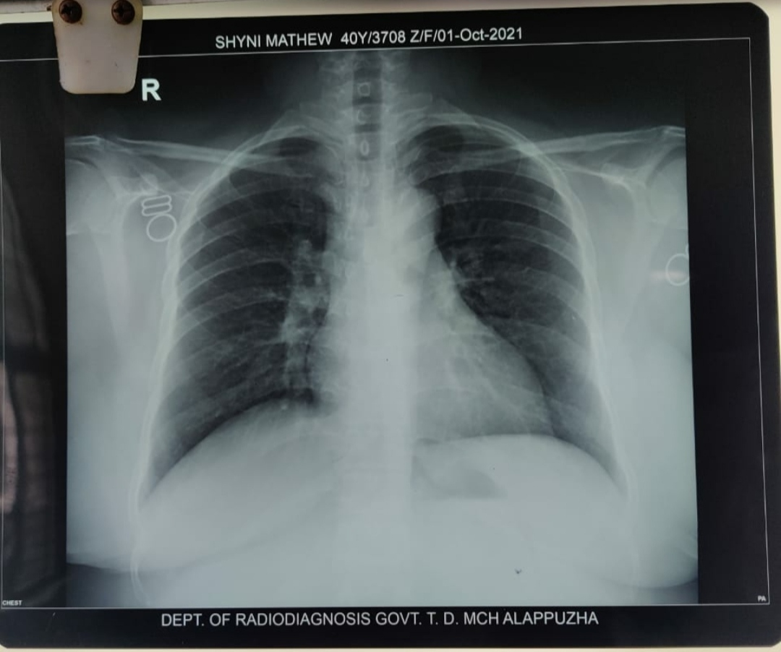

Slide 25
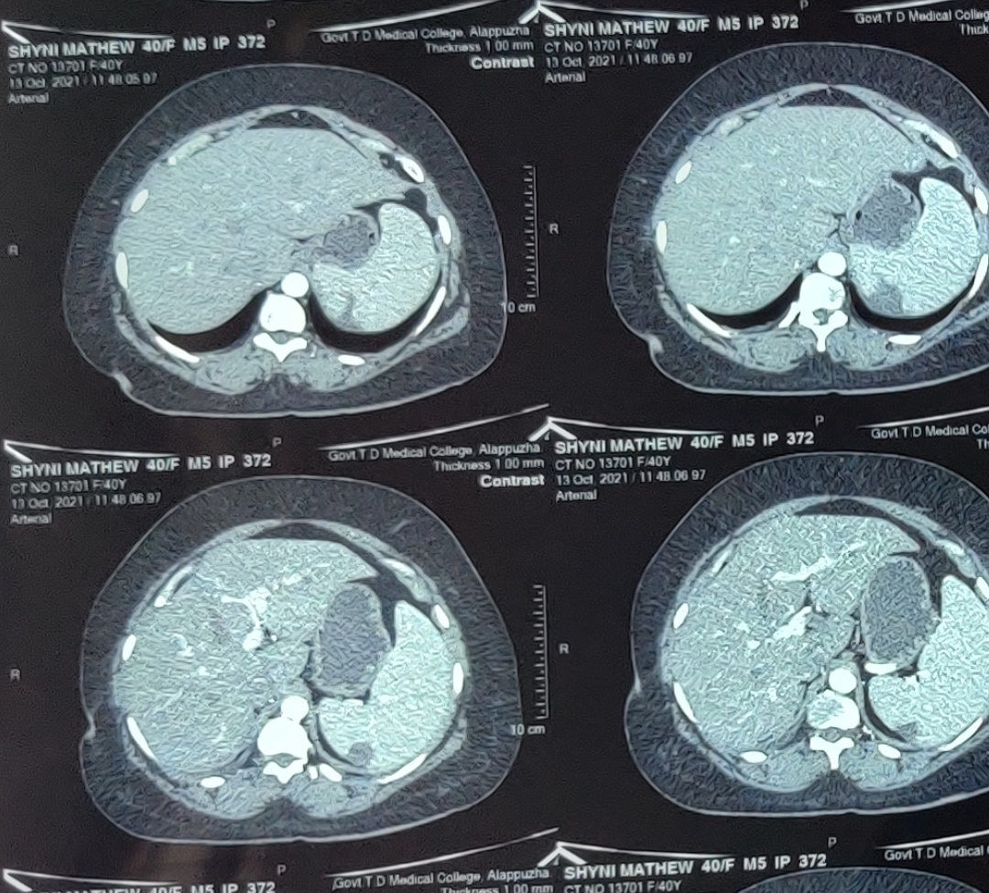

Slide 26
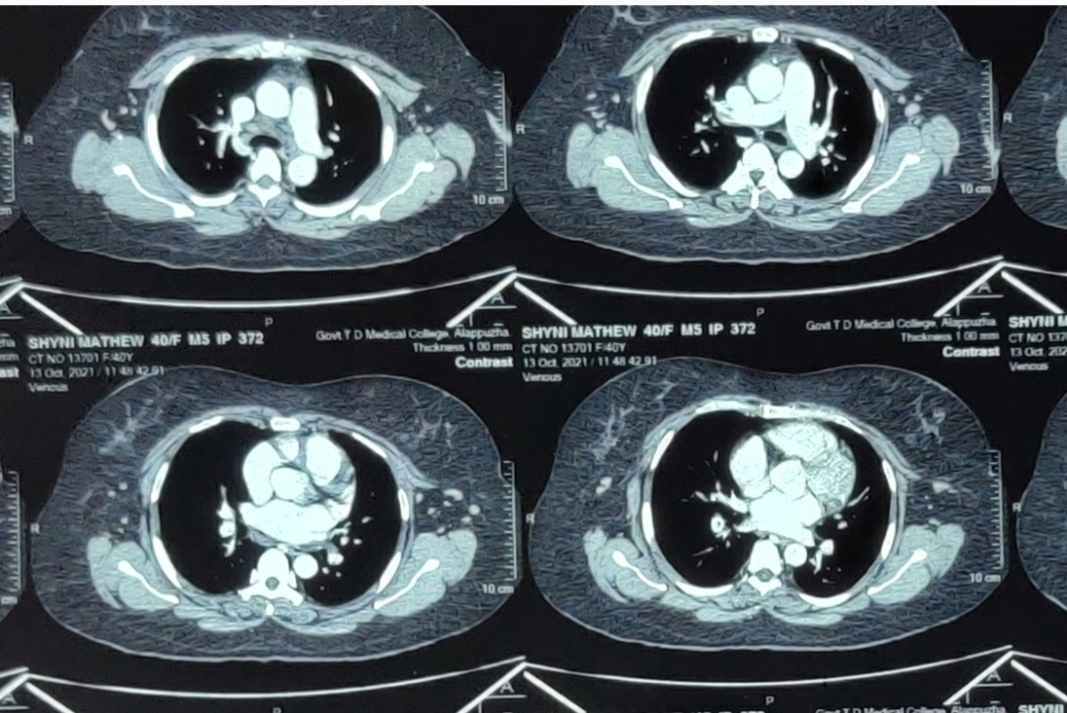

Slide 27
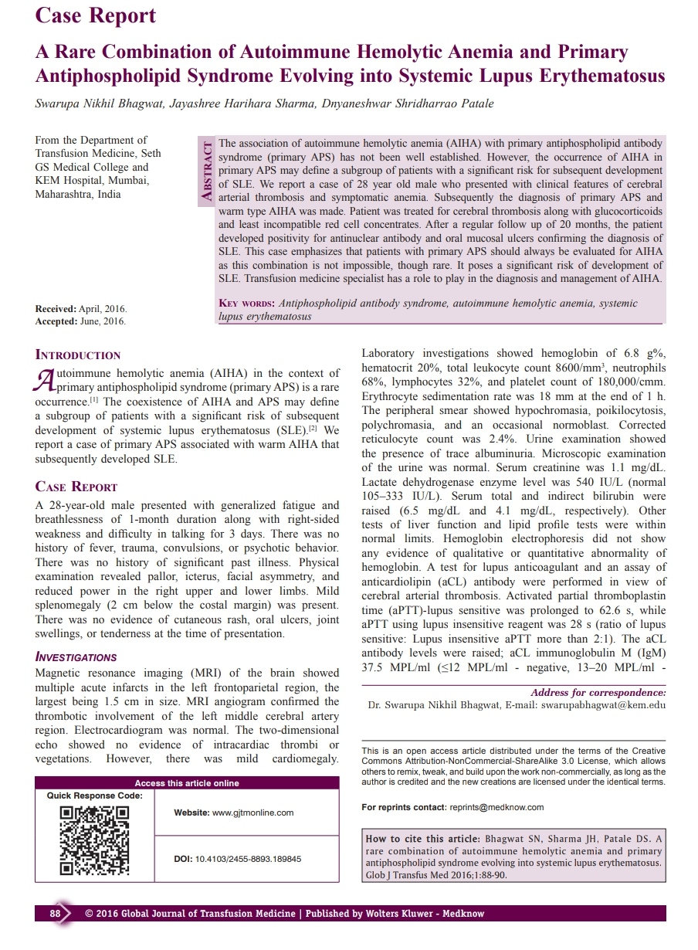

Slide 28
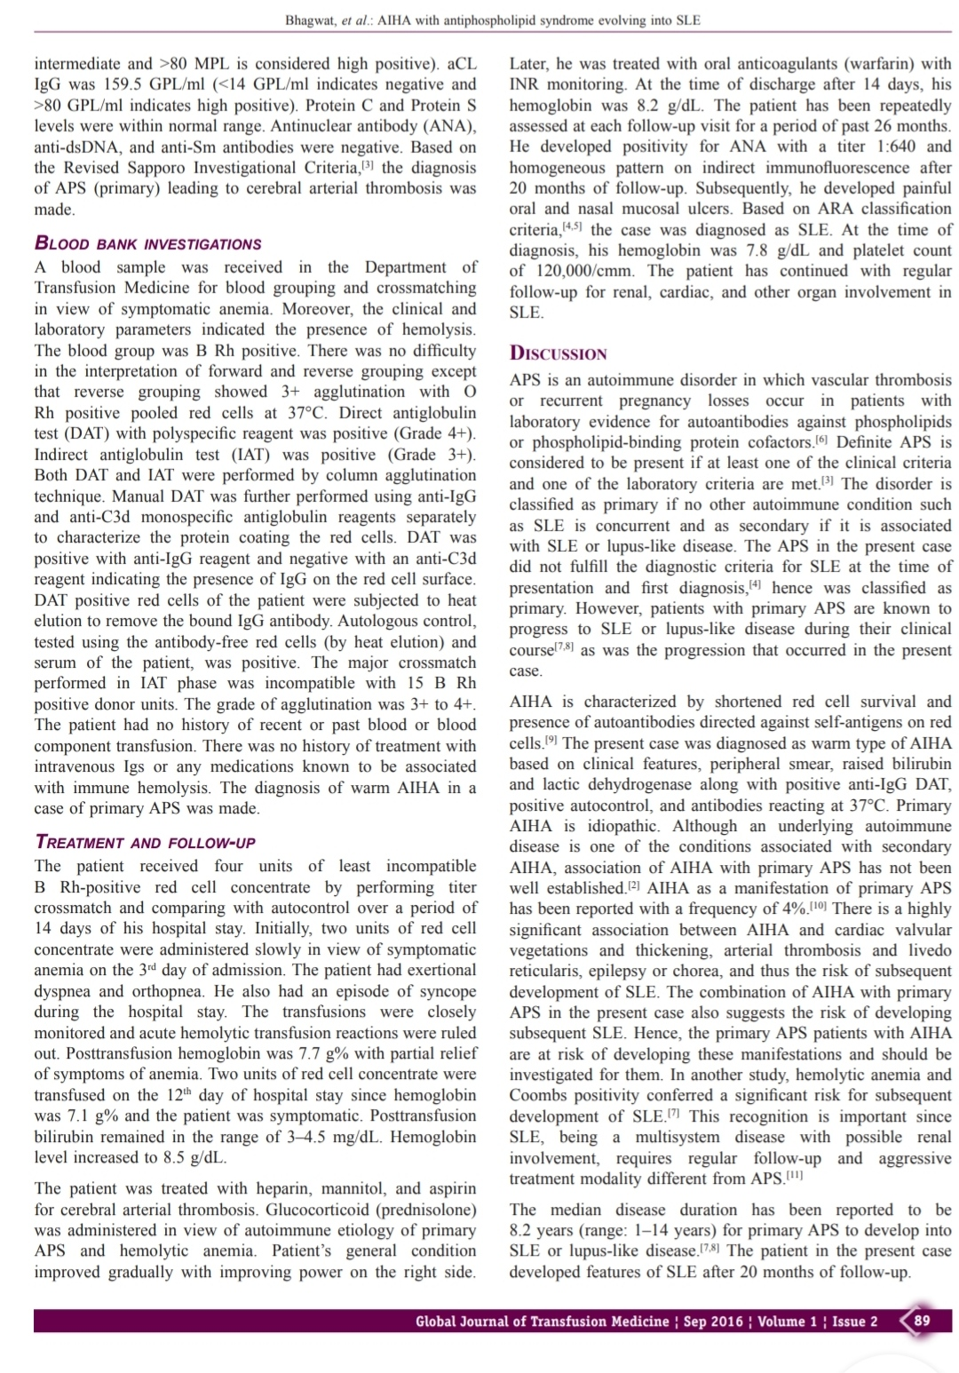

Slide 29
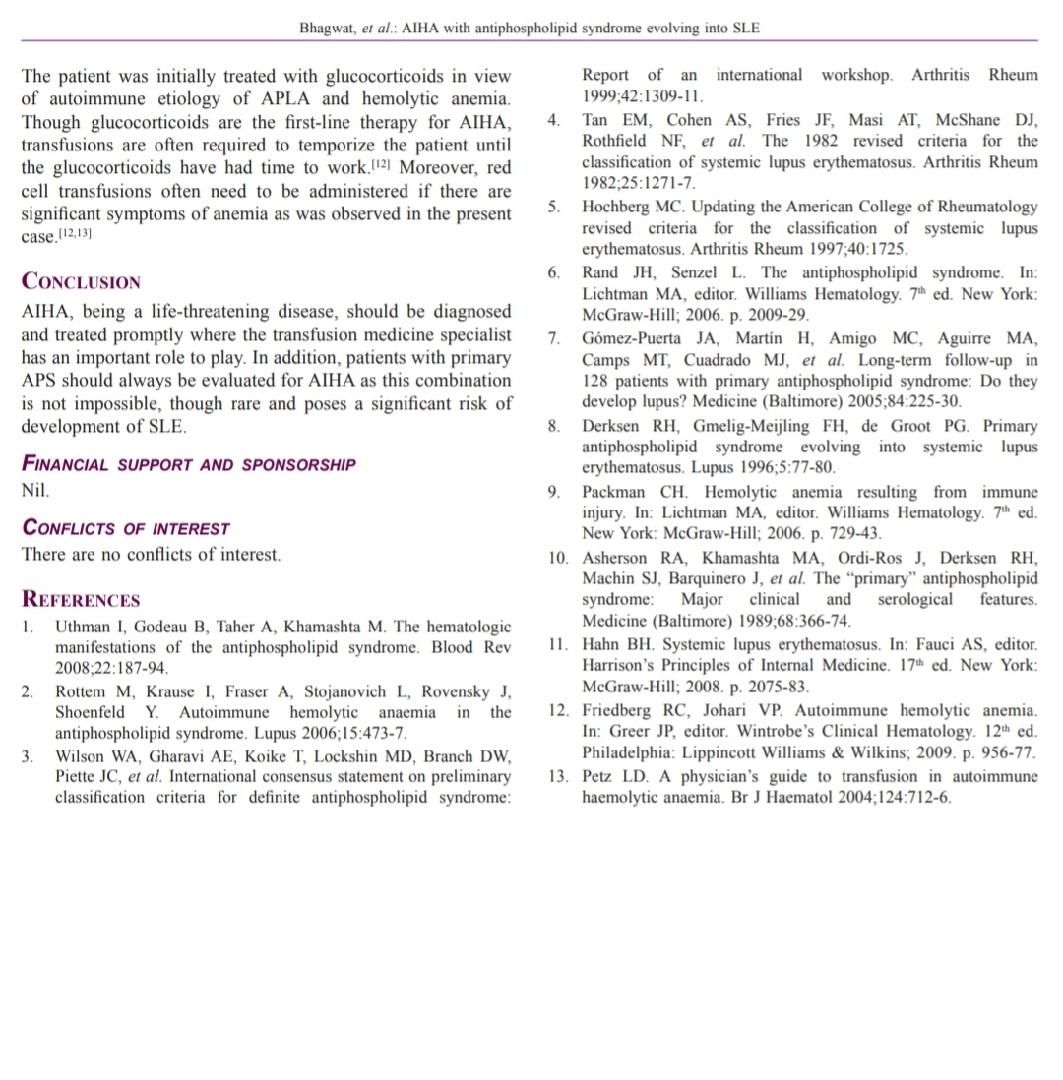

Slide 30
THANK YOU

