Slide 1
CIDP
DR SYAMILY

Slide 2
  Chronic inflammatory demyelinating polyneuropathy (also known as chronic inflammatory demyelinating polyradiculoneuropathy) is an acquired, immune-mediated neuropathy affecting peripheral nerves and nerve roots.
  Characterized by a relapsing-remitting or progressive course, glucocorticoid responsiveness, and electrodiagnostic or pathologic features of demyelination.

Slide 3
In its classic form, cidp manifests as a symmetric, motor-predominant neuropathy that results in both proximal and distal muscle weakness.
Recognized variants include asymmetric and/or sensory-predominant forms. all share the common pathophysiology of inflammatory demyelination.

Slide 4
pathophysiology
Primarily a t cell mediated process-supported by evidence of T cell activation, crossing of the blood-nerve barrier by activated T cells, and expression of cytokines, tumor necrosis factor, interferons.
Response to plasmapheresis suggest a possible role of b cell mediated immune response.
Both t cell as well as b cell mediated inflammation leads to neuronal damage and dysfunction
The activated t cells along with macrophage acts as antigen presenting cells and bind directly to targeted structures to promote demylination

Slide 5
in 10% of cidp cases, autoantibodies against nodal and paranodal proteins have been identified
Specific targets these autoantibodies includes
Neurofascin (NF) 155, a paranodal protein expressed by glial cells
NF140 and NF186, neuronal proteins present at nodes and axon initial segments
CNTN1 and contactin-associated protein 1 (CASPR1)

Slide 6
NEURO PATHOLOGIC FINDINGS
Biopsy reveals onion bulb formation with little inflammation
due to segmental demyelination and remyelination of peripheral nerves.
As a result, affected nerve fibers are enlarged due to whorls of overlapping and proliferating Schwann cell processes encircling bare axons.
Varying degrees of interstitial edema and endoneural inflammatory cell infiltrates, including lymphocytes and macrophages are seen .
The macrophages are thought to initiate the demyelination by degrading myelin

Slide 7
presentation
1.acute-onset CIDP-
patients present with more rapidly progressive symptoms
May mimic GBS
CIDP should be considered –deteriorates more than 9 weeks or relapse at least 3 times
2.progressive type –
accout for 60%
Common in old age
3.relapse and remitting type
1/3rd of cases

Slide 8
Clinical features
Proximal and distal muscle weakness
Usually symmetrical
Cranial nerve involvement- facial <5%
Auto immune less common
papilledema
Tremors
Sensory impairment-parasthesias,dysesthesias
ataxia

Slide 9
typical cidp
The most common subtype
accounts for at least 50 to 60 percent of all cases .
Onset – gradual , few months or longer
symmetric sensorimotor polyneuropathy with proximal and distal motor involvement that exceeds sensory involvement
Cranial nerve and bulbar involvement occur in 10 to 20 percent of patients
Facial nerve <5%
External ophthalmoplegia

Slide 10
most patients with typical CIDP also have sensory involvement and globally diminished or absent reflexes .
Sensory impairment - greater for vibration and position sense than for pain and temperature sense, reflecting the involvement of larger myelinated fibers.
This commonly results in gait ataxia because of impairment of proprioception .
Painful dysesthesias can occur.
Back pain may also be present.
Symptoms of lumbar spinal stenosis and cauda equina syndrome can occur rarely if there is marked nerve root hypertrophy.

Slide 11
Autonomic involvement in typical CIDP is generally mild and limited in distribution.
Constipation and urinary retention are not usually early symptoms, but may occur in more severe cases.

Slide 12
cidp variants
EUROPEAN ACADEMY OF NEUROLOGY(EAN) AND PERIPHERAL NERVE SOCEITY(PNS) criteria includes
1.MULTIFOCAL CIDP
2.FOCAL CIDP
3.MOTOR CIDP
4.SENSORY CIDP
5.DISTAL CIDP
Notes:
Clinical presntn different from typical cidp are consdrd cidp varints, bcz the shre the comn featues of demyelinatiom and response to immune therpy

Slide 13
Multifocal cidp
Synonyms
MADSAM(multifocal acquired demyelinating sensory and motor neuropathy)
multifocal demyelinating neuropathy with persistent conduction block
Lewis sumner syndrome
Multifocal inflammatory demyelinating neuropathy
Usually affects the upperlimb first, lowerlimb involvement later
CN involvement including 3,5,7,10, and 12

Slide 14
Focal cidp
Rare
Usually affects the brachial,or lumbosacral plexus
Can affect individual peripheral nerve as well

Slide 15
Motor cidp
Relatively symmetric proximal and distal weakness
Normal sensation clinically and electrodiagnostically
Typical cidp- sensation is abnormal
MMN-Pattern of weakness asymmetric,mainly affects upper limb
if sensory conduction is abnormal in Clinically motor cidp– motor predominat cidp
May deteriorate after corticosteroids

Slide 16
Sensory cidp
Characterised by gait ataxia,impairment of vibration and position sense and change in cutaneous sensation.
Muscle weakness is not present
If motor nerve conduction slowing or motor conduction block present – sensory predominat cidp

Slide 17
Distal cidp
Aka DADS(distal acquired demyelinating symmetric neuropathy)
P/W sensory loss in the distal UL and LL as well as gait instability
Weakness may occur,usually in the distal LL>UL
2/3rd of patients have IgM paraproteinaemic neuropathy, often with antibodies against myelin associated glycoprotein

Slide 18
Disorders not classified as cidp
Chronic immune sensory polyradiculopathy(CISP)
clinically sensory CIDP
with normal motor and sensory nerve conduction studies. .(sensory axons proximal to sensory root ganglia are affected)
somatosensory evoked potential may absent
2. Autoimmune nodopathies
Antibodies against nodal and paranodal cell adhesion molecules .
3.CIDP associated with other conditions
diabetes, monoclonal gammopathies, MGUS, HIV ,maliganacies

Slide 19
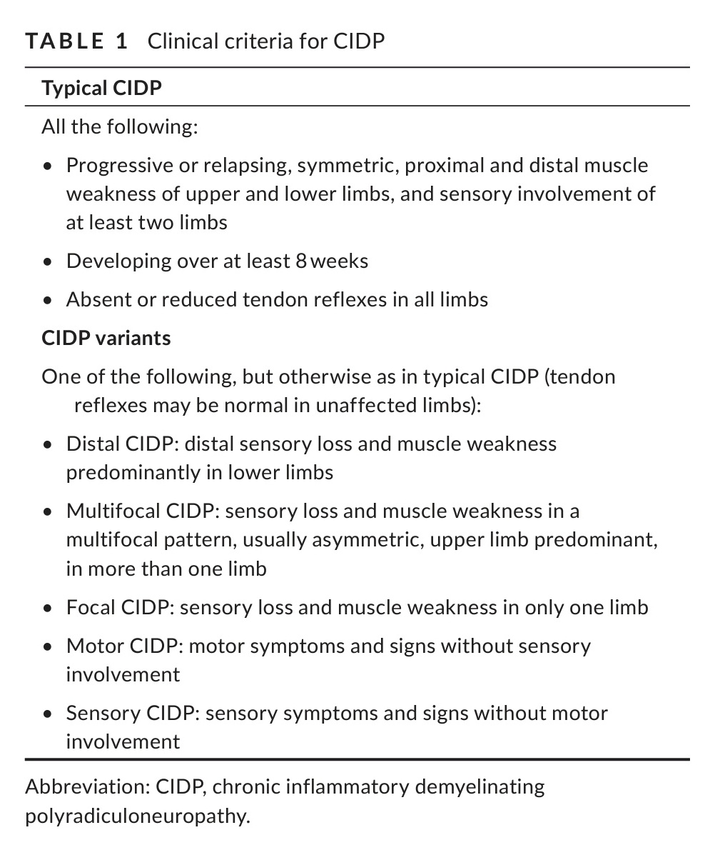
Clinical criteria

Slide 20
Supportive criteria
Response to treatment
Imaging
CSF study
Nerve biopsy
May support the diagnosis of CIDP in pts who fulfill clinical criteria for CIDP.

Slide 21
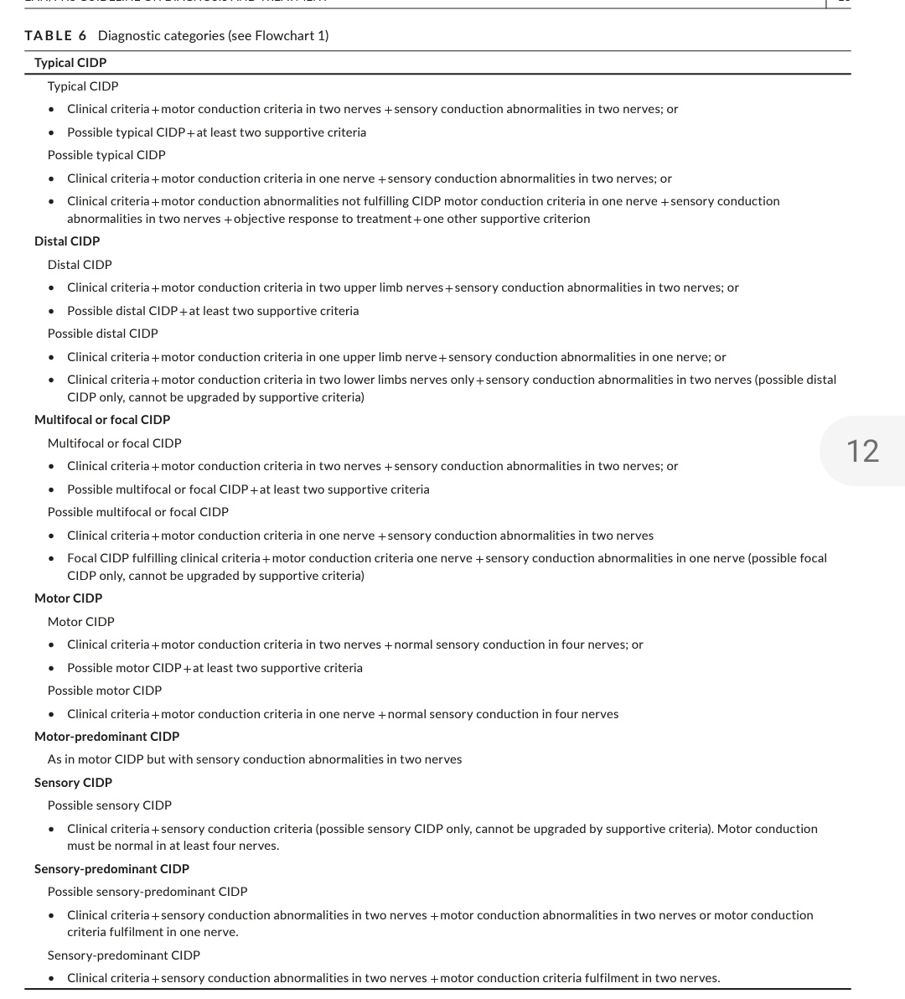

Slide 22
Diagnostic criteria –typical cidp
Typical cidp
All 3 clinical criteria + motor conduction criteria in two nerves + sensory conduction abnormalities in two nerves or
Possible typical cidp+ atleast two supportive criteria
Possobile cidp
Clinical criteria+ motor conduction criteria in one nerve + sensory conduction abnormalities in two nerves or
Clinical criteria+motor conduction abnormalities not fulfilling cidp motor conduction criteria in one nerve+ + sensory conduction abnormalities in two nerves+objective response to treatment+one supportive criteria

Slide 23
Diagnostic evaluation
1.history and examination
Points Favouring CIDP
Patients presenting with a progressive or relapsing-remitting polyneuropathy involving both motor and sensory axons.
Weakness predominates and affects proximal and distal muscles simultaneously and symmetrically.
Associated areflexia

Slide 24
Electrodiagnostic testing
Electrodiagnostic testing (nerve conduction studies of both sensory and motor nerves, electromyography) should be performed in all patients with suspected cidp .
The characteristic electrophysiologic features of CIDP are those of peripheral nerve demyelination, which include:
Partial conduction block .
Conduction velocity slowing .
Prolonged distal motor latencies .
Delay or disappearance of F waves
Temporal dispersion and distance-dependent reduction of compound motor action potential (CMAP) amplitude .

Slide 25
Laboratory testing
There are no laboratory test findings that specifically point to cidp.
Evaluation in patients with suspected cidp should include the following:
●fasting serum glucose and/or oral glucose tolerance test
●glycated hemoglobin (hba1c)
●serum calcium and creatinine
●complete blood count
●liver function tests
●thyroid function studies
●serum protein electrophoresis (spep) and immunofixation
●serum free light chain (flc) assay, or 24-hour urine protein electrophoresis (upep) and immunofixation

Slide 26
Additional tests in selected patients, including those with atypical presentations, may include:
●Borrelia burgdorferi serology
●C-reactive protein
●Antinuclear antibodies (ANAs)
●Angiotensin-converting enzyme
●Hepatitis panel (for types B and C)
●HIV antibody
●Chest radiograph
●Skeletal survey and vascular endothelial growth factor (VEGF) level, if a monoclonal gammopathy is found

Slide 27
LUMBAR PUNCTURE
Albuminocytologic dissociation is a hallmark of cidp and represents supportive evidence .

Slide 28
TREATMENT AND PROGNOSIS
Early administration of effective treatment is important in CIDP.
The goal is to stop the immune attack against the myelin sheath of peripheral nerves so that secondary axonal degeneration is minimized .

Slide 29
INITIAL THERAPY
Intravenous immune globulin
IVIG is an effective therapy for CIDP.
We start treatment with IVIG when a rapid response is a priority.
IVIG is usually easier to administer than plasma exchange and may have a more rapid response for disability improvement than with glucocorticoids.

Slide 30
Dosing regimens
The initial dose of IVIG is 2 g/kg infused over two to five days .
Many patients with CIDP require a treatment trial of repeat IVIG dosing every two to six weeks depending on clinical course.
For most patients, we repeat infusion of IVIG (1 g/kg) every three weeks for two to three months after the initial treatment before determining efficacy.

Slide 31
Plasma exchange
Plasma exchange is an effective alternative to IVIG; however, it may be less convenient to administer .
Dosing regimens – For patients with CIDP and severe disability, we suggest four to six exchanges over 8 to 10 days.
The plasma exchange schedule after that depends on clinical response but can usually be decreased to one exchange every three to four weeks.

Slide 32
GLUCOCORTICOIDS
Dosing schedule
For most patients, we prefer the use of pulse rather than daily glucocorticoids for initiation and initial titration of dosing .
We typically start with an initial dose of IV methylprednisolone (1000 mg/day) for three days, followed by 1000 mg one day a week for four weeks

Slide 33
. Options include dexamethasone 40 mg for four consecutive days once a month or prednisone 600 mg once a week .
In patients who respond to therapy, we taper either the dose or frequency once improvement or clinical stabilization occurs.

Slide 34
Alternative therapies
Alternative immunosuppressive agents are employed when glucocorticoids are contraindicated or are considered too risky or as steroid-sparing agents.
They may be useful in patients who do not respond to initial therapy as well as for patients who are refractory to alternative maintenance regimens.

Slide 35
The list of immune-modulator drugs that have been used to treat CIDP includes the following:
Cyclophosh;phamide
Azathioprine
Cyclosporine
Etanercept
Mycophenolate mofetil
Methotrexate
Rituximab
tacrolimus

Slide 36
Thank you

