Slide 1
Brain stem infarction
Dr Akhil Suresh

Slide 2
Authors
Supreeth N. Gowda¹; Orlando De Jesus².
Affiliations
¹ University of Kentucky
² University of Puerto Rico, Medical Sciences Campus, Neurosurgery Section
Publication History
Last Update: July 4, 2022.

Slide 3
composed of the midbrain, the pons, and the medulla oblongata, situated in the posterior part of the brain.

Slide 4
connection between the cerebrum, the cerebellum, and the spinal cord.

Slide 5
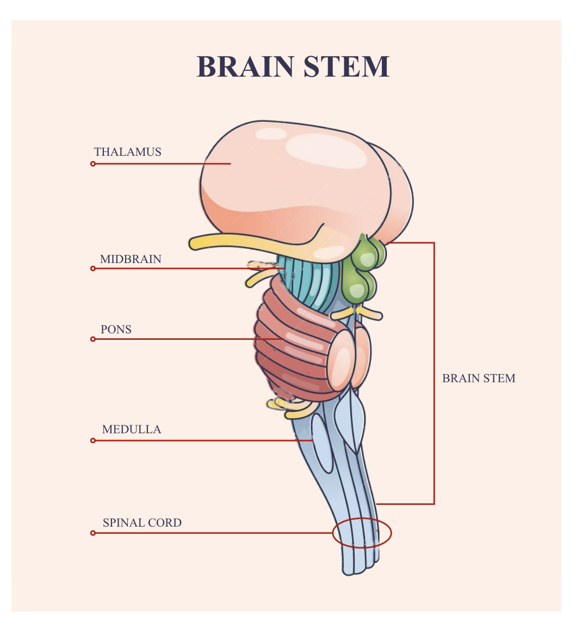

Slide 6
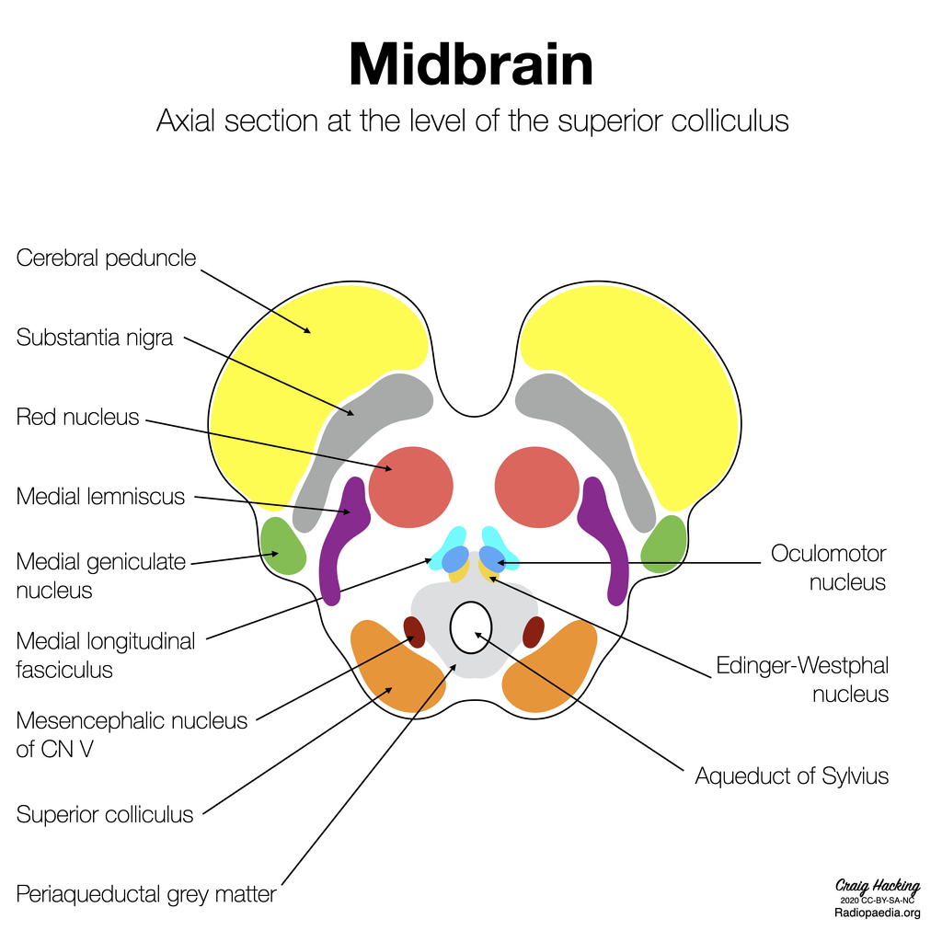

Slide 7
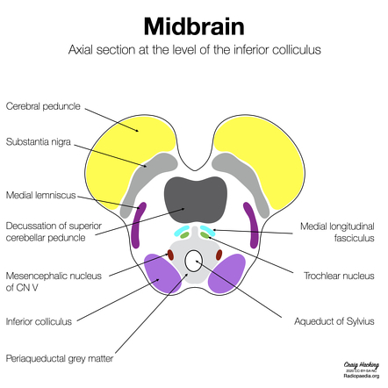

Slide 8
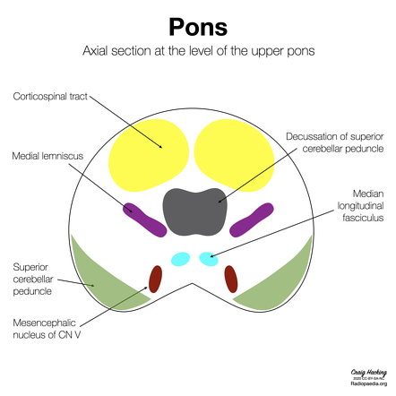

Slide 9
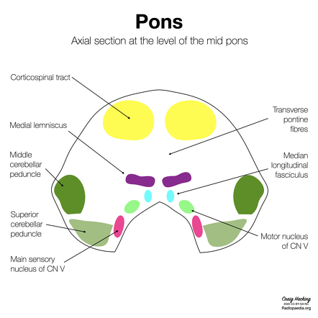

Slide 10
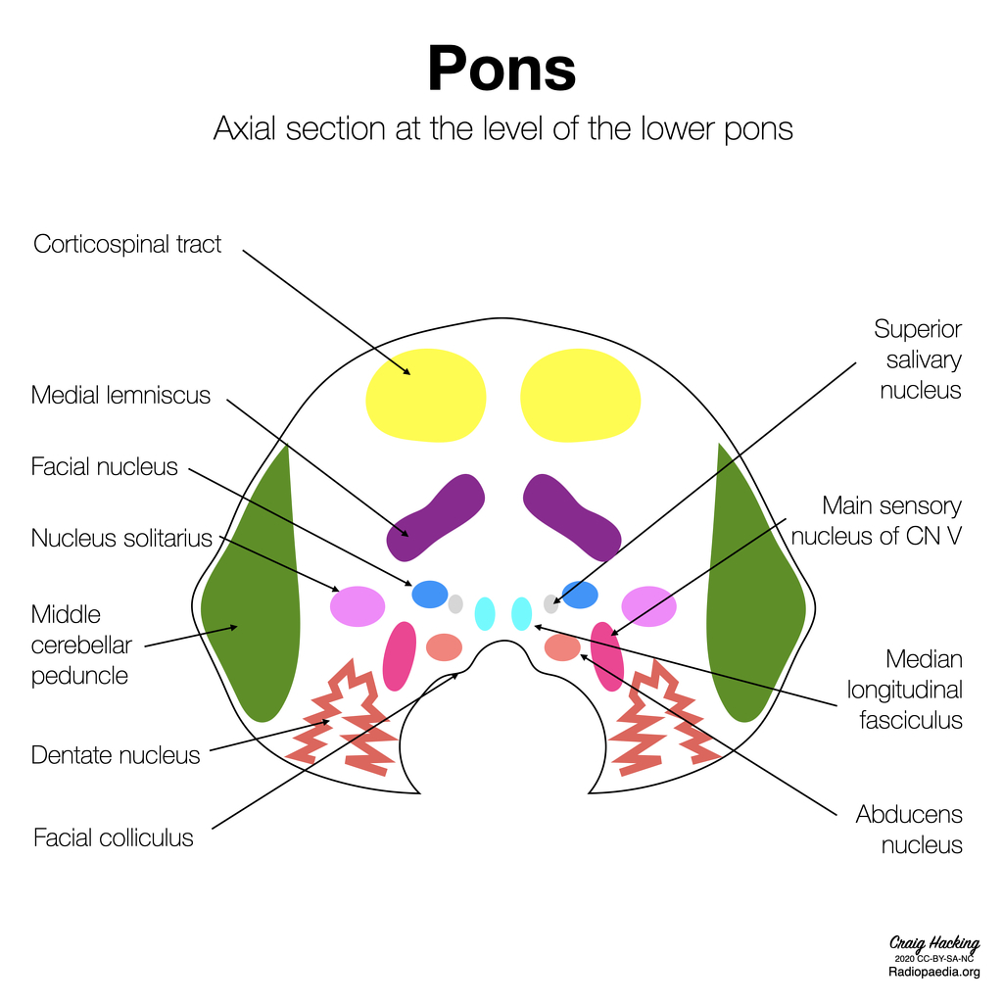

Slide 11
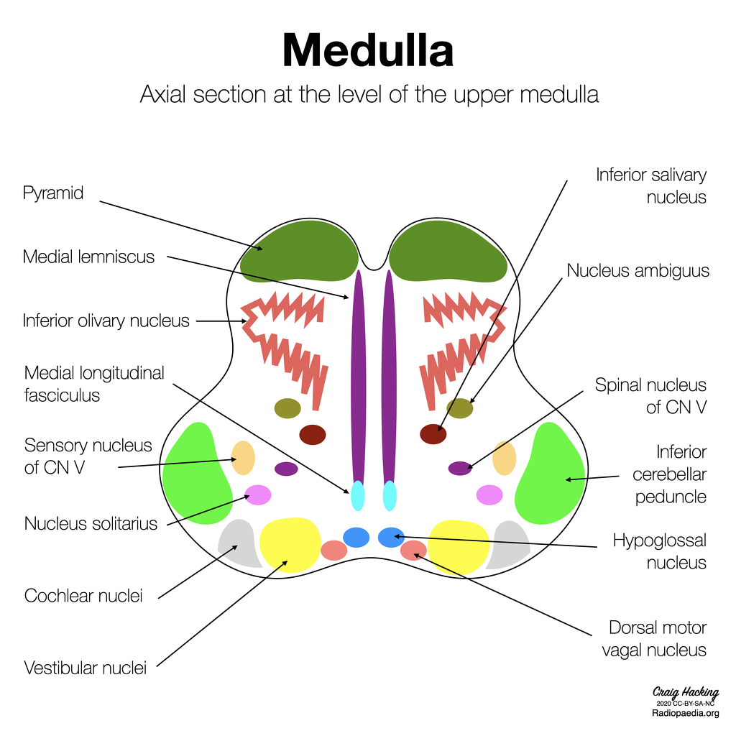

Slide 12
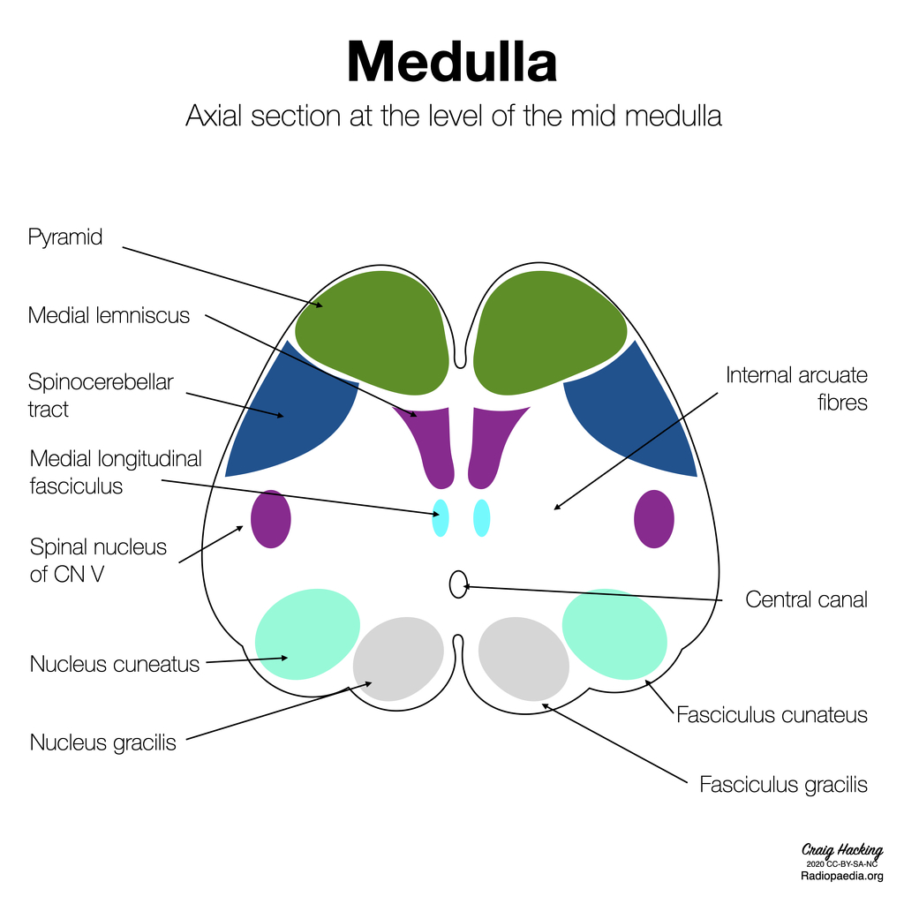

Slide 13
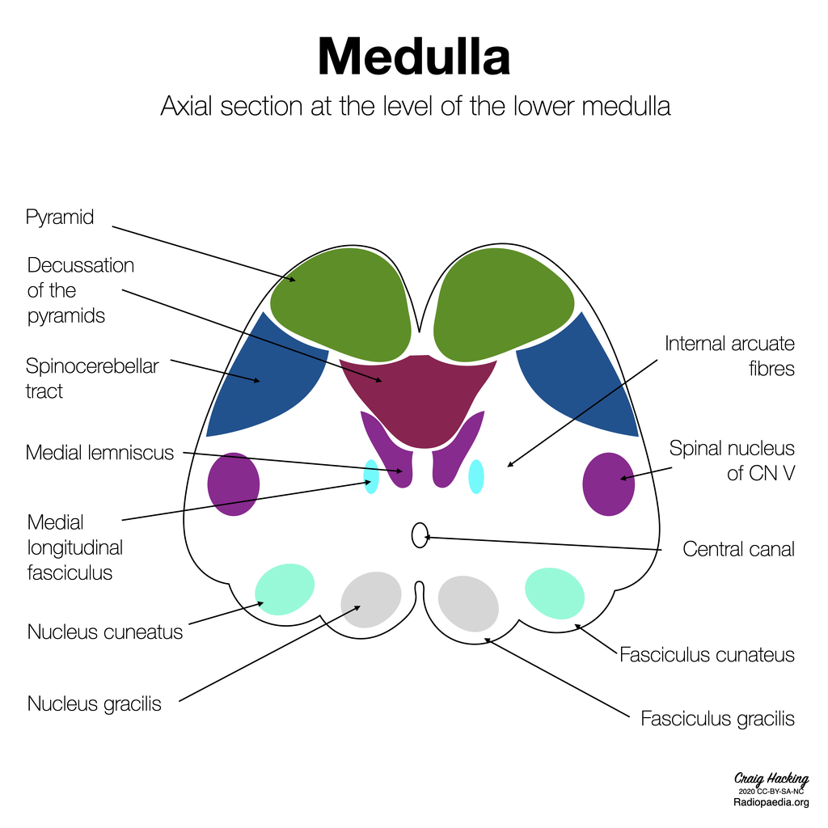

Slide 14
develops from the mesencephalon and part of the rhombencephalon, all of which originate from the neural ectoderm

Slide 15
organized internally in three laminae: tectum, tegmentum, and basis.

Slide 16
Gray matter in the brainstem is found in clusters all along the brainstem
forms mostly the cranial nerve nuclei, the pontine nuclei, and the reticular formation.

Slide 17
White matter in the form of various ascending and descending tracts can be found mainly in the basis lamina, which is the most anterior part

Slide 18
FUNCTIONS
responsible for multiple critical functions, including respiration, cardiac rhythm, blood pressure control, consciousness, and sleep-wake cycle

Slide 19
cranial nerve nuclei are present in the brainstem
a crucial role in vision, balance, hearing, swallowing, taste, speech, motor, and sensory supply to the face

Slide 20
The white matter of the brainstem carries most of the signals between the brain and the spinal cord
Helps with its relay and processing

Slide 21
BLOOD SUPPLY
mostly from the vertebrobasilar system.
The blood supply can be divided into a group of arteries supplying each region

Slide 22
Midbrain
Anteromedial: supplied by the posterior cerebral artery.
Anterolateral: supplied by the posterior cerebral artery and branches of the anterior choroidal artery.

Slide 23
Lateral: supplied by the posterior cerebellar artery, the choroidal artery, and the collicular artery.
Posterior: supplied by the superior cerebellar artery, the posteromedial choroidal artery

Slide 24
Pons
Anteromedial: supplied by the pontine perforating arteries, branches of the basilar artery.
Anterolateral: supplied by the anterior inferior cerebellar artery.
Lateral: supplied by the lateral pontine perforating arteries, branches of the basilar artery, anterior inferior cerebellar artery, or the superior cerebellar artery

Slide 25
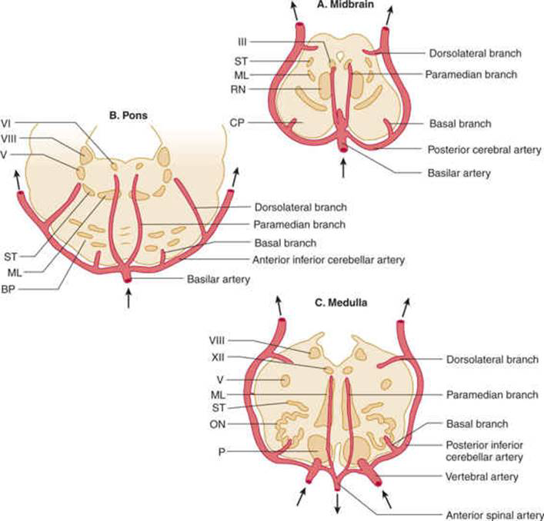

Slide 26
Medulla
Anteromedial: supplied by the anterior spinal artery and vertebral artery.
Anterolateral: supplied by the anterior spinal artery and vertebral artery.

Slide 27
Lateral: supplied by the posterior inferior cerebellar artery.
Posterior: supplied by the posterior spinal artery

Slide 28
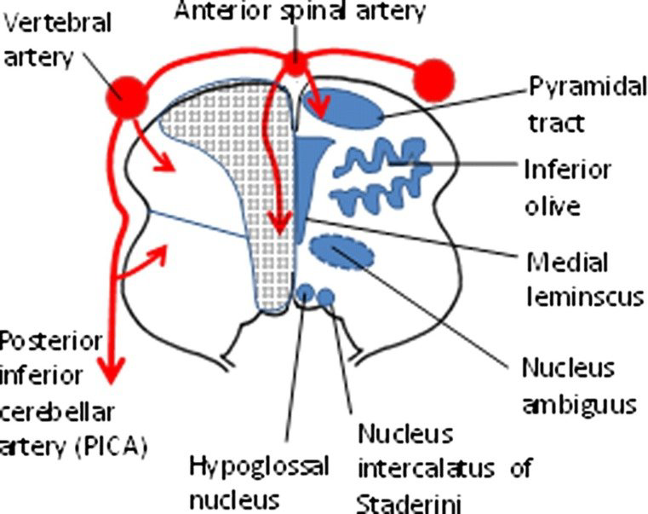

Slide 29
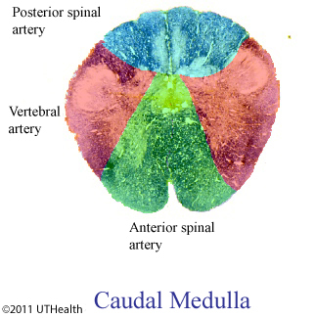

Slide 30
ETIOLOGY
sequelae of ischemia to any part of the brainstem, due to the loss of blood supply or bleeding

Slide 31
Atherosclerosis
Thromboembolism
lipohylanosis,
Tumor
arterial dissection
trauma.

Slide 32
In medulla oblongata infarcts, 73% are due to stenosis of the vertebral artery, 26% due to arterial dissection, and rest being caused by other causes like cardioembolic

Slide 33
the number of infarcts due to cardioembolic etiology increase to 8% in pontine infarcts and 20% to 46% in midbrain infarcts.

Slide 34
RISK FACTORS
hypertension, diabetes mellitus
metabolic syndromes, hyperlipidemia
Tobacco use, obesity
history of ischemic heart disease, atrial fibrillation
sleep apnea, lack of physical activity
use of oral contraceptives
fibromuscular dysplasia
trauma, and spinal manipulation

Slide 35
Pathophysiology
Ischemia causes tissue death
Cerebrum uses glucose, ketones are used in starvation
Little to no glucose reserve
Dependence on aerobic respiration and absent respiratory reserve makes cerebrum susceptible to infarction

Slide 36
Cellular cascade
Depletion of ATP due to lack of aerobic respiration in the mitochondria.
Loss of function of membrane ion pumps and impaired voltage gradient across membranes, leading to cellular edema

Slide 37
Excitotoxicity of the neurons due to the release of glutamate and synaptosomal-associated protein 25

Slide 38
further deterioration of energy levels and membrane ion potentials
. Production of reactive oxygen species and free radicals, leading to cell death

Slide 39
While the apoptotic/ necrotic pathway is in process, specific protective pathways are triggered

Slide 40
Expression of heat shock protein 70, B-cell lymphoma 2 gene family, and prion protein to prevent activation of the apoptotic cascade.

Slide 41
Release of Neurotrophin-3, interleukin-10, and granulocyte-colony stimulating factor, helping in the activation of survival pathways and reduction of proinflammatory cytokine activities

Slide 42
The cellular cascade is potentially reversible, which can lead to vasogenic edema over the next few hours

Slide 43
Vasogenic edema causes an increase in pressure in the surrounding tissue, leading to mass effect, and worsening the situation.
The eventual release of matrix metalloproteinases causes loss of structural integrity and the dissolution of the blood-brain-barrier

Slide 44
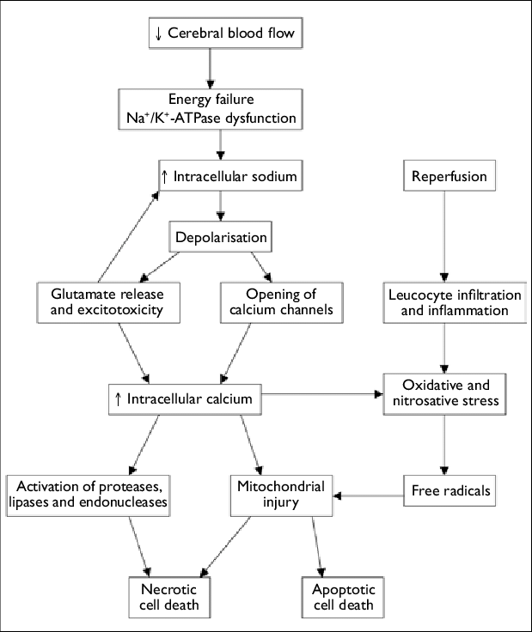

Slide 45
In the case of hemorrhagic etiology, the rupture of blood vessels causes hypoxia, pressure effects, and chemical irritation of brain tissue due to the disruption of blood-brain-barrier.

Slide 46
A loss of about 1.9 million neurons in the brain happens each minute in an untreated stroke.

Slide 47
History and physical examination
Time of ischemic insult
Comorbidities
Look for signs of raised ICT
Look for deficits
CT brain
MRI brain with arteriogram

Slide 48
Brainstem lesions can be divided into three broad categories to identify the affected region or function of the brainstem

Slide 49
Ascending and descending pathways
Weakness, loss of pain and temperature sensation, ataxia, Horner syndrome, loss of position and vibration sensation, gaze palsy

Slide 50
Nuclei and cranial nerves
Ocular and extraocular muscle weakness, loss of sensation over the face, autonomic dysregulation, dysphagia, dysarthria, dysphonia, vertigo, alteration in taste and hearing

Slide 51
Integrative and other functions
Choreoathetosis, tremors, ataxia, central dysautonomia, gaze paresis, lethargy, locked-in syndrome

Slide 52
CT Brain
MRI DWI and FLAIR
Arteriogram
Cardiac evaluation

Slide 53
Due to the high density of nuclei and fibers running through the brainstem, the lesion in various structures gives rise to different signs and symptoms.
Variously named stroke and stroke syndromes have been described in the literature

Slide 54
Top of the basilar syndrome
Also known as the rostral brainstem infarction.
Occurs due to occlusion of the distal basilar artery and its perforators.

Slide 55
It results in alternating disorientation, hypersomnolence, unresponsiveness, hallucination, and behavioral abnormalities along with visual, oculomotor deficits, and cortical blindness.

Slide 56
Ondines syndrome
Affects the brainstem response centers for automatic breathing
. It results in complete breathing failure during sleep but normal ventilation when awake.

Slide 57
The blood supply affected is the pontine perforating arteries, branches of the basilar artery, anterior inferior cerebellar artery, or the superior cerebellar artery.

Slide 58
One and a half syndrome
Affects the paramedian pontine reticular formation and medial longitudinal fasciculus
. It results in the ipsilateral conjugate gaze palsy and internuclear ophthalmoplegia

Slide 59
The blood supply affected is the pontine perforating arteries and branches of the basilar artery.

Slide 60
Midbrain syndromes
Claude
Benedict
Nothnagel
Weber

Slide 61
Claude syndrome
Affects the fibers from CN III, the rubrodentate fibers, corticospinal tract fibers, and corticobulbar fibers.
The blood supply involved is from the posterior cerebral artery

Slide 62
It results in ipsilateral CN III palsy, contralateral hemiplegia of lower facial muscles, tongue, shoulder, upper and lower limb along with contralateral ataxia.

Slide 63
Dorsal mid brain syndrome ( benedict )
Also known as paramedian midbrain syndrome
affects the fibers from CN III and the red nucleus.
It results in ipsilateral CN III palsy, contralateral choreoathetosis, tremor, and ataxia

Slide 64
The blood supply involved comes from the posterior cerebral artery and paramedian branches of the basilar artery.

Slide 65
Nothnagel Syndrome
Affects the fibers from CN III and the superior cerebellar peduncle
It results in ipsilateral CN III palsy and ipsilateral limb ataxia
It can be due to quadrigeminal neoplasms and is often bilateral.

Slide 66
Ventral midbrain syndrome ( Weber)
Affects the fibers from CN III, cerebral peduncle (corticospinal and corticobulbar tract), and substantia nigra

Slide 67
It results in ipsilateral CN III palsy, contralateral hemiplegia of lower facial muscles, tongue, shoulder, upper and lower limb.
The involvement of substantial nigra is present can result in a contralateral movement disorder

Slide 68
Pontine syndromes
Brissaud-Sicard syndrome
Facial colliculus syndrome
Gasperini syndrome
Gelle syndrome
Grenet syndrome
Foville syndrome
Marie Foix syndrome
Locked in syndrome

Slide 69
Raymond syndrome
Raymond cestan syndrome
Millard gubler syndrome

Slide 70
Brissaud Siccard
Affects the CN VII nucleus and corticospinal tract
It results in ipsilateral facial cramps and contralateral upper and lower limb hemiparesis.

Slide 71
The blood supply affected is the posterior circulation.
Rarely, the syndrome can arise due to brainstem glioma.

Slide 72
Facial colliculus syndrome
Affects the CN VI nucleus, the CN VII nucleus, and fibers and the medial longitudinal fasciculus
It results in lower motor neuron CN VII palsy, diplopia, and horizontal conjugate

Slide 73
It can occur due to neoplasm, multiple sclerosis, or viral infection.

Slide 74
Gasperini syndrome
Affects the nuclei of CN V, VI, VII, VIII, and the spinothalamic tract.
It results in ipsilateral facial sensory loss, ipsilateral impaired eye abduction, ipsilateral impaired eye abduction, ipsilateral nystagmus, vertigo, and contralateral hemi-sensory impairment.

Slide 75
The blood supply involved derives from the pontine branches of the basilar artery and long circumferential artery of the anterior inferior cerebellar artery

Slide 76
Gelle syndrome
Affects the CN VII, VIII, and corticospinal tract
. It results in ipsilateral facial palsy, ipsilateral hearing loss, and contralateral hemiparesis.

Slide 77
Grenet syndrome
Affects CN V lemniscus, CN VII fibers, and spinothalamic tract.
It results in altered sensation in the ipsilateral face, contralateral upper, and contralateral lower limbs. It can arise due to neoplasm.

Slide 78
Foville syndrome
Inferior medial pontine syndrome
Lower dorsal pontine syndrome
The blood supply affected is from branches of the basilar artery

Slide 79
affects corticospinal tract, medial lemniscus, middle cerebellar peduncle, and the nucleus of CN VI and VII.
It results in contralateral hemiparesis, contralateral loss of proprioception & vibration, ipsilateral ataxia, ipsilateral facial palsy, lateral gaze paralysis, and diplopia

Slide 80
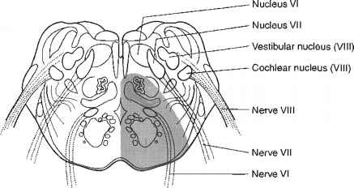

Slide 81
Marie Foix
Lateral pontine syndrome
The blood supply affected is the perforating branches of the basilar artery and anterior inferior cerebellar artery

Slide 82
Affects the nuclei of CN VII, & VIII, corticospinal tract, spinothalamic tract, and cerebellar tracts.
It results in contralateral hemiparesis, contralateral loss of proprioception & vibration, ipsilateral limb ataxia, ipsilateral facial palsy, lateral hearing loss, vertigo, and nystagmus

Slide 83
Locked in syndrome
Affects upper ventral pons, including corticospinal tract, corticobulbar tract, and CN VI nuclei.
It results in quadriplegia, bilateral facial palsy, and horizontal eye palsy.
The patient can move the eyes vertically, blink, and has an intact consciousness.

Slide 84
The blood supply affected is the middle and proximal segments of the basilar artery

Slide 85
Raymond syndrome
Affects the CN VI fibers, corticospinal tract, and corticofacial fibers
. It results in an ipsilateral lateral gaze palsy, contralateral hemiparesis, and facial palsy.

Slide 86
The blood supply involved is from the branches of the basilar artery

Slide 87
Raymond Cestan
Upper dorsal pontine syndrome
Circumferential branches of the basilar artery

Slide 88
Affects the longitudinal medial fasciculus, medial lemniscus, spinothalamic tract, CN V fibers and nuclei, superior and middle cerebellar peduncle.
It results in ipsilateral ataxia, coarse intension tremors, sensory loss in the face, weakness of mastication, contralateral loss of all sensory modalities

Slide 89
Millard Gubler
Ventral pontine syndrome
Derives from the branches of the basilar artery

Slide 90
Affects the CN VI & VII and corticospinal tract.
It results in ipsilateral lateral rectus palsy, diplopia, ipsilateral facial palsy, and contralateral hemiparesis of upper and lower limbs

Slide 91
Medulla oblongata
Avellis syndrome:
Affects the pyramidal tract and nucleus ambiguus
. It results in ipsilateral palatopharyngeal palsy, contralateral hemiparesis, and contralateral hemi-sensory impairment.
The blood supply affected is the vertebral arteries.

Slide 92
Babinski-Nageotte syndrome:
Also known as the Wallenberg with hemiparesis
affects the spinal fiber and nucleus of CN V, nucleus ambiguus, lateral spinothalamic tract, sympathetic fibers, afferent spinocerebellar tracts, and corticospinal tract.

Slide 93
It results in ipsilateral facial loss of pain & temperature, ipsilateral palsy of the soft palate, larynx & pharynx, ipsilateral Horner syndrome, ipsilateral cerebellar hemi-ataxia, contralateral hemiparesis, and contralateral loss of body pain and temperature.

Slide 94
The blood supply involved is from the intracranial portion of the vertebral artery and branches from the posterior inferior cerebellar artery.

Slide 95
Cestan-Chenais syndrome:
It affects the spinal fiber and nucleus of CN V, nucleus ambiguus, lateral spinothalamic tract, sympathetic fibers, and corticospinal tract.

Slide 96
It results in ipsilateral facial loss of pain and temperature, ipsilateral palsy of the soft palate, larynx & pharynx, ipsilateral Horner's syndrome, contralateral hemiparesis, contralateral loss of body pain & temperature, and contralateral tactile hypesthesia.

Slide 97
The blood supply affected is the intracranial portion of the vertebral artery and branches from the posterior inferior cerebellar artery

Slide 98
Hemimedullary syndrome (Reinhold syndrome):
Affects the nucleus & fiber of CN V, CN XII nucleus ambiguus, lateral spinothalamic tract, sympathetic fibers, afferent spinocerebellar tracts, corticospinal tract, and medial lemniscus.

Slide 99
It results in ipsilateral Horner's syndrome, ipsilateral facial loss of pain & temperature, ipsilateral palsy of soft palate, larynx & pharynx, ipsilateral tongue weakness, ipsilateral cerebellar hemi-ataxia, contralateral hemiparesis, and contralateral face sparing hemihypesthesia.

Slide 100
The blood supply involved is from the ipsilateral vertebral artery, the posterior inferior cerebellar artery, and branches from the anterior spinal artery.

Slide 101
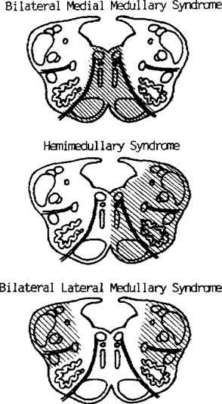

Slide 102
Jackson syndrome:
Affects CN XII and pyramidal tract. It results in ipsilateral palsy of the tongue and contralateral hemiparesis.
The blood supply involved is from the branches from the anterior spinal artery.

Slide 103
Lateral medullary syndrome (Wallenberg syndrome): Affects the spinal nucleus & fiber of CN V, nucleus ambiguus, lateral spinothalamic tract, sympathetic fibers, inferior cerebellar peduncle, and vestibular nuclei.

Slide 104
It results in ipsilateral Horner's syndrome, ipsilateral facial loss of pain & temperature, ipsilateral palsy of soft palate, larynx & pharynx, ipsilateral cerebellar hemi-ataxia, contralateral loss of body pain & temperature, nystagmus, dysarthria, dysphagia, and hyperacusis.

Slide 105
The blood supply affected is the vertebral artery and branches from the posterior inferior cerebellar artery.

Slide 106
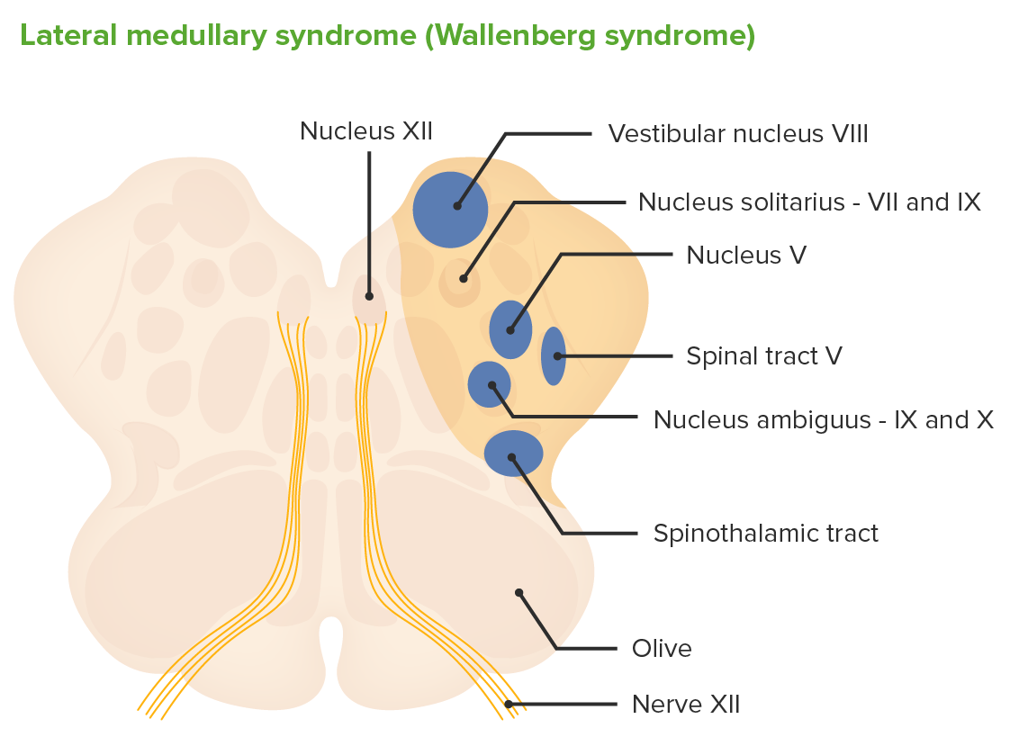

Slide 107
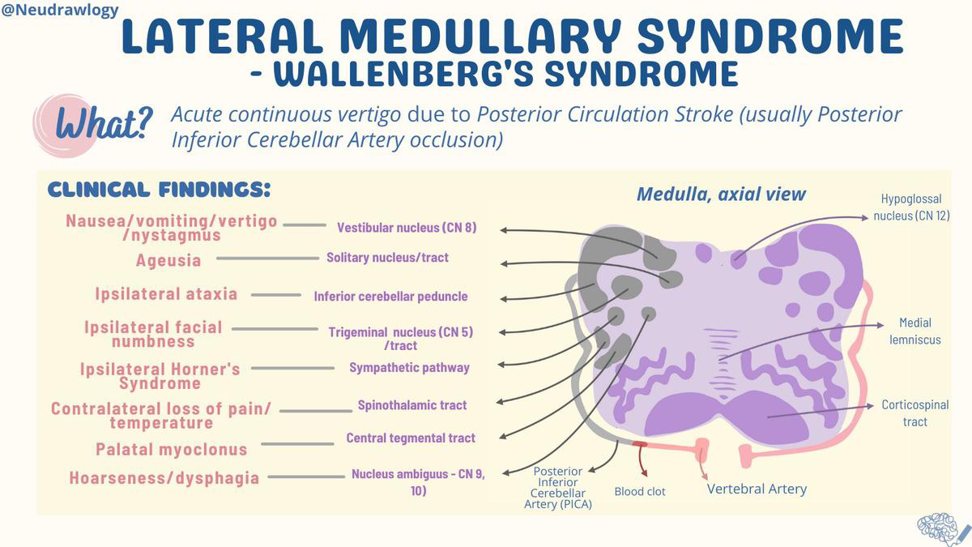

Slide 108
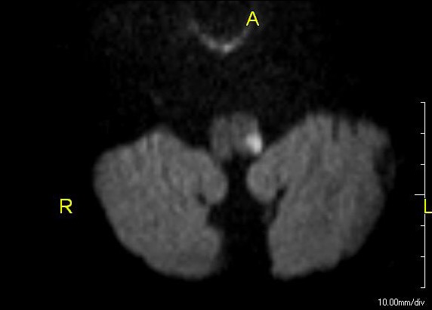

Slide 109
Medial medullary syndrome (Dejerine syndrome): Affects the fibers of CN XII, corticospinal tract, and medial lemniscus spinal.

Slide 110
Results in ipsilateral tongue weakness, contra lateral loss of proprioception & vibration, contralateral hemiparesis, and contralateral face sparing hemihypesthesia.

Slide 111
The blood supply affected is the branches from the vertebral artery and the anterior spinal artery.

Slide 112
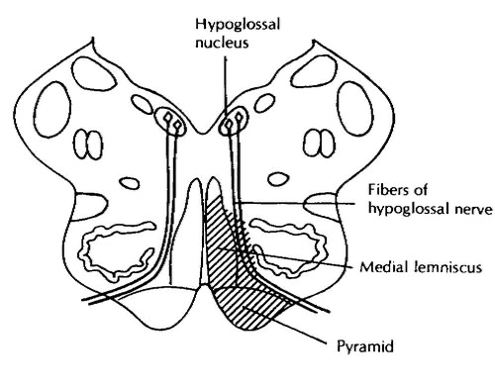

Slide 113
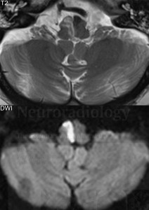

Slide 114
Schmidt syndrome:
Affects the fibers and nuclei of CN IX, X, XI, and pyramidal system.

Slide 115
It results in ipsilateral palsy of the vocal cords, soft palate, trapezius, & sternocleidomastoid muscle, and contralateral spastic hemiparesis.
The blood supply involved involves branches from the vertebral artery, the posterior inferior cerebellar artery the anterior spinal artery

Slide 116
Spiller syndrome:
Affects the fibers and nucleus of CN XII, corticospinal tract, and medial lemniscus spinal along with medial hemi-medulla.

Slide 117
Results in ipsilateral tongue weakness, ipsilateral loss of proprioception & vibration, contralateral hemiparesis, and contralateral face sparing hemihypesthesia.

Slide 118
The blood supply involved is from the branches from the vertebral artery and the anterior spinal artery.

Slide 119
Tapia syndrome:
Affects the nucleus ambiguus, CN XII, and pyramidal tract.

Slide 120
It results in ipsilateral palsy of the trapezius, sternocleidomastoid muscle, & half of the tongue, dysphagia, dysphonia, and contralateral spasmodic hemiparesis.

Slide 121
The blood supply involved is from the branches from the vertebral artery, the posterior inferior cerebellar artery the anterior spinal artery

Slide 122
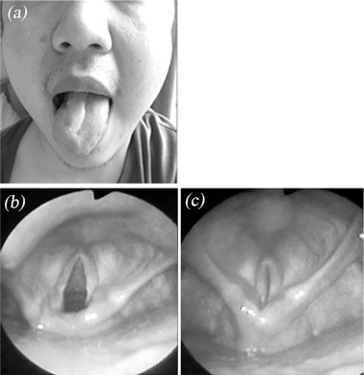

Slide 123
Vernet syndrome
Affects the CN IX, X, and XI.
It occurs due to compression in the jugular foramen

Slide 124
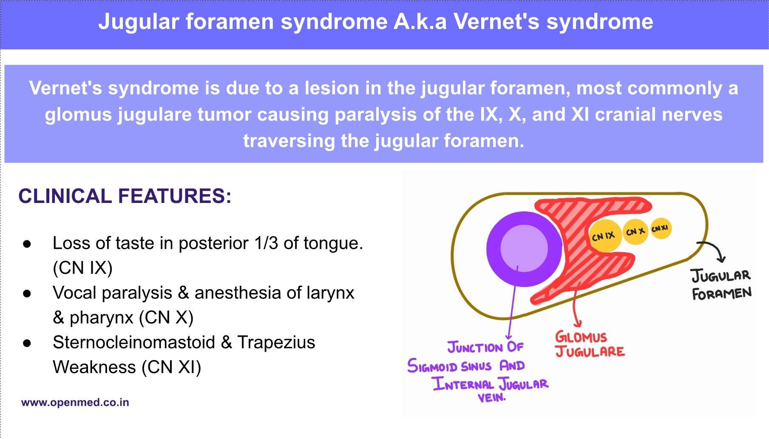

Slide 125
Management
Patients with last known normal within 4.5 hours can be considered as candidates for thrombolysis, whereas a 24 hour last known normal can be candidates for mechanical thrombectomy

Slide 126
Inclusion criteria for tPA:
Clinical diagnosis of ischemic stroke
<4.5 hours of the onset of symptoms
Age >18 and <80 years
Symptoms of stroke presenting for more than 30 minutes

Slide 127
Excision criteria for tPA:
Unknown timeline of onset of patient symptoms
Intracranial hemorrhage or any active bleeding
Persistently elevated blood pressure ≥ 185 mmHg systolic and ≥ 110 mmHg diastolic
Low platelets <100,000/mm3, altered INR >1.7, PT >15 sec or aPTT >40sec

Slide 128
Current use of anti-coagulant
Severe hypoglycemia <50mg/dL
History of previous intracranial hemorrhage
History of gastrointestinal bleeding in the past 21 days
History of intracranial or intraspinal surgery in the past 90 days
History of intra-axial intracranial neoplasm or gastrointestinal malignancy

Slide 129
Intravenous alteplase (recombinant tissue plasminogen activator)
should be given at the dose of 0.9 mg/kg (maximum dose of 90 mg/kg) with 10% as the loading dose in the first minute.

Slide 130
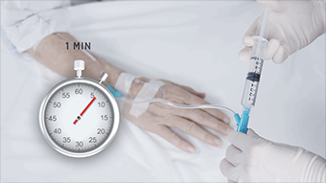

Slide 131
The patient must be under continuous observation.
Anti-platelet therapy must be withheld for at least 24 hours post thrombolysis and restarted after a head CT scan without evidence of bleeding

Slide 132
Mechanical endovascular thrombectomy
patients with large anterior circulation occlusion
; however, most strokes affecting the brainstem arises from posterior circulation perforating branches.

Slide 133
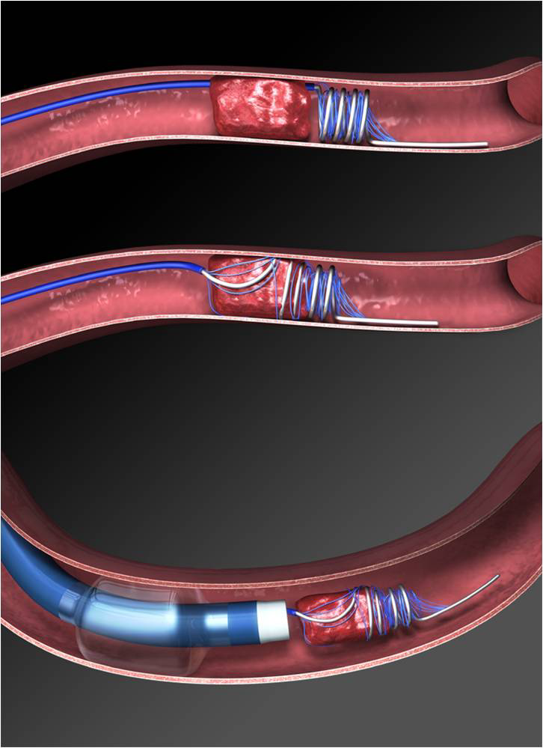

Slide 134
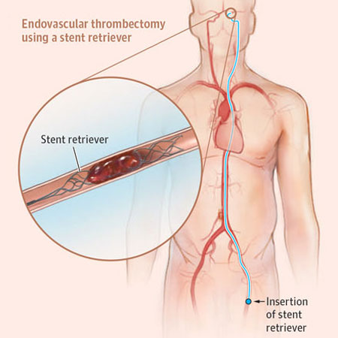

Slide 135
For those cases where the occlusion is at the main vertebral or basilar artery, endovascular thrombectomy is recommended for successful revascularization and favorable outcome.

Slide 136
Other studies have shown no evidence of a difference in favorable outcomes between endovascular therapy when compared to standard medical therapy alone.

Slide 137
Antiplatelet therapy:
The usage of acetylsalicylic acid as monotherapy or dual therapy along with clopidogrel within 24 – 48 hours after the onset of symptoms significantly improved patient outcomes

Slide 138
Management of risk factors
Medical
Life style modification

Slide 139
Differential diagnosis
Transient ischemic attack
Metastatic disease of the brain
Central pontine demyelination
Subarachnoid hemorrhage
Seizures
Basilar migraine
Basilar meningitis

Slide 140
Cerebellopontine angle tumors
Supratentorial hemispheric mass effect with herniation and brainstem compression
Hypoglycemia
Electrolyte imbalance
Conversion disorder

Slide 141
Prognosis
Untreated acute basilar artery occlusion has extremely high mortality approaching 90%
. For those patients who receive adequate treatment, the one-year survival rate is between 60 to 80%.

Slide 142
Complications
Hemorrhagic transformation
Seizures
Aspiration pneumonia
Myocardial infarction, arrhythmias, and heart failure
Dysphagia and dysphonia

Slide 143
Depression and anxiety
Blackouts and falls
Sleep disorders
Urinary tract infection
Deep vein thrombosis

Slide 144
Pulmonary embolism
Dehydration and malnutrition
Pressure sores and skin lesions
Orthopedic complications and contractures
Post-stroke fatigue

Slide 145
ACT FAST is an acronym suggested by the American Stroke Association to recognize the early symptoms of a stroke. It has the following components:
F-Face drooping
A-Arm Weakness
S-Speech
T-Time to call 9-1-1

Slide 146
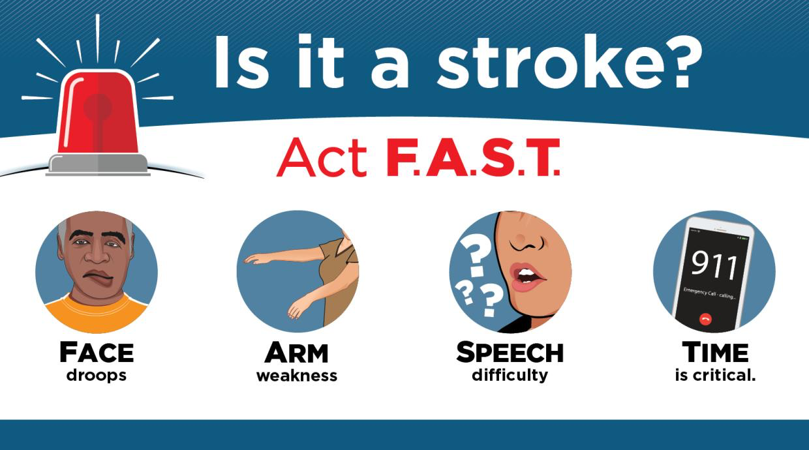

Slide 147
Along with FAST
if the patient experiences any of the following, emergency medical services must be activated
Sudden confusion
Sudden trouble seeing
Sudden numbness
Sudden trouble walking
Sudden severe headache

Slide 148
Thankyou

