Slide 1
Ascites
Presented by
Dr ROBINS ROY

Slide 2
Ascites
Defined as the accumulation of fluid in the peritoneal cavity.
It is a common clinical finding, with many extraperitoneal and peritoneal causes , but most common from liver cirrhosis .

Slide 3
CAUSES OF ASCITES
ASCITES WITH ANASARCA
congestive cardiac failure
nephrotic syndrome
hypoproteinemia with severe anemia {nutritional}
pericardial effusion
Constrictive pericarditis
Myxoedema
Protein losing enteropathy
Epidemic dropsy

Slide 4
ASCITES WITHOUT ANASARCA
Cirrhosis of liver (may lead to anasarca)
  Peritonitis –
  acute pyogenic peritonitis
  Tuberculous peritonitis
  Malignant peritonitis
  Sponteneous bacterial peritonistis
  Portal vein thrombosis
  Meig’s syndrome
  Pancreatic ascites (e.g from acute pancreatitis0
  Hepatic vein thrombosis ( Budd chiari syndrome)
  Rupture of hollow viscus within abdomen
  Lymphoma or leukemias
  Chylous ascites
  Haemoperitoneum following trauma

Slide 5
Most Common cause
Portal HTN secondary to chronic liver diseases ( cirrhosis)
  Intra-abdominal malignancy
  Congestive Heart Failure
  Mycobacterium tuberculosis

Slide 6
Portal Hypertension
It is a high blood pressure in the portal vein and its tributaries(portal venous system).
It is defined as a portal pressure gradient (the difference in pressure between the portal vein and the hepatic veins) of 5 mm Hg or greater.

Slide 7
Causes of portal hypertension
Intrahepatic causes: liver cirrhosis and hepatic fibrosis (e.g. due to Wilson's disease, hemochromatosis, or congenital fibrosis).
Prehepatic causes : portal vein thrombosis or congenital atresia.
Posthepatic obstruction occur at any level between liver and right heart, including hepatic vein thrombosis, IVC thrombosis, IVC congenital malformation, and constrictive pericarditis.

Slide 8
Cirrhosis
most common causes of cirrhosis:
Alcoholic liver disease or alcoholic hepatitis
viral hepatitis (B or C)
fatty liver disease

Slide 9
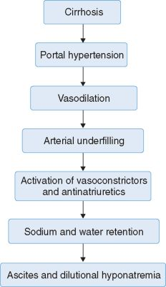

Slide 10
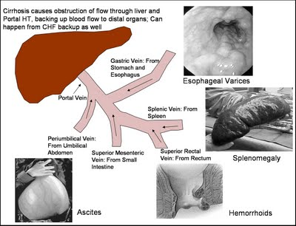

Slide 11
Other causes of ascites
Diseased peritoneum
  Bacterial peritonitis
  Tuberculous peritonitis
  Fungal peritonitis
  Human immunodeficiency virus (HIV)-associated peritonitis
Malignant conditions
  Peritoneal carcinomatosis
  Primary mesothelioma
  Pseudomyxoma peritonei
  Hepatocellular carcinoma

Slide 12
Other causes of ascites
Normal peritoneum
Portal hypertension
  Hepatic congestion, congestive heart failure, constrictive pericarditis, tricuspid insufficiency, Budd-Chiari syndrome
  Liver disease, cirrhosis, alcoholic hepatitis, fulminant hepatic failure, massive hepatic metastases
Hypoalbuminemia (SAAG < 1.1 g/dL)
  Nephrotic syndrome
  Protein-losing enteropathy
  Severe malnutrition with anasarca

Slide 13
Pathophysiology
Three theories of ascites formation have been proposed: under filling, overflow, and peripheral arterial vasodilation.
The under filling theory suggests that the primary abnormality is inappropriate sequestration of fluid within the splanchnic vascular bed due to portal hypertension and a consequent decrease in effective circulating blood volume.
This activates the plasma renin, aldosterone, and sympathetic nervous system, resulting in renal sodium and water retention.

Slide 14
Pathophysiology
The overflow theory suggests that the primary abnormality is inappropriate renal retention of sodium and water in the absence of volume depletion.
The most recent theory, the peripheral arterial vasodilation hypothesis, includes components of both of the other theories. It suggests that portal hypertension leads to vasodilation, which causes decreased effective arterial blood volume. As the natural history of the disease progresses, neurohumoral excitation increases, more renal sodium is retained, and plasma volume expands. This leads to overflow of fluid into the peritoneal cavity. The vasodilation theory proposes that underfilling is operative early and overflow is operative late in the natural history of cirrhosis.

Slide 15
, portal hypertension apparently leads to an increase in nitric oxide levels. Nitric oxide mediates splanchnic and peripheral vasodilation. Hepatic artery nitric oxide synthase activity is greater in patients with ascites than in those without ascites.
Regardless of the initiating event, a number of factors contribute to the accumulation of fluid in the abdominal cavity:
Elevated levels of epinephrine and norepinephrine are well-documented factors.
Hypoalbuminemia and reduced plasma oncotic pressure favor the extravasation of fluid from the plasma to the peritoneal fluid, and, thus, ascites is infrequent in patients with cirrhosis unless both portal hypertension and hypoalbuminemia are present.

Slide 16
Diagnosis:
1-history
Pts should be questioned about:
Liver diseases
Risk factors for Hepatitis C and hep B( needle sharing, tattoos, cocaine, heroin use

Slide 17
Pts with obesity, diabetes, hyperlipidemia and Nonalcoholic steatohepatitis ( NASH ) should be ruled out.
Pts with ascites who lack risk factors for cirrhosis should be questioned about cancer, heart failure, TB, dialysis, and pancreatitis.
Operative injury to the ureter or bladder can lead to leakage of urine into peritoneal cavity.
HIV pts may have infections lead to ascites.

Slide 18
SYMPTOMS-
Progressive swelling of abdomen with gain in weight.
Aching pain all over the abdomen do stretching; bloated feeling of abdomen.
Dyspnoea & even orthopnea (in large collection of fluid).
Swelling of lower limb ( due to ccf, nephrotic syndrome, functional ivc obstruction).
Paraesthesia in the distribution of lateral femoral cuteneous nerve (meralgia paraesthetica).
Oligouria

Slide 19
SIGNS-
GENERAL SURVEY-
the patient may be in propped up position due to dyspnoea.
Bipedal pitting edema.
Neck veins may engorged (due to hypervolaemia )
Obvious swelling of abdomen.

Slide 20
ABDOMEN-
Swelling of abdomen & there is fullness in flanks. The skin looks shiny.
Diverication of recti; there may be presence of abdominal (umbilical ) herniation or abdominal striae ( striae albicantes) .
Prominent veins in flanks
Umbillicus – flushed or everted with transverse slit.
Fluid thrill present .
Shifting dullness present.

Slide 21
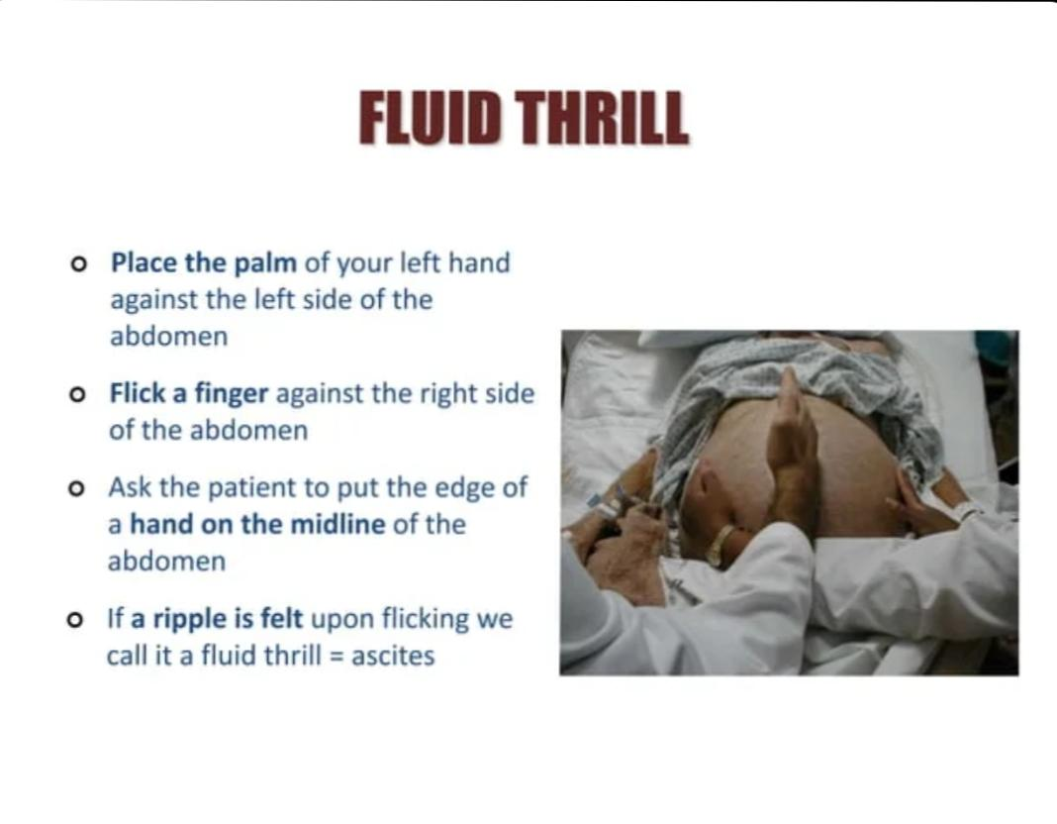

Slide 22
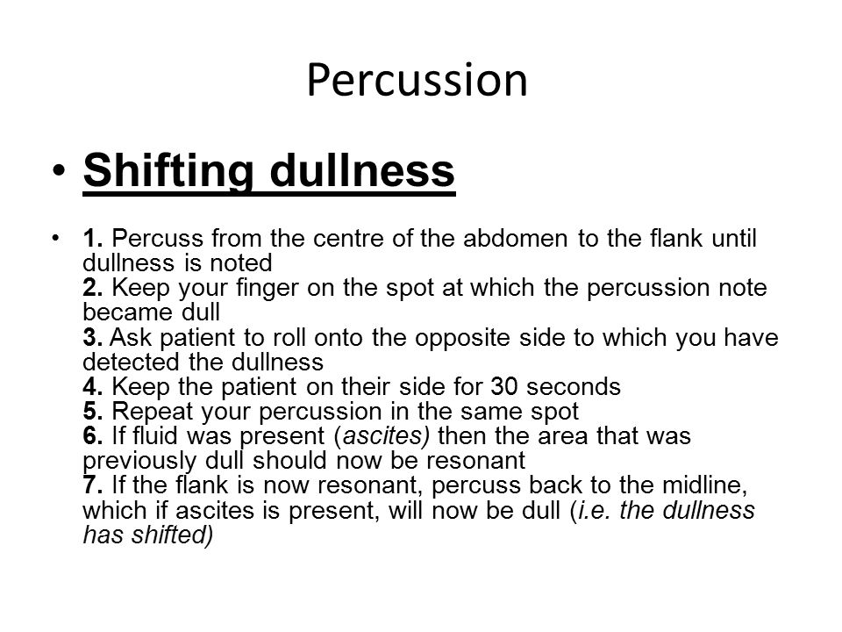

Slide 23
ESSENTIAL CRITERIA FOR POSITIVE FLUID THRILL:
Large amount of fluid (atleast 2 litre fluid is necessary to elicit fluid thrill).
Fluid should remain undertension.
Minimal fluid ( ½ to 1 litre)is required to demonstrate shifting dullness.

Slide 24
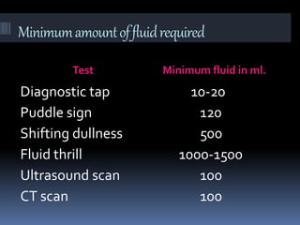

Slide 25
DIFFERENTIAL DIAGNOSIS
FAT- OBESITY( INVERTD UMBILICUS WITH ABSENT FLUID THRILL AND SHIFTING DULLNESS)
FAECES- MEGACOLON OR LOW GUT OBSTRUCTION( SYMMETRICAL ENLARGEMENT WITH VISIBLE PERISTALSIS)
FOETUS- PREGNANCY (FOETAL PARTS ARE PALPABLE; CENTRAL DULLNESS)
FLATUS- GASEOUS DISTENTION(FLANKS ARE NOT BULGRD; TYMPANIC NOTE ALL OVER ABDOMEN)
FLUID- OVARIAN CYST, ACSITIS
FULL BLADDER (FLANKS ARE TYMPANIC. PALPATION CAUSE PAINOR DISCONFORT AND DESIRE TO MICTURITION; USALLY ROUNDED CYSTIC SWELLING IN HYPOGASTRIUM WHICH IS DULL ON PERCUSSION SHIFTING DULLNESS ABSENT)

Slide 26
Diagnosis
-paracentesis
It is a diagnostic procedure to establish the etiology of new-onset ascites or to rule out spontaneous bacterial peritonitis in patients with preexisting ascites.
Large volume paracentesis is performed in hemodynamically stable patients with tense or refractory ascites to alleviate discomfort or respiratory compromise.
For diagnostic purposes, a small amount (20cc) may be enough for adequate testing.

Slide 27
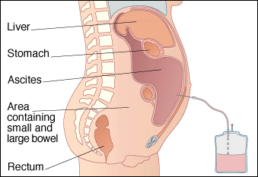
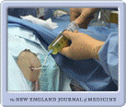

Slide 28
Ascitic fluid analysis
Cell count:
A white blood cell count is the most important.
A neutrophil > 250 cells/mm3 → spontaneous bacterial peritonitis
An elevated lymphocyte → tuberculosis or peritoneal carcinomatosis
Gram stain and culture:
for bacteria and acid fast bacilli

Slide 29
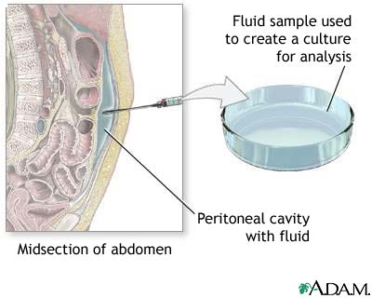
Red cell count
> 50.000/microliter →hemorrhagic ascites, which usually is due to malignancy, tuberculosis or trauma.

Slide 30
Serum-Ascites Albumin Gradient
Best single test for classifying ascites into portal hypertensive and non-portal hypertensive causes.
Calculated by:
Serum albumin – Ascites albumin= SAAG
SAAG >1.1 g/dL= Portal HTN
SAAG < 1.1 g/dL= Non-Portal hypertensive cause

Slide 31
WHAT IS SERUM- ASCITES ALBUMIN GRADIENT(SAAG)
If the serum albumin minus ascitic fluid albumin is equal to or greater than 1.1g/dl, the patient has portal hypertension. other than cirrhosis of liver this is a feature of ccf, budd-chiari syndrome, portal vein thrombsis, myxoedema.
If the gradient is less than 1.1 g/dl, usually it suggests malignancy acstis, tuberculous asctis pancreatic asctis or nephrotic syndrome
* saag is based on oncotic – hydrostatic balance and directly correlates with protal pressure.

Slide 32
SAAG
SAAG <1.1
Peritoneal carcinomatosis
Peritoneal Infection
(TB, Fungal, CMV)
Nephrotic syndrome
Pancreatic ascites
SAAG >1.1
Liver Disease
Hepatic Congestion
CHF
Tricuspid Insufficiency
Massive Hepatic Metastasis

Slide 33
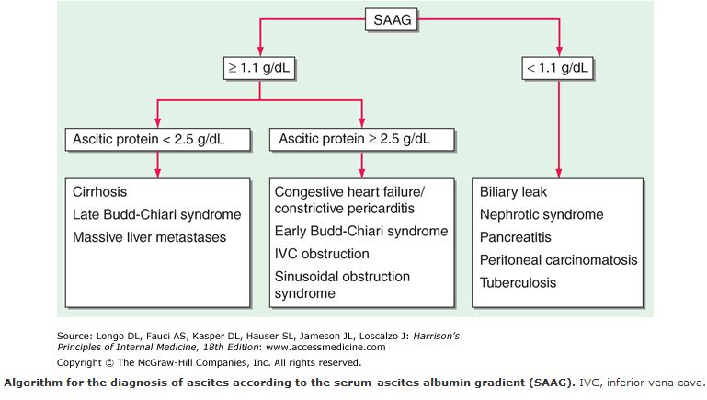

Slide 34
Total protein:
Helpful in diagnosing spontaneous bacterial peritonitis
Pts with a value<1 g/dl protein and glucose of <50mg/dl
have high risk of SBP
Cytology:
for malignant cells
Amylase:
to exclude pancreatic ascites

Slide 35
Ascitic Fluid
Appearance: The gross appearance of the ascitic fluid can be helpful in the differential diagnosis.
Turbid or cloudy: infected fluid.
Milky: Triglyceride concentration of greater than 200mg/dl (often greater than 1000mg/dl), malignancy is usually MC cause, but cirrhosis may present with chylous fluid.
Pink or Bloody: Pink fluid usually traumatic tap. Frankly bloody may occur in hepatocellular carcinoma, or other malignancy related ascites.
Brown: Deeply jaundiced pts may present with brown ascitic fluid, which may represent gallbladder rupture or perforated duodenal ulcer.

Slide 36
WHAT’S CHYLOUS ASCITES
CHYLOUS- turbid, creamy or milky peritoneal fluid due to presence of lymph. it shows sudan iii staining fat globules and contains a large amount of chylomicrons.
CHYLOUS ASCITES CAUSES:
Tuberculosis, Filariasis, Trauma To The Abdomen, Intra-abdominal Malignancy, Nephrotic Syndrome, Congenital Lymphangectasisa Or Obstruction To The Thoracic Duct(eg. Lymphoma)

Slide 37
Management of Ascites
The goal is to prevent Na loading and increase renal excretion of Na and H2O and produce a net re-absorption of fluid from the ascites back into the circulating volume.
Dietary Na restriction
Diet of 2g sodium per day
Fluid Restriction:
Only done when serum Na is <125mmol/L
Check Labs
Ck serum electrolytes and creatinine every other day.
Weigh the patient and measure urinary output daily.

Slide 38
Management of Ascites
Goal- Negative sodium balance .(2 g Na+ / day)
Grade 2 ascitis mineralocorticoid antagonist first line
First episode of ascitis
Spirinolactone 100 mg/ day to 400 mg /day
Not responding
Diurectic added furesemide 40 mg/ day to 160 mg/day
Recurrent episode combined diurectic and mineralocorticoid antagonist given

Slide 39
Management of grade 3 Ascites
Large Volume Paracentesis
To relieve symptomatic tense ascites and peripheral edema.
Up to 20L can be removed over 4-6hr.
Removal of 5L or more of ascitic fluid during a single session.
8 g albumin/ L given after 5 L

Slide 40
Paracentesis Contraindications:
Acute abdomen (absolute)
Severe bowel distention
Previous abdominal surgery (if necessary perform open procedure)
Pregnancy (if necessary perform after first trimester using an open technique above the umbilicus)
Distended bladder that cannot be relieved by foley catheder
Infection at site of insertion (cellulitis or abscess)
Thrombocytopenia (relative)
Coagulopathy (relative)

Slide 41
Paracentesis Complications:
Bladder perforation
Small or large bowel perforation
Stomach perforation
Laceration of major vessels ( mesenteric, iliac, aorta)
Laceration of catheter or guide wire and loss in peritoneal cavity (requires laparotomy)
Abdominal wall hematoma
Incisional hernia
Wound infection
Wound dehiscence

Slide 42
Management of Ascites
Transjugular Intrahepatic Portasystemic Shunt:
The TIPS procedure is an interventional radiologic technique that reduces portal pressure and may be the most effective treatment for diuretic resistant ascites.
Risks:
Hepatic Encephalopathy (30% of pts)
Thrombosis and shunt stenosis.

Slide 43
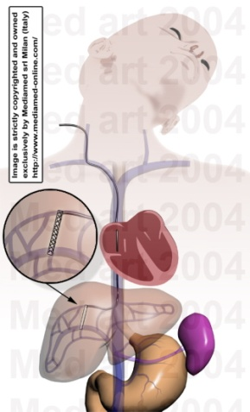
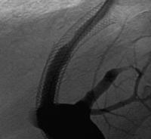
TIPS Procedure
side to side portacaval shunt, usually placed through the right internal jugular vein. A needle is placed through the IJV into the hepatic vein.

Slide 44
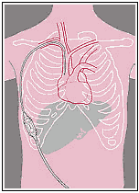
Peritoneovenous shunt:
:
Developed to return ascitic fluid from the peritoneal cavity directly to the systemic circulation.
Consists of an intra-abdominal tube connected through a valve to silicone tube that transverses the subcutaneous tissue up to the neck and enters one of the jugular veins.
This leads to diuresis and mobilization of ascites.

Slide 45
Risks of Peritoneovenous shunt:
DIC
Infection
Variceal bleeding
Small bowel obstruction
Shunt occlusion
Death
Due to these risk this procedure is rarely used.
Peritoneovenous shunts are therapeutic but do not improve survival rates in patients with cirrhosis and ascites.

Slide 46
Management of Ascites
liver transplantation:
Tx of choice
Corrects portal hypertension
Changes the natural course of progressive liver failure due to cirrhosis
Not all pts are candidates for transplant, and those who are may wait for years for a donor
Many die from complications of ascites while waiting for transplant donor

Slide 47
Complications from Ascites
Refractory Ascites:
Fluid overload that is unresponsive to Na-restricted diet and high dose anti-diuretic treatment.
Usually in the setting of chronic or acute liver diseases with associated portal hypertension.

Slide 48
POSSIBLE CAUSES OF REFRACTORY ASCITIS:
NON COMPLIANCE (NOT FOLLOWING THE ADEQUATE RESTRICTION OF SODIUM)
FUNCTIONAL RENAL FAILURE IN CIRRHOSIS OF LIVER
INFECTION
SPONTANEOUS BACTERIAL PERITONITIS
HEPATOMA
G.I. BLEEDING
NSAIDS (DEPRESS THE DIURETIC EFFECT OF FRUSEMIDE AND SPIRONOLACTONE)
PORTAL OR HEPATIC VEIN THROMBOSIS
SUPERIMPOSED CARDIAC OR RENAL FAILURE

Slide 49
Treatment of Refractory Ascites:
Liver transplantation is treatment of choice.
If unsuitable, treatment with:
Serial paracentesis
TIPS
Peritoneovenous shunt

Slide 50
Complications of Ascites
Hepatorenal syndrome:
Life-threatening medical condition that consists of
rapid deterioration in kidney function in individuals
with cirrhosis or fulminant liver failure. HRS is
usually fatal unless a liver transplant is performed,
although various treatments, such as dialysis, can
prevent advancement of the condition. It is a
common complication of cirrhosis, occurring in
18% of cirrhotics within one year of their
diagnosis, and in 39% of cirrhotics within five
years of their diagnosis.

Slide 51
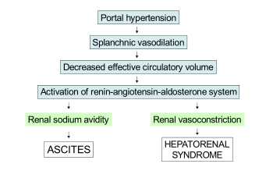

Slide 52
3 Spontaneous Bacterial Peritonits
20% of patients with cirrhotic ascites
Diagnosed with neutrophil count of
>250/mm3
Gram – neg organisms in 60% of cases
(E.coli and Klebsiella pneumoniae )
Gram + organisms 25% of cases
(Strep species )

Slide 53
Symptoms: Abdominal pain, fever, development of hepatic encephalopathy, diarrhea, hypothermia and shock.
Ascitic Protein level<1 g/dl is a risk for
Spontaneous Bacterial Peritonits.
Treatment: 3rd generation cephalosporin

Slide 54
Thank you

