Slide 1
ORIGINAL ARTICLE
JOURNAL CLUB ON 31/12/2020
NITHYA RAMANUJAN
JR1

Slide 2
TICAGRELOR VERSUS CLOPIDOGREL IN ELECTIVE PERCUTANEOUS CORONARY INTERVENTION (ALPHEUS): A RANDOMISED, OPEN-LABEL, PHASE 3B TRIAL
Published by Johanne Silvain et al on November 14 2020 in lancet

Slide 3
INTRODUCTION
Percutaneous coronary intervention (PCI) is widely used in patients with stable coronary artery disease and is considered a safe procedure.
Over the past decade, the rates of associated stent thrombosis, Q-wave myocardial infarction, stroke, and death have substantially decreased, and they are now considered rare periprocedural complications.
However, development of highly sensitive cardiac troponin assays has led to the documentation of frequent periprocedural myonecrosis.
Although often asymptomatic, these periprocedural complications can delay hospital discharge, and have been associated with an increased risk of future major cardiac adverse events, including death.

Slide 4
Side branch occlusion, slow coronary flow, and embolisation are potential mechanisms of atherothrombotic complications and could be reduced by more effective antiplatelet therapy than the recommended combination of aspirin and clopidogrel.
Intravenous cangrelor has shown benefit over clopidogrel in PCI, reducing ischaemic complications at the expense of increased bleeding.
Despite a higher risk of bleeding, prasugrel and ticagrelor, with a more potent and rapid onset of action compared with clopidogrel, are now the standard of care for PCI in patients with acute coronary syndrome, but have not been well investigated in elective PCI.

Slide 5
OBJECTIVE
The assessment of loading with the P2Y12 inhibitor ticagrelor or clopidogrel to halt ischaemic events in patients undergoing elective coronary stenting (ALPHEUS) study examined the effect of ticagrelor compared with clopidogrel to reduce periprocedural myocardial necrosis in stable coronary patients undergoing high-risk elective PCI.

Slide 6
METHODS
Study design and participants
The ALPHEUS study, a phase 3b, randomised, open-label trial, was done at 49 hospitals in France and Czech Republic.
Patients with stable coronary artery disease, defined as having a baseline cardiac troponin below the upper limit of the normal or a decreasing level in case of modestly positive cardiac troponin (within the grey zone specific to each high sensitivty troponin assay or below three times the upper limit of the local laboratory normal values), were eligible for the study if they had an indication for PCI and at least one high-risk characteristic.
Patients who were on chronic clopidogrel treatment (maintenance dose for more than 5 days) were eligible for the study.

Slide 7
Randomisation and masking
Eligible patients were randomly assigned (1:1) to either ticagrelor or clopidogrel by use of an interactive web response system available via the electronic case report form, and stratified by centre.
The study was open label, as a full double-blind design was not possible because of budget constraints.
However, the primary endpoint was based on the measurement of post-PCI troponin, which is not subject to interpretation or bias, and the clinical endpoints were all adjudicated in a masked fashion, in addition to reading of PCI videos at a central core laboratory and statistical analyses.

Slide 8
Administration of the loading dose of the study drug took place after the angiogram and before PCI, which could be staged (deferred PCI within 24 h of administration of the loading dose of study drug) or immediately after randomisation (ad-hoc PCI was defined as within 3 h after the angiogram).
Random assignment could not occur before the coronary status was known.

Slide 9
Procedures
Patients received a loading dose of ticagrelor 180 mg before PCI and 90 mg twice daily thereafter for 30 days or a loading dose of clopidogrel 300–600 mg (dose at the discretion of the physician) and 75 mg daily thereafter for 30 days.
Investigators could administer the loading dose as whole or crushed tablets.
The duration of study treatment was 30 days after PCI.
Beyond 30 days, the choice of treatment was left at the discretion of the treating physician.

Slide 10
A pharmacodynamic substudy (the Bio-ALPHEUS study) was done at five participating centres and analysed the level of P2Y12 inhibition in a masked fashion at the ACTION central core laboratory (Paris, France).
Samples were drawn at baseline, 4 h after the loading dose, and the day after PCI and platelet inhibition was evaluated using the vasodilator-stimulated phosphoprotein platelet reactivity index measured by ELISA.

Slide 11
Outcomes
Primary outcome- PCI related myocardial infarction (type 4a or 4b) or major myocardial injury within 48 h of the procedure (or at hospital discharge if earlier).
The definition of the primary outcome of the ALPHEUS trial corresponded to the third universal definition of myocardial infarction that was effective at the time of the study design.
The fourth universal definition of myocardial infarction was published while the study was ongoing, and the protocol was amended to include the new definition of myocardial injury in the main secondary outcome, combining PCI-related myocardial infarction (type 4a or 4b) and any type of myocardial injury (major or minor).

Slide 12
Other secondary outcomes included the composite of death, myocardial infarction (all type), or stroke or transient ischaemic attack; the composite of death or myocardial infarction (type 1, 4, and 5), major myocardial injury, urgent revascularisation, or recurrent ischaemia requiring catheterisation.
The primary safety outcome was major bleeding, evaluated by the Bleeding Academic Research Consortium (BARC) criteria (BARC 3 or 5).
Secondary safety outcomes included minor or nuisance bleeding (BARC 1 or 2) and any bleeding (BARC 1 to 5).
A net clinical benefit outcome comprising death, myocardial infarction, stroke, or major bleeding was also evaluated.

Slide 13
Bleeding risk was evaluated with the Dual Antiplatelet Therapy (DAPT) score and the PARIS bleeding score.
In addition to the baseline level, cardiac troponin was measured 6 h and 24 h after PCI or at discharge if this occurred earlier, and the peak values were considered for outcome assessment.
Clinical outcomes were evaluated at 48 h and 30 days.
All angiographic or PCI videos were analysed by at least two masked independent experts (who did not otherwise participate in the study) of the ACTION central core laboratory.
An independent clinical event committee whose members were unaware of the treatment assignments reviewed all outcomes, except death.

Slide 14
Statistical analysis
Assuming a total event rate (for the primary outcome) of 30% at 48 h in the clopidogrel group, we calculated that 856 patients per group were required.
Assuming a dropout rate of around 10%, 950 patients per group (1900 total patients) needed to be randomly assigned.
The safety analysis included all patients who received at least one dose of study drug.
The primary outcome was analysed by χ² test.
Sensitivity analyses were done for primary and secondary endpoints using multivariate mixed logistic models.
Kaplan-Meier estimates of clinical outcomes were also calculated for 30 days after the first dose.
All statistical analyses were done using SAS version 9.4 software.

Slide 15
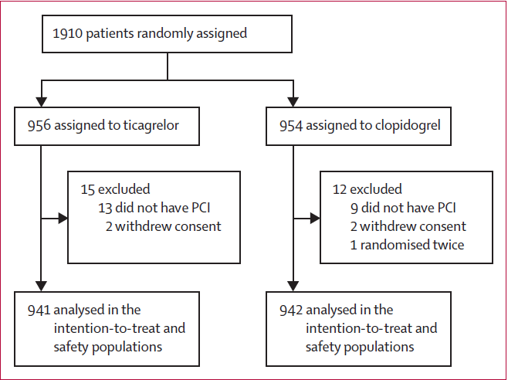
RESULTS
Between Jan 9, 2017, and May 28, 2020, 1910 patients were randomly assigned at 49 sites, 956 to the ticagrelor group and 954 to the clopidogrel group.
15 patients were excluded from the ticagrelor group and 12 from the clopidogrel group.

Slide 16
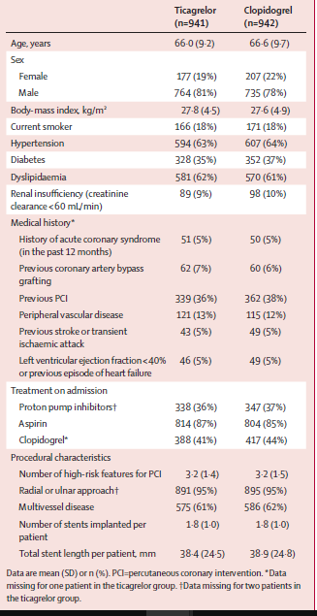
Patient baseline characteristics were similar between the study groups, and representative of a population of patients with stable coronary disease.
On admission, the electrocardiogram was normal in 1310 (70%) of 1883 patients and baseline cardiac troponin was negative in 1736 (93%) of 1883 patients.
Patients with three or more high-risk features represented 1246 (66%) of 1883 PCI procedures.
The bleeding risk was similar in both study groups when evaluated with the DAPT score, but slightly different, with more patients with low bleeding risk in the ticagrelor group when evaluated with the PARIS score.

Slide 17
A radial approach was used in 95% of 1883 cases and >99% of 3207 stents implanted were drug-eluting stents.
The loading dose of clopidogrel of 600 mg or more was chosen in 635 (67%) of 942 patients and crushed pills were used more frequently in the ticagrelor group than in the clopidogrel group (178 [19%] of 941 vs 62 [6·7%] of 942; p<0·0001).
PCI was done in an ad-hoc setting in 998 (53%) of 1883 patients, with no difference between the ticagrelor and clopidogrel groups (p=0·47), and deferred PCI was done in a median of 1·9 days (IQR 0·9–7·0), with no difference between the ticagrelor and clopidogrel groups (p=0·27).
The median delay from random assignment to PCI was 2·0 h (IQR 0·3–5·0) in the ticagrelor group and 2·1 h (0·3–4·8) in the clopidogrel group.
The median delay from loading dose to PCI was 1·7 h (0·3–4·1) in the ticagrelor group and 1·8 h (0·3–4·2) in the clopidogrel group.

Slide 18
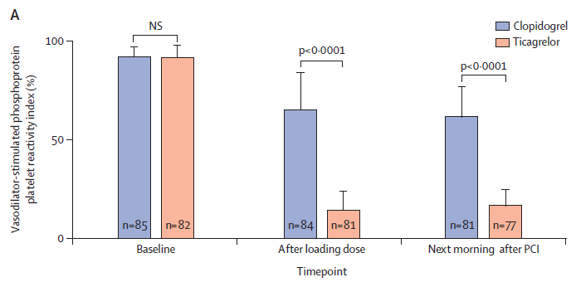
The main results of the masked prespecified platelet substudy in 167 patients showed that P2Y12-mediated platelet reactivity was significantly lower with ticagrelor than with clopidogrel when measured a mean of 4·1 h (SD 1·0) after the loading dose and the next day after PCI, a mean of 21·6 h (2·5) after the loading dose.
P2Y12-mediated platelet reactivity measured by the vasodilator-stimulated phosphoprotein in the ticagrelor group and clopidogrel group

Slide 19
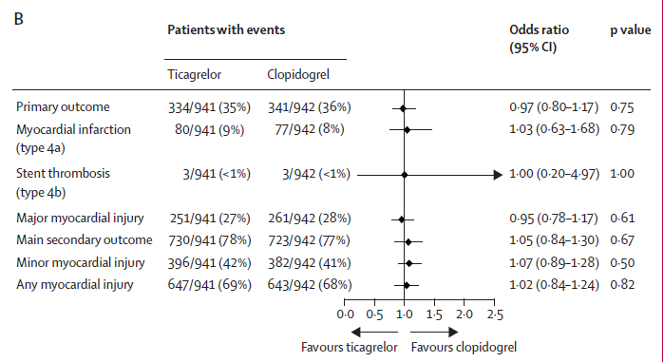
Primary and secondary outcomes at 48 h

Slide 20
At 48 h, the primary composite efficacy outcome of periprocedural myocardial infarction and major myocardial injury was observed in 334 (35%) of 941 patients in the ticagrelor group and 341 (36%) of 942 patients in the clopidogrel group (odds ratio 0·97, 95% CI 0·80–1·17; p=0·75)
Results were consistent across the individual components of the primary outcome.
They also adjusted these results on established risk factors for periprocedural events (diabetes, renal insufficiency, left ventricular ejection fraction <40% or previous episode of heart failure, multivessel disease, the number of stents implanted, and the total stent length per patient) and the findings were unchanged.
The main secondary outcome, comprising periprocedural myocardial infarction and any form of myocardial injury, was similar between the two groups.

Slide 21
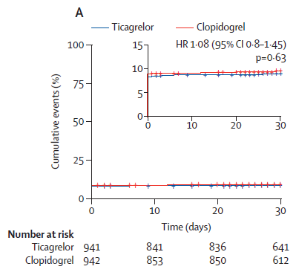
There were no significant difference between the study groups for all secondary efficacy outcomes at 30-day follow-up.
Kaplan-Meier curves for death, myocardial infarction, or stroke or transient ischaemic atack

Slide 22
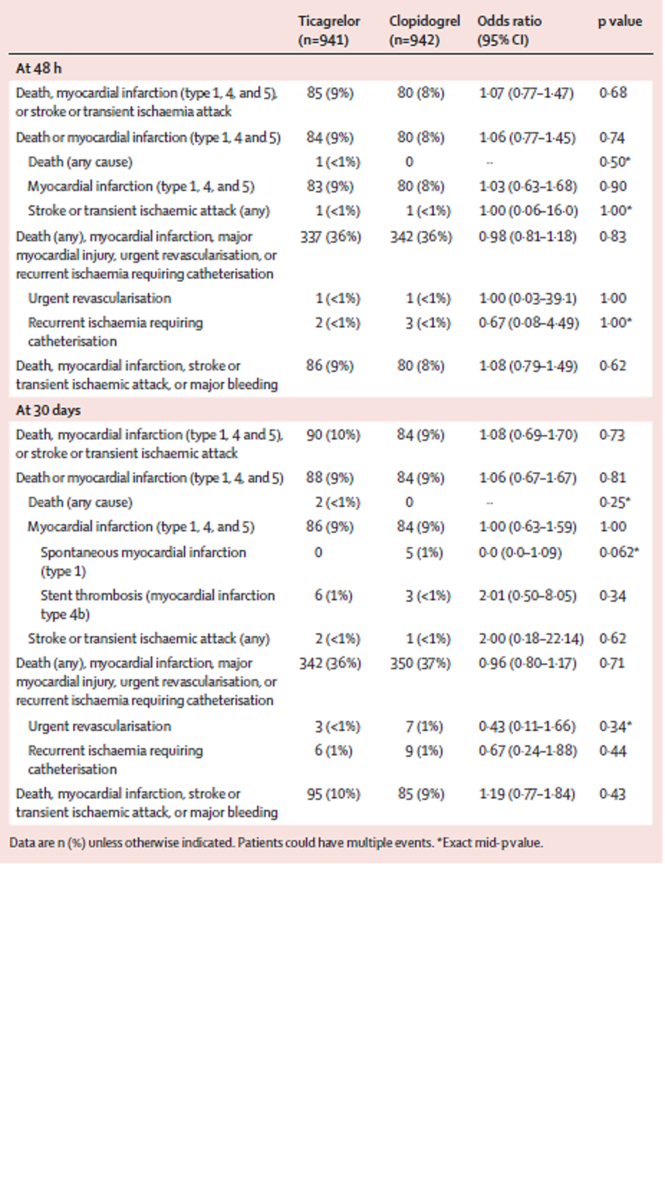

Slide 23
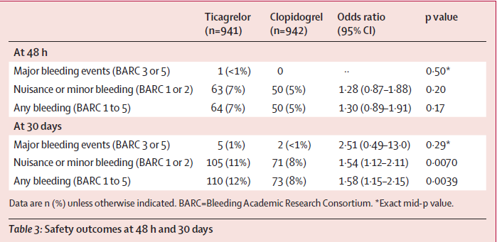
The primary safety outcome (major bleeding) occurred in only one patient at 48 h- in ticagrelor group and was infrequent and similar in both groups at 30 days.

Slide 24
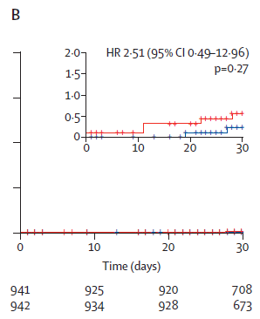
Kaplan-Meier curves for major bleeding at 30 days for ticagrelor versus clopidogrel
The rate of minor bleeding was not different at 48 h but was more frequent in the ticagrelor group compared with the clopidogrel group at 30 days, as was the rate of any bleeding.
The net clinical benefit outcome did not differ between the study group.
Non-bleeding adverse events, especially dyspnoea, were more frequent in the ticagrelor group compared with the clopidogrel group and led to more frequent discontinuation of study drug.

Slide 25
DISCUSSION
Despite a higher level of platelet inhibition, ticagrelor was not superior to clopidogrel in reducing periprocedural myocardial infarction or myocardial injury within 48 h of high-risk PCI in stable coronary patients.
Moreover, none of clinical outcomes differed between the study groups at 30-day follow-up.
The more potent platelet inhibitory effect of ticagrelor translated to increased minor bleeding.
This study supports the safety of elective percutaneous revascularisation, with low rates of complications.

Slide 26
By contrast, periprocedural myonecrosis was frequent in this study, with a similar level to other studies during the past decade, but could be more related to mechanical rather than thrombotic causes.
Primary outcome included myocardial infarction type 4a (157 [8%] events), type 4b (six [<1%] events), and myocardial injury as defined in the third universal definitions of myocardial infarction.
Our main secondary outcome, which included all degrees of myocardial injury, is aligned with the recent fourth universal definition of myocardial infarction,which appears to be very sensitive, as 1453 (77%) of 1883 patients in this study had some degree of myocardial injury or infarction.
Irrespective of the definition and severity of post-procedural myonecrosis, this study found no difference between the two study treatments.

Slide 27
Several studies and metanalyses have reported that periprocedural myonecrosis, even of limited magnitude, is associated with adverse cardiac events and all-cause mortality.
Failure of ticagrelor to prevent myonecrosis caused by PCI in stable patients with high-risk features contrasts with the effect of this drug in patients with acute coronary syndrome,which is a different situation with a more thrombotic physiopathology at the time of PCI.
In the present study, drug treatment was initiated before PCI in all patients and the results were consistent whatever the delay in administration before PCI.

Slide 28
The results are aligned with other studies in elective PCI, and providedresults of a pooled analysis of available global randomised data (ALPHEUS and SASSICAIA trials), representing 2664 stable coronary patients undergoing elective PCI and showing no benefit of stronger P2Y12 inhibition using ticagrelor or prasugrel compared with clopidogrel to decrease periprocedural complications.
The results are also aligned with studies of PCI in patients with non-ST elevation acute coronary syndrome,showing that oral antiplatelet pretreatment might cause more harm than benefit in patients treated with PCI.
The pharmacodynamic data show that ticagrelor was more potent than clopidogrel 4 h after the loading dose, with more than half of patients having high levels of P2Y12-mediated platelet reactivity in the clopidogrel group, as well as the next day after PCI, in line with previous pharmacodynamic studies in elective PCI.

Slide 29
Previous trials have shown a reduction in cardiac marker release and periprocedural events when using intravenous drugs such as glycoprotein IIb/IIIa inhibitors or cangrelor. These drugs immediately provide a more potent effect than that obtained with oral P2Y12 inhibitors.

Slide 30
Regarding safety and adverse events, procedures were done almost exclusively with radial access, therefore limiting the risk of access site major bleeding, with little non-access site bleeding (eg, ecchymosis or epistaxis) showing the safety of 30-day dual antiplatelet therapy with both drugs.
Beyond 30 days, de-escalation studies have suggested improved safety with single antiplatelet therapy (vs dual antiplatelet therapy) in elective PCI.

Slide 31
LIMITATIONS
First, this was an open-label trial with inherent biases that were controlled by the use of the prospective, randomised, open-label, blinded endpoint design, which comprised masked adjudication of all outcomes, masked measurement of troponin after PCI, and an independent masked review of all PCI videos by core laboratory expert readers.
Second, the trial does not provide reliable information on hard clinical outcomes, which are rare in elective PCI.
Third, all types of troponin assays were authorised in this trial to reflect real-life PCI centres but might have brought heterogeneity, as prognosis thresholds might be dependent on the type of assay used.
Fourth, study included patients on chronic clopidogrel therapy, which represented almost half the study population and could potentially have blunted the differential effect compared with ticagrelor. However, the prespecified subgroup analysis of clopidogrel-naive patients does not support this hypothesis.

Slide 32
CONCLUSION
In patients undergoing elective high-risk PCI, treatment with ticagrelor showed no difference compared with clopidogrel in reduction of periprocedural myocardial necrosis.
Treatment with ticagrelor did not cause an increase in major bleeding but increased the rate of minor bleeding at 30 days.
The results of the ALPHEUS trial support the use of clopidogrel as the standard of care for elective PCI in addition to aspirin and pave the way for the evaluation of other strategies to lower periprocedural myonecrosis after elective PCI.

