Slide 1
Approach to thrombocytopenia
jithin P JR1 Medicine

Slide 2
introduction
Platelets are one of the blood cells that are released from megakaryocytes
They have a vital roe in hemostasis
Normal count 150,000-450,000/micrL
thrombopoetin[TPO]
Lifespan 7-10 days

Slide 3
Decreased production Increased consumption
Marrow hypoplasia Immune mechanisms
Marrow infiltration coagulation activation
Hematinic deficiency mechanical pooling
Familial thrombocytopathies thrombotic microangiopathies

Slide 4
Decreased production
1 marrow hypoplasia
• Childhood bone marrow failure syndromes
e.g. Fanconi’s anaemia, dyskeratosis congenita, amegakaryocytic thrombocytopenia
• Idiopathic aplastic anaemia
• Drug-induced: cytotoxics, antimetabolites
• Transfusion-associated graft-versus-host disease

Slide 5
2 .Marrow infiltration
• Leukaemia
• Myeloma
• Carcinoma (rare)
• Myeloﬁbrosis
• Osteopetrosis
• Lysosomal storage disorders
e.g. Gaucher’s disease

Slide 6
3 .Haematinic deﬁciency
• Vitamin B12 and/or folate deﬁciency
4. Familial (macro-)thrombocytopathies
• Myosin heavy chain abnormalities, e.g. Alport’s syndrome,
Fechtner’s syndrome, May–Hegglin anomaly
• Bernard–Soulier syndrome
• Montreal platelet syndrome
• Wiskott–Aldrich syndrome (small platelets)

Slide 7
Increased consumption
Immune mechanisms
• Idiopathic thrombocytopenic purpura*
• Neonatal alloimmune thrombocytopenia
• Post-transfusion purpura
• Drug-associated, especially quinine, vancomycin and heparin
Coagulation activation
• Disseminated intravascular coagulation

Slide 8
Mechanical pooling
• Hypersplenism
Thrombotic microangiopathies
• Haemolytic uraemic syndrome (HUS) and atypical HUS
• Liver disease
• Thrombotic thrombocytopenic purpura
• Pre-eclampsia
Others
• Gestational thrombocytopenia
• Type 2B von Willebrand disease

Slide 9
approach
history and physical examination, results of the CBC, and review of the peripheral blood smear are all critical components in the initial evaluation of thrombocytopenic patients
myelodysplasia can present with isolated thrombocytopenia, the bone marrow should be examined in patients presenting with isolated thrombocytopenia who are older than 60 years of age.

Slide 10
physical examination can document an enlarged spleen, evidence of chronic liver disease
petechiae first appear in areas of increased venous pressure, the ankles and feet in an ambulatory patient
Wet purpura, blood blisters that form on the oral mucosa, are thought to denote an increased risk of life-threatening hemorrhage in the thrombocytopenic patient

Slide 11
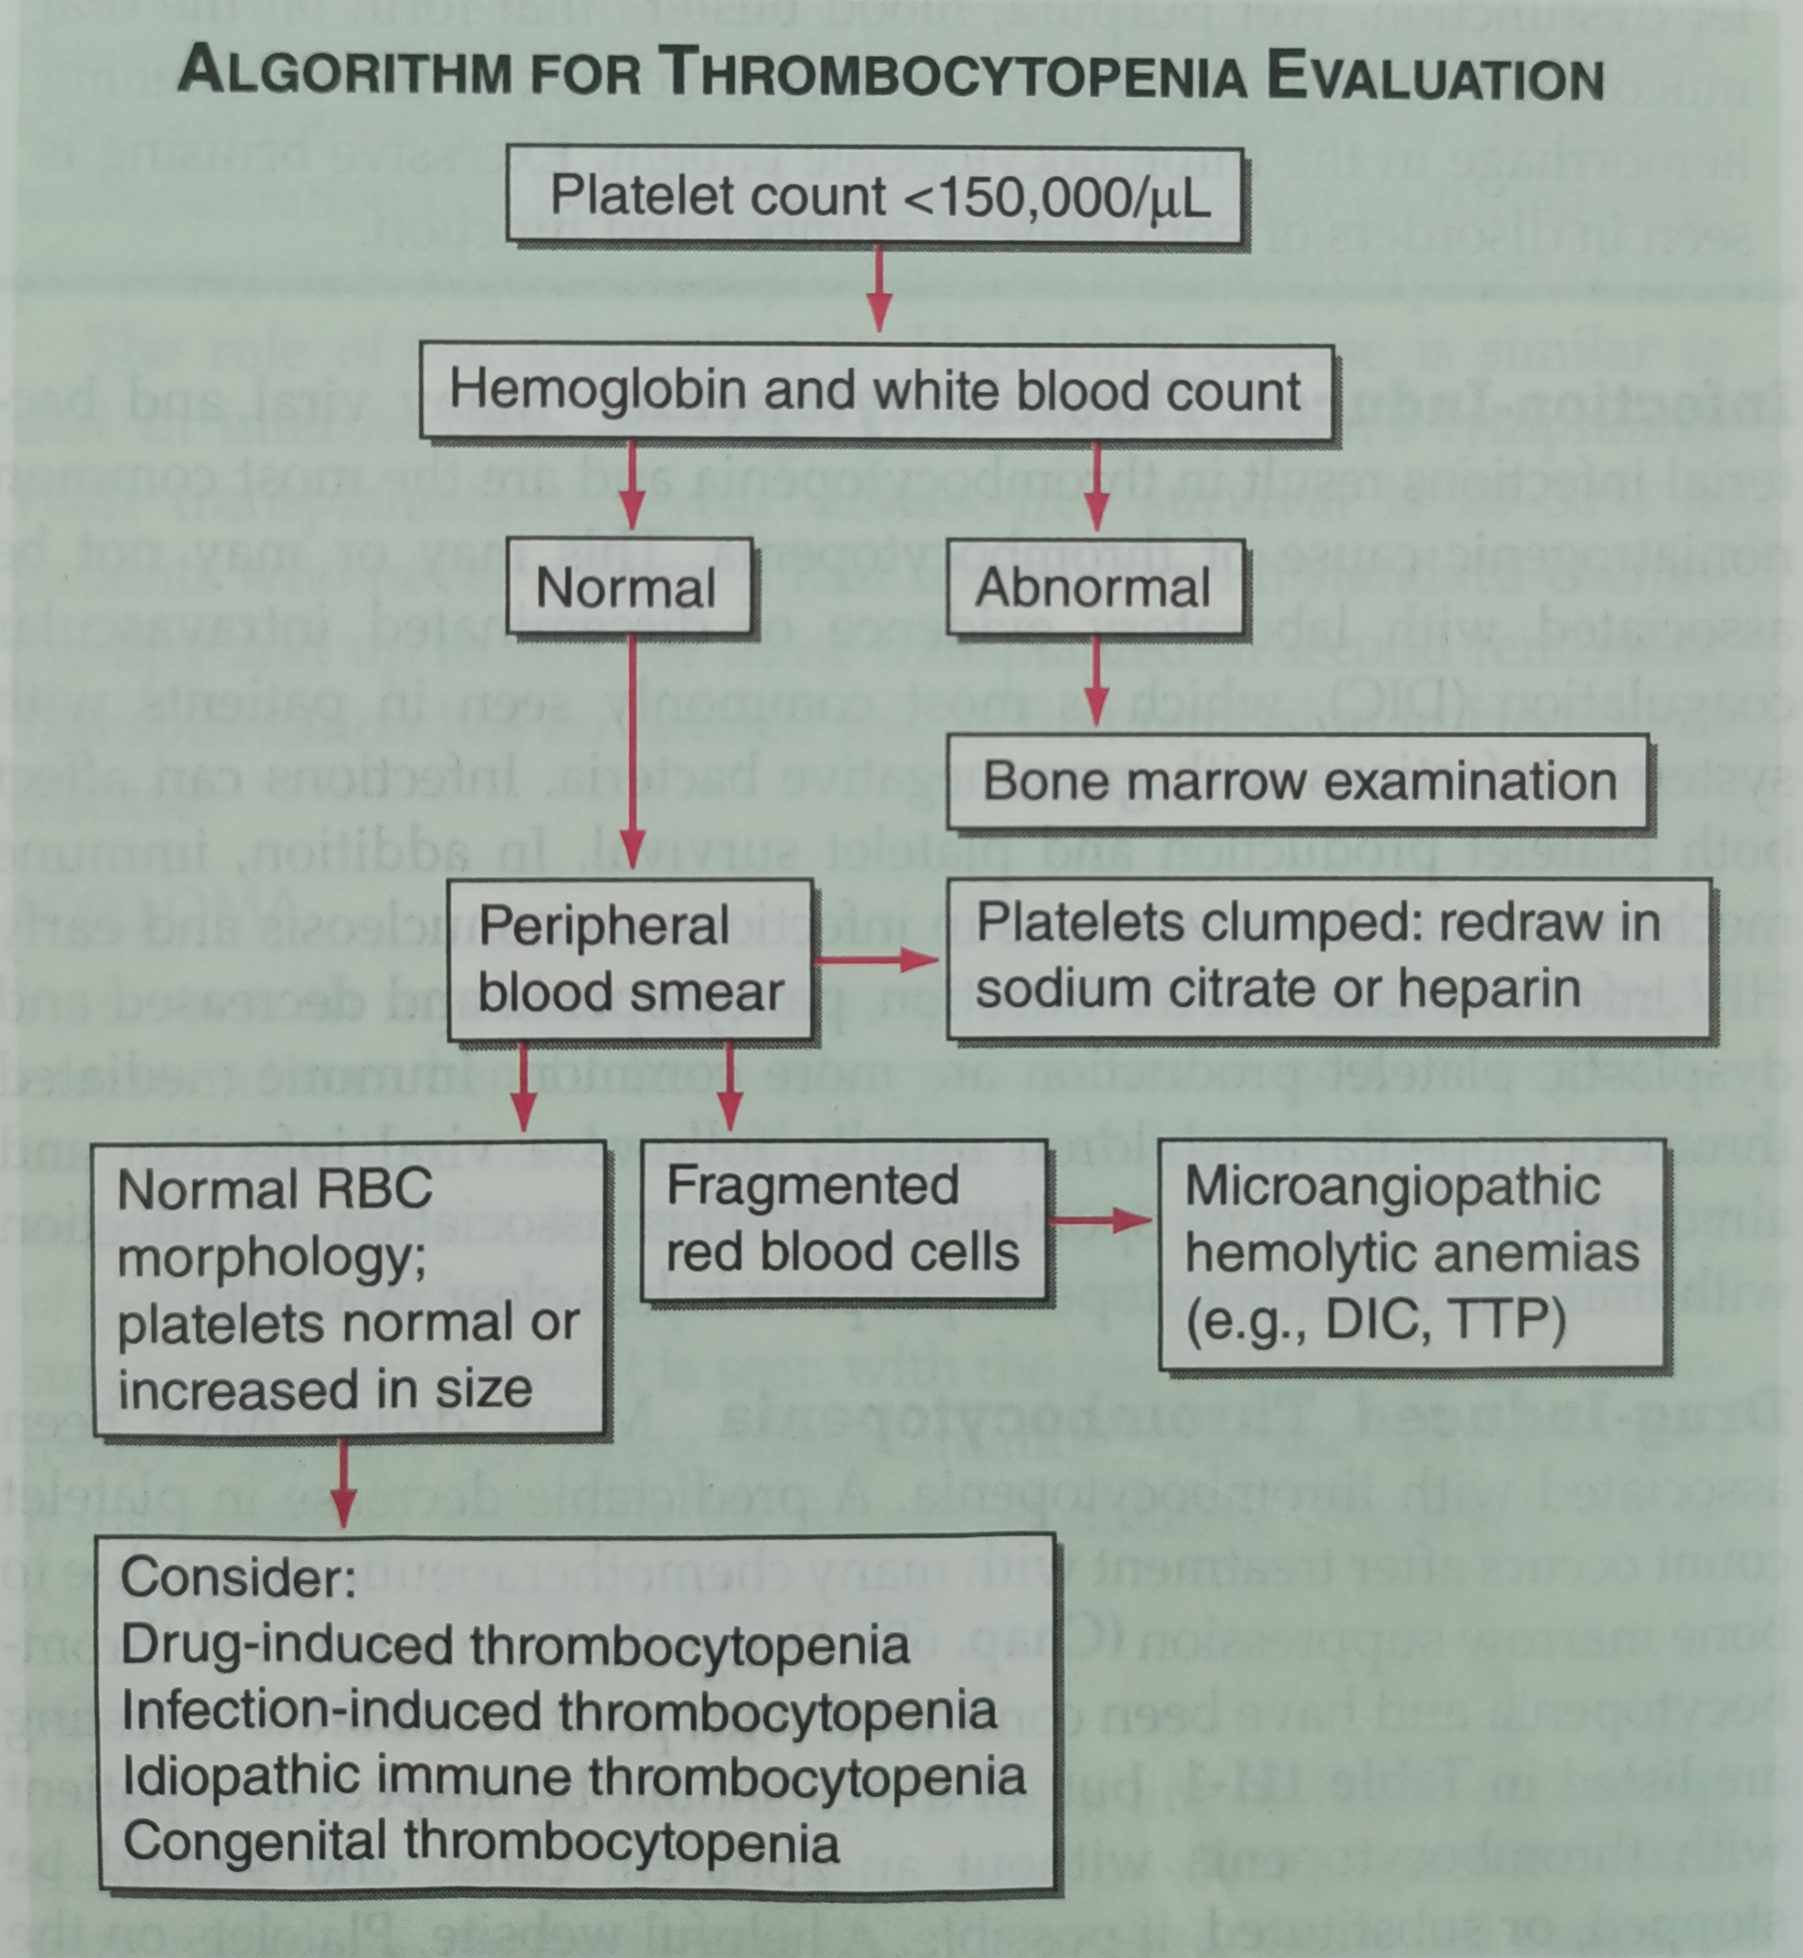

Slide 12
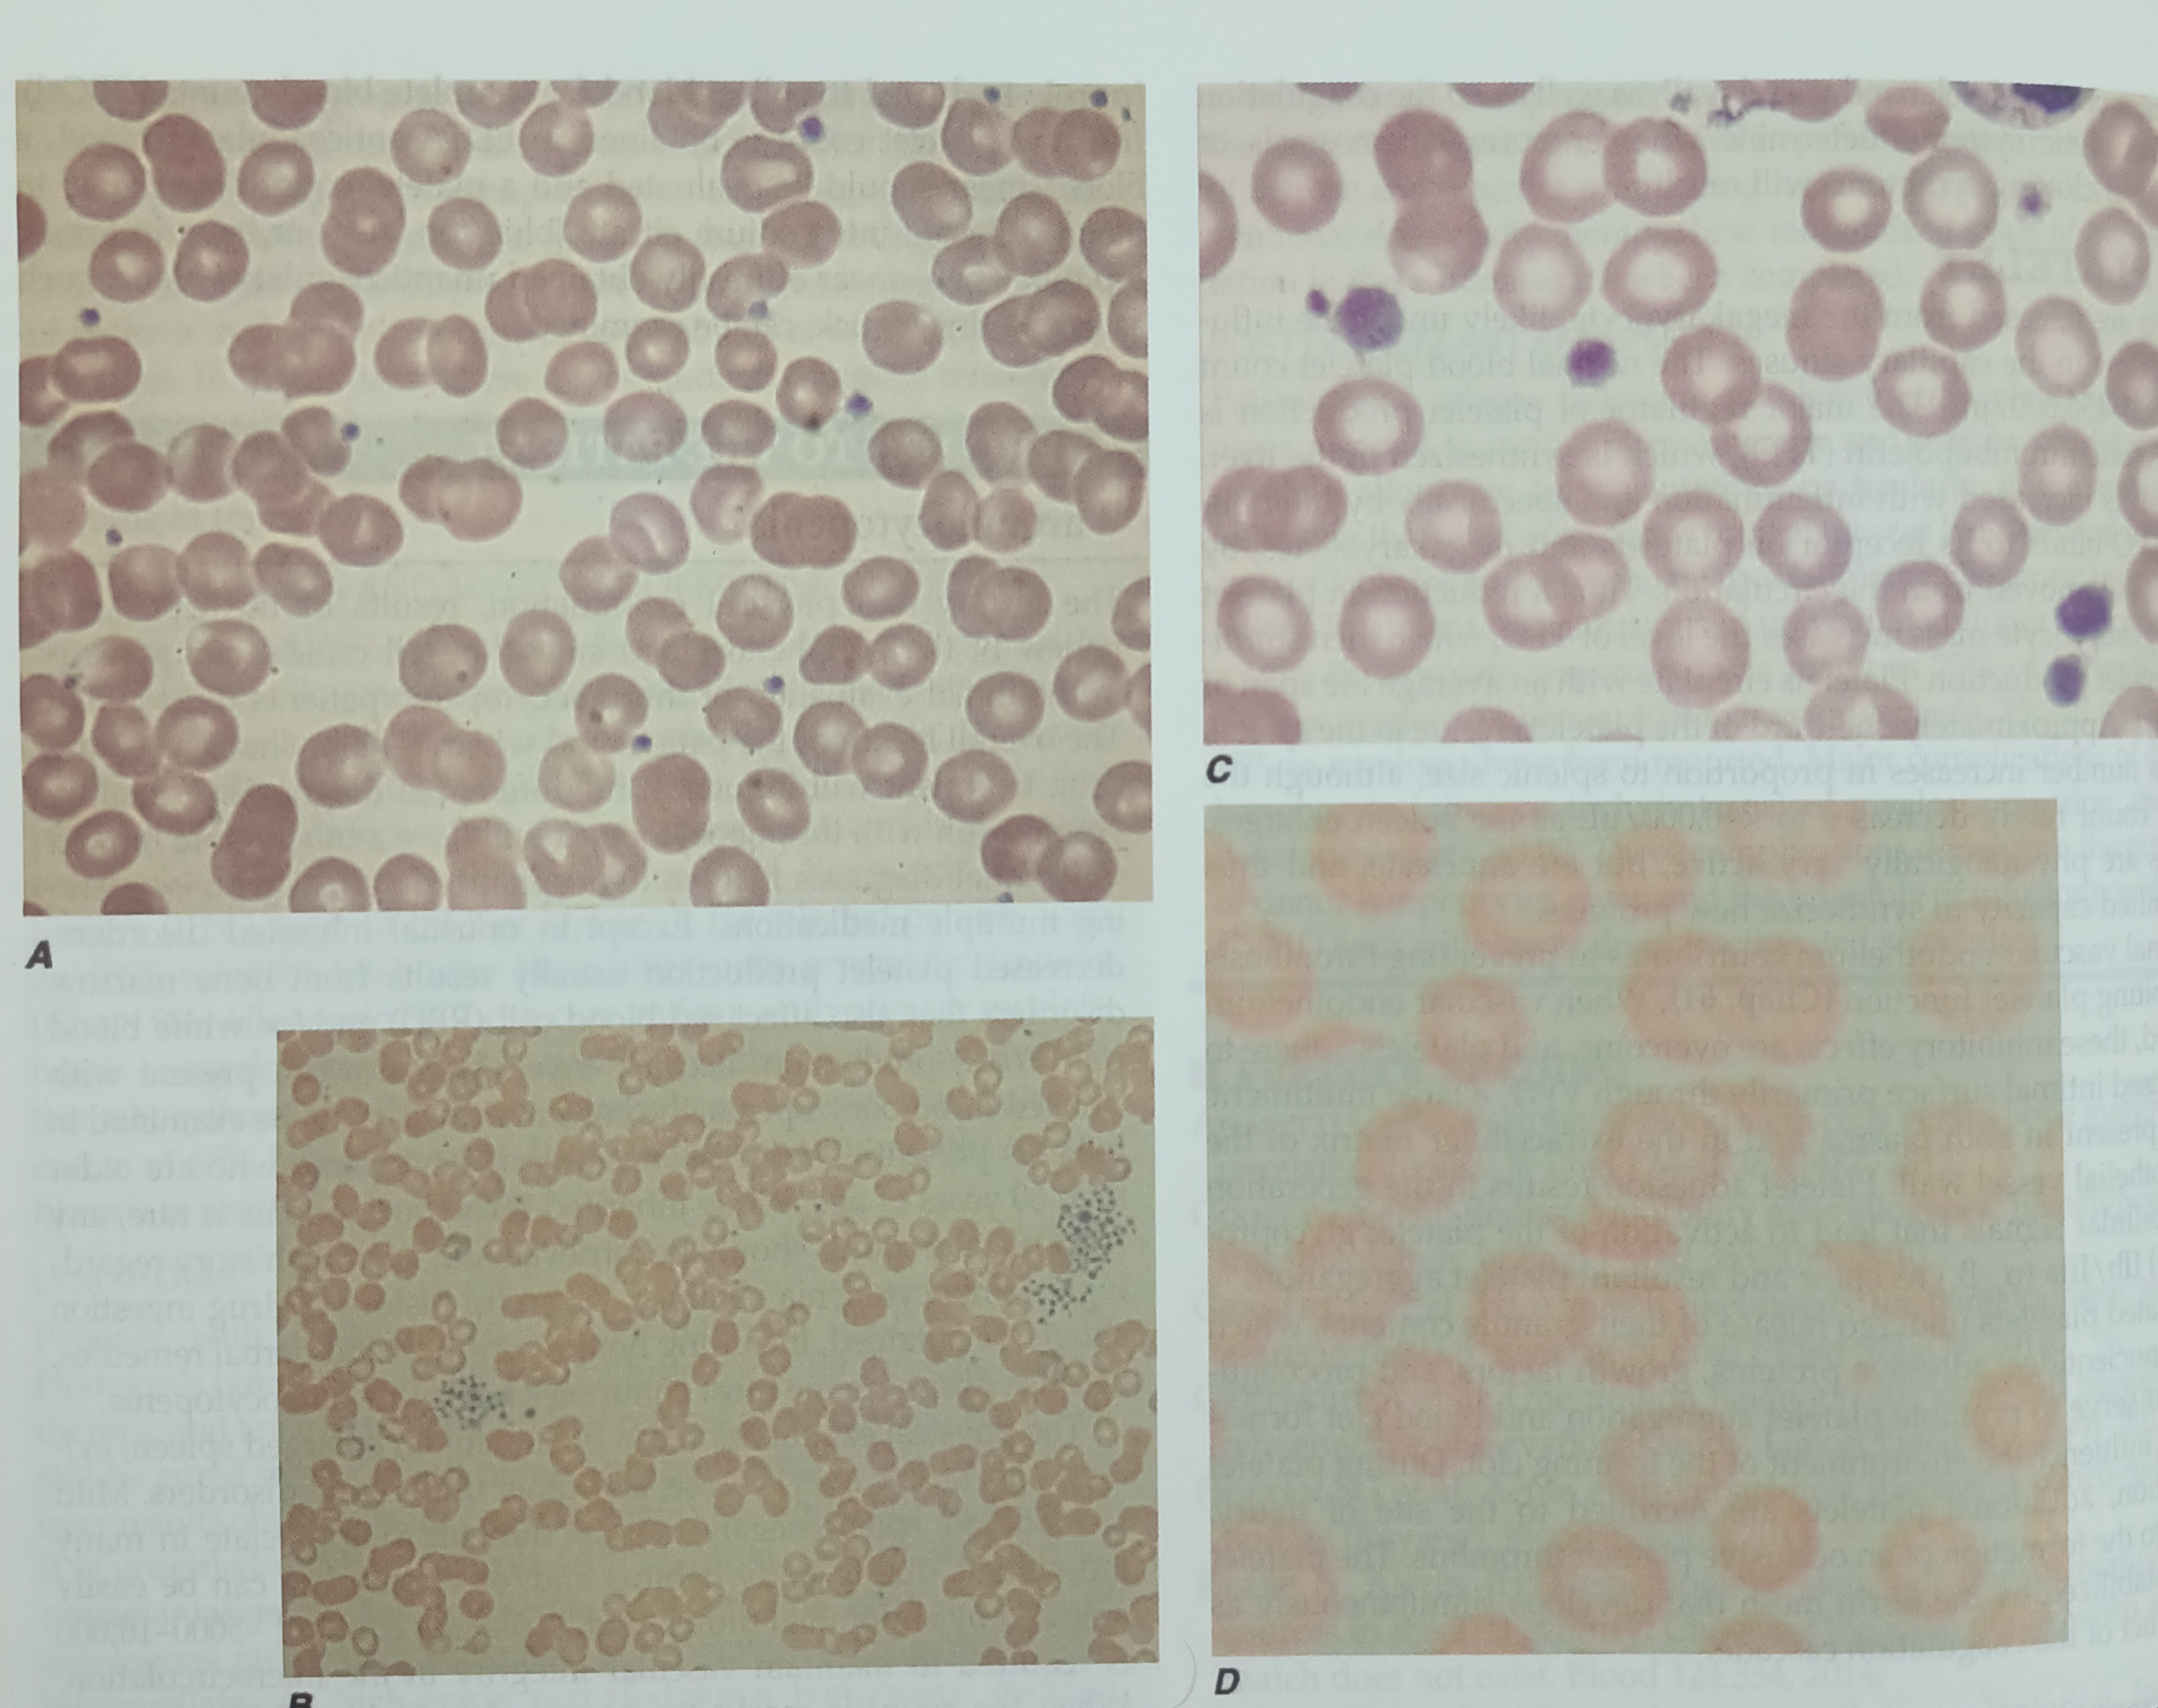

Slide 13
Peripheral smear
A key step is to review thrombocytopenia and able to rule out “pseudothrombocytopenia,”
It is an in vitro artifact resulting from platelet agglutination via antibodies (usually IgG, but also IgM and IgA) when the calcium content is decreased by blood collection in EDTA
sodium citrate (blue top tube) or heparin (green top tube) or a smear from a finger stick

Slide 14
infection
The most common noniatrogenic cause of thrombocytopenia
This may or may not be associated with laboratory evidence of disseminated intravascular coagulation (DIC), which is most commonly seen in patients with systemic infections with gram-negative bacteria
Infections can affect both platelet production and platelet survival.

Slide 15
immune mechanisms - as in infectious mononucleosis and early HIV infection.
Late in HIV infection, pancytopenia and decreased and dysplastic platelet production are more common.

Slide 16
Drug induced
A predictable decrease in platelet count occurs after treatment with many chemotherapeutic drugs due to bone marrow suppression
all drugs should be suspect in a patient with thrombocytopenia without an apparent cause and should be stopped, or substituted, if possible.

Slide 17
Classic drug-dependent antibodies are antibodies that react with specific platelet surface antigens and result in thrombocytopenia only when the drug is present.
they are more common with quinine and sulfonamides

Slide 18
The thrombocytopenia typically occurs after a period of initial exposure (median length 21 days), or upon re exposure
resolves in 7–10 days after drug withdrawal.
platelet Gp IIb/IIIa inhibitory drugs, such as abciximab, differs in that it may occur within 24 h of initial exposure. This appears to be due to the presence of naturally occurring antibodies that cross-react with the drug bound to the platelet.

Slide 19
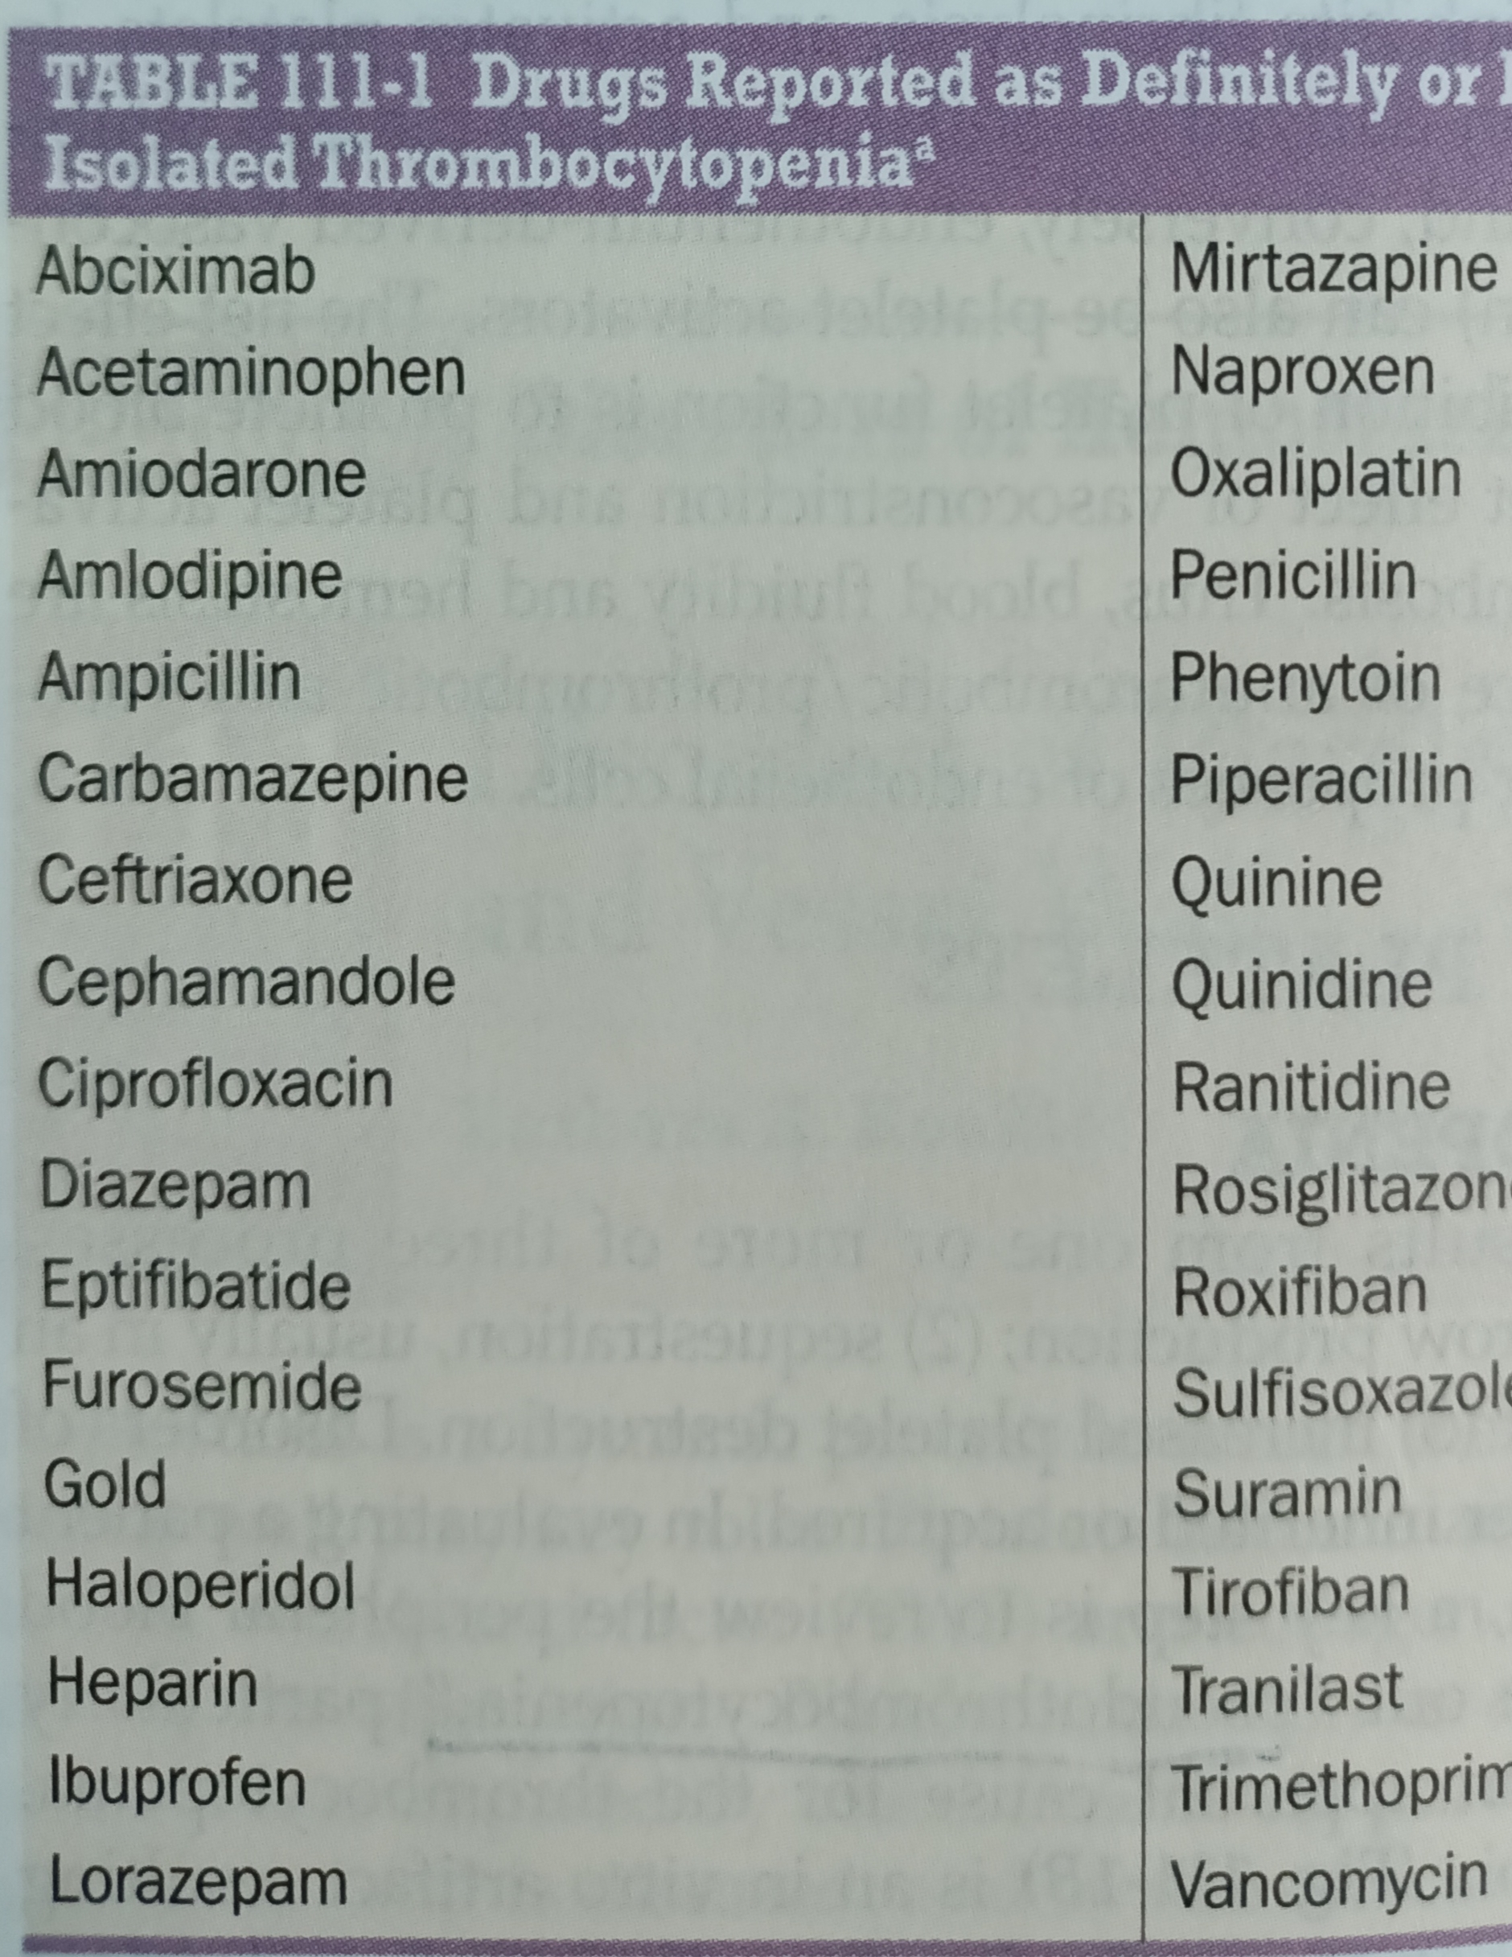

Slide 20
HIT
(1) The thrombocytopenia is not usually severe, rarely <20,000/μL
(2) Heparin-induced thrombocytopenia (HIT) is not associated with
bleeding and, in fact, markedly increases the risk of thrombosis.
HIT results from antibody formation to a complex of the platelet-specific protein platelet factor 4 (PF4) and heparin.
The anti-heparin/PF4 antibody can activate platelets through the FcγRIIa receptor and also activate monocytes and endothelial cells

Slide 21
HIT can occur after exposure to low-molecular-weight heparin (LMWH) as well as unfractionated heparin (UFH), although it is more common with the latter.
heparin for 5–14 days
It occurs before 5 days in those who were exposed to heparin in the prior few weeks or months (<~100 days) and have circulating anti-heparin/PF4 antibodies.

Slide 22
4T,s
Thrombocytopenia
Timing of platelet count drop
Thrombosis and other sequelae such as localized skin reactions
other causes of thrombocytopenia not evident.

Slide 23
treatment
Early recgnition and stop the drug
Alternatives
argatroban
Bivalirudin
Fondaparinax
Danaparoid
HIT antibody

Slide 24
Anticoagulation is considered in HIT due to high chance of thrombosis
Evidence of thrombus-3-6 months of warfarin
No thrombus-until few days after platelet recovery or 1 month
Warfarin therapy should be ovelaped with DTI or Fondaparinux and after resolution of thrombocytopenia

Slide 25
Immune thrombocytopenic purpura
acquired disorder in which there is immune-mediated destruction of platelets and possibly inhibition of platelet release from the megakaryocyte.
Secondary ITP
systemic lupus erythematosus (SLE), HIV and hepatitis C, are common causes.
The association of ITP with Helicobacter pylori infection is unclear but appears to have a geographic distribution.

Slide 26
serologic testing is usually not helpful due to the low sensitivity and specificity of the current tests
The peripheral blood smear may show large platelets, with otherwise normal morphology

Slide 27
testing for HIV infection and hepatitis C .
Serologic testing for SLE, serum protein electrophoresis, immunoglobulin levels to potentially detect hypogammaglobulinemia, selective testing for IgA deficiency or monoclonal gammopathies, and testing for H. pylori
Anemia- direct antiglobulin testing (Coombs’ test) should be performed to rule out combined autoimmune hemolytic anemia with ITP [Evans’ syndrome]

Slide 28
treatment
Initial treatment in patients without significant bleeding symptoms, severe thrombocytopenia (<5000/μL), or signs of impending bleeding (such as retinal hemorrhage or large oral mucosal hemorrhages) can be instituted as an outpatient using single agents- prednisone at 1 mg/kg,
Rh0(D) immune globulin therapy (WinRho SDF), at 50–75 μg/kg
the mechanism of action is production of limited hemolysis, with antibody-coated cells “saturating” the Fc receptors, inhibiting Fc receptor function

Slide 29
IVIgG is dosed at 1–2 g/kg total, given over 1–5 days
aseptic meningitis and renal failure.
Patients with severe ITP and/or symptoms of bleeding, hospital admission and combined-modality therapy is given using high-dose glucocorticoids with IVIgG or anti-Rh0(D) therapy
rituximab

Slide 30
Splenectomy has been used for treatment of patients who relapse after glucocorticoids are tapered
TPO receptor agonists
romiplostim
eltrombopag

Slide 31
Inherited thrombocytopenia
Autosomal dominant
May-Hegglin anomaly
Fechtner syndrome
Autosomal recessive
congenital amegacaryocytic thrombocytopenia
Thrombocytopenia with absent radii
Bernard soulier syndrome
X-linked- Wiskot-Aldrich syndrome

Slide 32
Thrombotic Thrombocytopenic Purpura
Pentad of findings
microangiopathic hemolytic anemia
thrombocytopenia
renal failure
neurologic findings
fever
inherited (Upshaw-Schulman syndrome) and idiopathic

Slide 33
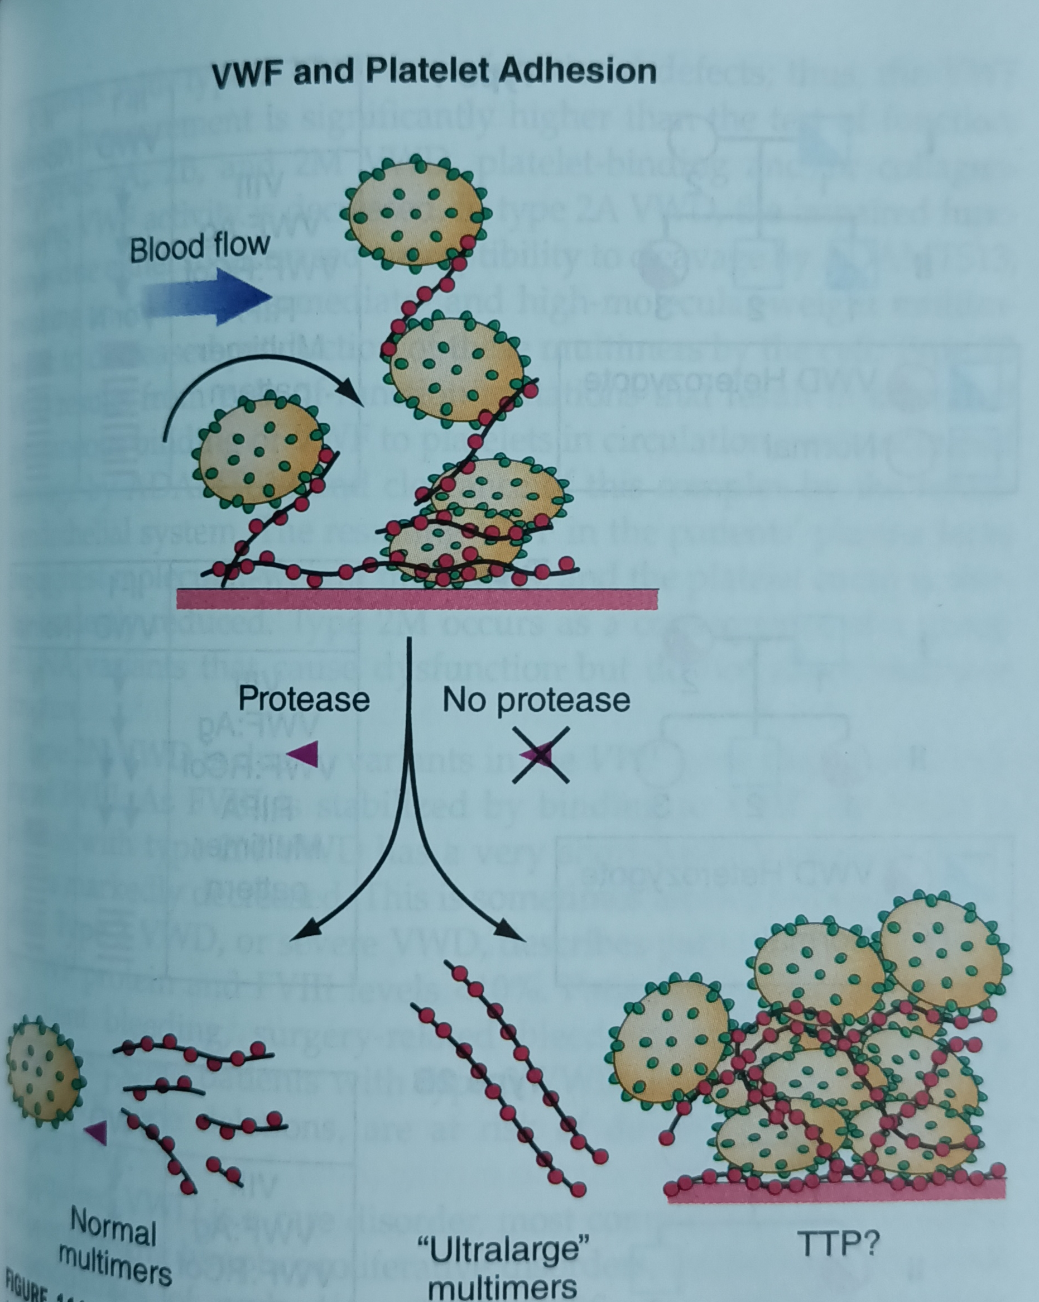

Slide 34
increased lactate dehydrogenase and indirect bilirubin,
decreased haptoglobin, and increased reticulocyte count
with a negative direct antiglobulin test.
The peripheral smear should be examined for evidence of schistocytes

Slide 35
Plasma exchange remains the mainstay of treatment of TTP. ADAMTS13 antibody-mediated TTP (idiopathic TTP) appears to respond best to plasma exchange. Plasma exchange is continued until the platelet count is normal and signs of hemolysis are resolved for at least 2 days.
Glucocorticoids used as an adjunct to plasma exchange
rituximab, vincristine, cyclophosphamide, and splenectomy, with rituximab

Slide 36
Hemolytic uremic syndrome
HUS is a syndrome characterized by acute renal failure, microangiopathic hemolytic anemia, and thrombocytopenia.
preceded by an episode of diarrhea, often hemorrhagic in nature, predominantly in children- Escherichia coli O157:H7
ADAMTS13 levels are generally reported to be normal in HUS
Treatment is mainly supportive
eculizumab [C5 blocker] and plasma exchange

Slide 37
Thank you

