Slide 1
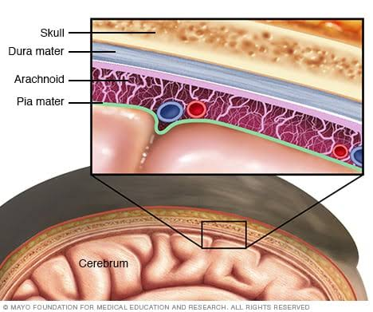
ACUTE MENINGITIS
DR HAREESH M V
JUNIOR RESIDENT
GENERAL MEDICINE

Slide 2
ACUTE MENINGITIS
ACUTE BACTERIAL MENINGITIS & ACUTE VIRAL MENINGITIS
Epidemiology
Etiopathogenesis
Clinical presentation
Diagnosis
Treatment

Slide 3

ACUTE BACTERIAL MENINGITIS
Acute purulent infection within the subarachnoid space (SAS)
DECREASED CONSCIOUSNESS
raised ICP
SEIZURES
*MENINGOENCEPHALITIS

Slide 4
EPIDEMIOLOGY
Most common form of suppurative CNS infection
The organisms most often responsible for community-acquired bacterial meningitis
Streptococcus pneumoniae (~50%),
Neisseria meningitidis (~25%),
group B streptococci (~15%),
Listeria monocytogenes (~10%).
Haemophilus influenzae type b <10 %

Slide 5
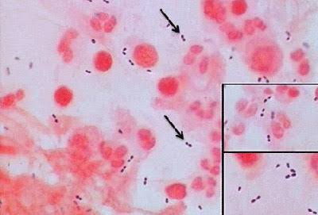
ETIOLOGY
S. pneumoniae
Most common cause of meningitis in adults >20 years of age
Predisposing conditions : pneumococcal pneumonia.
Risk factors : acute or chronic pneumococcal sinusitis or otitis media, alcoholism, diabetes, splenectomy, hypogammaglobulinemia, complement deficiency, and head trauma with basilar skull fracture and CSF rhinorrhea.
The mortality rate remains ~20% despite antibiotic therapy

Slide 6
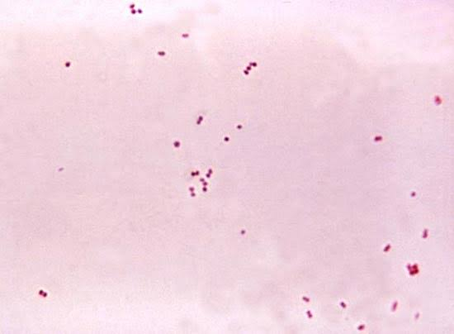
N. meningitidis
The presence of petechial or purpuric skin lesions : important clue
Fulminant meningitis→ progressing to death within hours of symptom onset.
Nasopharyngeal colonization→ an asymptomatic carrier state / invasive meningococcal disease.
Individuals with deficiencies of any of the complement components, including properdin, are highly susceptible to meningococcal infections.

Slide 7
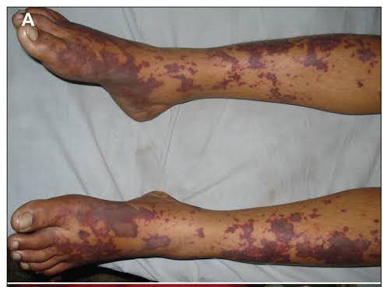
quadrivalent (serogroups A, C, W-135, and Y) meningococcal glycoconjugate vaccine: 11- to 18-year
The vaccine does not contain serogroup B, which is responsible for one-third of cases of meningococcal disease.
16–23 years : serogroup B meningococcal (MenB) vaccine ( ACIP recommendation)

Slide 8
Gram-negative bacilli
Meningitis in individuals with chronic and debilitating diseases such as diabetes, cirrhosis, or alcoholism and in those with chronic urinary tract infections.
Complicate neurosurgical procedures: craniotomy, and head trauma associated with CSF rhinorrhea or otorrhea.

Slide 9
H. influenzae type b (Hib)
Hib conjugate vaccine dramatically declined meningitis in children
More frequently, H. influenzae causes meningitis in unvaccinated children and older adults, and non-b H. influenzae is an emerging pathogen.

Slide 10
L. monocytogenes
Increasingly important cause of meningitis in neonates (60 years, and immunocompromised individuals of all ages.
Infection is acquired by ingesting foods contaminated by listeria.
Foodborne human listerial infection : from contaminated coleslaw, milk, soft cheeses, and several types of “ready-to-eat” foods, including delicatessen meat and uncooked hotdogs.

Slide 11
Meningitis | Etiological agent | Special features
Otitis, mastoiditis, and sinusitis → Meningitis | Streptococci sp., gram-negative anaerobes, Staphylococcus aureus, Haemophilus sp., and Enterobacteriaceae
Meningitis complicating endocarditis | viridans streptococci, S. aureus, Streptococcus bovis, the HACEK group
meningitis in neonates | Group B Streptococcus, or Streptococcus agalactiae | individuals aged >50 years, particularly those with underlying diseases
meningitis that occurs following invasive neurosurgical procedures | S. aureus and coagulase-negative staphylococci | shunting procedures for hydrocephalus, or as a complication of the use of subcutaneous Ommaya reservoirs for administration of intrathecal chemotherapy.

Slide 12
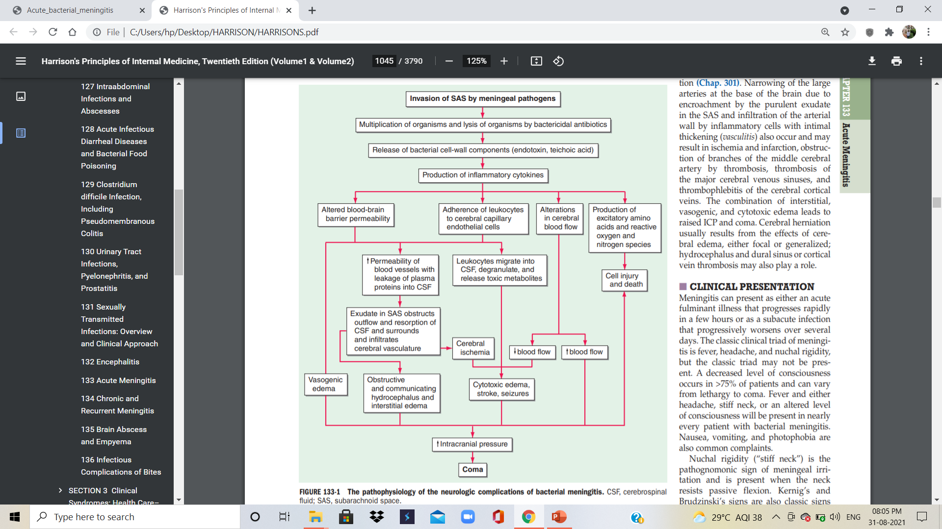
PATHOPHYSIOLOGY

Slide 13
CLINICAL PRESENTATION
An acute fulminant illness /subacute infection
Classic clinical triad of meningitis : fever, headache, and nuchal rigidity
Fever
Headache
stiff neck,
altered level of consciousness.
Nausea
vomiting
photophobia

Slide 14
Nuchal rigidity (“stiff neck”)
The pathognomonic sign of meningeal irritation
present when the neck resists passive flexion.
Kernig’s and Brudzinski’s signs are also classic signs
The high prevalence of cervical spine disease in older individuals may result in false-positive tests for nuchal rigidity.

Slide 15
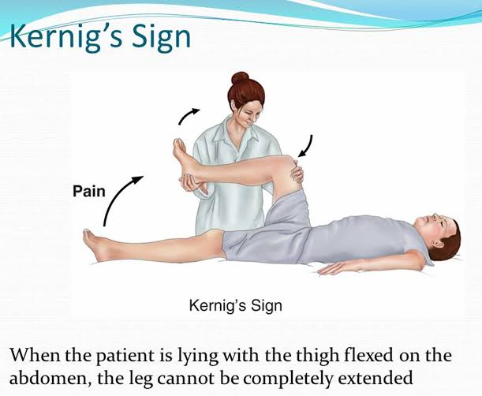
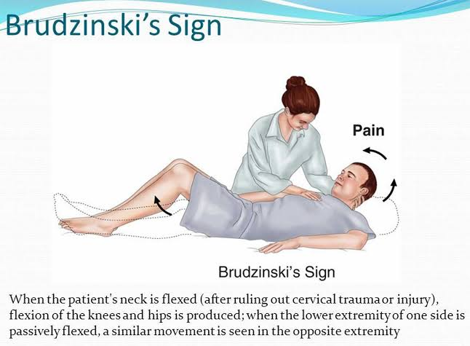
Kernig’s sign
elicited with the patient in the supine position.
The thigh is flexed on the abdomen, with the knee flexed; attempts to passively extend the knee elicit pain when meningeal irritation is present.
Brudzinski’s sign
elicited with the patient in the supine position
positive when passive flexion of the neck results in spontaneous flexion of the hips and knees.
Both may be absent or reduced in very young or elderly patients, immunocompromised individuals, or patients with a severely depressed mental status.

Slide 16
Seizures
occur as part of the initial presentation of bacterial meningitis or during the course of the illness in 20–40% of patients.
Focal seizures : due to focal arterial ischemia or infarction, cortical venous thrombosis with hemorrhage, or focal edema.
Generalized seizure activity and status epilepticus : hyponatremia, cerebral anoxia, or, less commonly, the toxic effects of antimicrobial agents.
A decreased level of consciousness occurs in >75% of patients and can vary from lethargy to coma
SEIZURES

Slide 17
Raised ICP
complication of bacterial meningitis → major cause of obtundation and coma
> 90% of patients will have a CSF opening pressure >180 mmH2 O, and 20% have opening pressures >400 mmH2 O.
The most disastrous complication of increased ICP is cerebral herniation.
The incidence of herniation in patients with bacterial meningitis : 1- 8% of cases

Slide 18
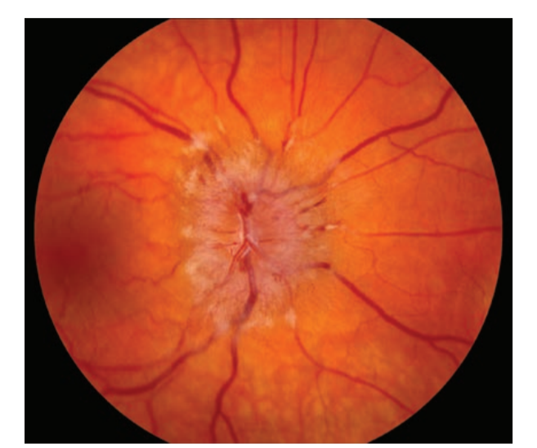
Signs of increased ICP
A deteriorating or reduced level of consciousness
Papilledema
Dilated poorly reactive pupils
Sixth nerve palsies
Decerebrate posturing
The cushing reflex (bradycardia, hypertension, and irregular respirations).

Slide 19
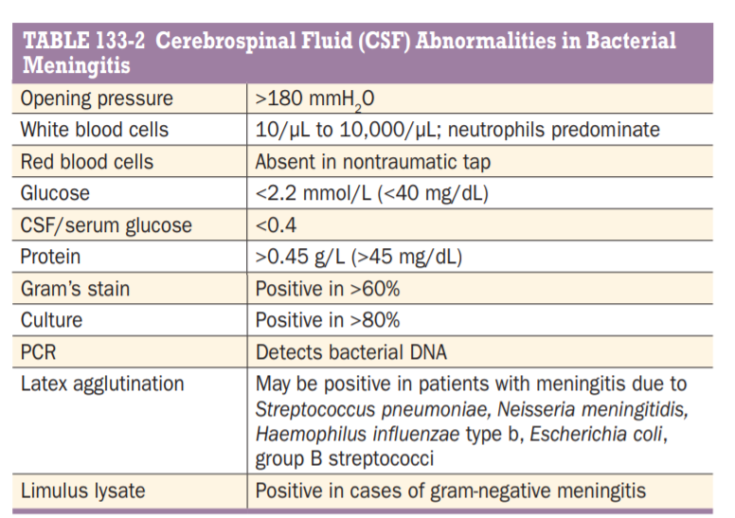
DIAGNOSIS
CSF Analysis

Slide 20
2) Neuroimaging
Almost all patients with bacterial meningitis will have neuroimaging studies performed during the course of their illness.
MRI is preferred over CT because of its superiority in demonstrating areas of cerebral edema and ischemia.
bacterial meningitis: diffuse meningeal enhancement is often seen after the administration of gadolinium.
Meningeal enhancement is not diagnostic of meningitis but occurs in any CNS disease associated with increased blood-brain barrier permeability

Slide 21
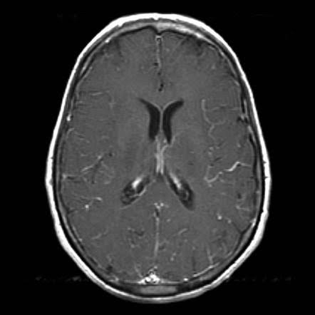
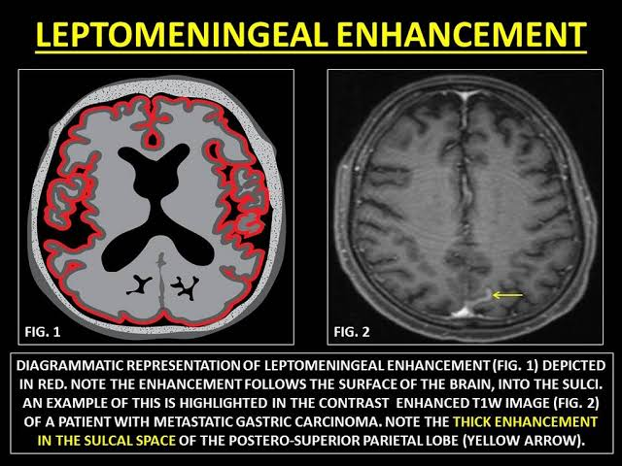

Slide 22
DIFFERENTIAL DIAGNOSIS
Viral meningoencephalitis & HSV encephalitis
Rocky Mountain spotted fever (RMSF)
Ehrlichioses
Focal suppurative CNS infections: subdural & epidural empyema and brain abscess
Subarachnoid hemorrhage

Slide 23
medication-induced hypersensitivity meningitis
chemical meningitis : rupture of tumor contents into the CSF (e.g., from a cystic glioma or craniopharyngioma epidermoid or dermoid cyst)
carcinomatous or lymphomatous meningitis
meningitis associated with inflammatory disorders : sarcoid, systemic lupus erythematosus (SLE), and Behçet’s syndrome
pituitary apoplexy;
uveomeningitic syndromes (Vogt Koyanagi-Harada syndrome)

Slide 24
TREATMENT
EMPIRICAL ANTIMICROBIAL THERAPY
SPECIFIC ANTIMICROBIAL THERAPY
ADJUNCTIVE THERAPY

Slide 25
EMPIRICAL ANTIMICROBIAL THERAPY
Bacterial meningitis is a medical emergency.
Goal : begin antibiotic therapy within 60 min of a patient’s arrival in the emergency room.
Empirical antimicrobial therapy is initiated in patients with suspected bacterial meningitis before the results of CSF Gram’s stain and culture are known.
S. pneumoniae & N. meningitidis : most common etiologic organisms

Slide 26
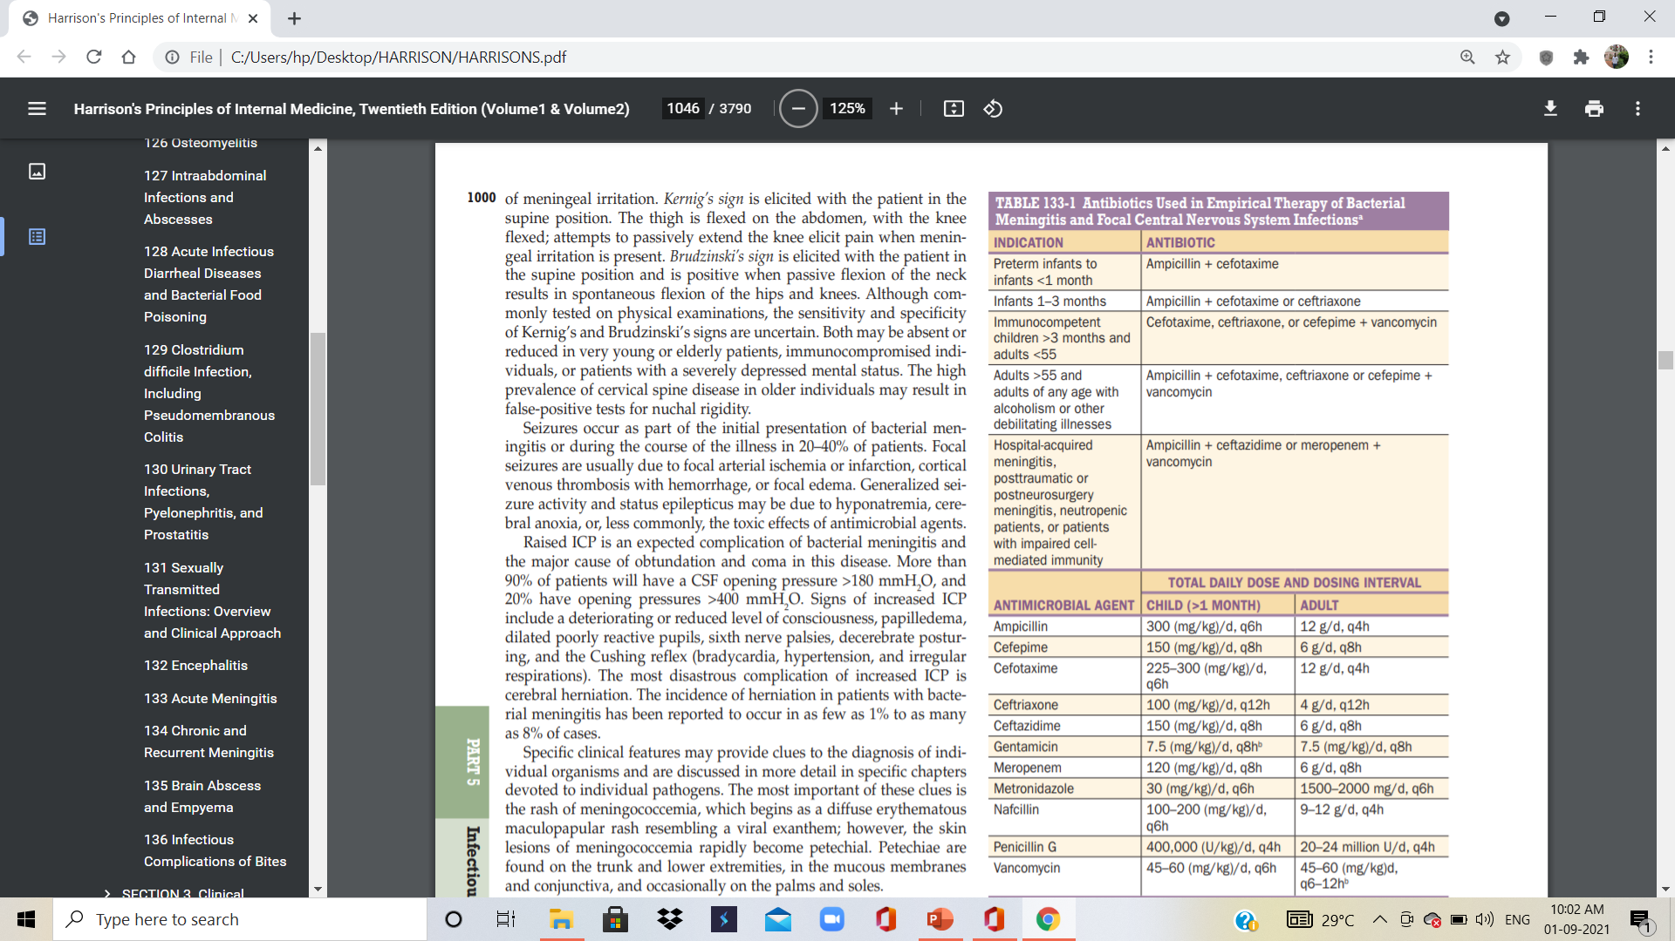
Combination of dexamethasone+ a third- or fourth-generation cephalosporin (e.G., Ceftriaxone, cefotaxime, or cefepime)+ vancomycin + acyclovir +/- doxycycline.

Slide 27
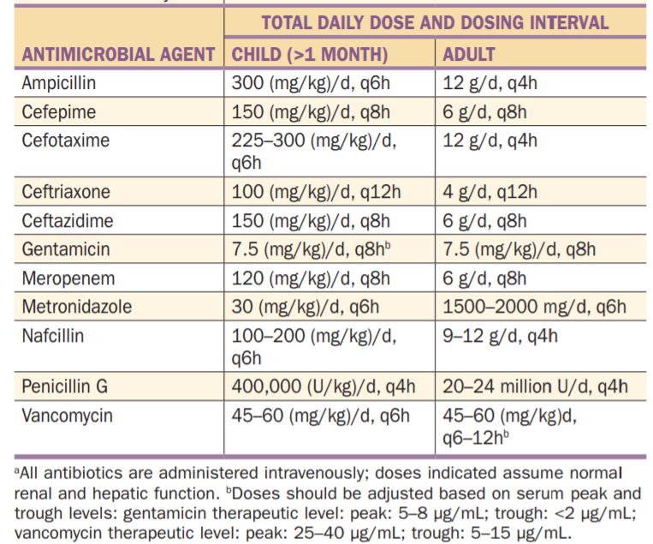

Slide 28
Ceftriaxone / cefotaxime
susceptible S. pneumoniae, group B streptococci & H. influenzae and adequate coverage for N. meningitidis.
Cefepime
Broad-spectrum fourth-generation cephalosporin
in vitro activity similar to that of cefotaxime / ceftriaxone against S. pneumoniae & N. meningitidis
Greater activity against Enterobacter species & Pseudomonas aeruginosa.
Equivalent to cefotaxime in the treatment of penicillin-sensitive pneumococcal and meningococcal meningitis

Slide 29
Ampicillin
for coverage of L. monocytogenes
in individuals 55, or those with suspected impaired cell-mediated immunity because of chronic illness, organ transplantation, pregnancy, malignancy, or immunosuppressive therapy.
Metronidazole
to cover gram-negative anaerobes in patients with otitis, sinusitis, or mastoiditis

Slide 30
Hospital acquired meningitis, (following neurosurgical procedures)
staphylococci and gram-negative organisms including P. aeruginosa
combination of vancomycin and ceftazidime or meropenem.
Ceftazidime or meropenem should be substituted for ceftriaxone or cefotaxime in neurosurgical patients and in neutropenic patients
ceftriaxone and cefotaxime do not provide adequate activity against CNS infection with P. aeruginosa

Slide 31
Meropenem
highly active in vitro against L. monocytogenes
demonstrated to be effective in cases of meningitis caused by P. aeruginosa
shows good activity against penicillin-resistant pneumococci.

Slide 32
SPECIFIC ANTIMICROBIAL THERAPY
Meningococcal Meningitis
ceftriaxone and cefotaxime provide adequate empirical coverage for N. meningitidis
penicillin G remains the antibiotic of choice for meningococcal meningitis caused by susceptible strains
uncomplicated meningococcal meningitis : 7-day course of IV antibiotic therapy .

Slide 33
Chemoprophylaxis for index case and all close contacts
Close contacts are defined as those individuals who have had contact with oropharyngeal secretions, either through kissing or by sharing toys, beverages, or cigarettes
2-day regimen of rifampin (600 mg every 12 h for 2 days in adults and 10 mg/kg every 12 h for 2 days in children >1 year).
Rifampin is not recommended in pregnant women.
Alternatively, adults can be treated with one dose of azithromycin (500 mg) or one intramuscular dose of ceftriaxone (250 mg).

Slide 34
Pneumococcal Meningitis
ceftriaxone, cefotaxime, or cefepime + vancomycin.
All CSF isolates of S. pneumoniae should be tested for sensitivity to penicillin and the cephalosporins.
Those with MICs of are considered to have, and those with MICs ≥2 μg/mL are considered resistant.
isolate of S. pneumoniae | MIC
susceptible to penicillin | 0.12 μg/mL
sensitive to the cephalosporins | MICs ≤0.5 μg/mL
intermediate resistance | 1 μg/mL

Slide 35
A 2-week course of intravenous antimicrobial therapy is recommended for pneumococcal meningitis.
repeat LP should be performed 24–36 h after the initiation of antimicrobial therapy to document sterilization of the CSF.
Failure to sterilize the CSF after 24–36 h of antibiotic therapy should be considered presumptive evidence of antibiotic resistance.
penicillin- and cephalosporin-resistant strains of S. pneumoniae : benefit from the addition of intraventricular vancomycin.
The intraventricular route of administration is preferred over the intrathecal route because adequate concentrations of vancomycin in the cerebral ventricles are not always achieved with intrathecal administration

Slide 36
Listeria Meningitis
treated with ampicillin for at least 3 weeks
Gentamicin is added in critically ill patients (2 mg/kg loading dose, then 7.5 mg/kg per day given every 8 h and adjusted for serum levels and renal function).
The combination of trimethoprim (10–20 mg/kg per day) and sulfamethoxazole (50–100 mg/kg per day) given every 6 h may provide an alternative in penicillin-allergic patients.

Slide 37
Staphylococcal Meningitis
Meningitis due to susceptible strains of S. aureus or coagulase-negative staphylococci is treated with nafcillin .
Vancomycin is the drug of choice for methicillin resistant staphylococci and for patients allergic to penicillin.
In these patients, the CSF should be monitored during therapy.
If the CSF is not sterilized after 48 h of intravenous vancomycin therapy, then either intraventricular or intrathecal vancomycin, 20 mg once daily, can be added.

Slide 38
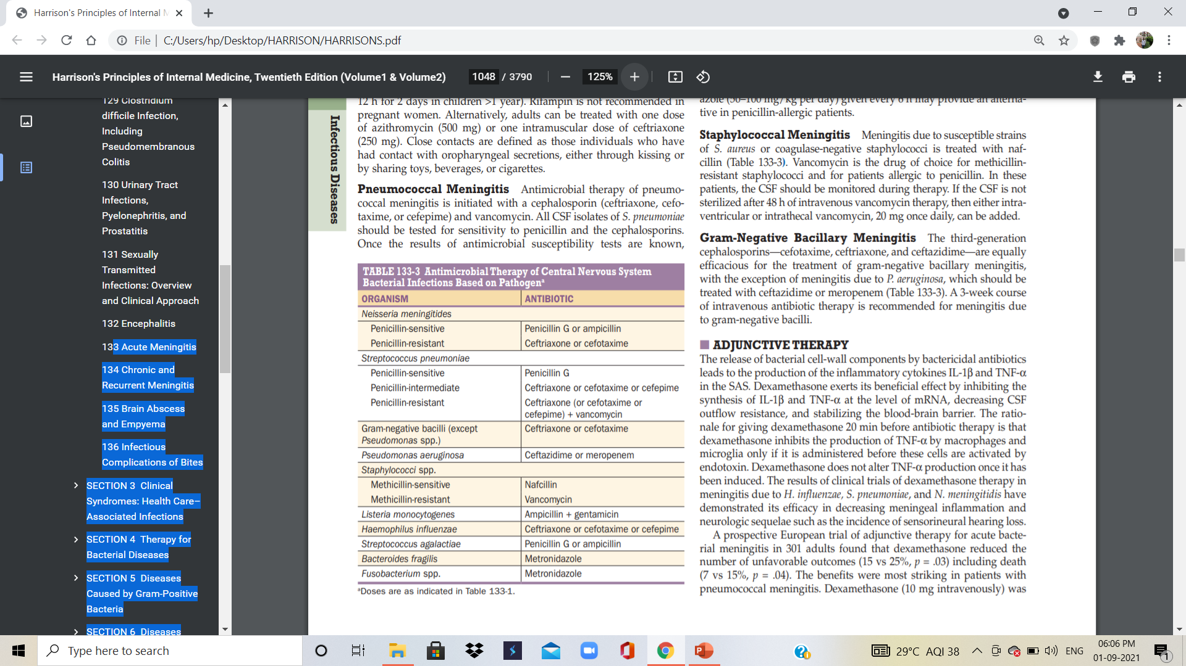
Gram-Negative Bacillary
third-generation cephalosporins—cefotaxime, ceftriaxone, and ceftazidime—
exception of meningitis due to P. aeruginosa: treated with ceftazidime or meropenem
A 3-week course of intravenous antibiotic therapy is recommended for meningitis due to gram-negative bacilli.

Slide 39
ADJUNCTIVE THERAPY
Bactericidal antibiotics → release of bacterial cell-wall components →inflammatory cytokines (IL-1β & TNF-α ).
Dexamethasone : inhibit the synthesis of IL-1β and TNF-α at the level of mRNA, decreasing CSF outflow resistance, and stabilizing the blood-brain barrier.
Dexamethasone is given 20 min before antibiotic therapy
demonstrated its efficacy in decreasing meningeal inflammation and neurologic sequelae such as the incidence of sensorineural hearing loss

Slide 40
INCREASED INTRACRANIAL PRESSURE
Emergency treatment of increased ICP includes elevation of the patient’s head to 30–45°, intubation and hyperventilation (Paco2 25–30 mmHg), and mannitol.
Patients with increased ICP should be managed in an intensive care unit
accurate ICP measurements are best obtained with an ICP monitoring device

Slide 41
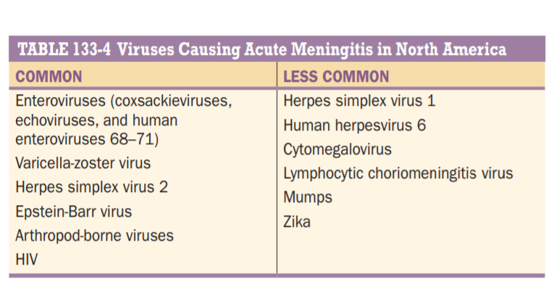
VIRAL MENINGITIS
ETIOLOGY

Slide 42
CLINICAL MANIFESTATIONS
Immunocompetent adults : headache, fever, and signs of meningeal irritation coupled with an inflammatory CSF profile.
Headache : frontal or retroorbital and associated with photophobia and pain on moving the eyes.
Nuchal rigidity : may be mild and present only near the limit of neck anteflexion.
Constitutional signs : malaise, myalgia, anorexia, nausea and vomiting, abdominal pain, and/or diarrhea.
Patients often have mild lethargy or drowsiness
profound alterations in consciousness- do not occur in viral meningitis

Slide 43
LABORATORY INVESTIGATIONS
CSF Examination
The typical CSF profile : pleocytosis, a normal or slightly elevated protein concentration (0.2– 0.8 g/L [20–80 mg/dL]), a normal glucose concentration, and a normal or mildly elevated opening pressure (100–350 mmH2 O).
Organisms are not seen on Gram’s stain of CSF.
Total CSF cell count : 25–500/μL
(several thousand/ μL - lymphocytic choriomeningitis virus (LCMV) and mumps virus)

Slide 44
CSF -Differential count : Lymphocytes predominant.
PMNs may predominate in the first 48 h of illness, especially with infections due to echovirus 9, West Nile virus (WNV), eastern equine encephalitis (EEE) virus, or mumps.
A PMN pleocytosis occurs in 45% of patients with WNV meningitis and can persist for a week or longer before shifting to a lymphocytic pleocytosis.
PMN pleocytosis + low glucose : CMV infections in immunocompromised hosts /bacterial meningitis / parameningeal infections.

Slide 45
CSF glucose concentration : normal in viral infections
decreased in 10–30% : mumps , LCMV, echoviruses and other enteroviruses, HSV-2, and VZV.
As a rule, a lymphocytic pleocytosis with a low glucose concentration should suggest fungal or tuberculous meningitis, Listeria meningoencephalitis, or noninfectious disorders (e.g., sarcoid, neoplastic meningitis).

Slide 46
Polymerase Chain Reaction
single most important method for diagnosing CNS viral infections.
In enteroviral , HSV infections , CMV, Epstein-Barr virus (EBV), VZV, and human herpesvirus 6 (HHV-6).
CSF PCR tests are available for WNV but are not as sensitive as detection of WNV-specific CSF IgM.
PCR is also useful in the diagnosis of - Mycoplasma pneumoniae
PCR of throat washings may assist in diagnosis of enteroviral and mycoplasmal CNS infections.
PCR of stool specimens may also assist in diagnosis of enteroviral infections .

Slide 47
Viral Culture
viruses may be isolated from throat swabs, stool, blood, and urine.
During enteroviral infections, viral shedding in stool may persist for several weeks..
Enteroviruses and adenoviruses | feces
enteroviruses, and LCMV | blood
mumps and CMV | urine
enteroviruses, mumps, and adenoviruses | throat washings

Slide 48
Serologic Studies
Serologic studies are important for the diagnosis of arboviruses such as WNV
however these tests are less useful for viruses such as HSV, VZV, CMV, and EBV that have a high seroprevalence in the general population.
CSF oligoclonal gamma globulin bands occur in association with a number of viral infections.

Slide 49
DIFFERENTIAL DIAGNOSIS
untreated or partially treated bacterial meningitis
early stages of meningitis caused by fungi, mycobacteria, or Treponema pallidum (neurosyphilis
meningitis caused by agents such as Mycoplasma, Listeria spp., Brucella spp., Coxiella spp., Leptospira spp., and Rickettsia spp.;
parameningeal infections;
neoplastic meningitis
meningitis secondary to noninfectious inflammatory diseases, including medication-induced hypersensitivity meningitis, SLE and other rheumatologic diseases, sarcoidosis, Behçet’s syndrome, and the uveomeningitic syndromes.

Slide 50
SPECIFIC VIRAL ETIOLOGIES
Enteroviruses (EV)
Arbovirus infections
HSV meningitis
VZV meningitis
EBV infections
HIV meningitis

Slide 51
TREATMENT
Analgesics, antipyretics, and antiemetics.
Fluid and electrolyte status should be monitored.
Patients with suspected bacterial meningitis should receive appropriate empirical therapy pending culture results .
Hospitalization : immunocompetent patients /Immunocompromised patientsand patients
Oral or intravenous acyclovir may be of benefit in patients with meningitis caused by HSV-1 or 2 and in cases of severe EBV or VZV infection.

Slide 52
Seriously ill patients : intravenous acyclovir (15–30 mg/kg per day in three divided doses), which can be followed by an oral drug such as acyclovir (800 mg five times daily), famciclovir (500 mg tid), or valacyclovir (1000 mg tid) for a total course of 7–14 days.
Patients who are less ill can be treated with oral drugs alone.
Patients with HIV meningitis should receive highly active antiretroviral therapy
There is no specific therapy of proven benefit for patients with arboviral encephalitis, including that caused by WNV.

Slide 53
Intramuscular gamma globulin or intravenous immunoglobulin (Ivig) : deficient humoral immunity (E.G., X-linked agammaglobulinemia)
Intraventricular administration of immunoglobulin through an ommaya reservoir : chronic enteroviral meningitis who have not responded to intramuscular or intravenous immunoglobulin
Role of vaccination.

Slide 54
THANK U

