Slide 1
WILSON’S DISEASE: REVISITING AN OLD FRIEND
World Journal of Hepatology

Slide 2
Introduction
Genetics
Clinical features
Diagnosis
Treatment

Slide 3
Introduction
Autosomal-recessive monogenic disorder
First described in 1912 by Kinnear Wilson
Due to mutation in the ATP7B gene, which encodes a transporter protein with ATPase activity. This transporter is involved in incorporating copper into apoceruloplasmin, which is finally eliminated in bile.
Mutation leads to free copper being released into the bloodstream which is then excreted via urine.

Slide 4
Genetics
The ATP7B gene is located on chromosome 13q14.3 and comprises 20 introns and 21 exons, encoding a protein of 165 amino acids[
800 mutations have been discovered
Mutations mainly affect the central regions of the gene (both 8 and 14 exons are the most frequently affected)
most common mutations are H1069Q and R778L
90 -98% heterozygous with each allele showing different mutation

Slide 5
Phenotype and penetrance are extremely variable
Even patients carrying two disease-causing mutations do not necessarily have a demonstrable alteration of copper metabolism
Some of the proposed reasons are differences in copper intake, individual antioxidant capacity or susceptibility to liver fibrosis, and hormonal influences

Slide 6
The European Association for the Study of the Liver (EASL) and the American Association for the Study of Liver Diseases (AASLD) recommend an appropriate study of the index case taking into account the family history of liver- and brain-related disease
These guidelines propose to assess the patient's siblings since the risk of WD is 25%

Slide 7
Clinical features
Usually occurs between 5 to 35 years of age
it should be investigated in patients with liver failure due to an unknown cause and those with liver disease and neuropsychiatric symptomatology

Slide 8
Liver
The clinical spectrum ranges from asymptomatic patients, with mild analytical alterations, to subjects with fulminant liver failure.
Acute (from acute hepatitis to fulminant liver failure) and chronic presentation (from steatosis to compensated and decompensated cirrhosis)
Asymptomatic forms usually have only hepatomegaly, discretely elevated transaminases, or are identified during the screening of an index case

Slide 9
Acute presentation:
WD should be suspected in a patient with acute hepatitis, in which viral hepatitis is ruled out.
Present with jaundice and abdominal
Beyond these signs and symptoms, the elevation of hemoglobin, cholinesterase, and low alkaline phosphatase are characteristic of acute WD
Sometimes may present as hemolytic anemia with negative coombs test
2%-5% of acute liver failure events

Slide 10
CHRONIC PRESENTATION
Starts as a slight transaminase elevation that progresses slowly to fibrosis and, finally, cirrhosis
Splenomegaly maybe seen as part of portal hypertension
Young patients more than three years of age showing cirrhosis should be evaluated for WD
WD can initially be confused with autoimmune hepatitis, as they occur at a similar age and are manifested by jaundice and increased transaminases and gammaglobulins
Wilsons disease can also lead to hepatic steatosis

Slide 11
Neurologic symptoms:
Typically appears after liver manifestations
Mainly through extrapyramidal system dysfunction and bulbar involvement
Most common symptom - dysarthria
Other manifestations : tremors, parkinsonism, involuntary movements, cerebellar dysfunction, chorea, or hyperreflexia
Dystonia affecting the face and jaw – wilsons face

Slide 12
Psychiatric symptoms
Initial manifestation in 1/3rd patients
Typical symptoms are depression and anxiety
Changes in behavior or personality or impulsivity can occur
Affective disorders are more common than psychotic spectrum disorders

Slide 13
Occular manifestations:
Kayser-Fleischer´s (KF) ring is a frequent manifestation of WD, which affects the Descemet membrane of the cornea
The slit-lamp examination shows a brown-gold colored ring on the periphery of the cornea
It is present in more than 90% of patients with WD showing neurological involvement but only in half of cases with liver disease
The KF ring does not affect vision, and its disappearance has been seen in patients undergoing effective treatment and liver transplantation
KF ring has also been described in cholesteatic syndromes

Slide 14
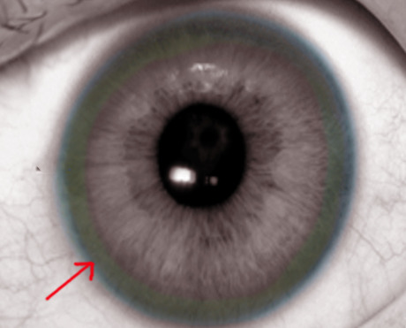

Slide 16
Diagnosis
no specific diagnostic tests for WD . Instead, a combination of clinical signs and symptoms and some tests are required to achieve the final diagnosis.

Slide 17
Ceruloplasmin
Carries 90% of serum circulating copper
synthesized in the liver and excreted into the circulation from hepatocytes, mostly as holoceruloplasmin (containing six copper atoms) and the rest as apoceruloplasmin (not joined to copper)
Ceruloplasmin levels may be determined enzymatically by its copper-dependent oxidase activity or by immunological assays.
Immunological assay measures the total ceruloplasmin level but not the ceruloplasmin oxidase activity. So the use of enzymatic assays is more appropriate

Slide 18
Blood ceruloplasmin levels are typically low (< 0.2 g/L) in patients with WD and neurological involvement
May be higher in up to half of patients
ceruloplasmin levels can be reduced in other conditions such as renal or enteric protein loss, malabsorption, end-stage liver disease, or aceruloplasminemia
Ceruloplasmin is also an acute-phase reactant and may be elevated in inflammation or infections, resulting in false negatives in WD patients

Slide 19
Serum copper
Normal or elevated serum copper levels along with decreased ceruloplasmin suggestive of increased non ceruloplasmin bound copper
Low total serum copper levels maybe found even though free copper (albumin-bound copper or non-ceruloplasmin bound copper) may be increased.
Total serum copper mostly reflects ceruloplasmin-bound copper

Slide 20
Patients with WD have free copper levels between 10-20 mg/dL and symptomatic individuals have levels > 20 mg/dL
It is preferable to use enzymatically determined ceruloplasmin levels when calculating free copper

Slide 21
In 2009, a new method called exchangeable copper (CuEXC) was proposed for the direct determination of labile copper
values greater than 2.08 mmol/L suggest a high risk of severe neurological disease
When its threshold is higher than 18.5%, this biomarker reaches a sensitivity and specificity close to 100% in WD diagnosis
Therefore, it could differentiate WD from other liver diseases and healthy heterozygous subjects, representing a promising family screening marker

Slide 22
Urinary copper excretion
Urinary copper excretion in 24 h reflects the amount of circulating non-ceruloplasmin copper
Cut off for children : 0.64 mmol/24 h or 40 g/24 h
Cut off for adults is 1.6 mmol/24 h (100 g/24 h)
In up to 16%-23%, especially in asymptomatic children and siblings, urinary copper excretion may be lower than the values set

Slide 23
After D penicillamine (DPA) administration (1.000 mg administered in two doses), urinary copper excretion is measured
urinary copper excretion values > 160 μg/24 h is compatible with WD in children
patients with autoimmune hepatitis, cholestatic diseases, acute liver failure, or asymptomatic heterozygous patients can show elevated urinary copper excretion

Slide 24
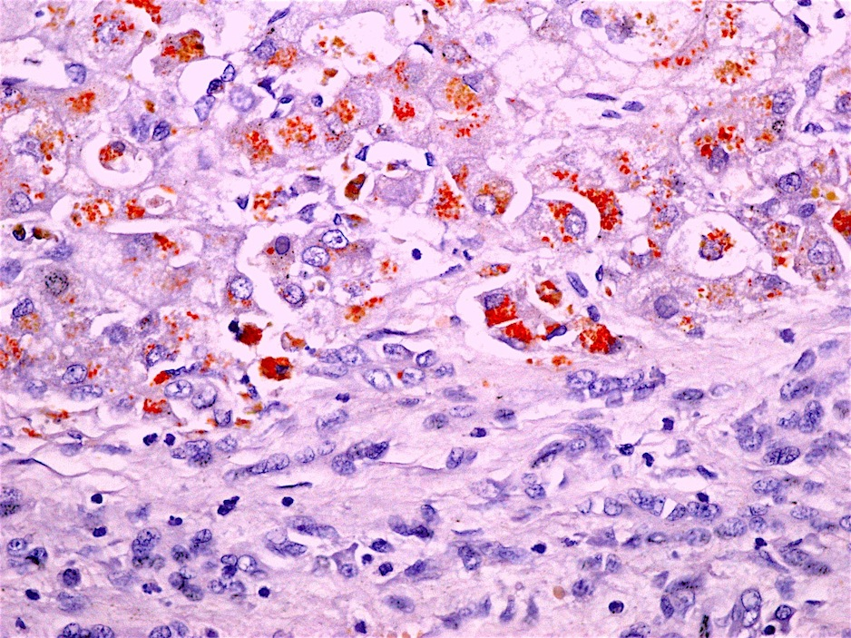
Liver biopsy
invasive technique
Use is limited to patients with compatible clinical or biochemical findings but without a definite diagnosis.
No specific histological changes-Mild steatosis may be observed
staining of metallothionein (protein-bound to intrahepatocyte copper) by orcein or lysosomal copper complexes, using rodain or rubenic acid, show liver copper deposits

Slide 25
hepatic accumulation of copper cannot be ruled out with histochemistry as staining only reveals copper deposits in less than 10% of patients.
intrahepatic copper quantification is essential for the diagnosis of WD after a hepatic biopsy.
For the determination of copper in dry weight, it is necessary to obtain a significant sample (at least 1 cm) and its placement in a copper-free and dry container.
Values greater than 250 μg/g (4 mmol/g) are diagnostic, while values less than 50 μg/g (0.8 μmol/g) make the diagnosis highly unlikely.

Slide 26
Neurological and psychiatric assessment
Magnetic resonance imaging (MRI) shows structural abnormalities with a hyperintensity in the T2 sequence in the basal ganglia, tectum, spinal bulb, thalamus, and brainstem
Decreased intensity in the T1 sequence in the basal ganglia
giant panda face sign, found in 14% of patients-hyperintensity of the tegmentum of the midbrain, especially around the red nucleus, which maintains its normal hypointensity on T2-weighted imaging axial sections of the brain.
Gaint panda face with the tectal and center-protuberance plaque's hyperintensity and the simultaneous involvement of the basal ganglia, thalamus, and brainstem, are practically pathognomonic of WD

Slide 27
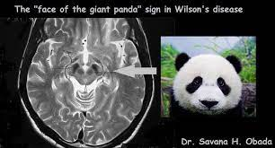

Slide 28
Genetic testing
Direct sequencing of the ATP7B gene – greatest efficacy
most common mutation (H1069Q) is present in 40%-50% of patients in Western countries
However, 17% of patients with a diagnosis established by the Leipzig criteria do not have any identifiable ATP7B gene mutation
explained by the inability of genetic testing to distinguish disease-specific mutations from polymorphisms of the gene and the absence of analyzing the noncoding regions of the gene

Slide 29
How is the diagnosis established?
single test does not allow a definite diagnosis of WD
scoring system that combines clinical parameters with biochemical imaging tests, known as the Leipzig criteria
More than 4 points are required to establish the diagnosis of WD according to these criteria
liver biopsy and the genetic assessment may not be needed if other test results add up to at least 4 points

Slide 32
Treatment
Lifelong treatment is necessary even in asymptomatic patients
Once treatment is indicated for WD, it should be monitored in terms of efficacy (including adherence to treatment) and side effects
Assess urinary copper excretion
every two weeks for 4-6 wk, then
every 2-3 mo for 6-12 months

Slide 33
DPA – d penicillamine
First-line drug for WD
Mechanism
chelation of circulating copper →excreted in the urine
Induces synthesis of metallothionein in the liver, a cysteine-rich protein with a high affinity for metal ions.

Slide 34
Dose
Adults- 750-1500 mg orally
Children- 20 mg/kg/d, in 2 or 3 divided doses
Should not be taken with food, antacids, or iron supplements because they decrease its absorption
Pyridoxine supplementation recommended
DPA therapy have hepatic improvements upto 90 %.
Efficacy of DPA in neurologic WD- less satisfactory

Slide 35
ADVERSE REACTIONS OF DPA
Early (1-3 wk) → Fever, cutaneous eruptions, myelosuppression, proteinuria, lymphadenopathy
Late (>3wks)→ Renal: Nephrotoxicity
→Lungs: Goodpasture syndrome
→Bone marrow: Aplasia
→Skin: Pemphigus, pemphigoid lesions, aphthous stomatitis, hair loss
→Autoimmunity: Lupus erythematosus, myasthenia gravis, polymyositis,
immunoglobulin A depression
Dose-dependent Side effects- Pyridoxine deficiency
Mammary hypertrophy
Skin: Elastosis serpiginosa, lichen planus, progeria-
like skin changes
Neurological deterioration (10%-50%)

Slide 36
If adverse reactions occurs, DPA discontinued and replaced with another drug
Neurological worsening – less with Zn salts

Slide 37
Trientine
Chelating agent, similar mechanism of action and efficacy to DPA
Forms a complex with four nitrogen atoms and copper→ excreted in the urine
DOSE
Adults -Orally 900 to 2700 mg/d(initial chelation phase)
750 to 1500 mg/d (maintenance phase)
Children-20 mg/kg/d is recommended in children
Challenge in trientine treatment- instability, kept cold (2ºC-8ºC).
Well-tolerated chelating agent, but higher rates of neurological deterioration is observed
Few side effects: Bone marrow depression, sideroblastic anemia hemorrhagic gastritis and skin rash N

Slide 38
Zinc salts
Induces metallothionein synthesis in enterocytes, and hepatocytes
Dose- 150 mg/d, divided in 3 doses,
children lower than 50 kg-75mg/day
At least 30 min before meal
Side effects -Gastric irritation elevation of serum amylase and lipase ,bone marrow depression
neurological deterioration is very uncommon
Zinc salts are not recommended as initial treatment, particularly in acute liver failure.
First-line therapy →asymptomatic patients or as maintenance treatment after initiation with chelating agents

Slide 39
NEW TREATMENT OPTIONS
Trientine tetrahydrochloride stable at normal temperature
Tetrathiomolybdate ammonium (TTM) -potent decoppering drug, reduces intestinal absorption of copper→ forms a tripartite complex with proteins and copper→ subsequently excreted.
Not associated with neurological deterioration
Methanobactins being investigated with positive results in WD treatment.
Remove copper from the mitochondria, avoiding cell toxicity, acute liver failure

Slide 40
Copper restriction -Diet
Avoid→ chocolate, fruits, nuts, mushrooms, liver, seafood
AASLD and EASL guidelines recommend avoiding the intake of high-concentration copper foods or water, particularly within the first year of diagnosis

Slide 41
Liver transplantation
Good survival rate
Indication - acute liver failure
end-stage liver disease
King's score -decide on LT-index, greater than 11 is associated with a high risk of death
Provides functionality for hepatic ATP7B→in normalization of copper metabolism and removal
chelation therapy may be discontinued after LT

Slide 42
Treatment in special situations: Pregnancy
Should not discontinued in pregnant patients
DPA has teratogenic potential
copper deficiency may have teratogenic effect, advised to reduce chelating therapy by 25%-50% during pregnancy

Slide 43
Prognosis
absence of adequate treatment, the prognosis of WD is fatal
severe neurological alterations may not be improved, although most patients show significantly improved neurological involvement.
psychiatric manifestations also improve, even disappear
patients with cirrhosis often remain compensated and do not have cirrhosis complications and patients with WD and liver cirrhosis should be screened for HCC

Slide 44
FUTURE TREATMENT APPROACHES FOR WD
Liver-targeted gene therapy
Murillo et al demonstrated that the use of recombinant adeno-associated viral vector (rAAV8), containing complementary DNA encoding copper transporting ATPase2, normalized soluble holoceruloplasmin, and hepatic parenchymal copper levels for more than six months after a single administration, in an animal model
hepatocyte transplantation has been proposed as an alternative approach to LT, but has disadvantages such as weak viability in cell culture, the complexity of hepatocyte source, and the vulnerability to cryopreservation

Slide 45
Stem-cell therapy -potential therapeutic approach in several liver diseases.
The differentiation potential of mesenchymal cells into hepatocytes has been demonstrated.
Induced Pluripotent Stem Cells (iPSCs)
previous study described the generation of iPSCs from WD donor fibroblasts (skin samples) that bear the R778L mutation in the ATP7B gene→ differentiation into hepatocyte-like cells with defective copper transport. They reported gene correction using a lentiviral vector.
genetically corrected iPSCs could be an option for autologous transplantation in WD patients

Slide 47
THANK YOU

