Slide 1
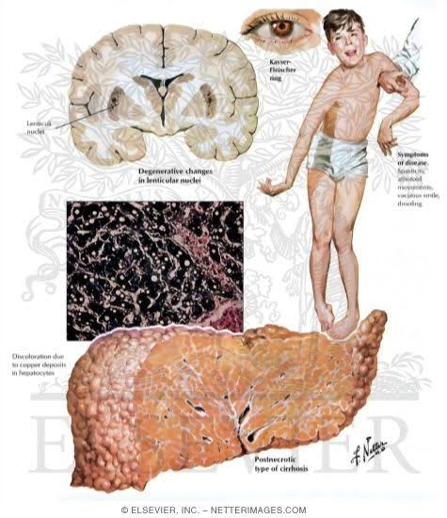
Wilson’s Disease: Clinical Practice
Guidelines
DR HAREESH M V.
JR3- GENERAL MEDICINE

Slide 2
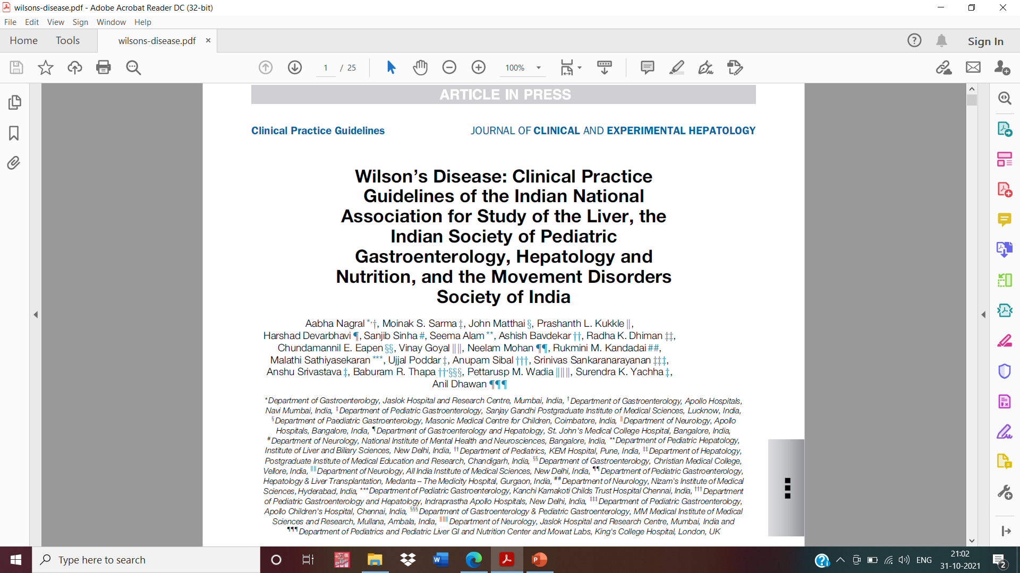

Slide 3
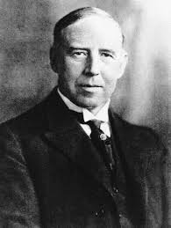
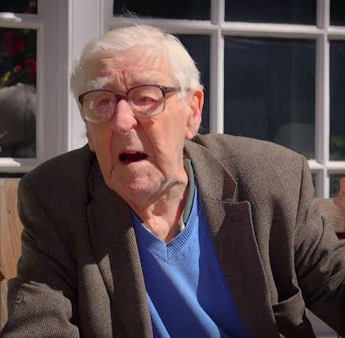
HISTORICAL PERSPECTIVE
1861 : The first possible case of WD was described by frerichs
Kayser(1902) & fleischer (1903) : greenish brown Ring around cornea in patients of suspected multiple Sclerosis.
1911 : Wilson - familial “progressive lenticular degeneration” in association with cirrhosis of the liver
Walshe (1956) demonstrated treatment success with D penicillamine (DP) (1956) and trientene (1969).

Slide 4
EPIDEMIOLOGY
Global prevalence of WD is 1/10,000 to 1/30,000.
Parts of Europe such as Romania and Sardinia report highest prevalence
In India, there are no community-based incidence and prevalence studies of WD.
Among pediatric liver diseases, WD accounts for 7.6–19.7% in tertiary hepatobiliary centres.

Slide 5
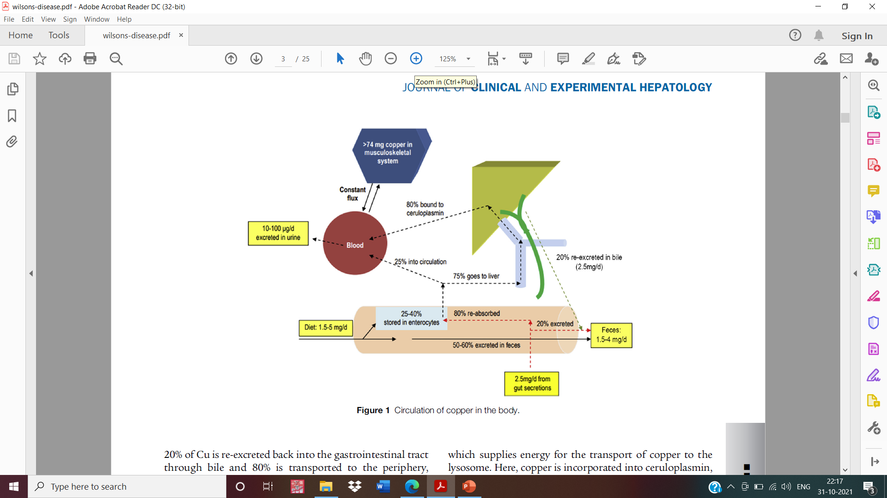
Normal copper fluxes and pools
The body contains 110 mg of Cu
The Cu pool in the musculoskeletal system
is in constant exchange with plasma.
Plasma contains approximately 1 mcg/ml : 60–95% bound to ceruloplasmin.
Ceruloplasmin is a source of Cu for peripheral organs
Cu is an essential cofactor for many enzymes.
Muscles | 28 mg
Bones | 46 mg
Connective tissues | 36 mg

Slide 6
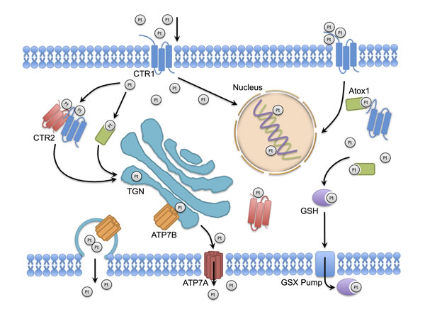
PATHOGENESIS
Autosomal recessive disorder- ATP7B gene (chromosome 13q)
expressed in hepatocytes, Kidneys, and placenta
Encodes for P-type ATPase or copper translocase ATP7B
This Photo by Unknown Author is licensed under CC BY

Slide 7
ATP7B : helps in transport of copper to the trans-golgi network and the biliary excretion of copper.
Antioxidant protein 1, a copper chaperone : deliver copper to the 6 copper-binding domains in ATP7B.
Binding of copper to ATP7B causes adenosine tri phosphate (ATP) hydrolysis which supplies energy for the transport of copper to the lysosome.
Here, copper is incorporated into ceruloplasmin, which is then released in the circulation.

Slide 8
Levels of copper in the hepatocytes regulate the intracellular distribution and function of ATP7b
With normal copper levels, ATP7B helps In synthesis of cuproproteins such as ceruloplasmin.
Apoceruloplasmin (Copper-free ceruloplasmin) is less stable in Circulation than holo-ceruloplasmin (copper-bound ceruloplasmin).
When intracellular copper is in excess, ATP7b facilitates Its excretion into bile by exocytosis.

Slide 9
Mutations in ATP7B
Decreased synthesis of copper-bound ceruloplasmin
increased cytosolic levels of copper
increased Mitochondrial, and nuclear levels of copper
Impaired excretion of copper

Slide 10
Copper-Induced Liver Injury
Increased intracellular copper
Induces oxidative stress
Production of hydroxyl radicals and reduced superoxide dismutase and glutathione
Damage of cellular lipids, proteins, and nucleic acids
Manifesttions of cirrhosis,lenticular degeneration
Mitochondrial dysfunction

Slide 11
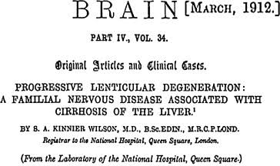
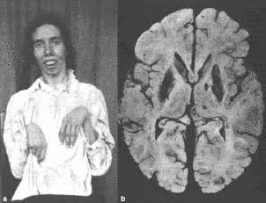
Clinical manifestations

Slide 12
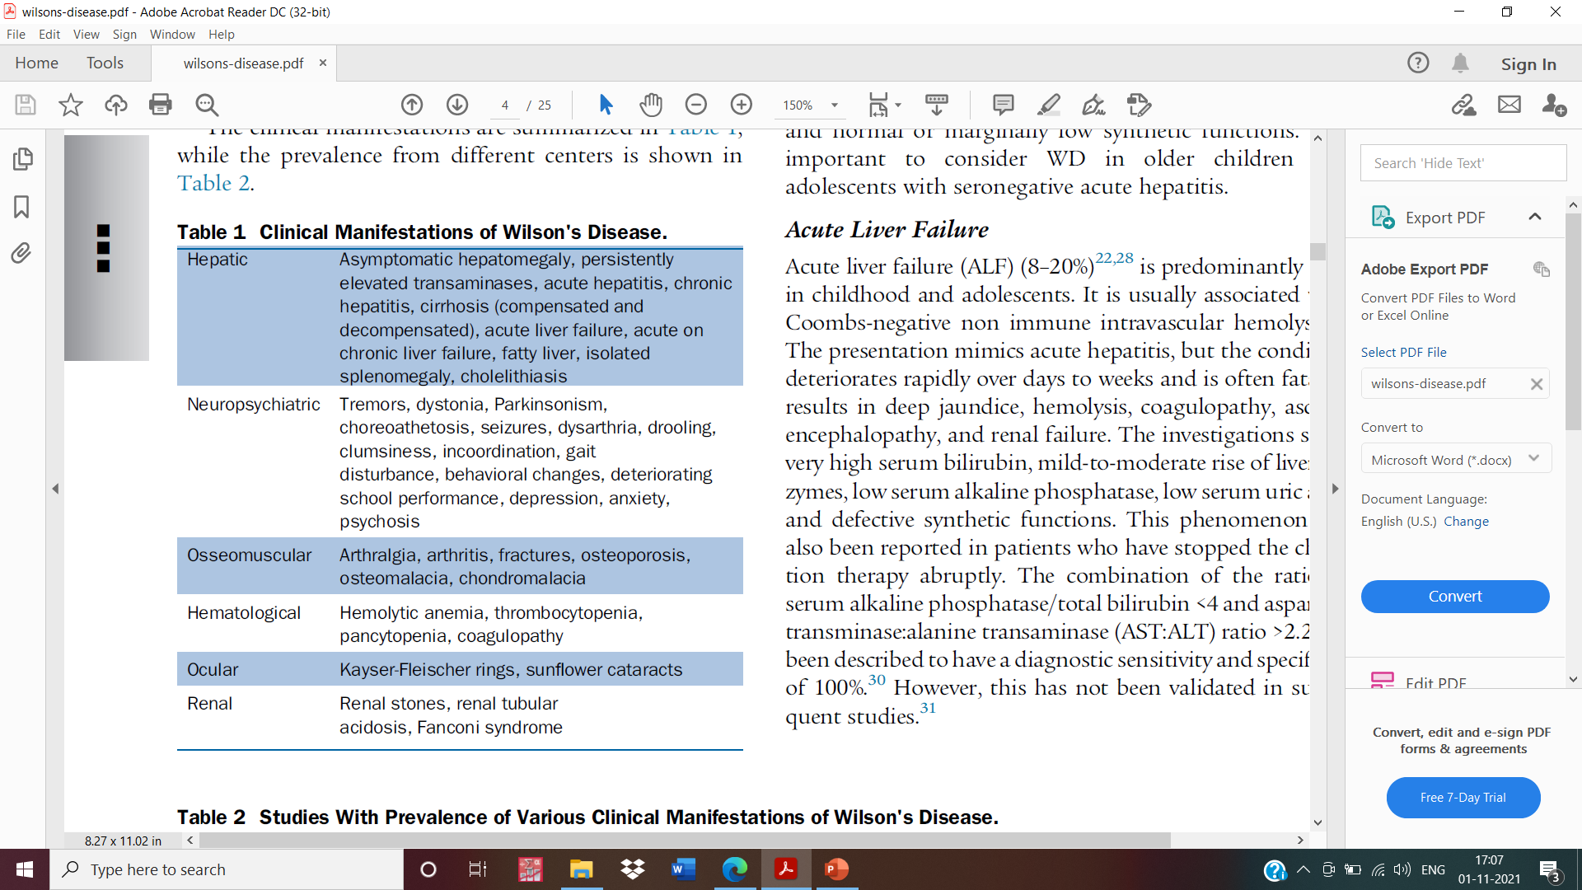

Slide 13
Clinical features depend on the predominant organ involved (mainly liver and brain
The disease has been reported from 3 to 85 years of age.
Although copper starts accumulating soon after birth, the disease takes atleast 3 years to manifest.

Slide 14
Age-phenotypic presentation: Walshe and Yealland
 | Hepatic presentation | Neuropsychiatric Presentation
<10 years: | 83% | 17%
10–18 years:; | 52% | 48%
>18 years: | 24% | 74%
Isolated hepatic involvement | 20–54%
Isolated neurological | 8–22%
Neurohepatic | 11–36%
asymptomatic | 15–35%

Slide 15
Hepatic Manifestations
Asymptomatic WD : 3–40%
Incidentally detected hepatomegaly, raised transaminases
siblings of the index WD patients detected on Screening.
these cases are identified in first Decade of life or in adolescence.

Slide 16
Acute hepatitis (10–25%)
mimics acute viral hepatitis, Autoimmune hepatitis, and drug-induced liver injury.
Symptoms
Jaundice, anorexia, nausea, malaise, fever, pale stools, Pain in the abdomen
Biochemical investigations
Conjugated hyperbilirubinemia, raised transaminases,
normal or marginally low synthetic functions
consider WD in older children and adolescents with seronegative acute hepatitis

Slide 17
Acute liver failure (8–20%)
Predominantly seen in childhood and adolescents.
Usually associated with coombs-negative non immune intravascular hemolysis
Mimics acute hepatitis deteriorates rapidly over days to weeks fatal
Deep jaundice, hemolysis, coagulopathy, ascites, encephalopathy, and renal failure

Slide 18
Investigations
Very high serum bilirubin, mild-to-moderate rise of liver enzymes, low serum alkaline phosphatase, low serum uric acid, and defective synthetic functions.
The combination of the ratio of serum alkaline phosphatase/total bilirubin <4 and
aspartate transminase:alanine transaminase (AST:ALT) ratio >2.2 has been described to have a diagnostic sensitivity and specificity of 100%

Slide 19
Acute on chronic liver failure
Acute on chronic liver failure (ACLF) : WD was the underlying chronic liver disease in 42–43% cases
Viral hepatitis deteriorates underlying hepatic WD and is the first manifestation of the disease.
There is a prodrome followed by deep jaundice, early-onset ascites, encephalopathy, and coagulopathy rapidly progressing to a multiorgan dysfunction

Slide 20
Chronic hepatitis (10–30%)35 is seen especially in adolescents and young adults
35%– 60% patients may present with complications of cirrhosis
The development of hepatocellular carcinoma (HCC) in patients with WD is rare compared with other causes of cirrhosis

Slide 21
Neurological Manifestations
Patients with neurological presentations tend to be older (second/third decade)
usually have a kayser-fleischer (KF) ring
Early or subtle neurological manifestations in young children : deterioration of handwriting and school performance, dysarthria, and drooling of saliva

Slide 22
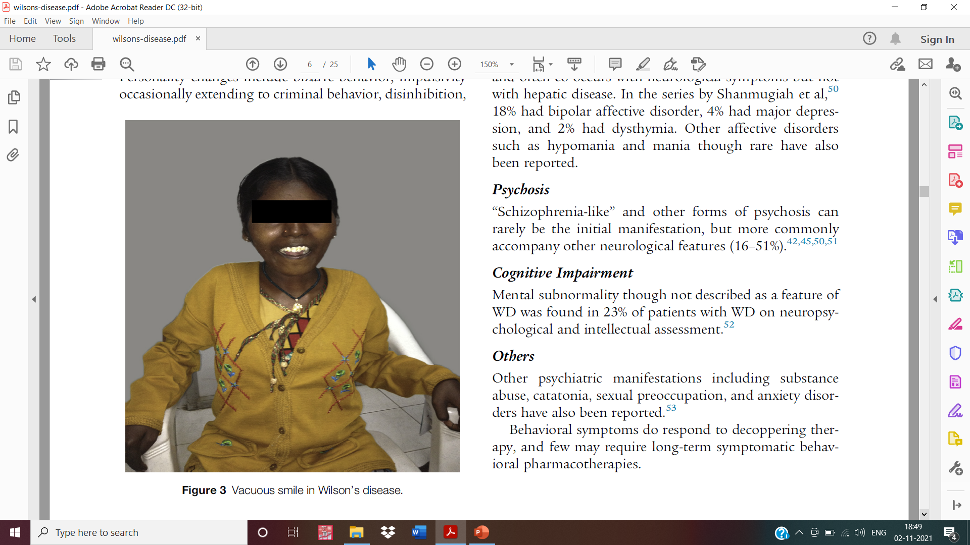
“WILSON'S FACIES”
Wilson's facies is scored on the presence of vacuous smile, open mouth, hypersalivation, and dull look, a unique feature which gives an estimate of severity

Slide 23
Primarily, the neurological form consists of extrapyramidal manifestations, but not exclusively limited to it.
Broadly, the extrapyramidal neurological abnormalities can be classified as:
(A) an akinetic-rigid syndrome similar to parkinson's disease
(B) pseudosclerosis dominated by tremor
(C) ataxia
(D) a dystonic syndrome

Slide 24
Psycho-behavioral Manifestations
Psycho-behavioral issues are very common in WD
Core issues: organic dementia, psychosis, psychoneurosis, and behavioral disturbances characterized by impulsivity occasionally extending to unlawful behavior
The delay in diagnosis ranges from 1 to 5 years

Slide 25
Personality changes : bizarre behavior, impulsivity occasionally extending to criminal behavior, disinhibition, irritability, emotionality, decreased threshold for anger, and aggression
Depression is the most common psychiatric manifestation
“Schizophrenia-like” and other forms of psychosis can rarely be the initial manifestation, but more commonly accompany other neurological features

Slide 26
Ocular Manifestations
Kayser-Fleischer (KF) ring
Copper accumulates in the descemet's membrane of the cornea forming the KF ring
Greenish-brown in color
They are always bilateral and are seen in 50– 60% of hepatic and 95–100% cases of neurological WD

Slide 27
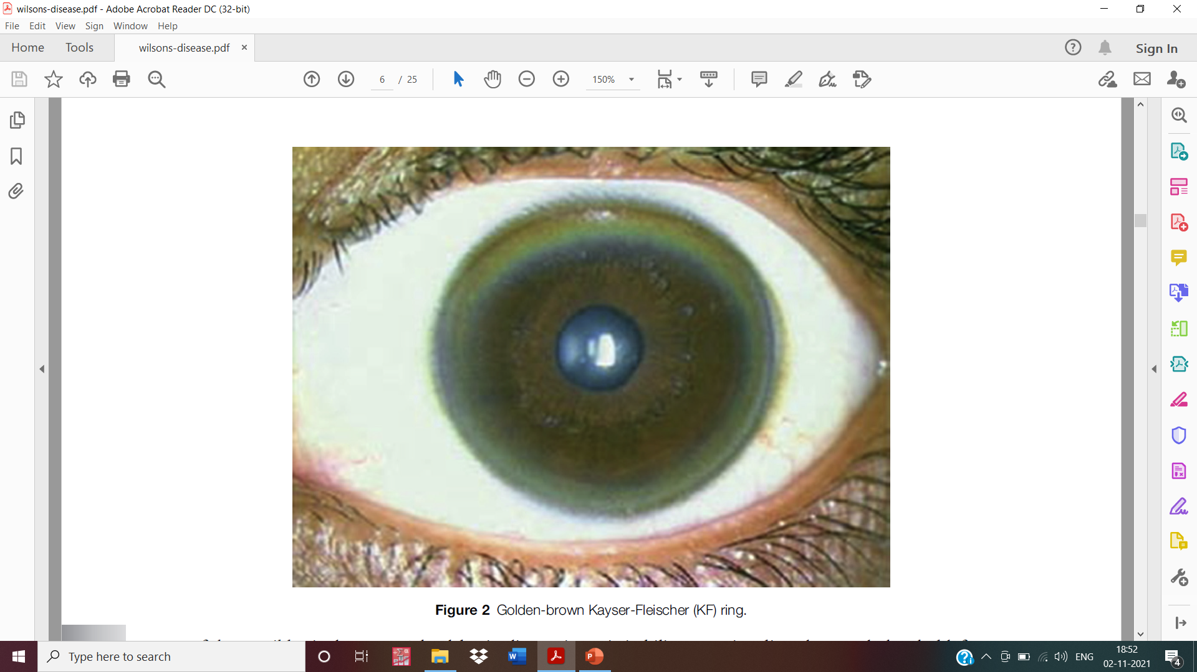

Slide 28
They appear sequentially at the (upper > lower > medial > lateral) segment of limbus and on chelation therapy disappear in the reverse direction.
KF rings may mimic bile pigment rings seen in the stromal layer of the cornea in advanced cholestasis and hence need to be confirmed by an experienced ophthalmologist

Slide 29
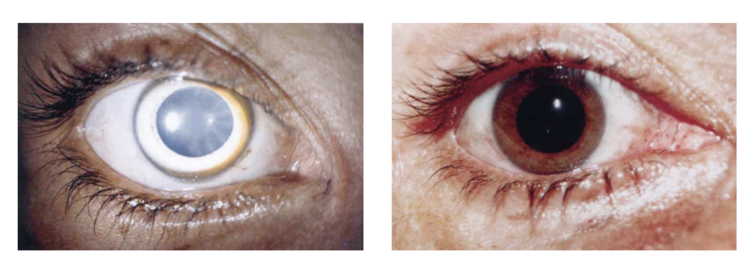
Sunflower cataract is uncommon (2–17%) and is due to copper deposition in the anterior capsule of the lens.
These are always associated with KF rings, do not disturb vision, and disappear with chelation therapy

Slide 30
Renal manifestations:
1. Renal tubular dysfunction with nephrocalcinosis (manifesting as microscopic hematuria) is not uncommon in WD (strength 1; level of evidence, B).
2. Children on DP should be periodically evaluated for proteinuria to detect drug-induced glomerular injury (strength 1; level of evidence, B).

Slide 31
Hematological manifestations:
1. Mild coombs-negative hemolytic anemia can occur in asymptomatic WD (strength 2; level of evidence, C).
2. Acute severe hemolysis can be an initial manifestation of ALF related to WD (strength 2; level of evidence, C).
3. WD should be suspected in adolescents and young adults with coombs-negative hemolytic anemia (strength 2; level of evidence, C).

Slide 32
Other system manifestations:
Joint manifestations may be the presenting symptoms of WD.
Precocious onset degenerative joint disease (osteoarthritis, chondrocalcinosis) in the second and third decade should raise a suspicion of WD (strength 2; level of evidence, B)
2. Asymptomatic arrhythmias are common, and therefore, a Cardiac evaluation may be routinely performed in all adult patients (strength 1; level of evidence, B).

Slide 33
DIAGNOSIS

Slide 34
Serum ceruloplasmin
Low level in a person with suspected disease may be suspicious of WD.
Normal values : falsely normal in acute inflammation (ceruloplasmin is an acute phase reactant).
Serum ceruloplasmin is typically lower in neuropsychiatric disease compared with liver disease

Slide 35
Ceruloplasmin levels may be decreased in patients
with other causes of cirrhosis, malabsorption, and renal disease.
Low serum ceruloplasmin levels alone cannot be
relied upon to make a diagnosis of WD, although very low levels below 5 mg/dl are highly suggestive of WD
Normal values | 20 to 40 mg/dl
strongly favor the diagnosis of WD | <10 mg/dl
Patients & about 20% of heterozygotes. | between 10 and 20 mg/dl

Slide 36
Twenty-four–hour urinary copper assay
Reflects the serum free copper level.
It is an excellent test in symptomatic patients, but may be false negative in those who are asymptomatic.
Level >100 mcg/dl is considered virtually diagnostic, but recent studies have shown that lowering the cutoff levels to 40 mcg/dl for asymptomatic patients increases the sensitivity

Slide 37
KF ring is highly specific for WD, but its absence does not rule out the diagnosis (strength 1; level of evidence, A).
Serum total copper has no role in the diagnosis of wd (strength 1; level of evidence, a).
Any degree of hemolysis in the setting of liver disease that is coombs-negative heightens the suspicion of wd (strength 2; level of evidence, a).
The presence of significant hemolysis in an individual with alf is almost always due to wd (strength 2; level of evidence, a).

Slide 38
Liver biopsy and liver copper:
1. There are no histopathological features pathognomic for WD (strength 2; level of evidence, A).
2. Liver copper estimation has limited usefulness due to nonavailability of the test as well as logistic and quality issues (strength 2; level of evidence, A).
3. Histochemical stains for copper may only provide supportive evidence for diagnosis of WD (strength 2; level of evidence,b).

Slide 39
Magnetic resonance imaging brain
“Face of giant panda”(14.3%)
Tectal plate hyperintensity (75%): MRI of brain with certain features such as tectal plate hyperintensity is pathognomonic of WD (strength 2; level of evidence, B).
Central pontine myelinolysis–like abnormalities (62.5%), and concurrent signal changes in basal ganglia, thalamus, and brainstem
These features when present are virtually pathognomonic of WD.

Slide 40
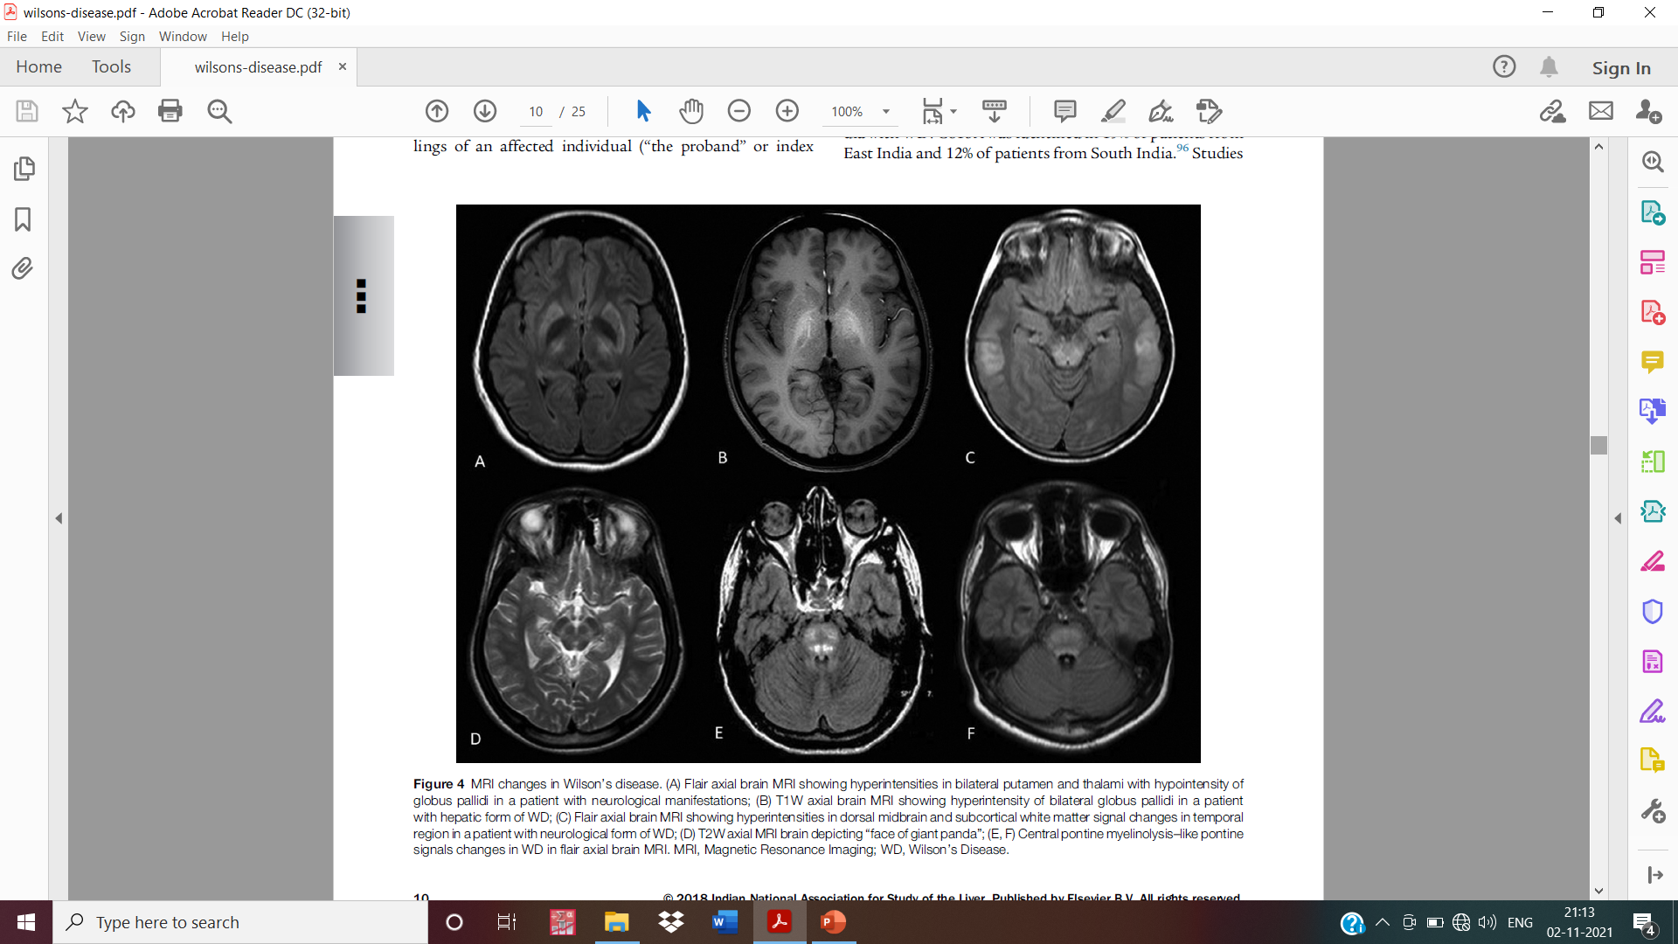

Slide 41
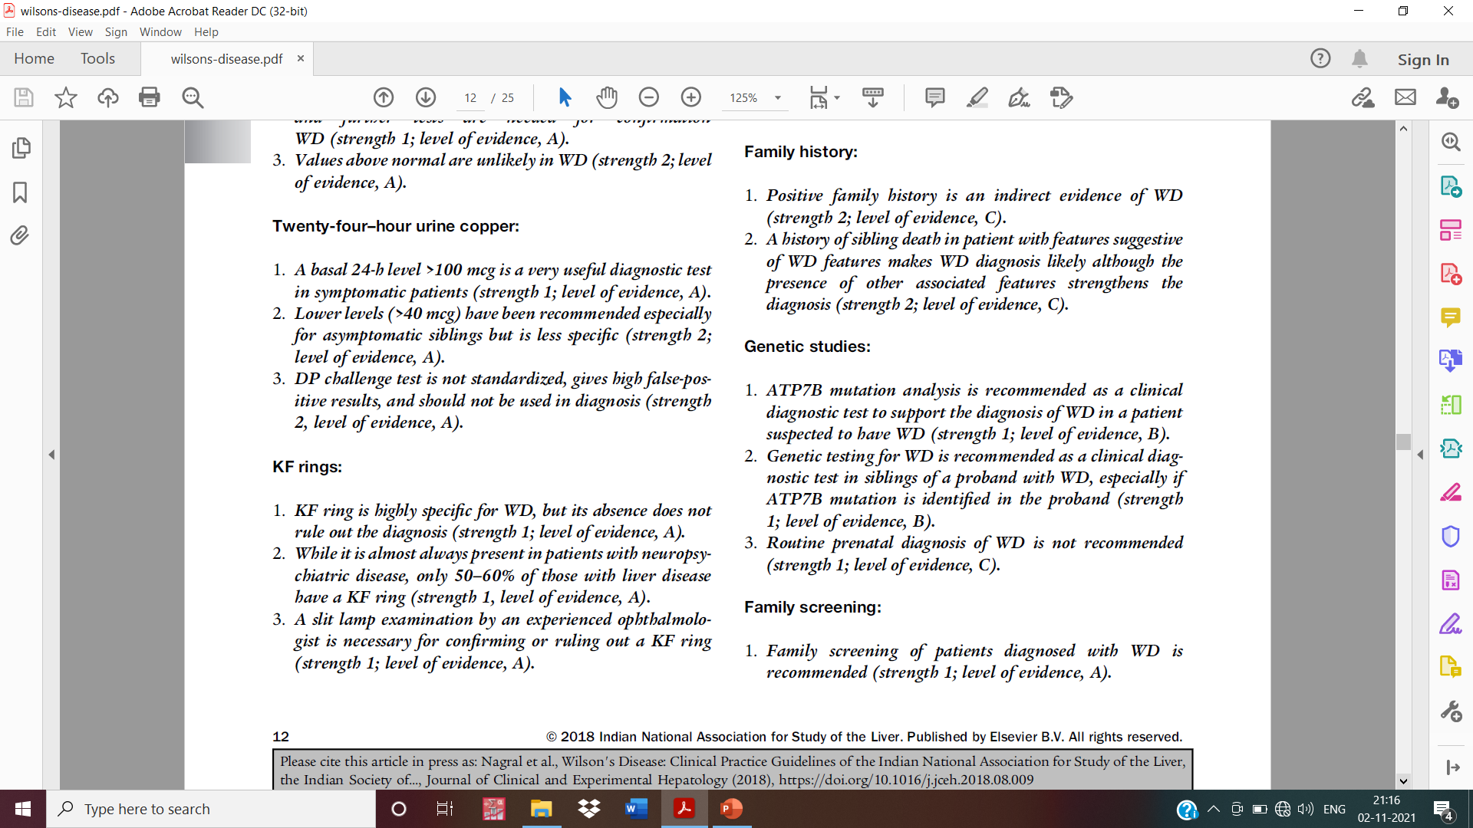

Slide 42
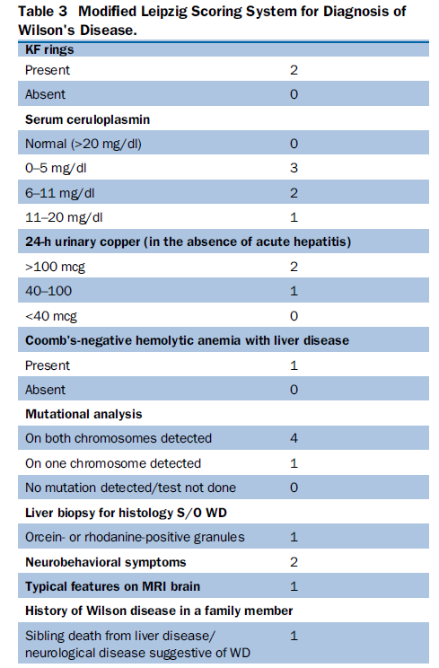
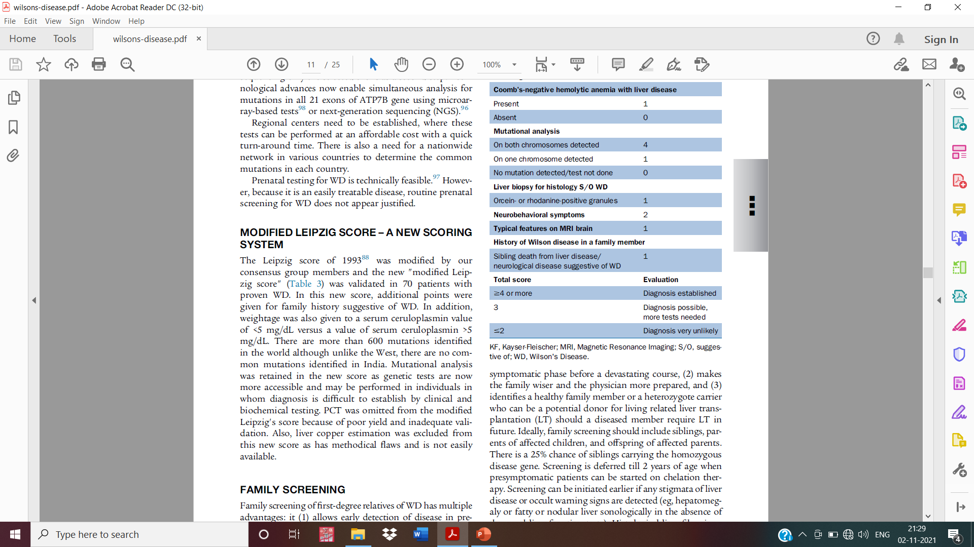

Slide 43
TREATMENT
D-penicillamine
DP is the preferred standard therapy for WD
DP binds to copper through disulfide bonds, and every gram promotes urinary excretion of 200 mg of copper.
It also induces hepatic metallothionein, a cytosolic metal-binding protein that sequesters copper, and renders it nontoxic.

Slide 44
Hepatic Cu levels fall during the first year but remain above normal for several years.
In neurological WD, a paradoxical worsening of symptoms is occasionally observed after starting DP : attributed to sudden mobilization of free copper from neurological tissues.
The dose of DP is 20 mg/kg/day in children, while adults receive 750–1500 mg per day in 2–3 divided doses on an empty stomach.

Slide 45
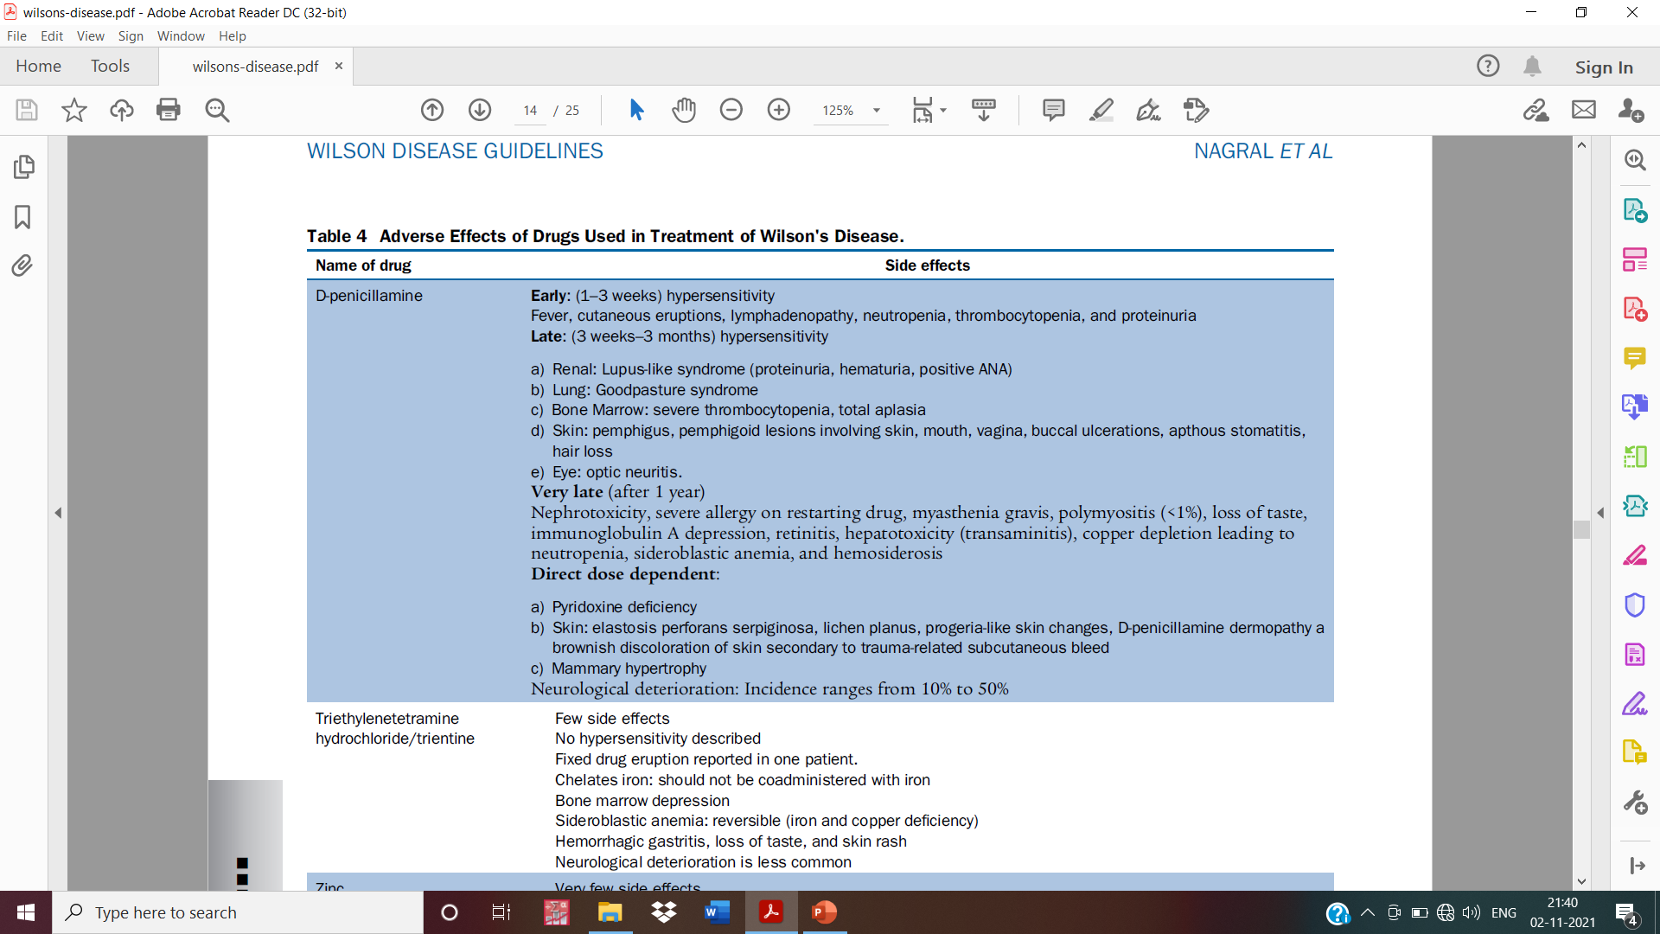

Slide 46
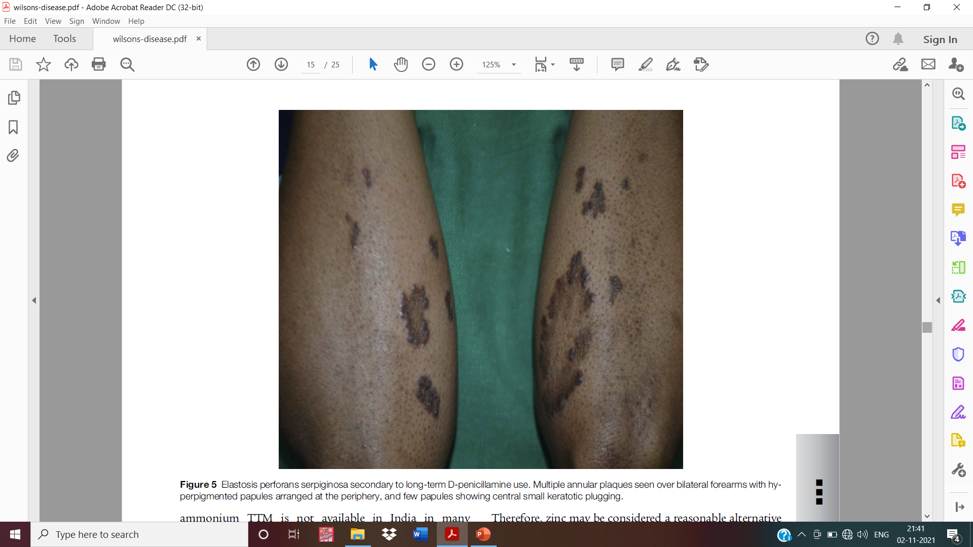

Slide 47
Trientine
Trientine (triethylenetetramine-2-hydrochloride) is a chelator with a mechanism of action similar to DP
Dosage is 750–1500 mg/day in 3 divided doses on empty stomach for adults (20 mg/kg/ day for children).
Trientine can also cause paradoxical worsening in neurological WD, hence, it should be started in low doses and increased slowly similar to DP.

Slide 48
Zinc
Acts by inducing metallothionein in enterocytes which preferentially binds absorbed cu, sequesters it in the enterocytes, and prevents its entry into the portal circulation.
As the enterocytes are naturally sloughed into the lumen, copper is excreted in the feces.
Zinc also induces metallothionein in hepatocytes and protects against cu toxicity.

Slide 49
Slow action and takes much longer to achieve a negative cu balance
Less effective as first-line therapy in symptomatic liver disease.
Acetate salts are preferred because of lesser incidence of gastric side effects.
Adults require 150 mg/day of elemental zinc in 3 divided doses, whereas children and those under 50 kg are given only 75 mg/day.

Slide 50
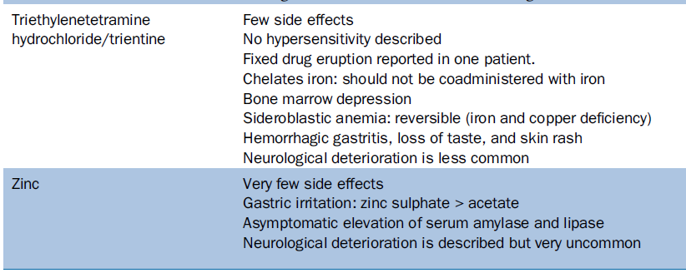

Slide 51
Ammonium tetrathiomolybdate
It binds to the copper in the food, thus preventing its absorption.
If taken on empty stomach, it is absorbed into the blood and forms a complex with circulating copper preventing cellular uptake, leading to its excretion in urine.
The dosage used is 20 mg 3 times a day with meals and 20 mg 3 times a day in between the meals.

Slide 52
TREATMENT PHASES
Initial Phase
Maintenance Therapy
lifelong therapy
prevents copper reaccumulation
Zinc, is the
drug of choice.
To reduce the body copper levels to subtoxic threshold
DP has traditionally been the drug of choice
DP and zinc sulfate
were both effective in the majority of neuro-WD patients.

Slide 53
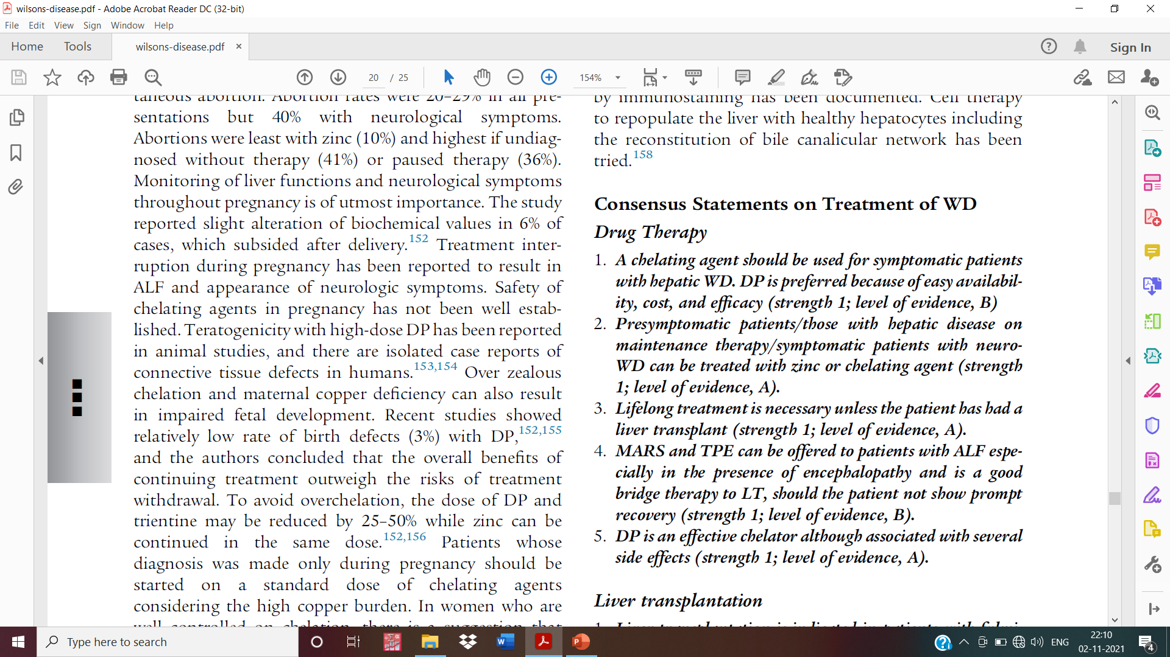

Slide 54
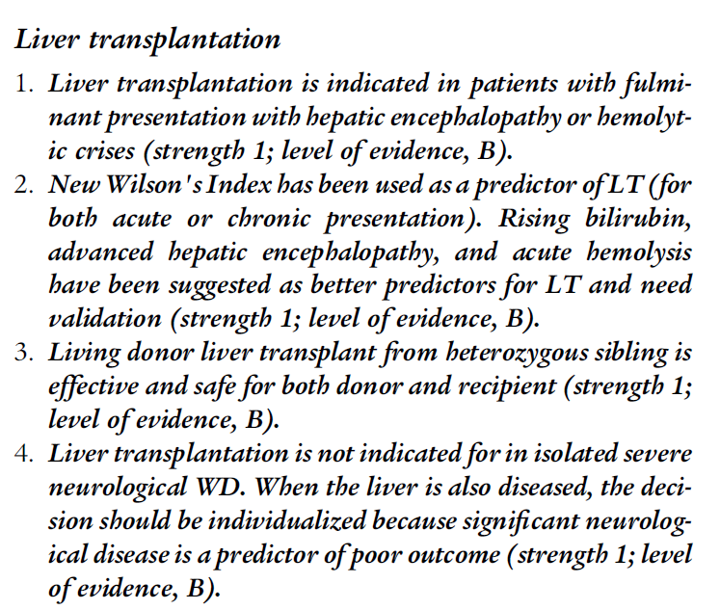

Slide 55
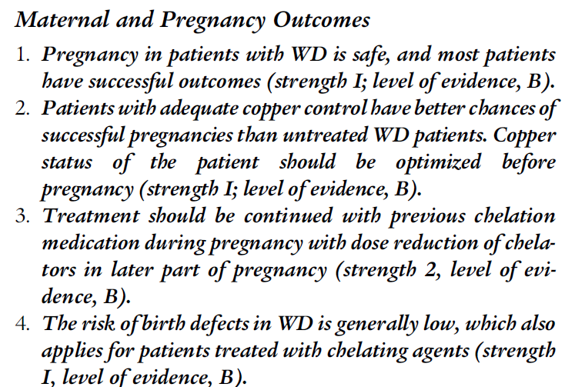
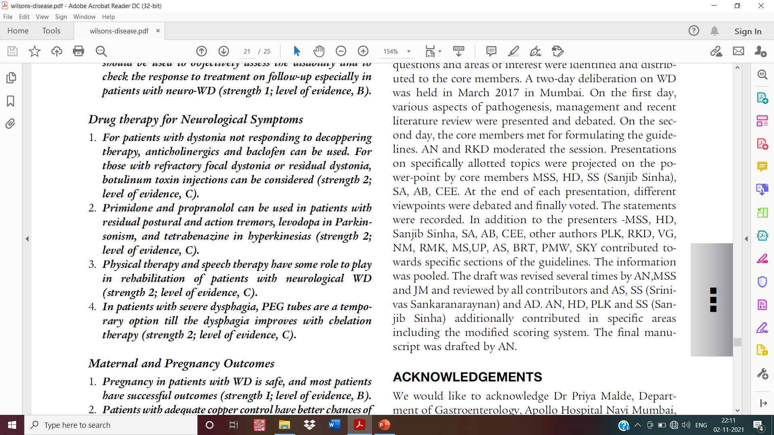

Slide 56
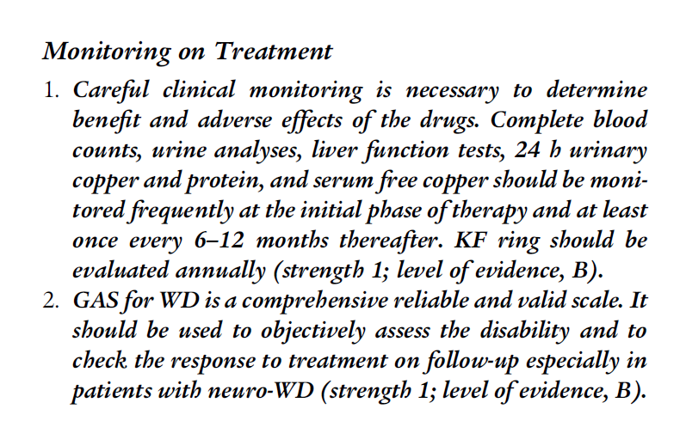

Slide 57


Slide 58
Thank you

