Slide 1
Vericiguat in Patients with
Heart Failure and Reduced Ejection Fraction
JOURNAL CLUB 3/11/21
VICTORIA ( VerICiguaT GlObal study in subjects with Heart Failure with Reduced Ejection FrAction )
Published on March 28, 2020, at NEJM
DR. MONET PHILIPOSE

Slide 2
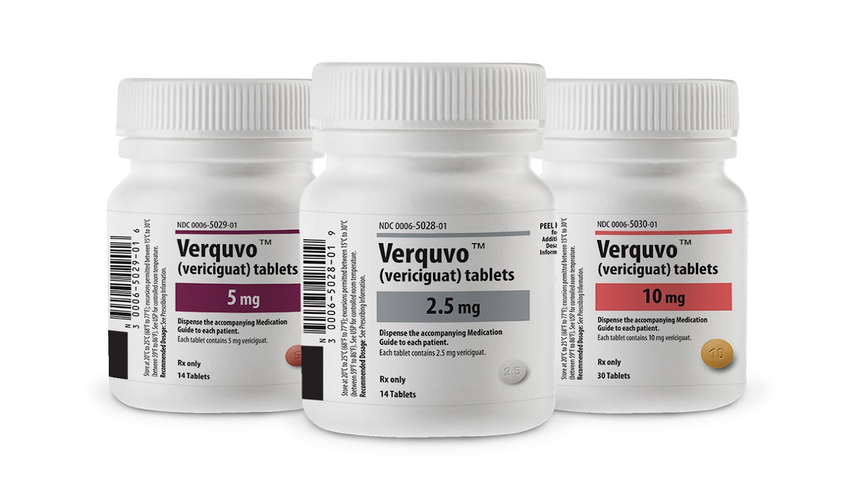

Slide 3
MECHANISM OF ACTION
2 forms of guanylate cyclase.
1. Transmembrane receptor for natriuretic peptides.
2. Soluble guanylate cyclase ( sGC) , a receptor for nitric oxide.
Nitric oxide and natriuretic peptides indirectly increase phosphokinase G (PKG) levels through sGC by activating GTP → cGMP.
PKG → cellular hyperpolarization and cardiac muscle relaxation

Slide 4
In patients with cardiovascular risk factors,
endothelium-generated ROS → decrease the NO levels and inactivates the sGC by removing the heme group from sGC. → decrease in PKG → impaired muscle relaxation resulting in stiffness.
Treatment of heart failure with nitric oxide generators are shown to have clinical benefit but is limited by the development of tolerance.

Slide 5
Vericiguat → stimulates sGC , activates the cGMP pathway independent of nitric oxide involvement.
Sensitizes soluble guanylate cyclase to nitric oxide .
Restores the cyclic guanosine monophosphate under low nitric oxide conditions and oxidative stress.
Compared to other nitro-vasodilators, vericiguat does not induce tolerance on long-term administrations.
An increase in cardiac output and cardiac index and a decrease in systemic vascular resistance has been noted with vericiguat at a 5.0 mg or higher dose.

Slide 6
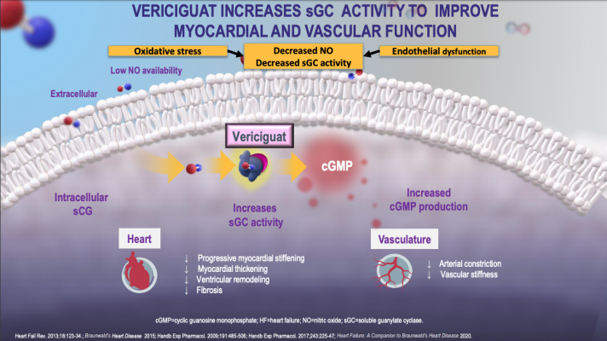

Slide 7
Administration
An increase in cardiac output, an increase in heart rate of 4 to 10 beats per minute, and an increase in the cardiac index are observed in patients who received a single dose of 5 to 15 mg per oral (PO).
According to phase III of the VICTORIA Heart Failure with Reduced Ejection Fraction study, the dose can be increased from 2.5 mg to 10 mg depending on patient response.
to be consumed with food

Slide 8
ADVERSE EFFECTS
Monitoring
Monitor blood pressure, heart rate, and hemoglobin in patients treated with vericiguat.
Headache and postural dizziness → due to vasodilation.
Diarrhea, nausea, and abdominal discomfort → due to smooth muscle relaxation.
Symptomatic hypotension, orthostatic hypotension, syncope, anemia
A mild increase in heart rate → compensatory baroreflex due to vasodilation and blood pressure reduction.

Slide 9
Contraindications
should be avoided on patients taking long-acting nitrates, soluble guanylate cyclase stimulator, or phosphodiesterase type 5 (PDE-5) inhibitor → concerning hypotension and syncope.
In patients with severe anemia because of concerns of a decrease in hemoglobin level with vericiguat.

Slide 10
VICTORIA TRIAL
Multi-center, randomized, parallel, placebo-controlled, double-blind, event-driven, pivotal phase III trial of efficacy and safety of the oral soluble guanylate cyclase stimulator vericiguat (MK-1242) in subjects with heart failure with reduced ejection fraction.

Slide 11
INCLUSION CRITERIA
Heart failure with reduced ejection fraction (ejection fraction <45%)
NYHA (New York Heart Association) class II-IV
Sinus rhythm: BNP (brain natriuretic peptide) >= 300 pg/ml or NTproBNP >=1000 pg/ml
Atrial fibrillation: BNP>=500 pg/ml or NT proBNP >=1600 pg/ml
SBP >100 mmHg and on no diuretics for 24 hours

Slide 12
Hypothesis:
Vericiguat is superior to placebo in increasing the time to the first occurrence of death from cardiovascular cause or hospitalization due to heart failure in participants with heart failure with reduced ejection fraction.

Slide 13
EXCLUSION CRITERIA
Systolic blood pressure < 100 mm Hg
Concurrent or anticipated use of long-acting nitrates, soluble guanylate cyclase stimulators, or phosphodiesterase type 5 inhibitors.
Use of intravenous inotropes or implantable left ventricular assist devices.

Slide 14
TRIAL CONDUCT
Screening period (0 to 30 days), without a run-in period → during which adherence to the entry criteria was confirmed.
Patients randomly assigned, in a 1:1 ratio, to 2.5 mg of vericiguat or matching placebo, within six strata based on geographic region and, within North America, race.
Doses were increased to 5 mg and ultimately to the target dose of 10 mg once daily in a blinded manner, as guided by evaluation of blood pressure and clinical symptoms.
Evaluated at weeks 2 and 4, and every 4 months thereafter until the end of the trial.
Intervention:
A single daily dose of 10 mg vericiguat in addition to heart failure guideline therapy.
Follow up for 10.8 months

Slide 15
TRIAL OUTCOME
Primary outcome event:
Cardiovascular death
First heart failure hospitalization.
Secondary outcomes
Components of the primary outcome.
Subsequent hospitalizations for heart failure
A composite of death from any cause or first hospitalization for heart failure, and death from any cause.

Slide 16
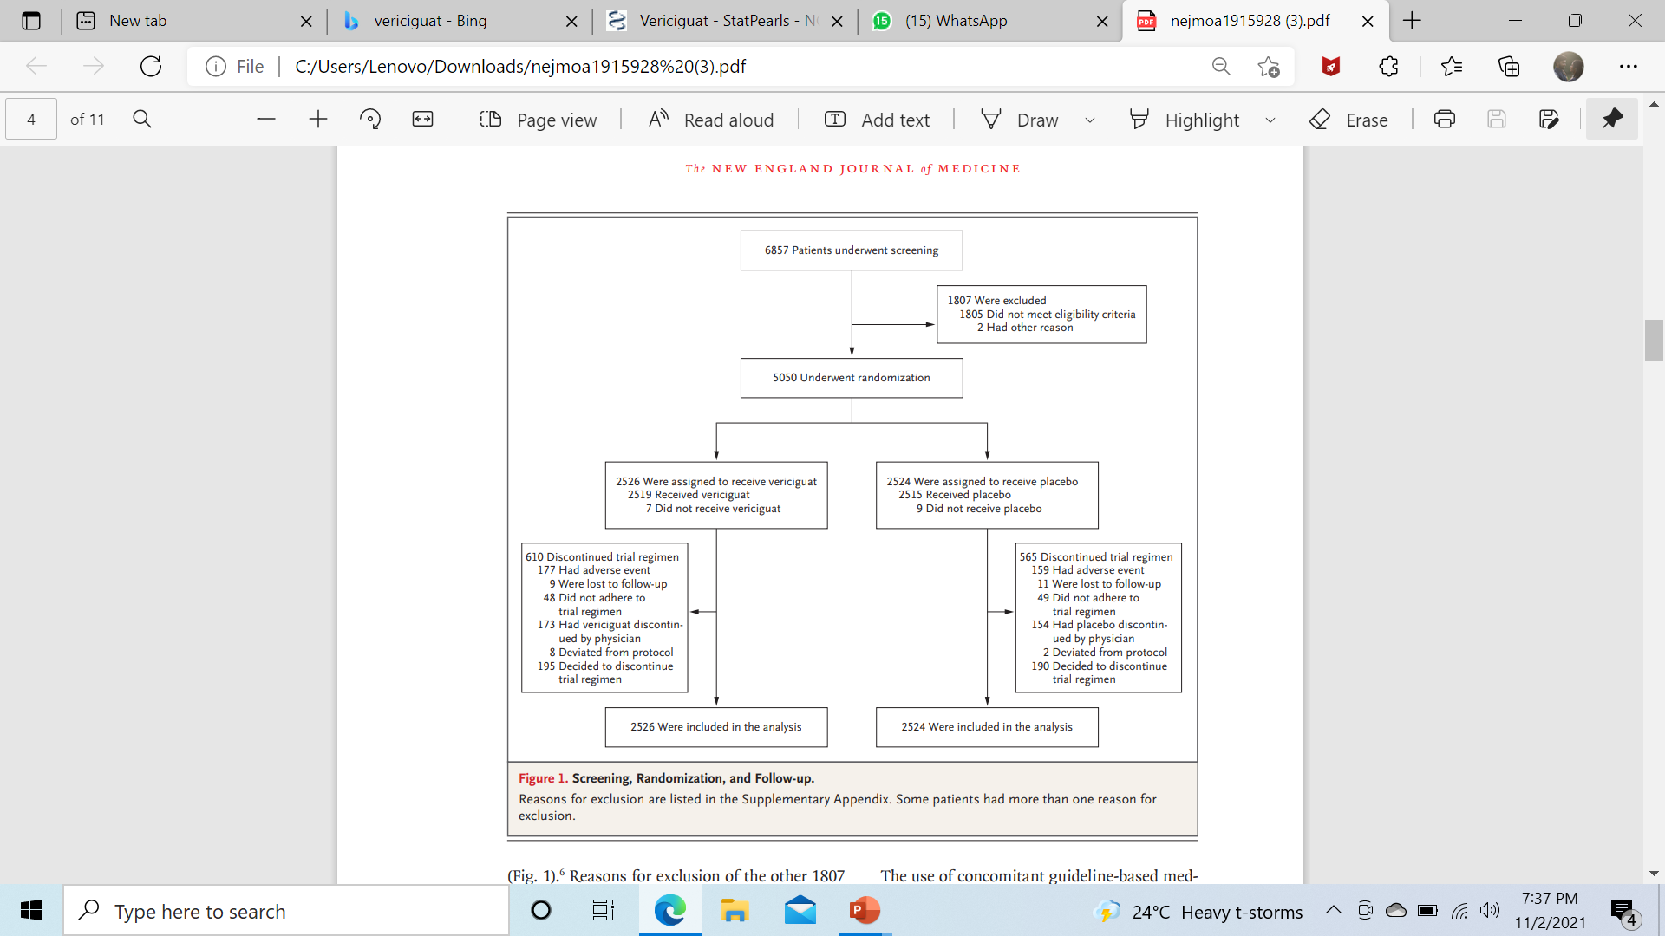
SCREENING ,
ANALYSIS
FOLLOW UP

Slide 17
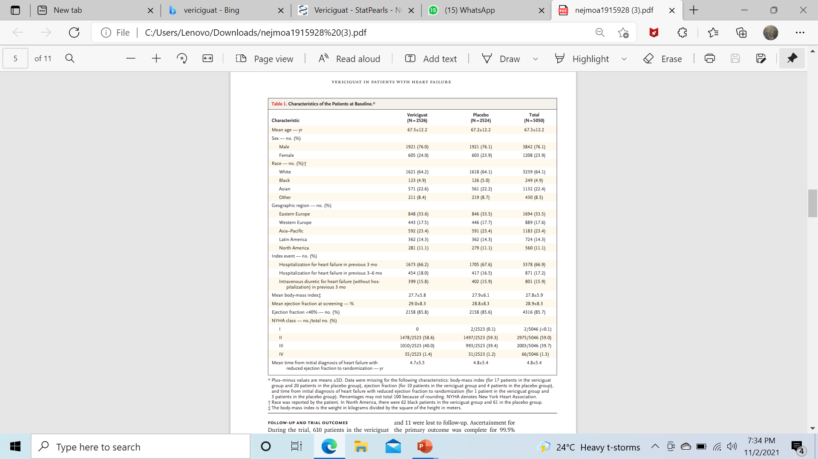
CHARACTERISTICS OF PATIENTS AT BASELINE

Slide 18
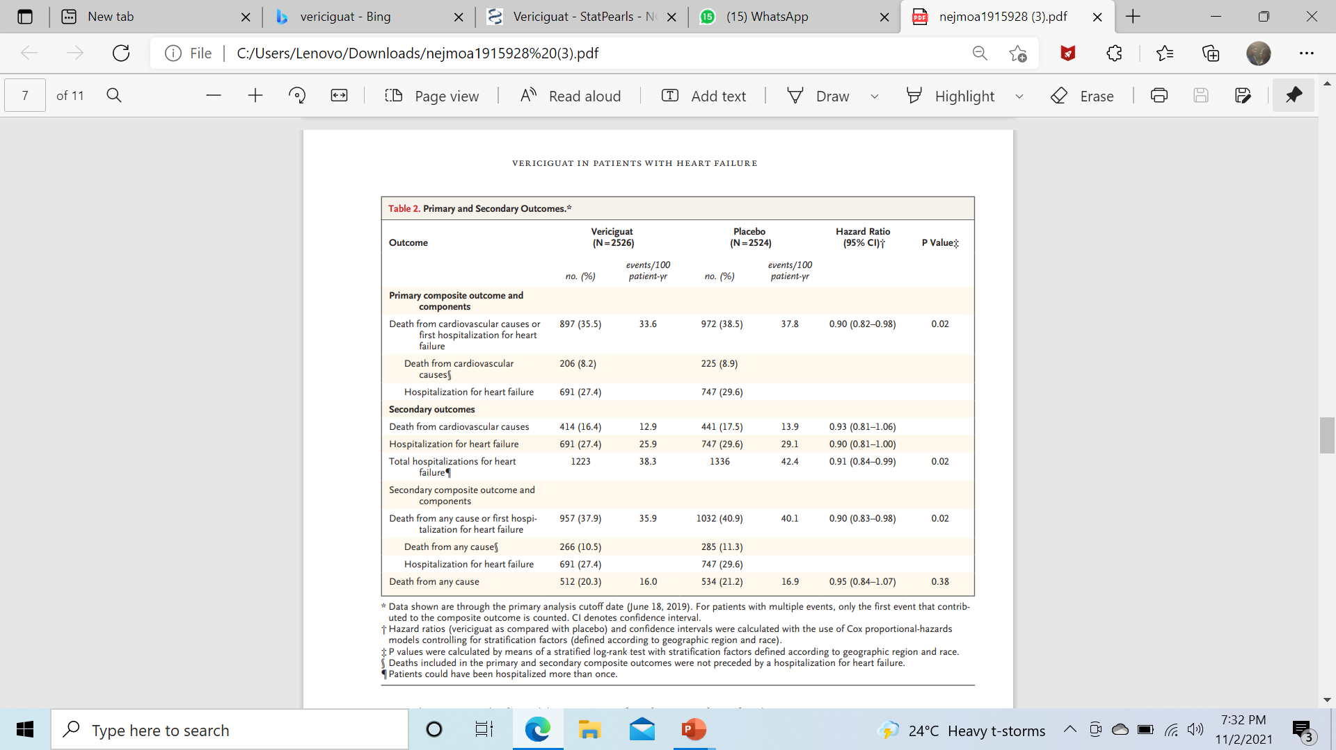
RESULTS

Slide 19
Conclusion:
Compared to placebo, vericiguat has a beneficial effect with a hazard ratio of 0.90 (95% CI: 0.82 – 0.98; P=0.02) for either of primary outcome events in patients with NTproBNP <8000 pg/ml.
The risk of primary outcome event in vericiguat compared to placebo in patients age < 75 and >= 75 years was 0.84 and 1.04 respectively (P value=0.030).

Slide 20
DISCUSSION
It is of interest to compare the current trial population with those of two previous trials involving patients with heart failure and a reduced ejection fraction.
In PARADIGM-HF (Prospective Comparison of Angiotensin Receptor–Neprilysin Inhibitor with Angiotensin-Converting Enzyme Inhibitors )to Determine Impact on Global Mortality and Morbidity in Heart Failure) and DAPA-HF (Dapagliflozin and Prevention of Adverse Outcomes in Heart Failure) trials, 25% and 32% of the patients, respectively, had either NYHA class III or IV heart failure, as compared with 41% of the patients in VICTORIA.
Similarly, the median NT-proBNP values were 1608 and 1437 pg per milliliter in PARADIGM-HF and DAPA-HF, respectively, as compared with 2816 pg per milliliter in VICTORIA.
These differences probably account for the 33.6% annualized rate of the primary composite outcome in the vericiguat group in our trial; this is more than two times as high as that seen in the two comparator trials.

Slide 21
THANK YOU !

