Slide 1
VISUAL PATHWAY

Slide 2
Stimulus-light
Receptors convert light to electrical impulses
1st order-bipolar neurons
2nd order-retinal ganglion cells
3rd order-starts from LGB

Slide 3
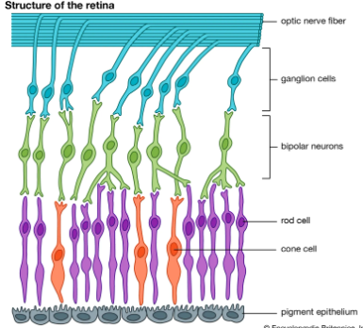

Slide 4
2 types of retinal ganglion cells
M cells and P cells
Mcells-10% of ganglion cells-where pathway-depth perception,stereognosis,colour ignorant------project to magnocellular neurons(layer 1and 2) of LGB
Pcells- 90% of ganglion cells---what pathway-Colour perception ,low contrast sensitivity----------via parvocellular pathway(layers 3,4,5,6)
Alzheimers,PD—affect M cells
ON—affect P cells

Slide 5
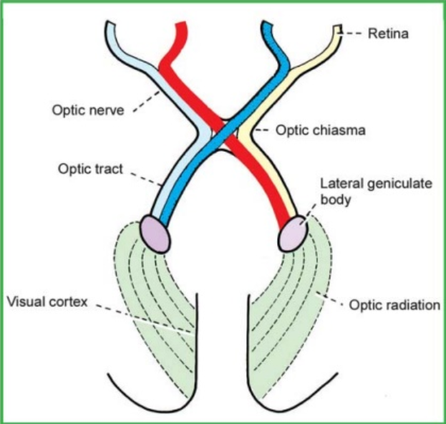

Slide 6
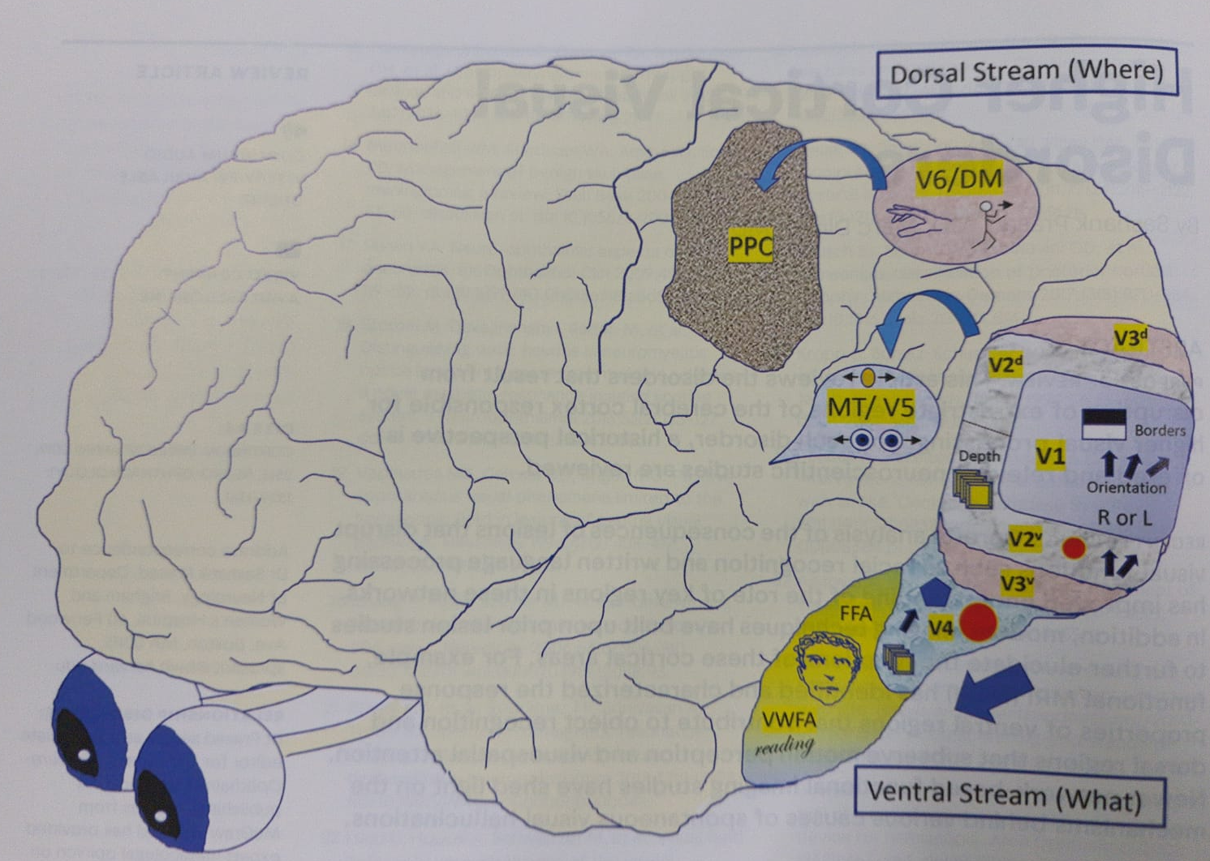

Slide 7
Ventral pathway
V1-Striate cortex-raw visual information(basic position ad orientation)
V2-analze the colour and background
V3-colour discrimination
V4-geometric shapes
v5,v6-fusiform face area and visual word form area

Slide 8
Dorsal pathway
V1-striate cortex
V2,v3 - visual spatial processing
V5- perception of motion
V6-visual stimuli associated with selfmotion

Slide 9
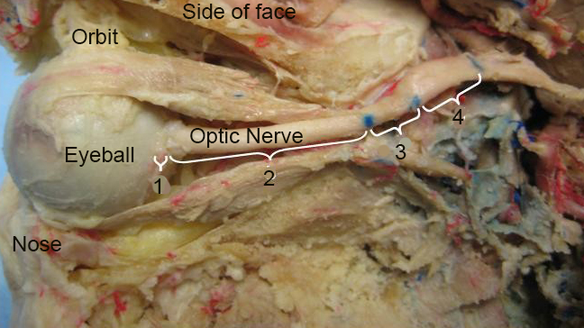
Optic nerve and the chiasm
1.intraocular part
2.intraorbital part
3.intracanalicular part
4.intracranial part

Slide 10
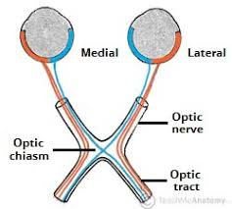
53 %fibres are crossed

Slide 11
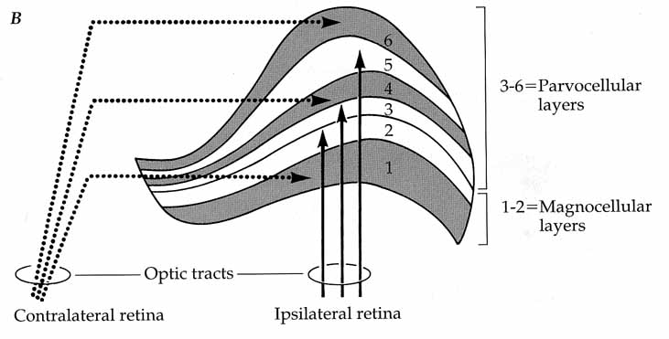
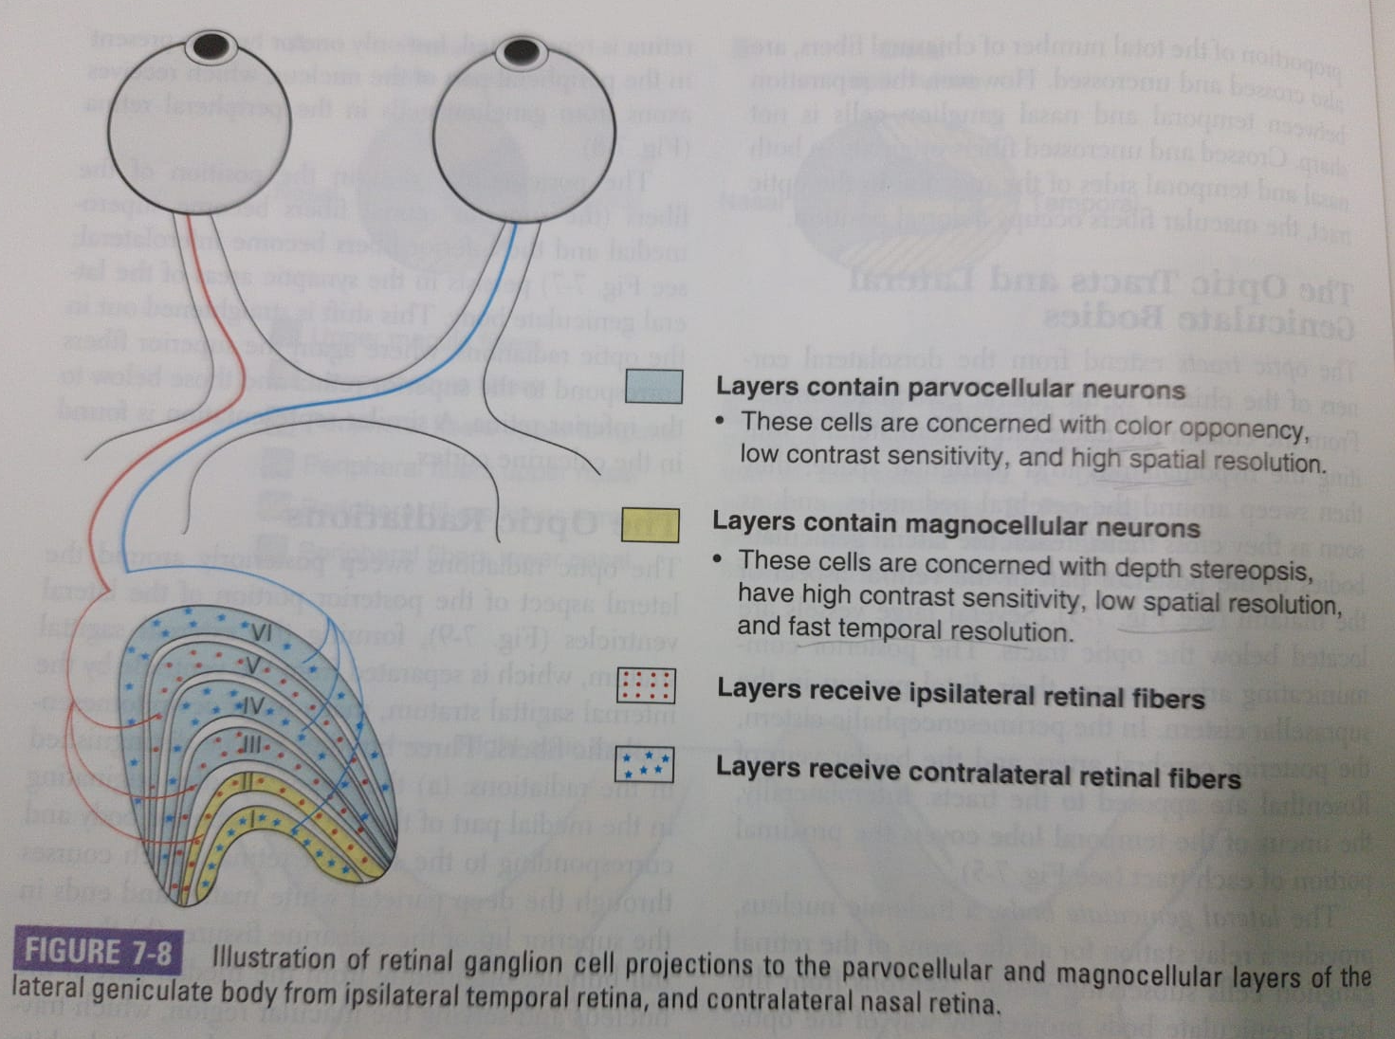
LGB

Slide 12
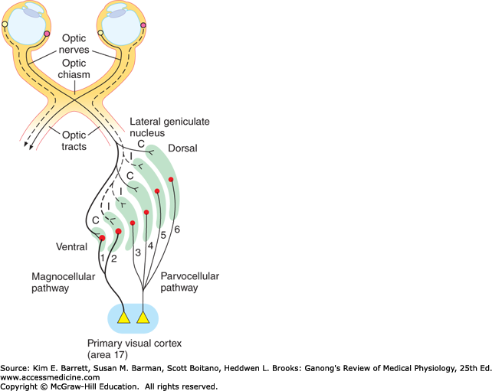

Slide 13
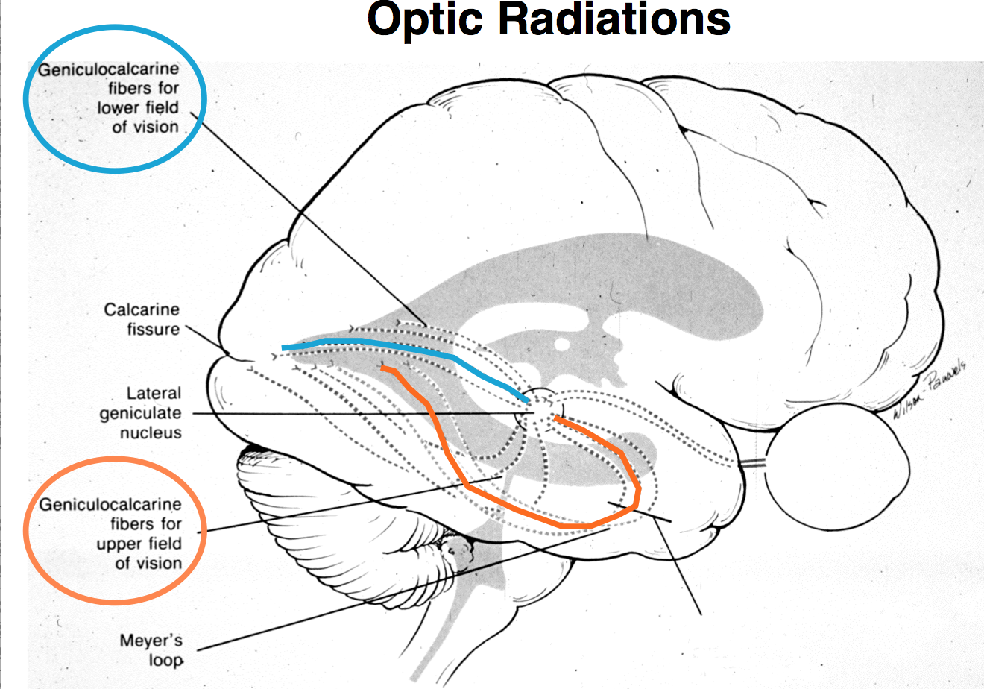
Optic radiation
Geniculo calcarine pathway
From optic tract to visual cortex
Superior fibres(Barums loop
Inferior fibres(Meyers loop

Slide 14
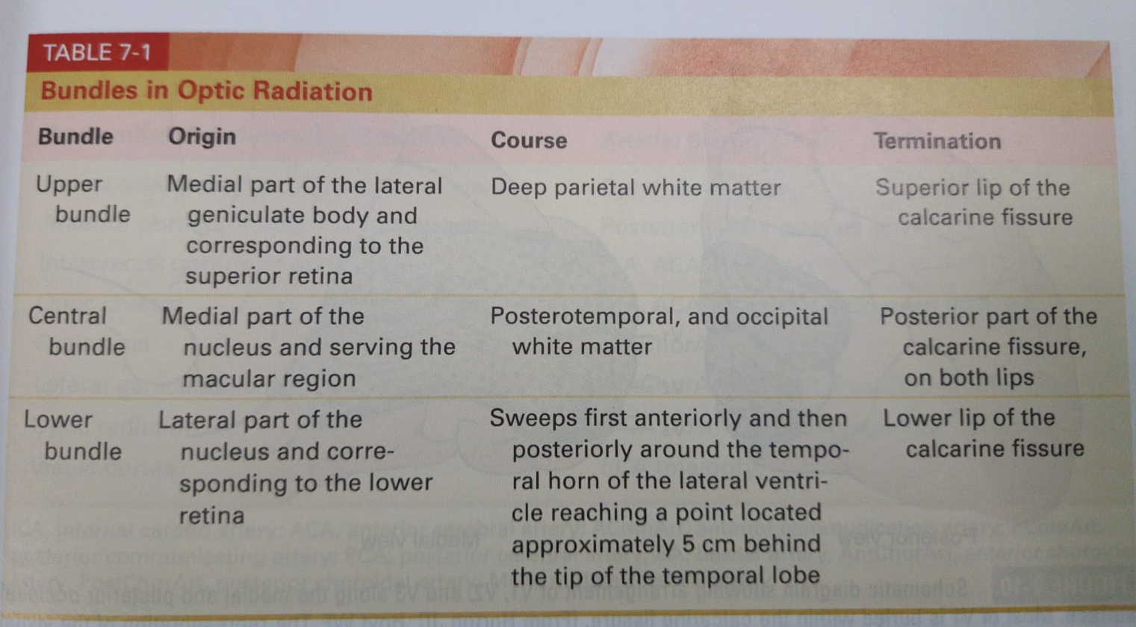

Slide 15
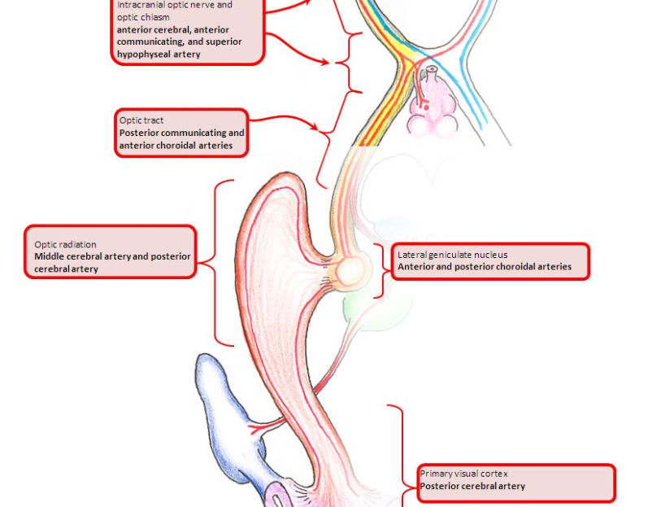
BLOOD SUPPLY

Slide 16
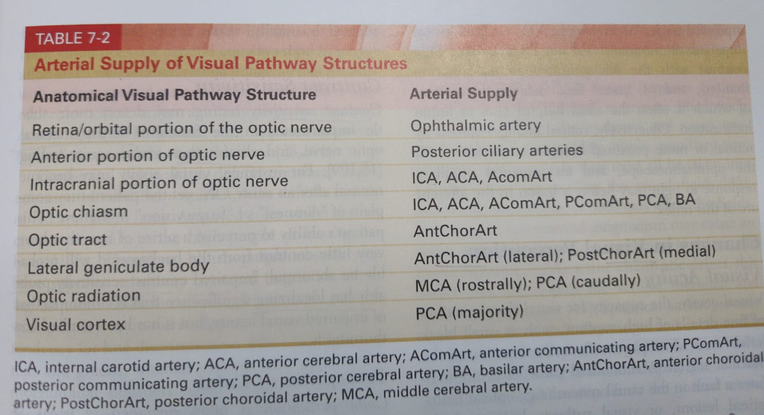
Vascular supply

Slide 17
Arrangement of fibres in various parts of visual pathway

Slide 18
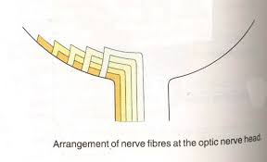
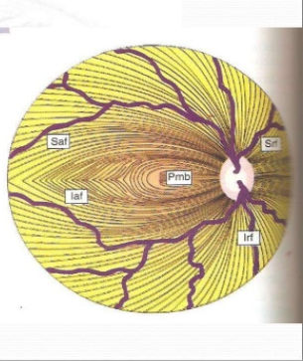
retina

Slide 19
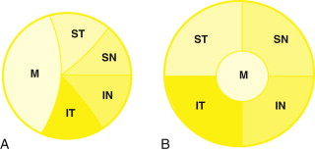
Optic nerve

Slide 20
chiasm
Lower nasal fibres traverse the chiasma ventrally and anteriorly
(therefore involved in lesions of pituitary origin-upper temporal quadrant field defect
Upper nasal fibres Traverse the chiasma high and posteriorly
(therefore first involved in lesions coming from above the chiasma:craniopharyngiomas
Macular fibres Occupies central part of the proximal end of the optic nerve Keep this position in anterior part of chiasma
Separated into crossing and uncrossing fibres
Crossing fibres runs backwards and upwards to decussate in the posterior most part of the chiasma
Lesions-central temporal hemianopic scotoma

Slide 21
Optic tract
Upper peripheral fibres situated medially in the optic tract
Lower peripheral fibres situated laterally
Macular fibres(temporal macular fibres of i/l eye and nasal macular fibres of c/l eye) situated dorsolaterally

Slide 22
LGB
Macular fibres:posterior two third of LGB
Upper peripheral fibres:medila half of anterior one third
Lower peripheral fibres:lateral half of anterior one third

Slide 23
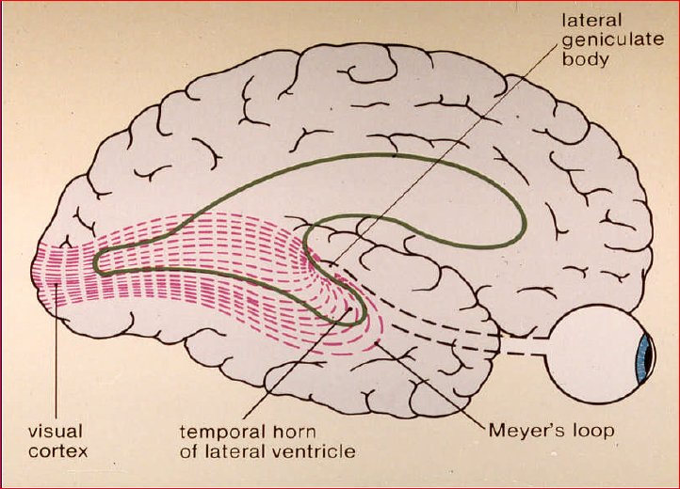
OPTIC RADIATION
Upper retinal fibres-upper part of the optic radiations(Barums loop)directed posteriorly through parietal lobe
Lower retinal fibres-lower part of the optic radiations(Mayers loop) through temporal lobe
Macular fibres-cenral part

Slide 24
VISUAL CORTEX
Right visual cortex-perceives objects from the temporal half of right retina and nasal half of left retina
Left visual cortex-from the temporal half of left retina and nasal half of right retina
Fibres from macular area relay in an extensive area placed posteriorly in the visualcortex
peripheral retina fibres situated anterior to the macular fibres

Slide 25
LOCALISATION OF LESION IN OPTIC PATHWAY
1.monocular /binocular(at or behind the chiasm)
Exceptions for monocular defect behind chiasm
1.junctional scotoma of traquair
2.half moon syndrome:monocular temporal cresent
Exception for binocular defect in front of chiasm
1.large prechiasmal tumors
2.multiple sclerosis

Slide 26
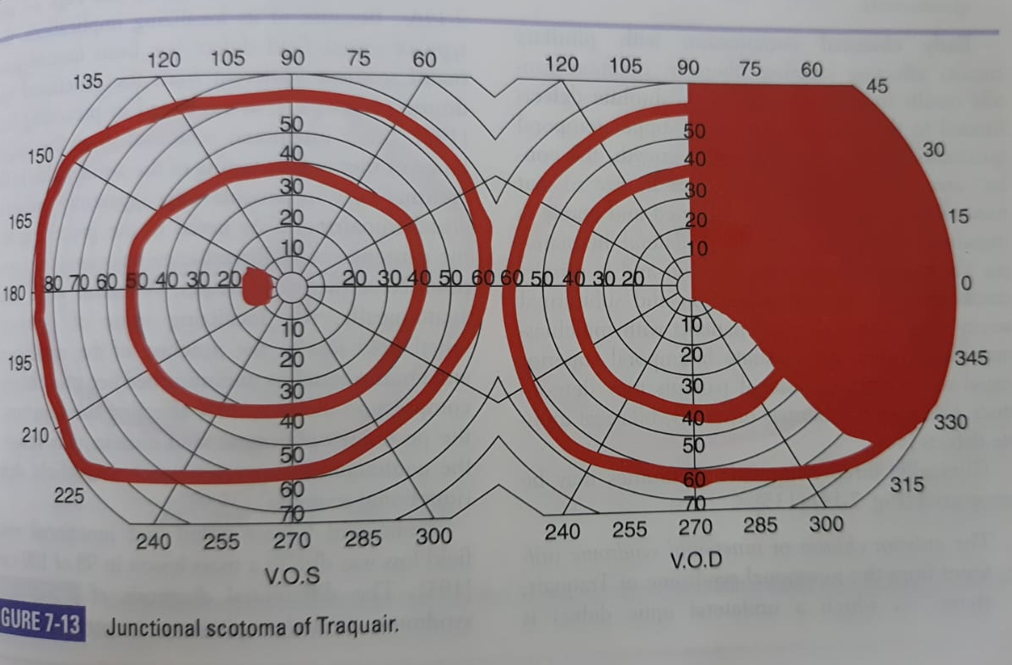
JUNCTIONAL SCOTOMA OF TRAQUAIR

Slide 27
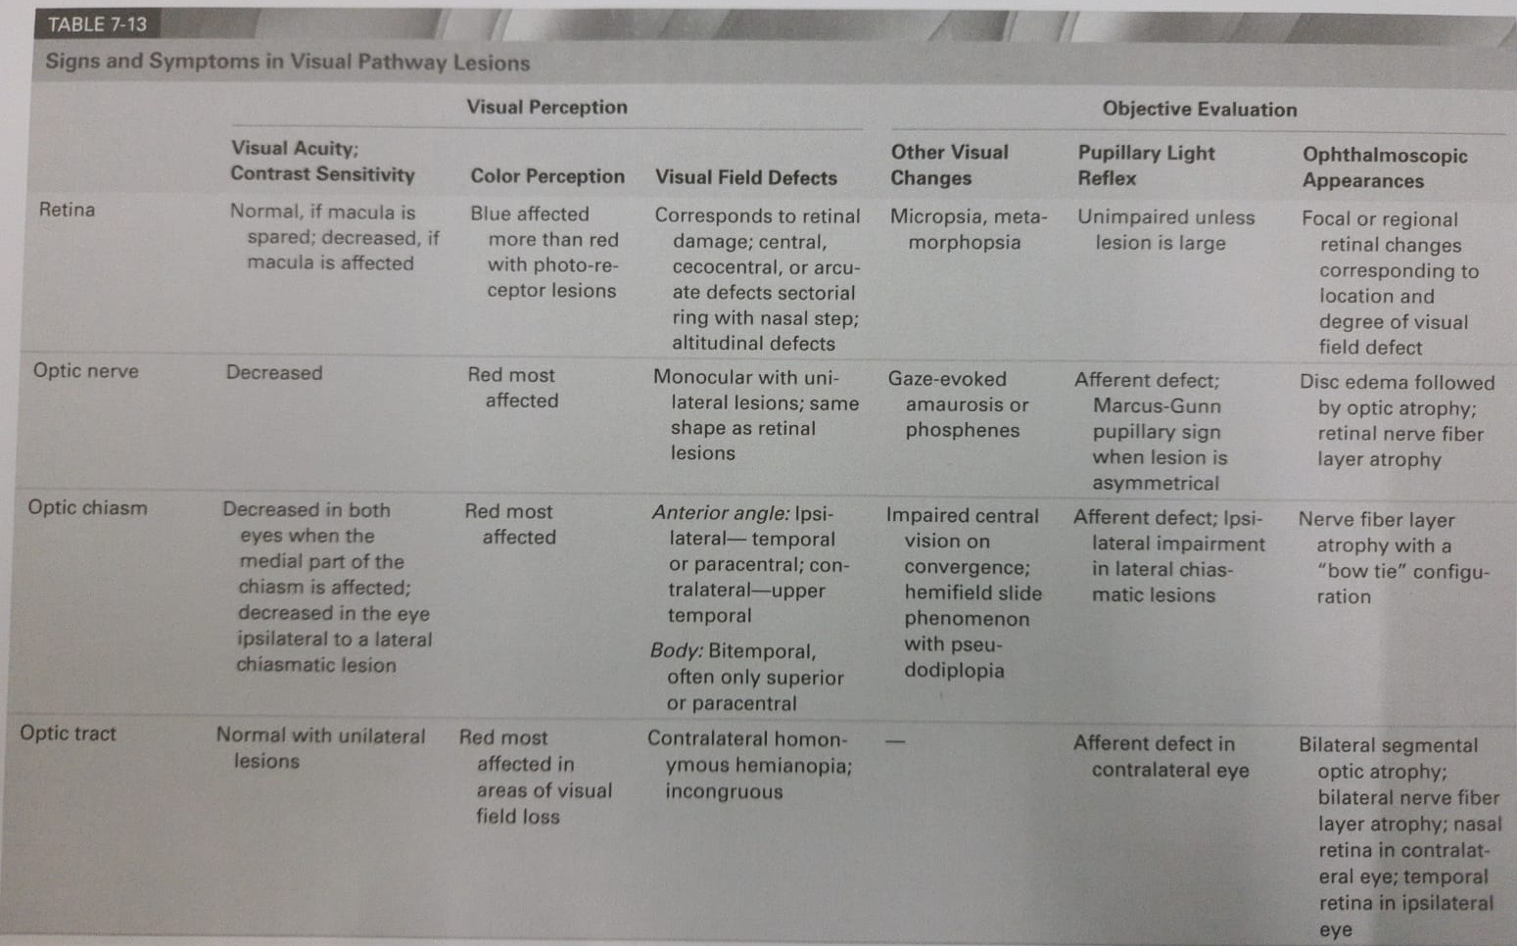

Slide 28
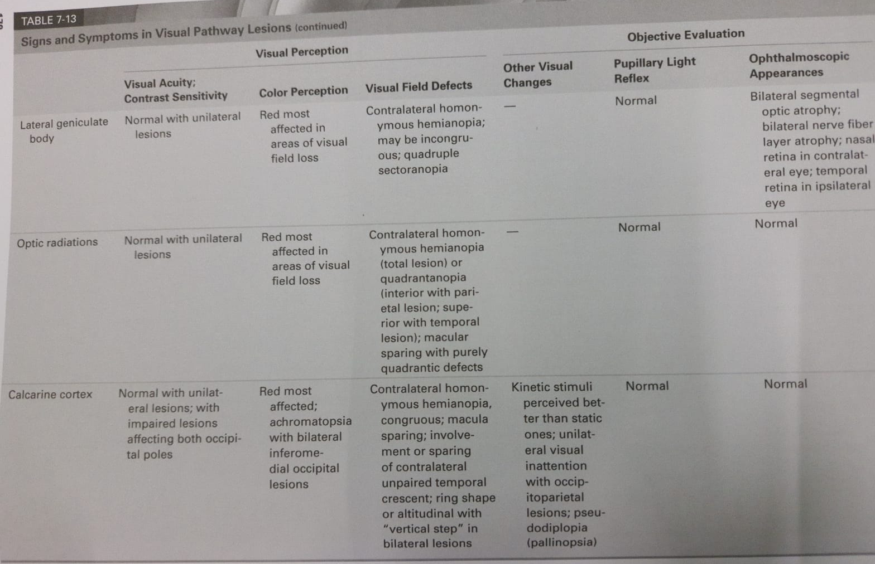

Slide 29
Localisation in chiasm
Anterior chiasm
Body of chiasm
Posterior chiasm

Slide 30
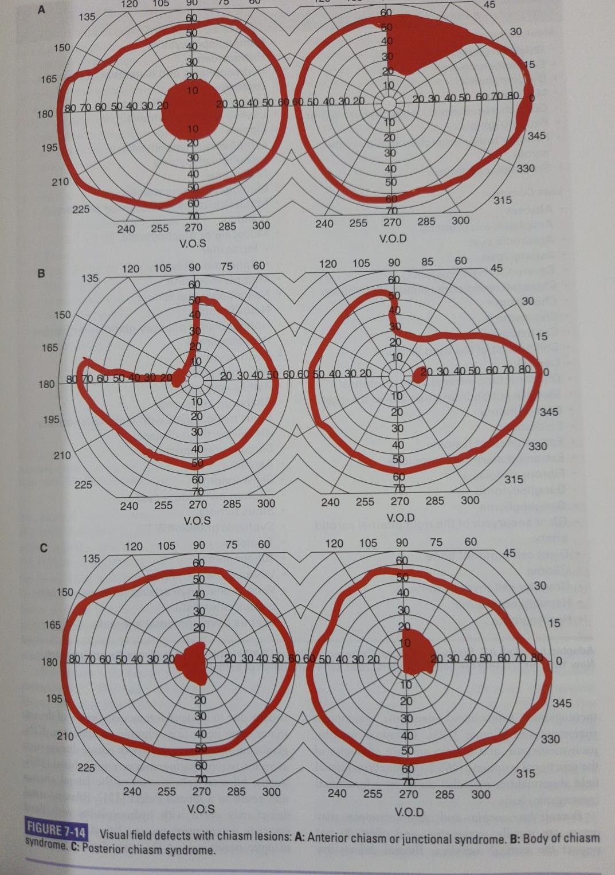

Slide 31
Decreased vision in either eyes-macular fibres
RAPD
HEMIFEILD SLIDE PHENOMENON
Bow tie atrophy of the the fundus

Slide 32
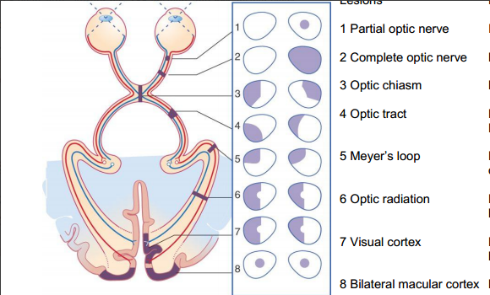
Lesion in the optic tract
Incomplete homonympous hemianopia
Incongruous field defects

Slide 33
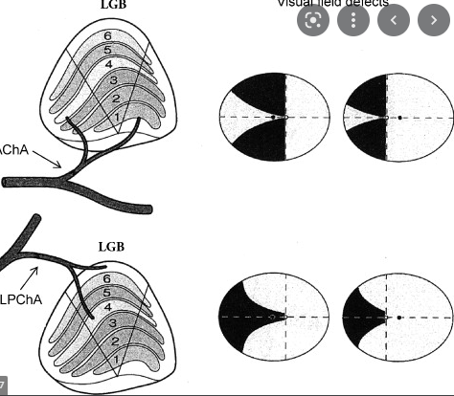
Lesion in LGB
Based on the vascularity lost
Sectoranopia
Anterior choroidal- quadruple sectoranopia
Lateral choroidal-horizontal sectoral field
defect

Slide 34
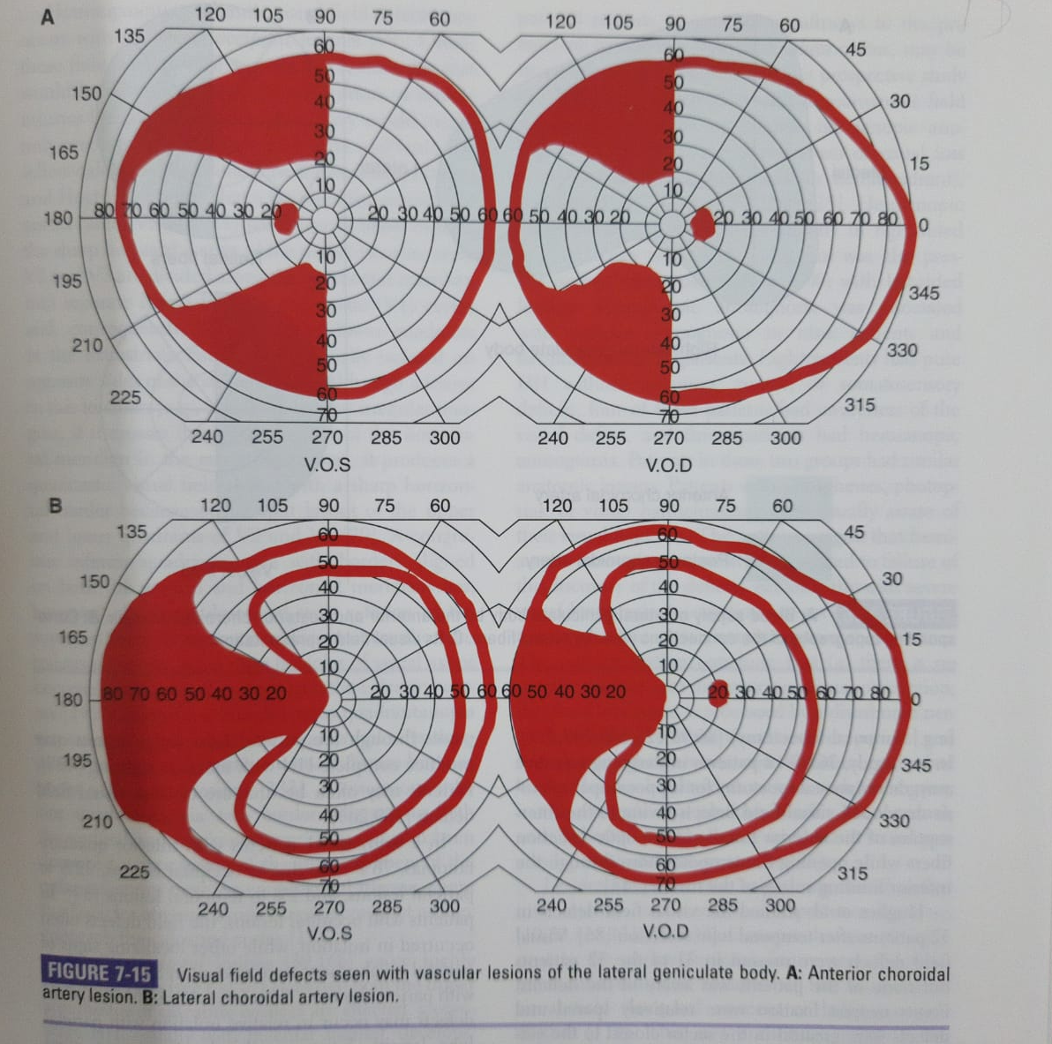

Slide 35
Lesion in the optic radiation
Pie in the sky
Pie on the floor
Inconguous field defects

Slide 36
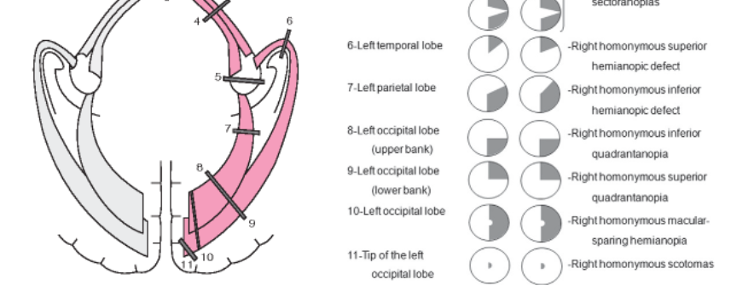
Lesions in the occipital lobe
Concept of monocular temporal cresent
Congruous homonymous hemianopia/quadrantanopia
Riddoch phenomenon

Slide 37
Riddoch phenomenon
Statokinetic dissociation
Though striate cortex is involved dorsal V5 is preserved
Responsible for motion processing
Direct Connection between LGB to v5
Pulvinar to superior colliculuspathway

Slide 38
THANK YOU

