Slide 1
Treatments in Ischemic Stroke:
Current and Future

Slide 2
Published in journal of European neurology
On august 2022

Slide 3
INTRODUCTION
Despite progress in the understanding of the pathophysiological mechanisms underlying stroke over the past 3 decades, concerning early diagnosis and the development of protocols that have reduced the door-to-needle time for acute ischemic stroke (AIS) treatment, several clinical gaps remain unsolved.

Slide 4
The evaluation of MRI mismatch between diffusion- weighted imaging (DWI) and fluid-attenuated inversion recovery (FLAIR), as well as CT perfusion (CTP) imaging can distinguish between core and penumbra.
These two advanced neuroimaging modalities have been used in an extended time window to select patients who are likely to benefit from both intravenous thrombolysis (IVT) and endovascular treatment (EVT) reperfusion strategies, also those presenting beyond the 4.5–6 h time window or with unknown/wake-up onset time.

Slide 5
Primary prevention stroke
stricter primary prevention of recognized modifiable risk factors: hypertension, smoking, obesity, diet, physical inactivity, diabetes, alcohol intake, psychosocial factors, cardiac disease, and apolipoprotein ratios
age is an important nonmodifiable risk factor.

Slide 6
Among cardiovascular diseases atrial fibrillation has been associated with increased risk of stroke.
Vitamin-K antagonists (VKAs) had been the cornerstone of anticoagulation in AF patients.
Direct oral anticoagulants (DOACs), are noninferior to VKAs in terms of efficacy, but are reported to have a better safety profile, due to a reduction in major bleeding rates: 50% decrease in the rates of symptomatic intracerebral hemorrhage.

Slide 7
There is still a residual risk for developing either an ischemic stroke and/or a systemic embolism as well as major and clinically relevant nonmajor bleeding with DOAC.
The development of safer molecules is a primary objective of current clinical research especially targeting on factor XI.

Slide 8
Acute ischemic stroke treatment
The only approved pharmacological systemic therapy for AIS is IVT with alteplase, a recombinant tissue plasminogen activator (rtPA) that is usually recommended to be administered within 4.5 h of symptom onset.
IVT can be administered alone or in combination with Endovascular thrombectomy (EVT) with mechanical thrombectomy (MT), in case of large vessel occlusion (LVO).
MT is recommended within 6 h from symptoms onset in patients with LVO in combination with IVT within 4.5 h of symptom onset and alone between 4.5 h and 6 h of symptom onset

Slide 9
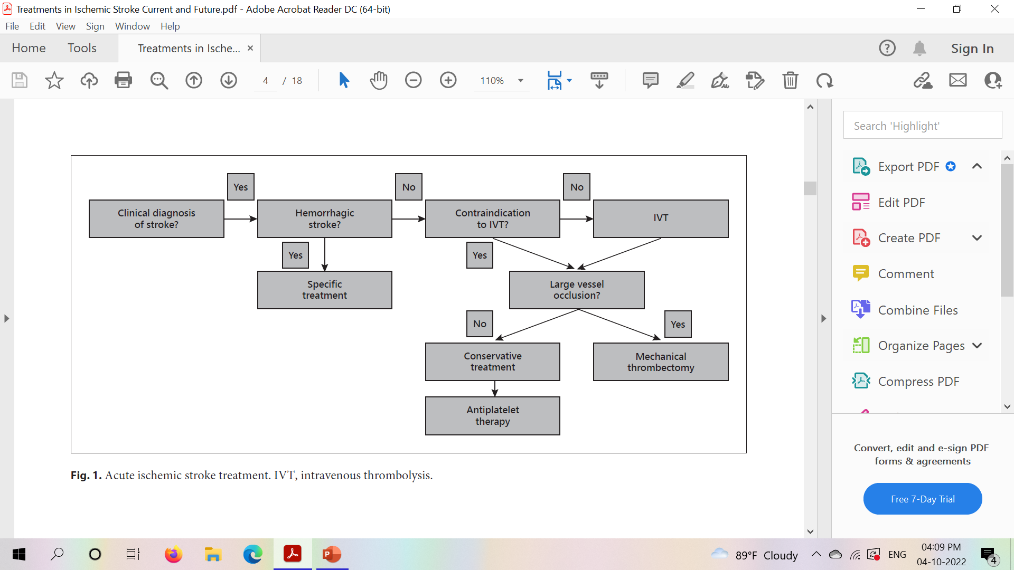

Slide 10
Imaging techniques
MRI-the presence of a visible ischemic lesion on DWI, combined with the absence of a clearly visible hyperintense signal in the same region on FLAIR, as predictive of symptom onset within 4.5 h before imaging.
CT perfusion (CTP) imaging can distinguish between core and penumbra.
These two modalities have been used in an extended time window to select patients who are likely to benefit from both IVT and EVT reperfusion strategies, when the time of AIS onset is unknown or beyond the 4.5–6 h time window.

Slide 11
CT angiography (CTA) and MR angiography allow the identification of LVO.
Collaterals: Each AIS patient has a different collateral status which affects revascularization success and functional prognosis.
CTA or MRI angiography can evaluate the cerebral collateral circulation in the circle of Willis with moderate-to-good diagnostic efficiency,
Limited power in evaluating the leptomeningeal collaterals

Slide 12
CTP may provide information regarding collateral status in the emergency room.
MRI parameters by comparison of the perfusion and diffusion images ; arterial spin labelling MRI also detect collateral status.
Recent evidences allow an extension of IVT time window through the new “tissue-window” approach guided by advanced neuroimaging techniques

Slide 13
2021 ESO guidelines on IVT recommend IVT with alteplase for patients with:
AIS of 4.5–9 h duration (known onset time) and with CT or MRI core/perfusion mismatch, and for whom MT is either not indicated or not planned.
patients with wake-up stroke, last seen more than 4.5 h earlier, with MRI DWI-FLAIR mismatch, and for whom MT is either not indicated or not planned.
For patients with wakeup stroke and a CT or MRI core/perfusion mismatch within 9 h from the midpoint of sleep, and for whom MT is either not indicated or not planned

Slide 14
Limitations
sICH is an uncommon (2–7% rate) but severe IVT complication.
Due to this bleeding risk, the narrow therapeutic window and the limited/delayed access to stroke centers, only 10–20% of patients receive fibrinolytic treatment , with an undefinable undertreatment of probably eligible patients.

Slide 15
Tenecteplase is a next-generation genetically modified rtPA and is currently the most promising alternative agent.
It has a similar efficacy, better safety profile, lower risk of hemorrhagic transformation, greater fibrin specificity, faster onset of action, and longer half-life.
Administered as an iv bolus.

Slide 16
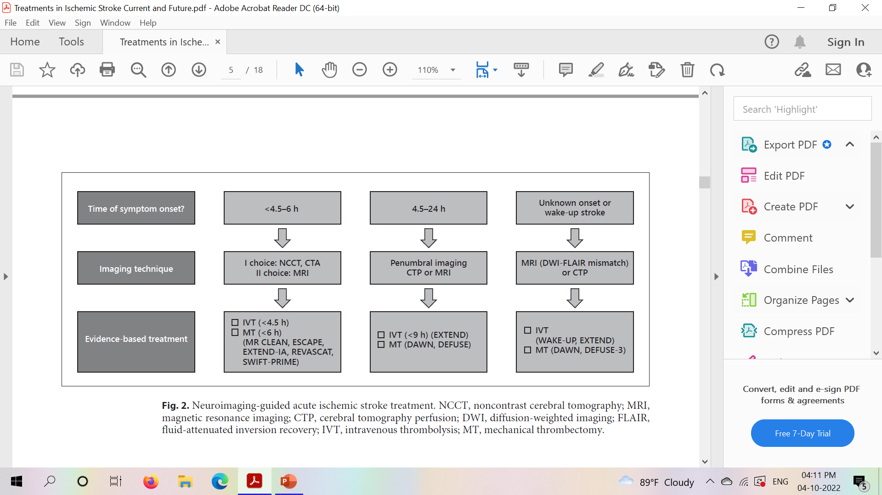

Slide 17
Early Secondary Prevention of Ischemic Stroke
The mainstay of early secondary prevention is 160–300 mg per day acetylsalicylic acid (ASA), administered within 48 h from stroke onset.

Slide 18
In cases of acute noncardioembolic minor ischemic stroke (defined as NIHSS score ≤3) and noncardioembolic high-risk TIA (defined as ABCD2 score ≥4), dual antiplatelet therapy (DAPT), administered within 12-24h of onset of symptoms, is a recommended strategy.
Current guidelines recommend 21 days of DAPT with aspirin and clopidogrel, followed by antiplatelet monotherapy, in both those patients.

Slide 19
For mild to moderate ischemic strokes with NIHSS≤5, high-risk TIA with ABCD2 score ≥6 or other high-risk factors, including intracranial atherosclerotic disease or internal carotid artery stenosis of at least 50%, guidelines recommend 30 days of DAPT with aspirin and ticagrelor followed by antiplatelet monotherapy.

Slide 20
Administration of antithrombotic agents, including aspirin, glycoprotein IIb/IIIa inhibitors, or thrombin inhibitors, during or immediately after alteplase infusion might reduce the risks of re-occlusion and therefore improve functional outcome.
This has not been approved due to the lack of evidence regarding safety.

Slide 21
Anticoagulation
Current international guidelines do not provide recommendations regarding the optimal timing for anticoagulation for post-acute cardioembolic ischemic stroke treatment.
ESO guidelines suggest administering antiplatelet therapy in the first 48 h after ischemic stroke in those patients with AF.
For mild strokes and small infarcts, therapy may be started at day 3 or 4 and at day 7 for moderate infarcts.

Slide 22
For large infarcts, anticoagulation treatment might be best delayed for 14 days after the index stroke
A recent pooled data analysis suggests, DOAC initiation within 1-2-3 or 4 days, according to stroke severity, decreases the risk of recurrent stroke or systemic embolism without an increase in major bleeding.

Slide 23
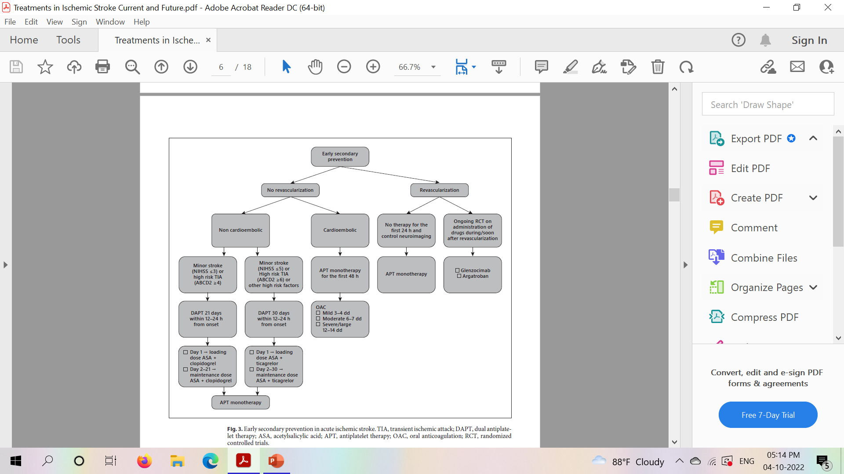

Slide 24
Secondary Prevention of Ischemic Stroke
In AF patients current guidelines recommend, instead of VKAs, one of the four DOACs, apixaban, dabigatran, edoxaban, and rivaroxaban, for their noninferior effectiveness, and better safety profiles compared to VKAs.
VKAs remain the first choice for AF patients with rheumatic mitral valve disease and/or a mechanical heart valve prosthesis.

Slide 25
DOACs have a residual bleeding risk and they have specifically designed reversal agents of their anticoagulant activity.
Idarucizumab is a monoclonal antibody fragment, developed to reverse the anticoagulant effect of dabigatran.
Andexanet alfa is a modified recombinant inactive form of human FXa developed for reversal of Fxa inhibitors.(incuding enoxaparin).

Slide 26
Several ongoing trials are evaluating the safety and efficacy of anti-FXIa in secondary prevention of ischemic stroke.
The clinical benefit of anti-FXIa is its selective inhibition within the intrinsic cascade coagulation factors, so that both the extrinsic and common pathways remain free for thrombin generation and intact for hemostasis, making the hemostasis-sparing anticoagulation approach possible.

Slide 27
For secondary prevention in the absence of AF, aspirin is the most widely used agent, with a relative risk reduction of 15% for any type of stroke.
“antiplatelet resistance” refers to the laboratory evidence of insufficient inhibition of platelet aggregation by antiplatelet agents in vitro.
“clinical resistance” and “treatment failure” refer to the inability of antiplatelets to prevent atherothrombotic events.

Slide 28
Causes for antiplatelet resistance:
Ischemic stroke is a heterogeneous disorder, deriving from typically several concomitant mechanisms.
patient nonadherence to prescribed therapy.
Clopidogrel is another antiplatelet agent.
A metaanalysis showed lower risks of recurrent stroke and bleeding events for clopidogrel compared to aspirin.

Slide 29
Brain Swelling, Neuroprotection, and Stem Cells in
Ischemic Stroke
Both IVT and MT stop ischemic injury, but are unable to reduce any additional damage that might be associated with post-reperfusion inflammatory response.
not able to promote neuro-regeneration.

Slide 30
when ischemia involves a large part of a hemisphere, space-occupying cerebral edema and intracranial hypertension can occur.
no RCT has been conducted to compare pharmacological therapy (osmotic therapy with nonosmotic therapy).
conservative treatment alone – 80% mortality rates.
Currently, the only recommended treatment with a reported benefit from RCTs results on mortality and disability is decompressive surgical therapy

Slide 31
Currently steroids have no role in reducing brain swelling
Deferoxamine, an iron chelator, has been investigated in TANDEM-1 trial by treating iron overload, might reduce brain edema.
Sulphonylurea, glyburide has been reported to prevent cerebral edema in anterior circulation malignant circulation.

Slide 32
Collateral circulation: nonmodifiable factors, such as aging and genetics, in adjunct to several modifiable ones, such as systemic diseases (cardio-cerebro-vascular or pulmonary disorders, dehydration) or medications (antihypertensives) might negatively influence its status
Collateral enhancing strategies include induced hypertension, lying flat head position, volume expansion, and sphenopalatine ganglion stimulation.
Regarding pharmacological treatments, nitric oxide, albumin, tumor necrosis factor-α inhibitors, sildenafil, erythropoietin, and statins have shown to increase arteriogenesis in animal models and in preclinical/clinical studies.

Slide 33
Conclusion
Extension of the time window for IVT ― EVT has been made guided by mismatch advanced neuroimaging techniques.
It has opened up the possibility of including more patients as revascularization therapy candidates.
the development of safer and more manageable thrombolytic agents would result in increased rates of treated patients.
The development of efficacious “rtPA helpers,” administered during or soon after revascularization, and post-acute drugs with neuroprotective and neurotrophic activities, is under investigation in several trials.

Slide 34
Regarding secondary prevention the longer the treatment period with antiplatelets or anticoagulants, the greater the risk of bleeding.
Aspirin is the most widely used agent for secondary prevention, but thrombotic events can occur despite being on antiplatelet therapy.

Slide 35
Thank you

