Slide 1
TREATMENT STRATEGY FOR RIFAMPICIN SUSCEPTABLE TUBERCULOSIS
NEJM ARTICLE DATED 9/3/2023
PRESENTED BY: DR ROBINS ROY

Slide 2
INTRODUCTION
TB remains a major global disease, with an estimated 9 million new TB cases and
1.5 million TB deaths per year. Although multi-drug resistant TB (MDR-TB),
defined as TB with resistance to rifampicin and isoniazid, is an increasing
problem and is complicated and expensive to treat, the large majority of new
cases of TB are drug-sensitive (DS-TB). Improving the treatment of DS-TB is likely
to bring important global health benefits both by directly improving outcomes of
patients and by preventing the generation of new cases of MDR-TB

Slide 3
For more than four decades, the global standard treatment for drug-
susceptible pulmonary tuberculosis has been a 6-month rifampin-
based regimen. Although the majority of patients can be cured with
much shorter treatment. Patients often fail to adhere to the long
treatment, leading to poor clinical outcomes including drug resistance,
which is expensive and difficult to treat.
.

Slide 4
It is hypothesized that a strategy involving initial treatment with an 8-
week regimen, extended treatment for persistent clinical disease,
follow-up after treatment, and prompt retreatment for the minority
of persons who have a relapse might lead to long-term efficacy that
would be noninferior to that of standard treatment, along with a
reduced total duration of treatment and other secondary advantages
for persons with tuberculosis and for treatment programs.

Slide 5
TRIAL DESIGN
To evaluate a treatment strategy for tuberculosis, conducted the Two-Month Regimens
Using Novel Combinations to Augment Treatment Effectiveness for Drug-Sensitive
Tuberculosis (TRUNCATE-TB) trial, a seamless phase 2–3, prospective, multicenter,
international, adaptive, multigroup, multistage, randomized, open-label, noninferiority
trial with a 96-week follow-up period.

Slide 6
INCLUSION CRITERIA
1 Age 18 to 65 years
2 Clinical symptoms consistent with pulmonary TB and/or evidence
of pulmonary TB on CXR
3. Sputum GeneXpert test positive
4. Willing to comply with the study visits and procedure

Slide 7
RANDOMIZATION AND TREATMENT STRATERGY
Participants were randomly assigned to undergo either standard treatment or a
strategy involving initial treatment with an 8-week regimen,
The standard TB management strategy
6 month (24 week) standard treatment regimen and treatment of relapses with a 6 to 8 month re-treatment regimen.
The standard treatment regimen comprises 4 drugs
Arm A 8 week rifampicin(10mg/kg), isoniazid, pyrazinamide, ethambutol, then
16 week rifampicin, isoniazid , ethambutol

Slide 8
2) TRUNCATE-TB management strategy
2 month (8 week) boosted treatment regimen, close monitoring after
treatment, and treatment of relapses with a 6-month standard treatment
regimen.
The boosted treatment regimens comprise 5 drugs, including modifications
to the standard regimen intended to increase sterilising activity:
Arm B: 8 weeks rifampicin (35mg/kg), isoniazid, pyrazinamide, ethambutol,
linezolid
Arm C: 8 weeks isoniazid, pyrazinamide, ethambutol, linezolid, bedaquiline

Slide 9
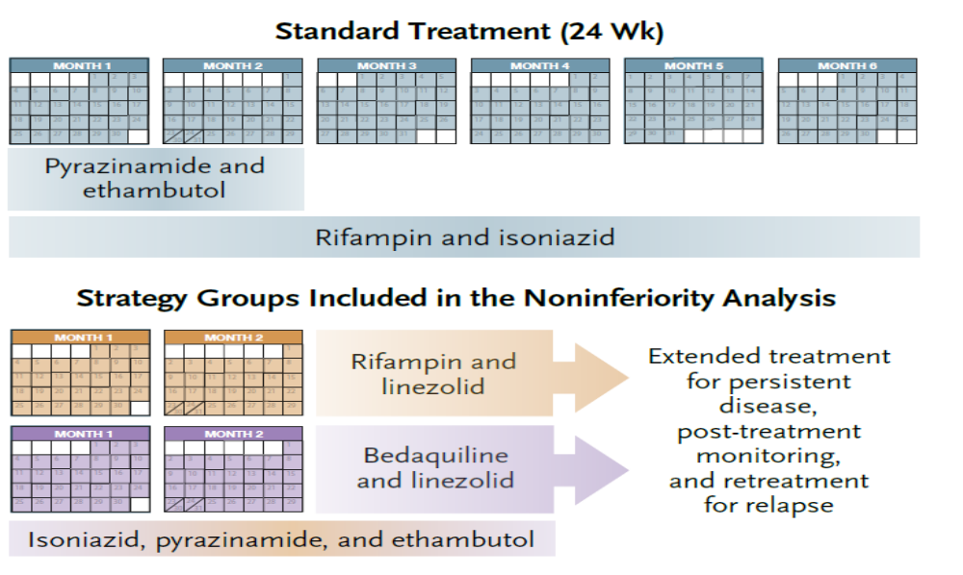

Slide 10
ASSESSMENT AND OUTCOME
Clinic visits were scheduled every 1 to 4 weeks through week 24, then every 12 weeks through week 96 At every visit, tuberculosis symptoms were reviewed with a standard checklist, adverse events were graded according to standard criteria,
A chest radiograph was obtained at screening, at weeks 8 and 96, at the end of treatment, and when relapse was suspected.
Respiratory disability was assessed at week 96 with the use of the Medical Research Council (MRC) breathlessness scale, and by means of spirometry,

Slide 11
Sputum was obtained for smear examination and liquid culture (Mycobacteria Growth Indicator Tube system, Becton Dickinson) at every visit and when relapse was suspected.
Drug resistance was determined with phenotypic susceptibility testing for standard drugs at baseline and for drugs associated with previous exposure at relapse . Whole-genome sequencing was performed on isolates obtained at baseline and at relapse.

Slide 12
PRIMARY EFFICACY OUTCOME
Patients who have an ongoing requirement for TB treatment, or who have ongoing TB disease activity at week 96 or who have died before week 96 (unless definitely unrelated to TB)
primary-outcome event occurred in
7 of the 181 participants (3.9%) in the standard-treatment group,
21 of the 184 participants (11.4%) in the strategy group with an initial rifampin–linezolid regimen and
11 of the 189 participants (5.8%) in the strategy group with an initial bedaquiline–linezolid .

Slide 13
SECONDARY OUTCOMES –PATIENT PERSPECTIVE
• Total days on TB drug treatment Defined as including all retreatment episodes
up to the final trial visit
• Time off work due to illness/treatment
. • Quality of life Patient
• Respiratory disability at week 96 using MRC scoring and spirometry
Total serious adverse events From randomisation to the final trial visit

Slide 14
The mean total duration of treatment through week 96 was 180 days in the standard-treatment group
,106 days in the strategy group with an initial rifampin–linezolid regimen, and
85 days in the strategy group with an initial bedaquiline–linezolid regimen .
Participants in the strategy groups reported low levels of difficulty and anxiety
related to the strategy and reported that the strategy had a positive effect on
their motivation to take treatment
most participants in the strategy groups (71.6% and 78.3%) indicated that they
would recommend the strategy to others.

Slide 15
SAFETY OUTCOMES
The incidences adverse events, serious adverse events, and death did not differ significantly between the standard-treatment group and the two strategy groups with complete enrollment .
The incidence of respiratory disability and the change in the FEV1 through week 96 were also similar in the three groups

Slide 16
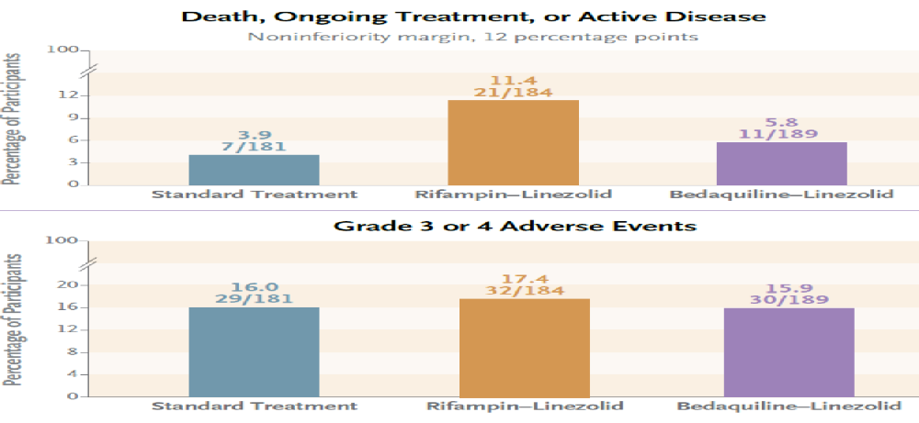

Slide 17
CONCLUSIONS
A strategy involving initial treatment with an 8-week bedaquiline–linezolid regimen was noninferior to standard treatment for tuberculosis with respect to clinical outcomes. The strategy was associated with a shorter total duration of treatment and with no evident safety concerns

Slide 18
DISCUSSION
The results of the TRUNCATE-TB trial showed that a strategy involving initial treatment with an 8-week regimen that contained bedaquiline and linezolid was noninferior to standard treatment with respect to the risk of a composite clinical outcome at week 96.
The efficacy of the strategy, as compared with standard treatment, was consistent across multiple subgroups that were defined according to baseline characteristics, including some that are indicative of severe disease and high relapse risk.

Slide 19
This treatment strategy was associated with a shorter initial course and with a shorter total duration of treatment than was standard treatment. Also, participants had higher level of motivation to adhere to an 8-week initial course than to standard treatment.
The 13-week reduction in the total treatment duration could allow program resources (both financial and human) to be redeployed to enhance adherence support during a shorter period.
This support may synergize with the increased individual motivation to better sustain adherence

Slide 20
Follow-up after treatment, which is an essential component of the strategy,
represents an additional burden for persons with tuberculosis and for
treatment programs, as compared with the usual practice of immediate
discharge after completion of standard treatment.
only a few participants discontinued visits or reported difficulty with
prolonged follow-up; most indicated that they would recommend the
strategy to others, which suggests a positive overall experience, and the
pragmatic monitoring approach is likely to be feasible for treatment
programs

Slide 21
                THANK YOU

