Slide 1
THROMBOSIS AND BLEEDING
DR MONET PHILIPOSE
JR MEDICINE

Slide 2
INTRODUCTION
Human hemostatic mechanisms- A balance between pro coagulant and anticoagulant forces
The procoagulation forces
  Platelet adhesions
  Aggregation
  Fibrin clot formation
The anticoagulant forces includes
  Natural inhibitors of coagulation
  Fibrinolysis

Slide 3
The major components of hemostatic systems are
Platelets and other formed elements of blood such as monocytes and red cells
Plasma proteins(the coagulation and fibrinolytic factors and inhibitors)
The vessel wall

Slide 4
STEPS OF NORMAL HEMOSTASIS
PLATELET PLUG FORMATION
On vascular injury,platelet adhere to the site of injury,mediated by von Willebrand factor(VWF)- the primary molecular glue,which is present in plasma and vessel wall subendothelial matrix.
Adhesion is also facilitated by direct binding to subendothelial collagen through platelet membrane collagen receptors
Adhesion results in platelet activation and aggregation
The process is enhanced by humoral mediators in plasma (epinephrine,thrombin),mediators released by activated platelets (ADP,serotonin) and vessel wall collagen,VWF

Slide 5
the platelet glycoprotein 2b/3a complex is the most abundant receptor on the platelet surface ,on platelet activation it enables binding to VWF and fibrinogen
Activated platelet undergo release reaction which promote further aggregation and inhibit anticoagulant factors
Additional platelets are recruited from the circulation to the site of vascular injury ---formation of an occlusive platelet thrombus
Platelet plug is anchored and stabilized by the developing fibrin mesh

Slide 6
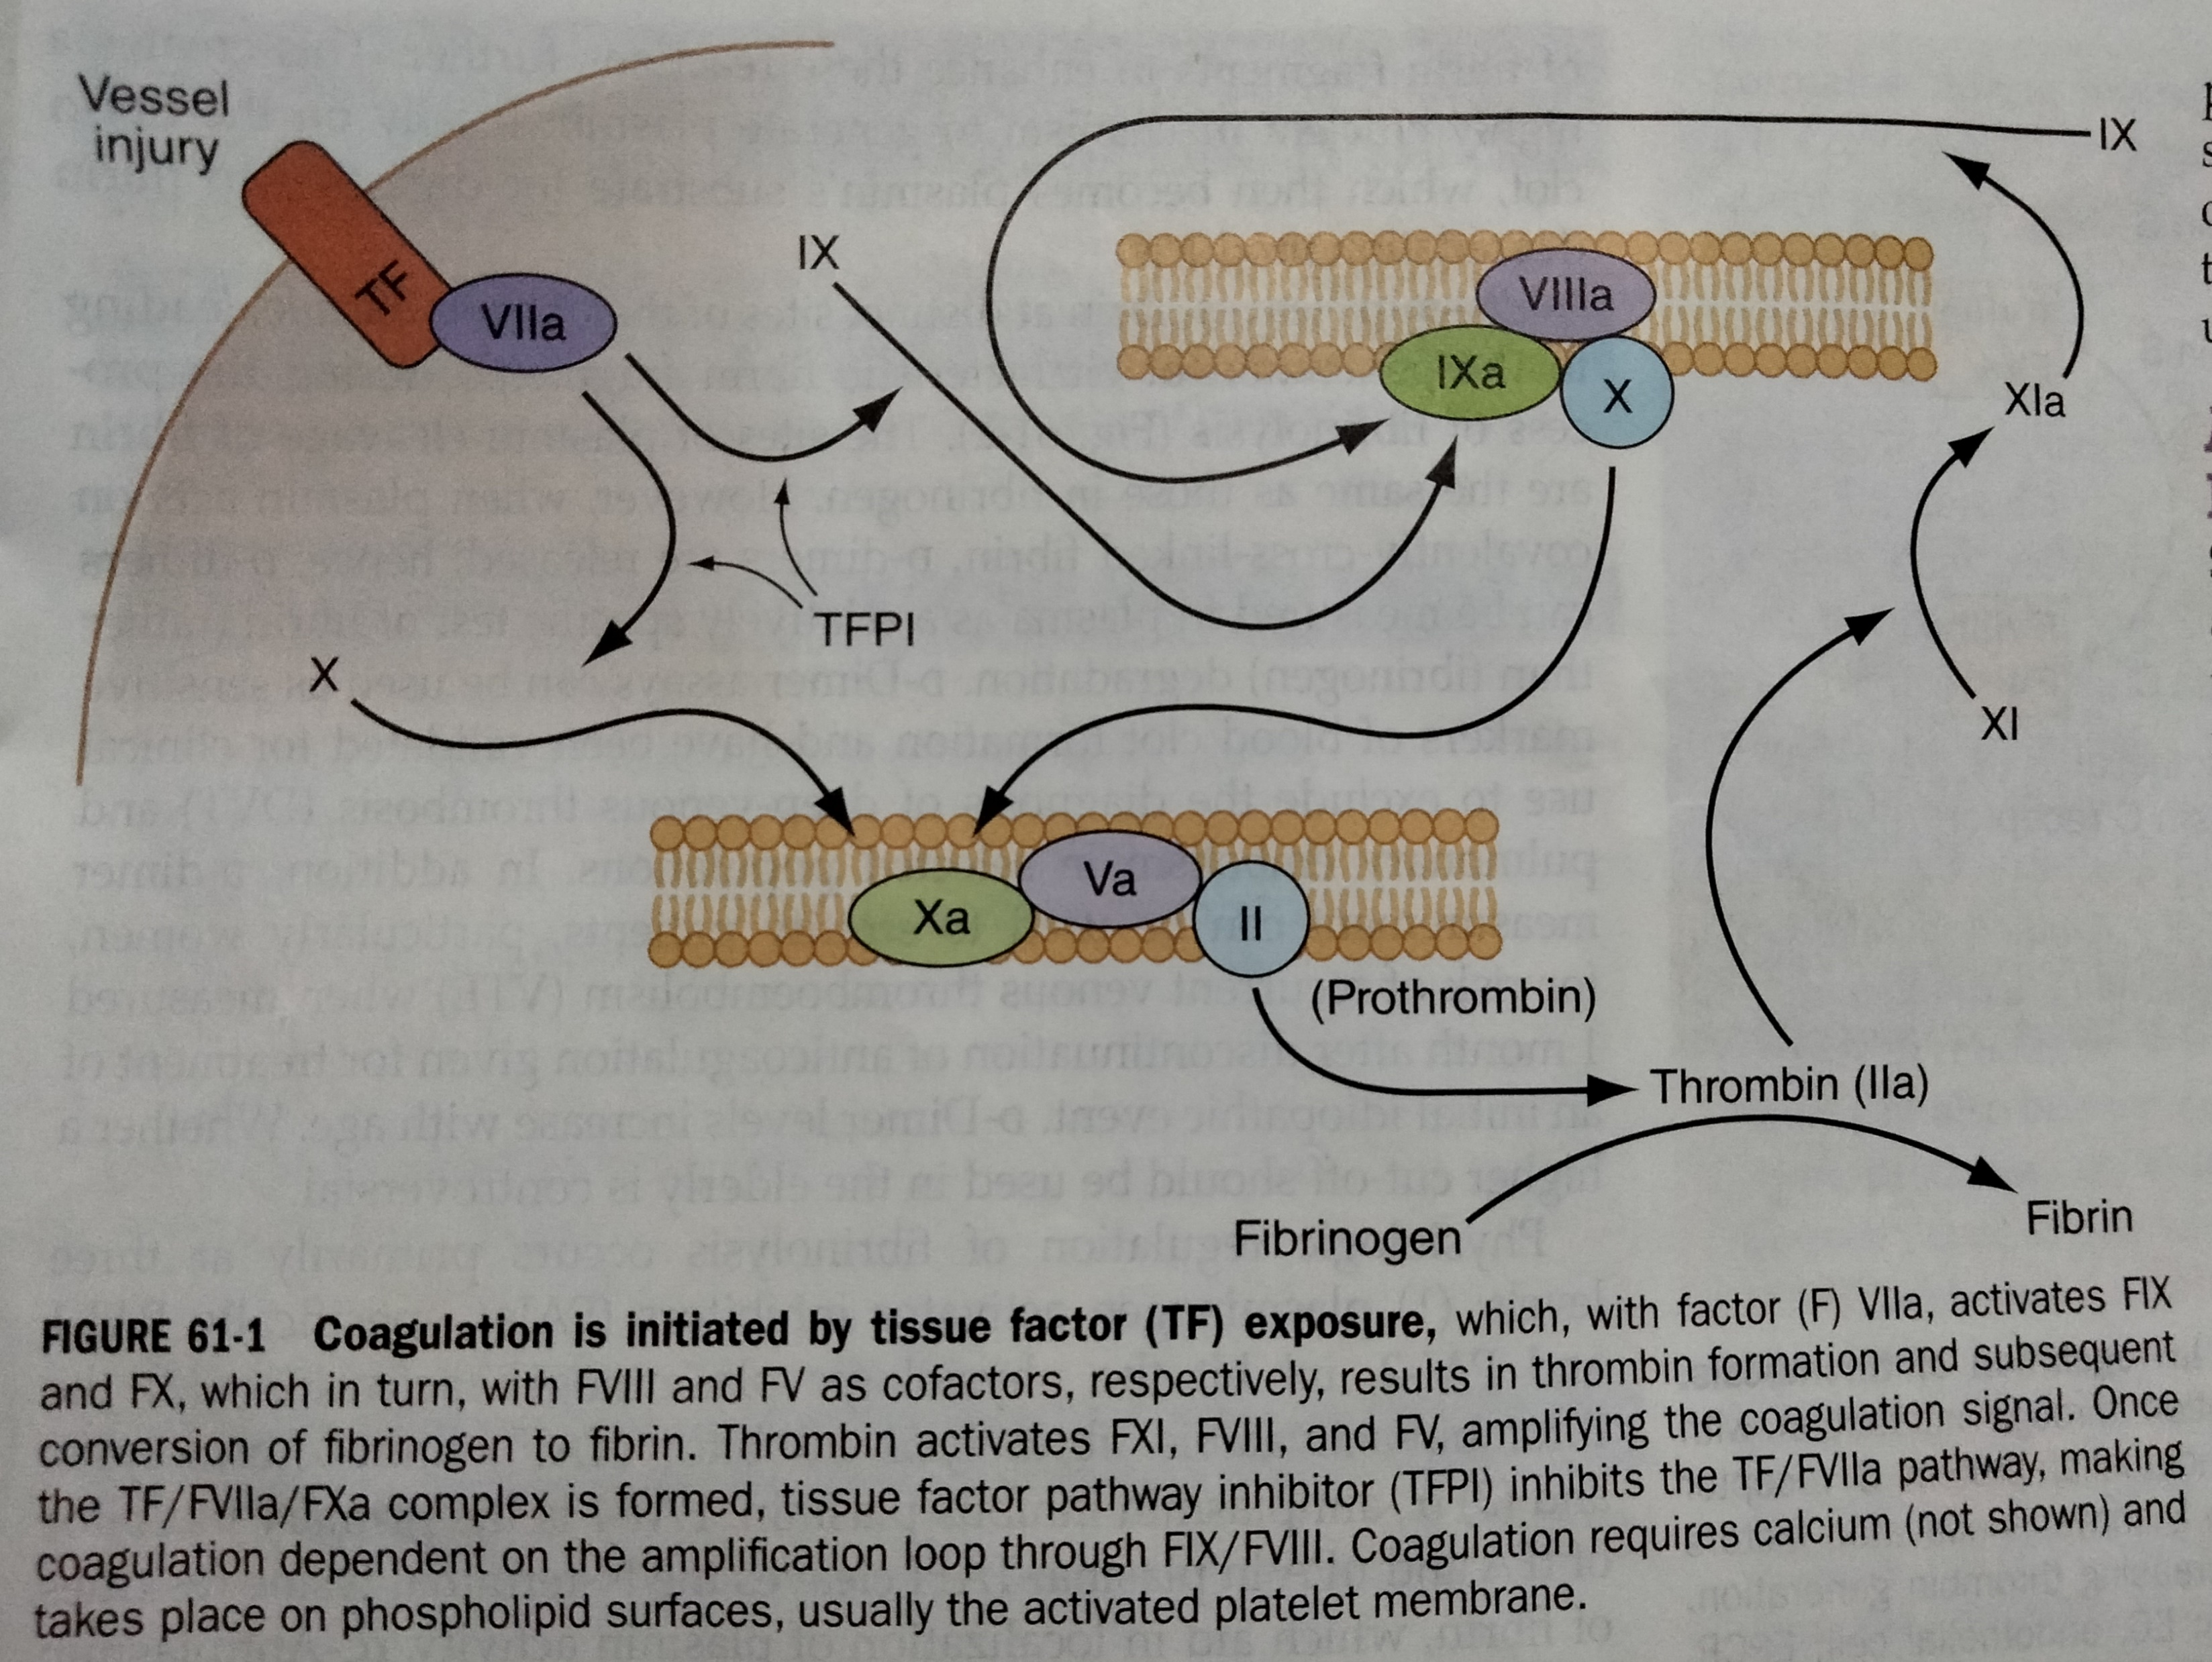
Fibrin clot formation

Slide 7
Anti thrombotic mechanism
Antithrombin is the major plasma protease inhibitor of thrombin and other clotting factors.
Anti thrombin neutralizes thrombin and other clotting factors.
Protein c is a plasma glycoprotein that becomes aan anticoagulant when it is activated by thrombin
The thrombin induced activation of protein c and then the binding of protein c to its receptor on endothelial cells places it in proximity to the thrombin thrombomodulin complex

Slide 8
Activated protein c cleaves the activated clotting factors 5 and 8 mediated by cofactor protein s.
Protein s is a glycoprotein that undergoes vitamin k depedent post translational modification
Tissue factor pathway inhibitor (TFPI) is a plasma protease inhibitor,that inhibits the tissue factor/ factor 7a/factor 10a complex.

Slide 9
THE FIBRINOLYTIC SYSTEM
Tissue plasminogen activator is released from endothelial cells
It binds the fibrin clot and activate plasminogen to plasmin.
Excess fibrin is degraded by plasmin to fibrin degradation products(FDP)

Slide 10
APPROACH TO THE PATIENT
Clinical presentation
Detailed personal and family history is important
History gives clues to the etiology by determining
the site of bleeding(mucosal,joint) or thrombosis(arterial and/or venous)
Whether an underlying bleeding or clotting tendency was enhanced by another medical condition or the introduction of medications or dietary suppliments.

Slide 11
History of bleeding
History of at risk situations –the response to past surgeries
History of spontaneous or trauama /surgery induced bleeding
Spontaneous hemarthroses-hallmark of factor 8 and 9 deficiencies
Mucosal bleeding- s/o platelet disorders or von Willebrand disorders termed as disorders of primary hemostasis or platelet plug formation

Slide 12
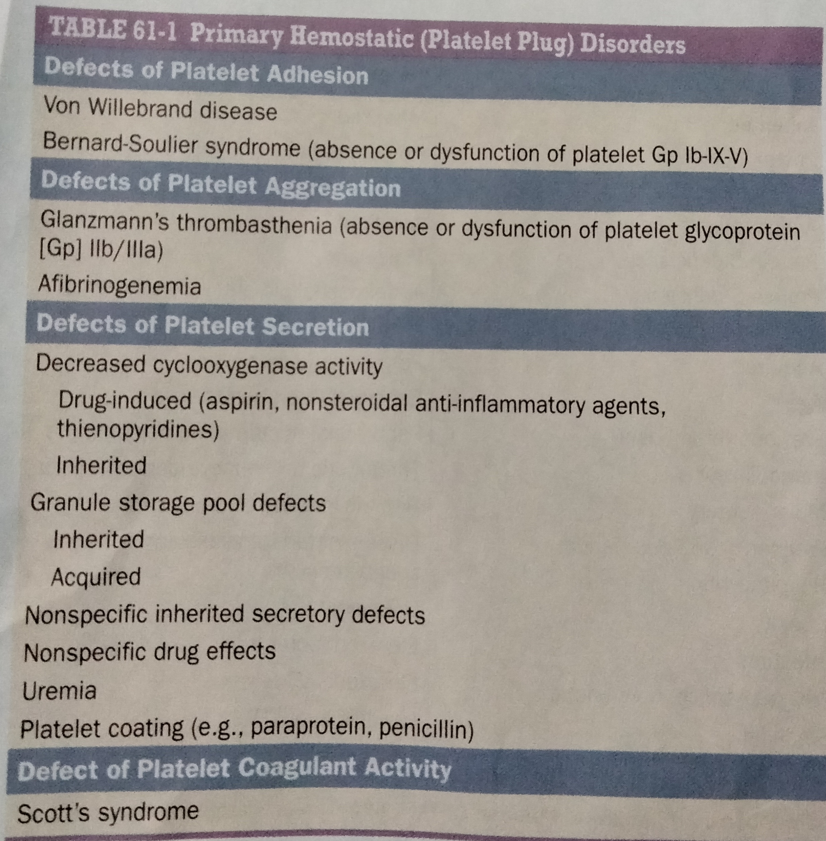

Slide 13
Any h/o prolonged bleeding with surgery,dental extractions and procedures and/or trauma, heavy menstrual bleeding(HMB) or postpartum hemorrhage(PPH),large bruises.
A bleeding score is used as a tool to predict patients more likely to have von Willebrand disease.

Slide 14
Easy bruising and HMB are common complaints with or without bleeding disorder
Easy bruising- may seen in abnormality of blood vessels or their supporting tissues
Ehlers-danlos syndrome- posttraumatic bleeding and hyper extensibility of jonts
Cushings syndrome ,chronic steroid use and aging-subcutaneous bleeding oocurs in response to minor trauma
History of epistaxis- common symptom in hereditary hemorrhagic telengiectasia and in boys with VWD.

Slide 15
Bleeding with eruption of primary teeth-children with more severe bleeding disorder like moderate/severe hemophilia
h/o heavy menstrual bleeding-loss of >80 ml of blood per cycle ,reported in majority of women with VWD,,factor 11 deficiency,and carriers of hemophilia
In women with type 1 VWD and symptomatic carriers of hemophilia A in whom levels of VW factor and factor 8 usually normalize during pregnancy,PPH may be delayed.
h/o rupture of ovarian cyst with intra abdominal hemorrhage

Slide 16
Aspirin and other NSAIDS that inhibit cyclooxygenase 1 impair primary hemostasis which may cause bleeding or unmask a previously occult bleeding disorder.
fish oil rich in omega fatty acid impair platelet function by producing more PGI3 and more thromboxane A3.
Vitamin E inhibit protein kinase c mediated platelet aggregation and nitric oxide production.

Slide 17
Bruising or mucosal bleeding may be seen in liver disease, severe renal impairment, hypothyroidism,paraproteinemia,amyloidosis and bone marrow failure.
Bleeding occurs in isolated thrombocytopenia usually only at counts less than 10000-20000.

Slide 18
HISTORY OF THROMBOSIS
Major risk factor for arterial thrombosis is atherosclerosis
For venous thrombosis,major risk factors are
Immobility
Surgery
Medical conditions such as malignancy, medications such as hormonal therapy,obesity and genetic predispositions

Slide 19
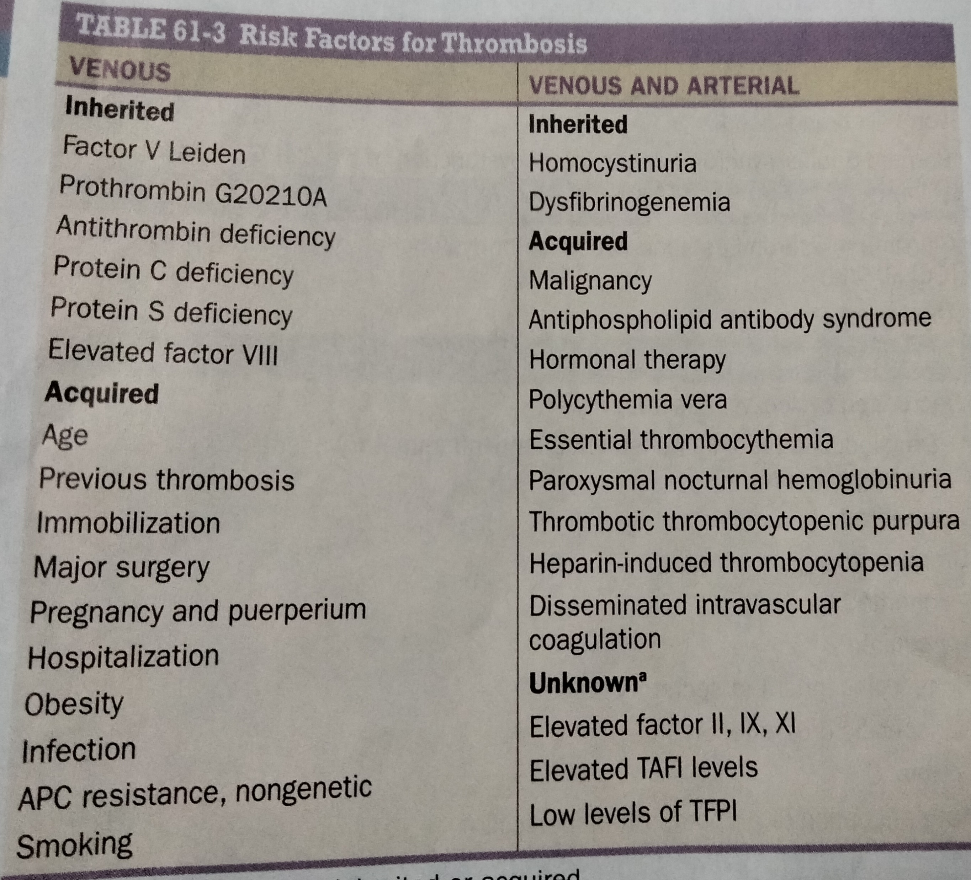

Slide 20
Screening assays
Most common screening tests are
Prothrombin time
Activated partial thromboplastin time
Platelet count
PT -assess the factor 1(fibrinogen),factor 2(prothrombin), factor 5,7 and 10
The PT measures the time for clot formation of citrated plasma after recalcification and addition of thromboplastin,a mixture of TF and phospholipids.

Slide 21
aPTT assess the intrinsic and common coagulation pathways,factor 12,11,9,8,10,5,2, fibrinogen.
Thrombin time – measure fibrinogen conversion to fibrin and are prolonged when the fibrinogen level is low
MIXING STUDIES- used to evaluate prolonged aPTT-PT to distinguish between factor deficiency and inhibitors
With isolated factor deficiencies the aPTT will correct with mixing,but with aptt prolongation due to lupus anticoagulant /inhibitors the mixing shows no correction.
Specific factor assays

Slide 22
Testing for thrombophilia
Antithrombin ,protein c,protein s levels,apla antibodies
D dimer assay

Slide 23
Measures of platelet function
Bleeding time used to assess the bleeding risk –does not predict bleeding risk with surgery
The PFA-100-an instrument that measures platelet dependent coagulaton under flow condition ,more sensitive and specific for VWD and platelet disorders
Thromboelastography- useful in guiding intra operative transfusion

Slide 24
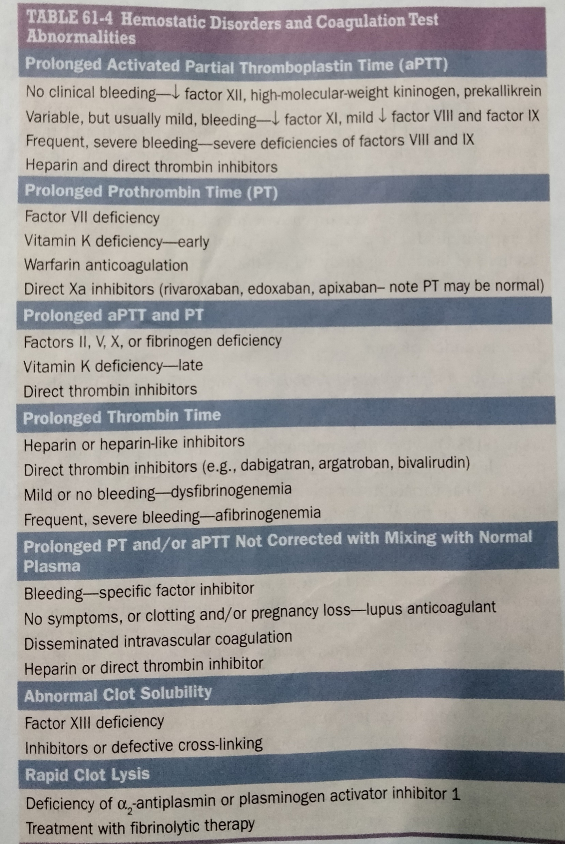

Slide 25
THANK YOU

