Slide 1
THE FACIAL NERVE : ANATOMY, CLINICAL EXAMINATION
Dr. Ibrahim Ali Saleem
JR, GENERAL MEDICINE

Slide 2
Introduction
Predominantly motor nerve
Muscles of facial expression, scalp,ear,buccinator,Platysma, stapedius, stylohyoid, posterior belly of digastric.
Parasympathetic secretory fibres : sublingual,submandibular salivary glands, lacrimal gland, oral aand nasal cavity mucous membranes.

Slide 3
Sensory function
M.imp : taste from anterior 2/3 of tongue
Exteroceptive sensation: ear drum, each
proprioception: from muscles it supplies
general visceral sensation: salivary glands, mucosa of nose and pharynx

Slide 4
Understanding Facial nerve as segments
1. Brainstem or intramedullary segment
From brainstem nuclei to exit point
2. Cisternal segment
Exit point to IAC
3. Meatal segment or canal segment
Through IAC to entrance of the facial canal
4. Labyrinthine segment
Upto geniculate ganglion

Slide 5
5.short horizontal segment
Geniculate ganglion to pyramidal eminence of the posterior wall of tympanic cavity.
6. Mastoid segment
Pyramidal eminence to stylomastoid foramen
7.extratemporal or peripheral segment
Upto pes anserinus

Slide 6
The motor portion
SUPRANUCLEAR INNERVATION
From lower 3rd of contralateral percentral gyrus
In the facial area of motor homunculus
Fibres descend via corticobulbar tract
Corona radiata - genu of internal capsule - medial part of cerebral peduncle - pons

Slide 7
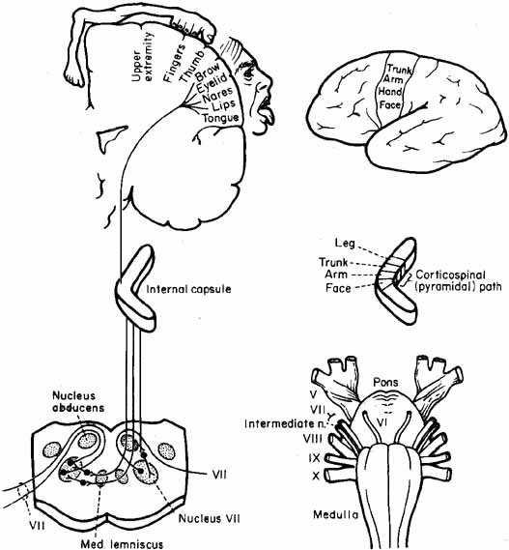
Then decussates to converge on facial nuclei

Slide 8
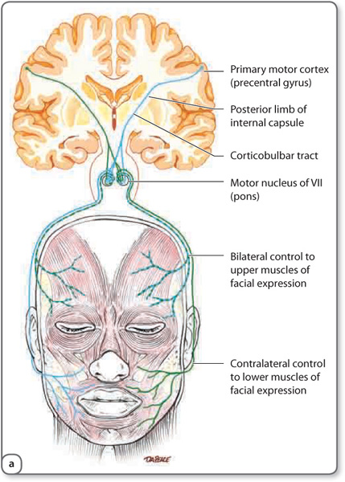

Slide 9
Innervation of lower 2/3 - half of face - predominantly contralateral supranuclear control
innervation of upper 3rd to half of face - ipsilateral supranuclear control
Voluntary facial expressions - primary motor cortex, ventral lateral premotor cortex, supplementary motor area
Emotional expressions - cingulate cortex which receive inputs from limbic system

Slide 10
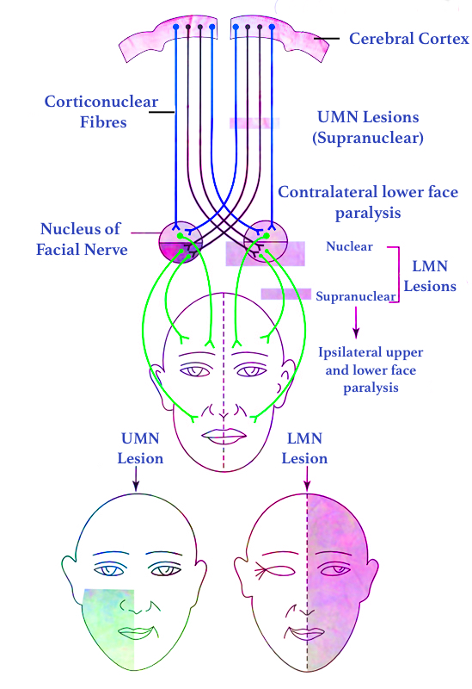

Slide 11
Aberrant pyramidal tract...
Most corticobulbar fibres - decussate in or rostral to pons
some descend in aberrant pyramidal tract to medulla - decussate- ascend contralaterally in dorsolateral medulla - facial nucleus
explains the occurence of ipsilateral umn facial palsy in LMS

Slide 12
Facial nucleus
Special visceral efferent, or branchiomotor
innervates muscles of 2nd branchial arch
Lies anteromedial to nucleus of spinal tract of CN V
anterolateral to nucleus of CN VI
posterior to superior olivary nucleus

Slide 13
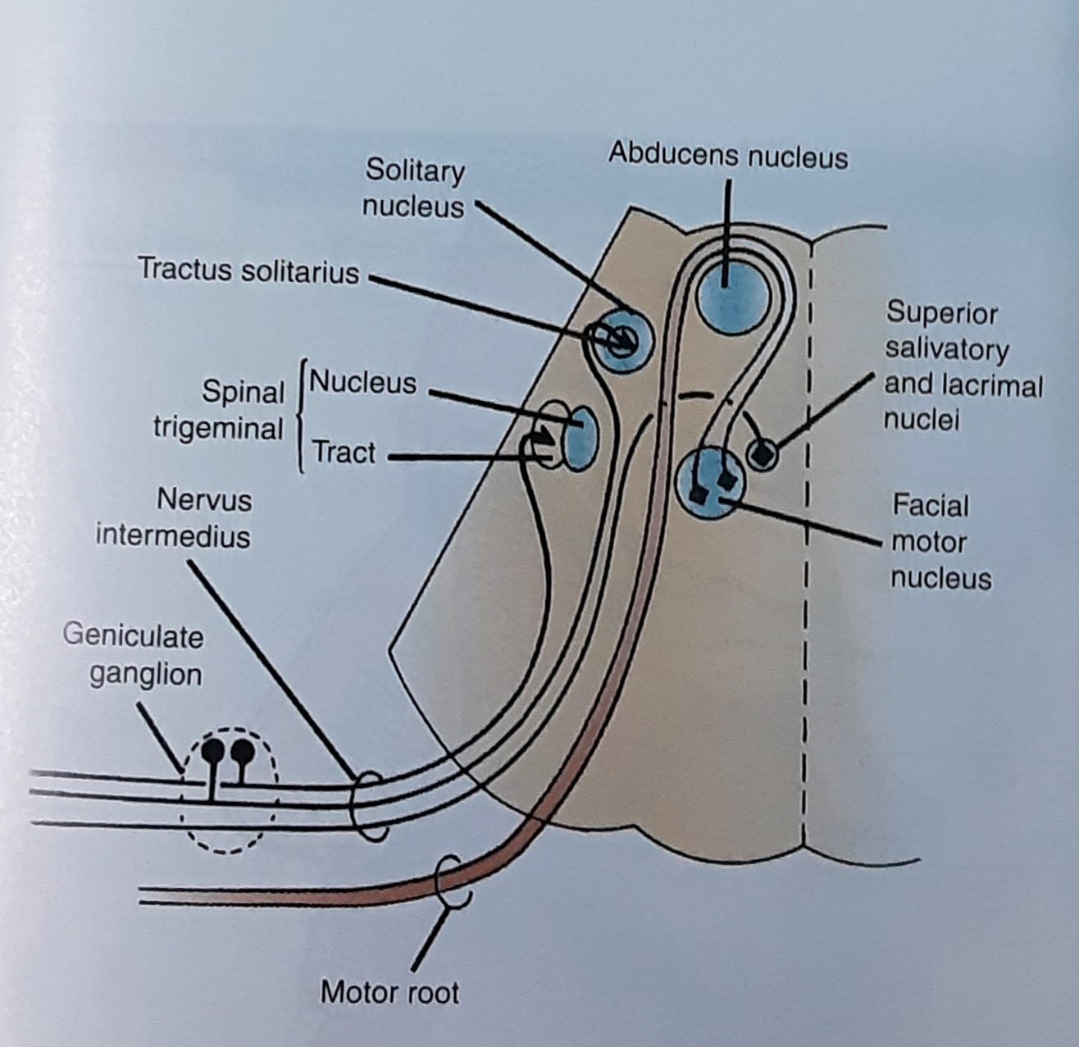

Slide 14
Subnuclei of facial nerve motor nucleus:
Lateral, medial, dorsal subnuclei
arranged in columns
Lateral subnuclei - lower facial muscles and buccinator
medial subnuclei - posterior auricular, platysma, occipital muscles, stapedius

Slide 15
Dorsal subnucleus - upper facial muscles via temporal, orbital and zygomatic br.

Slide 16
Course of facial nerve
Axons arise from dorsal surface of nucleus, travel dorsomedially
move up, encircle abducens nucleus - forms internal genu
this forms the facial colliculus - the bump in the rhomboid fossa of 4th ventricle floor

Slide 17
2 components of facial nerve
Motor root - 70%
Sensory root - 30% - form the Nervus intermedius (NI) - Both Sensory And Autonomic Fibres
the sensory and autonomic fibres run close to each other

Slide 18
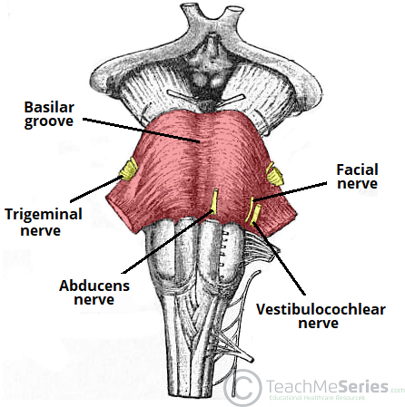
CN VII exits pons laterally - pontomedullary junction
caudal to roots of V, between olive and inferior cerebellar peduncle

Slide 19
NI - exits pons at PMJ closer to CN 8 than CN 7
At IAC, facial nerve motor root - groove on the anterosuperior surface of CN 8.
NI lies in between.
Close proximity to AICA.
On exiting IAC, meninges peirced to enter facial canal.

Slide 21
In the canal facial nerve and NI merges.
From facial canal to stylomastoid foramen, 3 segments present
1. LABYRINTHINE SEGMENT
Between cochlea and vestibule towards medial wall of tympanic cavity.
Ends at the first external genu. (Geniculate ganglion +)

Slide 22
2.HORIZONTAL OR TYMPANIC SEGMENT
From external genu runs 1cm horizontally
3.MASTOID OR VERTICAL SEGMENT
The nerve encounters 2nd external genu at the tympanic segment - 90 degree turn to enter the mastoid segment.
Nerve turns backwards and arches downwards behind the tympanic cavity - nerve to stapedius arises here

Slide 23
Nerve descends towards SMF
Chorda tympani given off 6mm before exiting via SMF.
EXTRATEMPORAL SEGMENT
3 branches arise
a. Posterior auricular : supplies occipitalis, posterior auricular and other auricular muscles
b. Digastric: supplies posterior belly of digastric

Slide 24
c. Nerve to stylohyoid
Nerve turns forward, enters parotid and divides into temporofacial and cervicofacial divisions at the pes anserinus.
Temporofacial br crosses the zygoma 1cm anterior to the ear - vulnerable to injury
Supplies all muscles of facial nerve expression

Slide 25
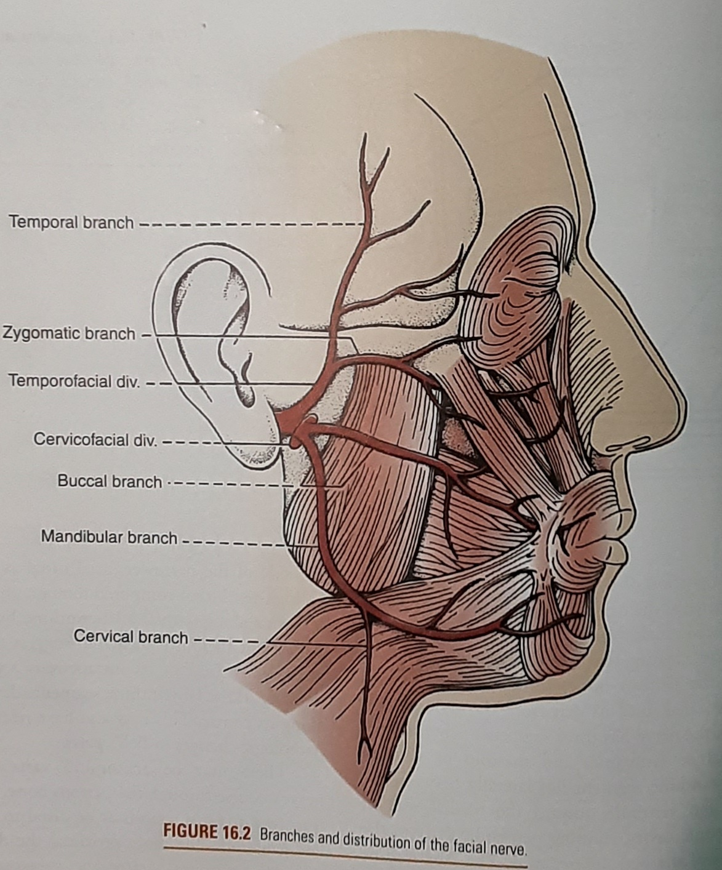

Slide 26
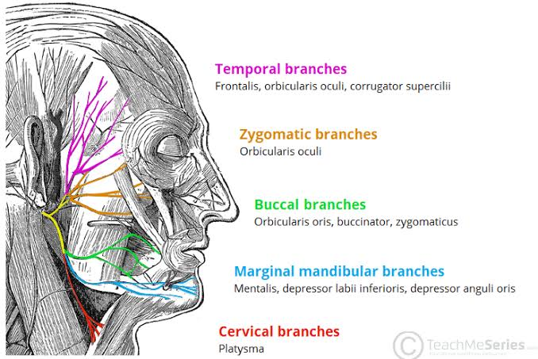

Slide 27
NERVUS INTERMEDIUS
Sensory and autonomic component
Runs intermediate between CN 7 and 8
fuses with geniculate ganglion at the external genu
Sensory cells - general somatic afferent GSA, special visceral afferent SVA
GSA - exteroceptive impulse from EAC, TM
SVA - taste from anterior two third of tongue

Slide 28
Autonomic component of NI
General visceral efferent parasymp fibres from superior salivatory and lacrimal nucleus ( scattered cells in RF near caudal end of motor nucleus)
supply the submandibular gland and submaxillary, lacrimal glands, glands in nasal mucosa

Slide 29
COURSE AND BRANCHES OF FACIAL NERVE

Slide 30
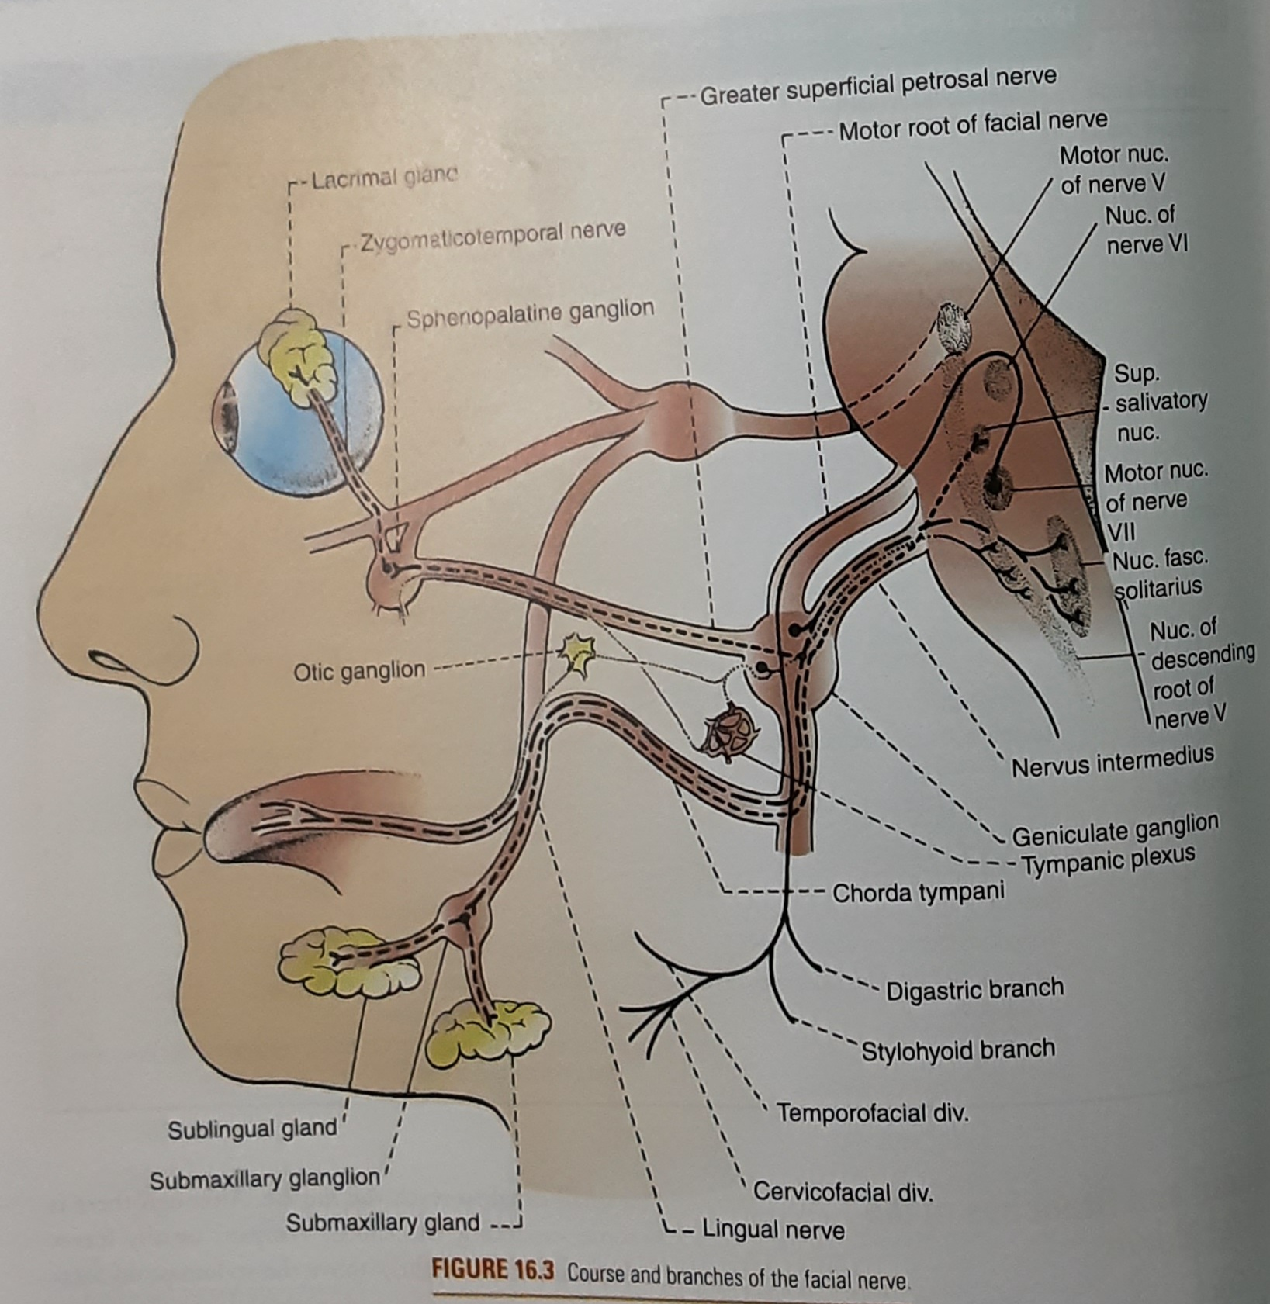

Slide 32
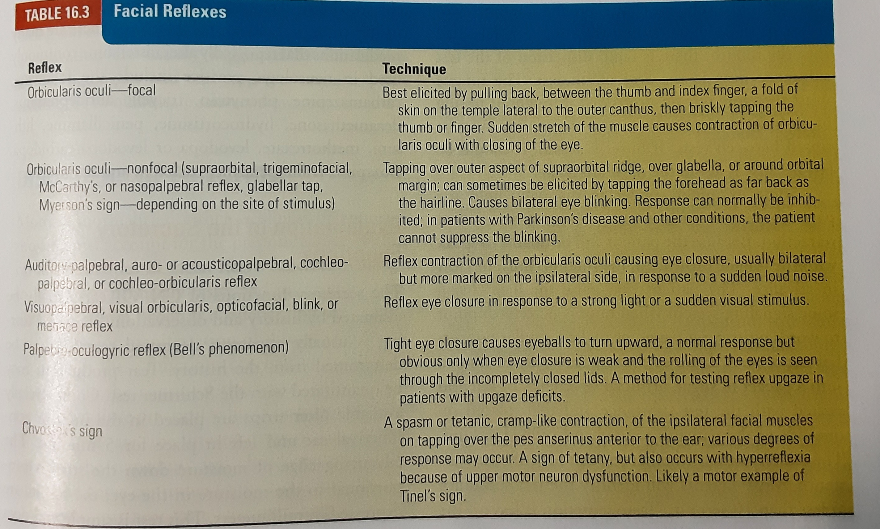

Slide 33
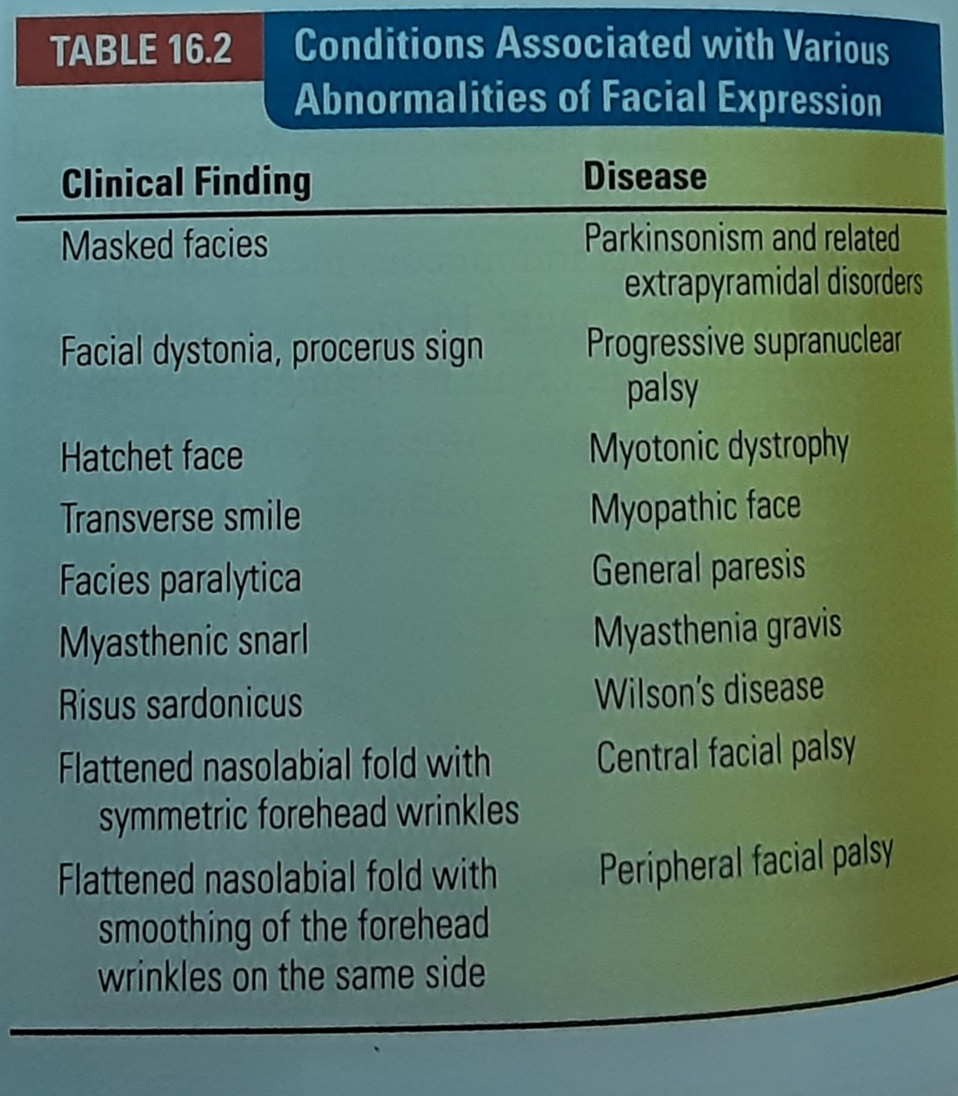

Slide 34


Slide 35


