Slide 1
THE BLEEDING LUNGS
CLINICAL CLUB
Dr. Nithya Ramanujan
JR3
M6 Unit

Slide 2
Mr X
54/m
Kayamkulam
Painter

Slide 3
Presenting complaints
Cough – 1 month
Hemoptysis – 5 days
Breathlessness – 5days

Slide 4
Cough since 1 month. Dry cough → expectoration of scanty mucoid sputum.
Breathlessness – 5 days more during night, following bouts of cough. Progressive. Orthopnea+
Hemoptysis – 5 days. Moderate in amount.
Right sided pricking type chest pain+. Increased on coughing and breathing.
H/o loss of weight and loss of apetite – 2 months
h/o decreased urine output- 1 day
Decreased food intake+

Slide 5
H/o low grade fever since 1day.
No h/o altered sensorium.
No h/o myalgia, rashes over body, bleeding manifestations.
No h/o pedel odema.
No h/o hematuria, dysuria, lower urinary symptoms.
No h/o joint pain/swelling, purple lesions over skin.
No h/o epistaxis.

Slide 6
No h/o evening rise of temperature, night sweats.
No h/o abdominal pain, loin pain.
No h/o palpitation, syncope or autonomic symptoms.
Referred from local hospital in v/o desaturation.

Slide 7
Past history
Recurrent episodes wheezing since 4 yrs, h/o oral steroids+. Not on regular inhaler.
No h/o TB, asthma, atopy
No h/o HTN, CAD, T2DM
No h/o recurrent ear discharge, ear infection, sinusitis

Slide 8
Family history
No h/o any similar illness
No h/o bronchial asthma, PTB

Slide 9
Personal history
Non veg diet
Sleep and apetite- decreased
Bowel habit- unaltered
Oliguria+
Heavy ethanolic since 35 years. 3 drinks/day atleast 3times/wk. last binge 2 weeks back.
Chronic smoker since 35 years, stopped 1 month back.

Slide 10
Socioeconomic status
Poor socioeconomic status

Slide 11
General examination
Conscious, oriented
Well built and nourished
Sitting due breathlessness
Occasional greying of hair
Subconjunctival haemorrhage right eye
Pallor +
Painless pandigital clubbing+
No icterus, cyanosis, lymphadenopathy, pedel odema
No flap

Slide 12
No rashes, palpable purpura
No cutaneous ulcer, nodules
No joint swelling, tenderness

Slide 13
Vitals
PR- 84/min. regular, normal volume and character, no RR/ RF delay, no vessel wall thickening. All peripheral pulsations felt equal and b/l
BP- 160/100mmHg in right upperlimb in sitting position
RR- 32/min, abdominothoracic
Temp- normal
SPO2- 86% RA → 98% 10L/min o2 →90% 15l/min o2(during rounds)

Slide 14
Respiratory system
Tachypnoeic, dyspneic
Accesory muscles of respiration working+
Normal shape of chest
Respiratory movements bilaterally equal
Normal resonant note in all areas
Air entry bilaterally equal, vesicular breathsounds heard b/l
Right mammary area bronchial breathing+
B/l creps in all areas(R>L)
B/l rhonchi+

Slide 15
CVS EXAMINATION
S1, S2+
No murmur
GIT EXAMINATION
Soft non tender
No organomegaly
Bowel sounds+
CNS EXAMINATION
HMF normal
Cranial nerves normal
Motor system and sensory system normal
No signs of meningeal irritation

Slide 16
?COPD acute exacerbation with right ML pneumonia due to infection/malignancy
? Bronchopneumonia with sepsis, oliguric AKI
?pulmonary tuberculosis

Slide 17
Investigations from outside
31/1/22
HB-7.5
TC-10,030
P83,L10
PLT-3.4L
ESR- 100
URE- 250 RBC/hpf, protein++
CXR PAV- bilateral infiltrates, R>L

Slide 18
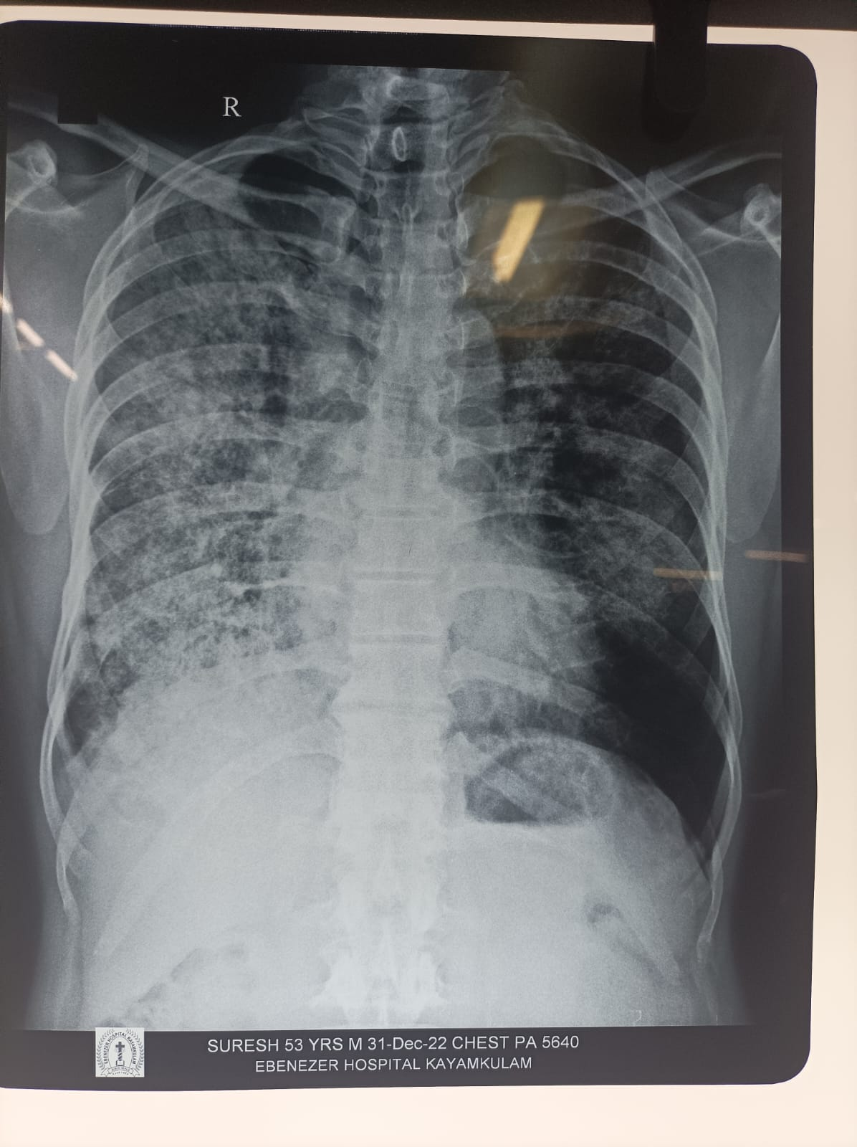

Slide 19
Summary
54 yr old male
K/c/o COPD
Subacute symptoms
Cough+ dyspnea+ hemoptysis+ pleuritic chest pain+ hypoxia+ diffuse lung infitrates → Type 1 respiratory failure (?bronchopneumonia/diffuse alveolar haemorrage/metastasis) +
Oliguria+microscopic hematuria+ proteinuria→ Rapidly progressive renal failure (?RPGN)
Pulmonary renal syndrome??

Slide 20
Differential diagnosis
Anti GBM disease
ANCA associated small vessel vasculitis
Granulomatosis with polyangitis
Microscopic polyangitis
Eosinophilic granulomatosis with polyangitis
Lupus nephritis with DAH
IgA vasculitis
Cryoglobuluinemic vasculitis
APLA syndrome
Infection related- lepto, hantavirus, legionella pneumonia, malaria
Opportunistic infection in immunocompromised

Slide 21
Cancer associated vasculitis(CAV)- MC being lymphoproliferative disorders producing paraneoplastic immune complex mediated small vessel vasculitis
Intravascular lymphoma
Sarcoidosis

Slide 22
Anti GBM disease- most likely
Favouring points
Points against
Male predominance
Bimodal – 3rd/6th decade
Lung haemorrhage (cough, hemoptysis+ renal failure( oliguria)
Few weeks or months
Symptoms of anemia may +(IDA)
Minor infection may trigger
Smoker
Urinalysis- hematuria, modest proteinuria
Systemic symptoms usually absent
Dark or red urine + usaully

Slide 23
Granulomatosis with polyangitis
(GPA)
Favouring
Against
5/6/7th decade
Male predominance
Non specific- fever, malaise, anorexia, wt loss
Renal involvement common- hematuria, proteinuria, renal failure
RPGN common+ pulmonary h’ge
India- PR3 ANCA and GPA less common
Myalgia, arthralgia often+
Cutaneous- purpura, small ulcers
URT invol common+++ sinusitis, rhinitis, OM, nasal septal collapse

Slide 24
Microscopic polyangitis-most likely
Favouring
Against
5/6/7th decade
Male predominance
India- MPO ANCA & MPA more common
Non specific sym- fever, malaise, anorexia, wt loss
Renal involvement common- hematuria, proteinuria, renal failure
RPGN common(100%)+ pulmonary h’ge
Nodular cutaneous lesion uncommon
URT invol- less common
Cutaneous- purpura, small ulcers++

Slide 25
Eosinophilic granulomatosis with polyangitis(EGPA)
Favouring
Against
Pulmonary h’ge
Renal involvement uncommon
RPGN less likely
Cutaneous- purpura, small ulcers
Nodular cutaneous lesion frequent
URT invol common++ sinusitis, rhinitis, OM, nasal septal collapse
Cardiac invol- myocarditis common
Mononeuritis multiplex- coomon
Eosinophilia, asthma common

Slide 26
Lupus nephritis with DAH
Favouring
Against
Smoking – environmental RF
Fatigue, fever, wt loss
Glomerulonephrits( microscopic hematuria+ proteinuria)
DAH can occur
Anemia( of c/c disease, haemolytic)
Female predominant, reproductive age
Cutaneous inv, musculoskeletal, serositis etc
Most common lung manifestation- pleuritic+/- effusion
Vasculitis is rare, but DAH, CNS vasculitis, mesenteric ischemia can occur.

Slide 27
IgA vasculitis(HSP)
Favouring
Against
Renal inv in 20-50% cases- microscopic hematuria
Adult IgA vasculitis- severe RPGN type 2
Common in children, <20yrs
Skin-palpable purpura
GIT in 50% cases- abdominal pain
Joint inv in 70%- athralgia

Slide 28
CRYOGLOBULINEMIC VASCULITIS
Favouring points
Against
Tiredness
Pulmonary infiltrates
Renal- microscopic hematuria, proteinuria/ nephritic s/d
DAH – seen in mixed iimunoglobulin subtype of CV
Strong association with HCV
Palpable non pruritic purpura, digital necrosis
Symmetrical arthralgia
Peripheral neuropathy
CCF/ mesenteric ischemia

Slide 29
APLA SYNDROME
Favouring points
Against
Smoking is risk factor
Renal involve can occur- TMA- Patients typically p/w subnephrotic proteinuria, impaired renal function and hypertension
Catastrophic APS- DAH occur
Young female with abortion/ premature delivery
P/w thrombocytopenia+ thrombosis (venous> arterial)

Slide 30
Infection related- lepto, hantavirus, legionella pneumonia, malaria
Favouring points
Against
Pulmonary and renal involvement
High grade fever, myalgia
Acute presentation usually

Slide 31
Opportunistic infection in immunocompromised host
Favouring point
Against
Constitutional symptoms+
h/o recurrent infections+

Slide 32
Investigations
1/1/23
Hb- 8
TC- 9600
P60%,L9%
Plt-2.3
ESR- 140
PCV-23
MCV-86
MCH-30
MCHC-34
RDW-12.8

Slide 33
RBS- 139
UR/CR- 185/15.2
Na/K- 127/5.9
Bil- 0.6
TP/Alb-6.6/3
OT/PT-23/16
ALP- 55

Slide 34
URE
Alb +
Sug- 0.5%
RBC- plenty/hpf
PC- 1-2/hpf
ECG- sinus tachycardia VR-150/min
CXR PAV- diffuse infiltrates b/l (R>L)

Slide 35
Ca- 7.4→8.2
Phos- 6.6
UA- 10.7
PT- 15
INR-1.14
APTT-41.6
iPTH- 108
HIV- NEG
HBsAg -NEG
Anti HCV -NEG

Slide 36
2/1/23
Hb- 6.2
Tc- 17600
Ur/ cr- 149/12.1
Na /K-131/4.9
LFT- normal ( except alb-2.8)
HRCT THORAX

Slide 37
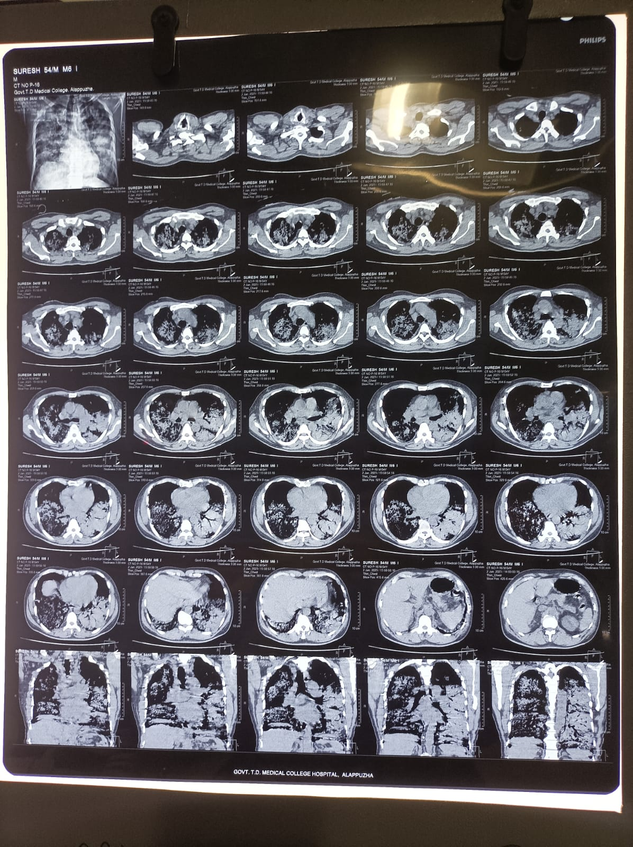

Slide 38
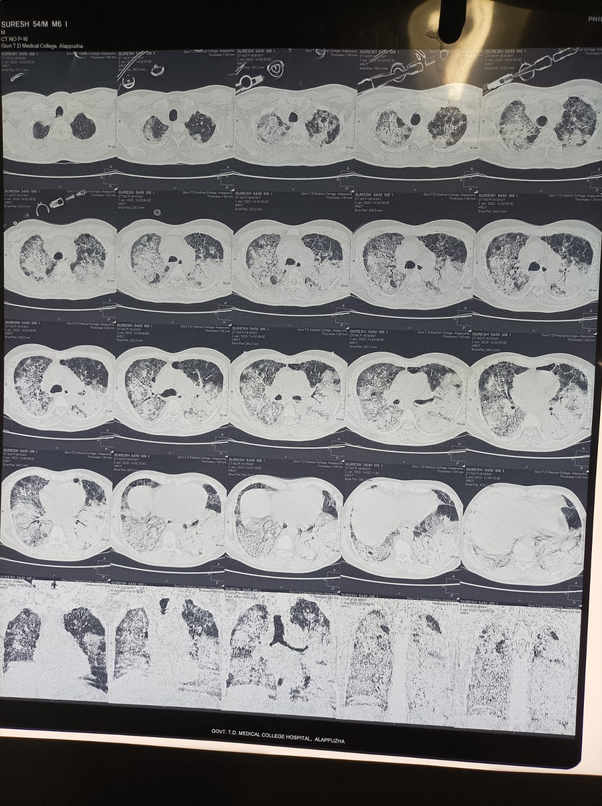

Slide 39
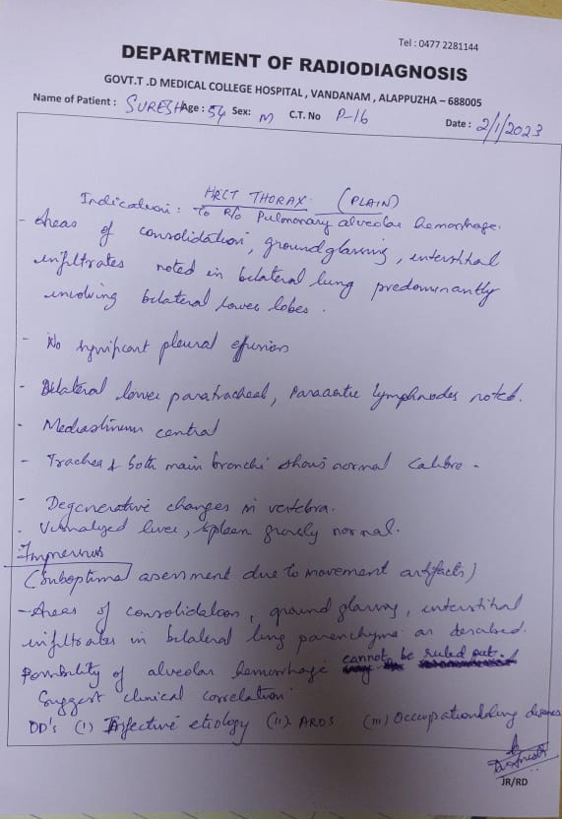

Slide 40
Iron studies
Ferritin-762.5
TSAT-16.5%
Iron- 57
TIBC-321
Mantoux test-neg

Slide 41
Pending
ANA profile
Anti dsDNA
Anti GBM
MPO ANCA
PR3 ANCA
LAC/anti beta2 GP1/ACLA
C3, C4
24hr urine protein
Igm lepto, scrub

Slide 42
3/1/23
Hb-4.8
Tc-13800
Plt-2.2L
Ur/cr-185/15.6
Na/K- 127/6.3

Slide 43
Course in hospital
In ward 1/1/23
O2 inhalation
Inj. Piptaz
Inj. Clindamycin
T. Azee
T. oseltamivir
Inj. Hydrocort
Nebulisation ipravent/ budecort
T. ethamsylate

Slide 44
After first biochemistry reports
T. sobisis
Antihyperkalemic measures
Emergency nephrology consultation done
Imp- probable RPGN- pulmonary renal syndrome
Anti GBM
ANCA vasculitis
Lupus nephritis
Hemodialysis advised, renal biopsy was planned

Slide 45
Pt shifted to MICU
CPAP
ABG
pH-7.228
pCO2-32.1
HCO3- 13.4
Po2-137
So2-99
Lac-0.39
Primary metabolic acidosis+ sec respiratory acidosis

Slide 46
1 session of HD given(2.5hr)
Inj. Methylprednisolone 500mg iv given after HD
2/2/23
HRCT thorax taken- s/o DAH
Inj. Methylprednisolone 750mg iv
Plex was initiated but terminated due to desaturation
3/1/23
Inj.Methylprednisolone 750mg iv
T. septran DS
ABG- metabolic acidosis
4 pint FFP
HD+ 2PRC f/b PLEX
Unfortunately pt deteriorated in dialysis room. Intubated, resuscitated, but succumbed to death.

Slide 47
Igm scrub- neg
Urine pc ratio- 2.2:1
LDH- 844(0-250)
AntidsDNA- neg
ANA Profile- neg
Anti GBM- neg
C3- 197(90-180)
APLA IgG, IgM- neg
Protein s- 70(74-120)
C-ANCA- Neg
P ANCA- Strong positive

Slide 48
True p-ANCA positive conditions
ANCA vasculitis
Drugs
Hydralazine
Propylthiouracil
Levamisole adultered with cocaine
Minocycline
Good pasture syndrome

Slide 49
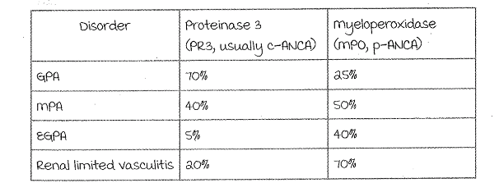

Slide 50
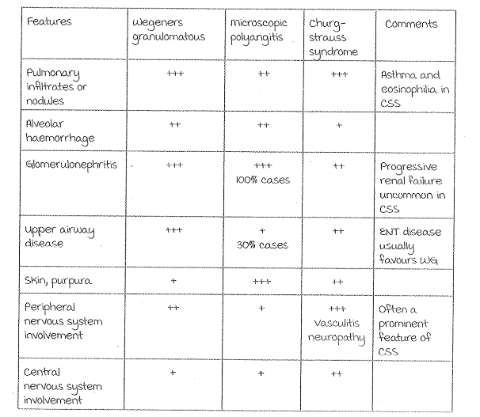

Slide 51
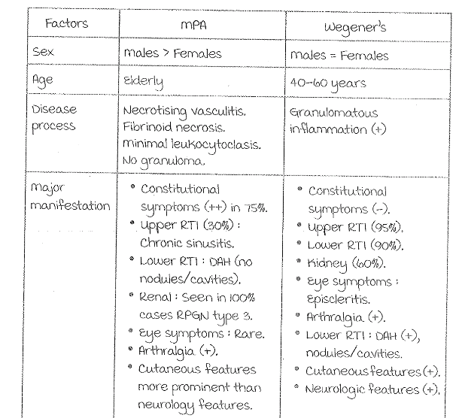

Slide 52
DIAGNOSIS
ANCA associated vasculitis(AAV)- PROBABLY MICROSCOPIC POLYANGITIS
Post mortem renal biopsy report awaiting

Slide 53
PULMONARY RENAL SYNDROME
Occurrence of renal failure + respiratory failure, characterised by rapidly progressive glomerulonephritis (RPGN) and diffuse alveolar haemorrhage (DAH)
Secondary to an underlying autoimmune process
Corresponding histology- glomerular crescents on renal biopsy and pulmonary capillaritis on lung biopsy
MCC of PRS in adults are AAV- 56–77.5% &
antiglomerular basement membrane(anti-GBM) disease -12.5–17.5%
Diseases a/w pulmonary h’ge and RPGN→ good pasture syndrome

Slide 54
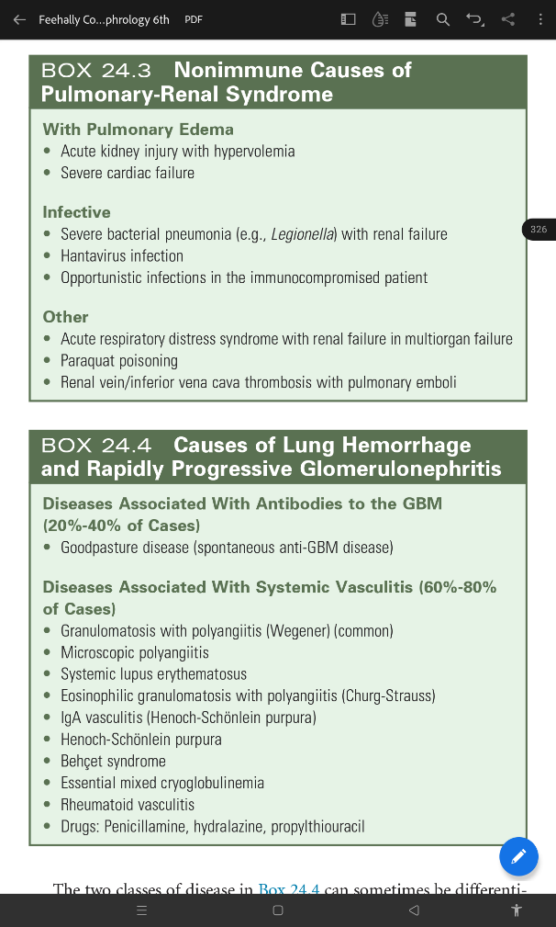

Slide 56
Clinical features
Acutely with lung h’ge or advanced renal failure, developed over weeks or months
Once RPGN developed, renal function deteriorate rapidly
Much rapid progression occur in MPA as more glomeruli affected simultaneously, and hence much narrower window of opportunity for treatment

Slide 57
Rapidly progressive glomerulonephritis(RPGN)
Acute severe glomerular injury, renal function to deteriorate markedly over days or weeks
p/w uremic emergency with nephritic syndrome or systemic disease with rapidly deteriorating renal function
Histologic counterpart- cresentric GN (fibrinoid necrosis of glomeruli + cresents)
Three distinct immunopathological entities
antibody mediated (type 1) –antiGBM d/s
immune complex mediated (type 2)- SLE
pauci-immune (type 3)- AAV

Slide 58
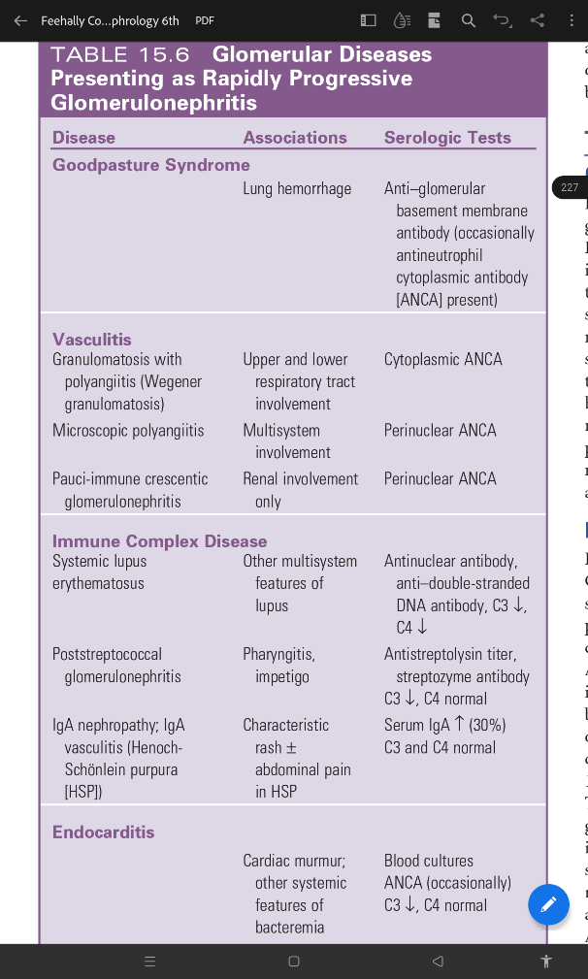

Slide 59
Diffuse alveolar haemorrhage(DAH)
Develop acutely over a few days, or more insidiously,
Range from mild illness to fulminant respiratory failure
Dyspnoea, hemoptysis, anemia and hypoxia (neither sensitive /specific)
May be complications of active vasculitis or its treatment (fluid overload or infection)
CXR
Rapidly changing opacities, extending (increased alveolar bleeding) or resolving without scarring (reabsorption of blood) within 48 hour
Pleural effusions not a feature and suggest cardiac failure or fluid overload
Echocardiography- cardiogenic pulmonary oedema

Slide 60
High-resolution CT
Presence of localised ground-glass opacification or more extensive consolidation with air bronchograms
DLCO- increased
Fibreoptic bronchoscopy and bronchoalveolar lavage
Acute bleed- fresh blood may be visible within subsegmental airways
Increasingly haemorrhagic return on serial bronchoalveolar lavage (BAL)
In subacute or recurrent DAH, the number of haemosiderin-laden macrophages on Prussian blue staining aids diagnosis ( usually <5%)
Lung biopsy- capillaritis (gold std)

Slide 61
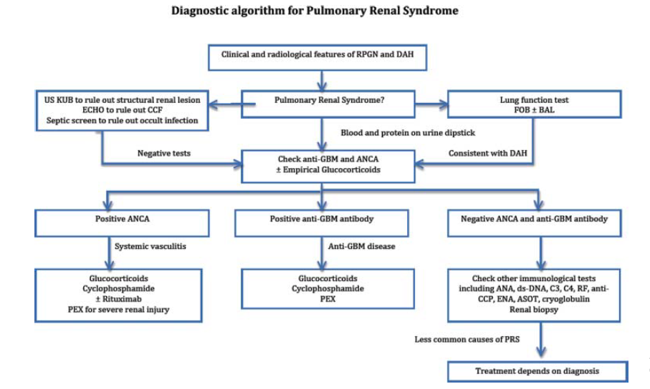

Slide 62
THANK YOU

