Slide 1
TDL Tumefactive Demyelinating Lesion
Javed Anees

Slide 2
Brief History
22/m with h/o C/c headache 4yrs, Diagnosed as TDL,may 2022,and was on steroids till Nov 22,stopped.
Admitted with gen aches and pain,focal neck pain in posterior aspect of neck
Left sided headache lasting for hours,No vomiting
No limb weakness,No bladder symptoms
O/E
PEARL,End point Nystagmus+,Fundus-N
Motor power-N,Organic fatigue +
Plantar-Extensor R,Flexor L

Slide 3
DTR: LL-Brisk, UL-N
Abd Reflexes-Absent
Bladder-N
To R/O Relapse
MOG associated Central Demyelination

Slide 4
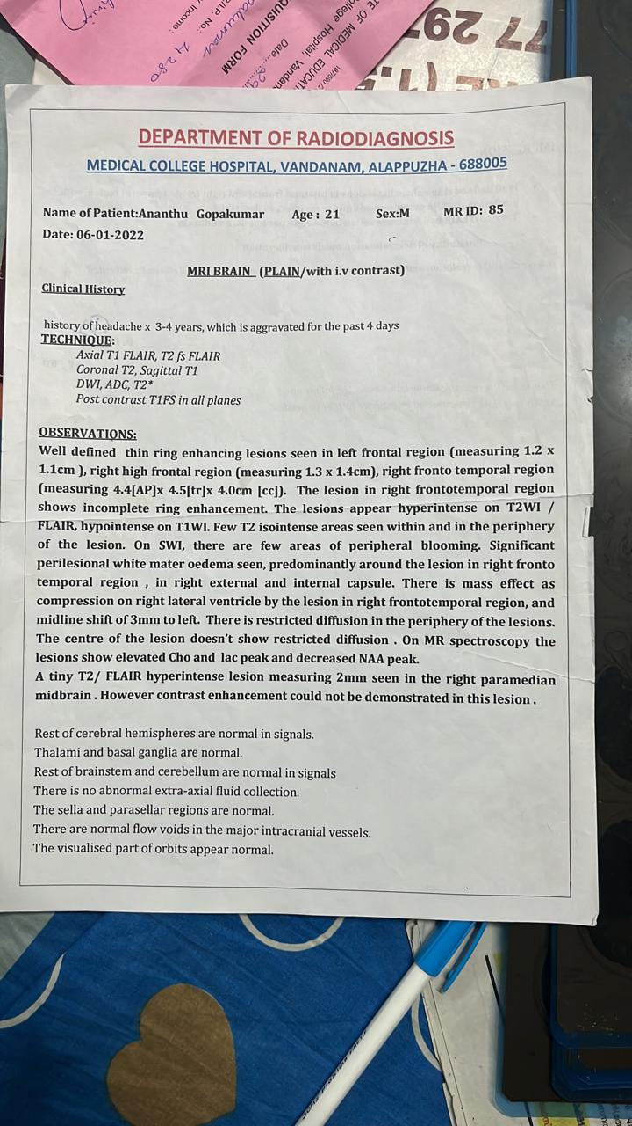

Slide 5
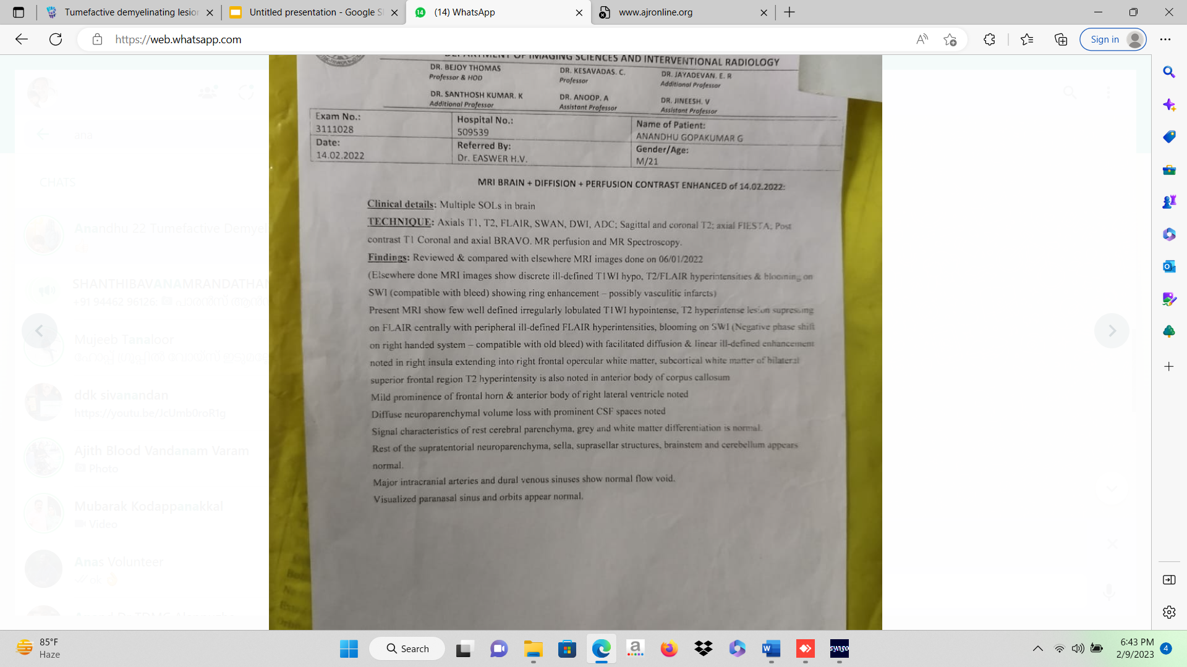

Slide 6
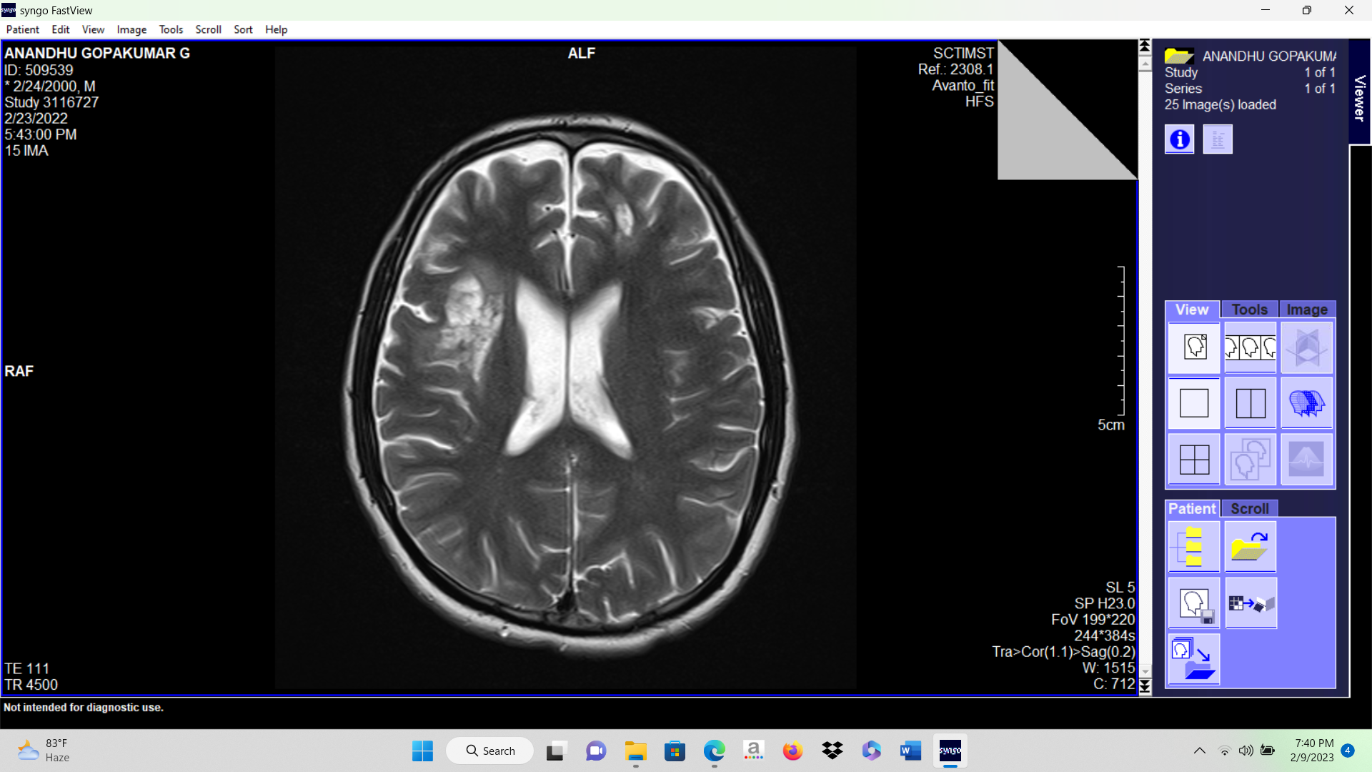

Slide 7
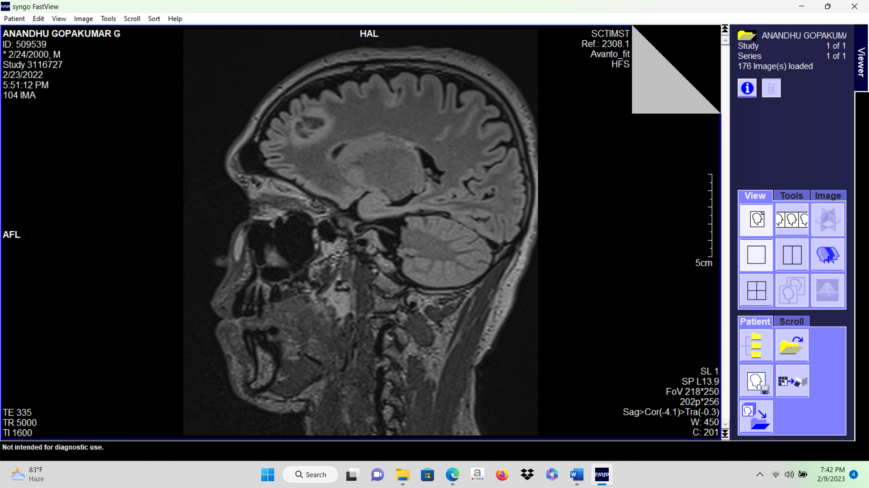

Slide 8
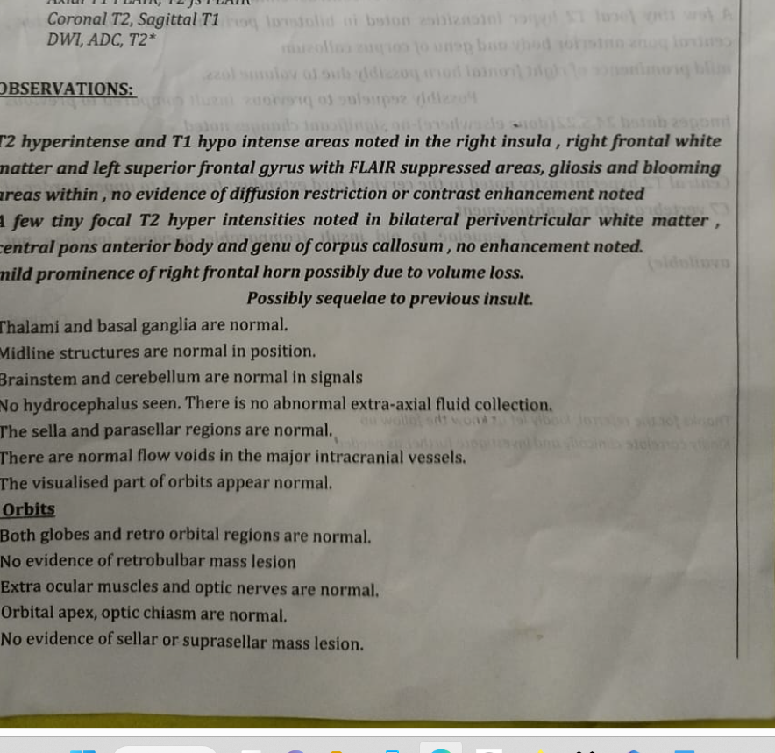
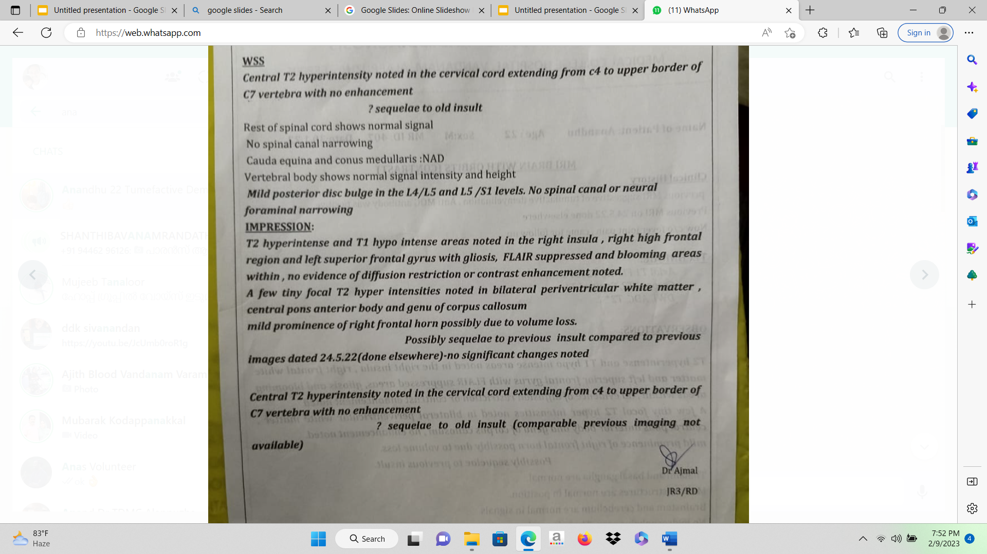

Slide 9
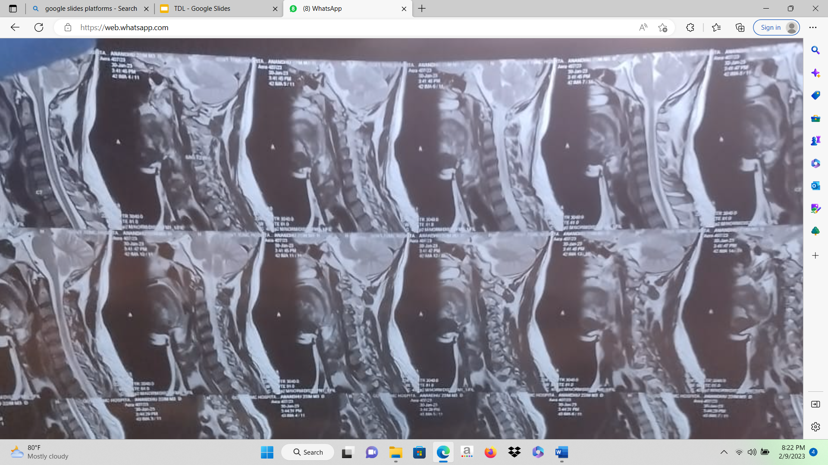

Slide 10
Discussion:
Tumefactive
>2cm lesion
54% of cases
F/o SOL
Demyelinating features
Biopsy may be required

Slide 11
Imaging features of TDL
Large lesion with little mass effect or vasogenic edema
-Supratentorial compartment and centered with in white matter,may involve cortical gray matter
Ringlike or Open Ringlike Enhancement: 50%
Commonly enhancement patterns will be in the form of an open ring,with incomplete portion on gray matter side of the lesion

Slide 12
MS : open ring pattern only in 9% lesions
Enhancing portion of ring represents leading edge of demyelination and thus favours white matter side of the lesion
Central non enhancing core represents a more chronic phase of inflammatory process
3)Central Dilated Veins within the lesion:T2 echoplanar images from MRI perfusion studies-Represent dilated veins draining toward distended subependymal veins

Slide 13
4) Decreased Perfusion: within tumefactive lesions.
rCBV (mean relative Cerebral Blood Volume) within tumefactive demyelinating lesions was lower than contralateral normal side,substantially less than high grade glioma and lymphomas
5)Rapid resolution after Steroid therapy

Slide 14
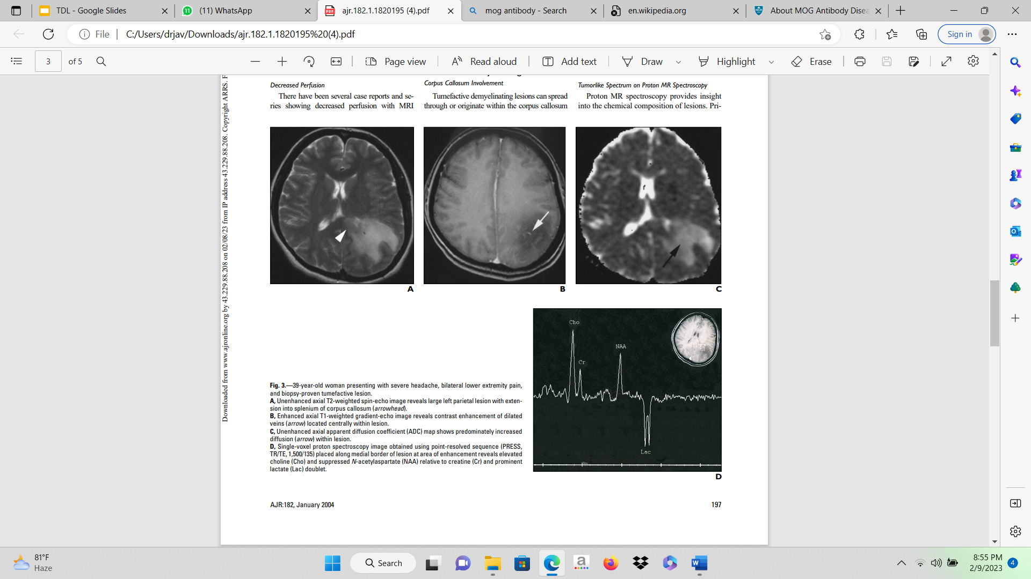

Slide 15
Imaging Not Specific For TDL
Corpus Callosal Involvement
Increased Diffusion: mildly increased diffusion coefficients within tumefactive demyelinating lesions-differentiates from cerebral abscesses,but not from necrotic neoplasms
Tumor like spectrum on proton MR Spectroscopy-TDL may mimic neoplasm
Magnetization Transfer:Decreased mag transfer values are Shown in plaques and healthy appearing white matter of patients with MS.need to be explored

Slide 16
D/D
Gliomas,Lymphomas,Metastases
Inflammatory Diseases:
*Granulomatous Angitis
*SLE
*Sjogrens ds
*Behcets ds
*PAN
*Paraneoplastic encephalomyelopathies
Notes:
Dry eyes mouth,hallitosis,caries,photosensitivity,malar rash
Behcets-Inv thalamus and Mesencephalic junction
Paraneoplastic-Headache,altered sensorium

Slide 17
Infectious Ds:
*Neuroborreliosis
*Human Lymphotropic Virus type 1 infections
*HIV
*Progressive Multifocal Leukoencephalopathy
*Neurosyphilis

Slide 18
Granulomatous Diseases:
*Sarcoidosis
*Wegners Granulomatosis
*Lymphomatoid Granulomatosis
Diseases of Myelin
*Metachromatic Leukodystrophy (juvenile and Adult)
*Adrenomyeloleukodystrophy

Slide 19
Miscellaneous:
*Spinocerebellar disorders
*Arnold-Chiari Malformation
*Vit B12 deficiency
*Optic neuritis
*Cerebellitis
*Brainstem encephalitis

Slide 20
Thank you

