Slide 1
Superficial Reflexes

Slide 2
Introduction
A reflex is an involuntary response to a sensory stimulus.
Sensory impulse is automatically converted into a motor effect through the involvement of CNS
Segmental and suprasegmental components.
Motor, Sensory or Autonomic.
Involuntary , Adaptive and Consistent response to a stimulus.
Depends on integrity of the reflex arc.

Slide 3
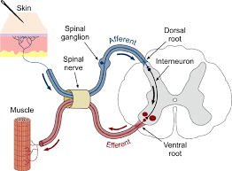
Reflex arc

Slide 4
Classification
Clinical classification | Anatomical classification | Physiological classification | Depending upon inborn or acquired reflexes
1. Superficial reflexes 2. Deep reflexes. 3. Visceral reflexes. 4. Pathological reflexes. | Segmental reflexes. Intersegmental reflexes. 3. Suprasegmental reflexes | Flexor reflexes Extensor reflexes | Unconditioned reflexes Conditioned reflexes

Slide 5
Superficial Reflexes
Superficial reflexes are responses to stimulation of either the skin or mucous membrane.
Elicited by a superficial skin or mucus membrane stimulus.
A light touch or scratch.

Slide 6
Characteristics
Polysynaptic reflexes
Respond slowly
Latency is longer
Fatigue easily – reproducing nature is less
Sensitivity and specificity is less
Not as consistently present as deep tendon reflexes
Abolished by pyramidal tract lesions

Slide 7
Classification
THE SUPERFICIAL REFLEXES OF THE UPPER EXTREMITIES
THE SUPERFICIAL ABDOMINAL REFLEXES
THE SUPERFICIAL REFLEXES OF THE LOWER EXTREMITIES
Superficial reflexes based on spinal nerves | Superficial reflexes based on cranial nerves
Plantar reflex Abdominal reflex Scapular reflex Anal reflex Cremasteric reflex Bulbocavernous reflex | Conjunctival reflex Corneal reflex Gag reflex

Slide 8
Clinically significant superficial reflexes
Conjunctival reflex
Corneal reflex
Abdominal reflex
Cremasteric reflex
Bulbocavernous reflex
Anal reflex
Plantar reflex

Slide 9
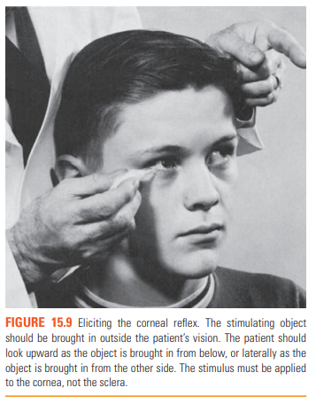
Conjunctival and Corneal reflexes
Afferent : 0pthalmic division of trigeminal nerve ( V 1 )
Center : Pons
Efferent : facial nerve ( VII )

Slide 10
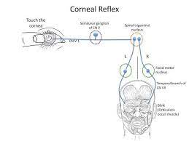
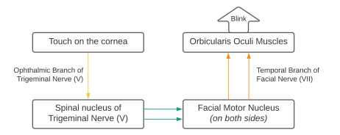

Slide 11
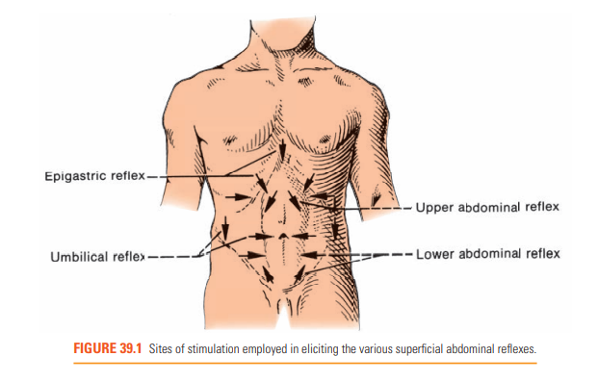
Abdominal reflexes
Root value : T 6 to T 12
Afferent and efferent components : intercostal nerves ( T 7 to T 10 ), iliohypogastric and ilioinguinal nerves ( T 10 to upper lumbar segments )
Quick, flicking contraction followed by immediate relaxation

Slide 12
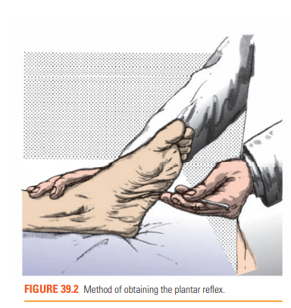
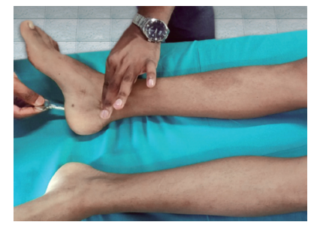
PLANTAR REFLEX AND VARIATIONS
Stroking the plantar surface of foot from the heel forward is normally followed by plantar flexion of foot and toes.
Root value : L 5
Afferent : posterior tibial nerve
Efferent : tibial and peroneal nerves
Pre requisites

Slide 13
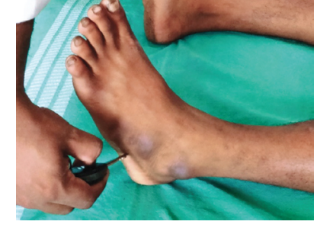
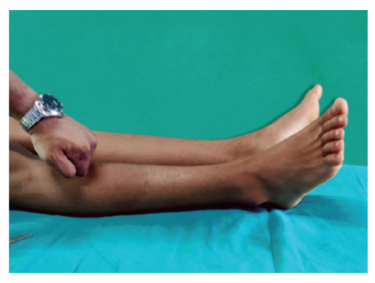
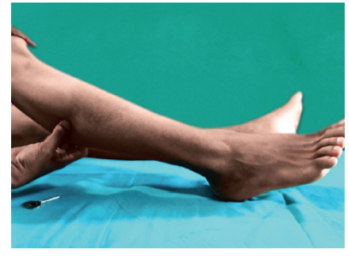
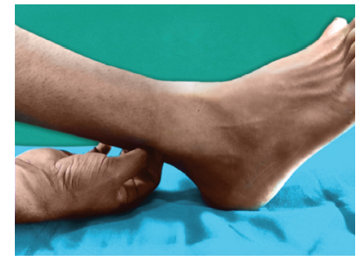
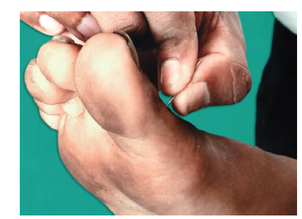
Other methods of obtaining plantar reflex

Slide 14
Normal response | Flexion of the great toe and other toes
Abnormal response (Babinski sign) | Dorsiflexion of great toe and small toes Fanning of toes Dorsiflexion of ankle Flexion of knee joint Flexion at hip joint Contraction of tensor fascia lata
Equivocal response | Rapid extension followed by flexion Only great toe extension Extension of great toe with flexion of fingers No response to the plantar stimulus Flexion at hip and knee, but no movement of toes
Minimal plantar response | No toe movement Contraction of tensor fascia lata with mild internal rotation and abduction of hip
Pseudo Babinski – withdrawal response | Voluntary extension of great toe due to hyperesthesia or strong painful stimulus Dystonic posturing of great toe

Slide 15
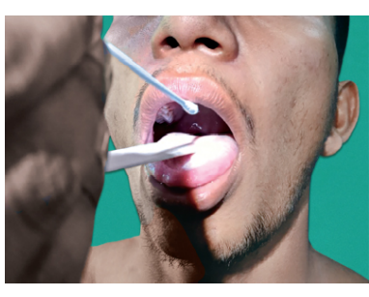
Gag reflex
Afferent :CN IX.
Center : medulla
Efferent :CNs IX and X
Elevation of the soft palate, closure of the glottis and constriction of the pharynx.

Slide 16
Reflex | Innervation | Response
The Cremasteric Reflex | Afferent : ilioinguinal nerve Center : L1 L2 spinal segment Efferent : genitofmoral nerve | Stimulation of upper and inner part of thigh in downward direction. contraction of the cremasteric muscle with a quick elevation of the homolateral testicle.
Superficial Anal Reflex | inferior hemorrhoidal nerve (S2-S5) | stroking or pricking the skin or mucous membrane in the perianal region contraction of the external sphincter
Bulbocavernous Reflex | S 2 , S 3 , S4 | grabbing, pinching, or tweaking of the glans contraction of the anal sphincter
Gluteal Reflex | Afferent : inferior gluteal nerve Center : L4–S2 Efferent : posterior rami of the lumbar and sacral nerves. | contraction of the gluteal muscles may follow stroking the skin
Palmar Reflex | C6–T1 | Gentle stroking across the palm of hand flexion of the fingers or a closing of the hand
The Scapular or Interscapular Reflex | C 5 to T 1 | Scratching the skin over the scapula or in the interscapular space contraction of the scapular muscles retraction and sometimes elevation of the scapula associated adduction and external rotation of the arm

Slide 17
Clinical significance
Corneal and conjunctival reflexes absent in trigeminal or facial nerve lesions.
Abdominal reflex absent in obese and multiparous women, in pyramidal tract lesions , poliomyelitis, herpes zoster and paraplegia. Overresponse in parkinsonism and psychoneurosis.
Babinski sign seen in UMN lesions .
Cremasteric reflex absent in elderly , pyramidal tract lesions, local diseases like hydrocele and epididymo orchitis
Bulbocavernous reflex lost in lesions of cauda equina, lower sacral roots, and conus medullaris.
Gag reflex bilaterally absent in some normal individuals. Unilateral absence signifies a lower motor.
hyperactive in pseudobulbar palsy and amyotrophic lateral sclerosis (ALS).

Slide 18
Thank you

