Slide 1
Dr JITHIN P
PLANTAR REFLEX

Slide 2
Superficial Reflexes
Superficial reflexes are responses to stimulation of either the skin or mucous membrane.
A light touch or scratch.

Slide 3
Characteristics
Polysynaptic reflexes
Respond slowly
Latency is longer
Fatigue easily – reproducing nature is less
Sensitivity and specificity is less
Not as consistently present as deep tendon reflexes
Abolished by pyramidal tract lesions

Slide 4
Classification
THE SUPERFICIAL REFLEXES OF THE UPPER EXTREMITIES
THE SUPERFICIAL ABDOMINAL REFLEXES
THE SUPERFICIAL REFLEXES OF THE LOWER EXTREMITIES
Superficial reflexes based on spinal nerves | Superficial reflexes based on cranial nerves
Plantar reflex Abdominal reflex Scapular reflex Anal reflex Cremasteric reflex Bulbocavernous reflex | Conjunctival reflex Corneal reflex Gag reflex

Slide 5
Plantar reflex

Slide 6
Procedure
All the leg muscles should be visible and in a relaxed state
expose leg upto groin
Check mobility of great toe
This can be achieved by positioning the patient in a way that knee is slightely flexed and hip is externally rotated
Patient should be warned that the sole is going to be scratched and ask him to try to let his limb remain floppy as possible.the toe should not be touched at all

Slide 7
It is best to advise the patient that the sensation may be slightely uncomfortable,
Examiner should ensure that the plantar surface of foot is free of any lesions before proceeding
SLOWLY OVER 6 SECONDS

Slide 8
Equipment
The plantar reflex should be elicited by a dull,blunt instrument that does not cause pain or injury
The dull point of a reflex hammer,a tongue depressor,edge of a key are often used
Sharp objects should be avoided

Slide 9
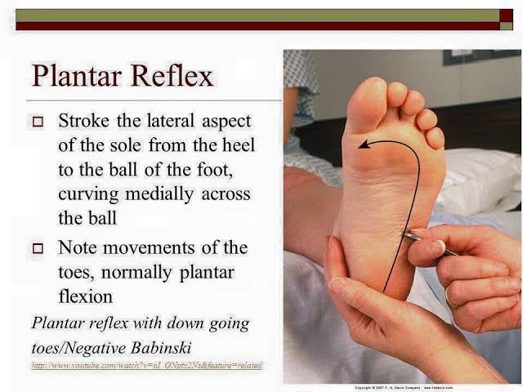

Slide 10
Pathogenesis of a normal plantar response
Stimulation of lateral plantar aspect of foot (S1 dermatome)normally leads to platar flexion of toes (due to stimulation of S1 myotome)
The response results from nociceptive fibres in S1 dermatome detecting the stimulation
Nociceptive input travel up the tibial and sciatic nerve to S1 region of spine and synapse with anterior horn cells
The motor response which leads to the plantar flexion is mediated through S1 root and tibial nerve

Slide 11
Normal plantar =flexor plantar response
The great toe will flex at MTP joint
Other toes will adduct

Slide 12
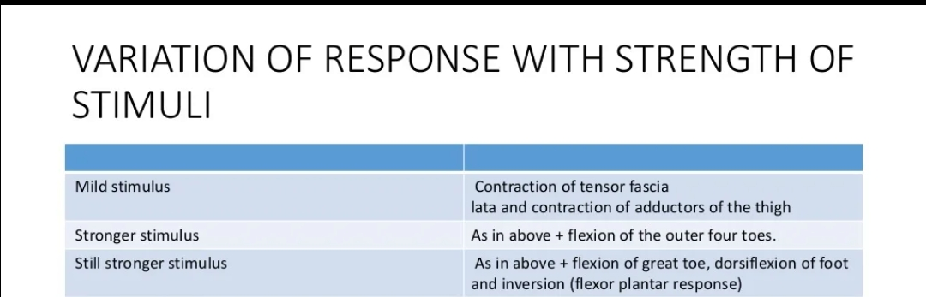

Slide 13
Babinskis sign
Extensor plantar response
Dysfunction of corticospinal tract

Slide 14
Components of Babinskis sign
Dorsiflexion of big toe at MTP joint
Fanning out and extension other toes
Dorsiflexion of ankles
Flexion of hip and knee
Contraction of tensor fascia lata

Slide 15
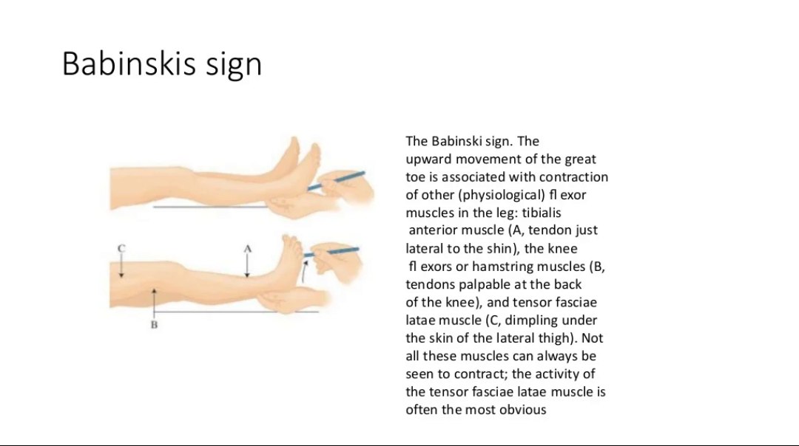

Slide 16
Pathogenesis of extensor response
The descending fibres of CST normally keep the ascending sensory stimulation from spreading to other nerve roots
When there is damage to CST,the nociceptive input spread beyond S1 anterior horn cells
This will leads to L5/L4 anterior horn cell firing
Contraction of toe extensors(extensor hallucis longus,extensor digitorum longus) via deep peroneal nerve

Slide 17
Babinskis sign occurs when stimulation of lateral aspect of foot leads to extension of big toe and fanning of the other toes
This suggest rhat there is spread of sensory input beyond S1myotome
An intact CST prevents such spread

Slide 18
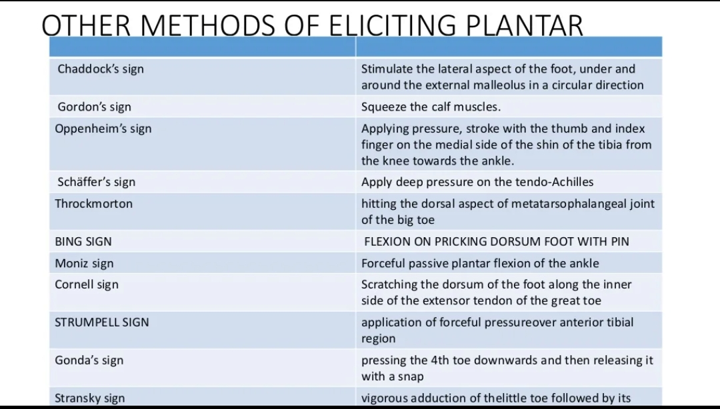

Slide 19
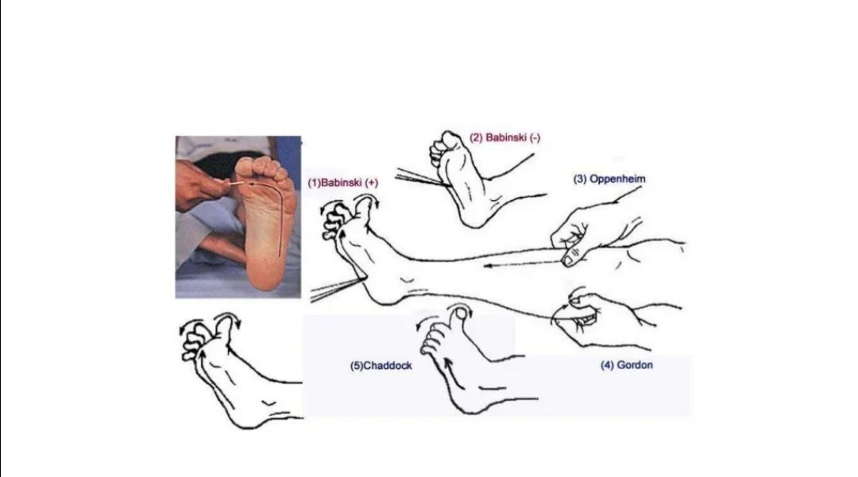

Slide 20
Causes of babinskis sign
UMN disease
Comatosed patients
Post ictal stage of epilepsy
Deep sleep
Infants<1 year of age( d/t incomplete myelination)
GA
ECT

Slide 21
Wthdrawal response
The patient quickely pulls the foot back away from the stimulus
In anxious individuals
In patients with peripheral sensory neuropathy
When an unduly sharp stimulus is given

Slide 22
Absent plantar
Cold feet
Anaesthesia of skin
Fixed big toe
Paralysis of muscles

Slide 23
Minimal Babinski sign
Contraction of hamstring muscles and tensor fascia lata

Slide 24
Exaggerated Babinski sign
It can be either in the form of flexor spasm or extensor spasm
Flexor spasm
  Spinal cord disease
  B/L UMN lesion at supraspinal level
  Multiple sclerosis
  Subacute combined degeneration of cord
Extensor spasm
  Crticospinal tract lesion when posterior column function is normal

Slide 25
Crossed extensor response
Unilateral stimulation produces bilateral Babinski in patients with B/L cerebral diseases and spinalncord disease

Slide 26
Pseudo Babinski sign
one may encounter this type of response in sensitive individuals,plantar hyperesthesia,and choreoathetosis due to hyperkinesis
True Babinski can be clinically differentiated by contraction of hamstring muscles and failure to inhibit the extensor response by pressure over base of great toe

Slide 27
Spontaneous babinski
Passive extension of knee joint or passive flexion of hip and the knee,may produce positive Babinski sign
In patients with extensive pyramidal tract diseae
Infants and children following manipulation of foot

Slide 28
Inversion of plantar reflex
In selective paralysis of short flexors of toes,plantar response may be extensor due to unopposed action of extensor group of muscles

Slide 29
Tonic plantar reflex
While eliciting plantar reflex,some times the toes adduct and flex with persistant plantar flexion of foot for a couple of minutes
This sign indicative of lesion in prefrontal cortex and extrapyramidal system
This is one of the release reflex

Slide 30
Triple flexion response
Represents profound dysfunction of CST,with spread of reflex to L3/L2 myotome
  Dorsiflexion of big toe,fanning of other toes
  Dorsiflexion of foot
  Knee flexion

Slide 31
Thank you

