Slide 1
SPINAL CORD
Dr Akhil Suresh

Slide 2
Development
third week of prenatal development, the ectoderm of the embryonic disk forms the neural plate
folds at the edges into the neural tube (neuraxis).

Slide 3
A group of cells migrates to form the neural crest, which gives rise to dorsal and autonomic ganglia, the adrenal medulla, and other structures
The middle portion of the neural tube closes first
. The openings at each end close later.

Slide 4
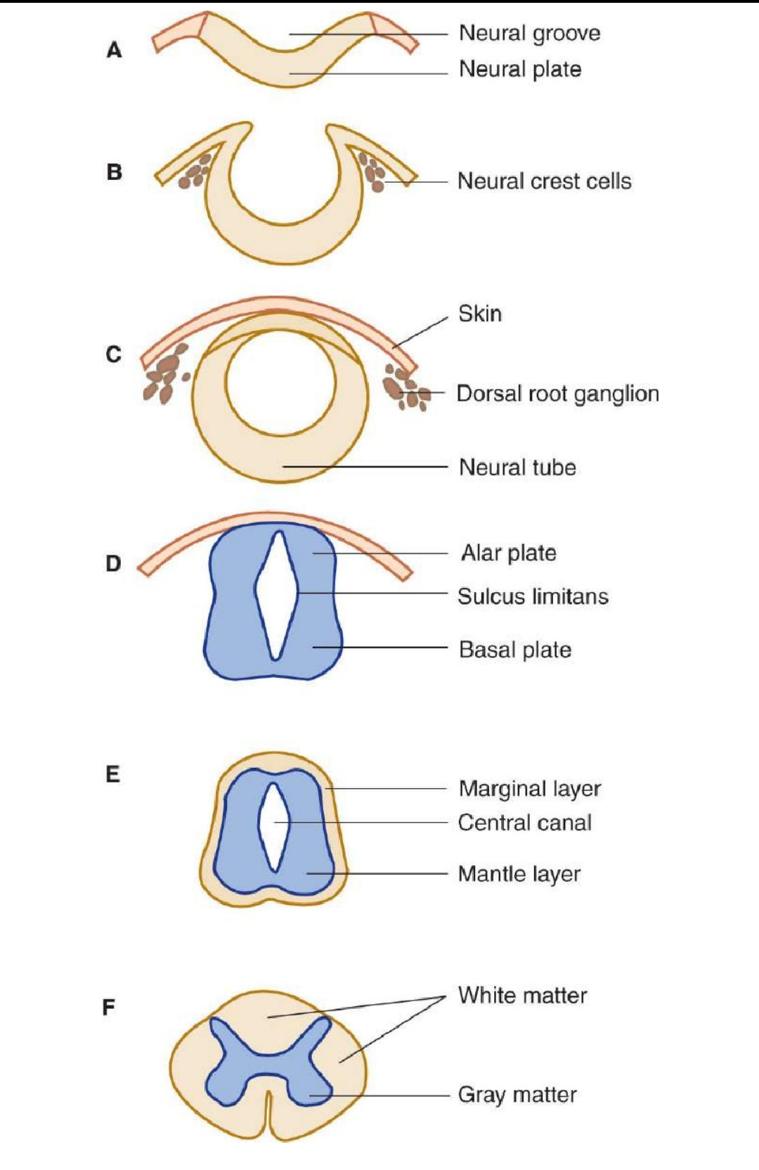

Slide 5
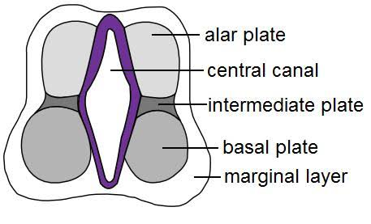

Slide 6
The cells in the wall of the neural tube divide and differentiate, forming an ependymal layer
encircles the central canal and is surrounded by intermediate (mantle) and marginal zones of primitiv neuronss and glial cells

Slide 7
The mantle zone differentiates into an alar plate, which containss mostly sensory neurons, and a basal plate, which is primarily composed of motor neurons.
These two regions are demarcated by the sulcus limitans, a groove on the wall of the central canal

Slide 8
The alar plate differentiates into a dorsal gray column
The basal plate becomes the ventral gray column
The processes of the mantle zone and other cells are contained in the marginal zone, which becomes the white matter of the spinal cord

Slide 9
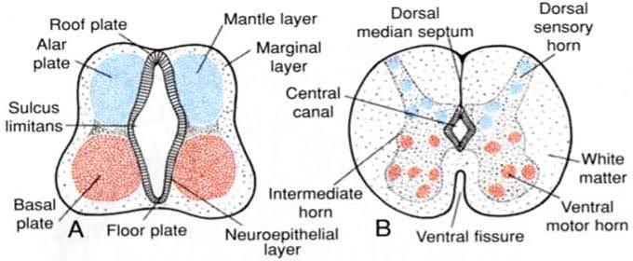

Slide 10
An investing layer of ectodermal cells around the primitive cord forms the two inner meninges: th arachnoid and pia mater (pia)
The thicker outer investment, the dura mater (dura), is
formed from mesenchyma.

Slide 11
The central canal is lined with ependymal cells and filled with cerebrospinal fluid.
It opens upward into the inferior portion of the fourth ventricle.

Slide 12
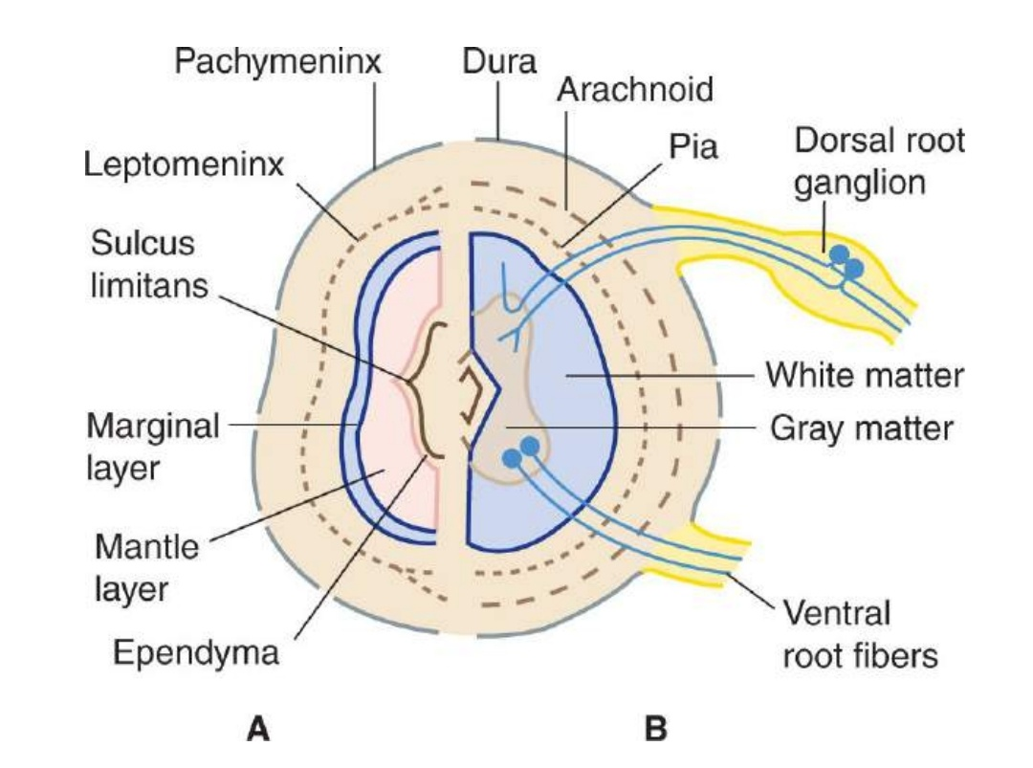

Slide 13
EXTERNAL ANATOMY OF THE SPINAL CORD
The spinal cord occupies the upper two-thirds of the adult spinal canal within the vertebral column
The cord is normally 42 to 45 cm long in adults and is continuous with the medulla at its upper end.

Slide 14
The conus medullaris is the conical distal (inferior) end of the spinal cord.
In adults, the conus ends at L1 or L2 level of the vertebral column.
The filum terminale, consisting of pia and glial fibers extend from the tip of the conus and attaches to the distal dural sac

Slide 15
ENLARGEMENTS
spinal cord widens laterally in the cervical enlargement and the lumbosacral enlargement
The latter tapers off to form the conus medullaris.

Slide 16
The enlargements of the cord contain increased numbers of lower motor neurons (LMNs) and provide the origins of the nerves of the upper and lowe extremities.
The nerves of the brachial plexus originate at the cervical enlargement; the nerves of lumbosacral plexus arise from the lumbar enlargement.

Slide 17
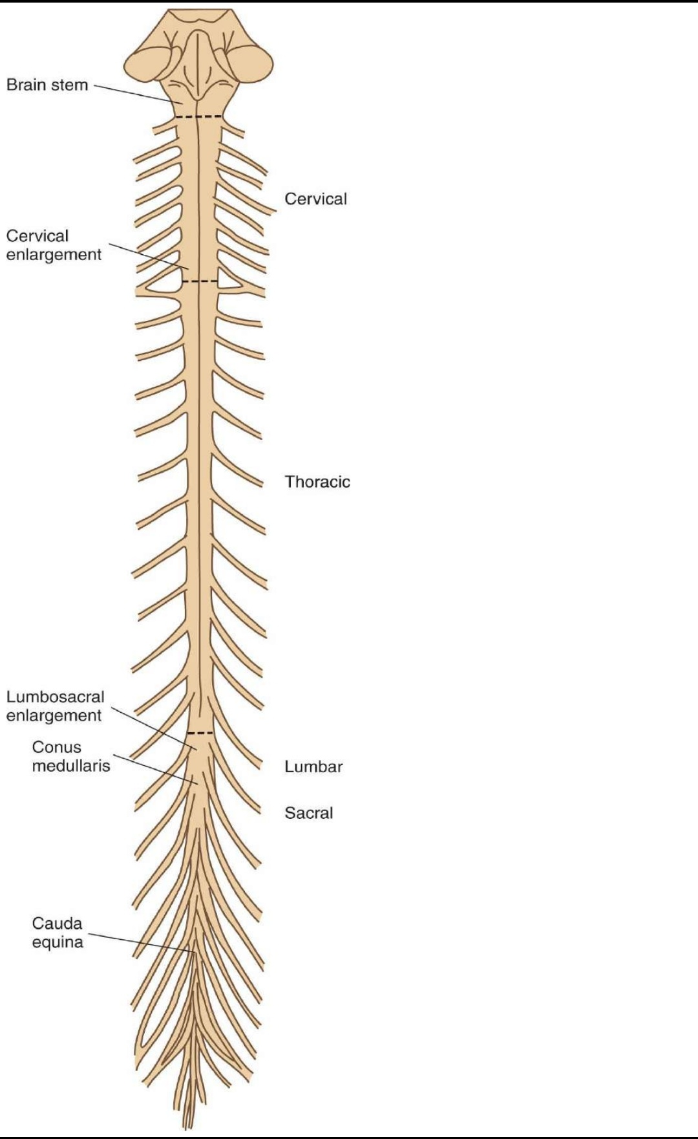

Slide 18
SEGMENTS
The spinal cord consists of approximately 30 segments
8 cervical (C) 12 thoracic (T) 5 lumbar (L) 5 sacral (S) few small coccygeal (Co) segments—that correspond to attachments of groups of nerve roots.

Slide 19
There are no sharp boundaries between segments within the cord itself.

Slide 20
Because the spinal cord is shorter than the vertebral column, each spinal cord segment at lower level is located above the similarly numbered vertebral body.

Slide 21
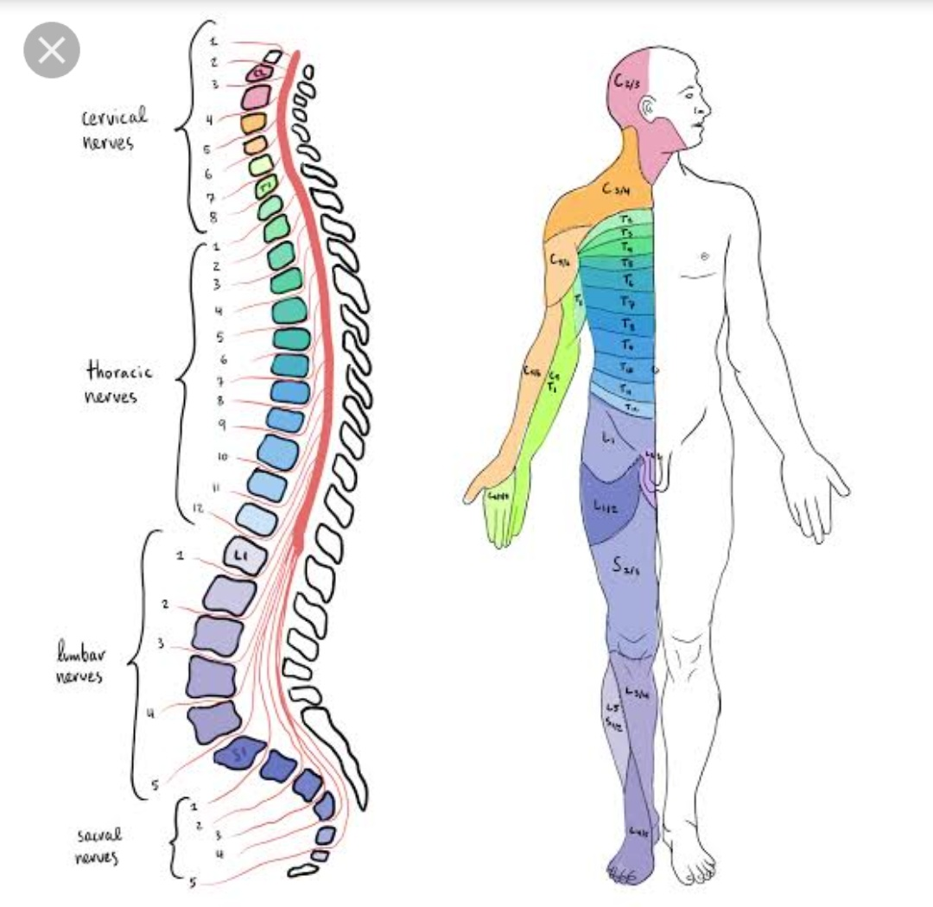

Slide 22
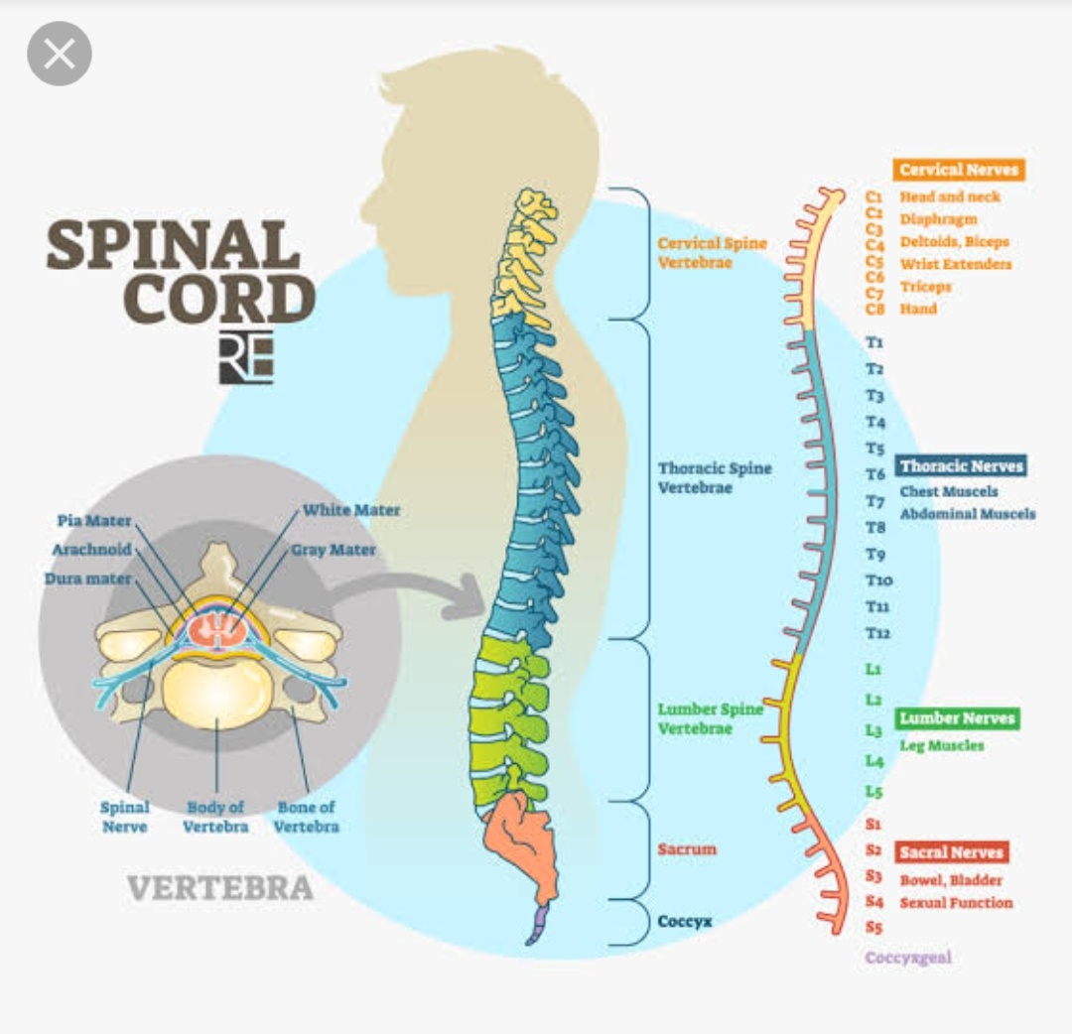

Slide 23
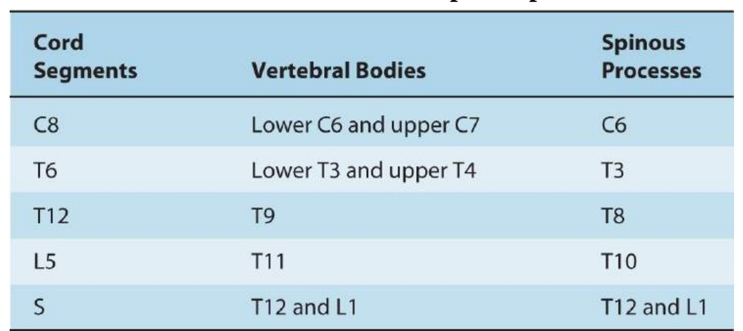
Anatomic Relationships of Spinal Cord and Bony Spine in Adults

Slide 24
LONGITUDINAL DIVISIONS
A cross section of the spinal cord shows a deep anterior median fissure and a shallow posterior (or dorsal) median sulcus
They divide the cord into symmetric right and left halves joined in the centra midportion

Slide 25
The anterior median fissure contains a fold of pia and blood vessels
its floor is th anterior (or ventral) white commissure

Slide 26
dorsal nerve roots are attached to the spinal cord along a shallow vertical groove, the posterolateral sulcus, which lies at a short distance anterior to the posterio mediann sulcus.
The ventral nerve roots exit in the anterolateral sulcus

Slide 27
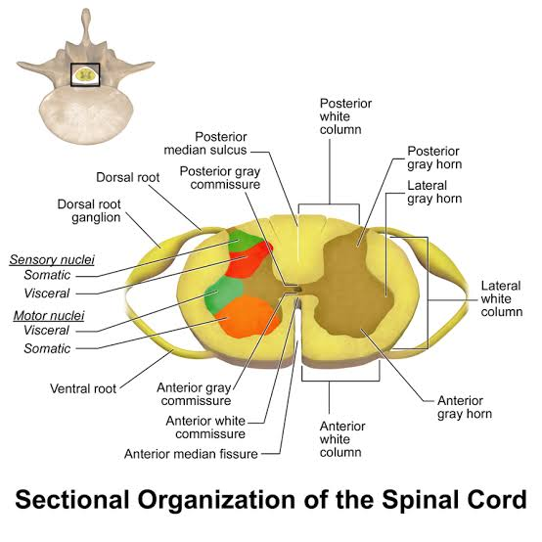

Slide 28
SPINAL ROOTS AND NERVES
Each segment gives rise to four roots: a ventral and a dorsal root on either side .
The first cervical segment usually lacks dorsal roots

Slide 29
Each of the 31 pairs of spinal nerves has a ventral root and a dorsal root;
each root is made up of 1 to 8 rootlets
Each root consists of bundles of nerve fibers

Slide 30
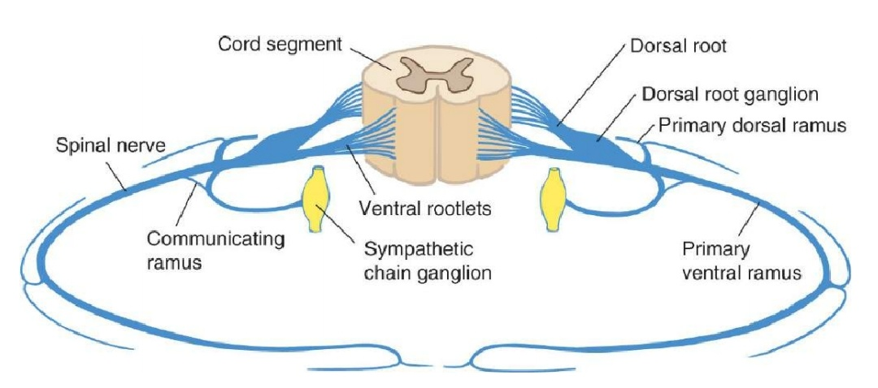

Slide 31
In the dorsal root of a typical spinal nerve, close to the junction with the ventral root, lies a dorsal root (spinal) ganglion, a swelling that contains nerve cell bodies that give rise to sensory axons.
The portion of a spinal nerve outside th vertebral column is sometimes referred to as a peripheral nerve.

Slide 32
The vertebral column surrounds and protects the spinal cord and normally consists of 7 cervical, 1 thoracic, and 5 lumbar vertebrae as well as the sacrum, which is usually formed by fusion of 5 vertebrae,and the coccyx.
The nerve roots exit from the vertebral column through intervertebral foramina

Slide 33
In the cervical spine, the numbered roots exit the vertebral column above the corresponding vertebral body.
The C8 root exits between vertebral bodies C7 and T1.
In the lower parts of the spine, the numbered roots exi below the correspondingly numbered vertebral body.

Slide 34
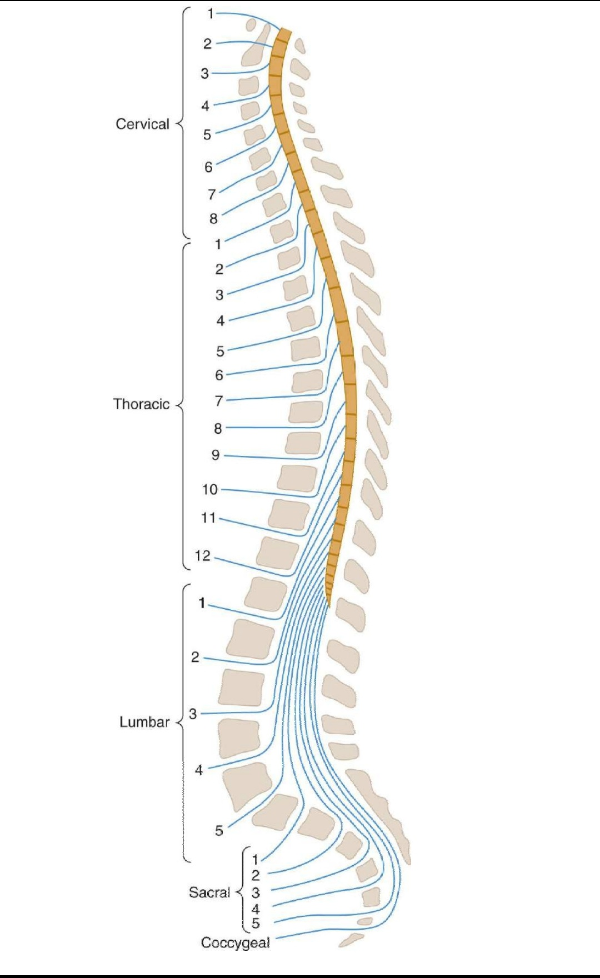

Slide 35
VENTRAL ROOT
ventral (or anterior) roots constitute motor outflow tracts from the spinal cord.
carry the large-diameter alpha motor neuron axons to the extrafusal striated muscle fibers
Smaller gamma motor neuron axons, which supply the intrafusal muscle of the muscle spindles

Slide 36
preganglionic autonomic fibers at the thoracic, upper lumbar, and midsacral levels
a few afferent, small-diameter axons that arise from cells in the dorsal root ganglia and convey sensor information from the thoracic and abdominal viscera.

Slide 37
DORSAL ROOT
dorsal (posterior) roots are largely sensory.
Each dorsal nerve root (except usually C1) contain afferent fibers from the nerve cells in its ganglion.
The dorsal roots contain fibers from cutaneous and deep structures

Slide 38
The largest fibers (Ia) come from muscle spindles and participates in spinal cord reflexes
the medium-sized fibers (A-beta) convey impulses from mechanoreceptors in skin and joint.

Slide 39
Most axons in the dorsal nerve roots are small (C, nonmyelinated; A-delta, myelinated)
carry information of noxious (eg, pain) and thermal stimuli.

Slide 40
Branches of a typical spinal nerve
Posterior primary division
Anterior primary division
Rami communicantes
Meningeal or recurrent meningeal branches

Slide 41
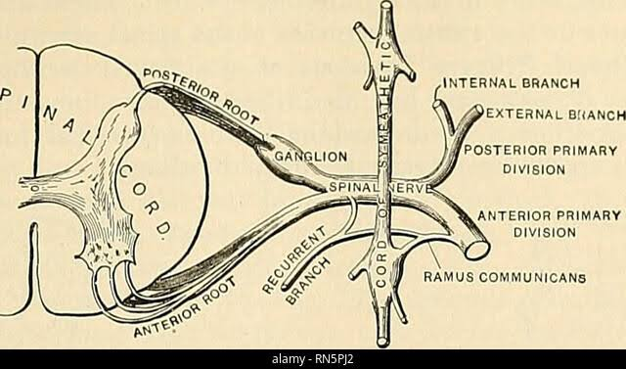

Slide 42
INTERNAL DIVISIONS OF SPINAL CORD
H-shaped internal mass of gray matter surrounded by whit matter.
made up of two symmetric portions joined across the midline by a transverse connection (commissure) of gray matter that contains the minute central canal or its remnants.

Slide 43
This gray matter extends the entire length of the spinal cord, and is considered to consist of columns.

Slide 44
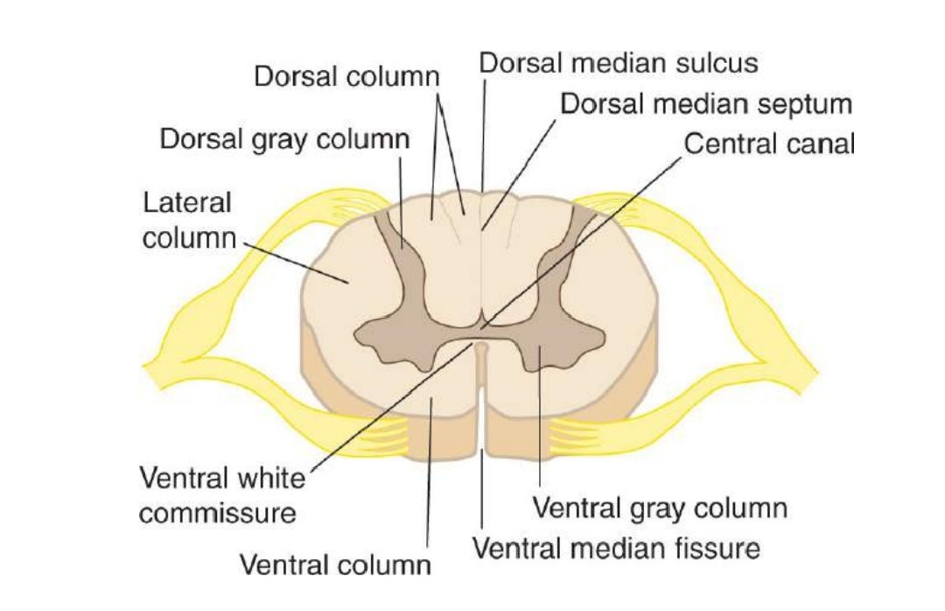

Slide 45
Ventral (or anterior) gray column (also called the ventral, or anterior, horn) is in front of the central canal.
It contains the cells of origin of the fibers of the ventral roots, including alpha and gamma motor neurons (“lower” motor neurons)

Slide 46
The intermediolateral gray column (or horn) lies between the dorsal and ventral gray columns
prominent lateral triangular projection in the thoracic and upper lumbar regions but not in the midsacral region

Slide 47
It contains preganglionic cells for the autonomic nervous system.
Within spinal segments T1 toL2, preganglionic sympathetic neurons within the intermediolateral gray column give rise to sympathetic axons that leave the spinal cord within the ventral roots and then travel to the sympathetic ganglia via the white rami communicantes

Slide 48
Within spinal segments S2, S3, and S4, there are sacralparasympathetic neurons within the intermediolateral gray column.
These neurons give rise to preganglionic parasympathetic axon that leave the spinal cord within the sacral ventral roots.

Slide 49
The dorsal gray column (also called the posterior,or dorsal, horn) reaches almost to the posterolateral (dorsolateral) sulcus.
A compact bundle of small fibers, the dorsolateral fasciculus(Lissauer’s tract), part of the pain pathway, lies on the periphery of the spinal cord.

Slide 50
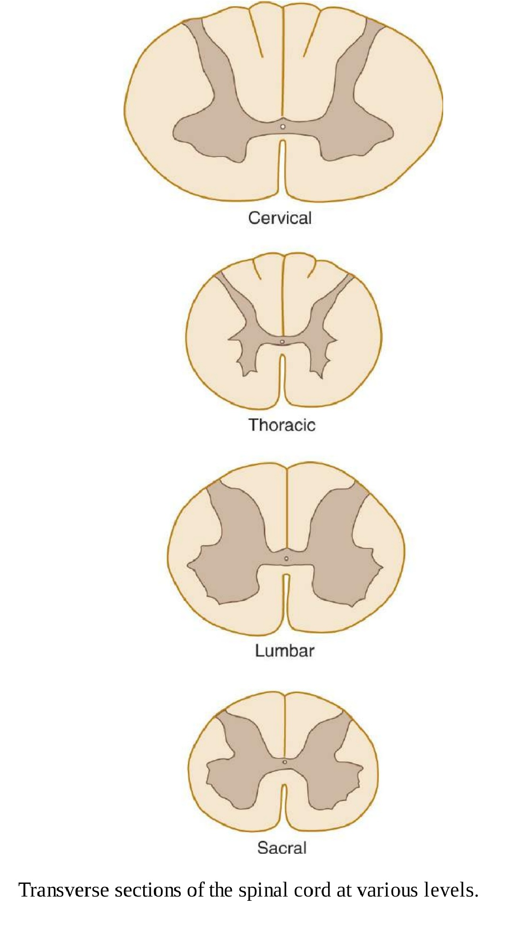

Slide 51
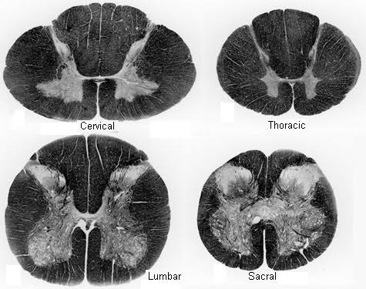

Slide 52
REXEDS LAMINAE
Layer of nerve cells
Superficial – painful stimuli
Deep – painful and non painful stimuli

Slide 53
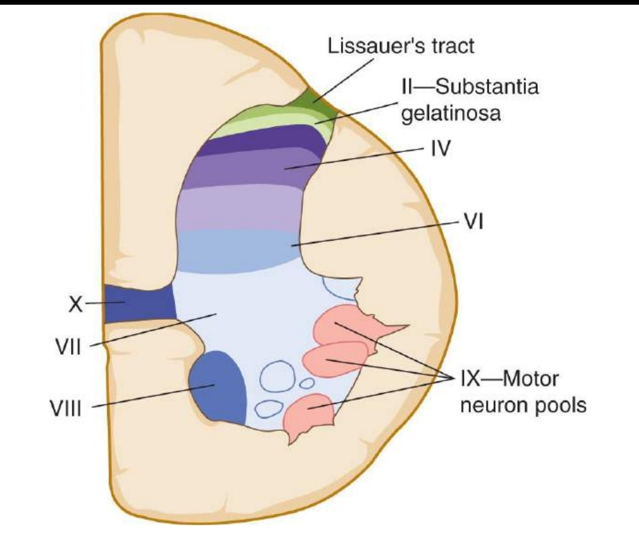

Slide 54
Lamina I
This thin layer contains neurons that respond to noxious stimuli and send axons to
the contralateral spinothalamic tract.

Slide 55
Lamina II
substantia gelatinosa
made up of small neurons, some of which respond to noxious stimuli.
Rich in Substance P

Slide 56
Laminas III and IV
nucleus proprius.
Their main input is from fibers that convey position and light touch sense.

Slide 57
Lamina V
This layer contains cells that respond to both noxious and visceral afferent stimuli

Slide 58
Lamina VI
This deepest layer of the dorsal horn contains neurons that respond to mechanical signals
from joints and skin.

Slide 59
Lamina VII
This is a large zone
contains the cells of the dorsal nucleus (Clarke’s column) medially as well as a large portion of the ventral gray column.
Clarke’s column contains cells that give rise to the posterior spinocerebellar tract.

Slide 60
Intermediolateral nucleus or cell column in thoracic and upper lumbar regions.
Preganglionic sympathetic fibers project from cells in this nucleus, via the ventral roots and white rami communicantes, to sympathetic ganglia

Slide 61
Laminas VIII and IX
represent motor neuron groups in the medial and lateral portionsof the ventral gray column.
The medial portion (also termed the medial motor neuron column) contains the LMNs that innervate axial musculature (ie, muscles of the trunk and proximal parts of the limbs)

Slide 62
lateral motor neuron column contains LMNs for the distal muscles of the arm and leg.
In general, flexormuscles are innervated by motor neurons located close to the central canal, whereas extensor muscles are innervated by motor neurons located more peripherally

Slide 63
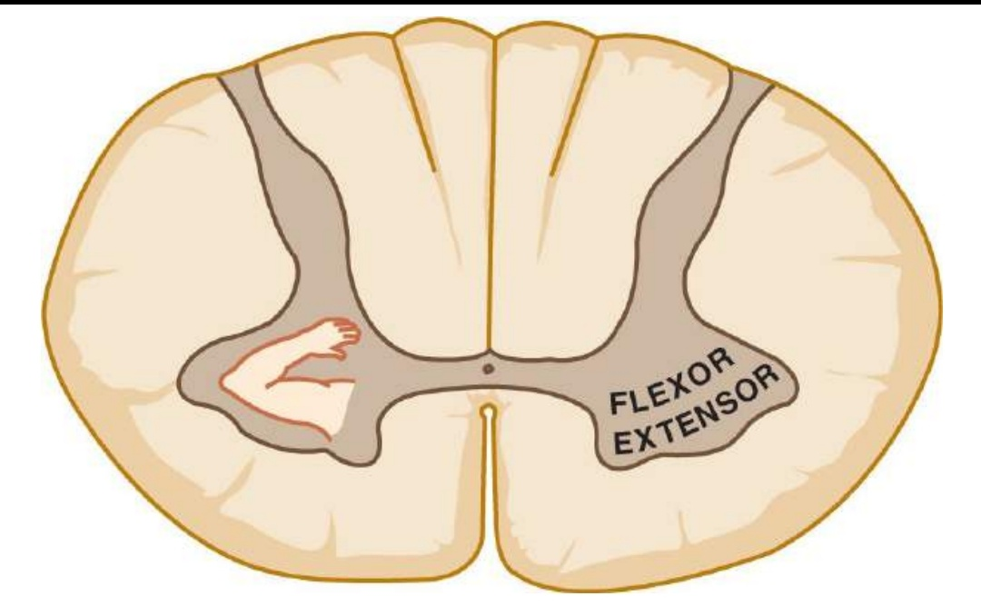

Slide 64
Lamina X
This represents the small neurons around the central canal or its remnants

Slide 65
White matter
Columns and tracts

Slide 66
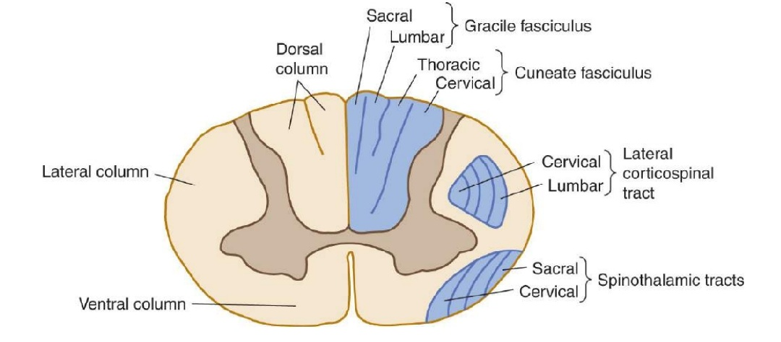

Slide 67
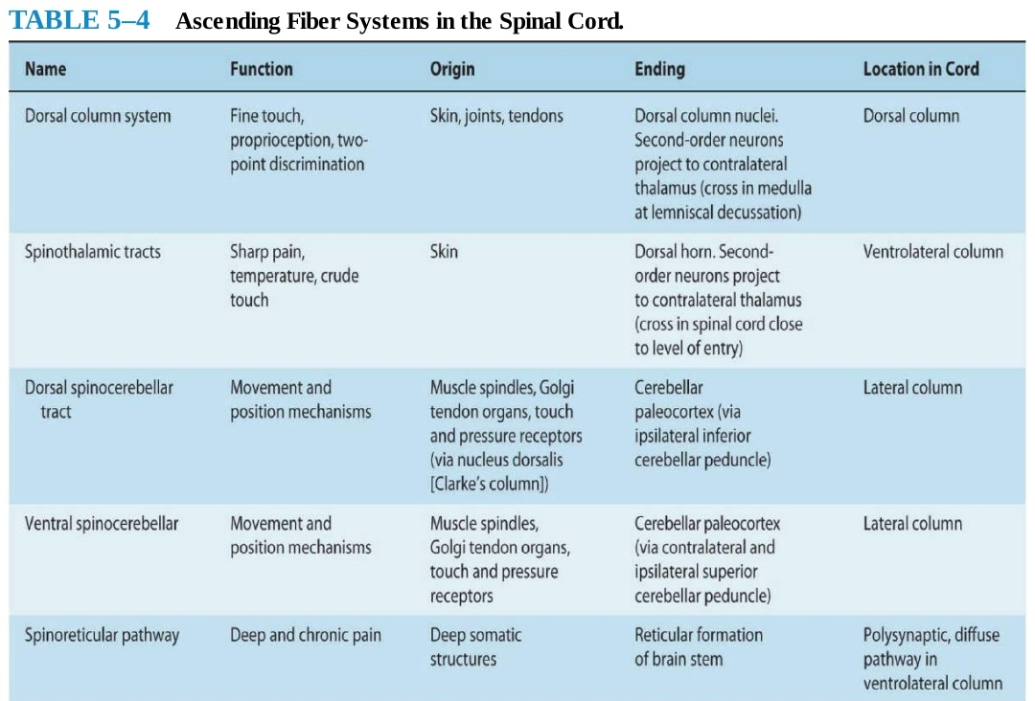
Ascending fibres

Slide 68
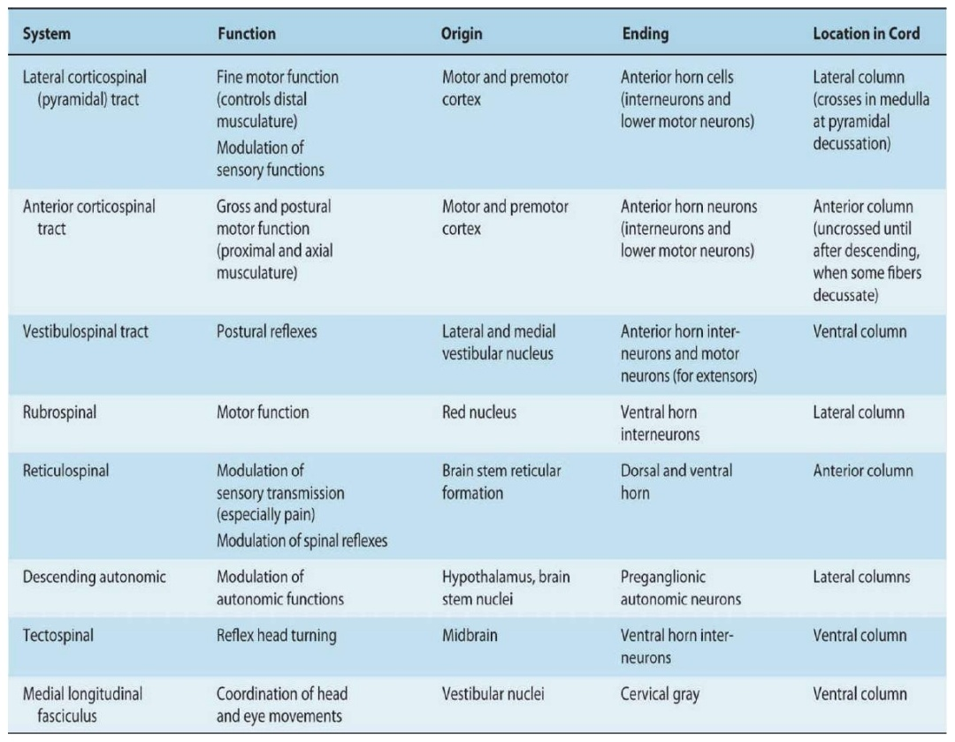

Slide 69
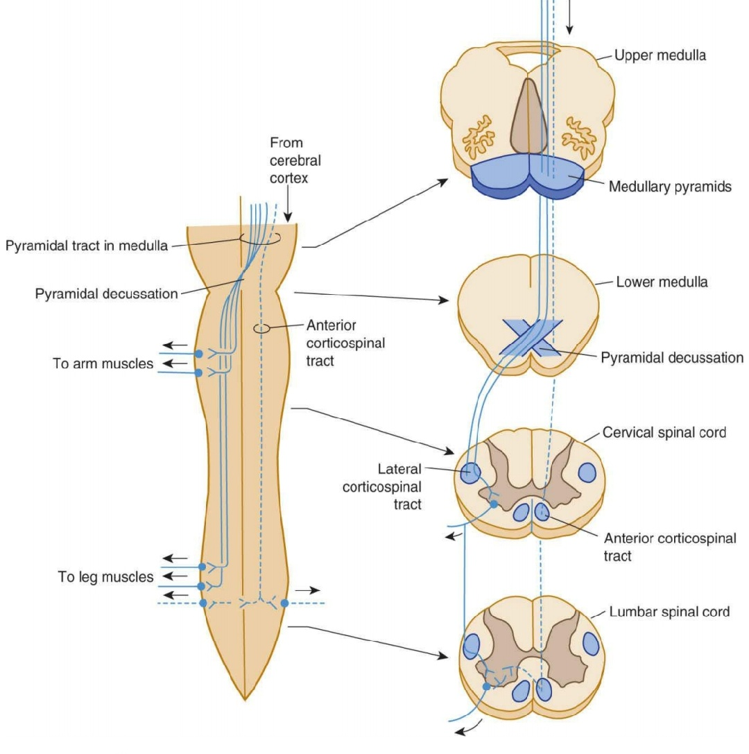

Slide 70
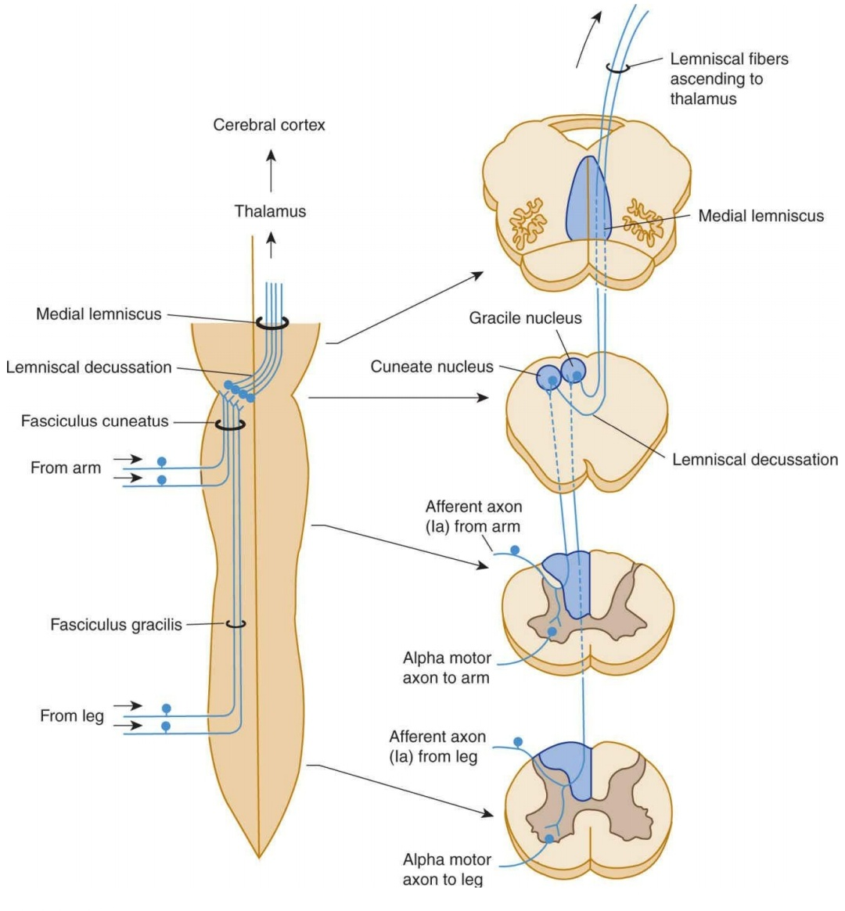

Slide 71
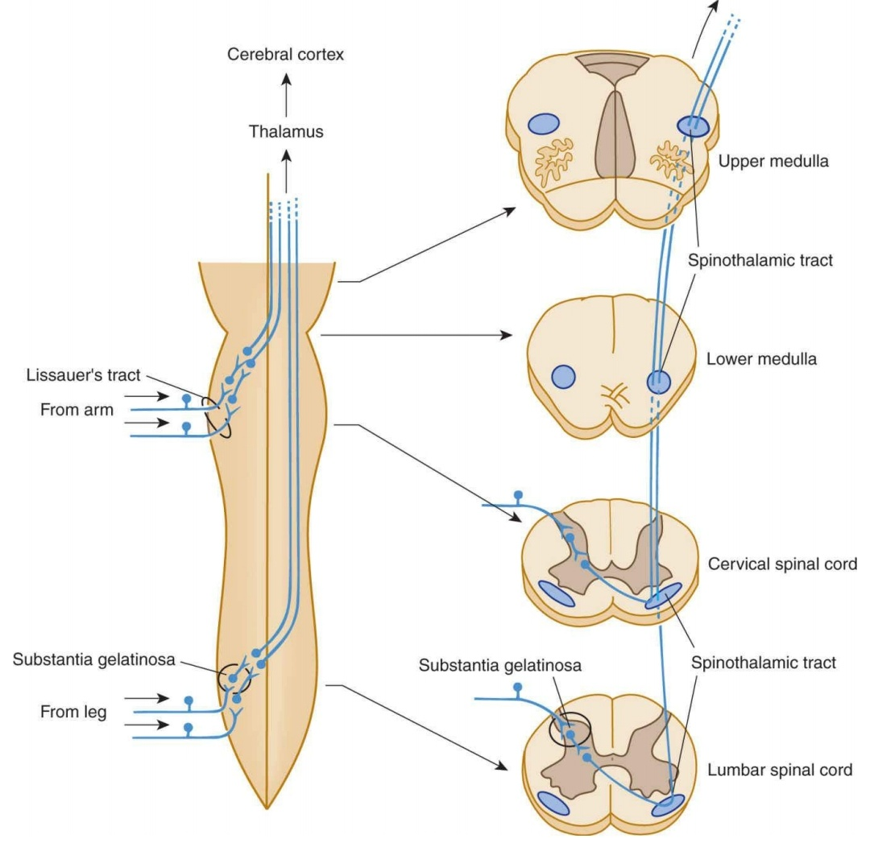

Slide 72
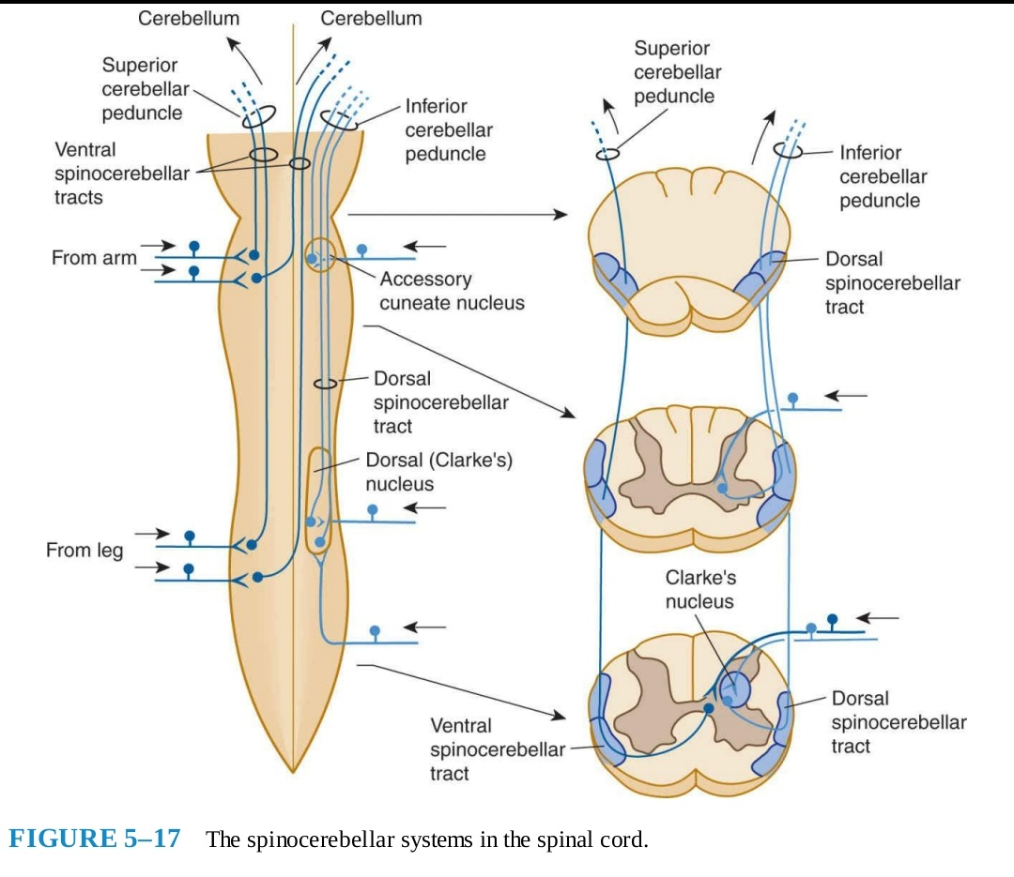

Slide 73
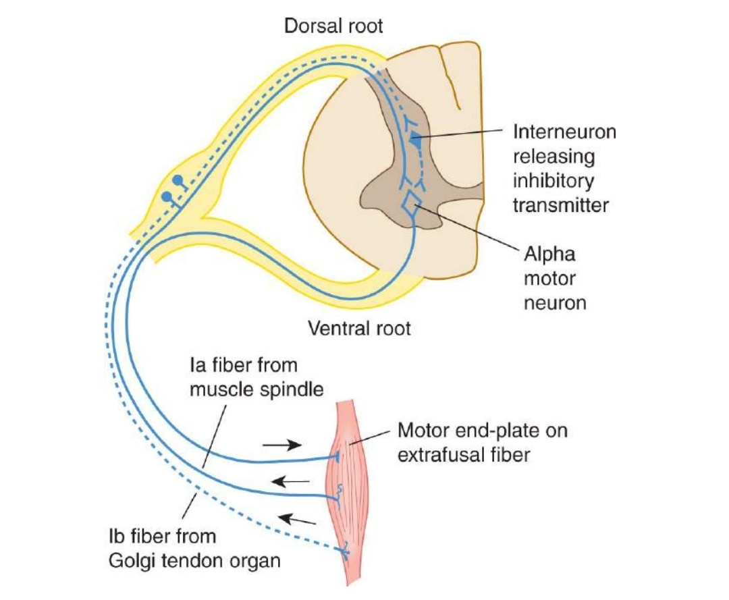

Slide 74
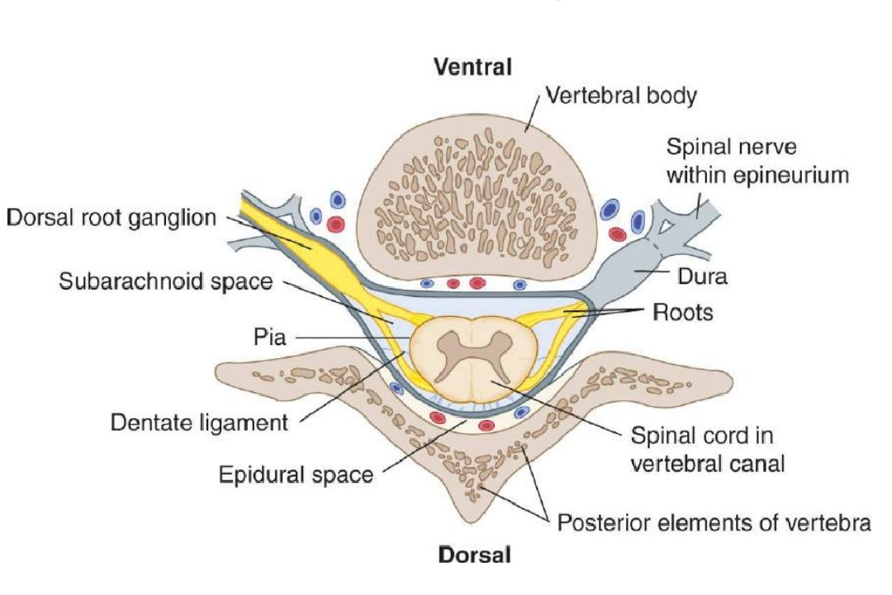

Slide 75
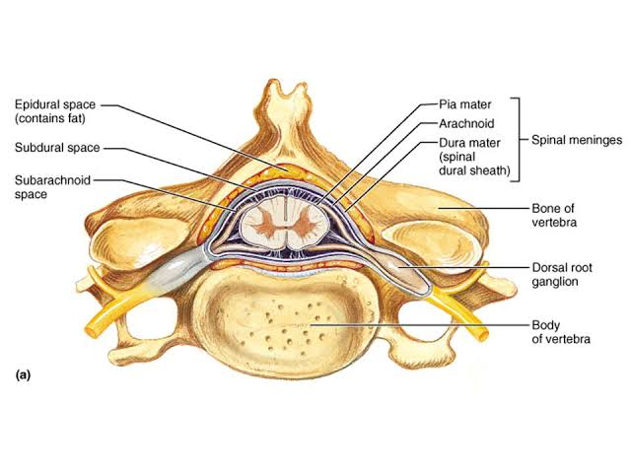

Slide 76
Investing membranes
Three
Dura – pachymeninix
Arachnoid and pia – leptomeninges

Slide 77
Duramater
Tough fibrous sheath
Extends from the foramen magnum upto the second sacral vertebrae
Ends as a blind sac
The epidural space separates it from the vertebral column

Slide 78
Arachnoid
Thin
Transparent sheath

Slide 79
Piamater
closely surrounds the spinal cord and sends septa into its substance
contributes to the formation of the filum terminale internum and externum

Slide 80
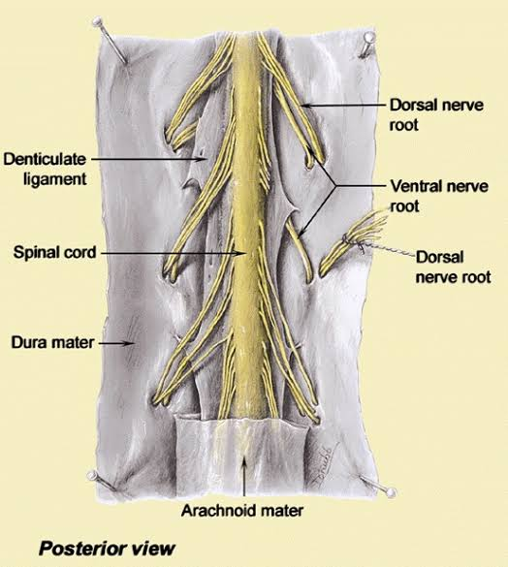

Slide 81
Filum terminal internum
a whitish fibrous filament that extends from the conus medullaris to the tip of the dural sac.
Filum is surrounded by cauda equina
Bathed in CSF

Slide 82
Filum terminal externum
extradural continuation of filum
attaches at the tip of the duralsac and extends to the coccyx.
The filum terminale stabilizes the cord and dura lengthwise

Slide 83
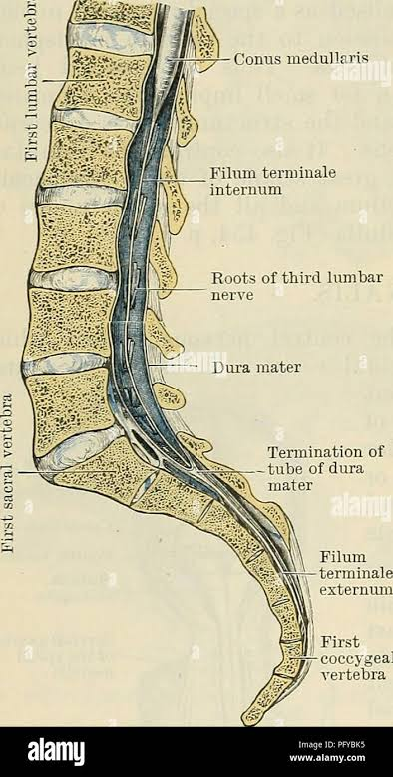

Slide 84
Dentate ligament
a long flange of whitish, mostly pial tissue that runs along both lateral margins of the spinal cord between the dorsal and ventral rootlets
Its medial edge is continuous with the pia at the side of the spinal cord

Slide 85
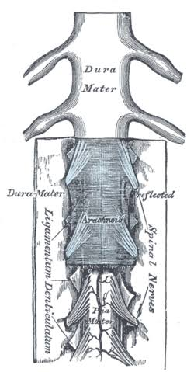

Slide 86
its lateral edge pierces the arachnoid at intervals (21 on eachside) to attach to the inside of the dura.
The dentate ligament helps to stabilize the cord from side to side

Slide 87
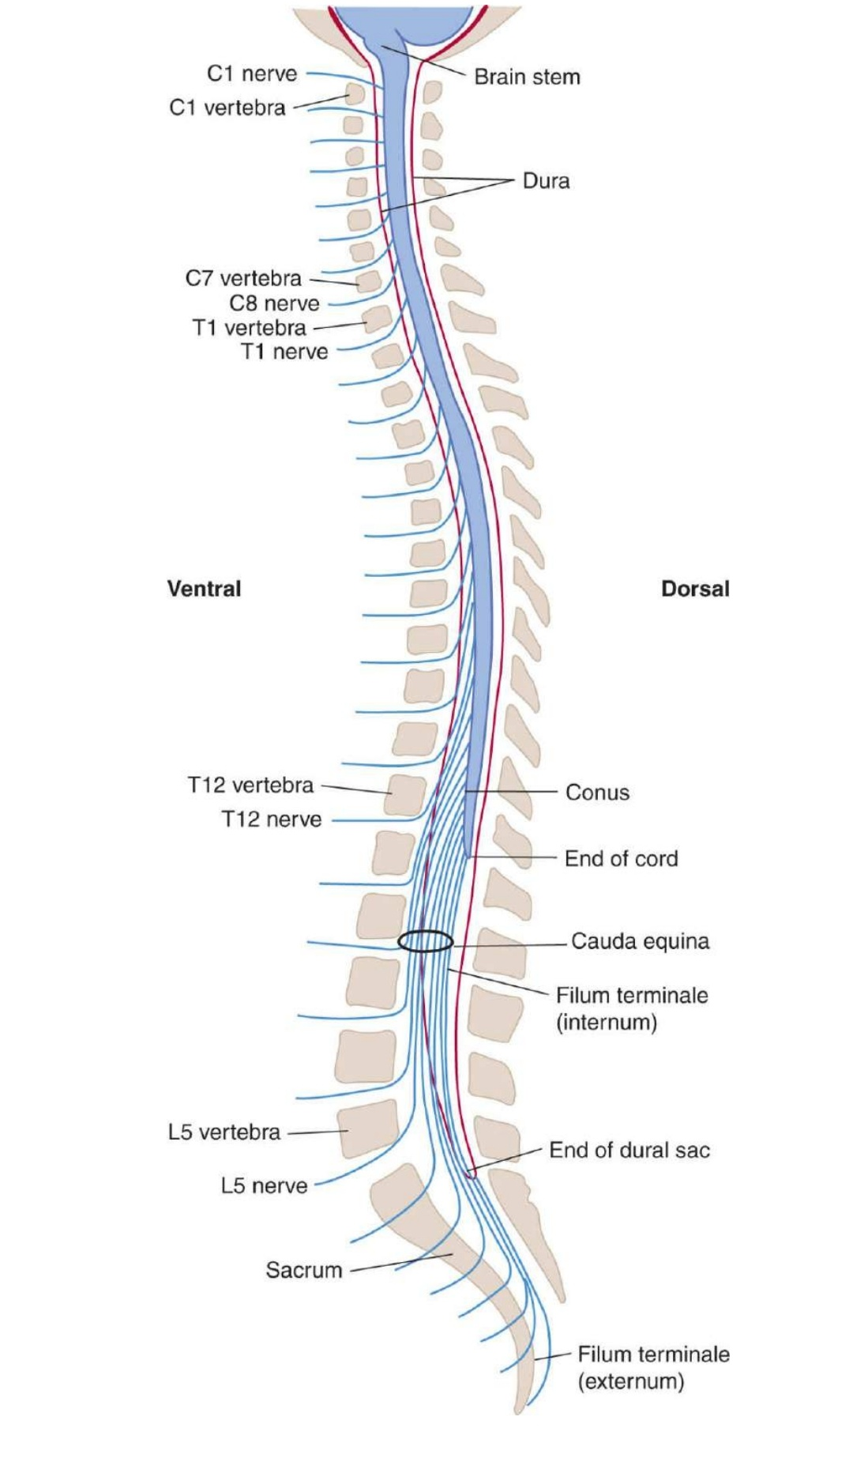

Slide 88
Blood supply
Anterior Spinal Artery
This artery is formed by the midline union of paired branches of the vertebral arteries
It descends along the ventral surface of the cervical spinal cord, narrowing somewhat near T4.

Slide 89
Anterior Medial Spinal Artery
This artery is the prolongation of the anterior spinal artery below T4

Slide 90
Posterolateral Spinal Arteries
These arteries arise from the vertebral arteries and course downward to the lower cervical and upperthoracic segments.

Slide 91
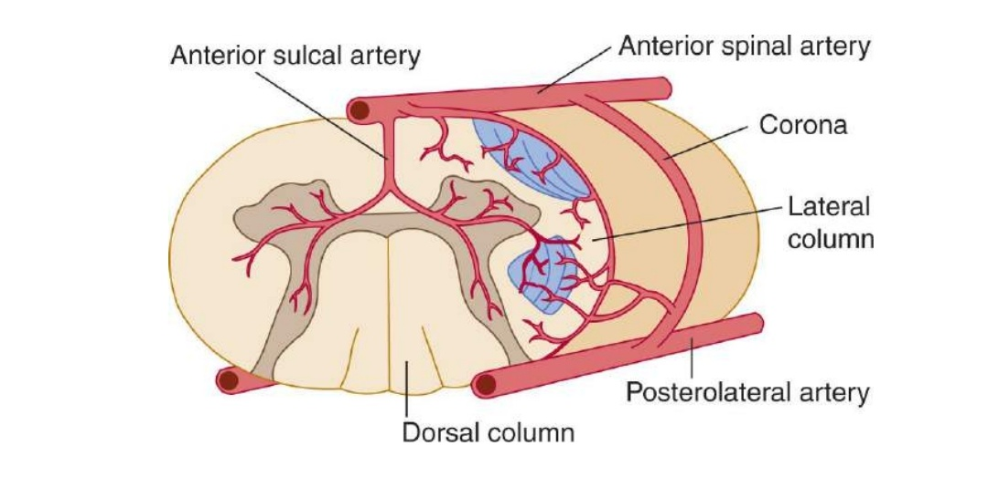

Slide 92
Radicular Arteries
Some intercostal arteries supply segmental (radicular) branches to the spinalcord from T1 to L1.
The largest of these branches, the great ventral radicular artery, also known as the artery of Adamkiewicz

Slide 93
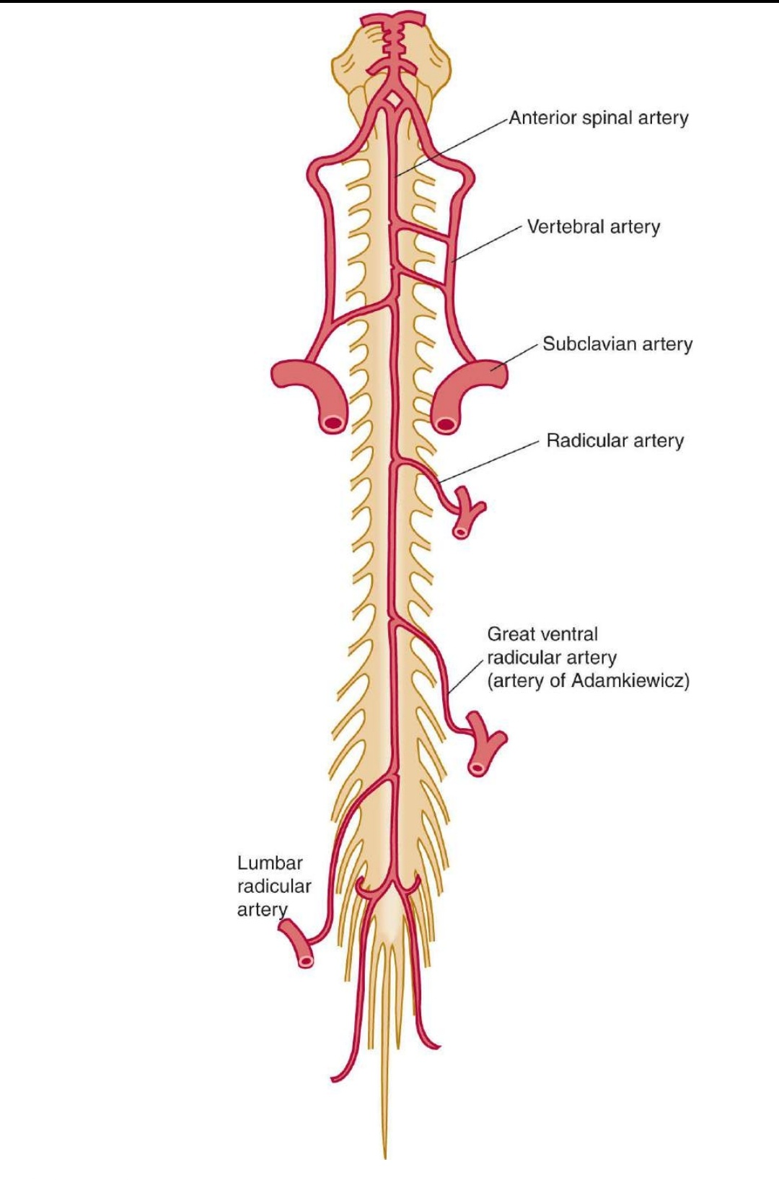

Slide 94
Artery of Adamkiewicz
enters the spinal cord between segments T8 and L4
usually arises on the left and, in most individuals, supplies most of the arterial blood supply for the lowerhalf of the spinal cord.
Although occlusion in this artery is rare, it results in major neurologic deficits (eg,paraplegia, loss of sensation in the legs, urinary incontinence)

Slide 95
Posterior Spinal Arteries
paired arteries,smaller than the single large anterior spinal artery;
branch at various levels to form the posterolateral arterial plexus.
supply the dorsal white columns and the posterior portion of the dorsal gray columns

Slide 96
Sulcal Arteries
In each segment, the branches of the radicular arteries that enter the intervertebral foramens accompanythe dorsal and ventral nerve roots.

Slide 97
These branches unite directly with the posterior and anterior spinalarteries to form an irregular ring of arteries (an arterial corona) with vertical connections.

Slide 98
Sulcal arteries branch from the coronal arteries at most levels.
Anterior sulcal arteries arise at various levels along the cervical and thoracic cord within the ventral sulcus
they supply the ventral and lateral columns on either side of the spinal cord

Slide 99
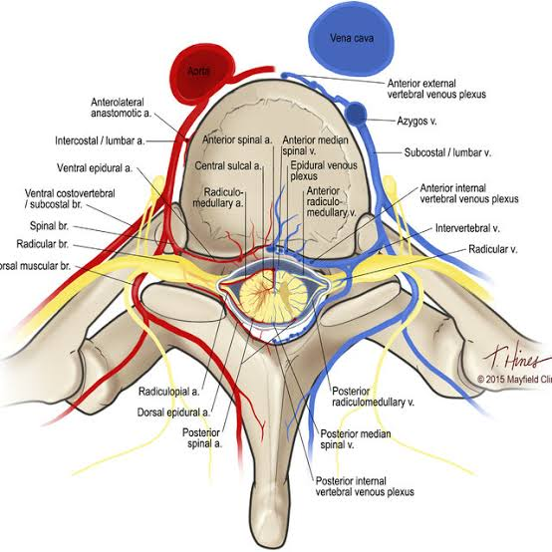

Slide 100
Veins
irregular external venous plexus
lies in the epidural space;
All drainage is ultimately into the venae cavae.

Slide 101
Communications
segmental veins,
basivertebral veins from the vertebral column
the basilar plexus in the head
By way of the pedicularveins, a smaller internal venous plexus that lies in the subarachnoid space.

Slide 102
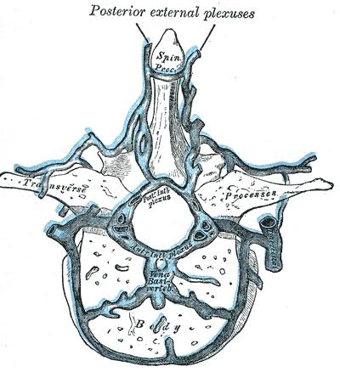

Slide 103
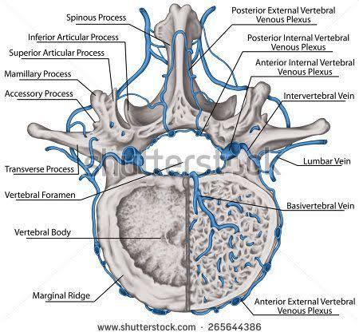

Slide 104
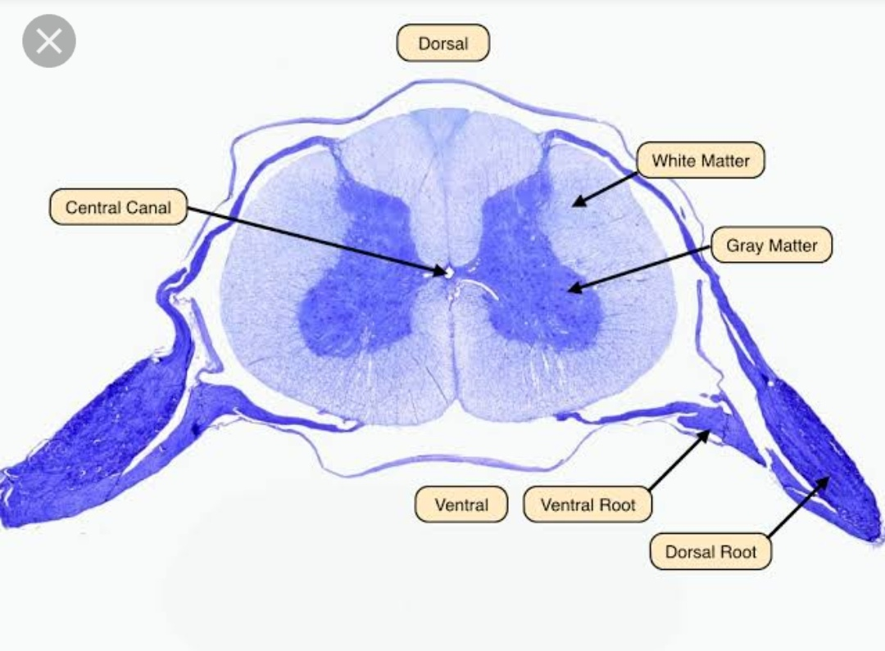
Microscopy

Slide 105
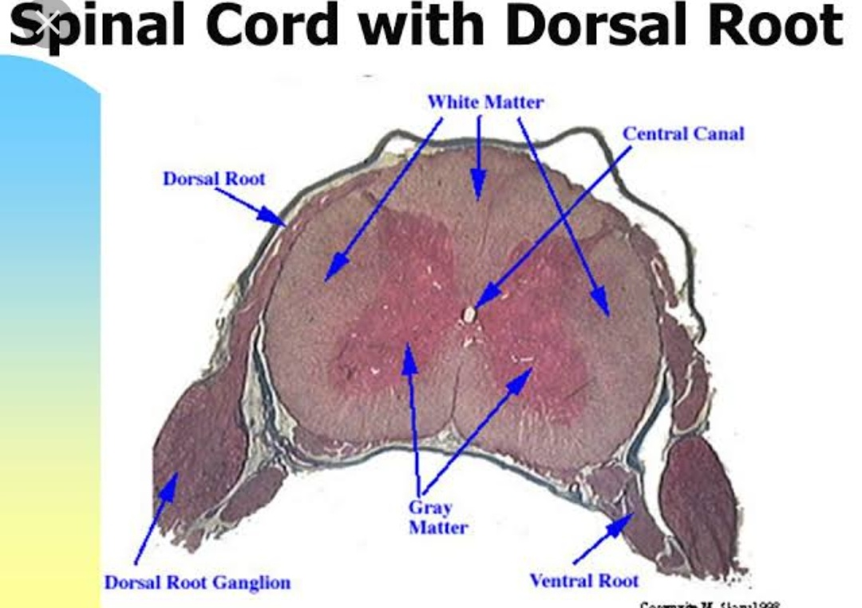

Slide 106
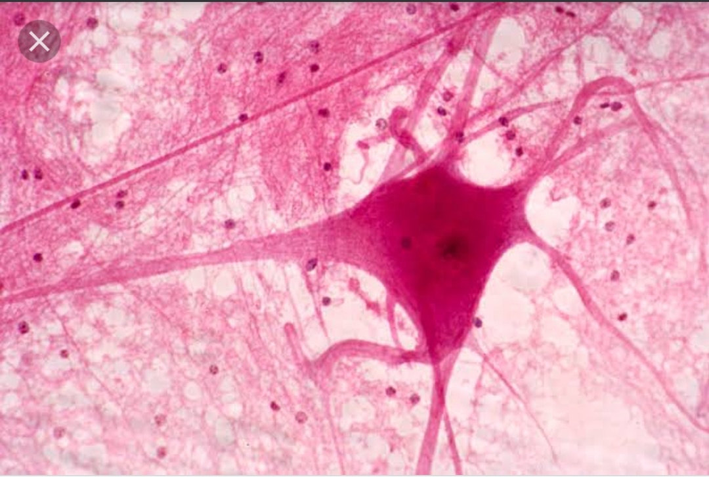

Slide 107
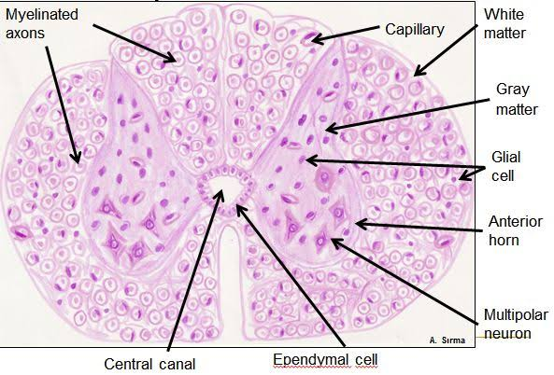

Slide 108
THANK YOU.

