Slide 1
Management of snake bite in india
Dr.Beno David
Jr3 M6 unit

Slide 2
introduction
Snakebite is an acute life threatening time limiting medical emergency.
Indian states with high incidence of snakebites cases are Tamil Nadu,kerala, West Bengal, Maharashtra.
Annual snakebite deaths were greatest in the states of Uttar Pradesh (8,700), Andhra Pradesh (5,200), and Bihar (4,500).
Although total number of bites may be more than 5-6 lakhs but only 30% are venomous bites.
Nearly 65.7% of the snakebite deaths were due to common krait bite, most of them occurring in the months of June to September

Slide 3
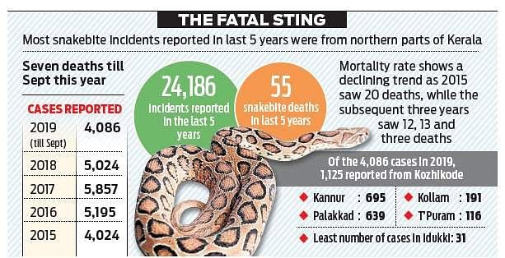

Slide 4
snakes
The three major families of venomous snakes are the
Elapidae
Viperidae
Hydrophidae

Slide 5
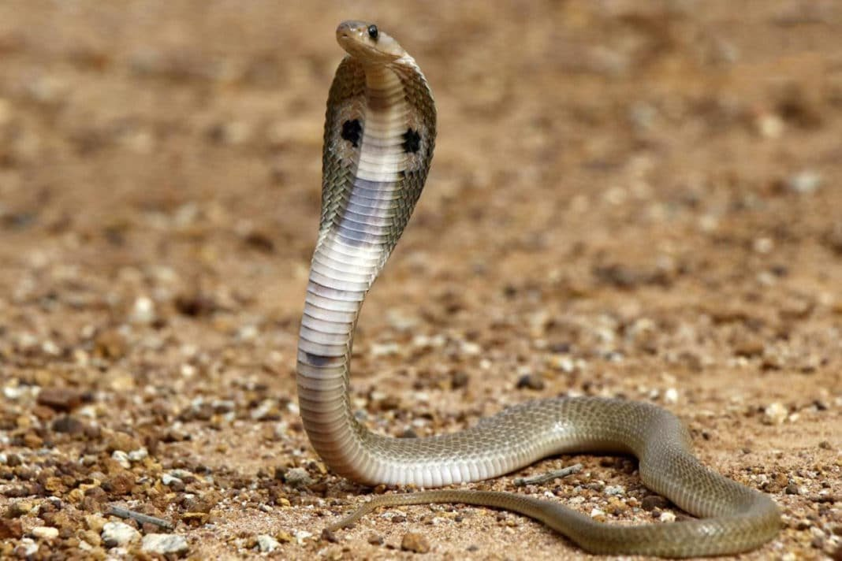
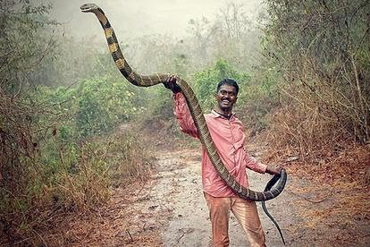
elapidae
Elapidae (cobra, king cobra, krait, and coral snake): These snakes have heads that are of about the same width as their necks. The head is covered with large scales but lack laureal shields
Cobra – Malayalam – moorkan , tamil- nallapaambu
Kingcobra Malayalam – Rajavembala , tamil – rajanagam

Slide 6
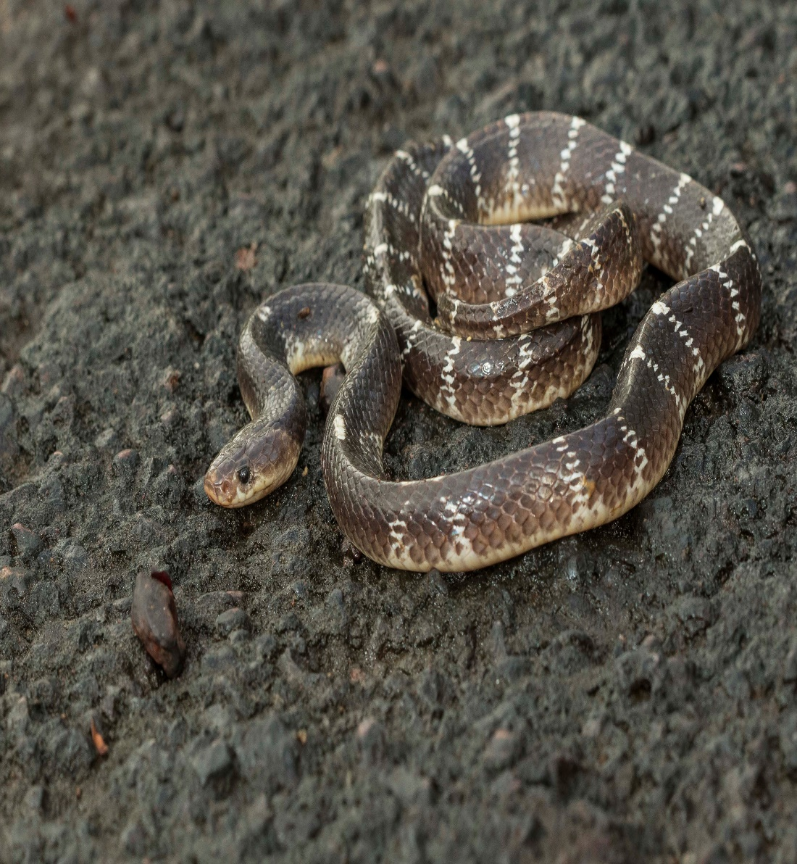
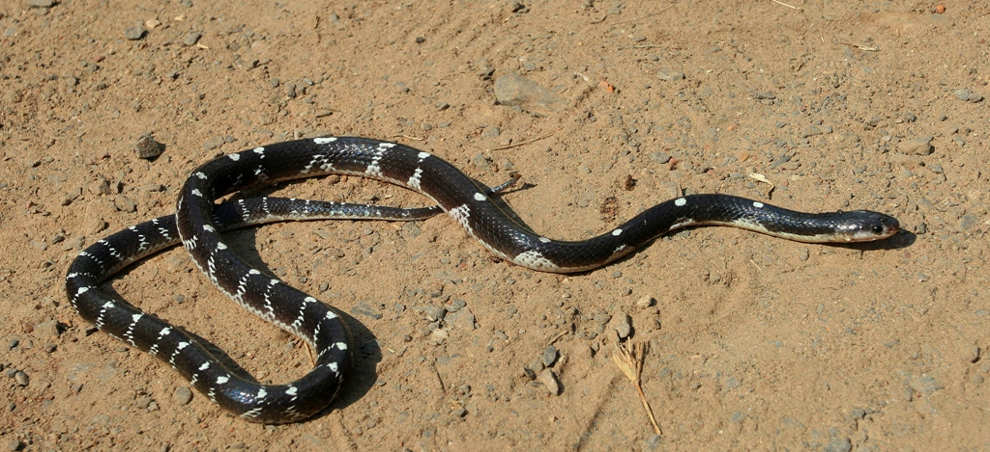
Indian krait-
Common krait
Malayalam – Vellikettan , tamil -kattuviriyan

Slide 7
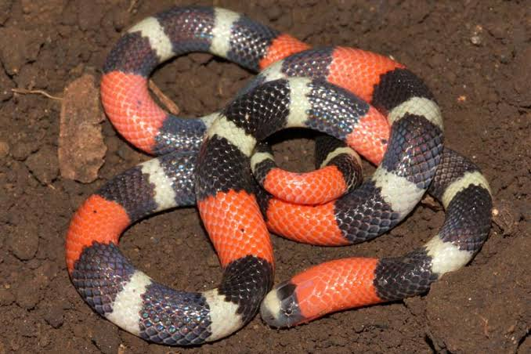
Coral snake

Slide 8
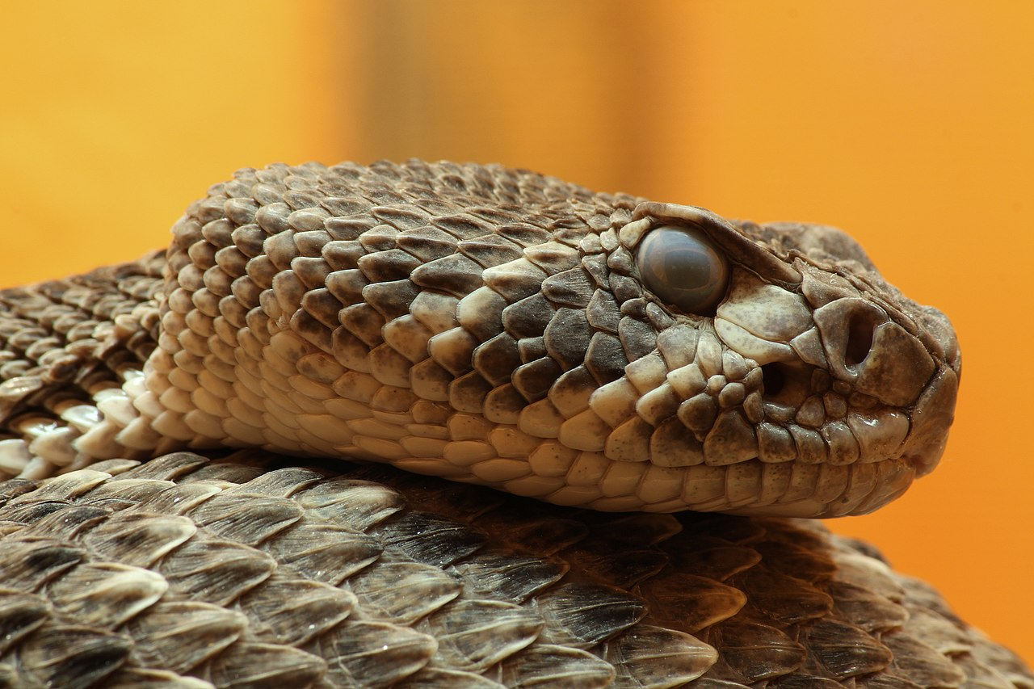
viperidae
The head of a viper is triangular, wider than the neck, and has laureal shields. They have vertically elliptical pupils and are ovi-viviparous.
The Crotalinae (pit vipers) have a special sense organ, the pit organ, to detect their warm-blooded prey. This is situated between the nostril and the eye.

Slide 9
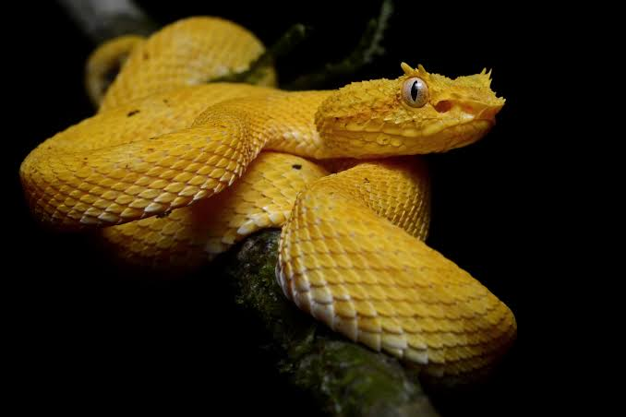
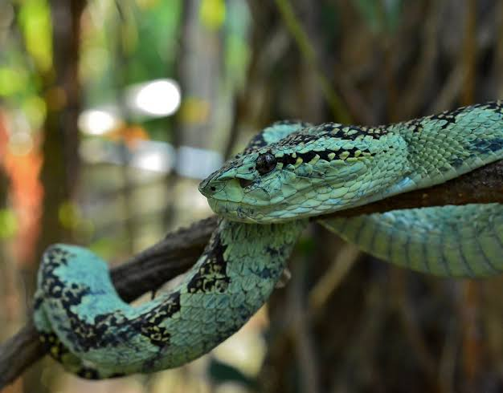
Viper Malayalam – anali , tamil viriyan

Slide 10
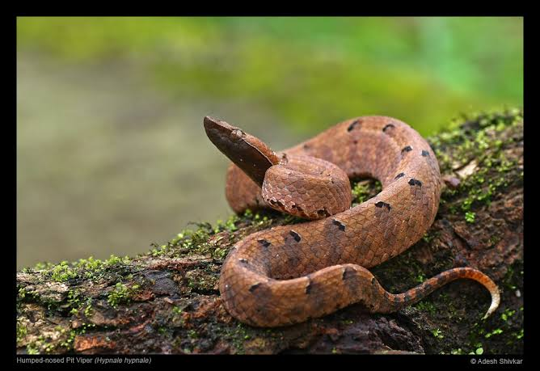
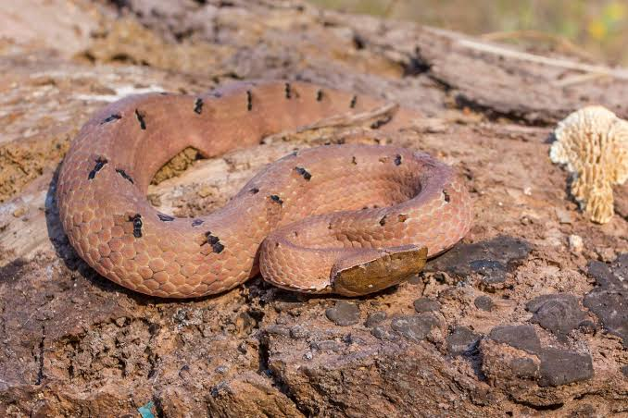

Slide 11
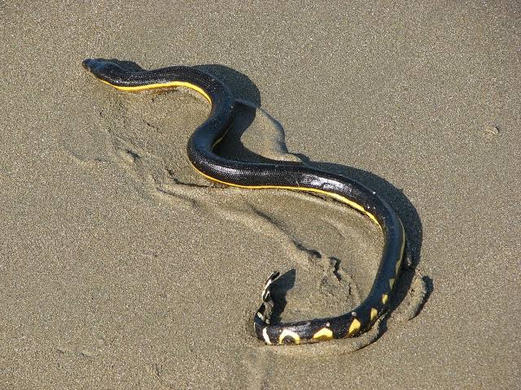
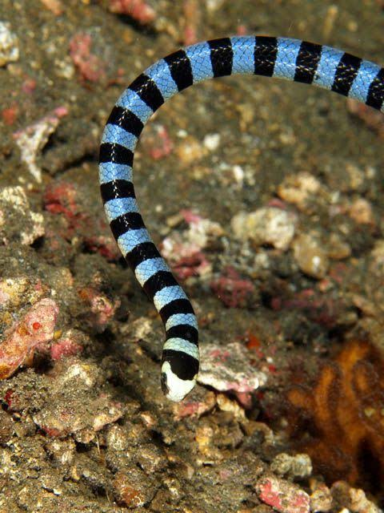
hydrophidae
Hydrophidae (sea snake): Sea snakes are found in the vicinity of the seacoast. They have a small head and a flattened tail that helps them swim. Though venomous, they seldom bite.

Slide 12
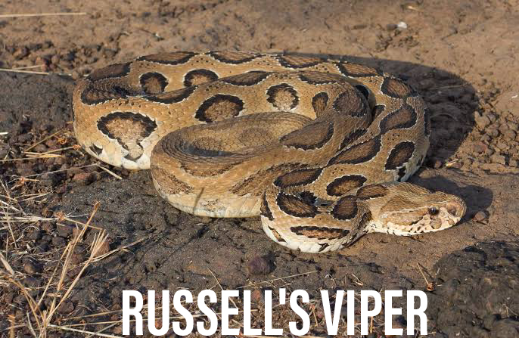
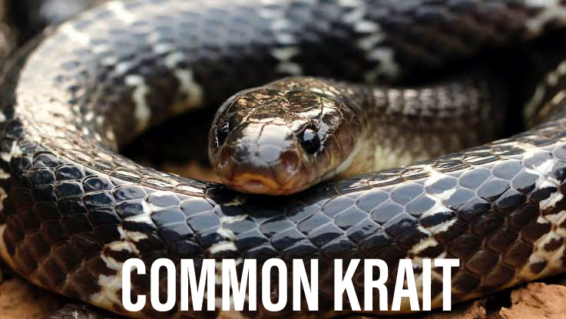
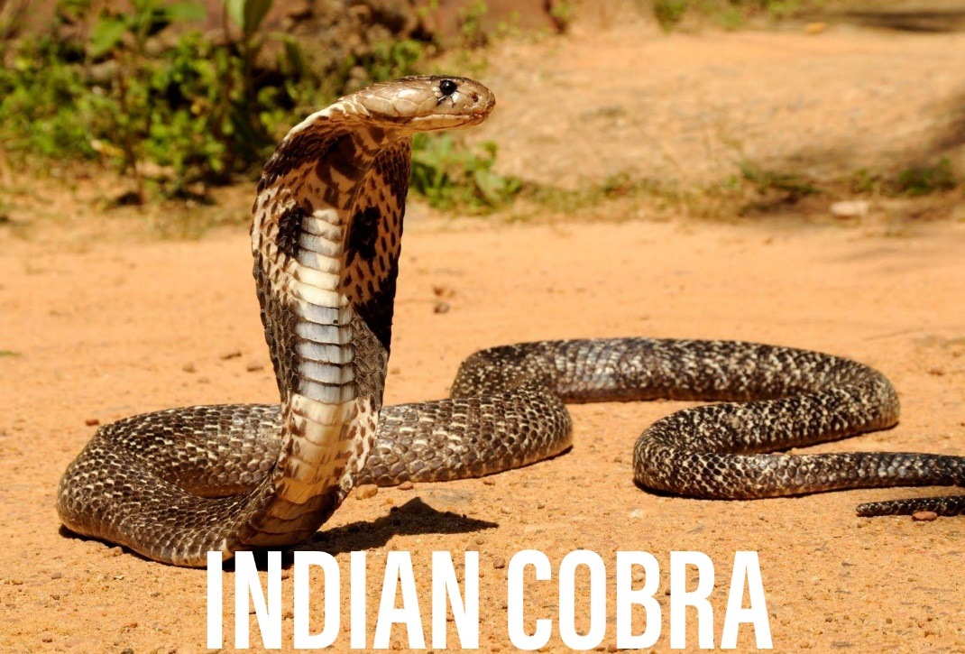
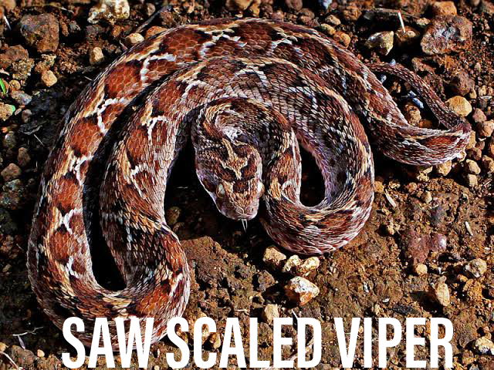
The big four

Slide 13
Stages of management -who
First aid treatment
Transport to hospital
Rapid clinical assessment and resuscitation
Investigations/laboratory tests
Clinical assessment and species diagnosis, if possible
Antivenom treatment
Observing the response to antivenom
Deciding whether further dose(s) of antivenom are needed
Supportive/ancillary treatment •
Treatment of the bitten part
Follow-up
Rehabilitation

Slide 14
AT THE COMMUNITY OR VILLAGE LEVEL
Check history of snakebite and look for obvious evidence of a bite (fang puncture marks, bleeding, swelling of the bitten part etc
However, in krait bite no local marks may be seen. can be noted by magnifying lens as a pin head bleeding spot with surrounding rash.
Reassure the patient as around 70% of all snakebites are from non-venomous species.
Immobilize the limb in the same way as a fractured limb. Use bandages or cloth to hold the splints (wooden stick), but do NOT block the blood supply or apply pressure.
Ideally the patient should lie in the recovery position (prone, on the left side) with his/her airway protected to minimize the risk of aspiration of vomitus.
Nil by mouth till victim reaches a medical health facility. .

Slide 15
Traditional remedies have NO PROVEN benefit in treating snakebite.
Shift the victim to the nearest health facility (PHC or hospital) immediately.
Arrange transport of the patient to medical care as quickly, safely
Inform the doctor of any symptoms such as progress of swelling, ptosis or new symptoms that manifest on the way to hospital.
Remove shoes, rings, watches, jewellary and tight clothing from the bitten area as they can act as a tourniquet when swelling occurs. Leave the blisters undisturbed
No time should be wasted in attempting to kill or capture the snake. This solely wastes time and can lead to other victims However, if the snake has already been killed, it should be taken with the patient to the dispensary or hospital for identification by the doctor.
However, do not handle the snake with your bare hands as even a severed head can bite!

Slide 16
Do not tie tourniquets as it may cause gangrenous limbs.
If victim is expected to reach the hospital in more than 30 minutes but less than 3 hours crepe bandage may be applied by qualified medical personnel till the patient is shifted to the hospital.
The bandage is wrapped over the bitten area as well as the entire limb with the limb placed in a splint. It should be capable of admitting a finger beneath it

Slide 17
In case of venomous envenomation, tourniquet should be removed starting of antisnake venom in the presence of the doctor
In case of multiple ligature, all the ligatures can be released in Emergency Room EXCEPT the most proximal one; which should only be released after admission and all preparations compared to Release of tight bands, bandages and ligatures:

Slide 18
Traditional Remedies
There is a key aspect to the mathematics of snakebite that must be understood to place traditional medicine in context.
In the case of 100 snakebites, 70 are likely to result from a nonvenomous species. The remaining 30 bites will result from a venomous species. However, approximately 50% of bites from venomous species result in a dry bite where no venom is injected.
It is thus likely that in the case of 100 snakebites, 85 victims will have nothing wrong with them and not require any treatment
This is the mathematics that shows how traditional treatments APPEAR to ‘cure’ snakebite.

Slide 19
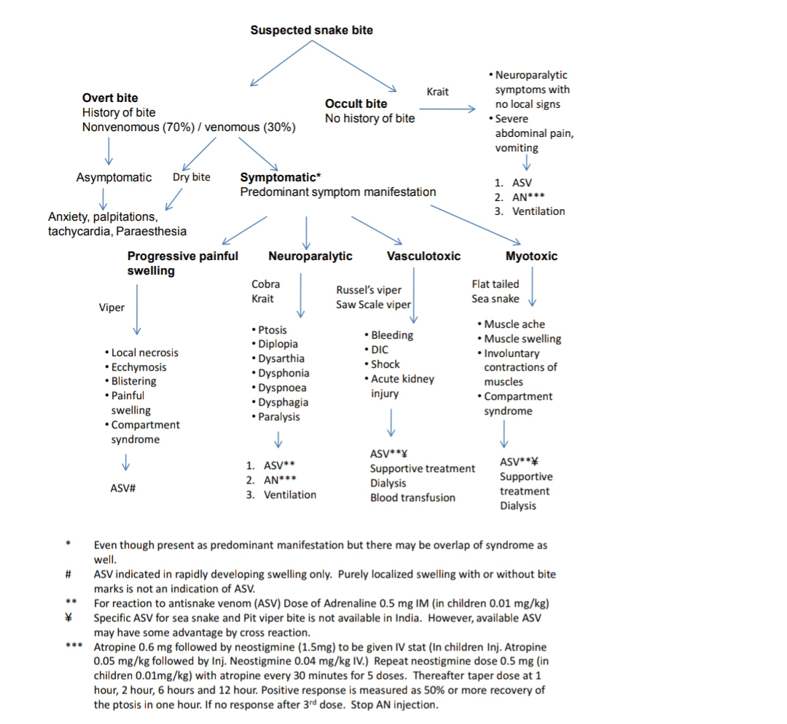

Slide 20
AT A HEALTH CARE FACILITY
Fang mark or their patterns have no role to determine whether the biting species was venomous or non venomous or amount of venom injected, severity of systemic poisoning and nature of poisoning
Envenomation can take many hours to present signs and symptoms (Very common in Krait bite). 4. The victim may be envenomed but no visible signs or immediately detectable symptoms are visible
Even in case of dry bite, symptoms due to anxiety and sympathetic overactivity (as above) may be present. As symptoms associated with panic or stress sometimes mimic early envenoming symptoms, clinicians may have difficulties in determining whether envenoming occurred or not.

Slide 21
Symptomatic Patients
Neuroparalytic snakebite
patients present with typical symptoms within 30 min– 6 hours in case of Cobra bite and 6 – 24 hours for Krait bite
however, ptosis in Krait bite have been recorded as late as 36 hours after hospitalization.
These symptoms can be remembered as
5 Ds and 2 Ps.
5 Ds – dyspnea, dysphonia, dysarthria, diplopia, dysphagia •
2 Ps – ptosis, paralysis

Slide 22
In chronological order of appearance of symptoms –
Furrowing of forehead,
Ptosis
Diplopia
Dysarthria
Dysphonia (pitch of voice becomes less)
Dyspnoea
Dysphagia
All these symptoms are related to 3rd, 4th, 6th and lower cranial nerve paralysis.
Finally, paralysis of intercostal and skeletal muscles occurs in descending manner.
Other signs of impending respiratory failure are diminished or absent deep tendon reflexes and head lag

Slide 23
To identify impending respiratory failure bedside lung function test in adults
Single breath count – number of digits counted in one exhalation - >30normal
Breath holding time – breath held in inspiration – normal > 45 sec
Ability to complete one sentence in one breath

Slide 24
Vasculotoxic
General signs and symptoms of Viperine envenomation
Vasculotoxic bites are due to Viper species. They can have local manifestations as well as systemic manifestations.
Local manifestations –
more prominent in Russel’s viper bite followed by Saw scaled viper and least in Pit viper bite.
Local manifestations are in form of: • Local swelling, bleeding, blistering, and necrosis. • Pain at bite site and severe swelling leading to compartment syndrome. Pain on passive movement. Absence of peripheral pulses and hypoesthesia over the fuels of nerve passing through the compartment helps to diagnose compartment syndrome. • Tender enlargement of local draining lymph node.

Slide 25
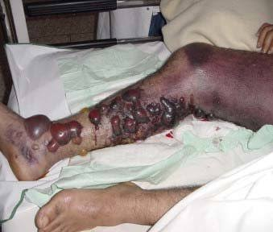
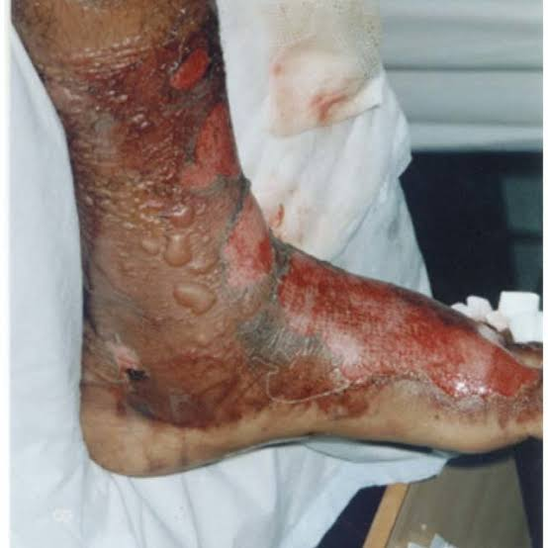
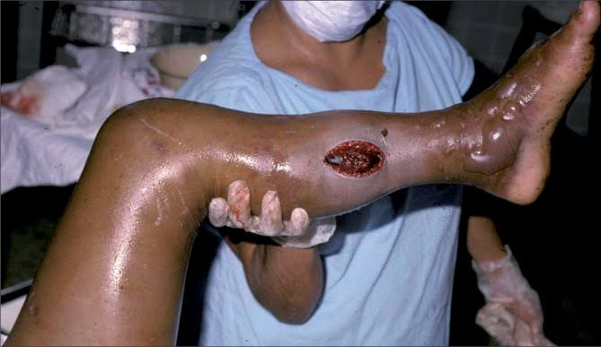
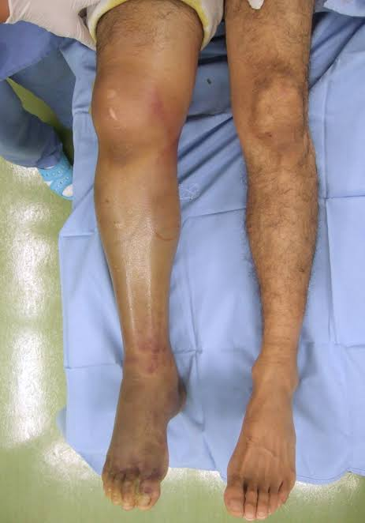

Slide 26
Visible systemic bleeding from the action of haemorrhagins e.g. gingival bleeding, epistaxis, ecchymotic patches, vomiting, hematemesis, hemoptysis, bleeding per rectum, subconjunctival hemorrhages,
continuous bleeding from the bite site, bleeding from pre-existing conditions e.g. haemorrhoids, bleeding from freshly healed wounds. •
Bleeding or ecchymosis at the injection site is a common finding in Viper bites.
The skin and mucous membranes may show evidence of petechiae, purpura ecchymoses, blebs and gangrene.
Swelling and local pain.
Acute abdominal tenderness may suggest gastro-intestinal or retro peritoneal bleeding

Slide 27
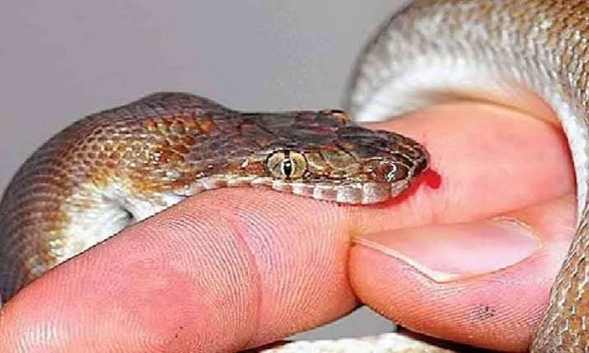
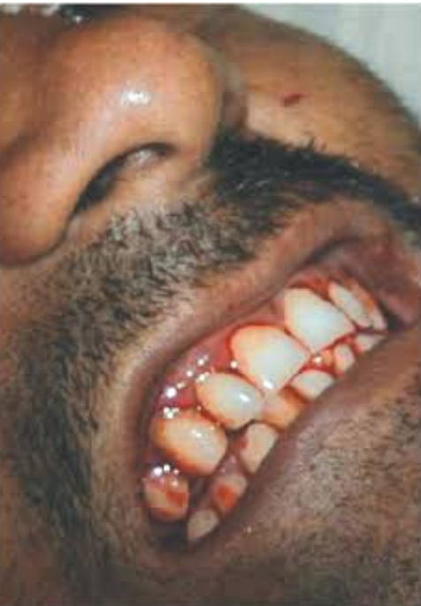
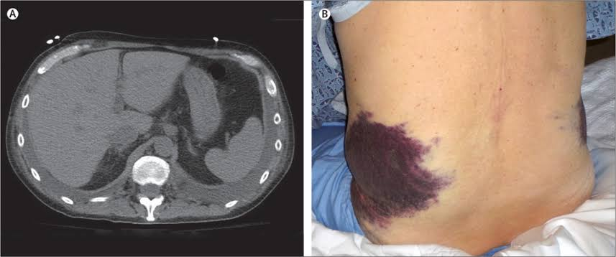
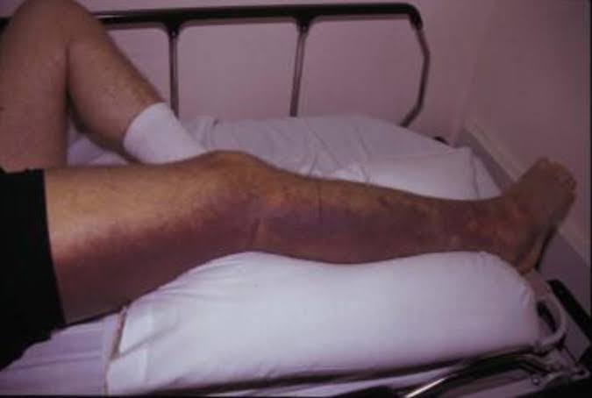

Slide 28
Life threatening complications are due to renal involvement.
Hematuria, hemoglobinuria, myoglobinuria followed by oliguria and anuria with acute kidney injury (AKI). Acute Kidney Injury .Some species e.g. Russell’s viper (Daboia sp) and Saw scale vipers (Echis sp) frequently cause acute Kidney Injury.
Hypotension due to hypovolaemia or direct vasodilatation or direct cardiotoxicity aggravates acute kidney injury. •
Parotid swelling, conjunctiva oedema, sub-conjunctival haemorrhage, renal failure, acute respiratory distress syndrome [leaking syndrome] and refractory shock.
Long term sequelae e.g. pituitary insufficiency with Russell’s viper (Daboia sp), Sheehan’s syndrome or amenorrhea in females

Slide 29
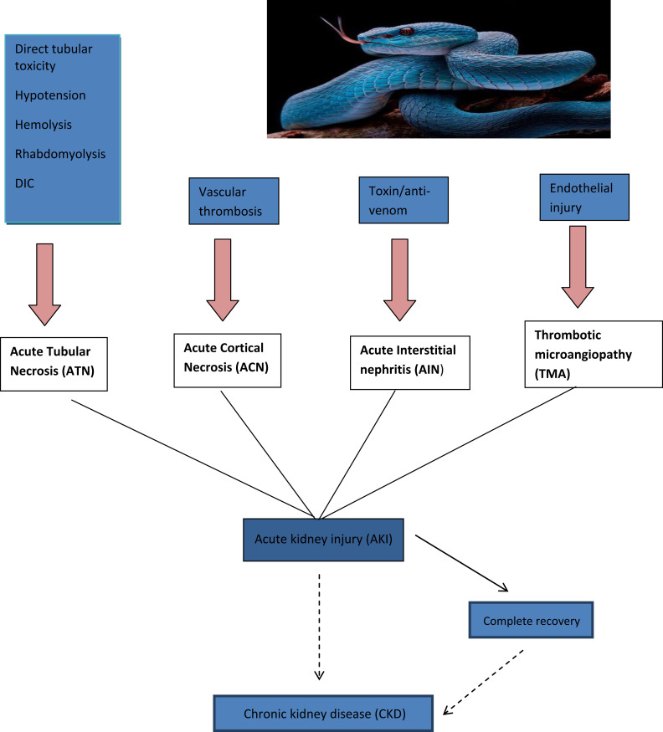

Slide 30
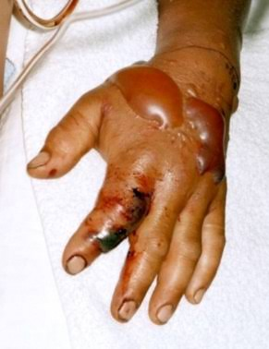
Painful Progressive Swelling (PPS)
Progressive painful swelling is indicative of local venom toxicity.
It is prominent in Russel’s viper bite, Saw scaled viper bite and Cobra bite.
Local necrosis which often has a rancid smell. Limb is swollen and the skin is taut and shiny. Blistering with reddish black fluid at and around the bite site. Skip lesions around main lesion are also seen.
Significant painful swelling potentially involving the whole limb and extending onto the trunk. • Compartment syndrome will present invariably
Regional tender enlarged lymphadenopathy

Slide 31
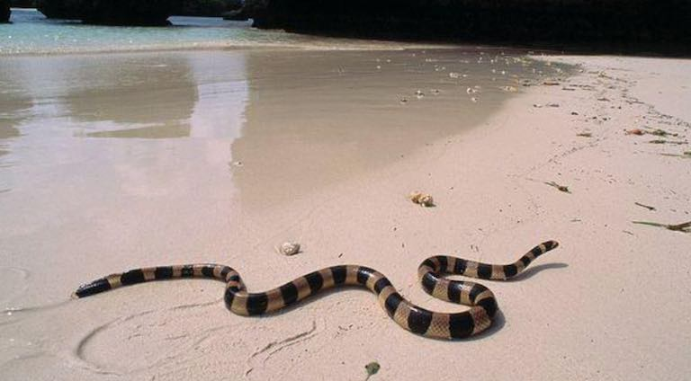
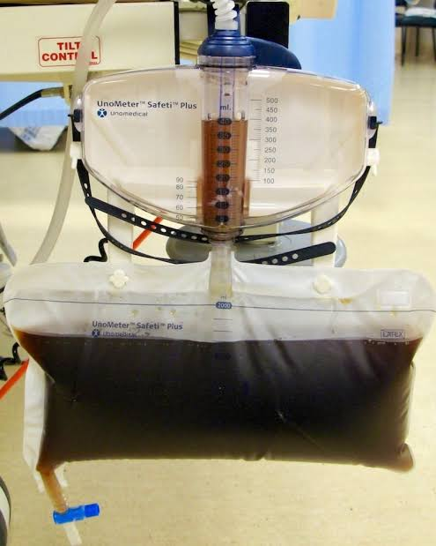
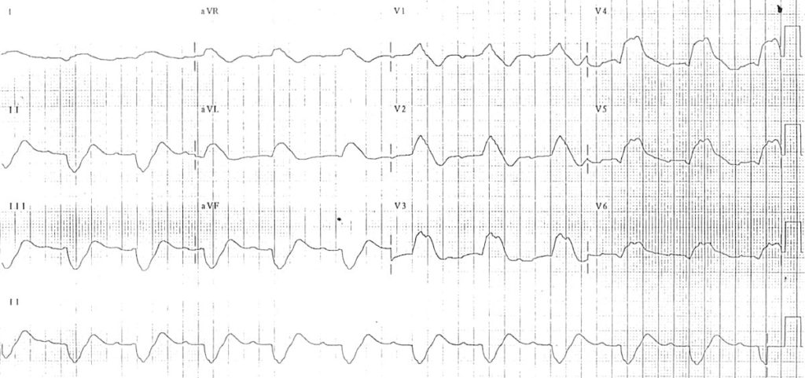
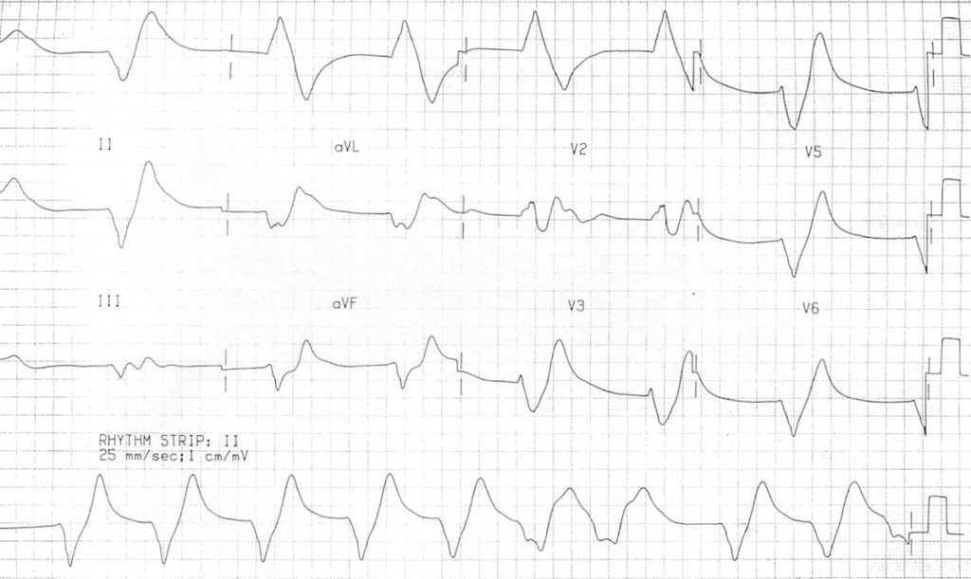
Myotoxic
This presentation is common in Sea snakebite.
Patient presents with Muscle aches, muscle swelling, involuntary contractions of muscles.
Passage of dark brown urine. •
Compartment syndrome, cardiac arrhythmias due to hyperkalaemia, acute kidney injury due to myoglobinuria, and subtle neuroparalytic signs

Slide 32
Occult snakebite
Krait bite victims often present in the early morning with paralysis with no local signs.
Krait has nocturnal habitat and has fine slender teeth. Hence bite marks usually cannot be identified even on close examination.
Typical presenting history is that the patient was healthy at night, in the morning gets up with severe epigastric/umbilical pain with vomiting persisting for 3 – 4 hours and followed by typical neuroparalytic symptoms within next 4- 6 hours. There is no history of snakebite. •
Unexplained respiratory distress in children in the presence of ptosis or sudden onset of acute flaccid paralysis in a child (locked-in syndrome) are highly suspicious symptoms in endemic areas particularly of Krait bite envenomation.
Early morning symptoms of acute pain abdomen with or without neuroparalysis can be mistaken for a acute appendicitis, acute abdomen, stroke, GB syndrome, myasthenia gravis and hysteria .Krait bite envenoming is diagnosed by developing descending neuroparalysis while GB syndrome is by ascending paralysis

Slide 33
CRITICAL ARRIVAL
Rapid primary clinical assessment and resuscitation
CABDE approach
Circulation (arterial pulse)
Airway
Breathing (respiratory movements)
Disability of the nervous system (level of consciousness)
Exposure and environmental control (protect from cold etc.)

Slide 34
Early clues that a patient has severe envenoming (WHO)
Snake identified as a very dangerous one. •
Rapid early extension of local swelling from the site of the bite.
Early tender enlargement of local lymph nodes, indicating spread of venom in the lymphatic system.
Early systemic symptoms: collapse (hypotension, shock), nausea, vomiting, diarrhoea, severe headache, “heaviness” of the eyelids, inappropriate (pathological) drowsiness or early ptosis/ophthalmoplegia.
Early spontaneous systemic bleeding.
Passage of dark brown/black urine

Slide 35
Diagnosis Phase: Investigations
Simple diagnostic test: 20 Minute Whole Blood Clotting Test (20WBCT)
It is considered as the most reliable test of coagulation
2-3 ml of fresh venous blood is placed in a NEW, CLEAN AND DRY GLASS vessel/tube and left at ambient temperature for 20 minutes.
The glass vessel should be left undisturbed for 20 minutes and then gently tilted, not shaken. If the vessel used for the test is not made of ordinary glass, or if it has been cleaned with detergent, its wall may not stimulate clotting of the blood sample (surface activation of factor XI – Hageman factor) and test will be invalid
If there is any doubt, repeat the test in duplicate, including a “control” (blood from a healthy person such as a relative) (WHO)

Slide 36
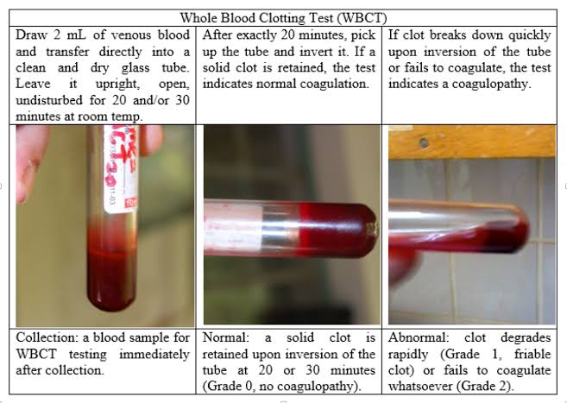
Results Interpretation If the blood is solid i.e. has clotted the patient has passed the coagulation test and no ASV is required at this stage.
The patient is re-tested every hour for the first three hours and then 6 hourly for 24 hours until either test result is not clotted or clinical evidence of envenomation to ascertain if dose of ASV is indicated.
In case test is non-clotting, repeat 6 hour after administration of loading dose of ASV. In case of neurotoxic envenomation repeat clotting test after 6 hours.

Slide 37
Other investigations that may assist in the management of snake bite at various levels of healthcare
At Primary health centre Peak flow meter in patients (adolescents and adults) presenting with neuroparalytic syndrome.
If Peak flow meter is not available in PHC then assess respiratory function using bedside tests –
single breath count
breath holding time
ability to complete one sentence in one breath as described earlier. Urine examination for albumin and blood by dipstick

Slide 38
At District Hospital
Prothrombin time Platelet count, Liver function test,Renal Function test (RFT) Serum Amylase Blood sugar ECG Abdominal ultrasound 2D Echo (if available)
At Tertiary Health Care Centre In addition to the above In neuroparalytic envenomation Arterial blood gases. Caution: Arterial puncture is contraindicated in patients with haemostatic abnormalities. Pulmonary function tests In Vasculotoxic venomation For coagulopathy- BT, CT, PT, APTT, Platelet, Serum Fibrinogen, FDP D-Dimer assay, LDH, peripheral blood smear Hemolysis -Urine for myoglobin, Urine haemoglobin For renal failure- Urine microscopy for RBC, casts, RFT, urinary proteins, creatinine ratio Hepatic injury – LFTs including SGOT, SGPT, Alkaline phosphatase, serum proteins Cardiotoxicity- CPK-MB, 2D Echo, BNP Myotoxic – CPK, SGOT, Urine myoglobin, compartment pressure Infection- Serum procalcitonin, culture (blood, urine, wound) and sensitivity Arterial blood gases and urine examination should be repeated at frequent intervals during the acute phase to assess progressive systemic toxicity).

Slide 39
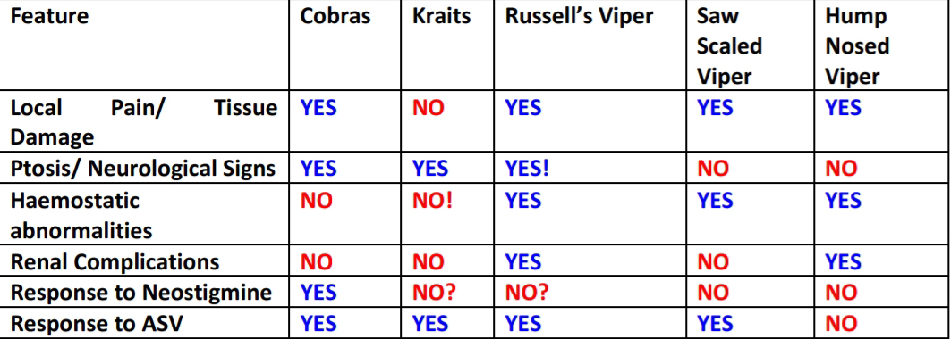

Slide 40
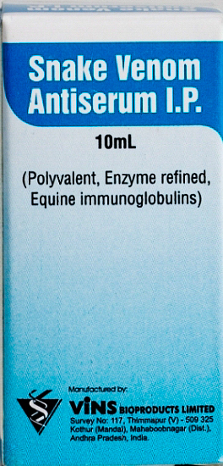
ANTI SNAKE VENOM (ASV)
If ASV is indicated i.e. signs and symptoms of envenomation with or without evidence of laboratory tests, administer full dose.
There are no absolute contraindications to ASV.
Do not routinely administer ASV to any patient claiming to have bitten by a snake as ASV exposes such patients to the risks of ASV reactions unnecessarily
However, at the same time do not delay or withhold ASV on the grounds of anaphylactic reaction to a deserving case.
Do NOT give incomplete dose.

Slide 41
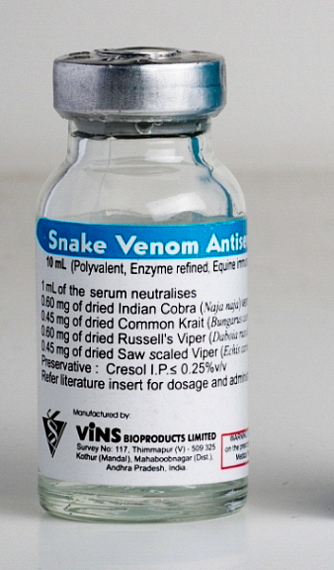

Slide 42
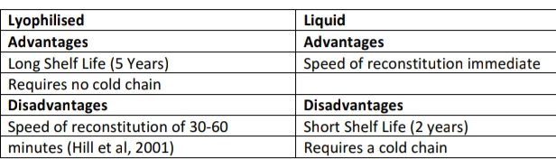
Dose of ASV ASV should be given only by the IV route, and should be given slowly, with the physician at the bed side during the initial period to intervene immediately at the first sign of any reaction. The rate of infusion can be increased gradually in the absence of a reaction until the full starting dose has been administered (over a period of ~1 hour)

Slide 43
Asv dosage
Neuroparalytic snakebite – ;
ASV 10 vials stat as infusion over 30 minutes followed by 2nd dose of 10 vials after 1 hour if no improvement within 1st hour

Slide 44
vasculotoxic snakebite
Low Dose infusion therapy – 10 vials for Russel’s viper or 6 vials for Saw scaled viper as stat as infusion over 30 minutes followed by 2 vials every 6 hours as infusion in 100 ml of normal saline till clotting time normalizes or for 3 days whichever is earlier.
High dose intermittent bolus therapy - 10 vials of polyvalent ASV stat over 30 minutes as infusion, followed by 6 vials 6 hourly as bolus therapy till clotting time normalizes and/or local swelling subsides.

Slide 45
Russell’s Viper injects on average 63mg of venom
Logic suggests that our initial dose should be calculated to neutralise the average dose of venom injected.
The range of venom injected is 5mg – 147 mg by a Russell ’s viper.
The total required dose range between 10 and 30 vials
As each vial neutralizes 6 mg of Russell’s Viper venom. Depending on the patient condition, additional vials can be considered.

Slide 46
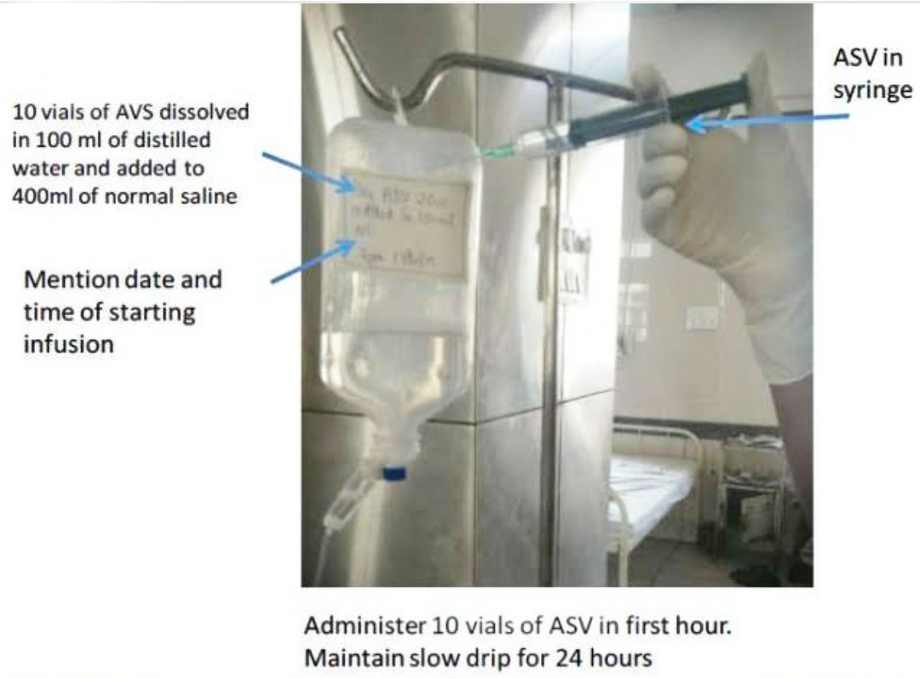
ASV infusion and dosage schedule Each vial of AVS be dissolved in 10 ml of distilled water and added to an infusion medium such as normal saline (i.e. 10 vials of AVS dissolved in 100 ml of distilled water and added to 400ml of normal saline). The volume of infusion is reduced according to the body size and the state of hydration of the patient. In oliguric patients restrict fluids and use infusion pump to give full dose of ASV over 30 minutes.

Slide 47
Monitoring of Patients on ASV therapy
All patients should be watched carefully every 5 min for first 30 min, then at 15 min for 2 hours for manifestation of a reaction. At the earliest sign of an adverse reaction suspend temporarily. Maintain a strict intake output chart and note colour of urine to detect acute kidney injury early.
ASV and Pregnancy
ASV should be given: In the same dose and Under the same criteria as Snakes inject the same dose of venom into children and adults. Children must therefore be given exactly the same dose of antivenom as adults. standard victims.
children
Snakes inject the same dose of venom into children and adults. Children must therefore be given exactly the same dose of antivenom as adults.

Slide 48
Adverse reactions
Early anaphylactic reactions occurs within 10–180 min of start of therapy and is characterized by itching, urticaria, dry cough vomitting hypotension, bronchospasm, and angioedema.
Pyrogenic reactions usually develop 1–2 h after treatment. Symptoms include chills and rigors, fever, and hypotension
Late (serum sickness–type) reactions develop 1–12 (mean 7) days after treatment. Clinical features include fever, nausea, vomiting, diarrhea, itching, recurrent urticaria, arthralgia, myalgia, lymphadenopathy, immune complex nephritis and, rarely, encephalopathy.
Drug of Choice Administer Epinephrine (adrenaline) (1 in 1,000 solution, 0.5 mg (i e 0.5 ml) in adults intramuscular over deltoid or over thigh The time for adrenaline to reach peak effect is 8 minutes via the IM route

Slide 49
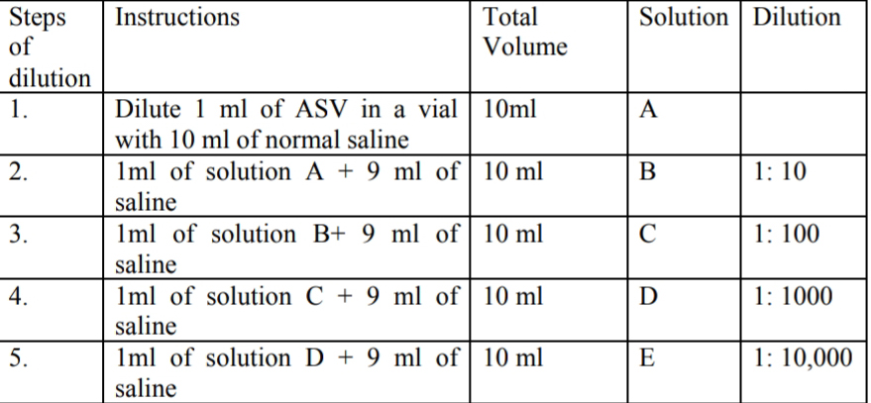
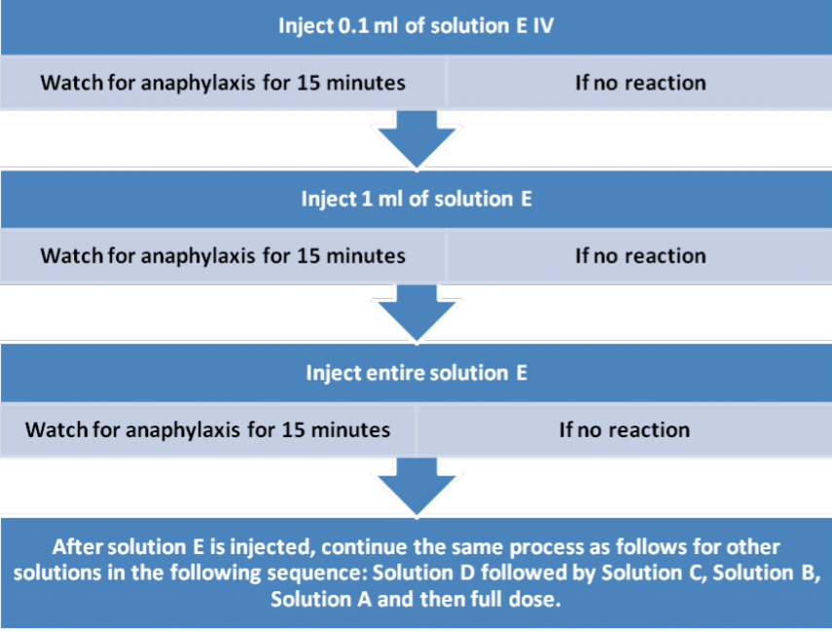

Slide 50
Neurotoxic Envenomation
effective for post synaptic neurotoxins such as those of the Cobra
Atropine 0.6 mg
followed by neostigmine (1.5mg) to be given IV stat
repeat dose of neostigmine 0.5 mg with atropine every 30 minutes for 5 doses
Thereafter to be given as tapering dose at 1 hour, 2 hour, 6 hours and 12 hour
A fixed dose combination of Neostigmine and glycopyrolate IV can also be used.

Slide 51
After 30 minutes, any improvement should be visible by an improvement in ptosis. Positive response to “AN” trial is measured as 50% or more recovery of the ptosis in one hour.
If there is no improvement after 3 doses of atropine neostigmine (within 1 h), this indicates probable Krait bite. Krait affects pre-synaptic fibres where calcium ion acts as neurotransmitter.
Give Inj. Calcium gluconate 10ml IV slowly over 5-10 min every 6 hourly and continue till neuroparalysis recovers which may last for 5-7 days.
Although artificial ventilation was first suggested for neurotoxic envenoming 135 years ago, patients continue to die of asphyxiation because some doctors believe that antivenom alone is sufficient treatment.

Slide 52
Haemotoxic Envenomation
Prolonged clotting test
10 vials of ASV
Recheck 20 mins clotting time after 6 hours
If still 20 mins ct prolonged repeat the initial dose .
Upto 30 vials can be given after testing each 6 hours
A large study recently done from south (Kerala) showed that upto 50 vials (500 ml) has been given for Haemotoxic poisoning

Slide 53
aki management
FAD within first 24 hours of the bite to avoid pigment nephropathy leading to acute tubular necrosis (ATN). Delayed FAD has no role.
Sequence of FAD in adults
Inj. Frusemide 40 mg IV stat
b) Inj. Normal saline 500 ml + 20 ml of NaHCO3 over 20 minutes
c) Inj. Ringer’s lactate 500 ml + 20 ml of NaHCO3 over 20 minutes
d) Inj. 5% dextrose 500 ml + 10 ml of Potassium Chloride over 90 minutes
e) Inj. Mannitol 150 ml over 20 min
Whole cycle completes in 2 h 30 min and urine output of 3 ml/min is expected.
If patient responds to first cycle continue for 3 cycles. FAD converts oliguria into polyuria and avoid ATN and acute kidney injury needing dialysis in more than 75% patients.

Slide 54
Indications for dialysis
Absolute value of Blood urea >130 mg/dl (27 mmol/L) (BUN 100 mg/dl)
Sr. Creatinine > 4 mg/dl (500 µmol/L)
OR evidence of hypercatabolism in the form of daily rise in blood urea 30 mg/dL (BUN > 15), Sr. Creatinine > 1 mg/dL,Sr. Potassium > 1 mEq/L and fall in bicarbonate >2 mmol/L g.
Fluid overload leading to pulmonary oedema
Hyperkalaemia (>7 mmol/l (or hyperkalaemic ECG changes)
unresponsive to conservative management. j. Uremic complications – encephalopathy, pericarditis.

Slide 55
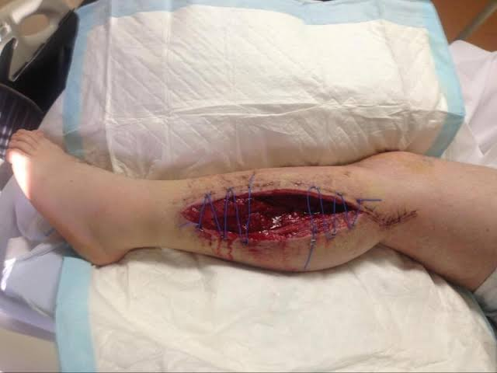
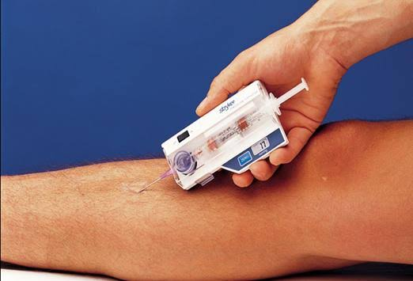
Clinical features of a compartmental syndrome
Pain on passive stretching
Pain out of proportion
Pulselessness
Pallor
Parasthesia
Paralysis

Slide 56
