Slide 1
SMALL FIBRE NEUROPATHY
DR AMRITA KURIAN
JUNIOR RESIDENT

Slide 2
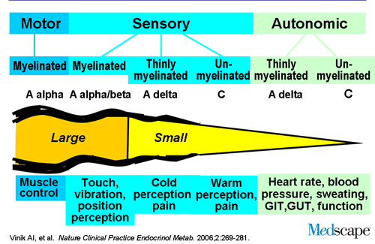
Erlanger and Gasser classification of nerve fibres

Slide 3
LARGE FIBRE
Heavily myelinated
A alpha : somatic motor , proprioception
A beta : proprioception, touch, vibration
A gamma : motor to muscle spindle
12 - 20 µm diameter
70 – 120 m/s (saltatory conduction)

Slide 4
SMALL FIBRE
Thinly myelinated and unmyelinated
A delta :
  1-6 µm, 4- 36 m/s
  Fast pain (sharp, lancinating)
  Cold

Slide 5
C fibre :
  0.2 -1.5 µm, 0.4 - 2.8 m/s
  Slow pain (burning, dull, poorly localized )
  Warmth
  Post ganglionic sympathetic
  Most numerous

Slide 6
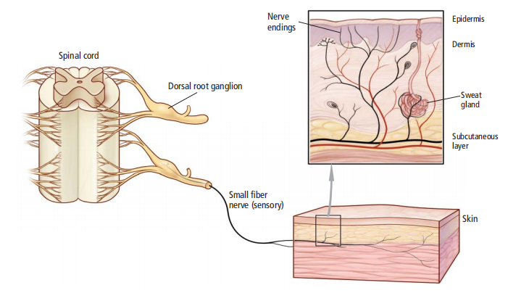

Slide 7
WHEN TO SUSPECT?
Loss of pain and temperature perception
Autonomic dysfunction
Preserved vibratory and position sense
Preserved muscle strength
Preserved DTR
Normal NCS

Slide 8
Small fiber neuropathies can occur without large fiber involvement, but in some cases they occur concomitantly or progress to involve large nerve fibers.

Slide 9
SYMPTOMS
Mostly occur in a symmetric length-dependent fashion : “stocking-glove pattern”
Sensory changes starting in the feet and gradually ascending up the legs and then to the hands.
Commonly reported neuropathic symptoms : Combinations of burning, tingling, numbness, sunburn-like and frostbite-like sensations

Slide 10
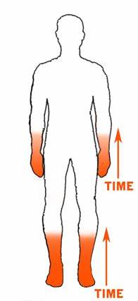
Symptoms can vary widely in severity.
Gradual onset of distal symptoms in the form of vague disturbances of sensation in the feet.
The feeling of a wrinkle in a sock that cannot be removed or of small pebbles or sand in the shoe.
A cold-like pain, tingling or a pins and needles sensation.
More severe symptoms include burning pain that often is persistent, although it may vary in intensity throughout the day.

Slide 11
Many also report transient electric shock–like pain, usually lasting only seconds, but quite severe and potentially multiple times per day.
Many symptoms worsen during periods of rest and at night.
In addition to spontaneous pain, many individuals report allodynia and hyperesthesia.
Patients frequently complain that the bedsheets are exquisitely painful, and therefore, wear socks or use “foot tents” to keep the sheets from making physical contact with the feet.

Slide 12
Autonomic and enteric dysfunction.
Dry eyes, dry mouth
postural lightheadedness, presyncope, syncope
palpitations
abnormal sweating
erectile dysfunction
nausea, vomiting, diarrhea, constipation, early satiety
difficulty with urinary frequency, nocturia, and/or voiding

Slide 13
Random patterns suggest an immune cause
Symptoms may also have a non–length dependent distribution that is asymmetric, patchy, intermittent, and migratory
Can involve the face, proximal limbs, and trunk.
Symptoms may vary throughout the day. Eg:starting with electric-shock sensations on one side of the face, followed by perineal numbness and then tingling in the arms lasting for a few minutes to several hours.

Slide 14
May be seen with diabetes and other common etiologies, but they often suggest an underlying immune-mediated disorder such as Sjögren syndrome or sarcoidosis.
Although large fiber polyneuropathy may also be non–length dependent, the deficits are usually fixed, with no migratory component.

Slide 15
CAUSES
UPTO HALF OF THE CASES - IDIOPATHIC
DIABETES IS THE MOST COMMON IDENTIFIABLE CAUSE

Slide 16
Diabetes and prediabetes (including both impaired glucose tolerance and impaired fasting glucose)
Individuals with diabetes and metabolic syndrome appear to have twice the risk of developing a small fiber neuropathy compared to those with diabetes alone.
Recent reports now are suggesting that the single largest contributing factor to neuropathy development is hyperlipidemia.

Slide 17
Some patients with diabetes also may experience an acute painful small fiber neuropathy associated with rapid glycemic control, also referred to as insulin neuritis or treatment-induced neuropathy.
HIV
Hepatitis C
Leprosy
Inflammatory neuropathies (such as Guillain-Barre syndrome and chronic inflammatory demyelinating polyneuropathy)
Celiac disease
Restless legs syndrome

Slide 18
complex regional pain syndrome type I
paraproteinemia
neurotoxic drug use
systemic lupus erythematosus
Sjogren’s syndrome
abnormal thyroid function
Amyloidosis (AL)
paraneoplastic syndromes
Inherited conditions : Fabry’s disease and the hereditary sensory and autonomic neuropathies.

Slide 19
CLINICAL ASSESSMENT
DETAILED HISTORY
Diabetes mellitus, hypothyroidism, chronic liver disease or kidney disease
History suggestive of CTD and autoimmune conditions
Alcohol use
Family history of neuropathy

Slide 20
Use of neurotoxic medications such as metronidazole, colchicine, and chemotherapeutic agents.
Relevant risk factors for HIV and Hepatitis C (eg, blood transfusions, sexual history, intravenous drug use)
Recent illnesses and vaccinations, as a small-fiber variant of Guillain-Barré syndrome has been described

Slide 21
EXAMINATION
Normal or near normal physical and neurologic examination.
The coordination, motor, and reflex examinations will be normal.
Light touch, vibration, and proprioception also may be normal, resulting in diagnostic confusion in some situations.
Patients may have decreased pinprick, decreased thermal sensation, or hyperalgesia in the affected region.

Slide 22
Mildly decreased vibratory sensation in some individuals. However, absent ankle jerk and reduced vibratory sense may also occur in healthy elderly people.
Associated skin changes in affected areas may include dry, cracked, or shiny skin, with discoloration and loss of hair.
Brittle nails
Orthostatic hypotension

Slide 23
DIAGNOSIS
The history and physical examination findings still are considered the gold standard against which all tests are compared when making a diagnosis of a small fiber neuropathy.
A detailed review of the symptoms, rate of progression, and complaints suggestive of autonomic fiber involvement
Generally, if a patient presents with a compelling history for a small fiber neuropathy and an appropriate clinical exam, further testing to confirm the diagnosis may be unnecessary.

Slide 24
Quantitative sensory testing (QST)
Measures the detection threshold of accurately calibrated sensory stimuli.
Heat or heat-pain detection thresholds are considered the most useful and specific for evaluation of a small fiber neuropathy.
Psychophysical in nature; requiring cooperation from the patient.
In conditions of cognitive impairment (due to disease or medication), the reliability of the test results are in question.

Slide 25
If abnormal, may signal dysfunction anywhere along the sensory pathway between the receptor apparatus, primary sensory cortex and association cortex.
Thus, abnormalities in either the central or peripheral nervous system can result in the same deficit.
QST is unable to distinguish between feigned and true loss of sensation.

Slide 26
Skin Biopsy
Skin specimens are obtained by 3-mm punch biopsy of the distal leg and thigh
Bright field immunohistochemistry is used with antibodies against protein gene product 9.5, a marker for all peripheral nerve fibers, and fiber densities are calculated.
Reduced intraepidermal nerve fiber density on skin biopsy is seen in small fibre neuropathy
Also seen in fibromyalgia and chronic pain syndromes.

Slide 27
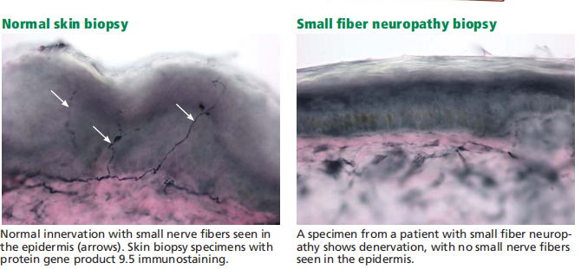

Slide 28
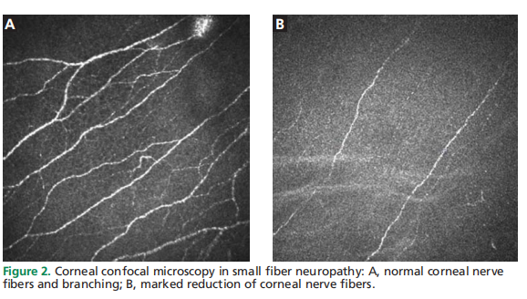
Corneal confocal microscopy is a promising new noninvasive diagnostic tool that provides objective quantification of small nerve fibers in the sub basal layer of the cornea, which holds the densest concentration of these fibers

Slide 29
Quantitative sudomotor axon reflex testing
A non invasive autonomic study that assesses the volume of sweat produced by the limbs in response to acetylcholine.
A measure of postganglionic sympathetic sudomotor nerve function, QSART has a sensitivity of up to 80%
QSART can also be considered in cases where skin biopsy may be contraindicated (eg, patient on anticoagulation).
Affected by a number of external factors, including caffeine, tobacco, antihistamines, and tricyclic antidepressants; these should be held before testing

Slide 30
Other diagnostic studies
Tilt-table and cardiovagal testing : for patients with orthostatic hypotension and palpitations.
Thermoregulatory sweat testing can be used to evaluate patients with abnormal patterns of sweating, eg, hyperhidrosis of the face and head.
EMG and NCS are normal in pure small fiber neuropathies.
If there is possible larger fiber involvement causing symptoms or occurring concomitantly with a small fiber neuropathy, these studies might be helpful

Slide 31
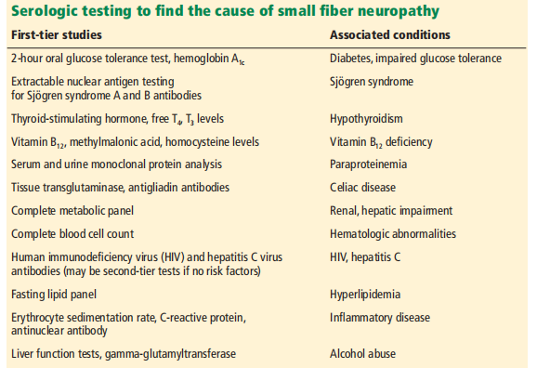
Serological tests to determine the etiology

Slide 32
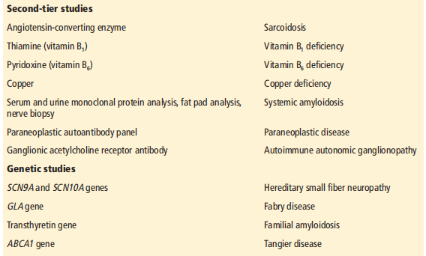

Slide 33
Diabetes and prediabetes
Diabetes is the most common identifiable cause of small fiber neuropathy and accounts for about a third of all cases.
Impaired glucose tolerance is also thought to be a risk factor and has been found in up to 50% of idiopathic cases of small fibre neuropathy.

Slide 34
Metabolic syndrome
Hyperlipidemia, hypertension, and obesity in addition to abnormal glucose metabolism with insulin resistance.
Individuals with diabetes and metabolic syndrome have twice the risk of developing a small fiber neuropathy compared to those with diabetes alone
Recent reports suggest that the single largest contributing factor to neuropathy development is hyperlipidemia ( via inflammatory pathway and oxidative stress)

Slide 35
Vitamin B12 deficiency
Correctable cause
Causes : decreased intake, pernicious anemia , medications that interfere with absorption (PPI, H2 receptor blockers , metformin)
Tests :
CBC and peripheral smear
Serum vitamin B12 level
Methylmalonic acid or homocysteine level in patients with subclinical or mild vitamin B12 deficiency

Slide 36
Celiac antibody panel
T-cell mediated enteropathy characterized by gluten intolerance and a herpetiform-like rash
2 presentations : neuropathy symptoms are preceded by the onset
of gastrointestinal symptoms, or they may occur in isolation.

Slide 37
Inflammatory disease testing
Sjögren syndrome accounts for nearly 10% of cases of small fiber neuropathy.
non–length dependent
Can precede sicca symptoms for up to 6 years, and in some cases are the sole manifestation of the disease.
SFN may also be associated with vasculitis, systemic lupus erythematosus, and other connective tissue disorders.

Slide 38
Testing should include:
Erythrocyte sedimentation rate, CRP and antinuclear antibodies:
Extractable nuclear antigen panel: SSA AND SSB autoantibodies
The Schirmer test or salivary gland biopsy should be considered for seronegative patients with sicca or a suspected immune mediated etiology,

Slide 39
Leprosy
Segmental demyelination is the final common pathway of nerve injury in leprosy
Sensory nerve conduction, cold and warmth perception - most frequently and earliest affected

Slide 40
Common nerve trunks involved :
  the ulnar and median nerves (claw hand)
  the common peroneal nerve (foot drop)
  the posterior tibial nerve (claw toes and plantar insensitivity)
  the facial nerve (lagophthalmos)
  the radial cutaneous nerve
  the great auricular nerve
Lab tools : skin biopsy and PCR

Slide 41
MANAGEMENT
Regardless of the cause , managing symptoms remains the key as pain and autonomic dysfunction can markedly impair the quality of life.
A multidisciplinary approach incorporating analgesics, physical therapy and lifestyle modifications is ideal.
Treat the underlying cause whenever identified.

Slide 42
Antidepressants
anticonvulsants
opioids
topical treatments.

Slide 43
Tricyclic antidepressants (TCAs) consistently are recommended as first tier drugs across all guidelines
Selected as first-tier choices based on their efficacy and other factors such as cost and availability.
mechanism of action : inhibition of serotonin and norepinephrine reuptake.

Slide 44
TCAs also have anticholinergic effects that can cause significant side effects for some patients, and specifically should be avoided in elderly adults.
Contraindicated in patients with a significant cardiac history, glaucoma, or recent monoamine oxidase–inhibitor (MAOI) use

Slide 45
Anticonvulsants also are routinely recommended for the treatment of neuropathic pain.
Gabapentin frequently is utilized as a first-line treatment of neuropathic pain(specifically postherpetic neuralgia and painful diabetic neuropathy).
Mechanism of action : via the voltage-gated α2δ calcium channel, modifying the release of excitatory neurotransmitters.
Well tolerated and not known to cause significant drug–drug interactions.

Slide 46
Pregabalin
Mechanism of action : through the voltage-gated α2δ calcium channels and is a presynaptic inhibitor of the release of glutamate, substance P, and calcitonin gene–related peptide (CGRP)
Should be used with caution in patients with congestive heart failure.
Angioedema rarely has been described as a side effect.
Combination regimens : combined gabapentin and nortriptyline were more effective than either drug alone for neuropathic pain.

Slide 47
Serotonin–norepinephrine reuptake inhibitors (SNRIs)
Both duloxetine and venlafaxine are recommended as second-line agents in most guidelines.
Effective in painful diabetic neuropathy
Should be avoided in patients with uncontrolled narrow-angle glaucoma or those being treated with MAOIs
Rare cases of abnormal bleeding, hepatotoxicity, and serotonin syndrome, ILD, eosinophilic pneumonia

Slide 48
Topical lidocaine frequently is recommended as a first- or second-line treatment of focal neuropathic pain.
Recommendations are typically for the lidocaine patch, also for lidocaine gel
Act by decreasing neuronal membrane permeability to sodium ions.
Should be avoided in regions of skin breakdown

Slide 49
Lastly, opioids and tramadol frequently are recommended as second- or third-line medications across all guidelines.
Tramadol and its active metabolite bind to central μ-opiate receptors and inhibit ascending pain pathways.
Tramadol also causes serotonin and norepinephrine–reuptake inhibition, another potential mechanism of pain relief.
Not preferred for chronic treatment.

Slide 50
Over-the counter-supplements : acetyl-l-carnitine and alpha lipoic acid and omega-3 fatty acids from seal oil improved corneal fibre density in patients with diabetic neuropathy

Slide 51
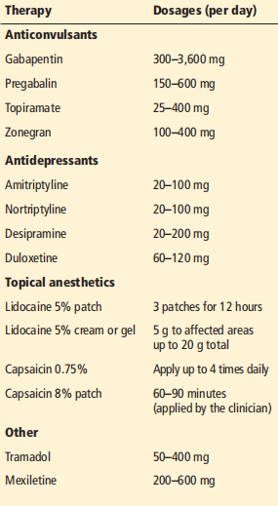

Slide 52
Take home messages
Small fibre neuropathy is a significant cause of morbidity that impairs the quality of life of patients
Upto 50% idiopathic; of the known causes most common is diabetes and prediabetes
Classical pattern of symmetric length dependent glove and stocking neuropathy
If diabetes ruled out, to consider amyloidosis and paraneoplastic panel in elderly
Management : TCA plus anticonvulsants (first line)
topicals, SNRI, opiods (second line)

Slide 53
THANK YOU

