Slide 1
SENSORY GANGLIONOPATHY
REVIEW ARTICLE, NEJM
AUTHORS: Anthony A. Amato, M.D., and Allan H. Ropper, M.D.
Harvard Medical School, Boston

Slide 2
The sensory ganglia contain the cell bodies of the sensory nerves and lie alongside both sides of the spinal cord, appended to the dorsal root of each spinal nerve.
Their proximal projections are the sensory nerve roots that enter the spinal cord, and their peripheral projections are the sensory fibers of peripheral nerves

Slide 3
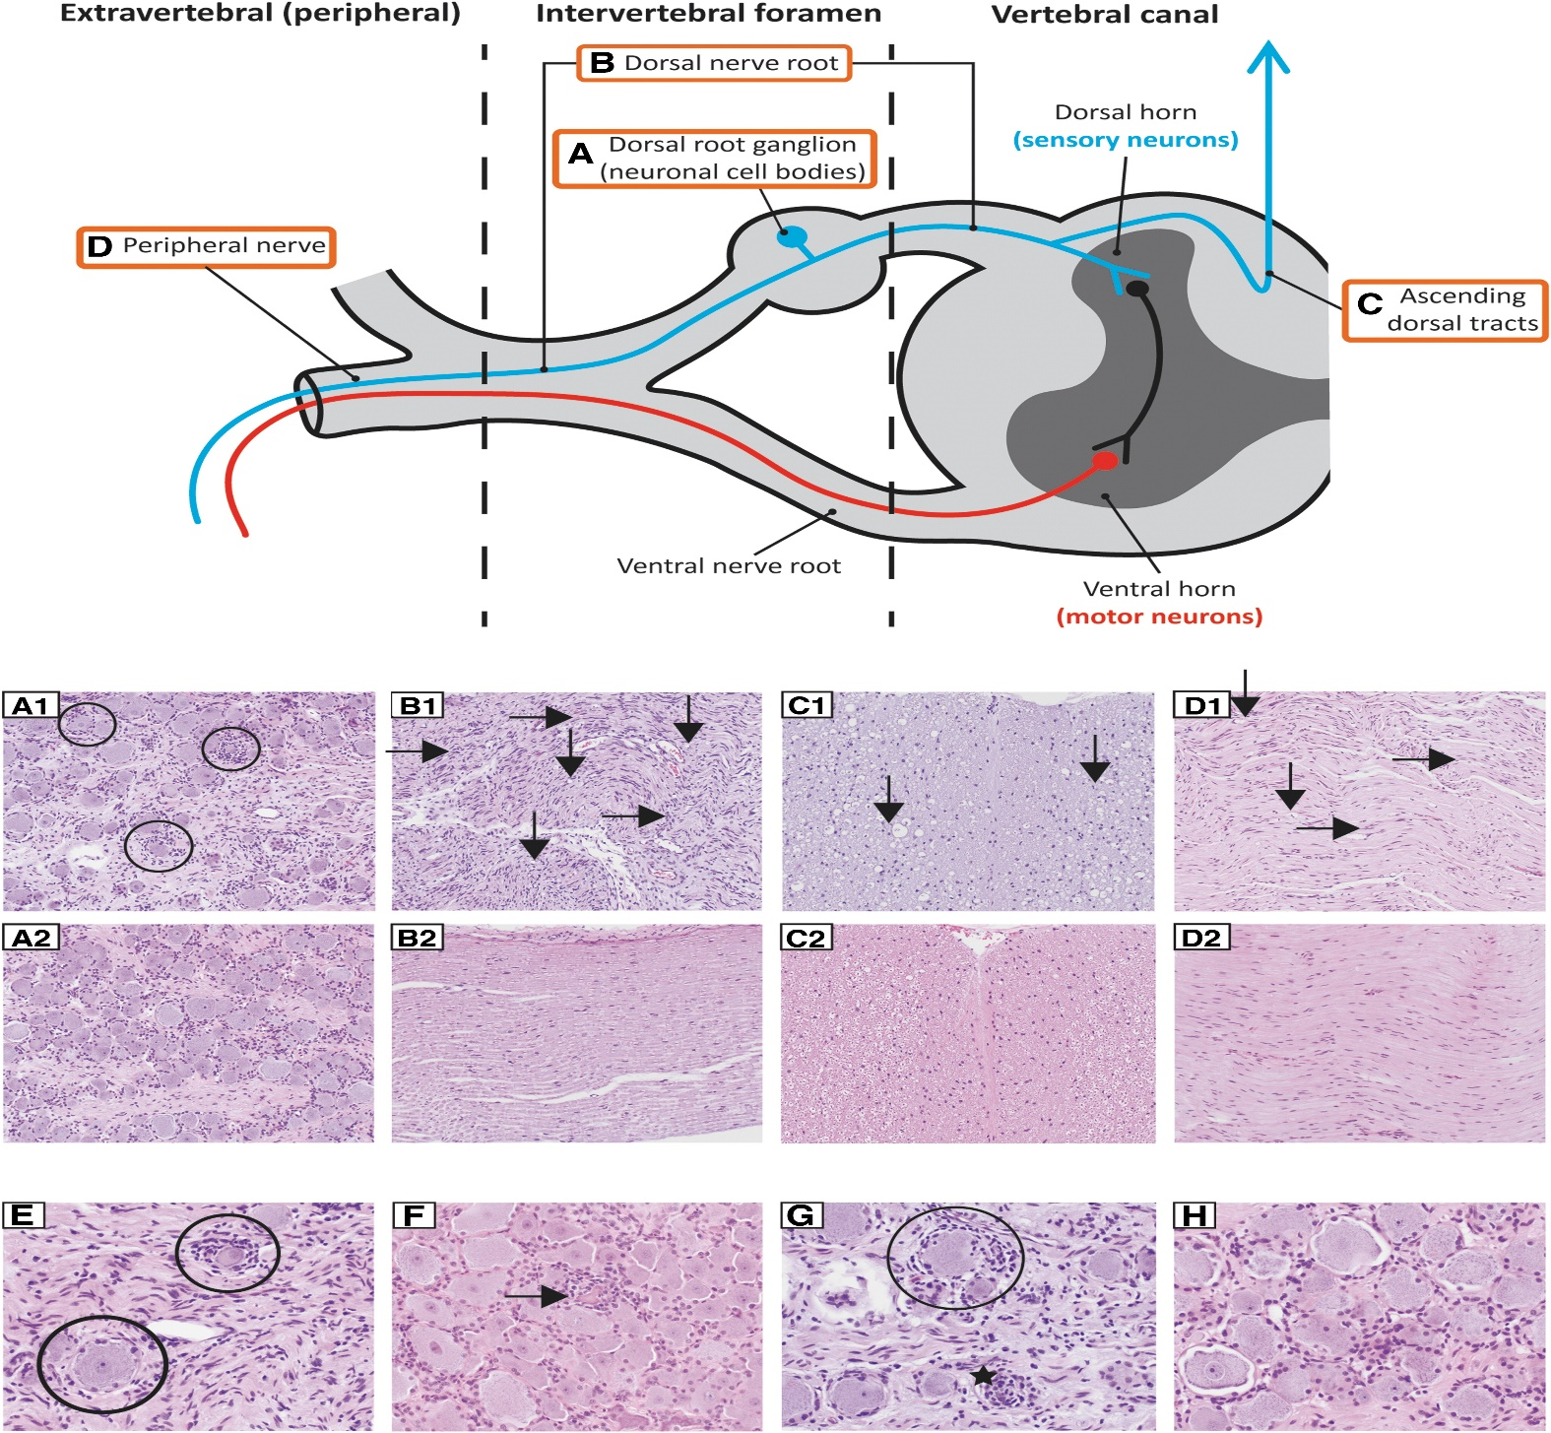

Slide 4
CLINICAL FEATURES
First, because they are confined to sensory neurons, sensory ganglionopathies do not cause weakness.
Second, most common polyneuropathies (e.g., those due to diabetes) result from axonal damage, which leads to degeneration in the distal parts of the longest nerves and symptoms that begin in the toes,
ascend the legs, and only later appear in the fingers and proximal parts of the body)

Slide 5
3)Sensory ganglionopathies are not dependent on the length of axons, and sensory features can start in any or all territories innervated by sensory neurons, particularly in the face, scalp, oral mucosa, trunk, and proximal limbs
Sensory ganglionopathies affect the neurons of large nerve fibers and, correspondingly, are associated with loss of touch, vibratory perception, and proprioception;
Pseudoathetoid posturing that represents a search for position in space; Romberg’s sign; and loss of tendon reflexes

Slide 6
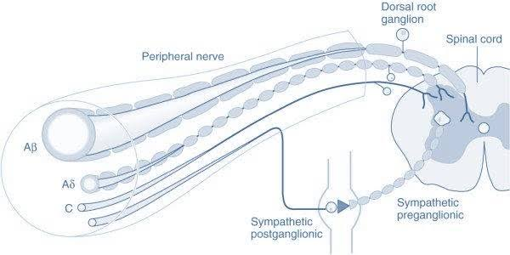
Ganglionopathies affect only the neurons of small sensory fibers, resulting in burning, and stabbing pains.
Disease processes that affect the sensory ganglia often also damage the autonomic ganglia, so patients with sensory ganglionopathies may also have dysautonomia (e.g., orthostatic hypotension, cardiac arrhythmia, gastric dysmotility, and sweating disturbances)

Slide 7
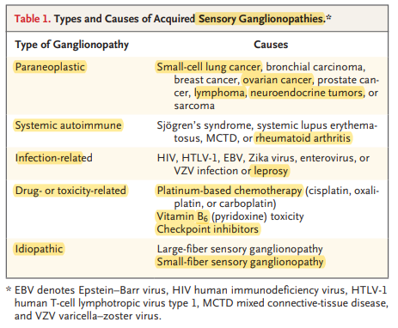

Slide 8
Most cases evolve over a period of days or weeks — more rapidly than typical peripheral neuropathies — and tend to become severe, affecting tactile sensibility to a degree that, for example, precludes a normal swallowing reflex because of loss of pharyngeal sensation.

Slide 9
The most common malignant process associated with sensory ganglionopathy is small-cell lung carcinoma
But the syndrome has also been associated with breast, ovarian, prostate, colon, and gastric cancers, lymphoma, neuroendocrine tumors, and other cancers.
Sensory symptoms can be acute or insidious and precede the diagnosis of cancer by weeks or months.

Slide 10
Antineuronal autoantibodies directed against a 35-to-40-kD protein or complex of proteins
1) the Hu antigen,
2)anti–collapsin response mediator protein 5 (CRMP5) antibody,
3) amphiphysin are found in serum or cerebrospinal fluid (CSF) from most patients with paraneoplastic sensory ganglionopathy.
Autopsy studies have shown inflammation and loss of ganglion cells in the dorsal root ganglia (Fig. 1A) and wallerian degeneration of the posterior columns in the spinal cord.

Slide 11
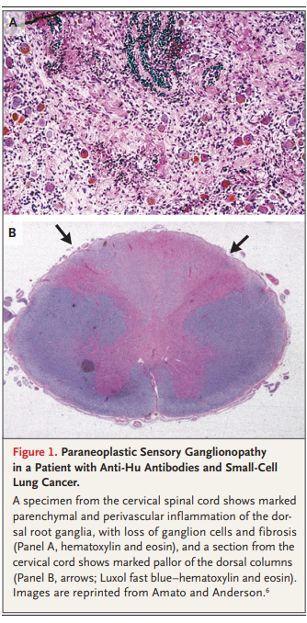

Slide 12
Polyneuropathies occur in 5 to 15% of patients with Sjögren’s syndrome, of which approximately 40% are large-fiber sensory ganglionopathies and 20% are small-fiber sensory neuropathies or ganglionopathies.
Symptoms may involve the arms more than the legs and may be asymmetric at the start but usually become generalized.
Facial and perioral numbness from involvement of the trigeminal ganglia is common

Slide 13
OTHER CAUSES
1)Ganglionitis-human T-lymphotropic virus type 1, enterovirus, Zika virus, and Epstein–Barr virus infections and leprosy.
2)Platinum compounds-Cisplatin, carboplatin, and oxaliplatin in large cumulative doses cause sensory ganglionopathy
3)Pyridoxine excess: >2g/ day
4)Idiopathic sensory ganglionopathy

Slide 14
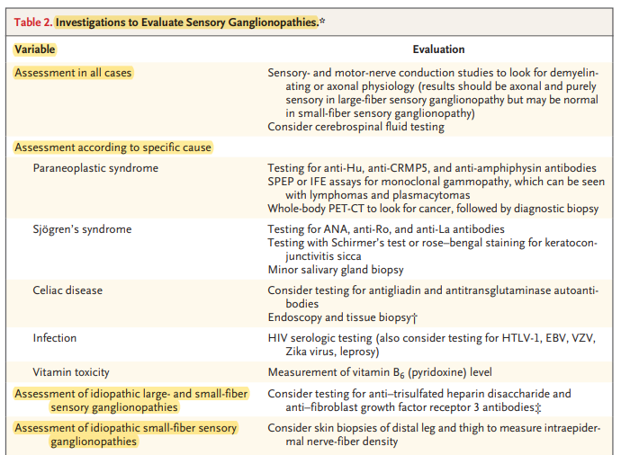

Slide 15
CSF EXAMINATION
. CSF examination in patients with sensory ganglionopathy may show elevated protein levels, mild pleocytosis, or oligoclonal bands, but these findings are neither sensitive nor specific, and the CSF examination is often normal

Slide 16
ELECTROPHYSIOLOGY IN GANGLIONOPATHY
Sensory-nerve conduction studies in the common large-fiber sensory ganglionopathies show reduced amplitudes of sensory nerve action potentials (SNAPs) with relative sparing of sensory latencies and conduction velocities.
Results of motor-nerve conduction studies and needle electromyographic studies are usually normal.

Slide 17
When the SNAPs in the arms (e.g., radial, median, or ulnar) or the blink reflex (assessing trigeminal sensory ganglion) are affected but those in the lower legs (sural and superficial peroneal) are normal, the findings support a pattern of involvement that is not nerve-length– dependent and is characteristic of a sensory ganglionopathy

Slide 18
Small fibre sensory ganglionopathy
In such patients, autonomic testing may show abnormalities in sudomotor function, as well as abnormal heart-rate and blood-pressure responses during the Valsalva maneuver and heart-rate variability with deep breathing.

Slide 19
Magnetic resonance imaging may show swelling, increased signal on T2-weighted images, or enhancement in the dorsal root ganglia, as well as degeneration of the posterior columns in the spinal cord.
Sensory-nerve biopsy may reveal a preferential loss of large myelinated fibers and an absence of clusters of small regenerating fibers — a feature that may help distinguish neuronopathy from axonal neuropathy. (Once the cell body is dead, axons cannot regenerate.)

Slide 20
TREATMENT OF SENSORY GANGLIONOPATHIES
A variety of immunotherapies (e.g., glucocorticoids, immunosuppressive agents, plasma exchange, intravenous immune globulin, and rituximab) have been tried in different forms of paraneoplastic and other immune-mediated sensory ganglionopathies .

Slide 21
Treating an underlying cancer usually fails to lead to remission of the ganglionopathy, but exceptions occur.
Immunotherapy occasionally halts disease progression, and some form of immunotherapy may be undertaken if the neurologic syndrome is progressive and has a duration of days or weeks

Slide 22
THANK YOU

