Slide 1
Vasopressor choice and timing in Vasodilatory shock
Bibymol joseph
Junior resident

Slide 2
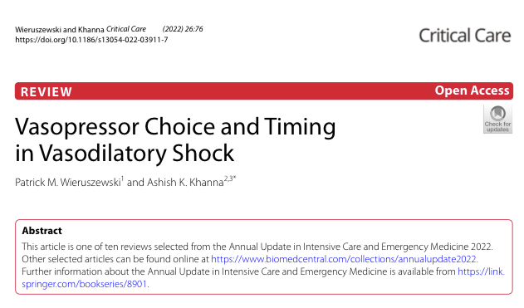

Slide 3
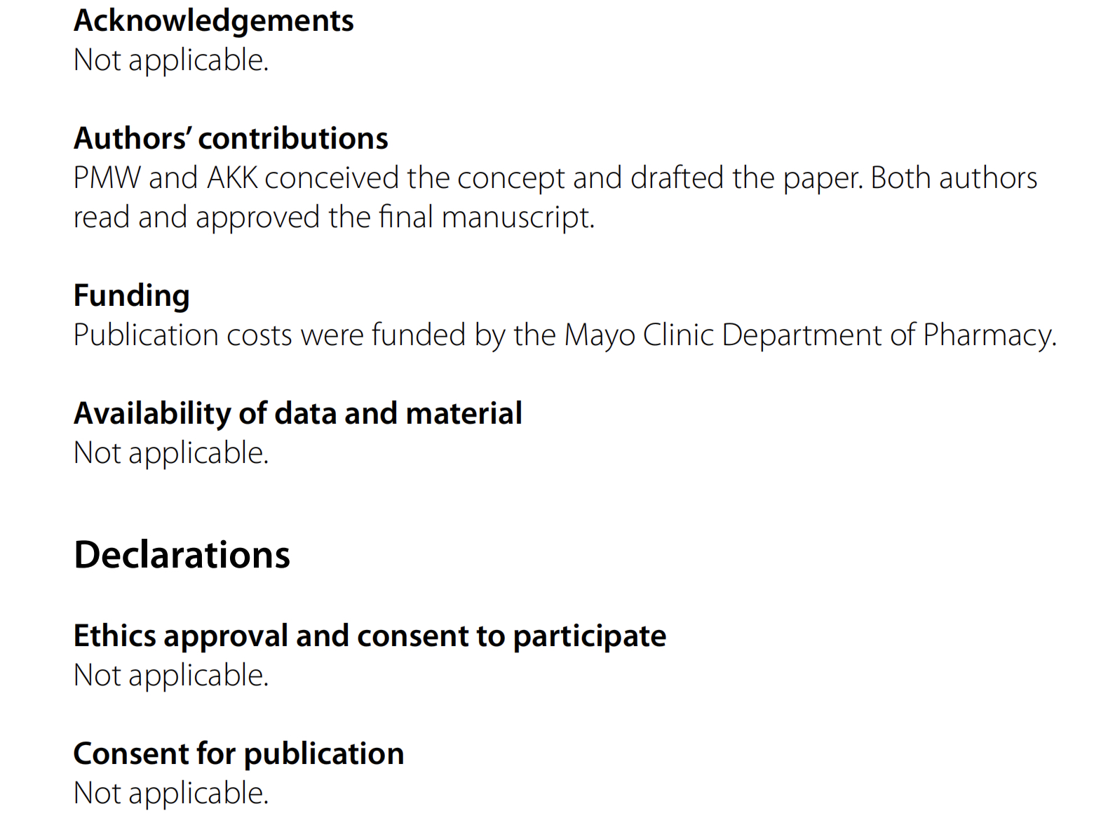

Slide 4
Introduction
Most common circulatory shock in ICU patients- vasodilatory shock
Sepsis- predominant etiology
Medical emergency
Reduced systemic vascular resistance and arterial hypotension.
Untreated- decreased O2 utilization, anaerobic metabolism, multi-organ failure, death

Slide 5
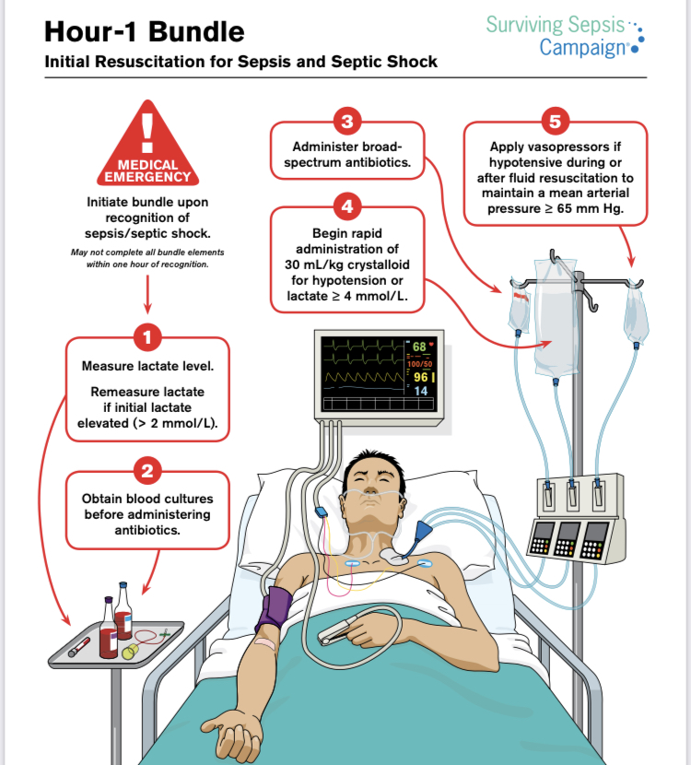

Slide 6
Balanced vasopressor approach
Classic approach- catecholamines applied and titrated.
Traditionally- initiate noradrenaline, uptitrate, reach refractoriness, then next vasopressor.
Delay attaining adequate perfusion pressure- leads to multi-organ failure.
End point of treatment failure- Refractory vasodilatory shock.

Slide 7
clinically characterized by a lack of sustainable adequate MAP despite increasing doses of a single or multiple vasopressors .
This state is a molecular combination of a complex set of physiological alterations coming together,
altered microcirculatory flow,
membrane hyperpolarization,
cellular relaxation,
vascular reactivity

Slide 8
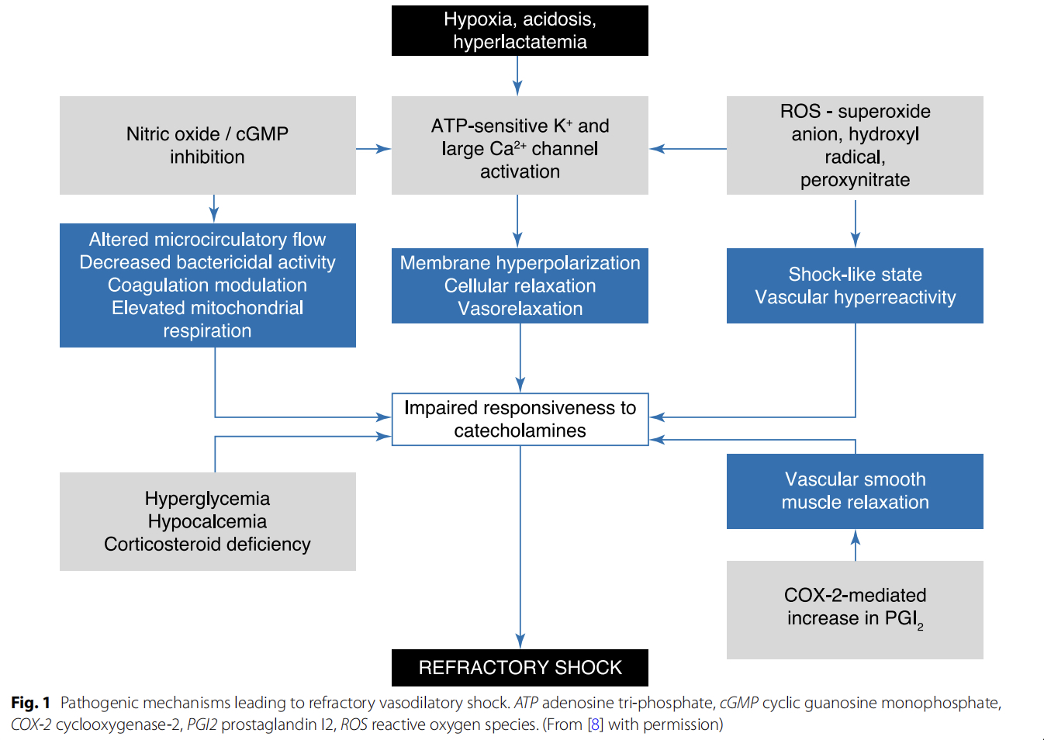

Slide 9
This approach leaves intensivists with many uncertainties,
(1) at what point do you consider norepinephrine-treatment failure,
(2) when do you apply a secondary vasopressor,
(3) which secondary vasopressor do you select?
Early, multimodal balanced vasopressor strategy as an alternative to the classic stepwise approach.

Slide 10
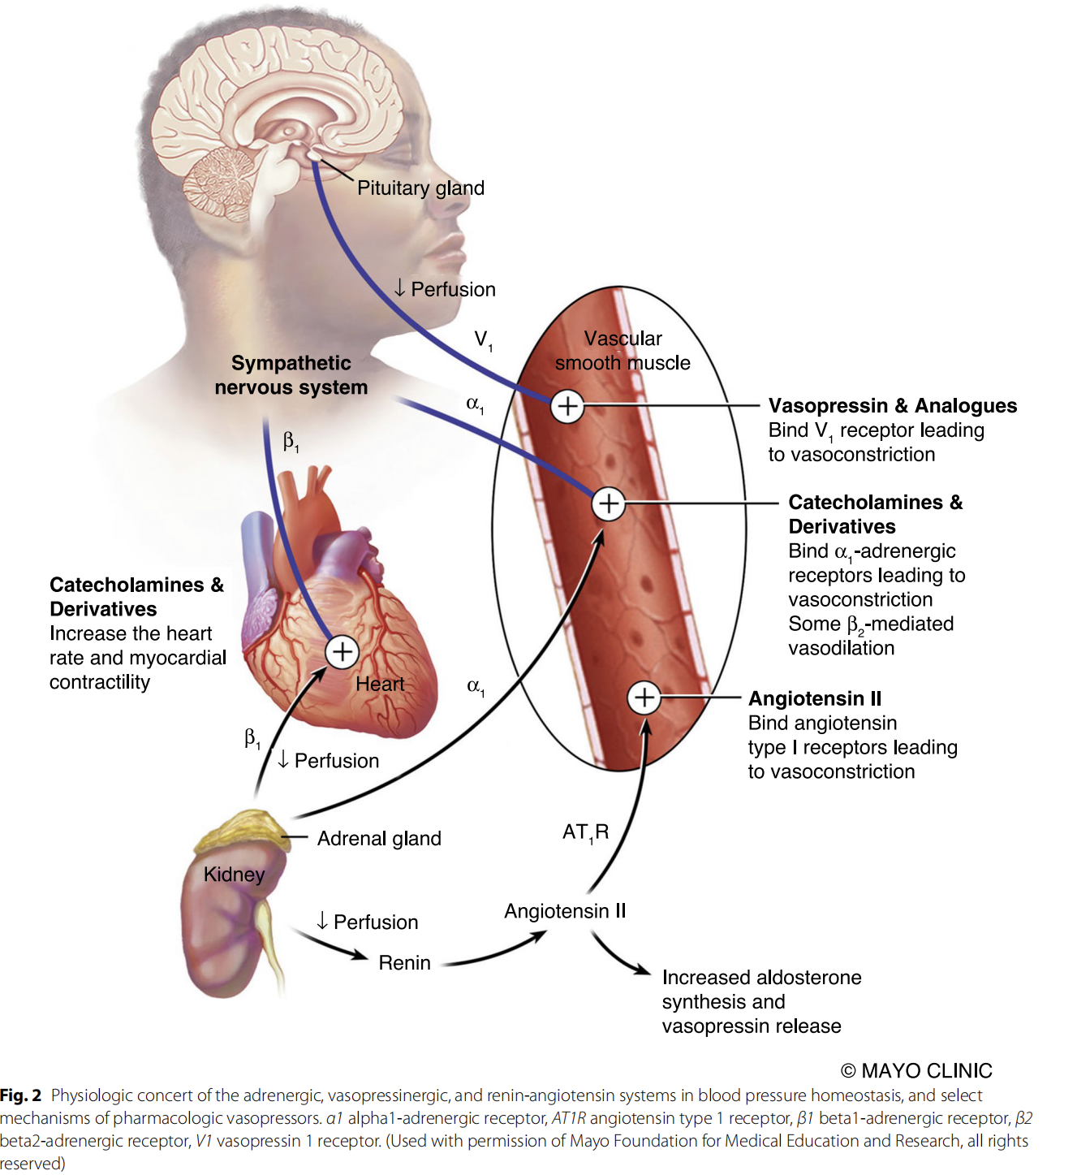
Normal blood pressure and circulatory homeostatsis
complex counter regulatory interplay of
the sympathetic nervous system, vasopressinergic system, and the renin-angiotensin system

Slide 11


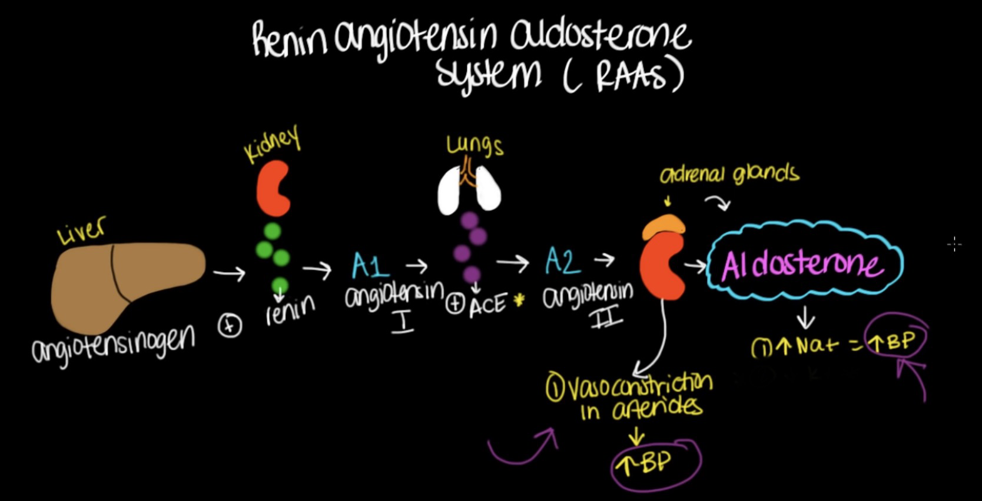

Slide 12
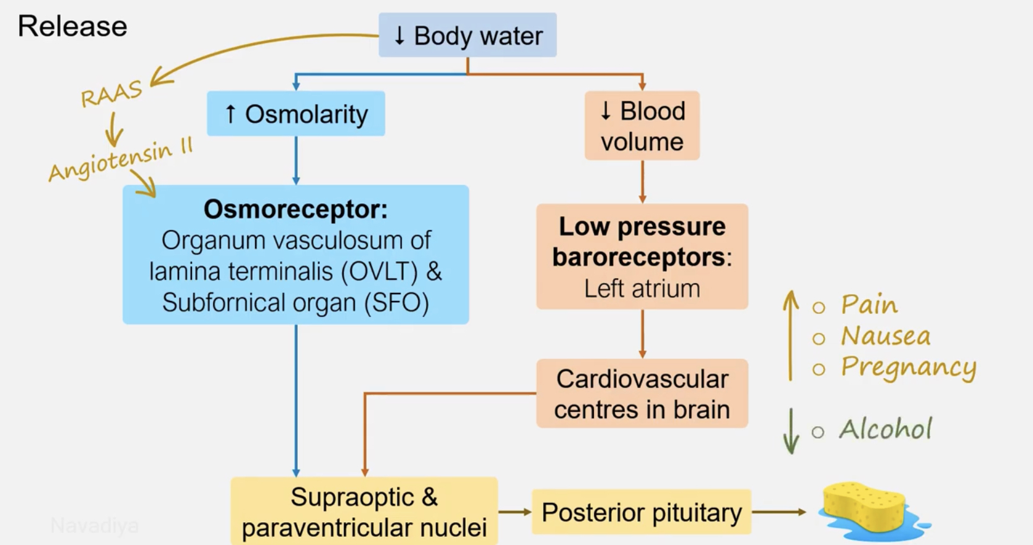

Slide 13
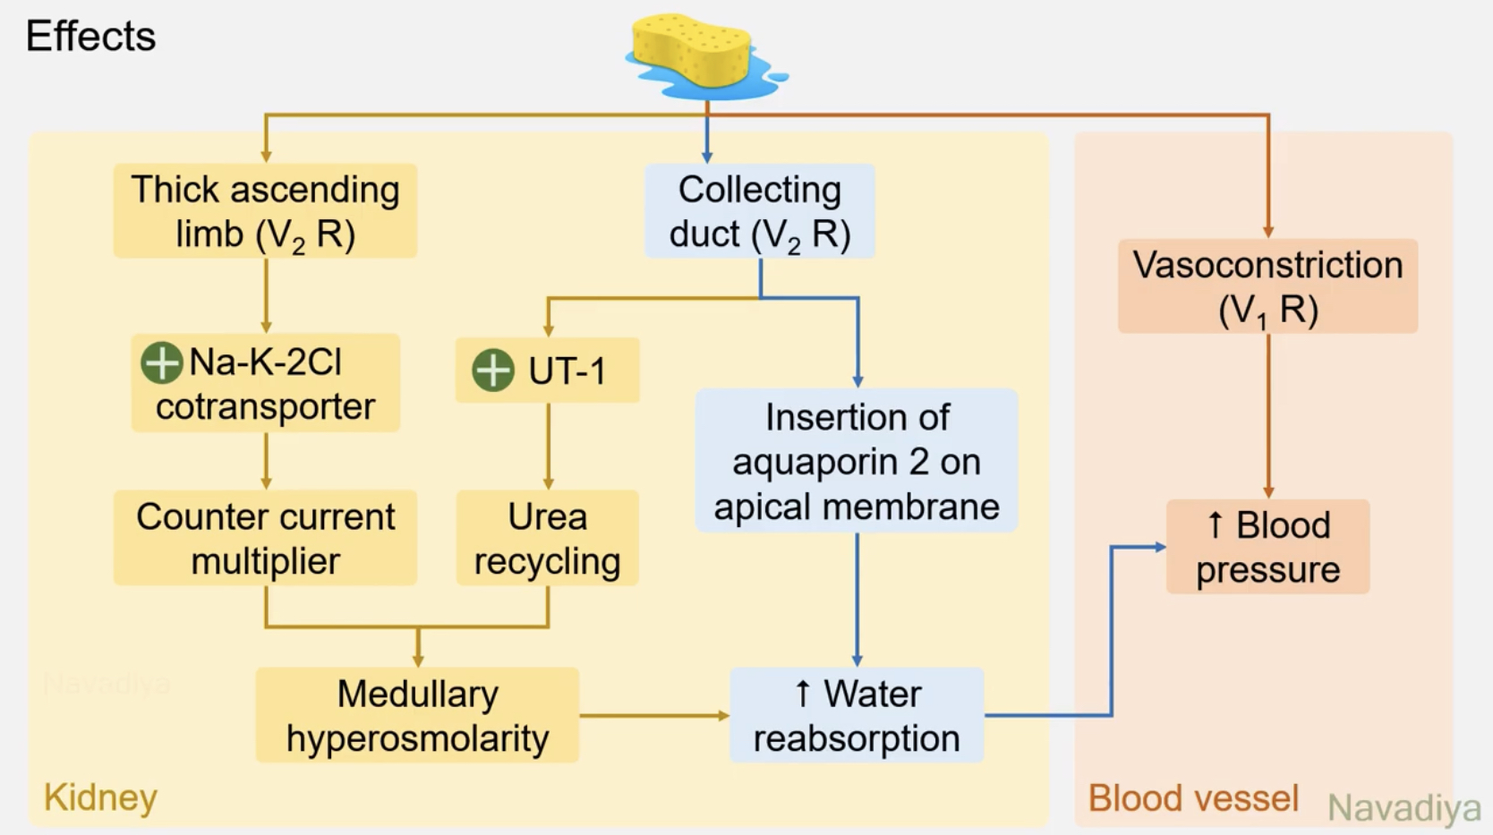

Slide 14
Homeostatic balance disrupted when these systems are offset.
Most objective finding- Macro-circulatory dysfunction- measure systemic blood pressure.
Microvascular and tissue damage
The systems responsible for homeostasis are also impaired:
Sepsis -hyperdynamic state, but the heart rate variability is decreased- sympathetic system affected.
Serum vasopressin levels are lower.
Various angiotensin receptors are down regulated- vascular hyporeactivity.
impaired endogenous catecholamine secretion

Slide 15
Timing
Goal of resuscitation- attain satisfactory perfusion pressure.
Delay- worsens organ failure and increases risk of mortality.
Increased in hospital death- most profound if vasopressor initiation delay > 14 hour
Increased risk of death for every hour in delay of vasopressors.
Study by Colon Hidalgo and Patel J et al - vasopressor recipients within 6 hours-
Achieved MAP twice as fast (1.5 vs 3 hours)
More time off vasopressors in 72 hours of shock
Three times more likely to survive at 30 days.

Slide 16
CENSER study
Pioneer study in concept of early initiation of vasopressors
Prospective double blind randomised trial
Noradrenaline initiation within 1 hour.
Early noradrenaline recipients- greater likelihood of shock reversal:
MAP > 65mm Hg for 2 readings
Urine output >0.5 ml/ kg/ hour for 2 hours
10 % reduction in lactate levels from baseline
Less likely to experience cardiogenic pulmonary edema or arrhythmias.

Slide 17
A recent large retrospective cohort- there is an increase in in-hospital mortality when there was a delay in initiation of vasopressin from shock onset ( 2.1 to 12.2 hours) and increasing lactate concentration.
Attention and more opportunity should be given for non-catecholamine vasopressors to act when the physiological milieu is still favourable.

Slide 18
Hyperlactatemia
Pathologic shock leads to arterial hypotension leading to regional and global tissue hypoxia.
Oxygen utilisation at cellular level is impaired and there is inadequate mitochondrial oxidation.
Hyperdynamic state secondary to stress leads to glycolysis.
Net result- hyperlactatemia, exacerbated by acidosis and impaired hepatic clearance.
Hallmark of poor prognosis in vasodilatory shock.

Slide 19
Initial lactose concentrations were higher (7.3 mmol/l) in those who died within 24 hours of presentation.
In a multivariable analysis, initial lactate concentration and organ failures as measured by mSOFA score were independent predictors of early death.
Lactate > 4mmol/l is an independent factor associated with a threefold greater risk of 28 day death in septic shock.
Even in patients requiring vasopressors, those with at least one lactate concentration > 2.5 mmol/l at any time during shock course has nearly half (57.1%) survival than those without hyperlactatemia.

Slide 20
Lactate concentration also provide insight into vasopressor selection.
But response is twice as likely among those with lower lactate concentrations.
When vasopressin addition to first line noradrenalin was delayed, odds of in-hospital death increased with increasing lactate concentration by as much as 18% per mmol/l at 12 hours from shock onset.

Slide 21
Catecholamine burden
Most obvious consequence of classic stepwise vasopressor approach.
Vasoconstrictive at alpha-adrenergic receptors throughout the vascular periphery-
Ischemic digits
Splanchnic hypoxia
Necrosis
In addition, Beta-receptor stimulation at myocardium makes these agents intolerable.
Arrhythmias occur in upto one-third of norepinephrine recipients.
Patients requiring higher doses, had mortality rates ranging from 60 – 90 %.

Slide 22
VASST trial
Catecholamine dosage is an easy bed side marker for deciding on vasopressor escalation.
Patients who received vasopressin when noradrenaline dose was < 15 micro gram/ min had lower 28 day and 90 day mortality.
Similarly in a recent analysis of > 1500 septic shock patients, in-hospital mortality was increased by 20.7% for every 10 micro gram/ min increase in noradrenaline dosage with addition of vasopressin as second line agent.
All data suggests that hemodynamic restoration and shock reversal- crucial determinant of survival probability.

Slide 23
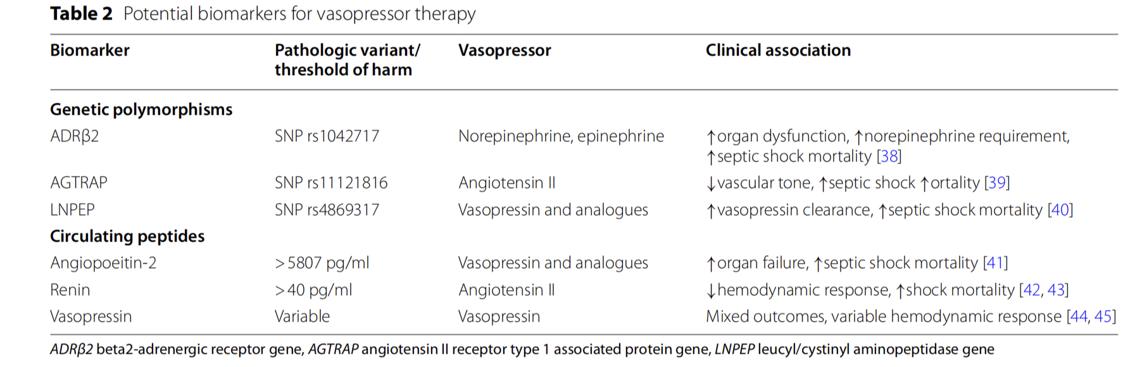
Path to personalisation:
Early multimodal vasopressor therapy
Phenotypic prognostication and pharmacologic response needs to be characterised- Tailor vasopressor therapy.

Slide 24
Serum Renin
Rapidly emerging potentially superior predictor of mortality in shock states in ICU.
Absolute renin threshold concentration and rate of rise of renin were both found to be superior to lactate in association with ICU and in-hospital mortality in critically ill patients.
It is more stable and concentration not influenced by renal replacement therapy or drugs altering renin-angiotensin cascade.
In patients with high-renin shock, angiotensin II has been shown to favourably benefit survival outcomes.
Limitation- lack of a true point-of-care assay to allow targeted resuscitation at bedside in response to concentration in a timely manner.

Slide 25
‘Broad-spectrum vasopressors’
Use of lower doses of multiple different classes of vasopressors.
This is in combination with extensive use of biomarkers.
The approach should be to de-escalate from the use of multiple biomarkers to a single one that stands out as clear signal of harm for the patient.

Slide 26
Example- Consider a patient with septic shock where vasopressin levels are disproportionately low compared with increase in lactate and renin,
Initial administration of vasopressin shows a clinical benefit.
So after initial broad spectrum strategy achieves perfusion targets, therapy should be transitioned into a vasopressin heavy approach.
Similarly, in the setting of high serum renin, an exquisite response to angiotensin II is an obvious rationale to continue with angiotensin II heavy vasopressor approach.

Slide 27
There is also benign shock, low dose catecholamine is all that is necessary.
Use of non-vasoconstricting adjuncts like corticosteroids targeted at the underlying pathology as catecholamine sparing strategies should not be ignored.
A balanced approach should be followed in the overall resuscitation of vaso-dilatory shock.

Slide 28
Conclusion
The classic approach is the stepwise escalation of vasopressors that lead to prolonged states of hypoperfusion, hyperlactatemia, excess Catecholamine exposure and poor outcome.
Therefore, an early balanced multimodal vasopressor therapy strategy provides a physiologic- guided approach to the complex, multifactorial pathogenesis of vasodilatory shock.
More data is needed in the development of biomarkers in individualised approach to vasopressor therapy in shock states.

Slide 29
References
Vincent JL, De Backer D. Circulatory shock. N Engl J Med. 2013;369:1726–34.
Khanna AK, Maheshwari K, Mao G, et al. Association between mean arterial pressure and acute kidney injury and a composite of myocardial injury and mortality in postoperative critically ill patients. Crit Care Med. 2019;47:910–7.
Maheshwari K, Nathanson BH, Munson SH, et al. The relationship between ICU hypotension and in-hospital mortality and morbidity in septic patients. Intensive Care Med. 2018;44:857–67.
Evans L, Rhodes A, Alhazzani W, et al. Surviving sepsis campaign: inter‑national guidelines for management of sepsis and septic shock 2021. Intensive Care Med. 2021;47:1181–247.
Scheeren TWL, Bakker J, De Backer D, et al. Current use of vasopressors in septic shock. Ann Intensive Care. 2019;9:20.
Beck V, Chateau D, Bryson GL, et al. Timing of vasopressor initiation and mortality in septic shock: a cohort study. Crit Care. 2014;18:R97
Gleeson PJ, Crippa IA, Mongkolpun W, et al. Renin as a marker of tissue-perfusion and prognosis in critically ill patients. Crit Care Med

Slide 30
Thank you

