Slide 1
RENIN ANGIOTENSIN SYSTEM INHIBITON IN ADVANCED CHRONIC KIDNEY DISEASES
Nov 3 2022 nejm
Chaithra k
Jr medicine

Slide 2
In patients with mild or moderate c/c kidney disease use of ACE inhibitors and ARBs reduces BP, slows decline in eGFR , reduces proteinuria delays progression to CKD.
Progression to advanced CKD is associated with increased risk of RRT, cardiovascular events and death
Current guidelines donot provide specific advice on whether to continue or stop ACE inhibitors and ARBs

Slide 3
This study Conducted the multicenter, randomized, open-label STOP-ACEi trial involving patients with advanced and progressive chronic kidney disease to assess whether the discontinution of RAS inhibitors would increase or stabilize the eGFR.

Slide 4
METHODS
Trial design
Patient underwent screening at 39 centres in UK
Trial was funded by national Institute for Health research and medical research council

Slide 5
METHODS- patient selection
Adults >18 yrs with stage 4 or 5 with CKD(eGFR-<30ml/1.73 m2 of body surface area)-if they are not receiving dialysis and had not undergone kidney transplantation
All eligible patients were required to have had a decreaseof > 2ml/minute /1.73m2/yr in the eGFR during the previous 2 yrs and to have been receiving treatment with an ACE inhibitor or ARB or both for more than 6 months
GFR measured using MDRD GFR calculator
Patients were randomly assigned 1:1 ratio either to continue /discontinue RAS inhibitors

Slide 6
In the 2 groups, target BP was 140/85mmHg
In the group that discontinued RAS inhibitors, any other antihypertensive agents was given—reinitiation was only last resort
In the continuation group clinician chose the agent and dose of RAS inhibitor, could combine it with any other antihypertensives
Follow up of all patients every 3 months after randomization for 3 yrs
Data censoring was performed at 3 years

Slide 7
Results
Patients
From 2014 to 2018 a total of 17290 patients screened in 39 centres
Of these 411 at the 37 Centres underwent randomisation to a trial group with 206 in discontinuationgroup and 205 in continuation group
Median age was 63 yrs and eGFR was 18 ml/Minute/1.73m2

Slide 8
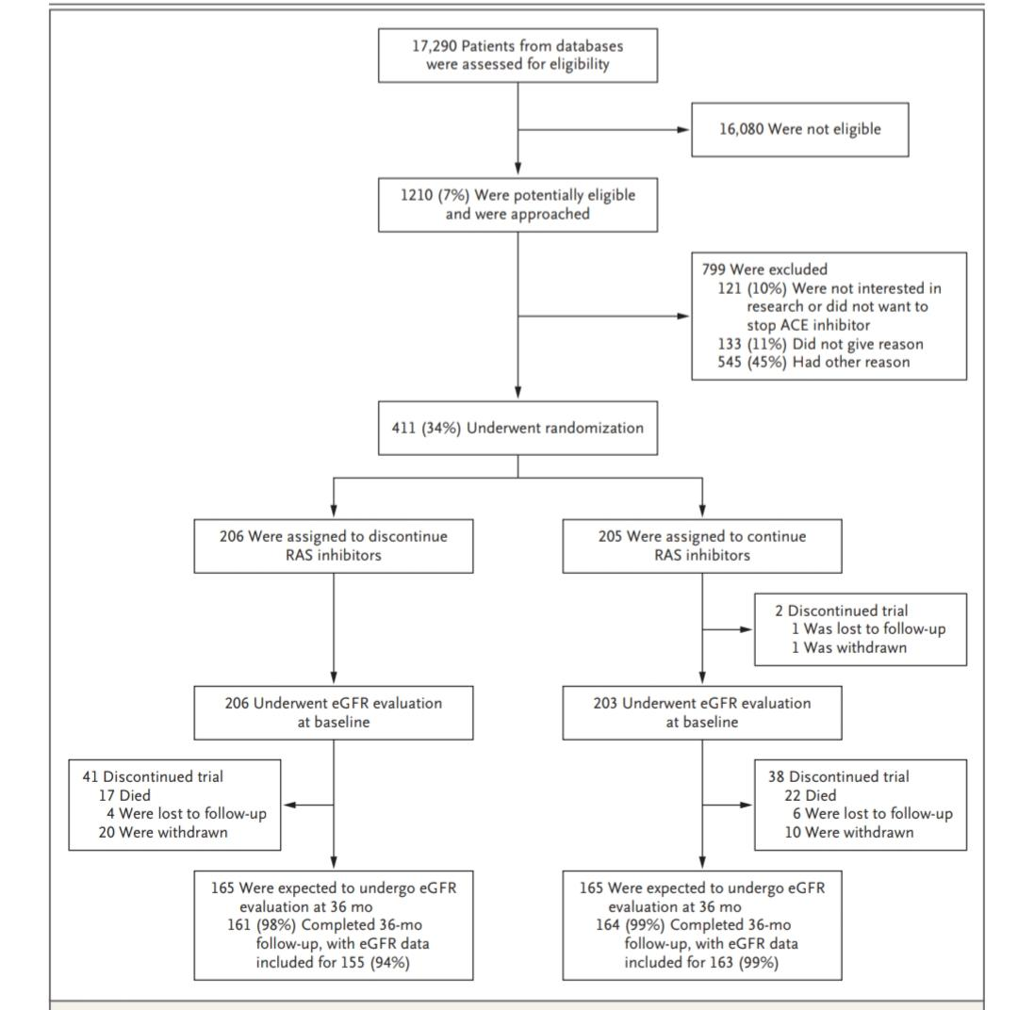

Slide 9
RESULTS
PRIMARY OUTCOME
eGFR at 3 yrs was measured as primay outcome
at 3 yrs among 411 patients eGFR of discontinuation group was 12.6+/-0.7
Continuation group was 13.3+/-0.6
P value =0.42
95% confidence interval ,-2.5 to1

Slide 10
SECONDARY OUTCOME
It included the development of ESKD / intitiation of RRT
ESKD OR initiation of RRT occurred in 128 pts(62%) in discontinuation and in 115 pts(56%)in continuation group
Adverse events were similar in the discontinuation and continuation group
with respect to cardiovascular events(108 vs 88) and deaths(20 vs22)

Slide 11
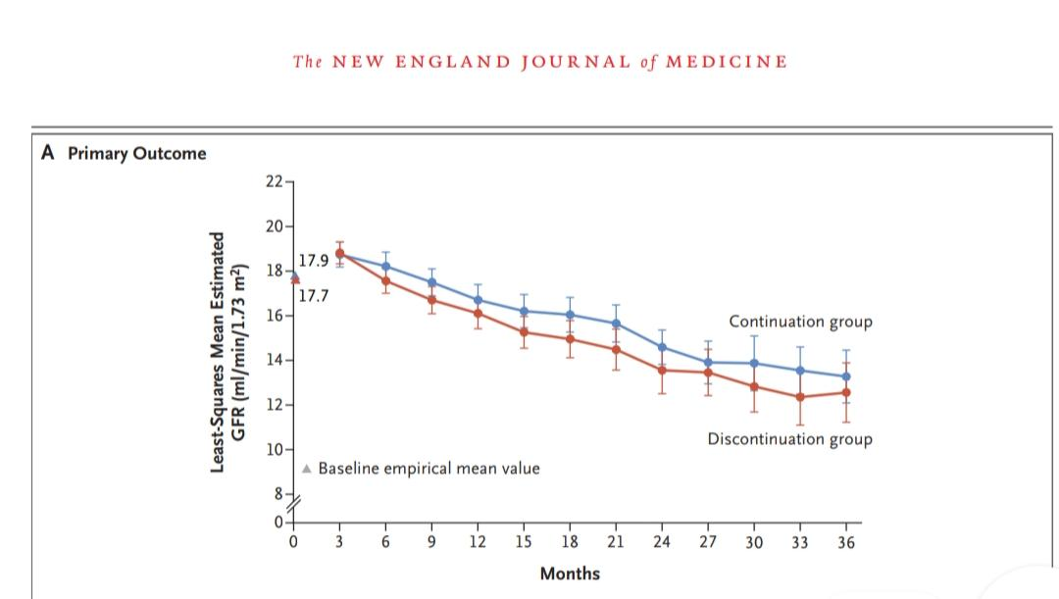

Slide 12
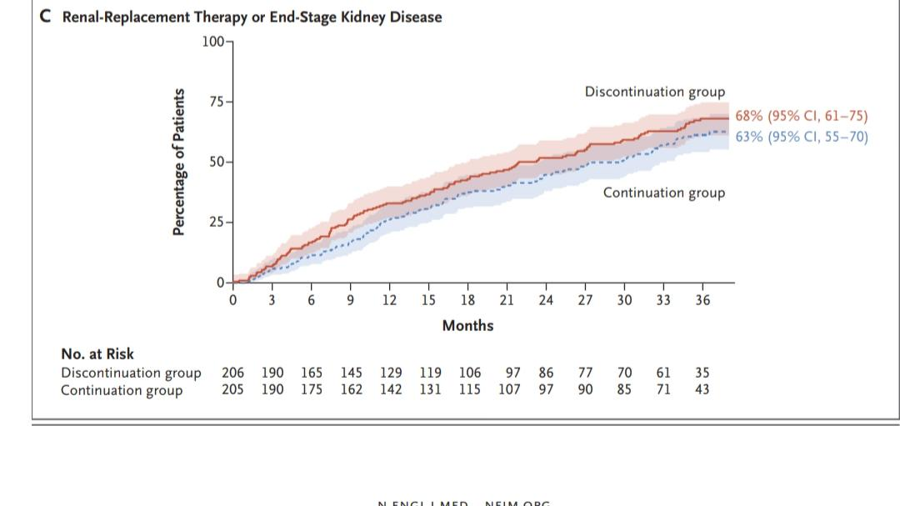

Slide 13
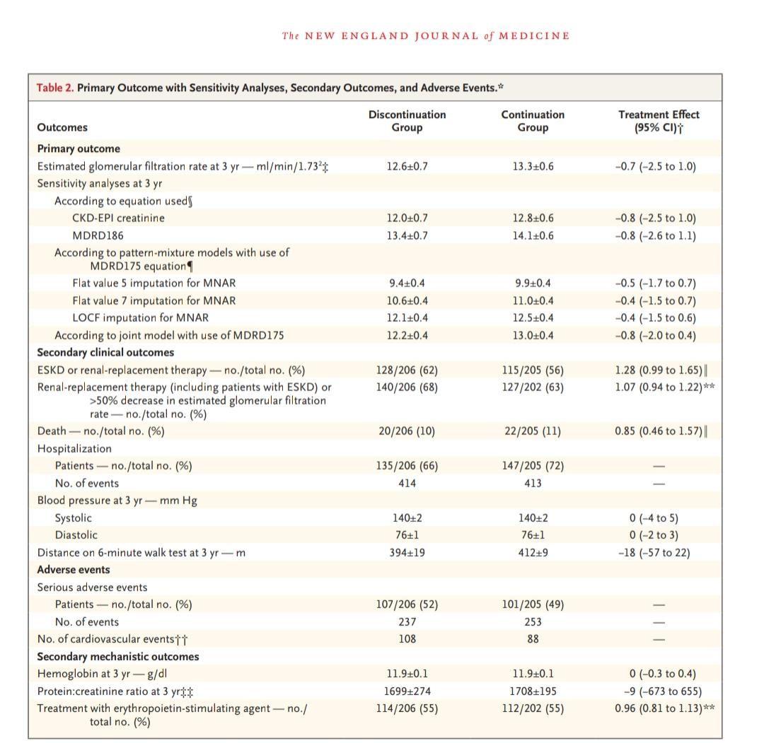

Slide 14
CONCLUSIONS
Among patients with advanced and progressive chronic kidney disease, the discontinuation of RAS inhibitors was not associated with a significant between-group difference in the long-term rate of decrease in the eGFR.
During the first year of follow-up, higher levels of systolic and diastolic blood pressures were observed in the discontinuation group, but there was little difference in these measures thereafter,

Slide 15
The numbers of hospitalizations for any reason were similar in the discontinuationgroup group and the continuation group (414 and 413, respectively),
During the first year after randomization, the discontinuation group had a transient increase in protein level, but little between-group difference was observed thereafter
The mean hemoglobin level was similar in the two groups at 3 years

Slide 16
No material differences in quality of life or exercise capacity were observed between the two groups.
In this trial, the discontinuation of RAS in-
hibitors in patients with advanced and progres-
sive chronic kidney disease did not lead to a
clinically relevant change in the eGFR or a be-
tween-group difference in the long-term rate of
decline in the eGFR

Slide 17
THANK YOU

