Slide 1
APPROACH TO PROTEINURIA
Dr Ibrahim Ali Saleem
JR2, General Medicine

Slide 2
Proteinuria : The ORIGINS
Almost always – Kidney
Pathological proteinuria : mainly affect glomerulus (esp podocyte)
Little albumin is filtered in health.

Slide 3
What about the normally filtered proteins?
Filtered proteins (mostly albumin) – internalized by proximal tubule
Surface proteins - cubulin, megalin
Degraded in lysosomes
Cubulin mutations – proteinuria (2g/day)
Cubulin polymorphisms – Variance in ACR in general population

Slide 4
The proteins in normal urine!
3 groups of proteins in normal urine
1. filtered protein, not reabsorbed - albumin
2. proteins actively secreted into urine
3. proteins lost from cells in the nephron and urinary tract
Serum proteins - Albumin – most abundant, alpha1 antitrypsin, alpha1 microglobulin
Secreted and structural proteins – Uromodulin (Tamm-Horsfall)
Notes:
Tamm Horsfall – secreted into Thick ascending limb, early distal tubule. Imp part of casts

Slide 5
Other proteins in urine
Tamm-Horsfall, IgA, Urokinase – Secreted by tubules
Beta2 macroglobulin, apoproteins, enzymes, peptide hormones – filtered freely.
Excessive production of abnormal protein – Overflow proteinuria
Exceeds tubular resorption capacity
Eg: plasma cell dyscrasia(MM),amyloidosis, lymphomas (with associated mononclonal light chain production)

Slide 6
Biomarker in urine for disease processes
ALBUMIN remains the best biomarker.

Slide 7
What normally prevents proteinuria?
Charge and size selectivity prevents proteins from crossing the glomerular wall
Normal glomerular endothelial cell – barrier with 100 nm pores – retain blood cells, allow passage of proteins
Glomerular basement membrane – traps large proteins (>100kDA)
Foot processes of epithelial cells – podocytes - slit diaphragms – allow molecular passage of small solutes, water, not proteins

Slide 8
If this barrier is disrupted – protein leaks into urine – glomerular proteinuria
Smaller proteins (<20kDa) – freely filtered but readily reabsorbed by the proximal tubule
In MCD – fusion of glomerular epithelial foot processes – selective loss of albumin – selective proteinuria
Other glomerular diseases – disrupted BM and podocytes – loss of albumin and other proteins - non selective proteinuria

Slide 9
PATHOLOGICAL PROTEINURIA
1. Glomerular proteinuria
Filter permeable to larger molecules. Common.
2.Tubular proteinuria
Proximal tubular damage – resorption defective. Less common.
3. Overflow proteinuria
Increase in filterable protein concentration in plasma
Resorptive capacity exceeded
Ig light chains/fragments, Lysozyme in monomyelocytic leukemia

Slide 10
Discerning the origin of proteinuria
1.QUANTITY.
>1.5 – 2 g/day proteinuria – very unlikely tubular pathology
s/o glomerular leak, nephrotic syndromes
2.RATIO.
ACR : PCR ratio > 0.4 – glomerular disease
< 0.4 – non albumin proteinuria

Slide 11
3. SPECIFIC ASSAYS FOR TUBULAR PROTEINS.
Identify LMW proteins which did not get internalized
Beta2 microglobulin <0.4 microgram/L – normal
Also – retininol binding protein, alpha1 microglobulin, lysozyme
4. TESTS FOR OVERFLOW OR EXOGENOUS PROTEINS.
Immunofixation for light chains - Bence Jones proteins.
SDS-PAGE gel electrophoresis – tubular proteinuria vs overflow proteinuria vs exogenous ( factitious – Munchausen syndrome )
Notes:
SDS-PAGE – Sodium dodecyl sulphate

Slide 12
PROGNOSTIC SIGNIFICANCE OF PROTEINURIA
Proteinuria implicated in worse cardiovascular outcomes in population studies (more than renal)
In patients with known renal disease - worse renal outcomes

Slide 13
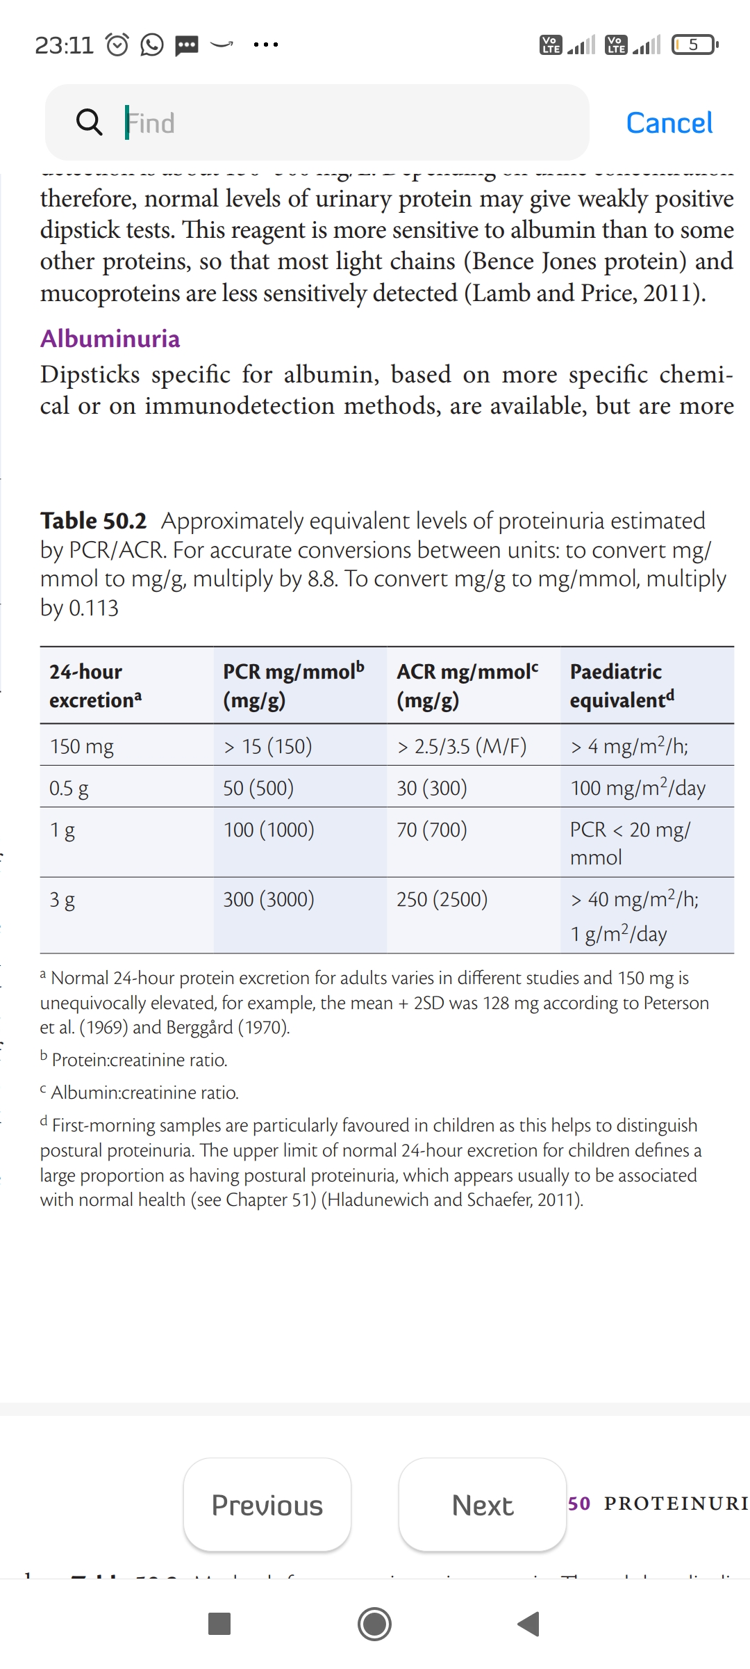
TESTING FOR PROTEINURIA
24-hr protein excretion – Normal <= 150mg/day (PCR – 15mg/mmol)

Slide 14
DIPSTICKS
TOTAL PROTEIN:
Detection based on color reactivity
Tetrabromphenol blue
Yellow – absence of protein at pH 3, Green – protein +
Lower limit of detection – 150 to 300mg/L
More sensitive to albumin.
False positive : at ph > 7, blood contamination, very dilute urine
Notes:
Alkaline urine interferes with this test.

Slide 15
DIPSTICKS
ALBUMINURIA:
Specific for albumin
More expensive
Microalbuminuria detection requires ACR or timed excretion test

Slide 16
PCR and ACR
24 hr collection of urine sample for protein excretion – inconvenient, error prone.
Urine ACR or PCR correlates well with 24hr excretion rates
Spot urine samples preferred now over 24hr sampling

Slide 17
METHODS FOR MEASURING URINE PROTEIN IN LAB
SULPHOSALICYLIC ACID TEST – earlier used. verifies dipstick results
Kjedahl – reference and research method
Biuret
Turbidimetric
Dye-binding
Nephelometric – measures albumin excretion, not total protein
Stick tests – usual clinical screening test

Slide 18
EVALUATION OF PROTEINURIA
Typically initiated after detection of proteinuria by dipstick test
Normal healthy individuals – trace or + levels
2-5% children,5% young adults, 16% elderly – proteinuria + on testing a single sample

Slide 19
Confirm and quantitate!
1. Check for HAEMATURIA
2. Exclude INFECTIONS – nitrites,wbc, microscopy, culture
Chyluria – lymphatic disease – rare – non renal proteinuria
Large no of lymphocytes in urine

Slide 20
3. Exclude TRANSIENT PROTEINURIA
Postural proteinuria - mc diagnosis in children and young people
First-in-morning sample tested
Post – exercise proteinuria – within hrs of exercise
Transient proteinuria during fever
Heart Failure

Slide 21
4. FACTITIOUS AND PSEUDOPROTEINURIA
Factitious - Munchausen – Electrophoresis detects it
Pseudoproteinuria – gelatin based volume expanders – gelofusine

Slide 22
DEGREE OF PROTEINURIA
1. NEPHROTIC RANGE
Proteinuria > 3g/day
40mg/m^2/day in children
PCR> 300mg/mmol or 3000mg/g
Almost always – glomerular disease
Investigations and renal biopsy indicated
MCD,FSGS, Membranous Nephropathy

Slide 23
PROTEINURIA 1-3g/day
Hematuria, Renal impairment, Young pts – further investigations, nephrological assessment required at even lesser proteinuria
<2-2.5g/day – consider tubular proteinuria
If glomerular cause not apparent - ACR/PCR ratio
ACR/PCR ratio <0.4 – non glomerular proteinuria
Consider and evaluate for Plasma cell dyscrasias

Slide 24
PROTEINURIA 0.3 to 1.0g/day
chances for identification of a specific glomerular disease - lower
Look for pointers – genetic,infective,systemic disease
Hematuria - ? Glomerular disease
Relevant in young pts – longer disease duration

Slide 25
MICROALBUMINURIA
Deranged function of glomerular filtration barrier
In cardiovascular disease – reduced capacity of proximal tubules for reabsorption
Young patients – likely early glomerular disease
Older patients – less specific test for renal disease

Slide 26
ASSESS OTHER RENAL RISK FACTORS
Family history, Drug history, HTN, low or falling eGFR
ASSESS AND MANAGE CARDIOVASCULAR RISK
Proteinuria a/w increased CVD and death
Worse risk with severity of proteinuria
ACE-I reduce proteinuria.
DAPA CKD TRIAL – Dapagliflozin reduces proteinuria in IgA nephropathy

Slide 27
