Slide 1
Prophylaxis of Rheumatic Fever/Rheumatic Heart Disease–Penicillin or Azithromycin, Who Wins?
Review article - Published online: 2021-04-13

Slide 2
The more than seven decades old Jones criteria for diagnosis and management of rheumatic fever (RF) should only form a skeleton base for today's way of diagnosis and management of RHD and not copied ad verbatim

Slide 3
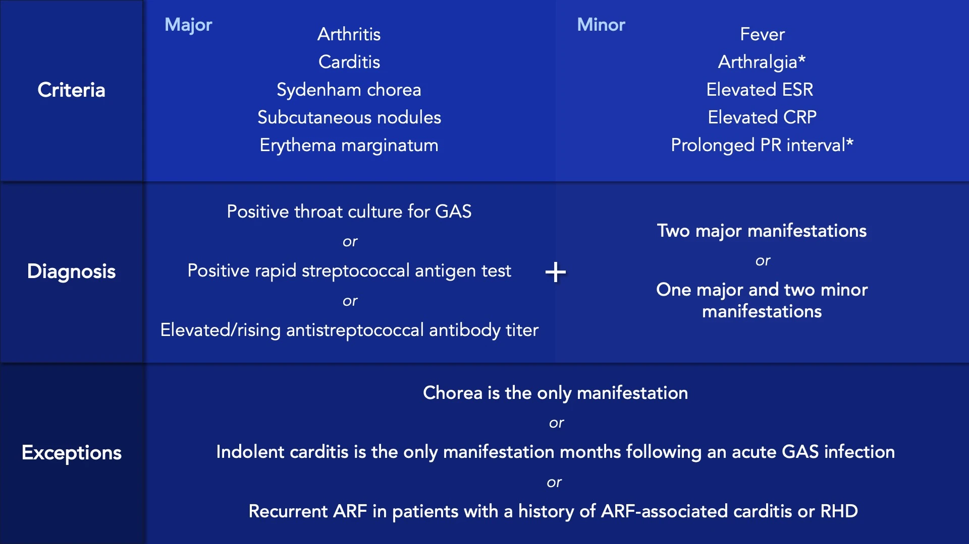

Slide 4
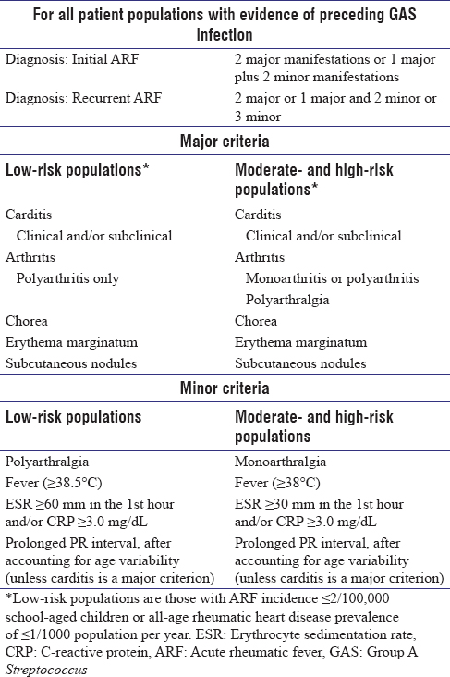

Slide 5
ARMOR for treatment and prophylaxis:
Acute rheumatic fever (ARF) begins with respiratory tract infection (RTI) or sore throat caused by group A β-hemolytic streptococci (GABHS).
Treatment and prophylaxis should be started on suspicion of RF/rheumatic heart disease (RHD

Slide 6
therefore, diagnostic criteria must include echo Doppler study.

Slide 7
For decades, the drug in use, such as penicillin, have failed to check the disease, prevent the disease, reduce the severity, or significantly alter the course of the disease.*

Slide 8
A study by the International RF study group from
11 countries in 1790 patients showed recurrence in 45 percent of patients who received benzathine penicillin prophylaxis compared with 11.5% who failed to comply

Slide 9
For more than five decades, the primary treatment and secondary prophylaxis of RF/RHD has been BPG injection,
1.2 million units after a sensitivity test and repeated every 21 days in the same dose with inconsistent results

Slide 10
Despite the discovery of a drug like azithromycin, which has a miraculous curative effect on the causative agent of RF/RHD, that is, group A streptococcus, it has not found a place in textbooks in the chapter on RF/RHD.

Slide 11
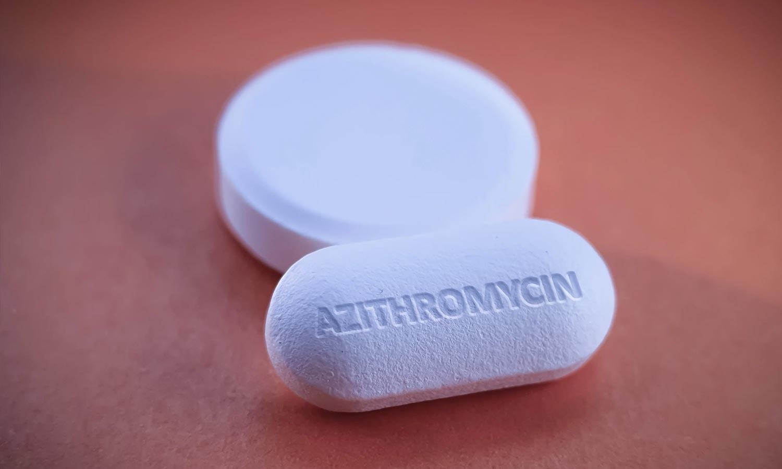
azithromycin is a class of antibiotics called Azalides.
The chemical name of azithromycin is 9-deoxy9- za9-a-methyl-9-ahomoerythromycin.
The molecular weight is 749.0.
Mode of action is inhibition of protein synthesis in bacteria by binding to 50s ribosomal subunits and preventing translocation of peptides

Slide 12
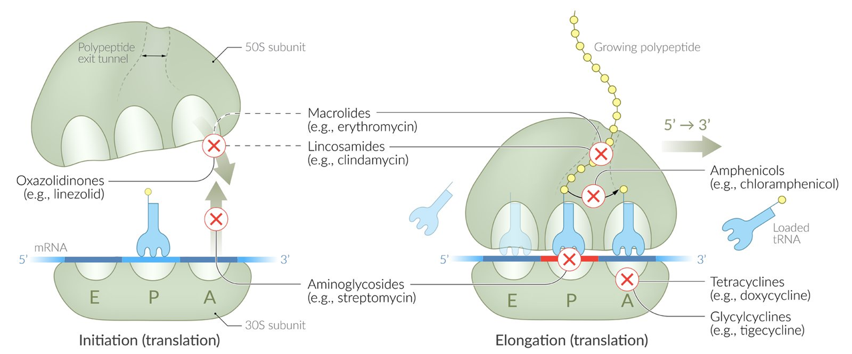
Mode of action

Slide 13
The advantages of Azithromycin for prophylaxis of
RF/RHD
Its long half-life, requiring only once a week administration.
Safety profile.
Autoimmune suppressant property

Slide 14
Suppressing inflammatory process in the heart.
It is effective orally, no degradation by the gastric acids.
It is well-absorbed, especially on an empty stomach.
Peak concentration achieved in 2.1 to 3.2 hours when taken orally and in 1 hour with IV administration

Slide 15
Due to its high concentration in phagocytes, the drug reaches the infection site.
From the phagocytes, the drug is released in graded manner with large concentrations at the infected site.

Slide 16
Due to ion trapping and high-lipid solubility in the plasma, the azithromycin concentration is 50 times higher than in tissues.
The concentration of azithromycin in lungs and tonsils exceeds MIC 90 after a single dose of 500 mg, which is a significant advantage.

Slide 17
Due to its long half-life, it requires a single dose per day.
Able to maintain the bacteriostatic drug levels for several days in infected tissue.
After a single dose of 500 mg of azithromycin, plasma concentration decreases in a polyphasic pattern with an elimination half-life of 68 hours.
However, the prolonged half-life of the drug is due to the extensive uptake and graded release of drug from tissues

Slide 18
If started with 500 mg daily for 5 consecutive days; in tissues, the drug persists for up to 6 days.
For treatment prevention and cure of RF/RHD, our focus should be to eradicate the GABHS infection as early as possible

Slide 19
The best drug for GABHS is azithromycin which, if started within 9 days of sore throat, can prevent almost all cases of ARF

Slide 20
Usually, the sore throat of viral or bacterial etiology resolves itself in 3 to 5 days.
Even after symptomatic improvement the full course of azithromycin 500 mg (12 mg/kg) once daily for 5 days should be given to prevent RF/RHD.

Slide 21
Secondary Prevention of RF
It is well-known that a patient who has had an attack of ARF is more prone to subsequent attacks, leading to progressive damage of the heart valves

Slide 22
An antibiotic effective against GABHS is essential to prevent organic heart valve disease by the culprit streptococci

Slide 23
For the past several decades, BPG 1.2 million units at intervals of 21 days has been the mainstay of treatment. Other antibiotics effective against group A streptococcus require daily dose.
Since 1991, after the discovery of azithromycin, it is the drug of choice for Group A Streptococcal (GAS) infections, and therefore it should be the drug of choice for RF/RHD because not to forget it is the causative organism, which should be the target of treatment

Slide 24
Below is a list of reasons for replacing Penicillin with
Azithromycin:
1. Today, healthcare workers avoid giving penicillin injections due to a fatal reaction in as much as 1 in 10000 among 20 lakh patients of RF/RHD in the world (AHA Scientific Statement Circulation March 24, 2009).3
2. BPG is unavailable and even sold at a very high cost in most developing countries.
3. The supply and demand ratio of benzathine penicillin is too low

Slide 25
4. Penicillin injection can result in severe reaction even after several doses; therefore, sensitivity tests and consent are required each time.
5. When there is an option of a painless, risk-free, safe, readily available oral drug, it is unethical to use an older, toxic drug without offering the patient the choice. Today, it is not a “take or die” situation.
6. Penicillin injection is oily, painful, more than 2 mL in quantity, to be given deep intramuscular, and challenging to be administered to cachectic malnourished children.

Slide 26
7. Penicillin itself causes transient valvulitis of mitral and aortic valve after injection, so, ironically, this prompts the physician to continue the injections for another 5 years or even lifelong.
8. Penicillin has interactions with drugs coprescribed in RF, that is, warfarin, aspirin, diuretics, etc.
9. Accidental IV injection can cause cardiorespiratory arrest and death

Slide 27
10. Hypersensitivity and allergic reactions are common.
11. Pseudomembranous colitis occurs with repeated injections.
12. Clostridium difficile associated diarrhea (CDAD) occurs, which increases morbidity and mortality.
13. Penicillin causes pain, fever, swelling, and inflammation, which are itself the features of the disease RF, increasing the morbidity due to RF and even anaphylaxis, resulting in mortality

Slide 28
The miracle solution is as follows
Tablet azithromycin 500 mg once daily for 5 days consecutively as initial treatment followed by prophylaxis with tablet azithromycin 500 mg once a week for 1 year only.
In children, a single dose of 10 mg/kg or 20 mg/kg for 3 days only can be given with good efficacy.
Above 5 years of age, a daily dose of 500 mg may be given

Slide 29
Explanation
Given only once in a week, azithromycin is sufficient to eradicate GAS infections and suppress any autoimmune destructive process

Slide 30
The inflammatory process may start in the heart valves within 9 days.
If the drug is to be given weekly for prophylaxis, 500 mg continued for 5days should be the starting dose to prolong the half-life of the drug

Slide 31
Up to 6 days, the drug persists in the tissues, if given according to this regime.
Azithromycin may be continued for 1 year in case of any relapse recurrence, new infection, any symptoms or feature of RF/RHD, or even started again if any features of RF occur

Slide 32
However, Each time azithromycin is started or switched to it must be given in a dose of 500 mg for 5 days

Slide 33
It should be used with caution in renal failure but safe in moderate hepatic impairment. Azithromycin is safe in pregnancy.

Slide 34
To prevent a recurrence, a serum penicillin level of > 0.02 µgm/mL is required.
However, with azithromycin, serum level is irrelevant, as it persists in tissues in high concentrations, and therefore it is more efficacious.
Azithromycin, if started within 9 days of sore throat, can prevent all cases of RF/RHD

Slide 35
The general reluctance to switch from penicillin to a new drug is because of the presumption that penicillin is the only drug efficacious in RF/RHD and the gold standard.
However, the question is, what is penicillin's role in RHD; after all, it is just used for its antistreptococcal efficacy, and that is all

Slide 36
Therefore, if a better drug with superior efficacy against GABHS is there without the disadvantages of penicillin and with which patient compliance be assured, should it not replace penicillin posthaste?

Slide 37
The rationale for giving azithromycin prophylaxis for only 1 year is that various studies have shown that it takes at least 2 weeks after a streptococcal infection for autoimmune destruction of heart valves
it is doubtful that the bacteria or its products could cause RHD after more than 3 months of entry.

Slide 38
Even in poststreptococcal reactive arthritis, valvular heart disease (VHD) is seen only for a few months after the streptococcal infection.
The recommendation is for only 1 year of secondary prophylaxis in these patients

Slide 39
The present recommendation of the American Heart Association for the duration of prophylaxis with BPG is 5 years to lifelong after the attack with a footer that this can be modified according to circumstances.

Slide 40
This footer makes it evident that the duration of treatment has been arbitrarily decided
time interval for causing autoimmune damage,
time gap for causing heart valve destruction from carditis,
persistence, disappearance, susceptibility of the bacteria,
epidemiological factors,
individual resistance, and comparison with other drugs have not been taken into consideration

Slide 41
A drug that has to be taken lifelong cannot be labeled prophylactic.
A drug that causes more risk to life than the disease cannot be used for prophylaxis.
There cannot be a better, more effective, safe long-acting oral drug for GAS than azithromycin

Slide 42
No doubt that for prophylaxis and treatment of RF/RHD, azithromycin wins hands down over BPG.

Slide 43
Arati Lalchandani et al In a study at GSVM Medical College, Kanpur, azithromycin was used exclusively in RF/RHD in patients from in and around Kanpur belonging to the lower socioeconomic strata.
The incidence of RF/RHD is approximately 4 per 1000

Slide 44
ARMOR criteria
Arthritis or arthralgia with typical features suggestive of RF, carditis or cardiac involvement, typical of RF or RHD, and echocardiographic evidence of rheumatic heart valve involvement should essentially be the criteria to diagnose RF and RHD with high specificity and sensitivity

Slide 45
ARMOR: Arati’s Regime for Management of RF
Azithromycin must be given in a dose of 500 mg one tablet daily for 5 days,
followed by one tablet once a week for 1 year for primary prevention, treatment and secondary prophylaxis of RF/RHD, respectively

Slide 46
Thank you

