Slide 1
APPROACH TO A PATIENT WITH HEART MURMUR
DR ARYA IGNATIOUS
JUNIOR RESIDENT
DEPT OF GENERAL MEDICINE

Slide 2
BASICS
S1 : CLOSURE OF AV VALVES
S2 : CLOSURE OF SEMILUNAR VALVES
SYSTOLE : PERIOD BETWEEN S1 AND S2
BLOOD FLOWS ACROSS AORTIC AND PULMONARY VALVES
DIASTOLE : PERIOD BETWEEN S2 AND S1
BLOOD FLOWS ACROSS MITRAL AND TRICUSPID VALVES

Slide 3
SIGNIFICANCE OF A MURMUR
When someone is found to have a murmur,
the murmur is organic (pathologic) ? Or ? a normal variant.
A "yes“ indicates structural cardiovascular disease.
determine the hemodynamic cause of the murmur and the anatomic origin.
Next, the possible etiologies of the heart disease should be investigated, and thus an assessment of the severity of the underlying condition can be made.

Slide 4
CLUES TO IDENTIFY PATHOLOGICAL MURMURS
All diastolic murmurs
All pansystolic and late systolic murmurs
Continuous murmurs
Very loud murmurs(grade 4 or higher)
Associated cardiac abnormalities (presence of left ventricular hypertrophy on precordial palpation, an ejection or midsystolic click, or an opening snap would suggest that the heart murmur represents a cardiac structural abnormality)

Slide 5
PHYSIOLOGY
Heart murmurs are caused by audible vibrations that are due to
  increased turbulence from accelerated blood flow through normal or abnormal orifices.
  flow through a narrowed or irregular orifice into a dilated vessel or chamber,
  or
  If blood flows in an abnormal direction; say (1)backward flow through an incompetent valve (2) ventricular septal defect, or (3) patent ductus arteriosus.

Slide 6
Thus, turbulence is thought to be the primary factor in the genesis of heart murmurs.
Determinants of turbulence :
  the velocity of blood flow; increase in velocity result in marked increase in turbulence.
  An obstruction to blood flow, like stenosis produces abnormal turbulence.
  Turbulence increases as the pressure gradient across the valve becomes larger.
  Turbulence increases when blood moves from a small to large chamber.
  Low blood viscosity (e.g., anemia) enhances turbulence.

Slide 7
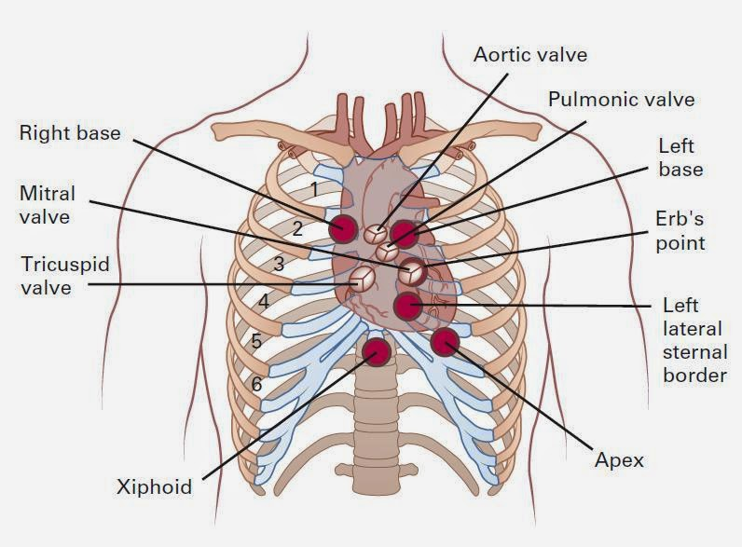
AREAS OF AUSCULTATION

Slide 8
CHARACTERISITCS OF A HEART MURMUR
The following features of murmurs should be consciously analyzed in each patient:
  Whether the murmur is systolic or diastolic
  The timing of the murmur within systole or diastole : early, mid, or late
  The duration of the murmur
  The intensity or loudness of the murmur, e.g., its grade
  The location and radiation of murmur
  The shape and pitch of the murmur
  Other cardiac abnormalities present on examination that may relate to the etiology of the murmur.

Slide 9
TIMING
Identify S1 and S2. Palpating the carotid pulse helps to determine the onset of ventricular systole. The carotid upstroke closely follows S1.
Systolic murmurs begin with or after the first heart sound (S1) and terminate at or before the component (A2 or P2) of the second heart sound (S2) that corresponds to their site of origin.
Diastolic murmurs begin with or after the associated component of S2 and end at or before the subsequent S1.
Continuous murmurs are not confined to either phase of the cardiac cycle but instead begin in early systole and proceed through S2 into all or part of diastole.

Slide 10
Within systole:
  Early systolic
  Mid – systolic
  Late – systolic
  Holocystolic
Within diastole
  Early diastolic
  Mid- diastolic

Slide 11
DURATION
SYSTOLE
The duration of a heart murmur depends on the length of time over which a pressure difference exists between two cardiac chambers, the left ventricle and the aorta, the right ventricle and the pulmonary artery, or the great vessels.
Any murmur that is truly holo- or pansystolic, regardless of shape, is caused by continuous pressure differential between two cardiac chambers.
Thus, the classic murmurs of a ventricular septal defect or mitral regurgitation begin with S1 and extend through S2. Severe obstruction of the left or right ventricular outflow tract (severe Aortic or Pulmonary stenosis) may cause a prolonged systolic murmur that is actually pansystolic.

Slide 12
The presence of a long systolic murmur should stimulate a careful evaluation of late systole through the use of selective listening. A careful focus on the last 25% of systole is important.
If sound vibrations end before S2 ie spares the last 1/3rd of systole, the murmur is usually an ejection murmur.
If the murmur extends to S2 (pansystolic), the differential diagnosis should include regurgitant lesions as well as severe, semilunar valvular stenosis.

Slide 13
DIASTOLE
Flow across a nonobstructive or mildly stenotic A-V valve produces a short mid-diastolic murmur
A long diastolic murmur following an opening snap is indicative of a persistent A-V gradient and significant mitral stenosis. With short cycle lengths, these murmurs will extend to S1.
Murmurs of aortic and pulmonary regurgitation start in early diastole and extend into mid-diastole.

Slide 14
INTENSITY
  grade 1 – very soft heard with great effort
  grade 2 – easily heard
  grade 3 – loud but without thrill
  grade 4 – loud with thrill
  grade 5 – heard with stethoscope edge touching the chest (thrill present)
  grade 6 – heard with stethoscope slightly off the chest
  Grade 3 or more indicates a structural heart disease .

Slide 15
It also implies high blood flow velocity at the site of murmur production. (eg: Small VSDs are accompanied by loud; usually grade 4 or greater systolic murmurs )
Factors diminishing intensity:
  obesity
  obstructive lung disease
  a large pericardial effusion.
  when cardiac output is reduced significantly
  when the pressure gradient between the involved cardiac structures is low.

Slide 16
Increased Intensity
  High cardiac output (hyperdynamic) states
  Thin chest wall
  Narrow thoracic diameter, e.g., "straight back," pectus excavatum
  Anemia (decreased blood viscosity)
  Tortuous aorta (close to chest wall)

Slide 17
LOCATION AND RADIATION
Recognition of the location and radiation of the murmur help facilitate its accurate identification.
Adventitious sounds, such as a systolic click or diastolic snap, or abnormalities of S1 or S2 may provide additional clues.
SHAPE
Crescendo
Crescendo-decrescendo : eg Aortic stenosis
Decrescendo: eg chronic Aortic regurgitation

Slide 18
Plateau: chronic Mitral regurgitation
PITCH
HIGH – WHISTLE LOW- RUMBLE
High pitched murmurs often correspond to high pressure gradients, hence the diastolic murmur of Aortic regurgitation (AR) is high pitched whereas murmur of mitral stenosis (MS) is a low frequency event.
The coarse systolic murmur of aortic stenosis (AS) may sound higher pitched and more acoustically pure at the apex :Gallavardin effect.

Slide 19
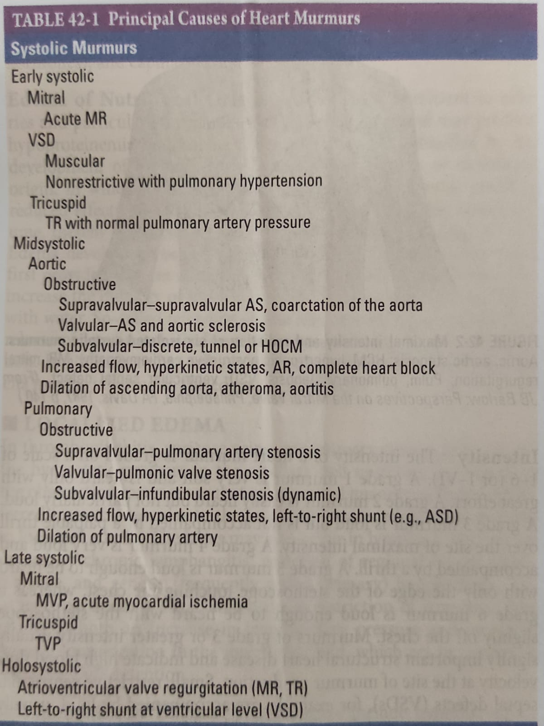

Slide 20
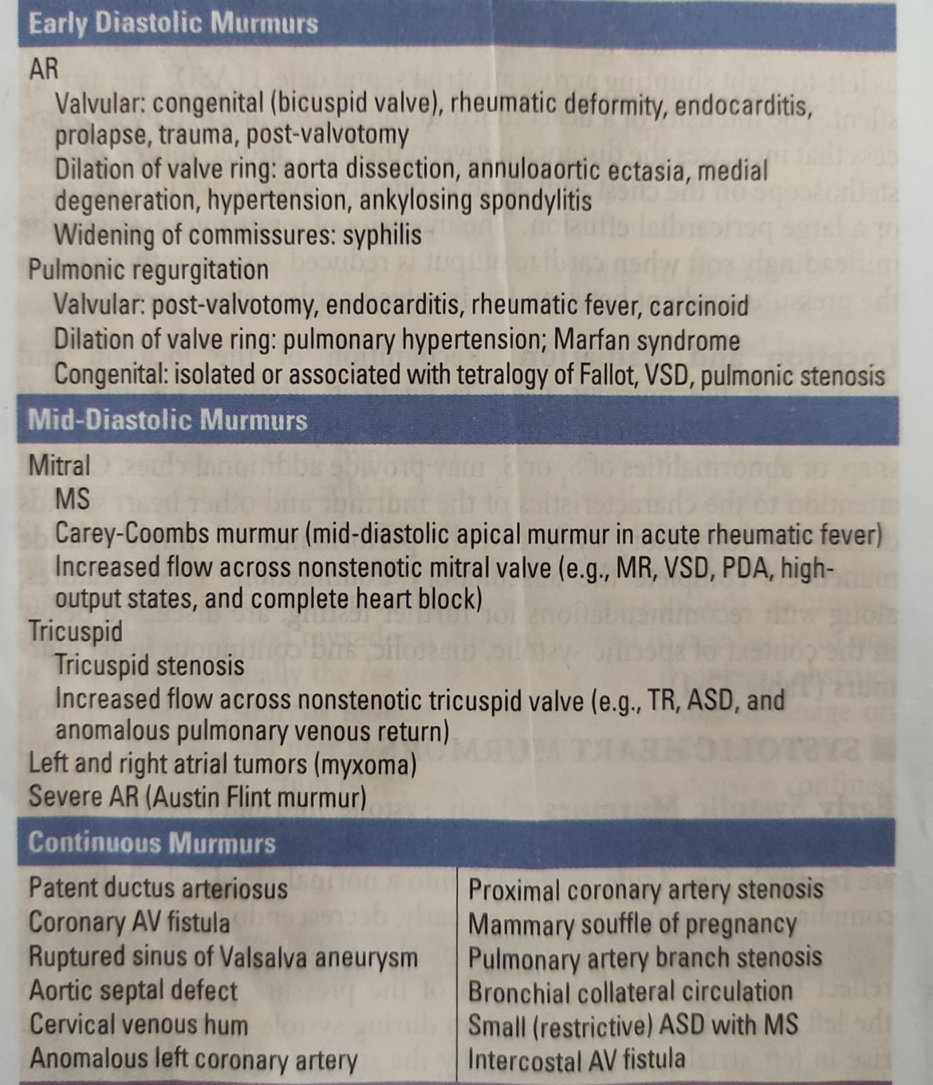
CLASSIFICATION OF MURMURS

Slide 21
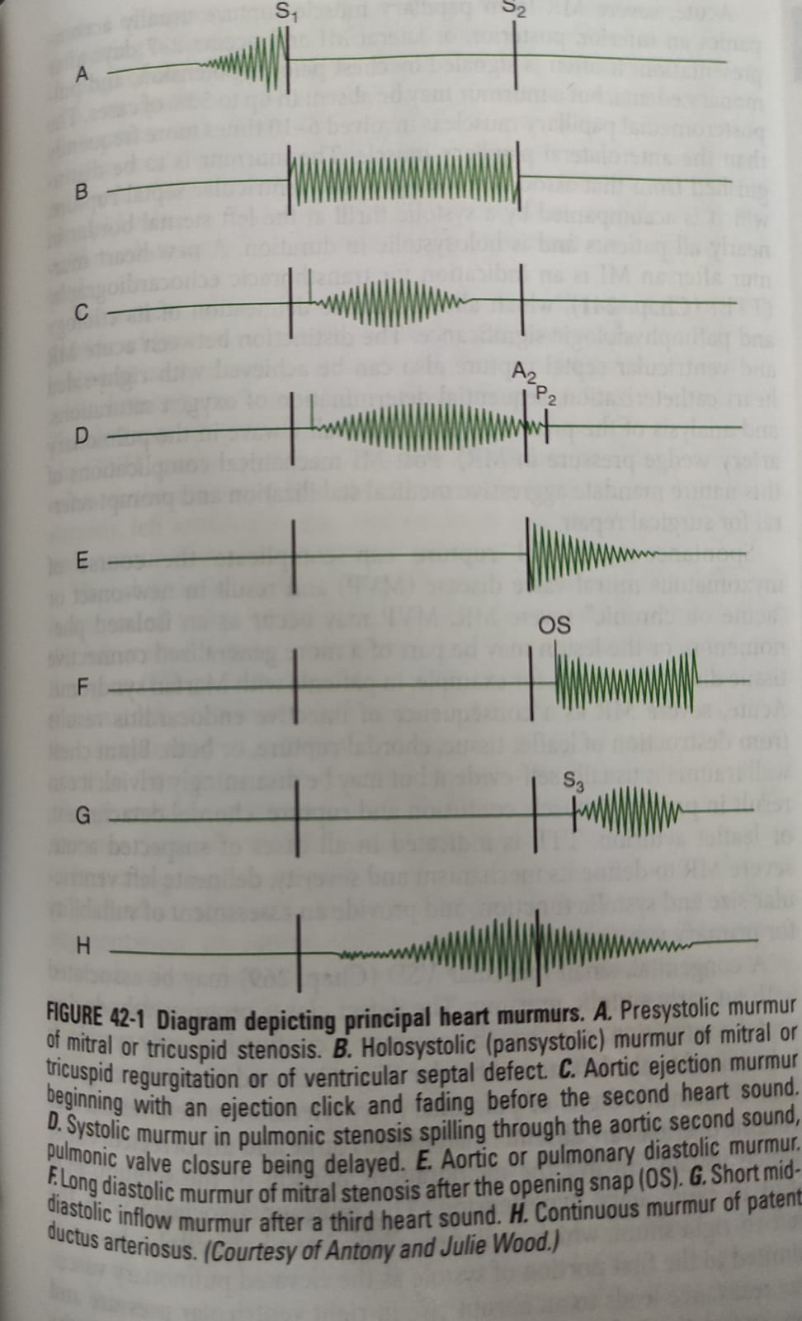
Diagram depicting the principal heart murmurs

Slide 22
SYSTOLIC MURMURS

Slide 23
EARLY SYSTOLIC MURMURS
Begin with S1,extend for a variable period and end well before S2.
1) Acute severe MR
  Regurgitation into a relatively non compliant normal sized atrium leads to early, decrescendo, best heard at or just medial to apex
  Causes papillary muscle rupture after acute MI, rupture of chordae tendinae in MVP, Infective endocarditis and Blunt chest wall trauma
2) small muscular VSD
  defect closes progressively during septal contraction.
  localised to left sternal border
  grade 4 or 5

Slide 24
3) Acute severe TR with normal pulmonary artery pressure
  Best heard at lower left sternal border
  soft: grade 1 or 2
  increase in intensity with inspiration (Carvallo’s sign)

Slide 25
MID SYSTOLIC MURMURS
Begin a short interval after S1 and end before S2
Crescendo-decrescendo in configuration
Eg : 1 AORTIC STENOSIS
  Loudest at aortic area
  radiates to carotids.
  Gallavardin Effect –transmission to apex where it becomes high pitched.

Slide 26
Features of severe AS:
  with a normal cardiac output; grade 4 or more
  soft or absent A2
  paradoxical splitting of S2,
  apical S4
  late peaking systolic murmur.
  Pulse: parvus et tardus

Slide 27
2) HOCM –
  lower left sternal border
  The intensity of the murmur may vary from beat to beat and after provocative maneuvers but usually does not exceed grade 3.
  The murmur classically will increase in intensity with maneuvers that result in increasing degrees of outflow tract obstruction, such as a reduction in preload or afterload (Valsalva, standing, vasodilators), or with an augmentation of contractility (inotropic stimulation).
  Maneuvers that increase preload (squatting, passive leg raising, volume administration) or afterload (squatting, vasopressors) or that reduce contractility (β-adrenoreceptor blockers) decrease the intensity of the murmur.

Slide 28
3) PULMONARY STENOSIS
  pulmonic area (2nd and 3rd left intercostal space)
4)Significant left to right shunting due to ASD
  Increased pulmonary blood flow and grade 2-3 midsystolic murmur at upper left sternal border with fixed split of S2
5)Aortic Valve sclerosis
  2nd right intercostal space, carotid upstrokes being normal and no LVH in ECG.

Slide 29
PHYSIOLOGIC MURMURS/ FUNCTIONAL MURMURS
Flow or Functional Murmur. These are by far the most common heart
murmurs and are found in many normal persons.
In the presence of a normal resting cardiac output the murmur is known as an innocent or functional murmur.

Slide 30
If the murmur is related to a hyperkinetic state with increased cardiac output and stroke volume, the murmur is known as a physiologic murmur.
  E.g.: in pregnancy, hyperthyroidism or anemia .
  Grade 1-2 mid systolic murmur heard the left lower sternal border
STILL’S MURMUR: Benign, grade 2, vibratory or musical midsystolic murmur at the mid or lower left sternal border in normal children and adolescents, best heard in the supine position

Slide 31
LATE SYSTOLIC MURMURS
Best heard at left ventricular apex - Mostly due to MVP – murmur is introduced by non ejection click
With the posterior leaflet prolapse – MR jet directed anteriorly and medially - murmur radiates to the base of heart and masquerades AS.
ant leaflet prolapse- posteriorly directed MR jet-radiates to axilla or left infrascapular region.

Slide 32
HOLOSYSTOLIC MURMURS
Begin with S1 continue through systole to S2
E.g. : 1 Chronic MR
Best heard at left ventricular apex, high pitched, plateau in configuration and radiates to the axilla
Causes of chronic MR : Rheumatic scarring of leaflets, Mitral annular calcification, post MI LV remodelling, severe LV enlargement (dilated cardiomyopathy)
2 Chronic TR
Softer than that of MR, loudest at lower left sternal border,
Carvallo’s sign positive

Slide 33
Associated with c-v waves in JVP, pulsatile and enlarged liver, ascites and peripheral edema
TR is more commonly a passive process.
Causes of primary TR : Endocarditis, RHD, Carcinoid, Ebsteins Anomaly
3 VSD –
Loudest at mid to lower left sternal border
radiates widely, thrill present in majority
No change with inspiration

Slide 34
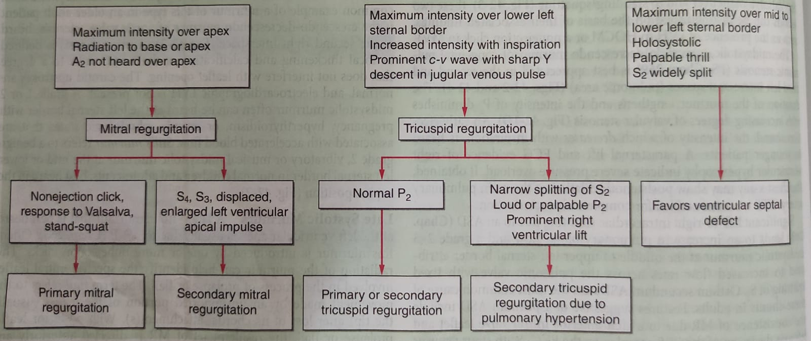

Slide 35
DIASTOLIC MURMURS

Slide 36
EARLY DIASTOLIC MURMURS
Begin immediately after S2 and end well before S1, Decrescendo in configuration
E.g. : 1 Chronic AR –
high pitched, blowing ,
second right intercostal space,
auscultated with patient leaning forward at end expiration
With primary valve disease, murmur radiated along left sternal border
When AR IS due to aortic root disease, murmur may radiate along right sternal border
  causes – Marfans syndrome with aneurysm, annuloaortic ectasia, ankylosing spondylitis, aortic dissection

Slide 37
Chronic, severe AR also may produce a lower-pitched mid to late, grade 1 or 2 diastolic murmur at the apex (Austin Flint murmur)
Distinguished from MS by absence of opening snap and response to vasodilator challenge
2 Pulmonic Regurgitation
decrescendo, early to mid-diastolic murmur (Graham Steel murmur) that begins after the pulmonic component of S2
best heard at the second left interspace, and radiates along the left sternal border.

Slide 38
The intensity of the murmur may increase with inspiration.
PR is most commonly due to dilation of the valve annulus from chronic elevation of the pulmonary artery pressure.
Signs of PAH (left parasternal heave and loud, single or narrow split S2 are present)
PR can also occur in endocarditis, with congenitally deformed valve or after repair of TOF.

Slide 39
MID DIASTOLIC MURMURS
Produced due to obstruction/augmented flow at mitral or tricuspid valve
E.g. : 1 Mitral stenosis –
  Most common cause –rheumatic fever
  opening snap shortly after S2, followed by a low pitched murmur best
  heard at LV apex with patient in lateral decubitus position
  Presystolic accentuation which disappears in atrial fibrillation
  The interval between A2 and opening snap varies inversely with the severity of stenosis.

Slide 40
2 Tricuspid stenosis –
  lower left sternal border increase in intensity with inspiration,
  prolonged y descent in jvp
3 Atrial Myxoma – may prolapse across mitral valve and obstruct LV inflow.
  No opening snap or presystolic accentuation
4 carey coombs murmur – short mid diastolic murmur in Acute Rheumatic Fever, due to flow through oedematous mitral valve

Slide 41
CONTINUOUS MURMURS
Begin in systole, peak near the second heart sound and continue into all or part of diastole
  1 PDA – best heard at Upper left sternal border
  2 Ruptured sinus of Valsalva aneurysm – upper right sternal border
  coronary arteriovenous fistula,
  At AV fistula for haemodialysis
  over intercostal collaterals in patients with coarctation of aorta
  venous hum in children and young adults (in right supraclavicular fossa)
  Mammary souffle in pregnancy

Slide 42
TO AND FRO MURMUR – in AS + AR (Here the midsystolic component decrescendos as it approaches S2)

Slide 43
DYNAMIC AUSCULTATION
RESPIRATION
Left-sided murmurs may be best heard at end expiration, when lung volumes are minimized and the heart and great vessels are brought closer to the chest wall. This phenomenon is characteristic of the murmur of AR.
Murmurs of right-sided origin, such as tricuspid or pulmonic regurgitation, increase in intensity during inspiration

Slide 44
ALTERATIONS OF SYSTEMIC VASCULAR RESISTANCE
The systolic murmurs of AR, MR and VSD become louder during sustained handgrip, simultaneous inflation of blood pressure cuffs on both upper extremities to pressures 20–40 mmHg above systolic pressure for 20 s, or infusion of a vasopressor agent. (All these maneuver raise the aortic pressure)
Murmur associated with AS or HOCM become softer or remain unchanged with these maneuvers

Slide 45
CHANGES IN VENOUS RETURN
The majority of murmurs decrease in intensity during the strain phase of the Valsalva maneuver or standing (positive intrathoracic pressure and decreased venous return)
Two notable exceptions are the murmurs associated with MVP and obstructive HOCM, both of which become louder during the Valsalva maneuver.
Squatting which increases venous return increases the intensity of all murmurs except MVP and HOCM

Slide 46
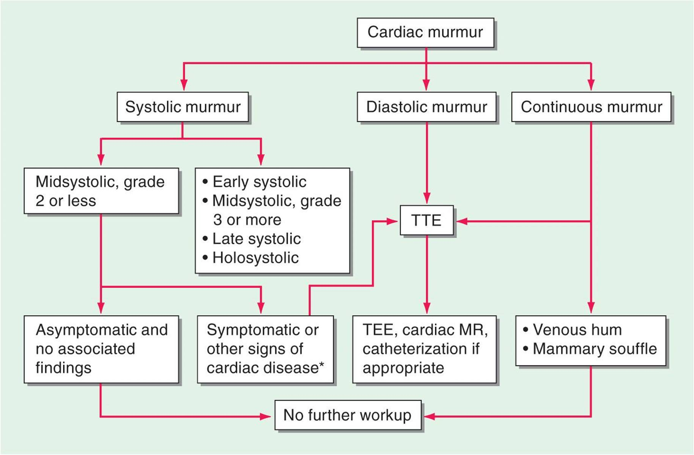
STRATEGY FOR EVALUATING HEART MURMURS

Slide 47
THANK YOU

