Slide 1
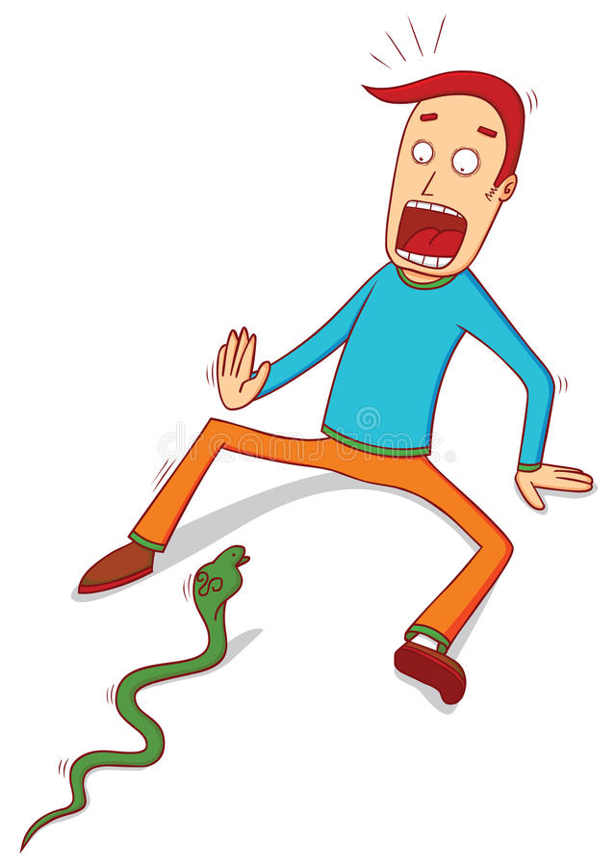

Clinical club presentation
By
Dr Vani Raj I
Jr1 under M1

Slide 2
Clinical club – BY M1 UNIT
27-01-2023
An 18 year Male ,Aman Lal from Rampur district of Uttar Pradesh,is a manual labourer at construction site at Alappuzha with no known comorbidities.
On 28-11-2022,He Presented with A/H/O unknown snake bite from his work site at around 7.30pm while he was drawing water from well
Bitten twice over (L) foot, First bite Over 1st metatarsophalangeal Joint & second bite over dorsum of (L) foot.

Slide 3
He alleged that one of his relatives Incised the bite site with shaving blade and tried to squeeze out the venomous blood.
Then he was taken to TDMC casuality at around 8:30 PM on the same date with presenting c/o
* Pain and swelling over (L) lower limb a/w blood oozing from bite(incision)
site.
No hlo bleeding manifestations like bleeding gums, hematuria,respiratory symptoms like dyspoea, decreased urine output, LOC

Slide 4
O/E
Patient was drowsy
PR – 108/min. BP- 90/60mmhg Spo2- 98% in room air
L/E : Mild swelling (+) over dorsum of (L) foot
Multiple Cut marks (+) over bite site and adjacent areas of (L) foot

Slide 5
MICU admission
Patient was shifted to MICU and a series of tests were done WBCT (Done from casuality also), BT,CT, PT/INR ,APTT, were done and Routine Investigations were sent including CBC,LFT,RFT,SE,RBS & ECG was taken
Meanwhile Patient ‘s general condition got worsened and started clo severe pain at bite site and pain over (L) calf(+) ,So ASV were administered at 9.00AM on 29-11-2022.

Slide 6
INVESTIGATIONS | 28-11-2022 | 29-11-2022 | 30-11-2022 | 01-12-2022 | 02-12-2022 | 03-12-2022 | 04-12-2022 | 05-12-2022 | 06-12-2022 | 07-12-2022 | 08-12-2022 | 09-12-2022
WBC
PLT
HB
PT
INR
APTT
S.CR
RBS

Slide 7
INVESTIGATIONS | 28-11-2022 | 29-11-2022 | 30-11-2022 | 01-12-2022 | 02-12-2022 | 03-12-2022 | 04-12-2022 | 05-12-2022 | 06-12-2022 | 07-12-2022 | 08-12-2022 | 09-12-2022
S.Bili
TP
ALB
OT/PT
ALP

Slide 8
Treatment given
DEFINITIVE TREATMENT
(1) ASV – Inj ASV 10 VIAL In 1 pint NS Over 1 hour followed by inj ASV 10VIAL in 1 pint NS over next 1 hour
SUPPORTIVE THERAPY
(1) Blood transfusion
(2) Inj PIPTAZ 2.2g IV Q8H
(3) Inj Cloxacillin 500mg Q6H

Slide 9
(4) Blood Transfusion i/v/o hemolysis
(5) Tab Ultacet 1-1-1
(6) Tab sobisis 500mg TDS
(7)Tab NAC 600mg 1-0-1
(8) Tab Udiliv 150mg 1-0-1
(9) Other supportive measures

Slide 10
Meanwhile patient developed oliguria and (L) LL cellulitis
L/E – Blackish discoloration of skin over affected area (+)
Swelling of (L) and (L) foot (+)
I/V/O cellulitis, his prescription was modified with addition of
(10) GM dressing

Slide 11
05-12-2022
Patient’ General condition got better ,(but pain over (L) leg and foot was still persisting )and hence shifted to ward 14 under M1
Meanwhile General surgery and Nephrology consultations were done and orders follwed.
But, when days passed,pain has increased and swelling of (L) LL worsened and noticed difficulty in extending (L) knee
O/E Patient was conscious oriented, PR -78/min. BP -110/80mmhg. Spo2-98% on RA

Slide 12
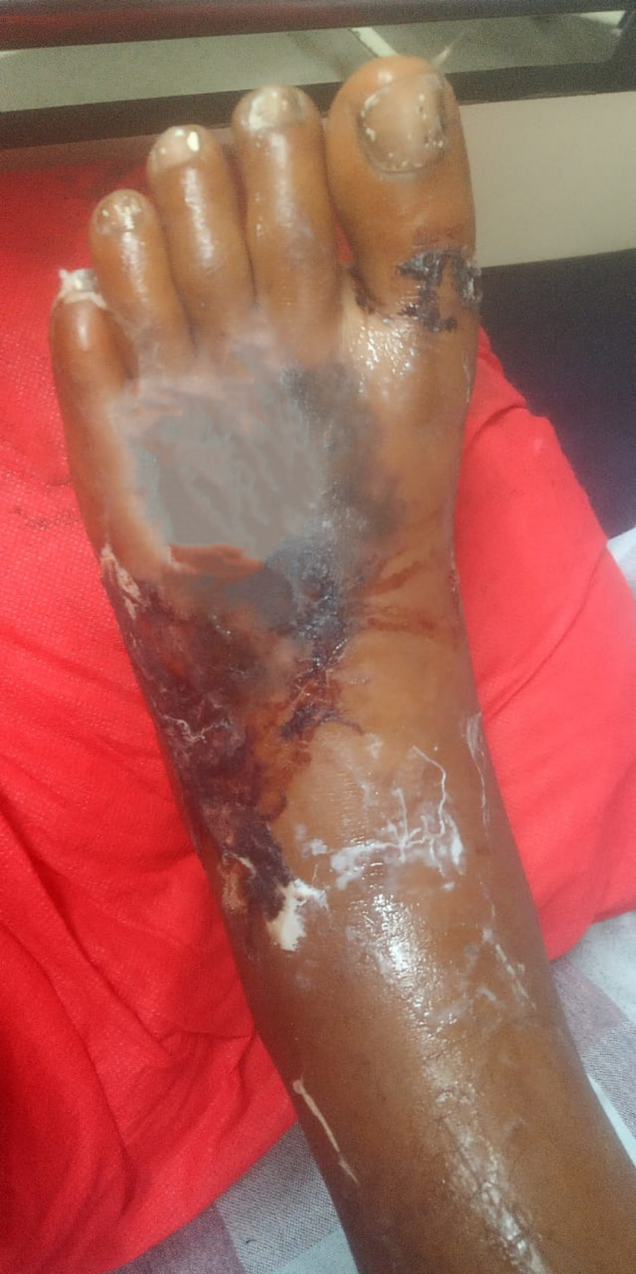
Systemic Examination
CVS -S1,S2 (+),NAS RS- NVBS(+),AEBE
P/A- Soft,non tender,no organomegaly
CNS- HMF Normal, inability to extend his (L) knee ( in a semiflexed position)
L/E – Swelling (+) over (L) leg and (L) foot dorsal aspect , Blackish discoloration of skin over the swelling (+)
But,All peripheral pulsations were felt including posterior tibial artery,& dorsalis pedis.

Slide 13
On 08-12-2022
PR -80/min. BP -110/70mmhg. Spo2-98% on RA
Systemic Examination
CVS –S1,S2 (+),NAS RS- NVBS(+),AEBE P/A- Soft,non tender,no OM
CNS- HMF Normal, inability to extend his (L) knee ( in a semiflexed position)
L/E – Swelling (+) over (L) leg and (L) foot dorsal aspect , Extensive Blackish discoloration of skin over the swelling (+), blisters or blebs (+)
But,All peripheral pulsations were felt including posterior tibial artery,& dorsalis Pedis.

Slide 14
I/v/o stiffness of (L) knee, inability/pain while trying to extend knee & worsening of cellulitis a repeat Venous and Arterial Doppler study of (L) LL was done and the results were s/o possibility of Thrombus in(L) Common Iliac Being Or Proximal part of external iliac vein.So,
Inj UFH 5000 U s/c Q8H was started
Inj Linezolid 600mg Q12H
Along with supportive measures like ambulation.

Slide 15
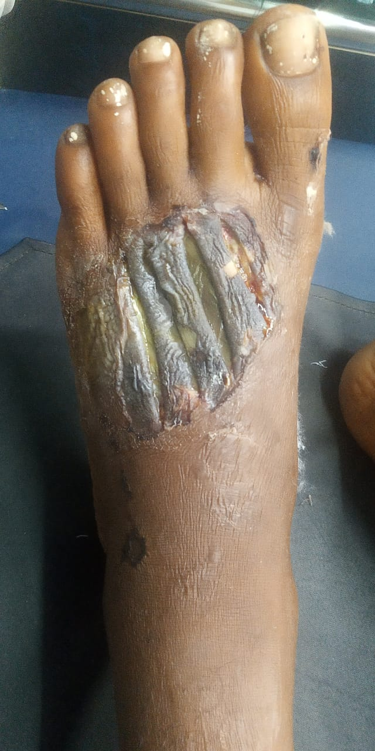
After 4 days of UFH,& Linezolid administration,pt’s condition got little better and patient party wished to take him to home town at UP for further treatment & Hence discharged at request on 11-12-2022.

Slide 16
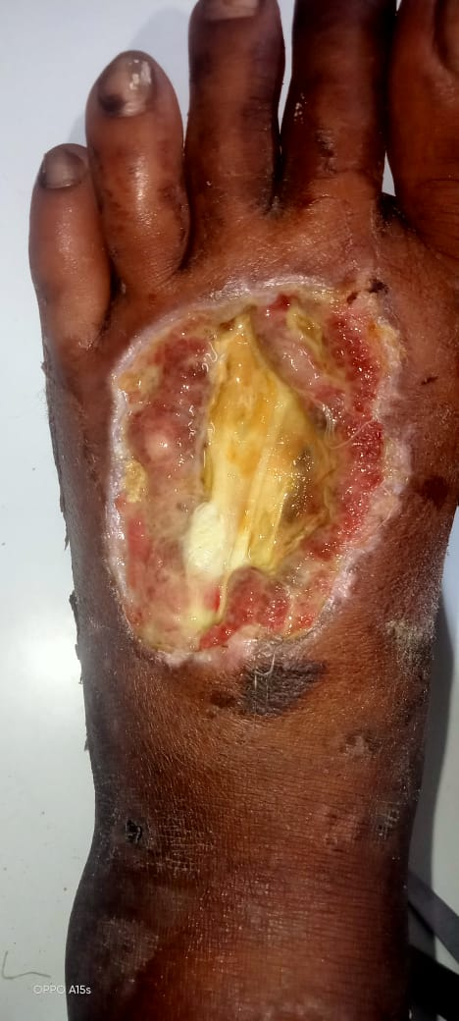
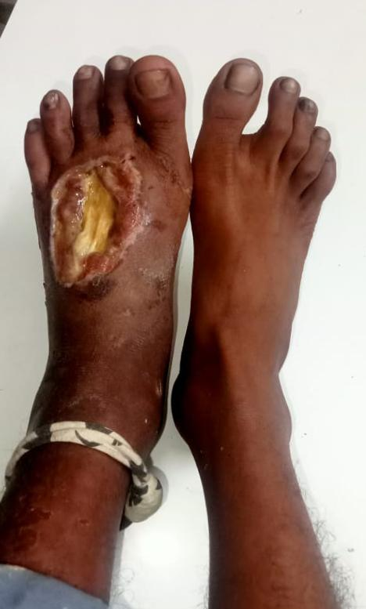
Present condition (Taken on 26-01-2023)

Slide 17
Classification of snakes
Poisonous snakes belong to three Families on the basis of poison secreted :
1. Elapidae : Neurotoxic
2. Viperidae : Vasculotoxic
3. Hydrophidae : Myotoxic

Slide 18
1. ELAPIDAE
Examples
A) Common Cobra
B) King Cobra
C) Krait : Subgrouped into :
a). Common krait or Bangarus caeruleus
b). Banded krait or Bangarus fasciatus
c). Coral snake
d). Tiger snake
e). Mambas
f). Death adder

Slide 19
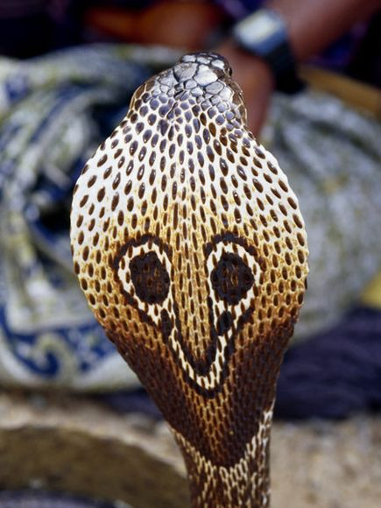
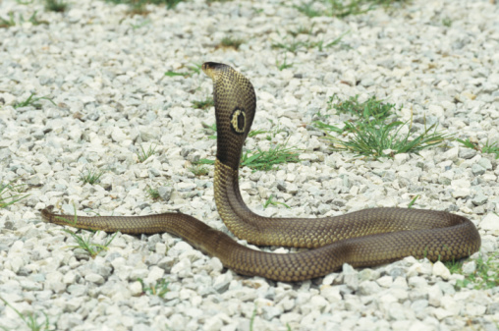
Common cobra
Seen through out India, Burma, Srilanka
Well marked hood
Single (monocellate) or double spectacle mark

Slide 20
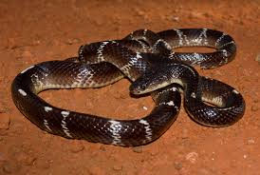
Common krait
Bungarus Caeruleus Neurotoxic

Slide 21
2. VIPERIDAE
They are grouped into:
A). Pitless Vipers : They are
a). Russel ‘s Viper
b). Saw-scaled Viper
B). Pit Vipers : They are
a). Pit Viper- Crotalidae
b). Common Green Pit Viper

Slide 22
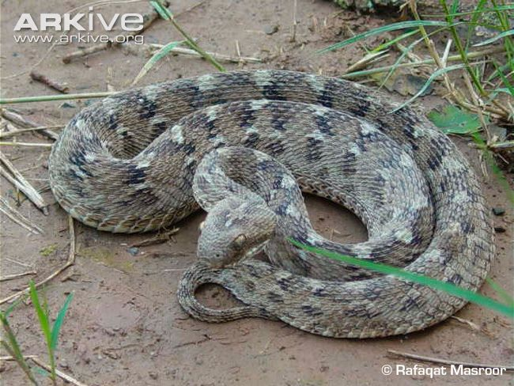
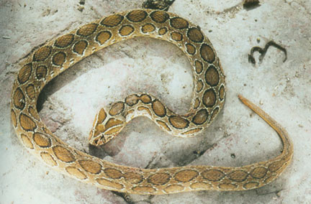
Saw scaled viper (carpet viper)
  Echis carinatus
  Haematotoxic
Russell’s viper
  Daboia russelli
  Haematotoxic

Slide 23
3. HYDROPHIDAE
20 types of sea snakes found in India.
All are poisonous.
They are myotoxic.

Slide 24
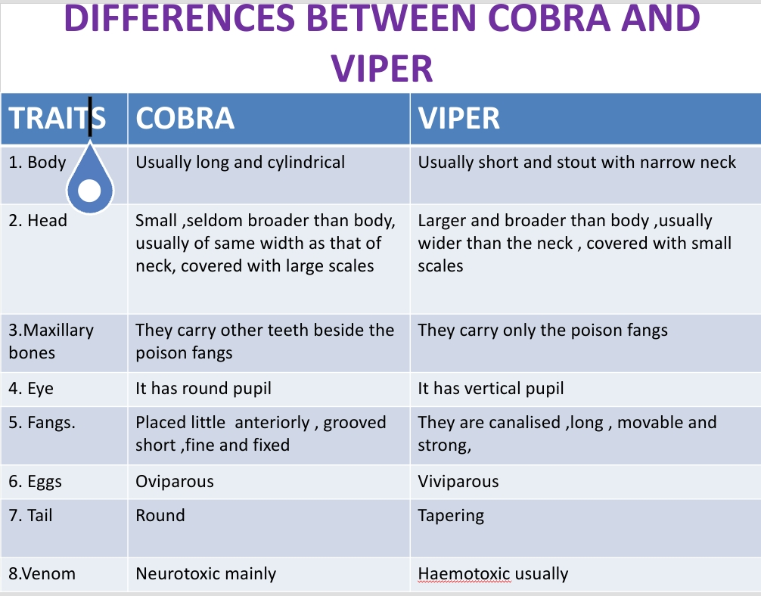

Slide 25
Snake Bite and Snake Venom
When a snake bites, it may excrete venom but this is dependent on the type of snake – venomous or non venomous.
Snake Venom is a Toxin (Hematotoxin, Neurotoxin, or Cytotoxin)
It is a varied form of saliva and excreted through a modified parotid salivary gland
  Located on each side of the skull, behind the eye
  Produced through a pumping mechanism from a sac that stores the venom, proceeds through a channel, down a tubular fang, hollow in the center to project the venom

Slide 26
SNAKE VENOM
Snake venoms are a combination of proteins and enzymes
90% protein by dry weight & most of these are enzymes
Have 25 different enzymes found in various venoms and 10 of these occur frequently in most venoms
Synergistic in effects: different venoms contain different combinations of enzymes causing a more potent effect than any of the individual effects (very similar to drug synergism)

Slide 27
Composition of snake venom
Enzymes-
Phospholipase A2( Lecithinase), 5’-nucleotidase,collaginase,L-aminoacid oxidase, protinases, hyaluronidase,
Ach, Phospholipase-b (ellipdae)
Endopeptidases, kininogenase, factor-X, prothrombin activating enzyme (viper)

Slide 28
Non Enzyme Peptides :
α- bungarotoxin,β- bungarotoxin,Crotoxin, Crotamine,Cardiotoxin.
Peptide- Pyroglutamyl peptide
Nucleoside-Adenine,Guanine,Inosine.
Lipid-Phospholipid,Cholestrol
Amine-Histamine,Serotonin,Spermin
Metal-Cu,Zn,Ni,Mg.

Slide 29
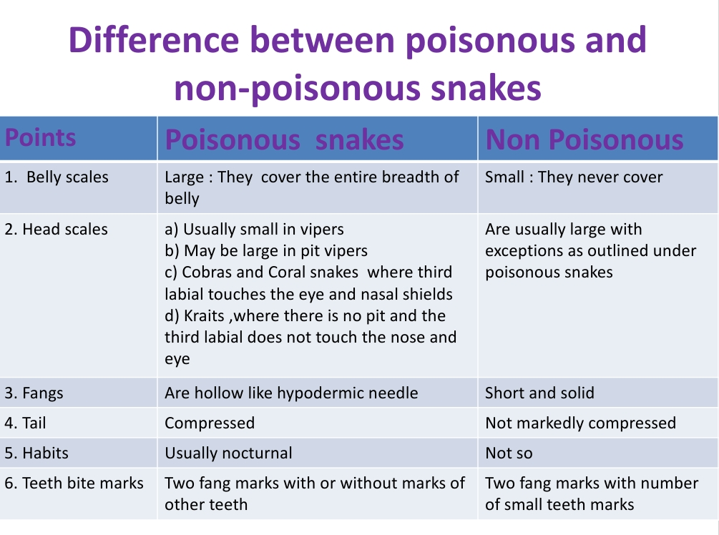

Slide 30
Mechanism of Toxicity of Venom
The most common types of enzymes are proteolytic, phospholipases and hyaluronidases
  Proteolytic Enzymes: digestive properties
  Phospholipases: degrade lipids
  Hyaluronidases: facilitates venom spread through out the body

Slide 31
SIGNS AND SYMPTOMS
A. Elapid Bite:
a). Local Features :
Fang marks
Burning pain
Swelling and discoloration
Serosanguinous discharge
Local symptoms are milder in comparison to that in Viperine bite.

Slide 32
Systemic fearures
Paralytic stage:
Ptosis.
Ophthalmoplegia
Drowsiness
Convulsion
Bulbar paralysis
Respiratory failure
death

Slide 33
B. Viperid bite :
Local features : Rapid swelling at bite site
Discoloration
Blister formation
Bleeding from bite site
Pain

Slide 34
Systemic features:
.Generalized bleeding : Epistaxis ,hemoptysis , hemetemesis ,bleeding gums ,hematuria , malena , hemaorrhagic areas over skin and mucosa
.Shock
.Renal failure

Slide 35
C. Hydrophid bite
Local features:
Local swelling
Pain
Systemic Features :
Myalgia
Muscle stiffness
Myoglobinuria
Renal failure

Slide 36
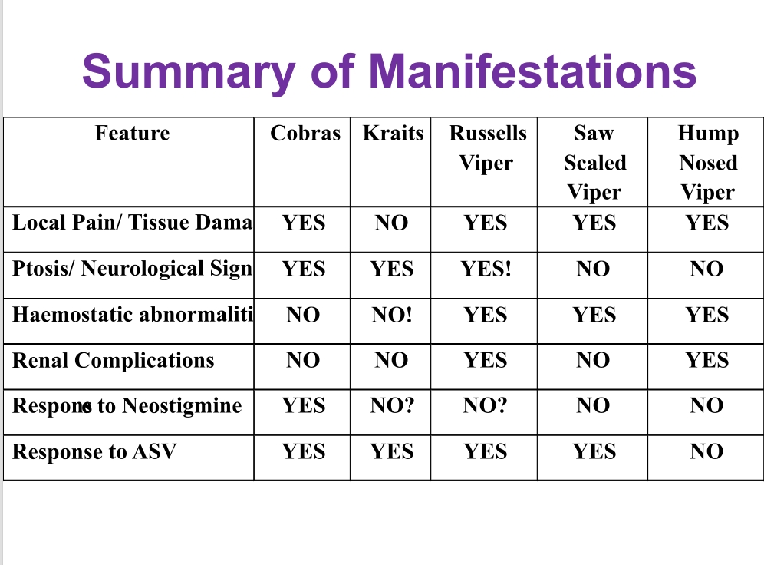

Slide 37
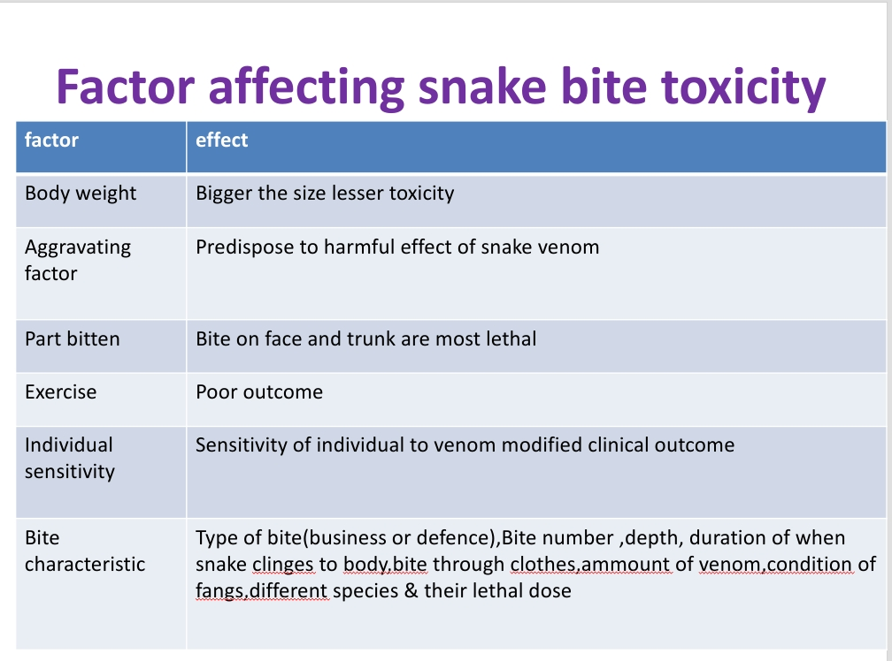

Slide 38
Prognosis assessment
Time of bite
Activity at the time of bite
First aid action taken since the bite
Clinical examination
20 mn whole Blood Clotting Test

Slide 39
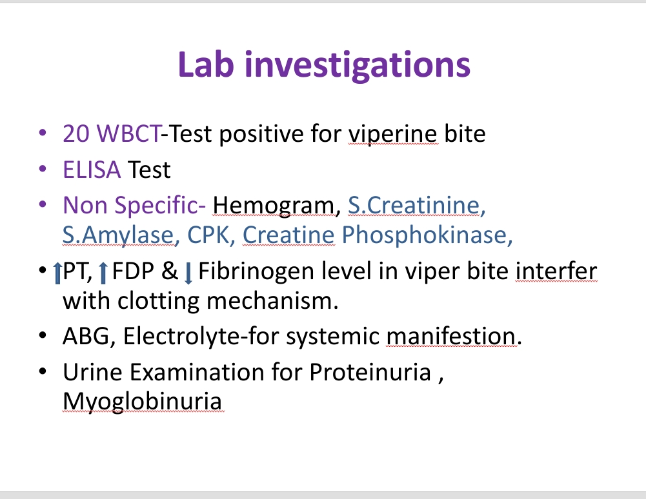
ECG-non specific changes
like bradycardia,
AV-block.
EEG-mainly in temporal lobe.60%
in
Grade-I,31% Grade-II,4%
Grade III

Slide 40
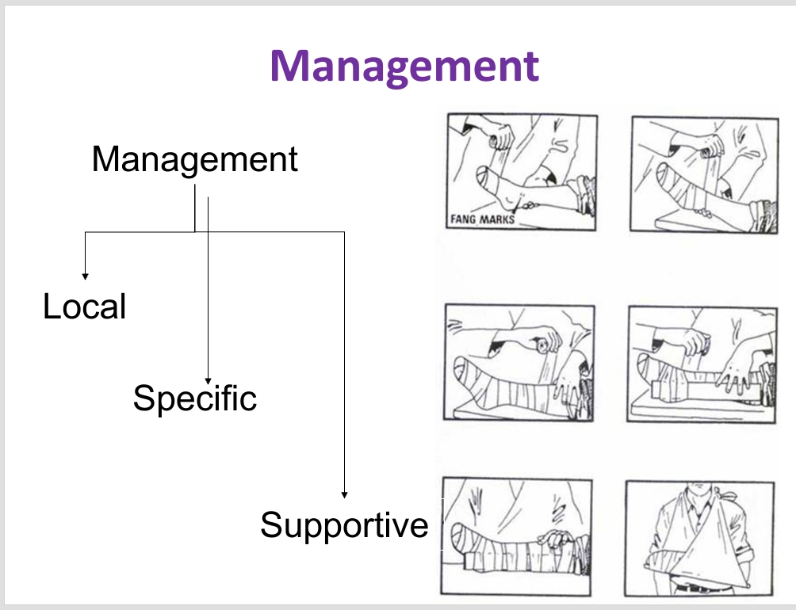

Slide 41
The first aid being currently recommended is based around the mnemonic: “Do it R.I.G.H.T.”
R =Reassure the patient. 70% of all snakebites are from non-venomous species. Only 50% of bites by venomous species actually envenomate the patient.
I = Immobilise in the same way as a fractured limb. Use bandages or cloth to hold the splints, not to block the blood supply or apply pressure. Do not apply any compression in the form of tight ligatures, they can be dangerous!
G.H. = Get to Hospital Immediately. Traditional remedies have NO PROVEN benefit in treating snakebite.
T = Tell the doctor of any systemic symptoms such as ptosis that manifest on the way to hospital.

Slide 42
Specific treatment-ASV
Indication for ASV
Spontaneous systemic Bleeding
WBCT > 20 min
Thrombocytopenia (platelet < 1 lac)
Shock, paralysis, ARF, Rhabdomyolysis, Hyperkalemia.
Local swelling involving > ½ of bitten limb
Rapid extension of swelling

Slide 43
Anti venom therapy
Ideally administer with in 4 hr but effective if given with in 24 hrs
In mild cases-5 vial (50 ml)
In moderate cases-5 to 10 vial
In severe cases-10 to 20 vial
Additional infusion containing 5 to 10 vial are infused until progression of swelling ceased and systemic symptoms are disappeared.

Slide 44
ASV can be administer slow i.v. injection or infusion @ rate of 2ml/min
AVS dilute 5-10 ml/kg body weight of normal saline or 5% dextrose and infused over 1 hr
ASV should never given locally at site of snake bite.

Slide 45
Disadvantages of asv
Pain at injection site
Hematoma formation
Increase intra compartmental pressure
ASV SENSTIVITY IS NOT RECOMMONDED NOW A DAYS

Slide 46
Adverse reactions of asv
Seen in 20 % patient
Early anaphylactic reaction-
Seen with in 10 min to 3 hrs
Urticaria, diarrhoea, tachycardia, fever, hypotension, etc.
Late Serum Sickness
1-12 days
Fever,nausea,vomiting,diarhoea,artheritis,nephrits,myoglobinuria.etc.

Slide 47
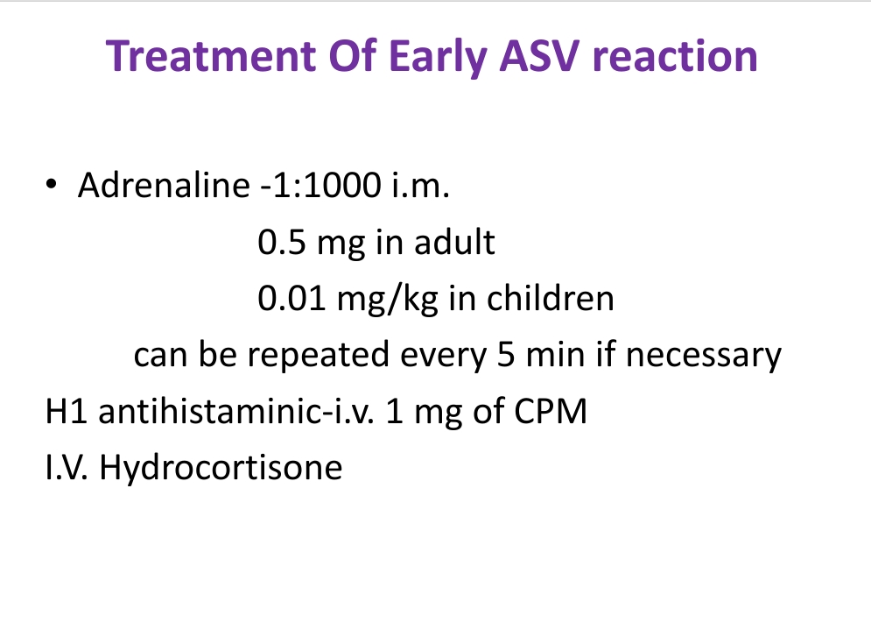
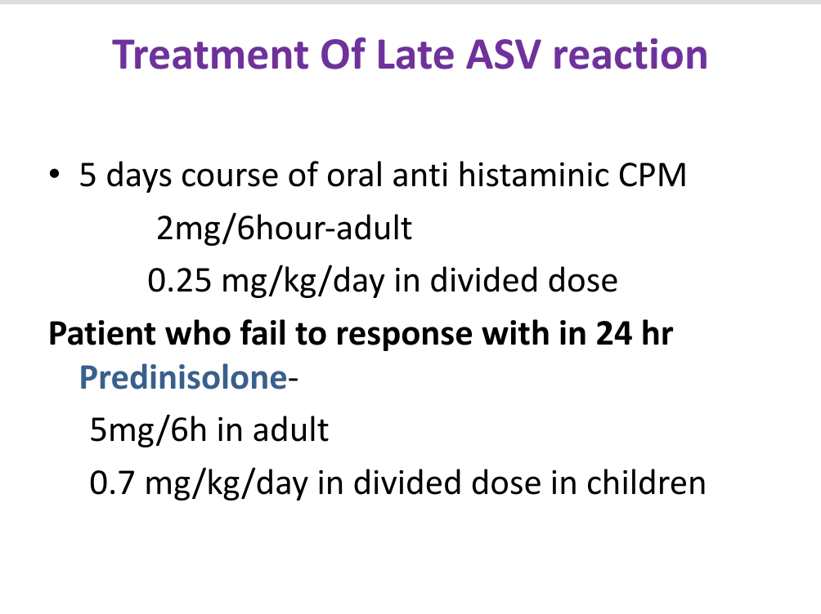

Slide 48
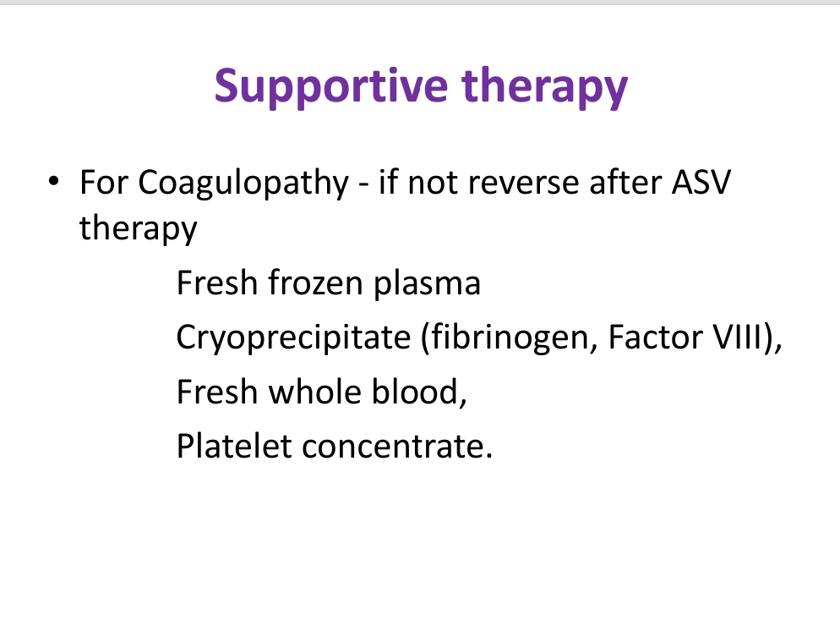

Slide 49
Snakebite is a significant public health issue that mainly affects poor farming communities in the rural tropics and subtropics .
Since June 2017, it has been recognized by the World Health Organization as a category A—Neglected Tropical Disease. Snakebites cause significant mortality and morbidity, particularly in South Asia.
Literature-based estimates suggest that there are 0.4 to 1.8 million envenomings and 20,000 to 90,000 deaths due to snakebite globally each year

Slide 50
Snakebite results in both acute and chronic effects of envenoming.
Acute envenoming can cause local swelling and necrosis at the bite site, venom-induced consumption coagulopathy (VICC), neurotoxicity, acute kidney injury, myotoxicity and cardiovascular effects.
Chronic effects include both medical and psychological illness. Overall, this causes a significant socioeconomic burden to the effected communities

Slide 51
Venom Induced Consumption Coagulopathy
Venom-induced consumption coagulopathy (VICC) is the most common and most important systemic effect of snake envenoming worldwide.
True and pit vipers (Family: Viperidae) and Australasian elapids (Family: Elapidae) are known to cause VICC in envenomed humans.
VICC is the broad term given to a coagulopathy resulting from consumption of clotting factors due to procoagulant toxins present in a snake venom.

Slide 52
In the past, VICC was incorrectly referred to as disseminated intravascular coagulation, because of the elevated D-dimer, prolonged prothrombin time and low fibrinogen levels that occur with VICC.
However, VICC differs from disseminated intravascular coagulation due to the absence of systemic microthrombi, the absence of end-organ failure, the rapid onset and resolution, the different pathogenesis and the lower mortality.

Slide 53
Although the term ‘haemotoxins’ is often used to describe the toxins that cause VICC, it is a broad term that can be used to refer to any haemostatically active venom component, including toxins acting on coagulation and fibrinolysis, toxins which disrupt the vascular endothelium and toxins that cause platelet dysfunction.
Toxins that act on coagulation factors are classified as procoagulant toxins, anticoagulant toxins and toxins that affect fibrinolysis

Slide 54
Procoagulant toxins cause VICC by activating the clotting pathway. They cause rapid clot formation in vitro, but in vivo they lead to the rapid consumption of clotting factors and coagulopathy, with the consequent risk of bleeding They are classified according to the part of the clotting pathway they act on .
These include factor V and factor X activators in Russell’s viper venom, prothrombin activators in carpet viper venom and Australasian elapid venoms, and thrombin-like enzymes in pit viper venoms

Slide 55
The activation of a clotting factor by procoagulant toxins leads to subsequent activation of other clotting factors downstream in the cascade, which get consumed in the process.
The final step in the pathway is the conversion of fibrinogen to fibrin, which results in low levels (hypofibrinogenaemia) or the absence (afibrinogenaemia) of circulating fibrinogen.
This and low levels of other factors (e.g., factors V and VIII) result in a coagulopathy—hence the term consumption coagulopathy

Slide 56
Procoagulant metalloproteinases in the venom promote a consumption coagulopathy by activating prothrombin, factor V, factor X or thrombin-like enzymes (fibrinogenases).
Venom induced coagulopathy may also be accompanied by a thrombotic microangiopathy consisting of thrombocytopenia (low platelets), microangiopathic hemolytic anemia and acute kidney injury.

Slide 57
Diagnosis of Vicc
Diagnosis is established using various laboratory tests designed to test the function of the clotting system and other blood components.
These tests include a complete blood count, prothrombin time with international normalized ratio, activated partial thromboplastin time, serum direct fibrinogen, and D-dimer.
Abnormal values of these tests in combination with recent history of snakebite suggest VICC.
The anticoagulation effects of snake venom can last for up to two weeks in some species without the administration of antivenom and should thus be considered as the relevant time course when distinguishing symptom causes

Slide 58
Treatment
Definitive
ASV Therapy
Supportive

Slide 59
THANK YOU

