Slide 1
SICKLE CELL SYNDROMES
Dr Akhil Suresh

Slide 2
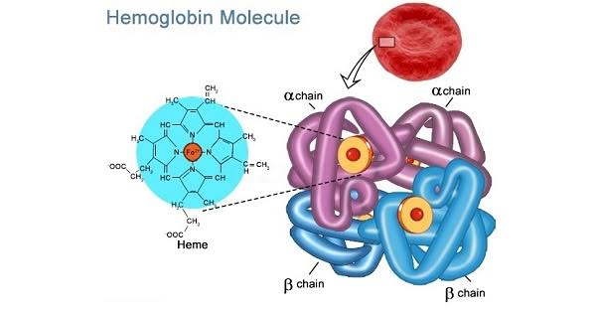

Slide 3
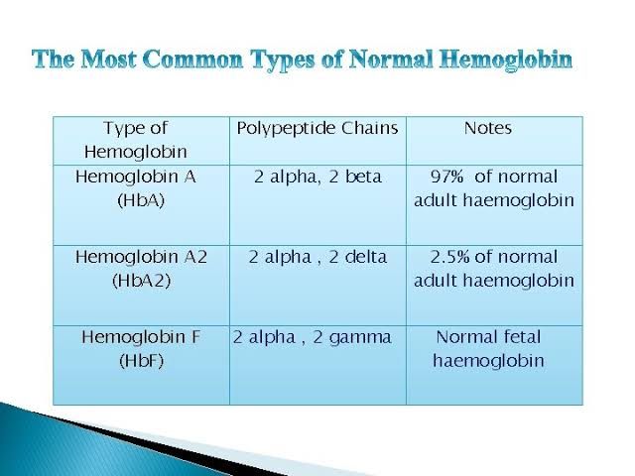

Slide 4
HbA
HbS
HbC
HbSC
HbF

Slide 5
Pathogenesis
Mutation in the beta globin Gene
Sixth amino acid from glutamic acid to valine (HbS)

Slide 6
Point mutation of HBB Gene
Chromosome 11 ; short arm
Beta globin gets misshapen

Slide 7
Valine is hydrophobic
Hydrophobic collapse of hemoglobin molecules occur
Transforms the RBCs into crystalloid structures

Slide 8
HbS transports oxygen very well
Once oxygen is released into the tissue the hemoglobin rapidly transforms to crystalloid forms called tactoids
They have sticky ends
Hydrophobic beta globin chains with other HbS molecules leading to clumping

Slide 9
Polymerises reversibly when deoxygenated
Causes RBC membrane stiffening,increases viscosity
Produce the SICKLE shape

Slide 10
Loss of pliability
Possess sticky membranes --- microvascular vasocclusion and hemolytic anemia
Clogging of capillaries ---- tissue ischemia, pain and end organ damage

Slide 11
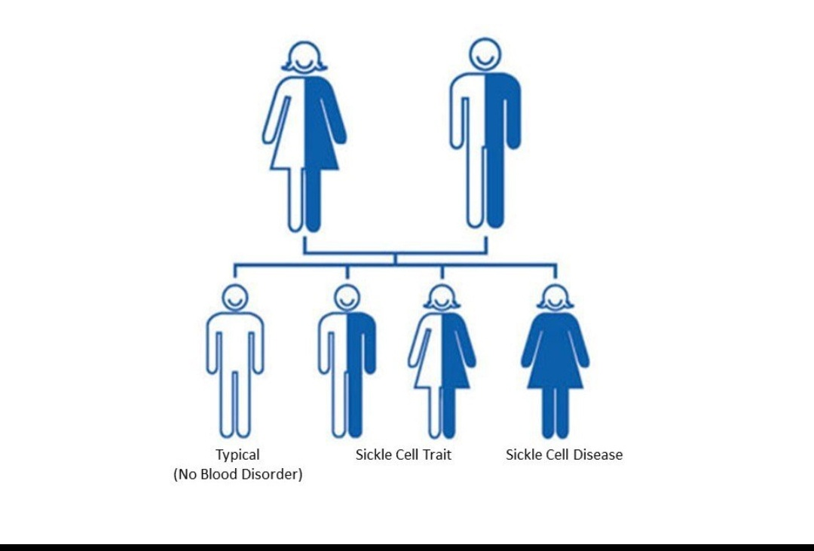

Slide 12
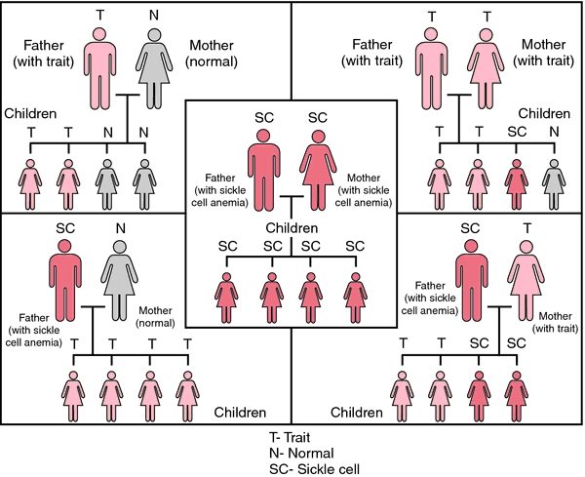

Slide 13
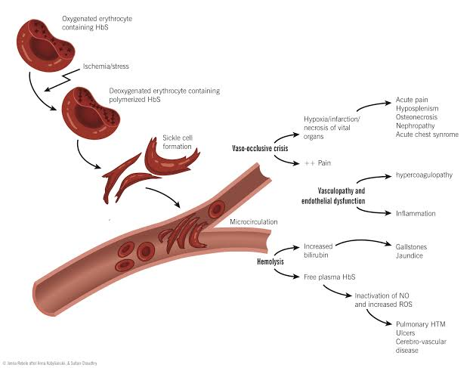
PATHOPHYSIOLOGY

Slide 14
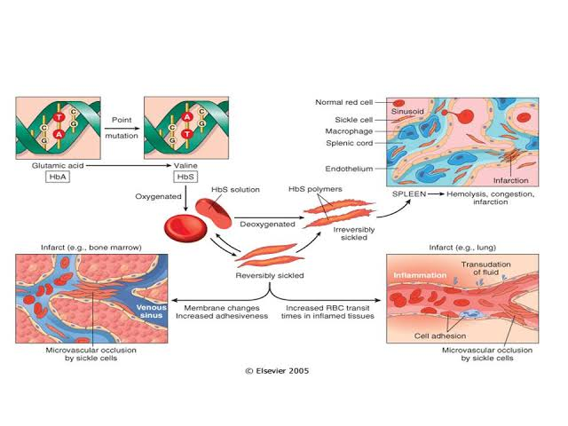

Slide 15
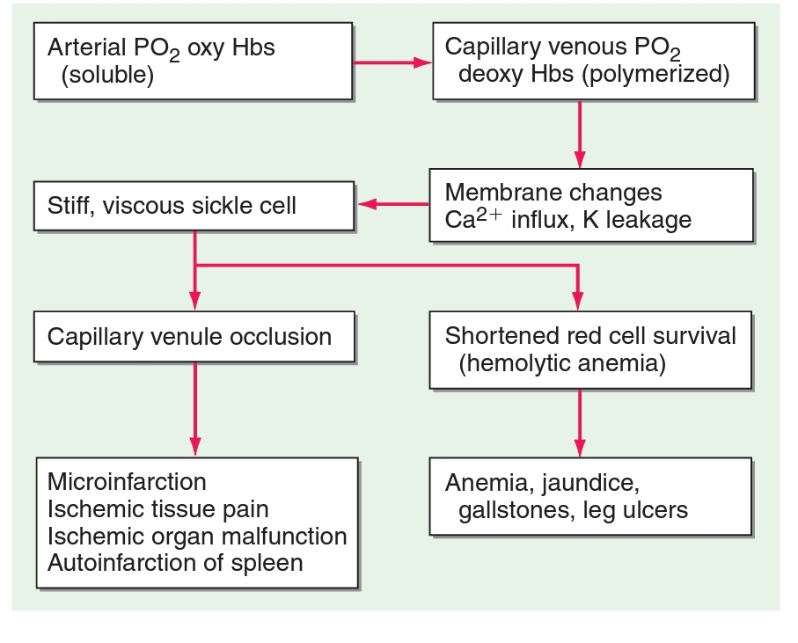

Slide 16
MANIFESTATIONS
Hemolytic anemia
hematocrits from 15 to 30%
significant reticulocytosis.

Slide 17
Anemia reduces blood viscosity. (protective)
an increase in the hematocrit and feedback inhibition of reticulocytosis might be beneficial
Adhesive reticulocytes cause vasoocclusion

Slide 18
. Granulocytosis is common.
The white count can fluctuate substantially and unpredictably during and between painful crises, infectious episodes, and other intercurrent illnesses

Slide 19
VASOCCLUSION
PAIN CRISIS
Intermittent episodes of vasoocclusion in connective and musculoskeletal structures produce ischemia manifested by acute pain and tenderness, fever, tachycardia, and anxiety.
recurrent episodes
most common clinical manifestation.

Slide 20
Varied frequency and severity
Pain can develop almost anywhere in the body
last from a few hours to 2 weeks.

Slide 21
these episodes are associated with accumulation of chronic end-organ damage.
Provocative factors include infection, fever, excessive exercise, anxiety, abrupt changes in temperature, hypoxia, and hypertonic dyes.

Slide 22
Repeated crises requiring hospitalization (>3 per year) correlate with reduced survival in adult life

Slide 23
Repeated micro-infarction can destroy tissues having microvascular beds prone to sickling.
Thus, the spleen is frequently lost within the first 18–36 months of life, causing susceptibility to infection, particularly by pneumococci.

Slide 24
SPLENIC SEQUESTRATION CRISIS
Acute venous obstruction of the spleen
a rare occurrence in early childhood
may require emergency transfusion and/or splenectomy to prevent trapping of the entire arterial output in the obstructed spleen.

Slide 25
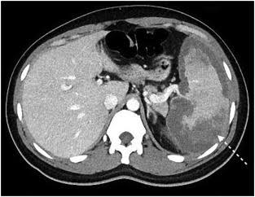

Slide 26
Occlusion of retinal vessels can produce hemorrhage, neovascularization, and eventual detachments.

Slide 27
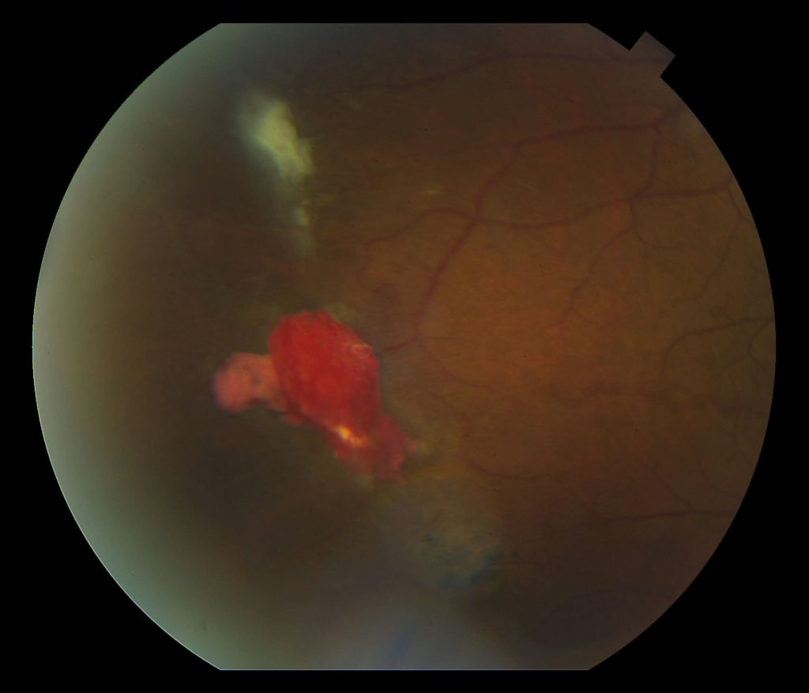
Salmon patch hemorrhage

Slide 28
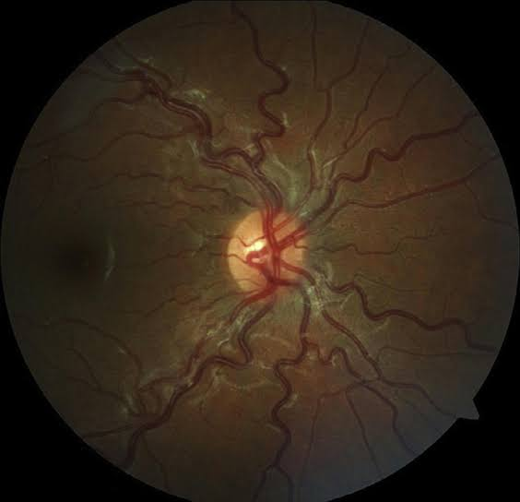

Slide 29
Renal papillary necrosis invariably produces isosthenuria.
widespread renal necrosis leads to renal failure in adults
a common late cause of death

Slide 30
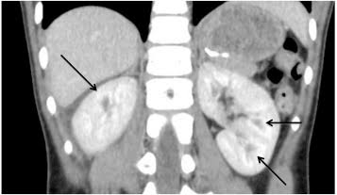

Slide 31
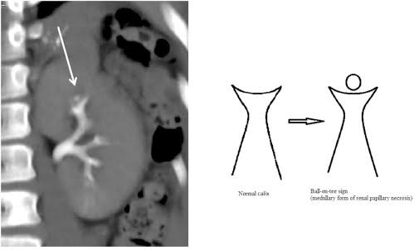

Slide 32
Bone and joint ischemia can lead to aseptic necrosis
the femoral or humeral heads
Chronic arthropathy
susceptibility to osteomyelitis

Slide 33
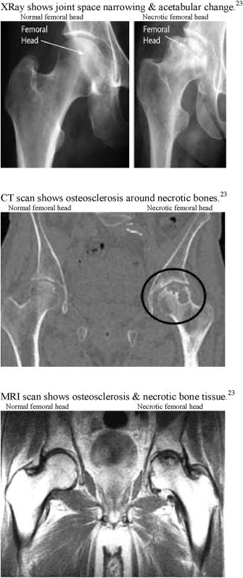

Slide 34
HAND FOOT SYNDROME
painful infarcts of the digits and dactylitis.

Slide 35
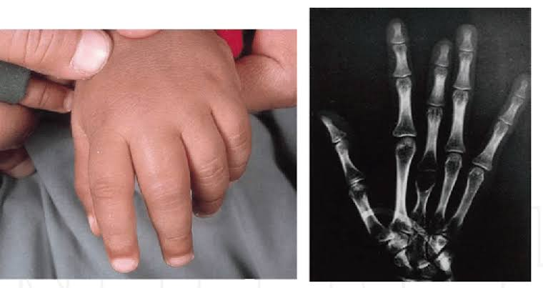

Slide 36
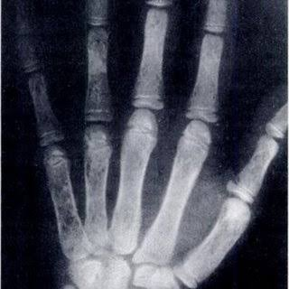

Slide 37
Stroke is especially common in children; a small subset tend to experience repeated episodes. Stroke is less common in adults and is often hemorrhagic. .

Slide 38
A particularly painful complication in males is priapism, due to infarction of the penile venous outflow tracts; permanent impotence is a frequent consequence.

Slide 39
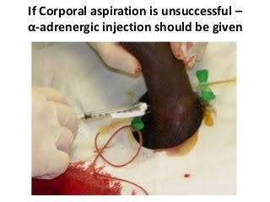

Slide 40
Chronic lower leg ulcers probably arise from ischemia and superinfection in the distal circulation

Slide 41
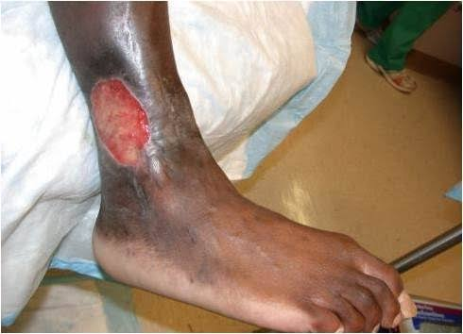

Slide 42
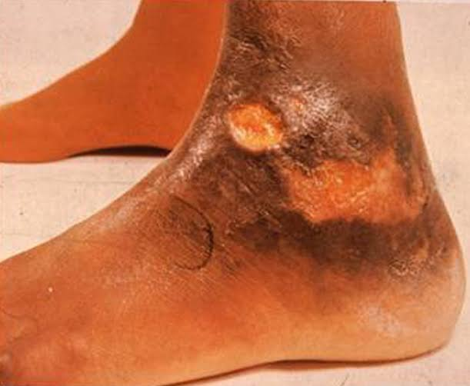

Slide 43
ACUTE CHEST SYNDROME
distinctive manifestation characterized by chest pain, tachypnea, fever, cough, and arterial oxygen desaturation
mimics pneumonia, pulmonary emboli, bone marrow infarction and embolism, myocardial ischemia, or in situ lung infarction.

Slide 44
reflectsin situ sickling within the lung, producing pain and temporary pulmonary dysfunction.
difficult to distinguish among other possibilities.
Pulmonary infarction and pneumonia are the most frequent underlying or concomitant conditions

Slide 45
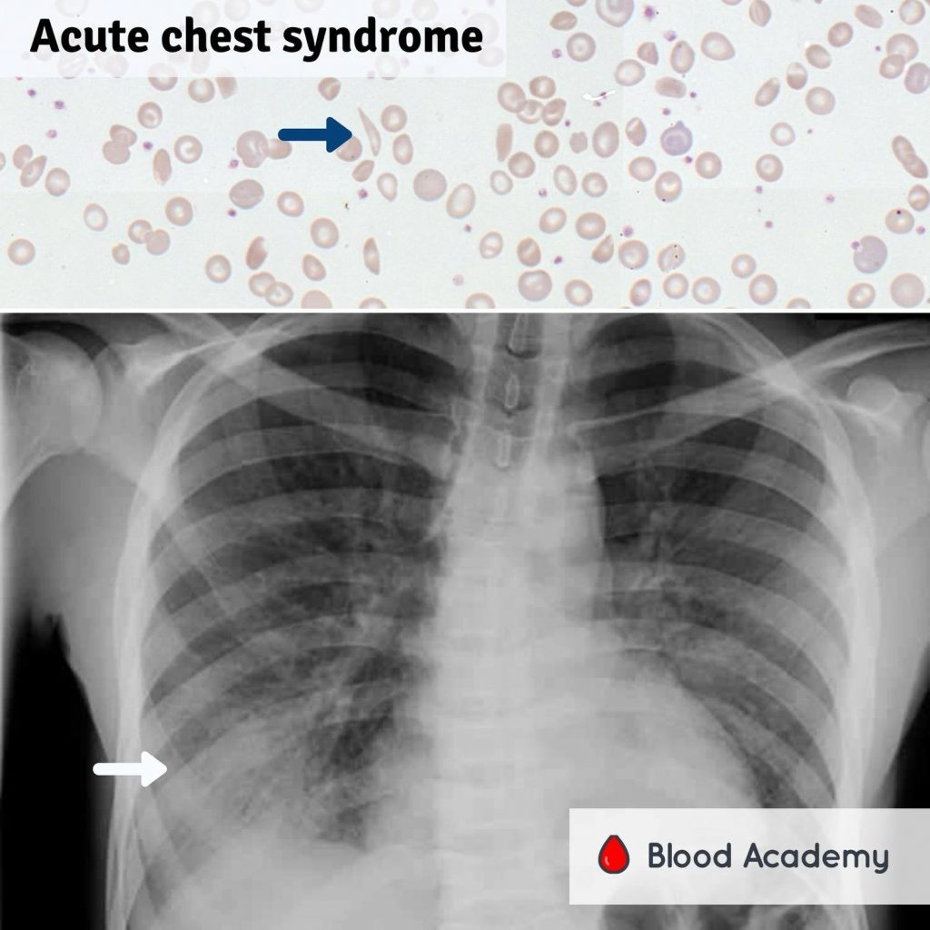

Slide 46
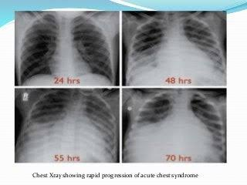

Slide 47
Repeated episodes and reduced survival.
Acutely, reduction in arterial oxygen saturation promotes sickling on a massive scale.

Slide 48
Chronic acute or subacute pulmonary crises lead to pulmonary hypertension and cor pulmonale
increasingly common cause of death as patients survive longer
possible role played by free plasma HbS in scavenging NO2, thus raising pulmonary vascular tone

Slide 49
clinical heterogeneity
Some patients remain virtually asymptomatic into or even through adult life
Some have repeated crises requiring hospitalization from early childhood.

Slide 50
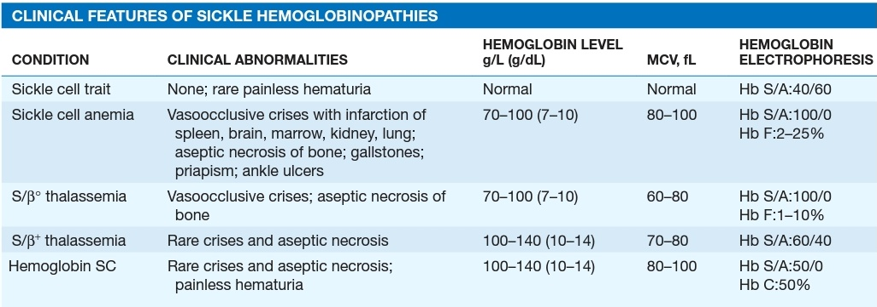

Slide 51
Sickle cell trait
usually asymptomatic.
Anemia and painful crises are rare.
An uncommon but highly distinctive symptom is painless hematuria

Slide 52
often occurring in adolescent males
probably due to papillary necrosis
Isosthenuria is a more common manifestation of the same process.
Sloughing of papillae with urethral obstruction
Avoidance of dehydration and extreme physical stress

Slide 53
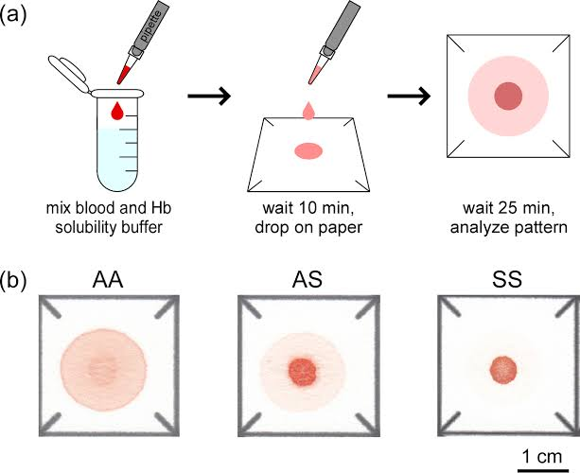
DIAGNOSIS

Slide 54
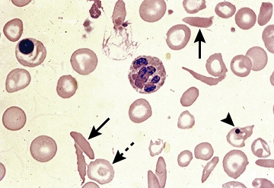

Slide 55
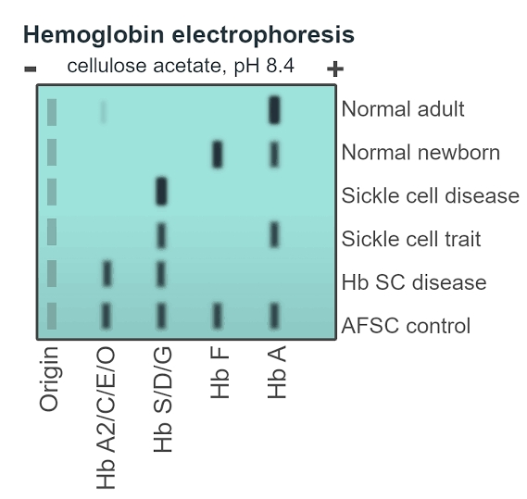

Slide 56
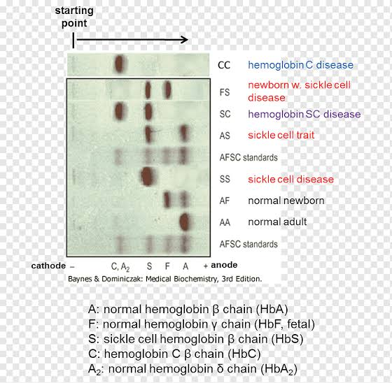

Slide 57
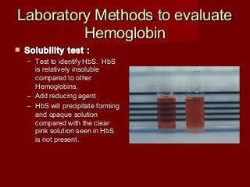

Slide 58
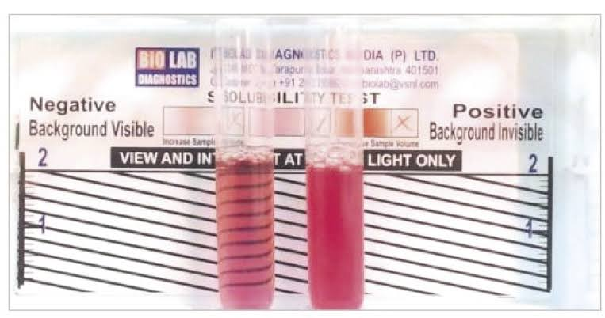

Slide 59
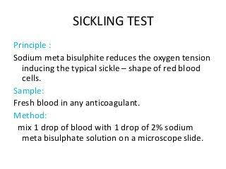

Slide 60
PROGNOSIS
more than three crises requiring hospitalization per year
chronic neutrophilia
a history of splenic sequestration or hand–foot syndrome
second episodes of acute chest syndrome.

Slide 61
history of cerebrovascular accidents are at higher risk for repeated episodes
require partial exchange transfusion
close monitoring using Doppler carotid flow measurements.

Slide 62
Patients with severe or repeated episodes of acute chest syndrome may need lifelong transfusion support
utilizing partial exchange transfusion, if possible.

Slide 63
TREATMENT
require ongoing continuity of care.
Familiarity with the pattern of symptoms
regular slit-lamp examinations to monitor development of retinopathy

Slide 64
Antibiotic prophylaxis appropriate for splenectomized patients during dental or other invasive proceduresv
Vigorous oral hydration during or in anticipation of periods of extreme exercise, exposure to heat or cold, emotional stress, or infection.

Slide 65
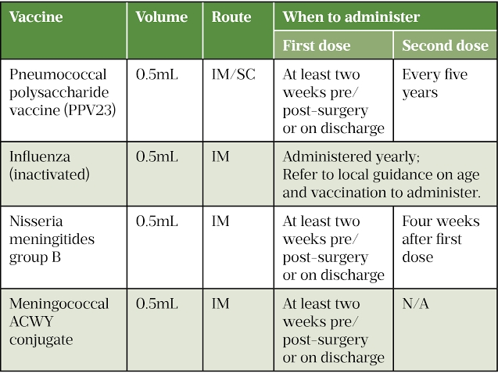

Slide 66
Acute painful crisis
vigorous hydration
Evaluation for underlying causes (e.g., infection)
aggressive analgesia
Inhalation of nitrous oxide can provide short-term pain relief
Nitrous oxide also elevates O2 affinity, reducing O2 delivery to tissues.

Slide 67
Many crises can be managed at home with oral hydration and oral analgesia.
Nasal oxygen should be employed as appropriate to protect arterial saturation.
Most crises resolve in 1–7 days.

Slide 68
Use of blood transfusion should be reserved for extreme cases
transfusions do not shorten the duration of the crisis.

Slide 69
In adults, the possibility of aseptic necrosis or sickle arthropathy must be considered, especially if pain and immobility become repeated or chronic at a single site.
Nonsteroidal anti-inflammatory agents are often effective for sickle cell arthropathy.

Slide 70
Acute chest syndrome
medical emergency
require management in an intensive care unit.
Hydration should be monitored
vigorous oxygen therapy

Slide 71
Diagnostic evaluation for pneumonia and pulmonary embolism
transfusion to maintain a hematocrit >30, and emergency exchange transfusion if arterial saturation drops to <90%.

Slide 72
end-stage renal failure
pulmonary hypertension
sickle cell cardiomyopathy
premature coronary artery disease
Sickle cell patients have received kidney transplants but with increased frequency of crises

Slide 73
Hydroxyurea (10–30 mg/kg per day)
increases fetal hemoglobin
exert beneficial affects on RBC hydration, vascular wall adherence, and suppression of the granulocyte and reticulocyte counts; .

Slide 74
dosage is titrated to maintain a white cell count between 5000 and 8000 per μL.
White cells and reticulocytes may play a major role in the pathogenesis of sickle cell crisis

Slide 75
Hydroxyurea should be considered in patients experiencing
repeated episodes of acute chest syndrome
more than three crises per year requiring hospitalization

Slide 76
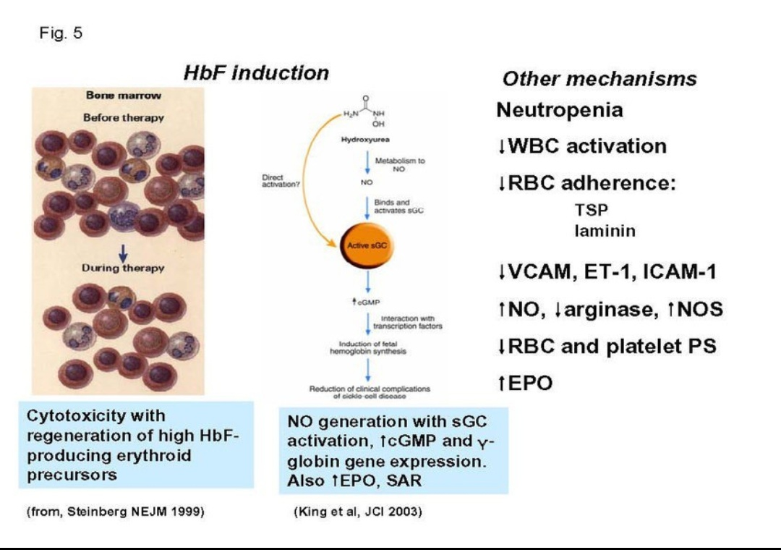

Slide 77
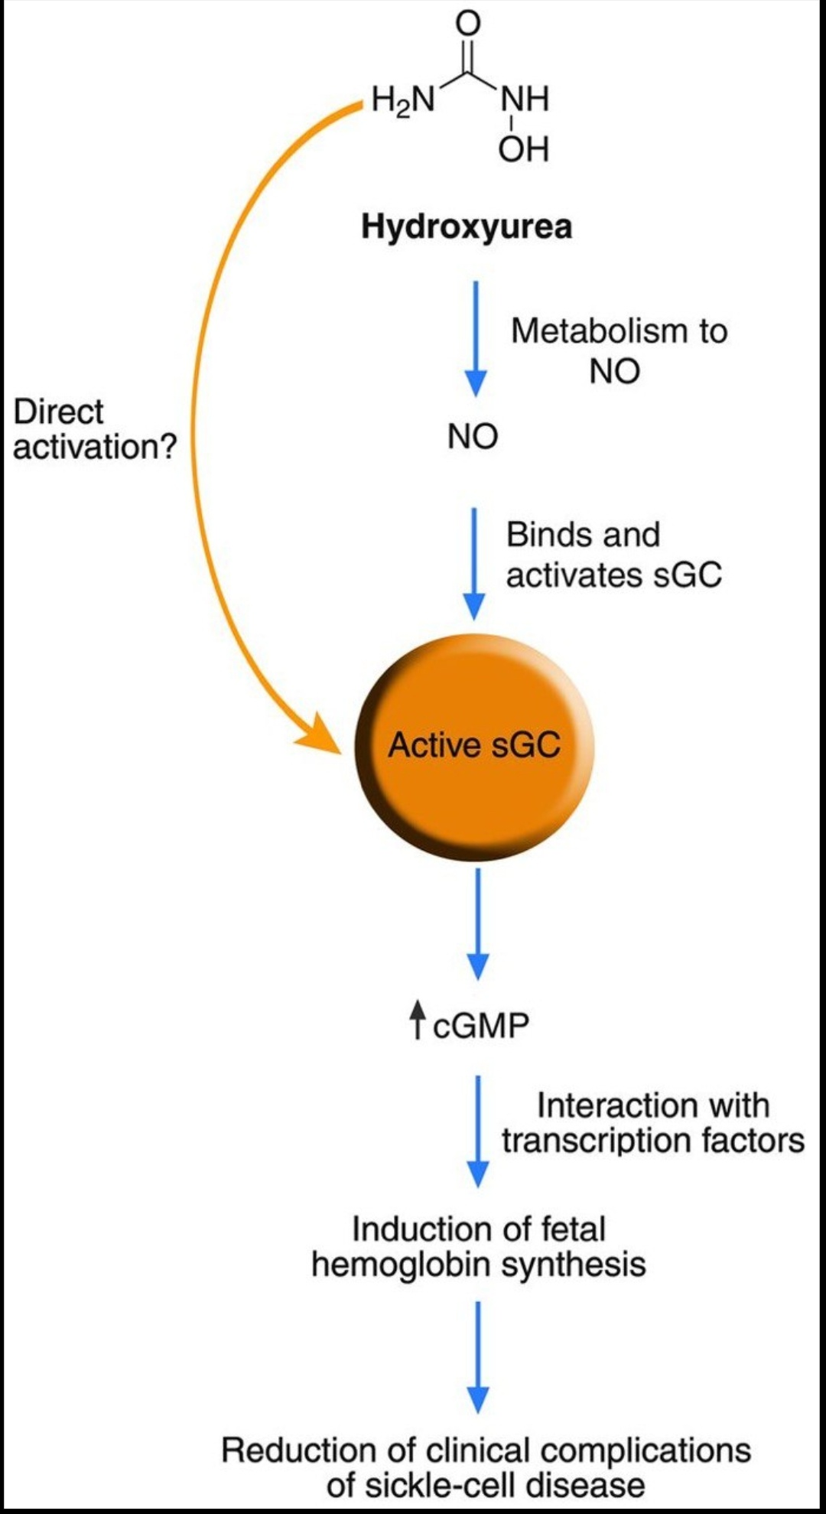

Slide 78
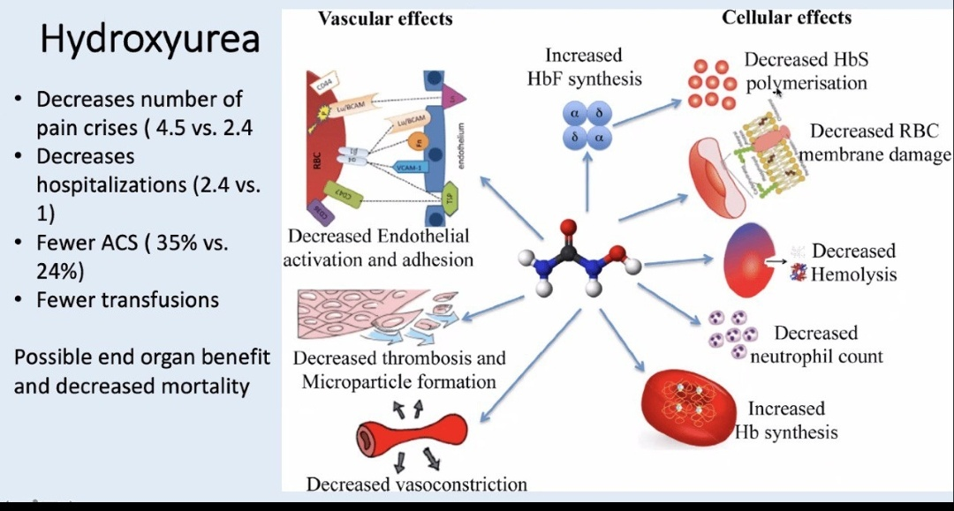

Slide 79
5-azacytidine
the first agent found to elevate HbF.
concerns about acute toxicity and carcinogenesis.
low doses of the related agent 5-deoxyazacytidine (decitabine) can elevate HbF with more acceptable toxicity.

Slide 80
Bone marrow transplant
provide definitive cures
but is known to be effective and safe only in children.
Partially myeloablative conditioning regimens (“mini” transplants) may allow more widespread use of this modality.

Slide 81
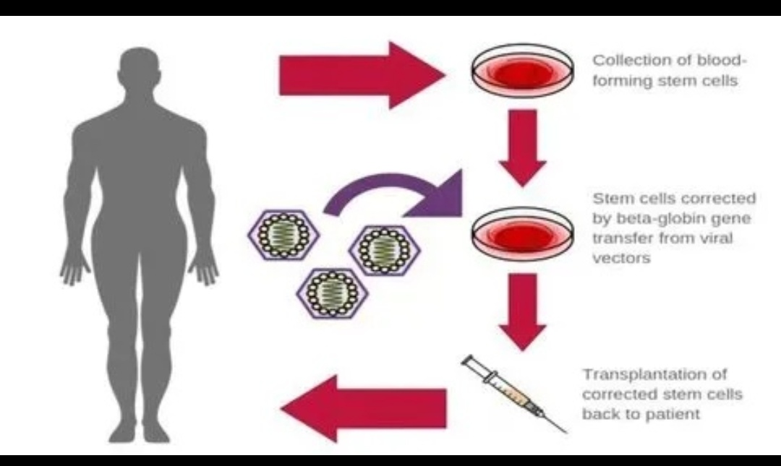

Slide 82
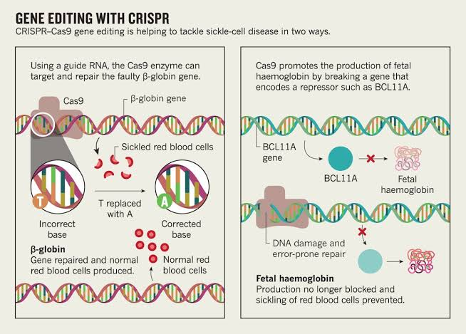

Slide 83
THANK YOU

