Slide 1
HEPATOMEGALY
DR KRISHNANUNNI G
JUNIOR RESIDENT 1

Slide 2
Introduction
The liver is an abdominal organ with multiple functions including filtering blood from the gastrointestinal (Gl) tract, secreting bile into the Gl tract, metabolizing drugs, and synthesizing proteins (eg, clotting factors).
The liver's vascularity, location, and functions make it susceptible to several conditions that result in hepatomegaly, defined as enlargement of the liver beyond its normal size.
Hepatomegaly may be suspected based on physical examination findings or imaging.
The liver is a wedge-shaped organ located in the right upper quadrant of the abdomen.

Slide 3
Location and size
The liver typically extends from the fifth intercostal space to the right costal margin in the midclavicular line.
By ultrasound, a normal liver span is usually <16 cm in the midclavicular line; however, liver size varies with sex and body size

Slide 4
Anatomical variations
A nonenlarged liver may be palpable on physical examination or may be interpreted as hepatomegaly on imaging due to anatomic variations
Riedel's lobe - Riedel's lobe is a downward, tongue-like projection of the right lobe of the liver that extends below the level of the umbilicus and may give a false impression of hepatomegaly. The presence of Riedel's lobe can be confirmed on liver cross-sectional imaging (eg, computed tomography [CT], magnetic resonance imaging [MRI]), and it is regarded as a benign condition

Slide 5
Caudate lobe papillary process -
Another anatomic variation that may be confused with hepatomegaly is projection of a papillary process from the caudate lobe (segment I) . The caudate lobe papillary process may extend posteriorly, lying between the
inferior vena cava (IVC) and aorta.

Slide 6
Physical examination
Physical examination - physical examination of the liver includes abdominal palpation and percussion ,determine liver span, we percuss and palpate the liver in the midclavicular line with the patient in a supine position

Slide 7
Palpation :
Traditional method-keep hand parallel to subcoastal margin,ask the patient to deep breathe and expire if liver is enlarged it will come and hit our hands
Preferred method - instead of one hand here we use two hands side by ask and use same mechanism
Hooking method - we will go behind the patient and hook from behind under the subcostal margin and try to palpate,these all not done in ascitis patient
Dipping method- preferred method in ascites patient,use two hands one above the other,press harder and displace fluid and try to palpate

Slide 8

Traditional method /preferred method/hooking /dipping method

Slide 9
Percussion
Liver span
Percuss from the 2nd ICS on right MCL to downwards ,we will get liver dullness at 5 th ICS and percuss down till we get resonance
Normal liver span 6 to 12 cm (at MCL)
4 to 8 cm (at mid sternal line)
Greater than 12 cm - hepatomegaly
Less than 6 cm - shrunken liver

Slide 10
Palpable but non enlarged liver
Palpable but nonenlarged liver - In addition to anatomic variants, a normal, nonenlarged liver may be
palpable because it is displaced below the right costal margin. Liver displacement may occur during deep inspiration
In patients with right pleural effusion
In patients with chronic obstructive pulmonary disease (hyperinflation of the chest with diaphragmatic descent may result in downward displacement of the liver)
In patients with a thin body habitus

Slide 11
Causes of tender hepatomegaly
Acute hepatitis
Imapaired venous outflow
Right heart failure
Hepatic sinusoidal obstruction syndrome (SOS)
Peliosis hepatis

Slide 12
Non tender hepatomegaly
Cholestatic liver disease
Storage disorder
Infiltration disorders
Other conditions

Slide 13
Causes of hepatomegaly
Tender hepatomegaly
Acute hepatitis
Impaired venous outflow
Non tender hepatomegaly
Cholestatic liver disease
Storage disorder
Infiltration disorders

Slide 14
Acute hepatitis
Hepatitis A E
Bacterial
Parasitic
DILI
Alcoholic hepatitis

Slide 15
Impaired venous outflow
Bud chiari syndrome
Right heart failure
Hepatic sinusoidal obstruction syndrome
Peliosis hepatis

Slide 16
Cholestatic liver disease
PSC
PBC
Storage disorders
Disorders of lipid metabolism
Disorders of glycogen metabolism
Gaucher’s disease
Alpha 1 antitypsin def
Hereditary hemochromatosis
Wilson disease

Slide 17
Infiltrative diseases
Granulomatous disease- TB , sarcoidosis
Hepatic amyloidosis
Hepatosplenic T Cell lymphoma
Malignant tumours
Benign lesions- hepatic hemangioma,hepatic adenoma,FNH
Others
Caroli disease
Polycystic liver disease

Slide 18
EVALUATION
— The initial evaluation of a patient with hepatomegaly includes obtaining a history to identify symptoms suggestive of underlying systemic disease and risk factors for liver disease, performing a physical examination to look for clues to the etiology and for signs of liver disease, and obtaining liver biochemical and function tests and Doppler ultrasound

Slide 19
SPECIAL POPULATIONS
Pregnant women — In late pregnancy, physical examination of the liver is difficult because of the expanding uterus. The liver is forced up further into the chest, and a palpable liver is an abnormal finding. In addition, spider angiomas and palmar erythema, which are associated with chronic liver disease, are common during pregnancy and usually disappear after delivery.

Slide 20
Thank you

Slide 21
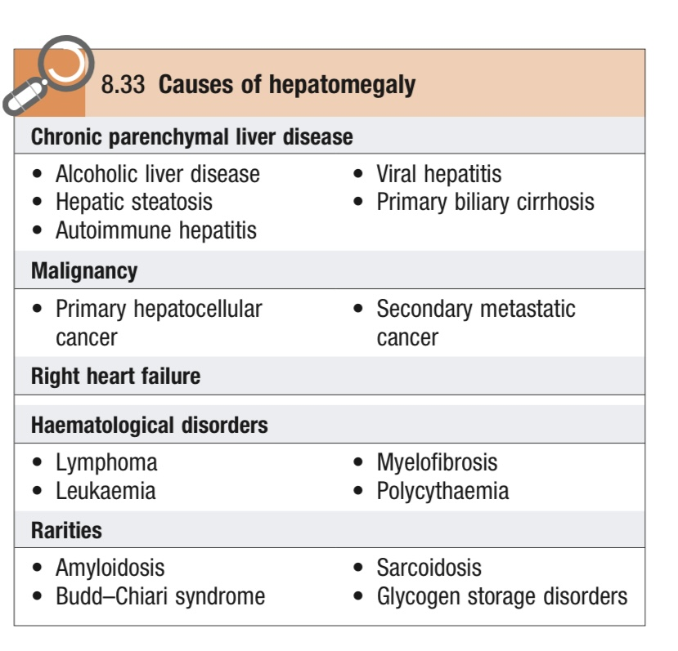
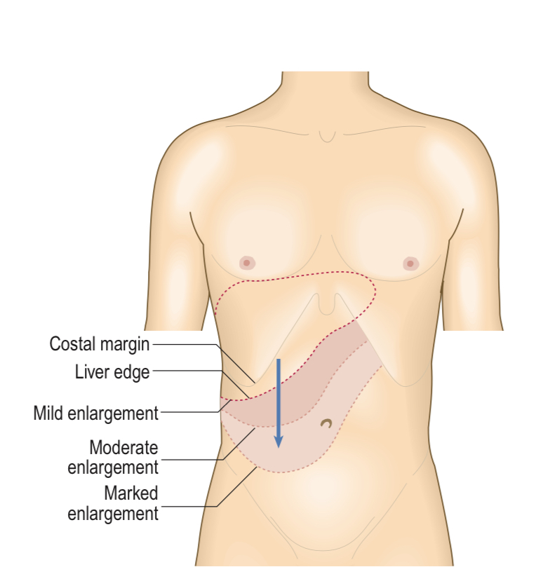

Slide 22
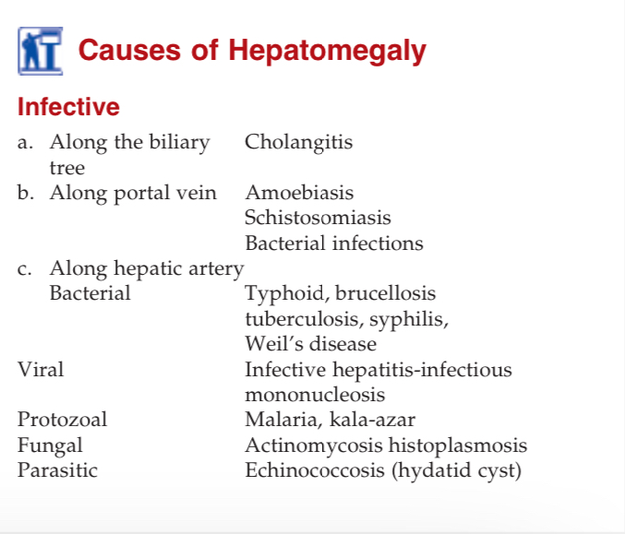

Slide 23
