Slide 1
An overlooked death trap
Dr Akhil Suresh
Junior resident

Slide 2
62 year old lady brought to medicine casualty with history of acute onset shortness of breath associated with profuse sweating.
Her complaints started around five hours back

Slide 3
No history of chest pain , palpitation or syncope
No history of fever, cough or rhinitis

Slide 4
Past history
History of ischemic heart disease on medical management for the past three years
History of systemic hypertension for the past three years
History of dyslipidemia for the past three years
No history of DM, CVA ,TB or COVID in the past

Slide 5
On examination
GCS full
Patient tachypnoec
Pulse not palpable
BP not recordable
Peripheries cold and clammy
Chest bilateral fine inspiratory crepitations all areas

Slide 6
ECG : NSR, VR 100, LAD , poor R wave progression
CBC no noticeable abnormality
Biochemistry panel revealed transaminitis and a creatinine of 1.7
OT/PT 129/47
Trop I positive

Slide 7
She was started on dual ionotropes , heparin and NIV
She was managed in casualty for around three hours and later on shifted to ward where she soon succumbed to death.

Slide 8
Scope of discussion
Ionotropes in heart failure
NIV in heart failure
Heart failure beyond ionotropes and NIV

Slide 9
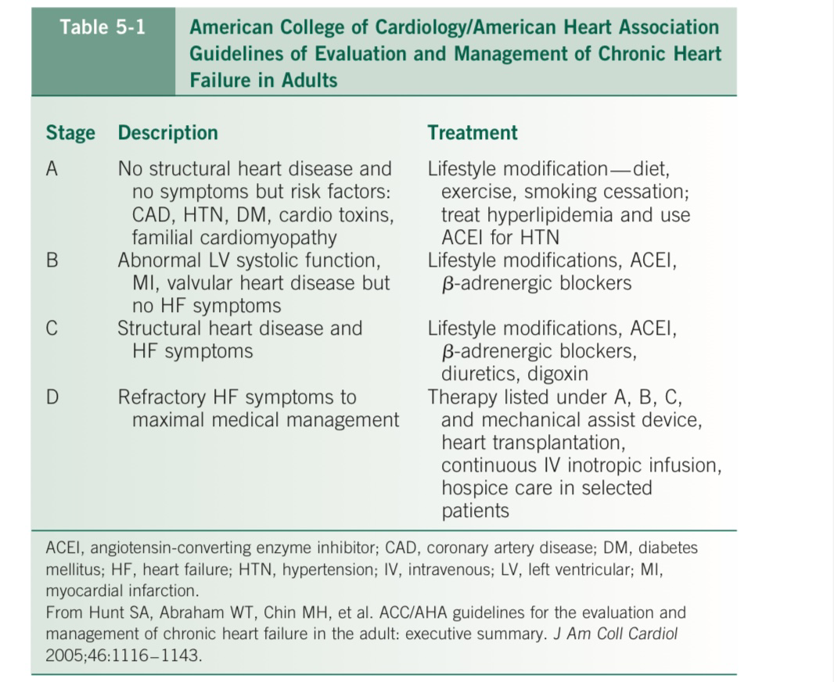

Slide 10
SYMPATHOMIMETIC AGENTS
Sympathomimetic agents are potent drugs that are primarily used to treat severeHF.
Beneficial and adverse effects are mediated by stimulation of myocardialb-adrenergic receptors.

Slide 11
The most important adverse effects are related to the arrhythmogenic nature of these agents and the potential for exacerbation of myocardial ischemia.
Treatment should be guided by careful hemodynamic and ECG monitoring.

Slide 12
Patients with refractory chronic HF may benefit symptomati- cally from continuous ambulatory administration of IV inotropes as palliative therapy or as a bridge to mechanical ventricular support or cardiac transplantation.

Slide 13
Dopamine
Used primarily for stabilisation of hypotensive patients

Slide 14
endogenous catecholamine that exerts its dose-dependent effects on the cardiovascular system via its interaction with four different receptors: dopaminergic type 1 and type 2 and adrenergic alpha-1 and beta-1

Slide 15
When used at lower doses of up to 2.5 μg/kg/min, its primary net effect is vasodilation of the splanchnic, coronary and renal vasculature

Slide 16
When administered in intermediate doses of 3–5 μg/kg/min, dopamine exhibits significant chronotropic and inotropic effects primarily by stimulating sarcolemmal beta-1 receptors in cardiomyocytes, but it also increases the pulmonary capillary wedge pressure (PCWP).

Slide 17
When used at higher doses of more than 5 μg/kg/min, its net effect is a potent vasoconstriction, facilitated mostly via its effect on alpha-1 adrenergic receptors of the vasculature.
This leads to a significantly elevated afterload that can prove detrimental for patients with AHF and systolic dysfunction.

Slide 18
The most notable adverse effects of dopamine include hypertension and tachyarrhythmias that are more frequently encountered at doses of >10 μg/kg/min

Slide 19
Dobutamine
synthetic analog of dopamine.
tolerance has been described, and several studies have demonstrated increased mortality in patients treated with continuous dobutamine.
No significant role in the treatment of HF resulting from diastolic dysfunction or a high-output state.

Slide 20
enhances cardiac contractility via its stimulatory effect on myocardial beta-1 receptors.
It also affects the peripheral vasculature due to its combined action on vascular alpha-1 receptors and beta-2 receptors

Slide 21
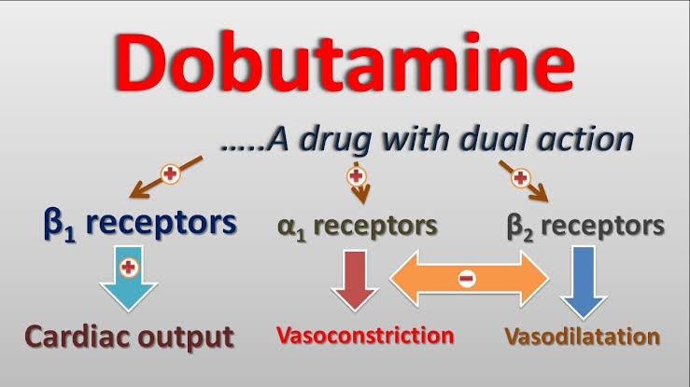

Slide 22
low doses of dobutamine (<5 μg/kg/min) for patients with AHF lead to increased cardiac output through enhanced inotropy, while simultaneously reducing afterload by exerting a vasodilatory effect on the peripheral arterial vasculature, thereby resulting in improved symptoms

Slide 23
doses exceeding 5 μg/kg/min, the effect on peripheral vessels shifts towards vasoconstriction as the alpha-1 agonist effect becomes significantly more potent.

Slide 24
Norepinephrine
endogenous molecule, acting most potently on vascular alpha-1 adrenergic receptors, inducing vasoconstriction and increasing systolic and diastolic blood pressures.
It also acts on cardiac beta-1 receptors, thereby exerting chronotropic and inotropic effects

Slide 25
Based on these properties, norepinephrine is primarily used in patients with AHF who present with cardiogenic shock, always in addition to another more potent inotropic agent.
Norepinephrine is also used in combination with inodilators to prevent the development of hypotension

Slide 26
norepinephrine is usually infused at a rate of 0.01–0.03 μg/kg/min but can reach up to 1 μg/kg/min, until target blood pressure is achieved.

Slide 27
Adverse events of norepinephrine include tachycardia that can significantly increase myocardial oxygen demand, which may be detrimental, especially in cases of active myocardial ischaemia.
norepinephrine has a direct toxic effect on cardiac cells, primarily due to cell apoptosis induced by beta adrenergic stimulation

Slide 28
Milrinone
a PDE3 inhibitor, is a commonly used inotropic agent in patients with severe HF or cardiogenic shock
It inhibits PDE3, which physiologically degrades intracellular cyclic adenosine monophosphate (cAMP). Through this inhibition, cAMP accumulates in the cell, causing protein kinase A activation

Slide 29
This facilitates more calcium ions to enter the myocardial cell, thus potentiating the actin-myosin cross-bridging leading to increased cardiac contractility.
This mechanism is independent of the beta-adrenergic pathway

Slide 30
Levosimendan
Levosimendan exerts its effects by acting on troponin C, rendering the cardiomyocyte more sensitive to the already existing levels of intracellular calcium, thereby increasing its contractility
Calcium sensitiser
Chance of arrhythmia is less

Slide 31
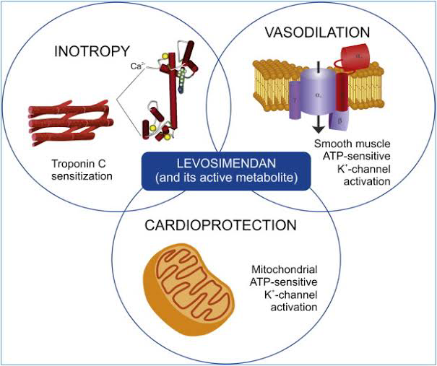

Slide 32
Omecamtiv mecarbil
cardiac myosin activator
It exerts its effect by binding on an allosteric site on myosin itself. This leads to a stabilisation of the lever arm of myosin, rendering it primed

Slide 33
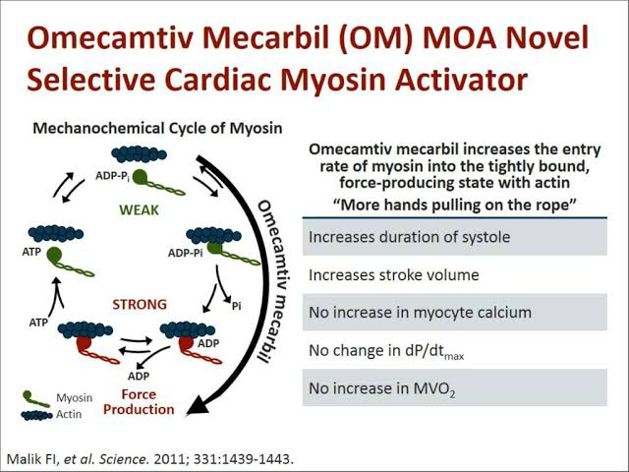

Slide 34
Less chance of MI and arrhythmia
Alternative to levosimendan

Slide 35
SERCA2a modulation
Sarcoplasmic reticulum Ca²⁺-ATPase (SERCA), and its 2a isoform, is a sarcolemmal membrane-bound enzyme that handles free calcium influx back in the sarcoplasmic reticulum in the post-systolic period.
SERCA2a, via this mechanism, affects the mechanics of both diastole and systole and its expression is long known to be reduced in HF patients, leading to systolic impairment

Slide 36
SERCA2a Gene Therapy
intracoronary administration of an adeno-associated virus type 1 encoding sarcoplasmic reticulum calcium ATPase

Slide 37
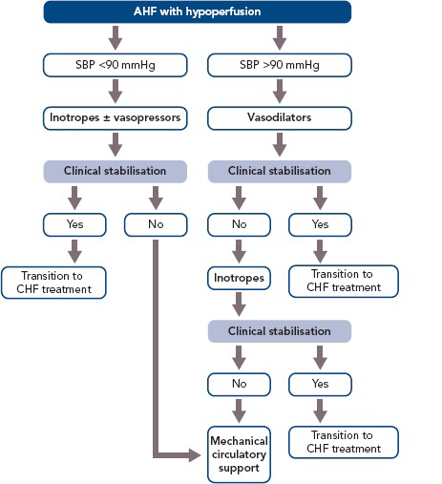

Slide 38
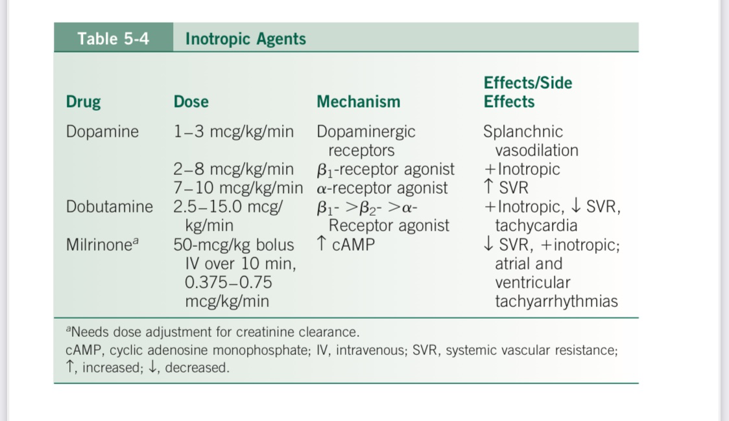

Slide 39
Optimum weaning
As soon as congestion is alleviated and renal function improves, shown by an increase in urinary output and a decrease in blood urea nitrogen and creatinine levels, inotropic support should be tapered with the goal of complete weaning.
During this time, standard oral HF treatment should be reinstated, and target doses should be reached after inotropic support is completely withdrawn.

Slide 40
Ionotrope dependence
Requires ionotropes for prolonged period
Usually bridged to transplantation or LVAD

Slide 41
In the case of primary renal failure, the choice of the appropriate inotropic agent is based primarily on its half-life.
Dobutamine is the agent with the shortest half-life (2 minutes), whereas levosimendan has an 80-hour half-life. Therefore, dobutamine is the agent of choice for these patients

Slide 42
For patients undergoing coronary artery bypass graft (CABG), the most widely used inotrope is dobutamine, as it provides better coronary perfusion without serious metabolic adverse effects.

Slide 43
Mechanical ventilation
Non invasive ventilation
CPAP
NIPSV
HFNC

Slide 44
NIV augments the inspiratory flow, increases the tidal volume, and unloads the inspiratory muscles
It improves alveolar ventilation, re-expands flooded alveoli and prevents microatelectasis.
it decreases respiratory rate, and the work of breathing

Slide 45
The effective filling and emptying of the heart is determined in part by cardiac transmural pressure (P_{TM}), the pressure difference between the inside of the heart and the intrathoracic pressure

Slide 46
In patients with AHF, the amplitude of inspiratory swings is greater and results in higher P_{TM}.

Slide 47
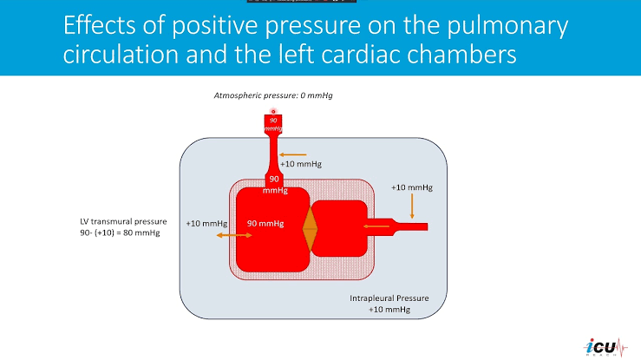

Slide 48
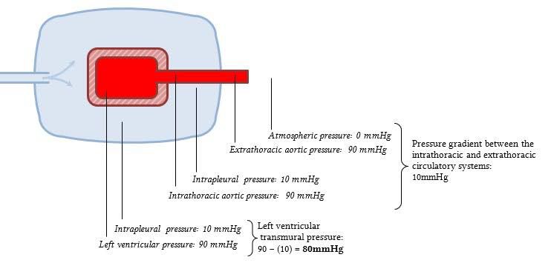

Slide 49
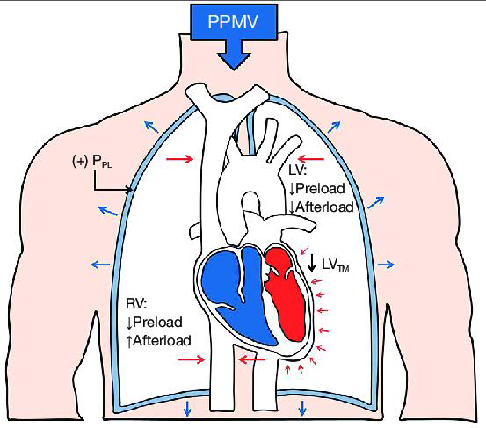

Slide 50
NIV also causes a decrease in the heart rate secondary to lung inflation and resultant increased parasympathetic tone

Slide 51
therapy with NIV in AHF is probably beneficial only in patients with systolic dysfunction.
In patients with predominantly diastolic dysfunction who require a relatively high filling pressure, the effects of positive pressure therapy can compromise venous return, resulting further in hypotension and prerenal azotemia

Slide 52
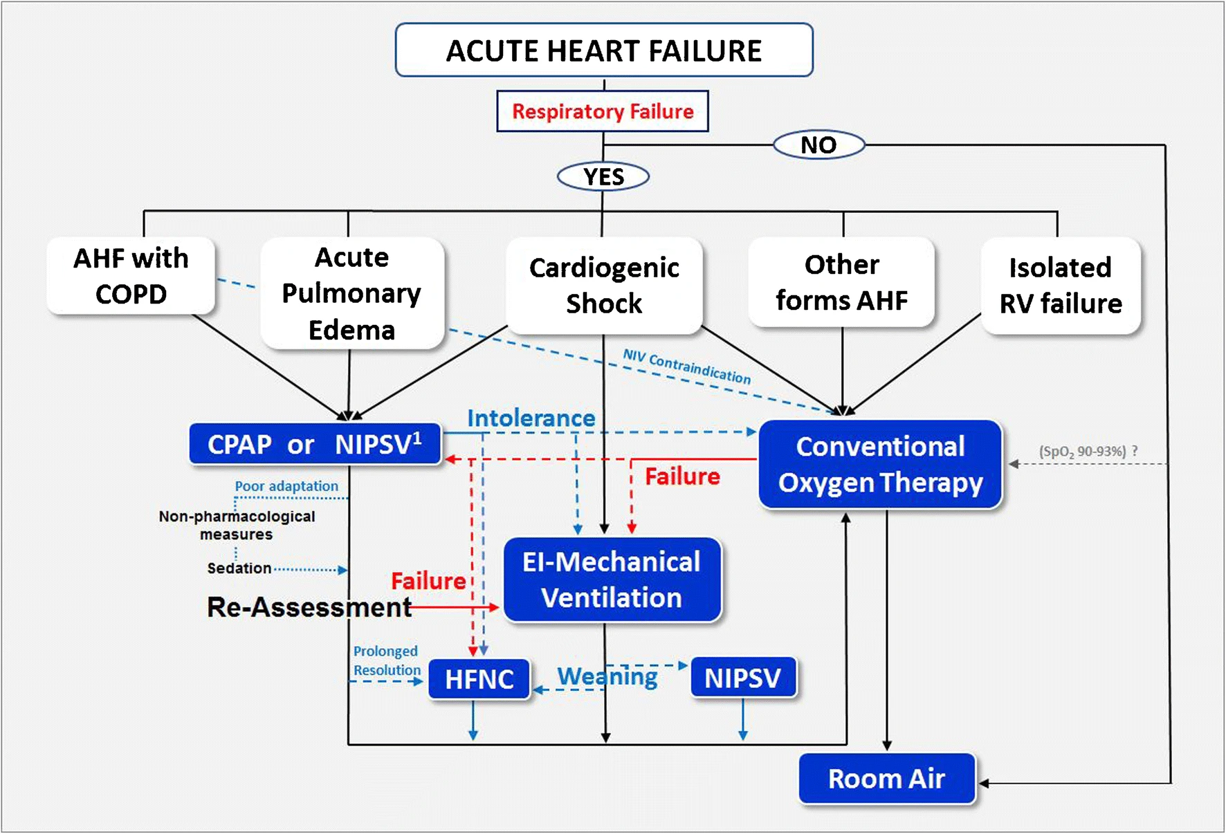

Slide 53
although the indication of NIV remains limited in hypotensive patients, it may be cautiously considered in selected CS patients.

Slide 54
Non pharmacological measures
Coronary revascularisation
Reduces ischemia
May improve systolic function in some patients

Slide 55
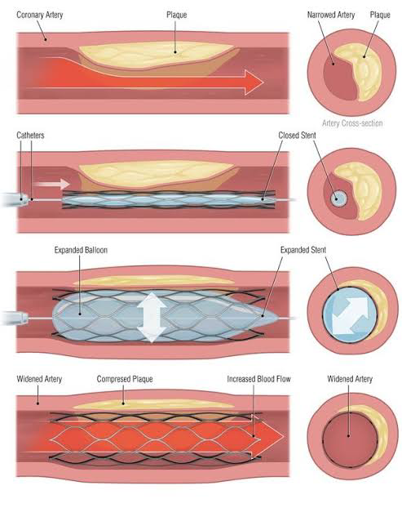

Slide 56
CRT or biventricular pacing
beneficial in some patients with an EF of less than 35%, NYHA class III–IV HF, and conduction abnormalities (left bundle branch block and atrioventricular delay).

Slide 57
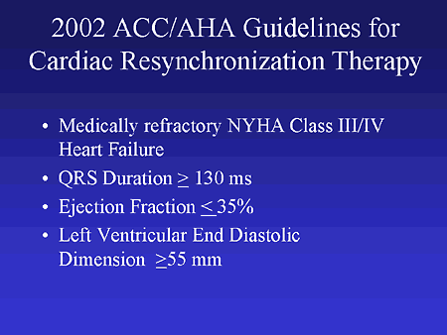

Slide 58
implanting a pacemaker, usually just below the clavicle. Three wires (leads) connected to the device monitor the heart rate to detect heart rate irregularities and emit tiny pulses of electricity to correct them. In effect, it is "resynchronizing" the heart.

Slide 59
Cardiac resynchronization therapy with a pacemaker (CRT-P). The device used for cardiac resynchronization therapy has three leads that connect the pacemaker to the right upper chamber of the heart (right atria) and both lower chambers (ventricles).

Slide 60
Cardiac resynchronization therapy with a pacemaker and an ICD (CRT-D). This device may be recommended for people with heart failure who also have a risk of sudden cardiac death. It can detect dangerous heart rhythms and deliver a stronger shock of energy than a pacemaker can deliver. This shock can reset the heartbeat.

Slide 61
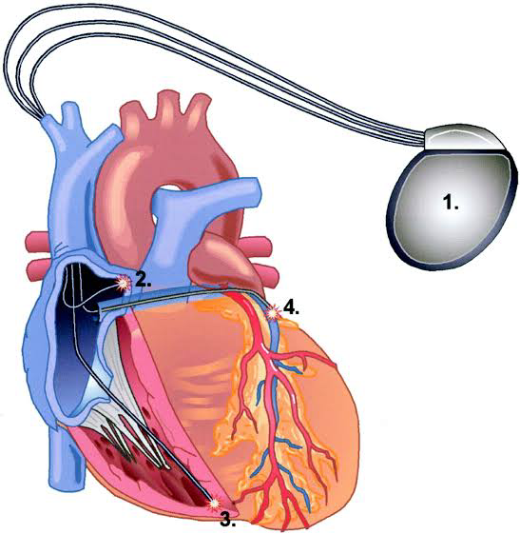

Slide 62
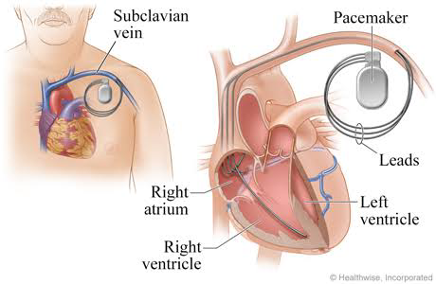

Slide 63
ICD
recommended for selected HF patients with an EF less than 35% for primary prevention of SCD.
Sudden death occurs six to nine times more often in patients with HF compared to the general population and is the leading cause of death in ambulatory HF patients
Patients should receive at least 3 months of optimal medical therapy prior to reassessment of EF and implantation of an ICD.

Slide 64
Following an acute MI or revascularization, EF should be assessed following40 days of optimal therapy prior to ICD implantation.
ICD therapy should be deferred in patients with advanced age, life-shortening co-morbidities, and end-stage HF patients who are not candidates for transplantation

Slide 65
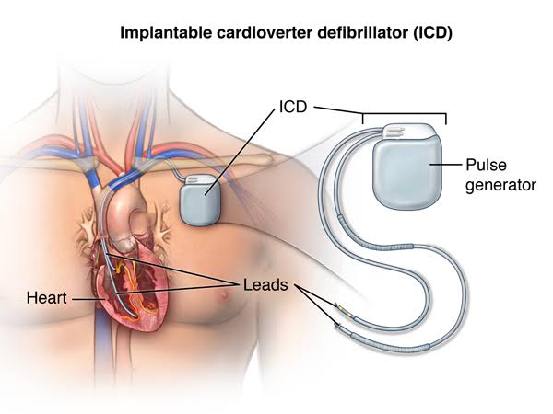

Slide 66
IABP
considered for patients who have failed other therapies, have transient myocardial dysfunction, or are awaiting a definitive procedure such as left ventricular assist device (LVAD) or transplantation.
Severe aortoiliac atherosclerosis and moderate-to-severe aortic valve insufficiency are contraindications to IABP placement

Slide 67
The IABP consists of a long polyurethane type catheter with a 10-15cm balloon at the end.
This catheter is normally inserted via the femoral artery and passed into the descending thoracic aorta until the tip is positioned 2cm just below the left subclavian artery and the lower end of the balloon just above the renal arteries.

Slide 68
The catheter attaches to a pressurised flush system, similar to that of an arterial line, and also to the pump itself where helium is shuttled in and out of the catheter so that the balloon can inflate and deflate

Slide 69
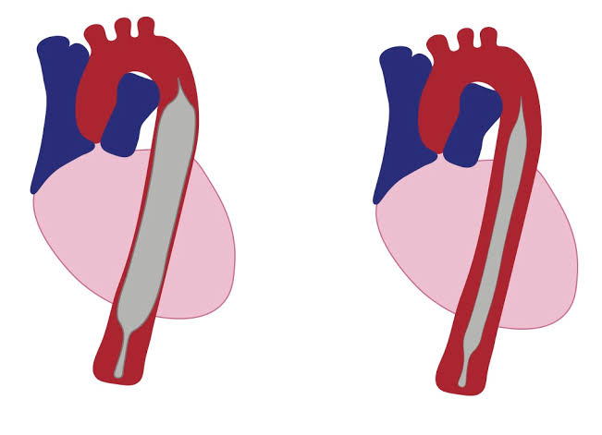

Slide 70
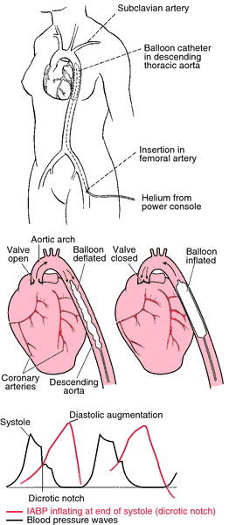

Slide 71
Inflation of the balloon during diastole just after aortic valve closure, and deflation just prior to ventricular systole reduces the pressure workload of the left ventricle and lessens oxygen demand and consumption by the myocardium

Slide 72
LVAD
Percutaneous LVADs are now available to provide short-term support for patients in cardiogenic shock and have been shown to have superior hemodynamic effects compared to the IABP

Slide 73
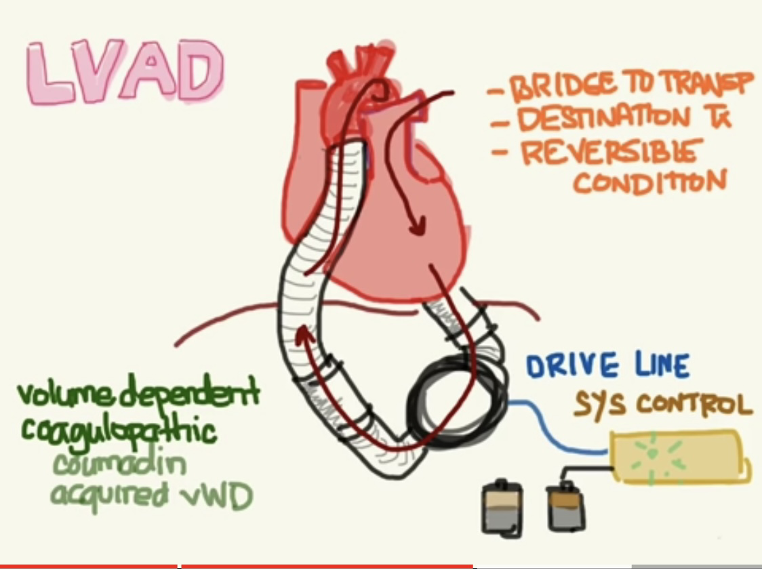

Slide 74
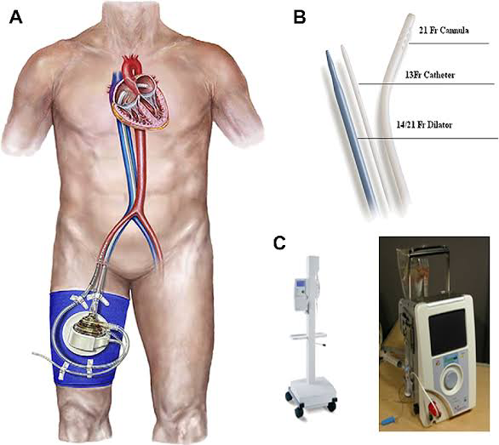

Slide 75
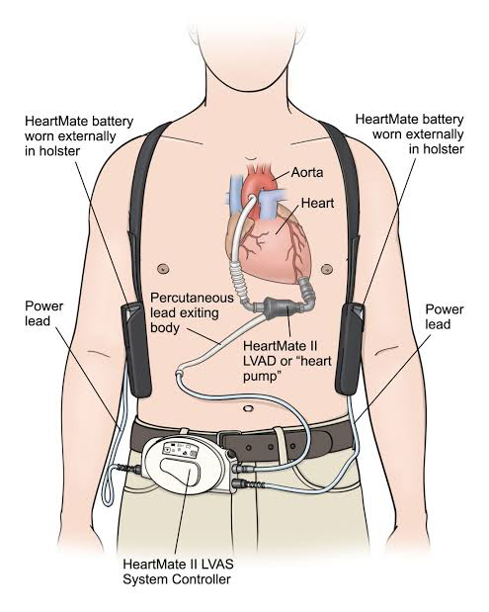

Slide 76
VADs support the failing heart by unloading the ventricle and generating flow to the systemic and/or pulmonary circulation.
They can be used to support the left ventricle, right ventricle or both the ventricles.
LVAD is the main assist device used in clinical practice

Slide 77
VAD typically has an inflow cannula, an outflow cannula, a pumping chamber, per-cutaneous driveline, a controller and power supply
VADs are usually implanted through a median sternotomy.
The inflow cannula is connected to the heart and it decompresses the ventricular cavity and an outflow cannula returns blood to either the ascending aorta or the main pulmonary artery.

Slide 78
The pumping chamber of the VAD is implanted sub-diaphragmatically to a pre-peritoneal or intra-abdominal position or may be situated in a para-corporeal position outside the body

Slide 79
A percutaneous driveline, containing the control and power wires, is tunnelled through the skin of the abdominal wall.
It connects the device to an external portable driver consisting of an electronic or pneumatic controller and a power supply that may be worn around the waist, carried in a shoulder bag, or contained within a small bedside monitor

Slide 80
Cardiac transplantation
age65 years (although selected older patients may also benefit)
have advanced HF(NYHA class III–IV)
strong psychosocial support system
Exhausted all other therapeutic options
free of irreversible extra cardiac organ dysfunction that would limit functional recovery or predispose them to post-transplant complications

Slide 81
Post transplant complications include acute and chronic rejection, typical and atypical infections, and adverse effects of immunosuppressive agents.
Cardiac allograft vasculopathy (CAD/chronic rejection) and malignancy are the leading causes of death after the first post-transplant year

Slide 82
Thankyou

