Slide 1
Phase 2 Trial of Baxdrostat for Treatment-Resistant Hypertension
DR AKSHAY RAJU
JR3 MEDICINE

Slide 2
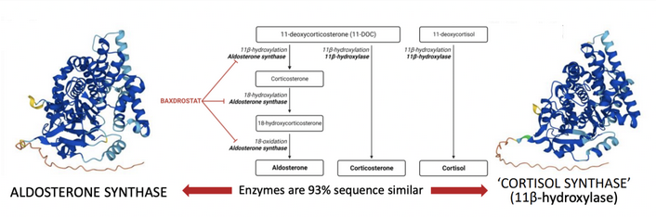
BACKGROUND
Aldosterone synthase controls the synthesis of aldosterone
  pharmacologic target for the treatment of hypertension for several decades.
Selective inhibition of aldosterone synthase is essential
  difficult to achieve
  because cortisol synthesis is catalyzed by another enzyme that shares 93% sequence similarity with aldosterone synthase.

Slide 3
The main limitations of spironolactone with respect to side effects —
    gynecomastia in men and
    menstrual irregularities and postmenopausal bleeding in women
— are due to the off-target blockade of multiple steroid hormone receptors by spironolactone.
  In addition : risk of inducing hyperkalemia with spironolactone
An alternative strategy to mineralocorticoid receptor blockade is to lower aldosterone levels through inhibition of aldosterone synthase.
However, the development of such a drug has been thwarted by the 93% sequence similarity between aldosterone synthase and the final enzyme required for cortisol synthesis, 11β-hydroxylase.

Slide 4
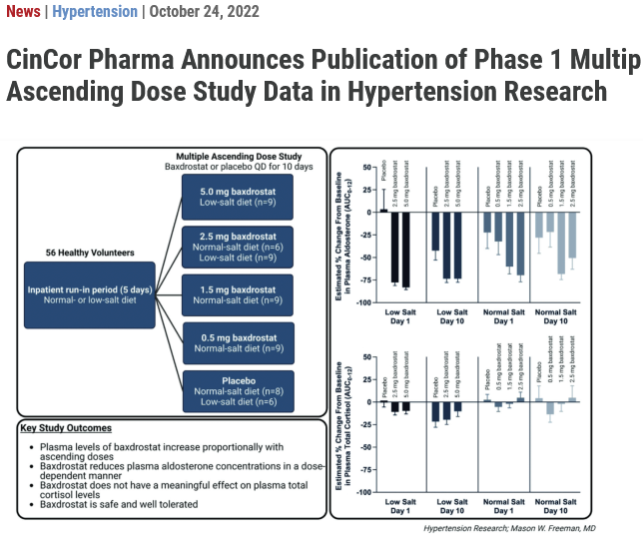
In preclinical and phase 1 studies,
  Baxdrostat had 100:1 selectivity for enzyme inhibition
  Baxdrostat at several dose levels reduced plasma aldosterone levels but not cortisol levels.

Slide 5
HYPERTENSION
Leading global risk factor for cardiovascular disease, stroke, disability, and death
Affects ~ 1.4 billion persons worldwide
Approximately 10% of persons with hypertension (10 to 12 million persons) : treatment-resistant hypertension
  “elevated blood pressure despite concurrent use of at least three antihypertensive drugs of different classes, including a diuretic”
  Treatment-resistant hypertension : substantially increased risk of cardiovascular and renal adverse events.

Slide 6
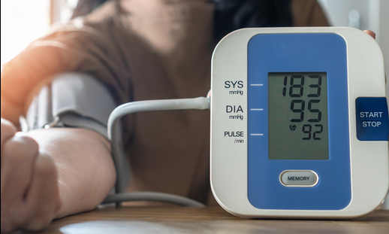
CURRENT MANAGEMENT
Patients with treatment-resistant hypertension are often prescribed at least four antihypertensive agents
  Goal : in-office systolic blood pressure of less than 130 mm Hg and diastolic blood pressure of 80 mm Hg or less.
Current guidelines : recommend addition of spironolactone, as a fourth-line agent
A total of 40 to 50% of patients with hypertension STILL remain inadequately treated.
No new class of antihypertensive medication has been approved since 2007

Slide 7
Aldosterone synthase inhibitors
Aldosterone synthase inhibitors target a likely cause of treatment resistance
  by suppressing hormone synthesis rather than by blocking the mineralocorticoid receptor
Data from preclinical and phase 1 studies :
  baxdrostat has high selectivity (selectivity ratio, 100:1) for aldosterone synthase as compared with 11β-hydroxylase INSPITE OF SEQUENCE SIMILARITY
  In the current trial, they examined the efficacy and safety of baxdrostat in patients with treatment-resistant hypertension.

Slide 8

TRIAL DESIGN AND POPULATION
BrigHTN : had an adaptive design.
  multicenter,
  randomized,
  double-blind,
  placebo-controlled,
  parallel-group,
  dose-ranging trial,

Slide 9
INCLUSION CRITERIA
The trial enrolled men and women who were :
18 years of age or older,
Receiving stable doses of at least three antihypertensive medications (one of which was a diuretic),
Mean blood pressure of at least 130/80 mm hg while seated
Blood pressure was determined as the average of three measurements obtained with the use of an automated in-office blood-pressure monitor

Slide 10
EXCLUSION CRITERIA
Key exclusion criteria were :
Mean seated systolic blood pressure of at least 180 mm hg or a diastolic blood pressure of at least 110 mm hg
Estimated glomerular filtration rate (GFR) of less than 45 ml per minute per 1.73 m2 of body-surface area
Uncontrolled diabetes.
To be eligible for the trial, patients who had been receiving a mineralocorticoid receptor antagonist or a potassium-sparing diuretic were required to discontinue these agents for a total of 4 weeks before randomization

Slide 11
TRIAL PROCEDURE
After a screening period of up to 8 weeks,
  eligible patients entered a 2-week, single-blind run-in period
  to determine whether medication adherence was a factor in not attaining their blood-pressure goal.
Patients with at least 70% adherence (determined on the basis of pill counts) to each antihypertensive medication and placebo during the run-in period and a seated blood pressure of at least 130/80 mm Hg
  were randomly assigned to receive either 0.5 mg, 1 mg, or 2 mg of baxdrostat or matching placebo.
The doses of baxdrostat were selected on the basis of decreases in aldosterone levels that had been measured in previous multiple-ascending-dose study.

Slide 12

FOLLOWUP
After randomization,
Clinical visits were conducted on days 3, 8, 15, 22, 43, 64, and 85 (the last day of the treatment period)
Follow-up telephone call occurred 1 week after the last dose

Slide 13
ETHICAL CONSIDERATIONS
BrigHTN was conducted primarily at community-based practices in the United States, as well as at a small number of academic hospital–based practices.
The trial was designed by CinCor Pharma, CinRx Pharma, and external scientific advisers and funded by CinCor Pharma.
The trial was conducted in accordance with the principles of the Declaration of Helsinki and the Good Clinical Practice guidelines of the International Council for Harmonisation.
All the clinical sites that participated in the trial obtained approval from an institutional review board at the site that was authorized to approve studies involving humans, and all patients provided written informed consent before enrollment in the trial.
An independent data monitoring committee performed a formal unblinded interim analysis when approximately 200 patients had completed the 12-week treatment period.

Slide 14
END POINTS
The primary efficacy end point :
  Change in the mean seated systolic blood pressure from baseline to the end of the 12-week treatment period
  In each baxdrostat group as compared with the placebo group.
The secondary end points :
  Change from baseline in the mean seated diastolic blood pressure and
  Percentage of patients with a seated blood pressure of less than 130/80 mm hg at the end of the 12-week treatment period.

Slide 15
The safety end points included adverse events, vital signs, and the results of laboratory tests, electrocardiography, and physical examinations.
Prespecified adverse events of special interest were hyperkalemia, hyponatremia, and hypotension warranting clinical intervention.
Patients with potassium levels between 5.5 and 5.9 mmol per liter were contacted and asked to return for a repeat electrolyte measurement as soon as feasible, but they continued to receive baxdrostat or placebo.
In contrast, patients with potassium levels between 6.0 and 6.4 mmol per liter were directed to discontinue baxdrostat or placebo and return for reevaluation as soon as feasible.
Exploratory pharmacokinetic and pharmacodynamic analyses were performed to assess the levels of plasma baxdrostat, serum and urinary aldosterone, and serum cortisol as well as plasma renin activity.

Slide 16
STATISTICAL ANALYSIS
Estimated sample size of 77 patients in each group : 80% power
Difference in the mean (±SD) seated systolic blood pressure of 5±11 mm hg after the 12-week treatment period between each of the three baxdrostat groups and the placebo group
Initial enrollment of 348 patients (87 per trial group) was planned :
  Based on the assumption of a 13% early withdrawal rate
Patients were stratified according to their :
  Baseline systolic blood pressure (<145 mm hg or ≥145 mm hg) and
  Baseline estimated gfr (<60 ml per minute per 1.73 m2 or ≥60 ml per minute per 1.73 m2).

Slide 17
The primary efficacy analysis
Compared the change in the mean seated systolic blood pressure from baseline to the end of the treatment period
Between each baxdrostat group and the placebo group in the modified intention-to-treat population (patients who received at least one dose of baxdrostat or placebo and had a baseline value for the systolic blood-pressure assessment).

Slide 18
The secondary efficacy end pointanalysis
change from baseline in diastolic blood pressure was analyzed with the use of linear regression
A sensitivity analysis was performed for missing data for the primary end point

Slide 19
A total of 779 patients underwent screening, and 360 were included in the placebo run-in period. A total of 275 patients were randomly assigned to receive once-daily baxdrostat at a dose of 0.5 mg (69 patients), 1 mg (70 patients), or 2 mg (67 patients), or placebo (69 patients). One patient who was randomly assigned to receive baxdrostat in the 1-mg group never received the drug, so the modified intention-to-treat population included 274 patients (Figure 1). The trial groups were similar with respect to demographic and clinical characteristics at baseline. The trial population was predominantly White (70%). Black patients constituted a higher percentage of patients in the trial (28%) than their proportionate representation in the U.S. population (Table S1). The trial included a sizable percentage of patients who identified as Hispanic (43%) and a small percentage who identified as Asian (2%)

Slide 20
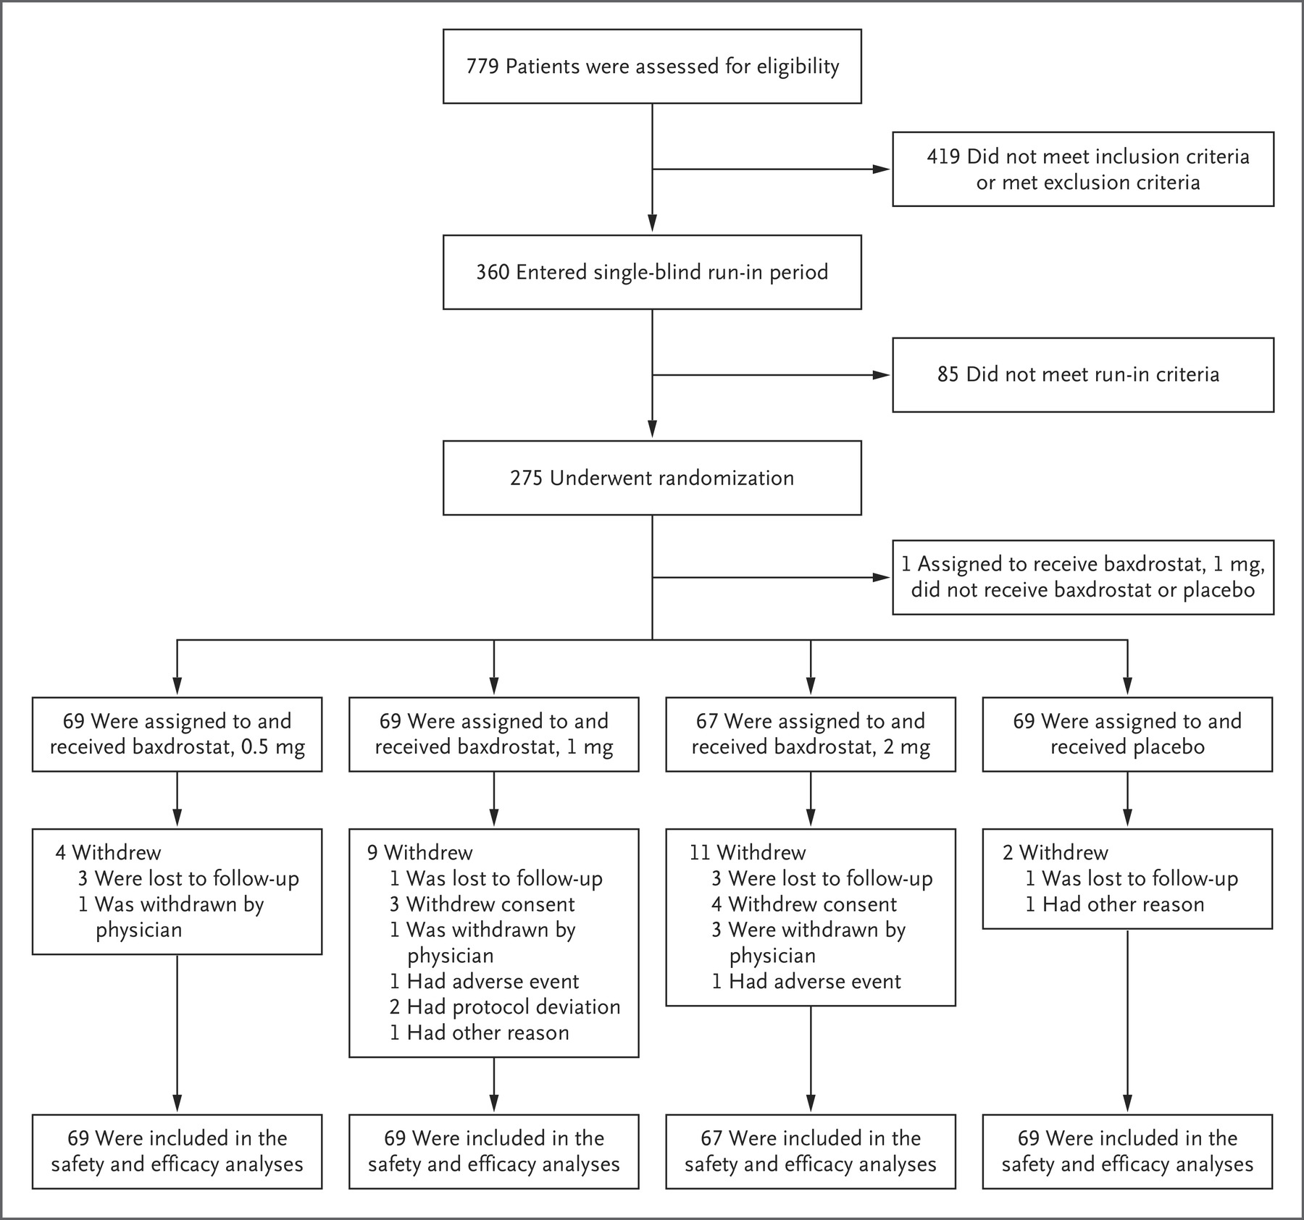

Slide 21
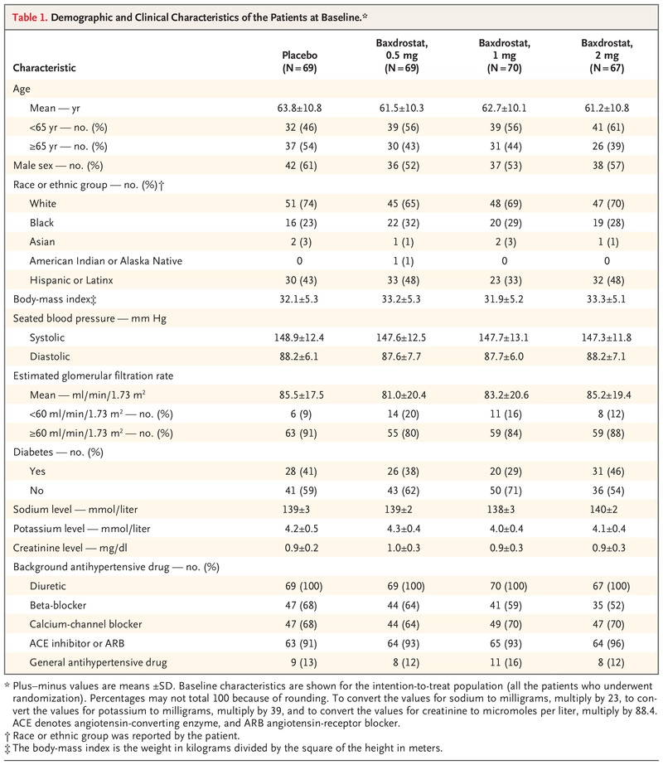

Slide 22
The first patient underwent screening on July 30, 2020, and the last patient visit occurred on June 14, 2022.
A total of 248 patients (90%) completed the 12-week treatment period
The most common reasons for trial discontinuation were withdrawal of consent (7 patients) and loss to follow-up (8 patients).
Although discontinuations were not shown to be related to adverse events, adverse events initially occurred at a higher frequency in the 1-mg and 2-mg dose groups than in the 0.5-mg and placebo groups
Fewer losses to follow-up occurred in the latter half of the trial, potentially because of improved coronavirus disease 2019 protocols and immunization, and these losses were evenly distributed among the trial groups
The use of background medication was similar among the trial groups.
  All the patients received a diuretic, 91 to 96% received an angiotensin-converting–enzyme inhibitor or angiotensin-receptor blocker, and 64 to 70% received a calcium-channel blocker

Slide 23
OUTCOMES
Estimated sample size of 77 patients in each group : 80% power
Difference in the mean (±SD) seated systolic blood pressure of 5±11 mm hg after the 12-week treatment period between each of the three baxdrostat groups and the placebo group
Initial enrollment of 348 patients (87 per trial group) was planned :
  Based on the assumption of a 13% early withdrawal rate
Patients were stratified according to their :
  Baseline systolic blood pressure (<145 mm hg or ≥145 mm hg) and
  Baseline estimated gfr (<60 ml per minute per 1.73 m2 or ≥60 ml per minute per 1.73 m2).

Slide 24
PRIMARY END POINT
After the prespecified interim analysis, the trial was stopped early because the independent data monitoring committee concluded that the trial had met the criteria for overwhelming efficacy.

Slide 25
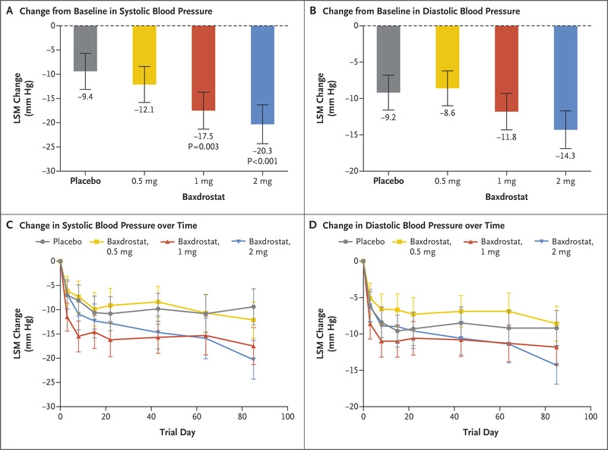
At week 12, baxdrostat was associated with dose-dependent changes in the least-squares mean (±SE) systolic blood pressure of −20.3±2.1 mm Hg, −17.5±2.0 mm Hg, and −12.1±1.9 mm Hg at the 2-mg, 1-mg, and 0.5-mg doses, respectively
As compared with the change in systolic blood pressure of −9.4 mm Hg in the placebo group,
  significantly greater decreases in systolic blood pressure in the 2-mg baxdrostat group
  (difference between the 2-mg group and the placebo group, −11.0 mm Hg; 95% confidence interval [CI], −16.4 to −5.5; P<0.001)
  significant decrease in systolic blood pressure 1-mg baxdrostat group (difference between the 1-mg group and the placebo group, −8.1 mm Hg; 95% CI, −13.5 to −2.8; P=0.003),
  but these decreases in 1-mg baxdrostat group were not significantly greater with the 0.5-mg dose.

Slide 27
SECONDARY END POINTS
At the 2-mg dose, baxdrostat reduced diastolic blood pressure by 14.3±1.31 mm Hg.
The difference in the change in diastolic blood pressure between the baxdrostat 2-mg group and the placebo group was −5.2 mm Hg (95% CI, −8.7 to −1.6)

Slide 28
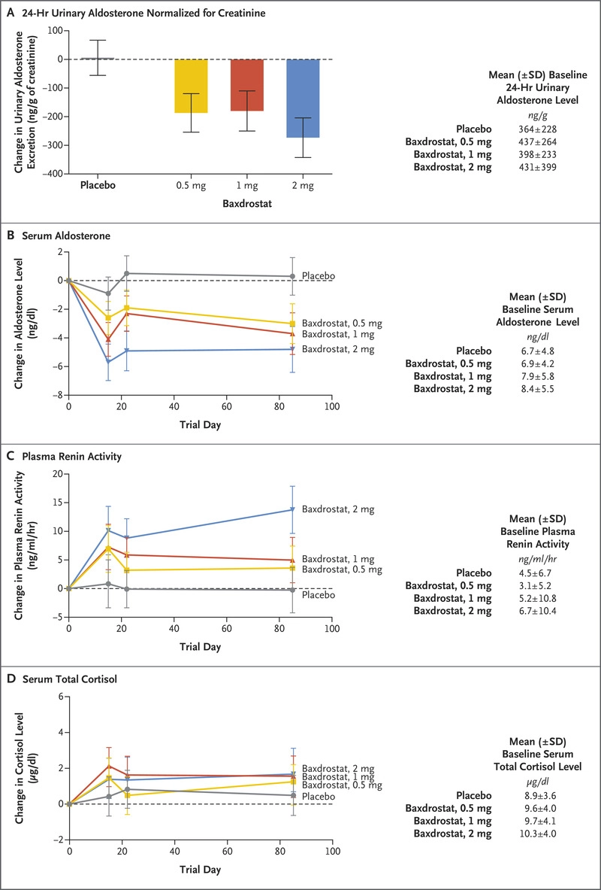
Effects of Baxdrostat on Pharmacodynamic Measures.
The use of baxdrostat led to a sustained dose-dependent decrease in serum aldosterone levels
The least-squares mean differences in changes in aldosterone levels at the end of the trial between the baxdrostat groups and the placebo group ranged from :
  −3.0 ng per deciliter (95% CI, −4.3 to −1.7) (−83.2 pmol per liter; 95% CI, −119.3 to −47.2) at the 0.5-mg dose
  −4.9 ng per deciliter (95% CI, −6.3 to −3.5) (−135.9 pmol per liter; 95% CI, −174.8 to −97.1) at the 2-mg dose.

Slide 29
The 24-hour urinary aldosterone levels decreased with all three dose levels of baxdrostat
The changes in the urinary aldosterone level (normalized for urinary creatinine excretion) from baseline to the end of the trial were :
  −187 ng of aldosterone (95% CI, −254 to −119) per gram of creatinine with the 0.5-mg dose,
  −180 ng of aldosterone (95% CI, −250 to −110) per gram of creatinine with the 1-mg dose, and
  −273 ng of aldosterone (95% CI, −342 to −204) per gram of creatinine with the 2-mg dose.
In patients in the placebo group, the urinary aldosterone level increased by 6 ng of aldosterone (95% ci, −55 to 67) per gram of creatinine.

Slide 30
The least-squares mean change in plasma renin activity from baseline to the end of the trial was higher by 13.8 ng per milliliter per hour (95% CI, 9.6 to 17.9) in the 2-mg baxdrostat group than in the placebo group.
Serum cortisol levels were not reduced in any of the baxdrostat groups throughout the trial, and there were no significant differences between the baxdrostat groups and the placebo group in the least-squares mean change in these levels at week 12.
At the highest dose level of baxdrostat, the least-squares mean change in the serum cortisol level from baseline to the end of the trial was 1.91 μg per deciliter (95% CI, 0.70 to 3.12) (52.7 nmol per liter; 95% CI, 19.3 to 86.1)

Slide 31
Adverse Events That Occurred during the Treatment Period.
No deaths occurred during the trial
baxdrostat had an overall acceptable side-effect profile
A total of 232 adverse events occurred during the treatment period in 120 patients (44%)
A higher percentage of patients in the 1-mg group (52%) and 2-mg group (48%) had adverse events than those in the 0.5-mg group (35%) or the placebo group (41%).
Adverse events that occurred in 5% or more patients in any of the trial groups were urinary tract infections, hyperkalemia, headache, and fatigue.
Most adverse events (62%) were mild, and 89% were deemed by the investigators to be unrelated to baxdrostat or placebo.
None of the serious adverse events were deemed by the investigators to be related to baxdrostat or placebo.
There were no instances of adrenocortical insufficiency.

Slide 32
DISCUSSION
Trial showed substantial decreases in blood pressure when patients with treatment-resistant hypertension who were receiving stable doses of at least three antihypertensive medications also received the selective aldosterone synthase inhibitor baxdrostat.
The reduction in blood pressure was associated with a decrease in the plasma aldosterone level and a compensatory increase in plasma renin activity, without reduction in the cortisol level.
Baxdrostat generally had an acceptable side-effect profile, and none of the patients discontinued the trial because of hyperkalemia.

Slide 33
BP REDUCTION
This trial adds to the evidence that aldosterone appears to be a driver of treatment resistance, showed dose-related reductions in both blood pressure and indexes of aldosterone secretion.
Did not compare baxdrostat with alternative drugs.
A meta-analysis involving 11,000 participants from 42 trials :
  With currently licensed drugs (angiotensin-converting–enzyme inhibitors, calcium-channel blockers, or diuretics) in addition to previous therapy,- reduction in systolic blood pressure was by a mean of 7 to 8 mm hg

Slide 34
BAXDROSTAT AND ADRENALS
The first aldosterone synthase inhibitor to enter clinical development, LCI-699 (osilodrostat), was associated with off-target inhibition of cortisol synthesis and was ultimately repurposed to treat excess cortisol states rather than hypertension.
The selective action of baxdrostat may avert the risk of inducing adrenal insufficiency and the loss of blood-pressure–lowering efficacy that can result from the accumulation of mineralocorticoid receptor–activating steroid precursors seen with first-generation aldosterone synthase inhibitors.
These advantages will need to be confirmed in phase 3 trials involving more patients over a longer period.

Slide 35
BAXDROSTAT AND S.K
In this trial, few patients who received baxdrostat had recurrent hyperkalemia, and the cases of elevated potassium levels resolved quickly, without dose modification or intervention other than routine dietary advice.
The limitations of the present phase 2 dose-ranging trial include the fact that it was
not designed to test the benefits and risks of aldosterone synthase inhibition beyond 12 weeks,
nor to compare aldosterone synthase inhibition with alternative antihypertensive agents.
The selection of patients with an estimated GFR greater than 45 ml per minute reduced the likelihood of hyperkalemia
planned longer-term studies may determine whether the incidences of hyperkalemia and other adverse events differ from those reported for currently licensed drugs.

Slide 36
CONCLUSION
In this trial, aldosterone synthase inhibition with baxdrostat led to substantial reductions in systolic and diastolic blood pressure in patients with treatment-resistant hypertension.

Slide 37
THANK YOU

