Slide 1
A TWISTED TUBE
Dr Sooryalekshmi
Jr1 ,M5

Slide 2
THE HISTORY...
58 /M
K/c/o COPD
Admitted with low grade fever *5 days
cough with purulent expectoration *5days
acute exacerbation of breathlessness*2 days

Slide 3
CLINICAL EXAMINATION
Showed features s/o COPD
Vitals stable
No e/o respiratory failure

Slide 4
Accidentally noticed...
Weak lower limb pulses{From Femoral downwards bl}
Bp. R. UL – 140/90 mmHg L . UL 142/96
R .LL. - 126 /88 mmHg L . LL – 130/90

Slide 5
We thought of…
Peripheral occlusive arterial disease (as patient was a c/c smoker)

Slide 6
Other causes of Unequal UL & LL pulses
Coarctation of aorta
Aortoarteritis
Aortic dissection

Slide 7
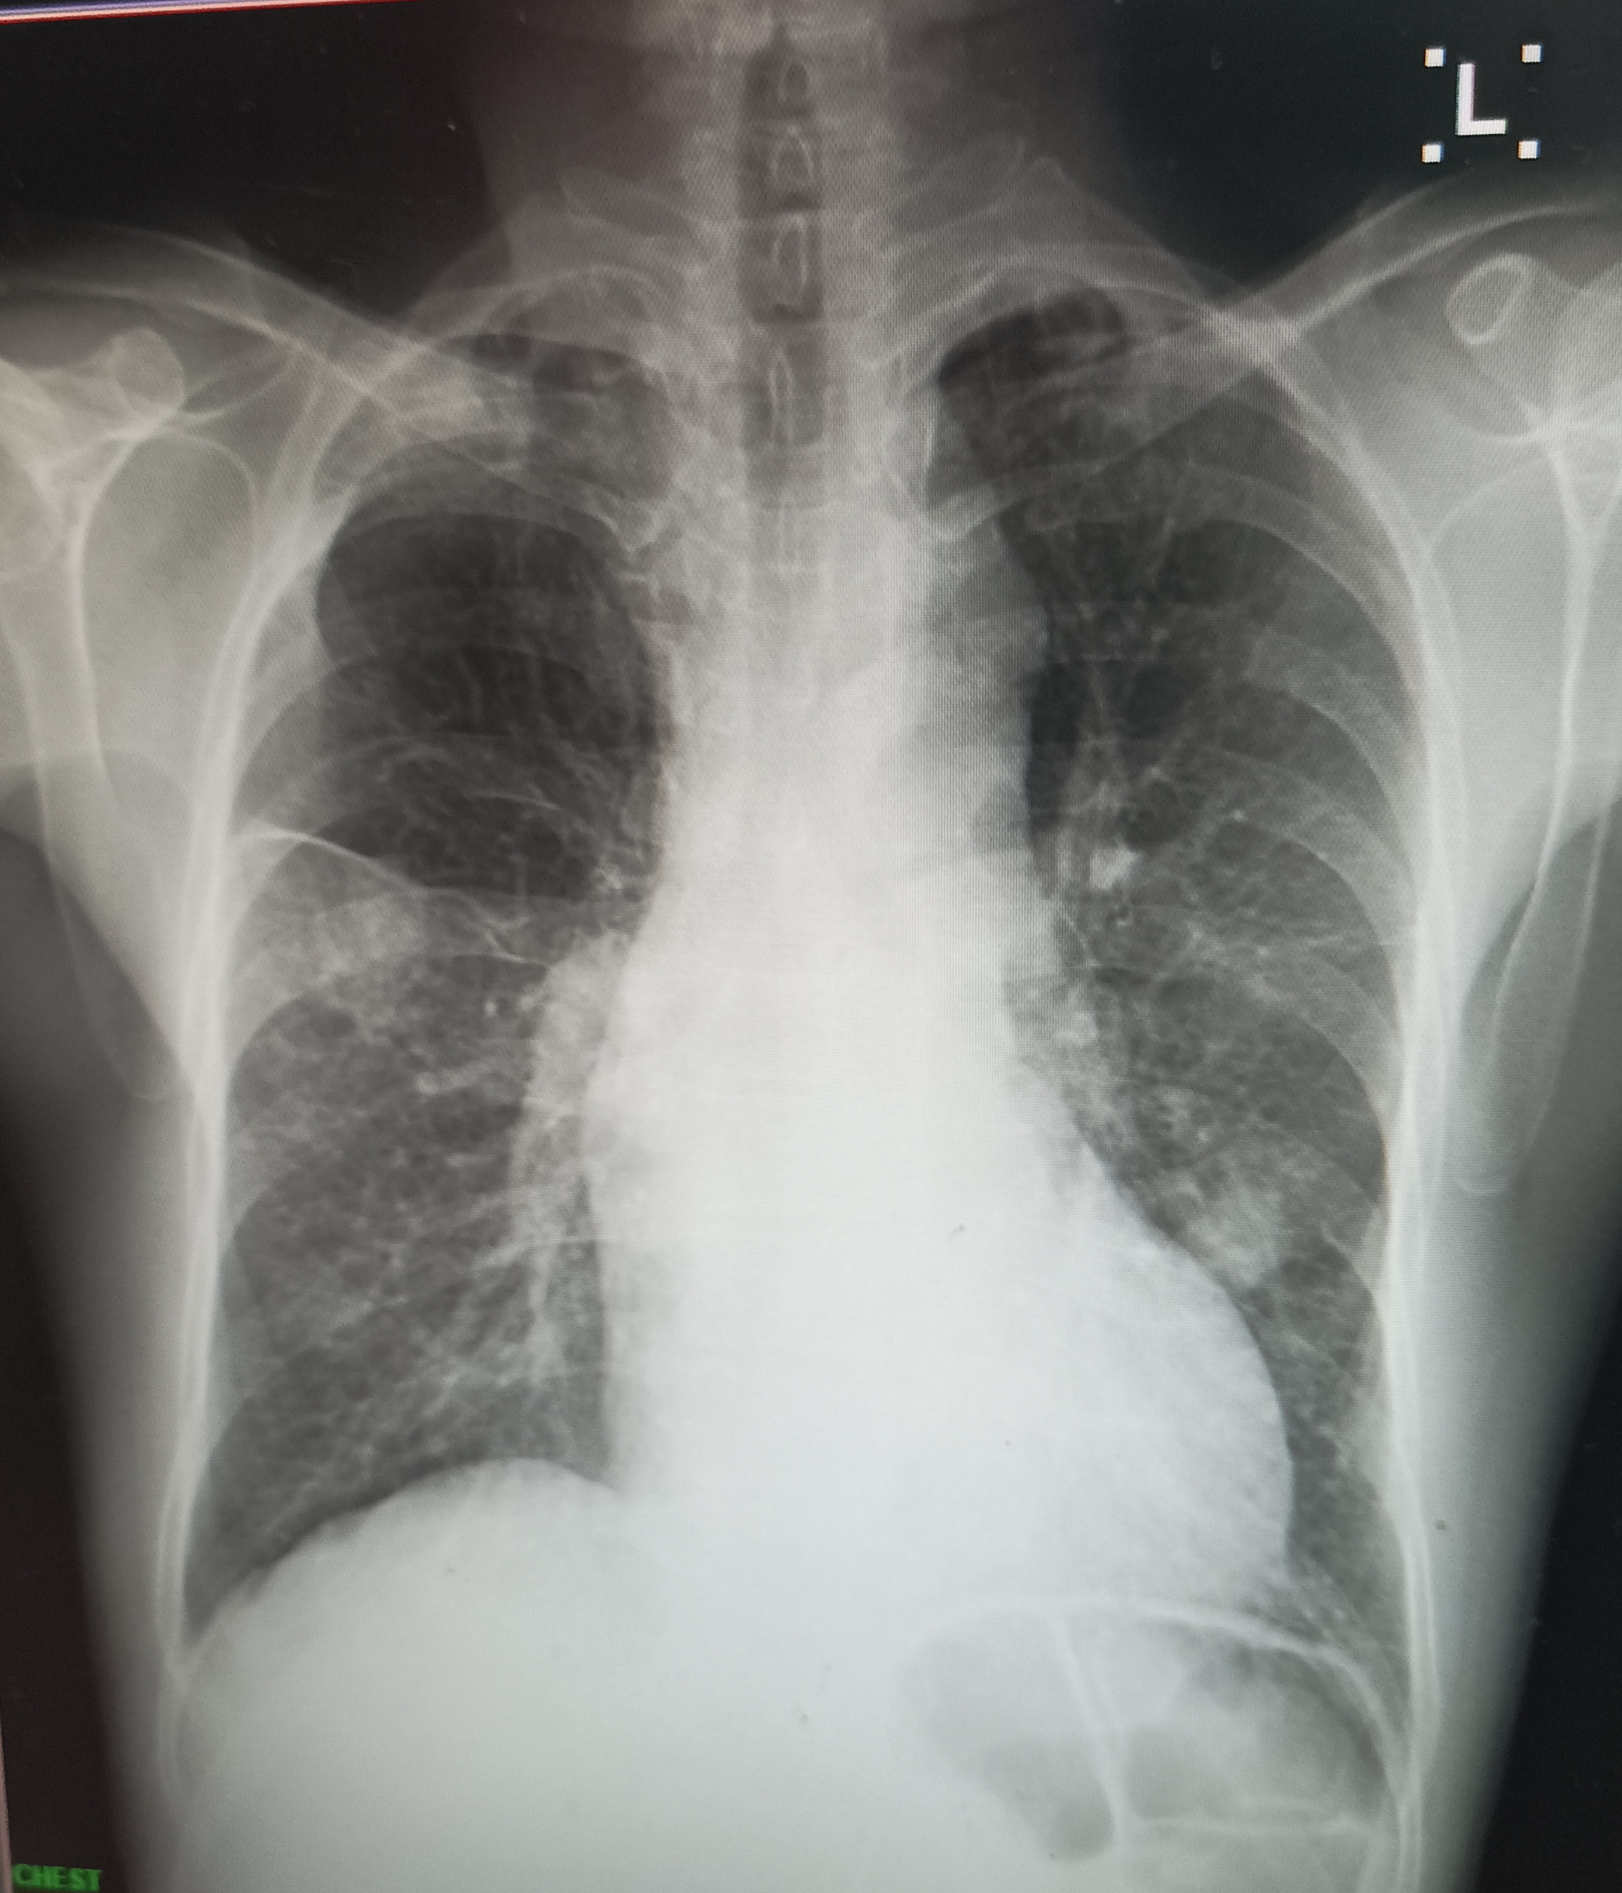
We proceeded with the usual investigations for the patient…

Slide 8
We ordered for a CECT Thorax
Which revealed an unusual finding !!
(We asked the RD to look specifically for any CoA as he had significantly weak pulses from Femoral downwards)

Slide 9
A Pseudocoarctation of Aorta !!

Slide 10
Pseudocoarctation of aorta
Kinking of aorta
At the level of ligamentum arteriosum
No pressure gradient across the lesion
Congenital.
incidental detection – as clinically stable
Diagnosis –CT angiogram & cardiac catheterization & cardiac MRI

Slide 11
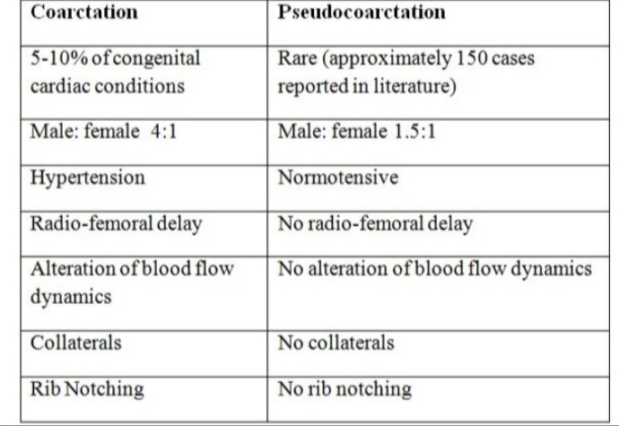

Slide 12
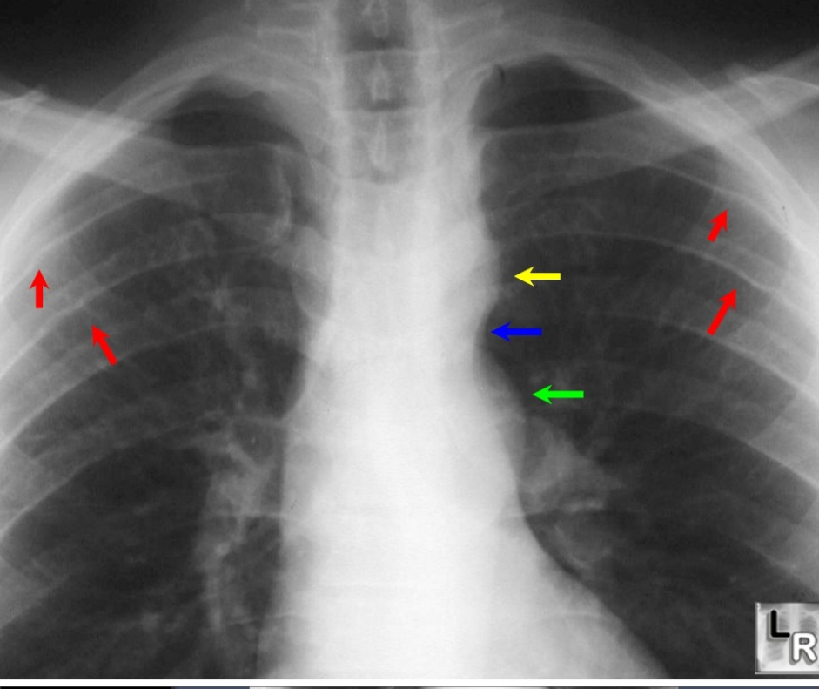

Slide 13
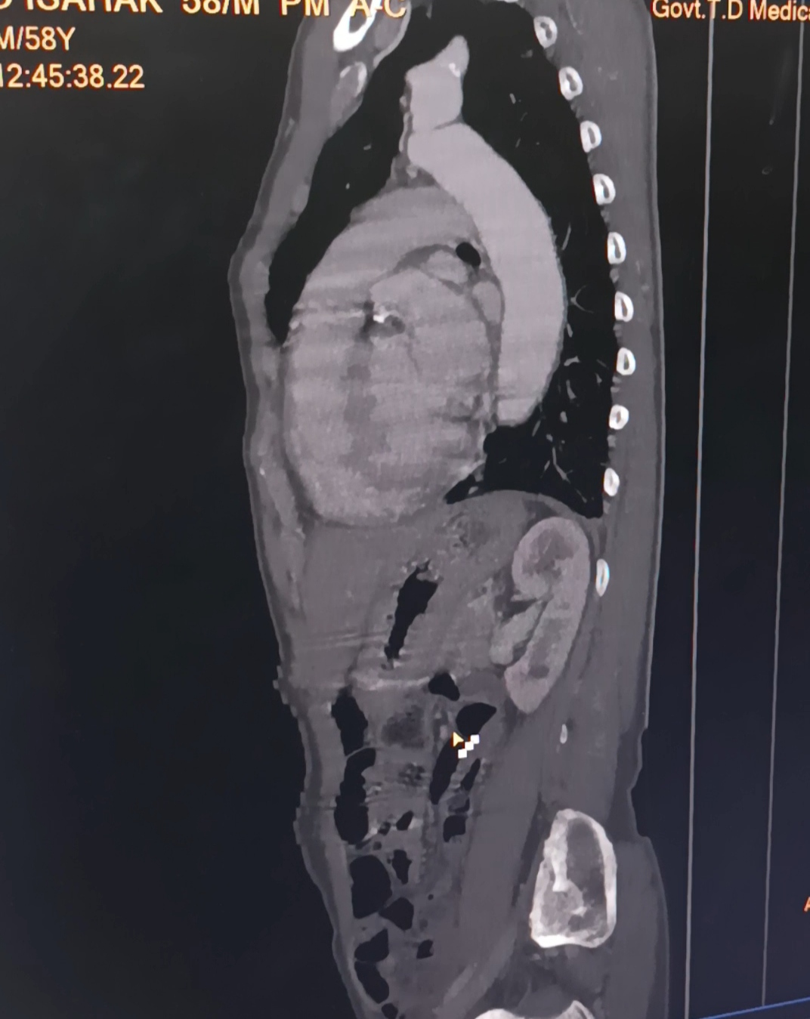
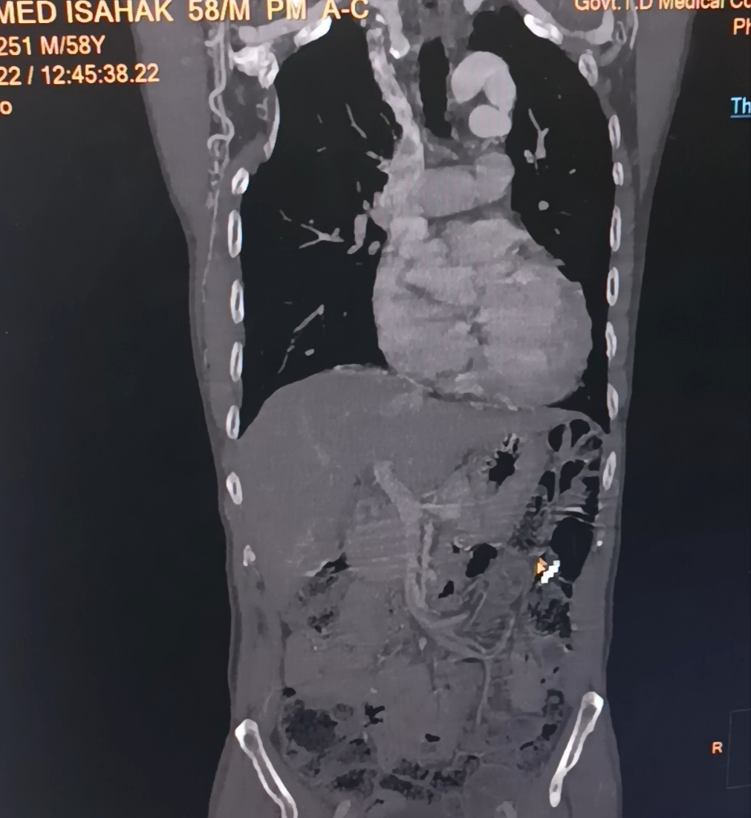
Ct aortogram- pseudocoarctation of aorta

Slide 14
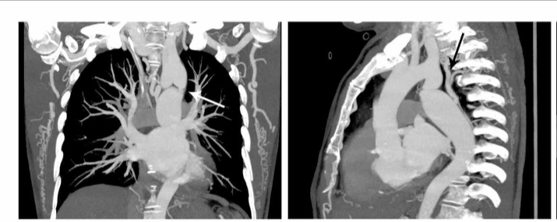
Coarctation of aorta – ct aortogram

Slide 15
Pseudocoarctation differ from coarctation by
High aortic arches,which may rise higher than clavicle
Absent or mild aortic lumen stenosis
Absence of collateral circulation
Absent LVH and ascending aorta dilatation

Slide 16
Management
Symptomatic cases- managed surgically
Asymptotic cases – follow up by aortogram and cardiac catheterization

Slide 17
Thank you…

