Slide 1
PORTOPULMONARY HYPERTENSION

Slide 2
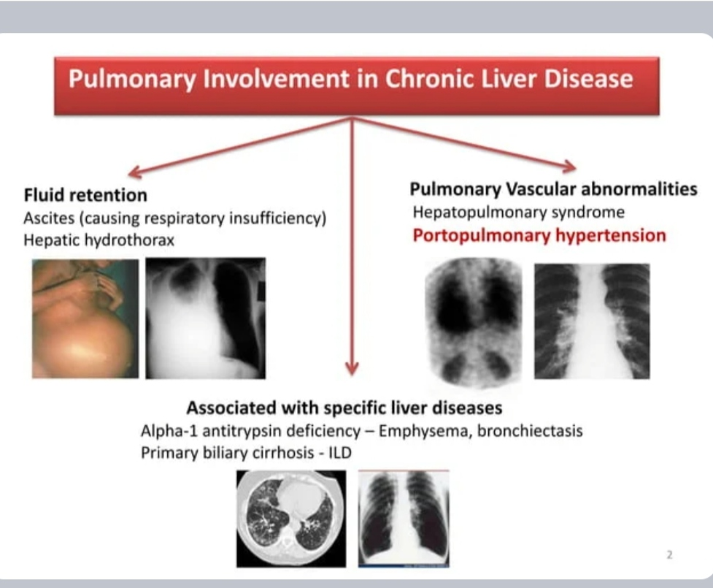

Slide 3
INTRODUCTION
Portopulmonary hypertension (PoPH) refers to pulmonary arterial hypertension that is associated with portal hypertension
It is a well recognized complication of portal hypertension due to chronic liver disease or extrahepatic causes.

Slide 4
Elevated mean pulmonary artery pressure (mPAP) >20 mmHg at rest
Normal or low pulmonary capillary wedge pressure ≤15 mmHg at rest
An elevated pulmonary vascular resistance (PVR; ≥3 Wood units or 240
dynes/sec/cm ]) AND
Clinical portal hypertension ( splenomegaly , ascites, thrombocytopenia , esophageal varices, portosystemic shunts ) with or without chronic liver disease)

Slide 5
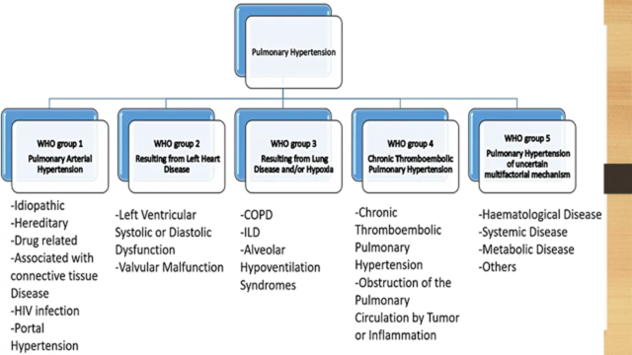

Slide 6
Portal hypertension must exist for PoPH to develop
Chronic liver disease without portal hypertension does not cause PoPH .
Causes of Portal hypertension in patients with PoPH – cirrhosis in majority of cases.

Slide 7
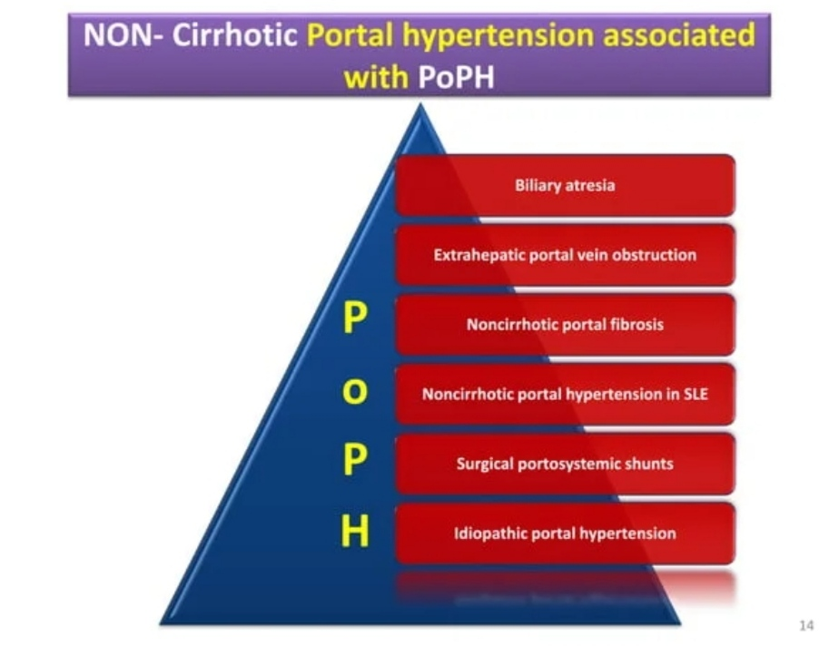

Slide 8
PATHOGENESIS
Imbalance of vasoconstrictive and vasodilatory mediators
- humoral substance(s) (which would normally be metabolized by the liver) is able to reach the pulmonary circulation through portosystemic collaterals, resulting in PPHTN .
These include serotonin, interleukin-1,endothelin-1, glucagon, secretin, thromboxane B2, and vasoactive intestinal peptide

Slide 9
Genetic predisposition – several mutations have been proposed in pathways that involve estrogen signaling, cell growth, apoptosis, and oxidative stress.
Thromboembolism from the portal venous system-thrombi from the portal circulation pass through portosystemic shunts and reach the pulmonary circulation, resulting in PAH .

Slide 10
Hyperdynamic pulmonary circulation – with increased right ventricular output and blood flow through the pulmonary vascular bed causing increased shear stress on the vascular wall resulting in PAH.
Inflammation – Many cytokines including interferon gamma are elevated in patients with chronic parenchymal liver disease.

Slide 11
PATHOLOGY
The pulmonary histopathology of PPHTN is indistinguishable from PAH due to other causes .
These findings include medial hypertrophy, remodeling of the muscular pulmonary artery walls, and in situ thrombosis.

Slide 12
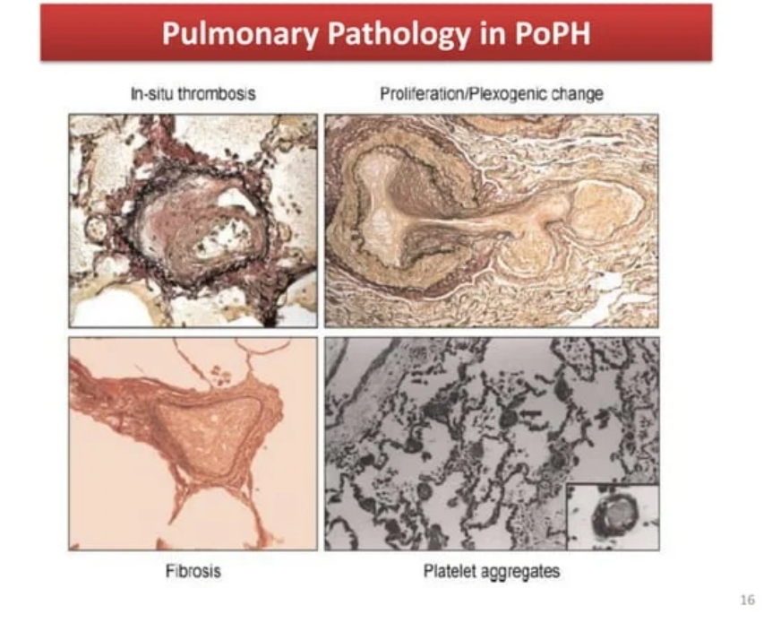

Slide 13
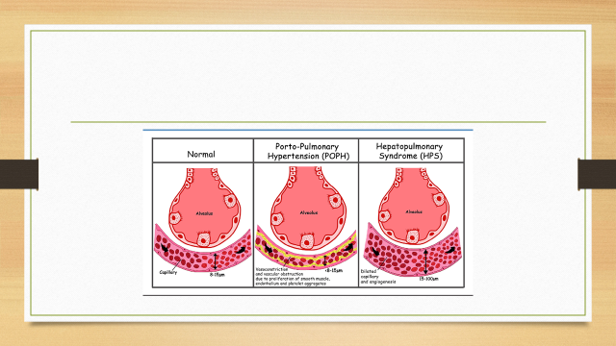

Slide 14
DIAGNOSTIC EVALUATION
Suspecting PAH
Clinical presentation — PPHTN should be suspected in patients with portal hypertension who present with symptoms and signs suggestive of PAH
dyspnea on exertion
Atypical chest pain,
elevated jugular venous pressure
leg edema
The pulmonary manifestations of PPHTN are identical to other types of PAH

Slide 15
The interval between the first manifestation of portal hypertension and the documentation of PAH ranges from 2 to 15 years

Slide 16
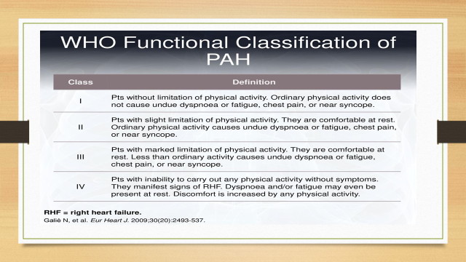

Slide 17
DIAGNOSIS
The diagnosis of PPHTN requires
confirmation of PAH
exclusion of alternative causes of PAH and PH
confirmation of portal hypertension

Slide 18
Confirmation of PAH can be done by
Elevated mean pulmonary artery pressure (mPAP) >20 mmHg at rest
Normal or low pulmonary capillary wedge pressure ≤15 mmHg at rest
An elevated pulmonary vascular resistance (PVR; ≥3 Wood units or 240
dynes/sec/cm ])

Slide 19
An elevated PVR is important since it distinguishes patients with precapillary disease from those who have a passive elevation in the mPAP from hyperdynamic circulatory changes associated with chronic liver disease.

Slide 20
Confirming portal hypertension — from history, physical examination, imaging, or pathology that suggests chronic liver disease or portal hypertension.
confirmed by hepatic venous catheterization to measure the hepatic venous pressure gradient

Slide 21
MANAGEMENT
General measures — General measures are PAH- and portal hypertension related.
Pulmonary arterial hypertension-related —
exercise as tolerated
Smoking cessation
oxygen and diuretics.
Anticoagulation is not advised.

Slide 22
Portal hypertension-related
Avoidance of beta-blockade — avoided in patients with PPHTN since they can worsen right heart failure due to a reduction in right ventricle cardiac output and increase in pulmonary vascular resistance
Avoidance of transjugular intrahepatic portosystemic shunt — increase right ventricle preload and worsen heart failure and is consequently generally avoided in those with PPHTN

Slide 23
LIVER TRANSPLANTATION
Pulmonary pressures may improve or normalize following liver transplantation,
can only be pursued in patients with end-stage liver disease who meet liver
transplantation criteria, provided their PPHTN is treated and responsive to
PAH-specific therapy

Slide 24
Pulmonary arterial hypertension-directed therapy — PAH-specific therapy is directed at the PAH itself rather than the underlying cause.
Agent selection is determined by many factors, particularly WHO functional class

Slide 25
WHO functional class I (observation) —
do not require pharmacologic therapy
they should be clinically monitored (eg, every three to six months) for disease progression
Any coexisting conditions that worsen pulmonary hypertension should also be treated (eg, cardiac disease,interstitial lung disease).

Slide 26
WHO functional class II to IV (pharmacotherapy) —
patients with WHO functional class II, III, or IV should be referred to a specialized center to be evaluated for PAH-specific pharmacotherapy.
Calcium channel blockers should be avoided.

Slide 27
ENDOTHELIN RECEPTOR ANTAGONISTS (ERAS)
bosentan, can be associated with liver toxicity (transaminitis, liver failure, cirrhosis).
ERAs should be avoided in those whose transaminase level is greater than three times the upper limit of normal and in those with moderate to severe liver disease.
Patients with PPHTN should have liver function monitored monthly during ERA therapy.
ERAs may also place these patients at risk of fluid retention necessitating an adjustment in diuretic therapy.
Ambrisentan and macitentan are less hepatotoxic than bosentan.but patients develop more fluid retention with ambrisentan

Slide 28
Nitric oxide-cyclic guanosine monophosphate enhancers — These agents include two families of drugs
the guanylate cyclase stimulant-riociguat,
PDE5Is-sildenafil and tadalafil

Slide 29
PHOSPHODIESTERASE-5 INHIBITORS (PDE5IS),
sildenafil and tadalafil
metabolism is not affected by liver dysfunction.
some data suggest that PDE5Is may increase splanchnic flow to worsen portal hypertension.

Slide 30
PROSTACYCLIN PATHWAY AGONISTS
oral selexipag, which may be administered to patients with WHO functional class II and III
Other agents (epoprostenol, treprostinil, iloprost) are often reserved for patients with WHO functional class IV and those who need a bridge to liver transplantation.

Slide 31
REFRACTORY DISEASE
Right to left shunts and lung transplantation — Shunts are appropriate(eg, atrial septostomy) as a bridge to lung transplantation in those with severe symptomatic PPHTN that is refractory to combination therapy.

Slide 32
PROGNOSIS
Patients with PPHTN may have worse outcomes than patients with other types of group 1 pulmonary arterial hypertension (PAH).
High pulmonary vascular resistance (PVR) is a risk factor for mortality.
Other risk factors for death include severity of liver disease,poor six-minute walk distance, high right atrial pressure, and high pulmonary capillary wedge pressure

Slide 33
DIFFERENTIAL DIAGNOSIS
HPS – platypnea, orthodeoxia, and evidence of an intrapulmonary shunt on echocardiography that may help to distinguish it from PAH
Heart failure with preserved or reduced ejection fraction
Diaphragmatic compromise from ascites.
Hepatic hydrothorax

Slide 34
Thank u

