Slide 1
ORIGINAL ARTICLE
DR SANJU S
JUNIOR RESIDENT
DEPARTMENT OF GENERAL MEDICINE

Slide 2
INHALED TREPROSTINIL IN PULMONARY HYPERTENSION DUE TO INTERSTITIAL LUNG DISEASE
AARON WAXMAN
NEW ENGLAND JOURNEL OF MEDICINE
JANUARY 28, 2021

Slide 3
INTRODUCTION
Precapillary pulmonary hypertension is defined as an elevation in mean pulmonary arterial pressure and pulmonary vascular resistance.
In the World Health Organization (WHO) classification of pulmonary hypertension, precapillary pulmonary hypertension due to lung disease is classified as group 3.
The most common lung diseases associated with group 3 pulmonary hypertension are chronic obstructive pulmonary disease and interstitial lung disease.

Slide 4
Pulmonary hypertension has been reported in up to 86% of patients with interstitial lung disease
It is associated with reduced exercise capacity, greater need for supplemental oxygen, decreased quality of life, and earlier death.
Currently no approved therapies for these patients.

Slide 5
Treprostinil is a stable analogue of prostacyclin
It promotes direct vasodilation of pulmonary and systemic arterial vascular beds and inhibits platelet aggregation.
An inhaled formulation of treprostinil was previously shown to improve exercise capacity after 12 weeks of therapy in patients with group 1 pulmonary hypertension.
Data from previously completed pilot studies suggest that inhaled treprostinil can improve hemodynamics and functional capacity in patients with group 3 pulmonary hypertension

Slide 6
OBJECTIVE
The objective of the trial was to evaluate the safety and efficacy of inhaled treprostinil in patients with pulmonary hypertension due to interstitial lung disease.

Slide 7
TRIAL DESIGN AND
Multicenter, randomized, doubleblind, placebo-controlled trial.

Slide 8
TRIAL POPULATION
INCLUSION CRITERIA
Both male and female Age > or = 18 yrs
The subject has a confirmed diagnosis of World Health Organization Group 3 pulmonary hypertension based on computed tomography imaging, which demonstrates evidence of diffuse parenchymal lung disease performed within 6 months prior to randomization. Subjects may have any form of interstitial lung disease or combined pulmonary fibrosis and emphysema.
Subjects are required to have a right heart catheterization within 1 year prior to randomization with the following documented parameters:
a. Pulmonary vascular resistance >3 Wood Units and
b. A pulmonary capillary wedge pressure of ≤15 mmHg
c. A mean pulmonary arterial pressure of ≥25 mmHg

Slide 9
4. Baseline 6-minute walk distance ≥ 100 meters.
6. Subjects on a chronic medication for underlying lung disease (ie, pirfenidone, nintedanib, etc) must be on a stable and optimized dose for ≥30 days prior to randomization.
7. Subjects with connective tissue disease must have a Baseline forced vital capacity of <70%.

Slide 10
EXCLUSION CRITERIA
The subject has a diagnosis of pulmonary arterial hypertension or pulmonary hypertension for reasons other than World Health Organization Group 3 pulmonary hypertension due to interstitial lung disease .
The subject has shown intolerance or significant lack of efficacy to a prostacyclin or prostacyclin analogue that resulted in discontinuation or inability to effectively titrate that therapy.
The subject has received any pulmonary arterial hypertension approved therapy including: prostacyclin therapy , IP receptor agonist (selexipag), endothelin receptor antagonist, phosphodiesterase type 5 inhibitor, or soluble guanylate cyclase stimulator within 60 days of randomization.

Slide 11
The subject has evidence of clinically significant left-sided heart disease as defined by:
a. Pulmonary capillary wedge pressure >15 mmHg
b. Left ventricular ejection fraction <40%
The subject is receiving >10 L/min of oxygen supplementation by any mode of delivery at rest at Baseline.
Exacerbation of underlying lung disease or active pulmonary or upper respiratory infection within 30 days of randomization.
Initiation of pulmonary rehabilitation within 12 weeks prior to randomization.
Acute pulmonary embolism within 90 days of randomization.

Slide 12
TRIAL PROCEDURES
Within 30 days after screening, eligible patients were randomly assigned in a 1:1 ratio to receive inhaled treprostinil or placebo in a double-blind manner.
Inhaled treprostinil (0.6 mg per milliliter) was administered by means of an ultrasonic, pulsed delivery nebulizer at 6 μg per breath.
Placebo was administered similarly as a visually identical solution.
The first dose of trial drug (3 breaths) was administered in the clinic, followed by at least a 1-hour observation period.
The dose of treprostinil or placebo was adjusted, with dose escalation.

Slide 13
TRIAL ASSESMENT
The 6-minute walk test was performed and laboratory data were obtained at baseline and at weeks 4, 8, 12, and 16, or at the time of early discontinuation of treprostinil or placebo.
Pulse oximetry was performed immediately before, during, and after each 6-minute walk test.
Measurement of N-terminal pro–B-type natriuretic peptide (NT-proBNP) levels and pulmonary function tests were performed at baseline and atweeks 8 and 16 (or at early discontinuation) .
The St. George’s Respiratory Questionnaire (SGRQ), a quality-of-life measure, was completed at baseline and week 16 or at the time of early discontinuation.

Slide 14
OUTCOME MEASURES
The primary end point of the trial - difference between the two groups in the change in peak 6-minute walk distance from baseline to week 16.
Secondary efficacy end points were analyzed in the following hierarchical testing order:
1.The change in NT-proBNP level from baseline to week 16,
2.The time to clinical worsening
Occurrence of clinical worsening is defined as
.Hospitalisation for cardiopulmonary indication
.Decrease in 6 min walk distance .15% from base line
.Death from any cause
. Lung transplantation

Slide 15
3.The change in 6-minute walk distance at peak plasma treprostinil level at week 12
4. Change in 6-minute walk distance at trough treprostinil level at week 15.

Slide 16
STATISTICAL ANALYSIS
For the primary efficacy analysis, the change in 6-minute walk distance was analyzed by mixedmodel repeated-measures methods.
If the result for the primary efficacy end point was significant, secondary efficacy end points were to be evaluated according to a hierarchical testing procedure.
Confidence intervals have not been adjusted for multiplicity and cannot be used to infer definitive treatment effects for secondary efficacy end points.

Slide 17
RESULTS
PRIMARY END POINT
Mean difference between the treprostinil group and the placebo group in the change from baseline in peak 6-minute walk distance was 31.12 m .
Similar effects were observed across subgroups, including subgroups defined by disease cause and severity, baseline hemodynamics, and dose group .

Slide 18
SECONDARY AND EXPLORATORY END POINTS
The NT-proBNP level decreased 15% from baseline with inhaled treprostinil and increased 46% from baseline with placebo
Clinical worsening occurred in 37 patients (22.7%) in the treprostinil group, as compared with 54 patients (33.1%) in the placebo group
change from baseline to week 12 in peak 6-minute walk distance was 31.29 m greater in the treprostinil group than in the placebo group
change from baseline to week 15 in trough 6-minute walk distance was 21.99 m greater in the treprostinil group

Slide 19
SAFETY END POINTS
The most frequently reported adverse events were cough, headache, dyspnea, dizziness, nausea, fatigue, and diarrhea
Significantly fewer patients in the treprostinil group than in the placebo group had exacerbations of underlying lung disease
Inhaled treprostinil had no deleterious effect on any pulmonary function test variable during the trial

Slide 20
DISCUSSION
Pulmonary hypertension frequently complicates the treatment of patients with interstitial lung disease
It is associated with worse functional status, greater need for supplemental oxygen, and worse outcomes.
In the INCREASE trial, patients treated with inhaled treprostinil had significant improvements in exercise capacity, as evidenced by changes in the 6-minute walk distance.
Treatment with inhaled treprostinil was also associated with a lower risk of clinical worsening than that in patients who received placebo
Reductions in NT-proBNP levels and fewer exacerbations of underlying lung disease, over the 16-week treatment period observed .

Slide 21
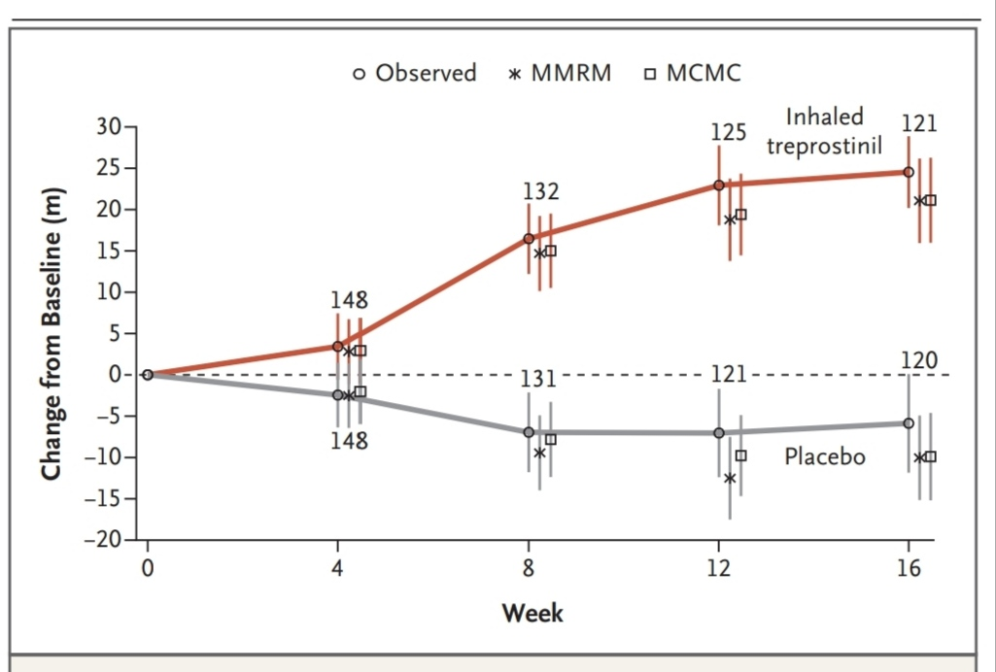

Slide 22
The most frequently reported adverse events were cough, headache, dyspnea, dizziness, nausea, fatigue, and diarrhea.
The use of inhaled treprostinil was not associated with any decrement in lung function.
Inhaled agents have the advantage of preferentially redirecting blood flow to the best-ventilated lung units, thus reducing the risk of ventilation– perfusion mismatching.

Slide 23
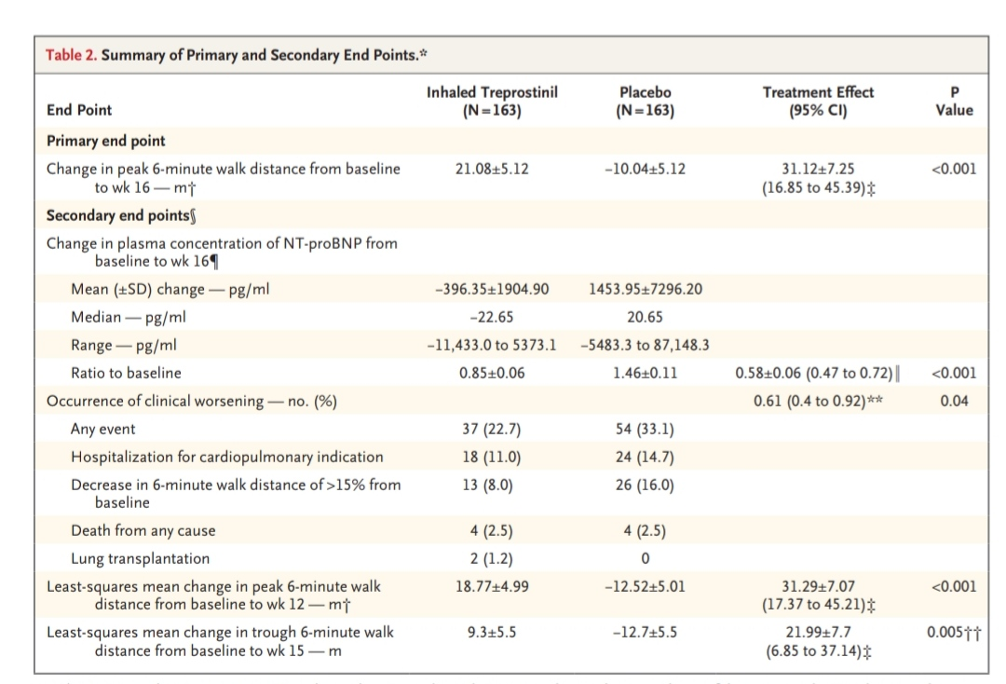

Slide 24
LIMITATIONS
The trial was of short duration
21% of the patients discontinued the trial prematurely (before week 16).
Events of clinical worsening and exacerbation of underlying lung disease were investigator-reported and not adjudicated by an independent review committee.

Slide 25
CONCLUSION
Among patients with pulmonary hypertension due to interstitial lung disease, treatment with inhaled treprostinil improved exercise capacity as shown by improvement in the 6-minute walk distance through the end of the 16-week treatment period.
Treatment with inhaled treprostinil was associated with a lower risk of clinical worsening than that with placebo, a reduction in NT-proBNP levels, and fewer exacerbations of underlying lung disease

Slide 26
THANK YOU

